Slide 1

BASIC TERMS AND CONTEXT OF ECONOMICS
LESSON I
Dr. Ingrid Majerova
Microeconomics/EVS/NAMIB

Slide 2
FIRST…
Basic informations
Name: Michal Tvrdoň
Office: A 403
E-mail: tvrdon@opf.slu.cz
Consulting hours:
Info: my public
Moodle

Slide 3
SYLLABUS
Introduction into Economics
Market, Demand and Supply
Consumer´s Behavior Theory – the Introduction
Consumer´s Equilibrium, Demand Analysis
Firm’s Production Function
The Costs Analysis
Firm´s Revenues, Profit Maximization Rule
Perfect Competition Firm Equilibrium
Imperfect Competition, Monopoly´s Equilibrium
Oligopoly
Monopolistic Competition
The Input Market and its Characteristics
The Labor Market
The Capital Market

Slide 4
MARKET
Outline of the lecture
What is Economics?
Two Branches and Kinds of Economics …
Factors of Production …
Returns of Scale….
Models in Economics …

Slide 5
GENERAL ECONOMIC THEORY
WHAT IS ECONOMICS …
Introduction to the study of economic disciplines is a general economic theory
  deals with the regularities of society´s economic life,
  describes abstract mechanisms of their functioning that help to understand the logic of real economic processes.
Economics therefore examines how scarce resources are used to produce commodities
ECONOMICS IS SCIENCE, ECONOMY IS REALITY

Slide 6
MICROECONOMICS
Microeconomics deals with behavior of individual units:
A) when consuming
B) when producing
Microeconomics and Optimal Trade-offs
  1. Consumer Theory
  2. Workers
  3. Theory of the Firm
Microeconomics and Prices
  The role of prices in a market economy
  How prices are determined

Slide 7
MICROECONOMIC ANALYSIS
Microeconomics deals with behavior of individual units:
A) when consuming
B) when producing
Microeconomics and Optimal Trade-offs
  1. Consumer Theory
  2. Workers
  3. Theory of the Firm
Microeconomics and Prices
  The role of prices in a market economy
  How prices are determined

Slide 8
GENERAL ECONOMIC THEORY
TWO BRANCHES OF ECONOMICS
Mathematical branch - asserts that the criterion of truthfulness is the possibility of mathematical proof:
PROFIT = ...
Social branch - rejects mathematics in economics, economics is a science of human behavior and production
UNABLE TO WRITE INTO FORMULAS….

Slide 9
POSITIVE AND NORMATIVE ECONOMICS
TWO ECONOMICS
Positive economics - accepts the economic reality as it is. Its aim is to describe this reality and find in it regularities of the functioning:
AN INFLATION RATE IS 1 %.
Normative economics - exploring of reality is just the starting point. It evaluates the established facts and evaluates them usually critically. The aim of normative economics is to construct a prototype of more perfect economic system, play an active role in the development of human society.
OPTIMAL GROWHT OF REAL GDP SHOUL BE 3% .

Slide 10
MICROECONOMICS AND MACROECONOMICS
TWO ECONOMICS
Economics is divided into:
  Microeconomics - examines the behavior of individual economic entities (households, firms and state) and development of individual markets
  PRICES ON MOBILE PHONE MARKET
  Macroeconomics - deals with the economy as a whole (aggregate level)
CHANGES OF AGGREGATE PRICE LEVEL (INFLATION)

Slide 11
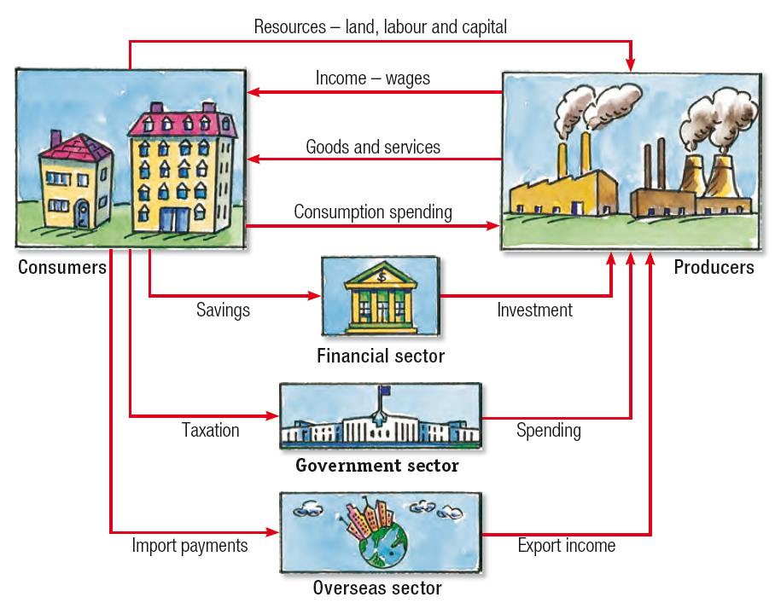

Slide 12



SOME IMPORTANT TERMS
INPUTS AND OUTPUTS
Inputs - goods or services which are used by companies in manufacturing
FLOUR
Outputs - goods or services that are either consumed or used for further production

Slide 13
SOME IMPORTANT TERMS
ECONOMIC RARENESS
Economic goods - items that man needs or desires; goods are materials that satisfy human wants and provide utility
A common distinction is made between goods that are tangible property, and services, which are non-physical
- Economic goods are characterized by their rarity
All goods are characterized by two properties
  usefulness (satisfies the needs)
  availability (scarcity)
Rare good - a subject that is useful, goods are limited, consumers are willing to pay for them, most of goods are rare
Free good - a subject that is useful and also freely available (e.g. water, air)

Slide 14
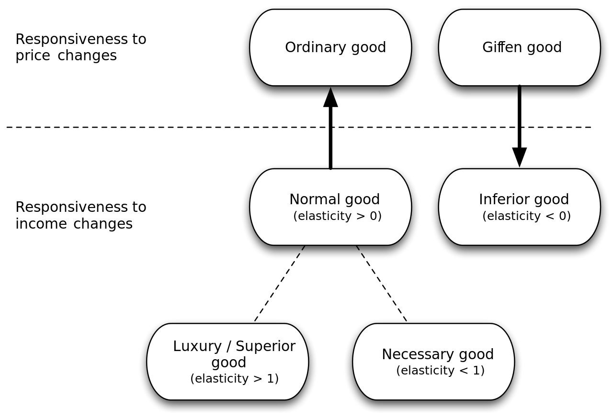
TYPES OF GOOD

Slide 15
classification of goods according to their exclusivity and competitiveness
rivalrous or rival if its consumption by one consumer prevents simultaneous consumption by other consumers, or if consumption by one party reduces the ability of another party to consume it (TV)
A good is considered non-rivalrous or non-rival if, for any level of production, the cost of providing it to a marginal (additional) individual is zero, or in other words may be consumed by one consumer without preventing simultaneous consumption by others (e.g. Broadcast TV)

Slide 16
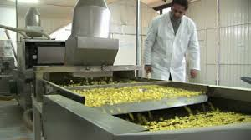
SOME IMPORTANT TERMS
PRODUCTION
Production - the process of transformation of natural resources (through factors of production) to economic goods that satisfy needs
man must produce most of the goods from natural sources, which can be found in nature in limited or unlimited amount
  but these resources by themselves are useless

Slide 17
SOME IMPORTANT TERMS
FACTORS OF PRODUCTION
In the production of economic goods human uses rare goods - Factors of Production - F:
Land - A - is a product of nature, but it is not a free good. Land rent is a revenue from the land. Land is a part of natural resources.
PRIMARY PRODUCTION FACTOR
Labor - L - is a human activity, the holder is human. The result of the use of labor is wage.
PRIMARY PRODUCTION FACTOR
Capital - K - goods that were made to participate in the production of other goods.

Slide 18

SOME IMPORTANT TERMS
FACTORS OF PRODUCTION
Capital - is not made for immediate consumption, but to become a production factor. Capital can also be called capital goods. The result of using capital is profit or interest.
SECONDARY PRODUCTION FACTOR
Technology - a special form of capital, which has no material form (thoughts, ideas, original approach). Can significantly multiply the effects of labor and capital.
Income from the production factors have motivational character
driving force of the economic system.

Slide 19
SOME IMPORTANT TERMS
RETURNS OF SCALE
High production efficiency is conditioned by high returns of production factors.
The Law of Diminishing Returns - return of one factor, whose volume increases, will decrease.
Valid only assuming that output is increasing due to the growth of a one factor of production when volume of other factors is unchanged.

Slide 20
SOME IMPORTANT TERMS
THREE TYPES OF RETURNS OF SCALE
Increasing Returns of Scale - growth in the volume of used production factors leads to more rapid growth of revenues from them.
Constant Returns of Scale - income from production factors increases proportionally with the growth of the scale of their involvement in the production.
Diminishing Returns of Scale - revenue growth in factors of production is lower than the growth of these factors.

Slide 21

SOME IMPORTANT TERMS
MODELS IN ECONOMICS
The economic relations are displayed by the models
The economic model is a (non)formalized displaying of real functioning economy, whose main aim is to simplify the described economic system, keeping its essential characteristics.
It can be formulated:
  verbally,
  graphically,
  mathematically.

Slide 22
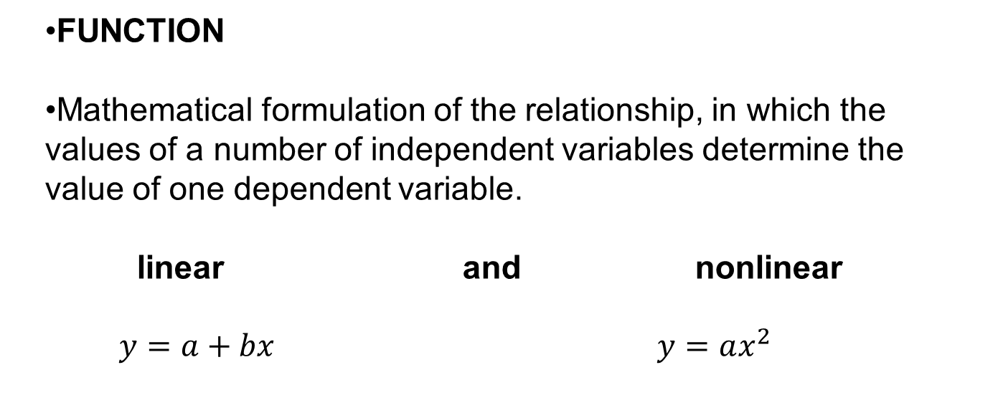
SOME IMPORTANT TERMS
ECONOMIC ANALYSIS
FUNCTION
Mathematical formulation of the relationship, in which the values of a number of independent variables determine the value of one dependent variable.
linear and nonlinear
$y=a+bx$ $y=ax^{2}$

Slide 23
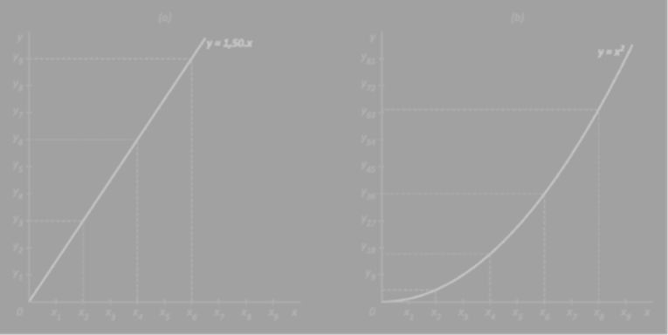
SOME IMPORTANT TERMS
ECONOMIC ANALYSIS
GRAPH
graphical representation of the function
alteration of function is expressed with slope
The slope of the linear function graph is expressed mathematically by first derivative

Slide 24
SOME IMPORTANT TERMS
ECONOMIC ANALYSIS
The derivative is changing of the dependent variable related to infinitely small change in the independent variable.
Economics interprets the first derivative of the total variable function as its (total) marginal variable.
Marginal value expresses increase in the dependent variable due to changes in the independent variable by one unit.
We also determine the average value (the share of dependent variable per unit of the independent variable)

Slide 25
THE END
THANK YOU FOR YOUR ATTENTION . . .

