Slide 1

STATEMENT OF CASH FLOWS
Ing. Markéta Šeligová, Ph.D.
MANAGERIAL ACCOUNTING/NANMU

Slide 2
STATEMENT OF CASH FLOWS
Outline of the lecture
Statement of cash flows
Operating activities
The indirect method
Investing and financing activities
Free cash flow

Slide 3
STATEMENT OF CASH FLOWS
STATEMENT OF CASH FLOWS (1)
three major financial statements are required for external reports - an income statement, a balance sheet, and a statement of cash flows
the statement of cash flows highlights the major activities that impact cash flows and, hence, affect the overall cash balance
managers focus on cash for a very good reason - without sufficient cash at the right time, a company may miss golden investment opportunities or may even go bankrupt
the statement of cash flows answers question that cannot be easily answered by looking at the income statement and balance sheet

Slide 4
STATEMENT OF CASH FLOWS
STATEMENT OF CASH FLOWS (2)
the statement of cash flows is a valuable analytical tool for managers as well as for investors and creditors, although managers tend to be more concerned with forecasted statements of cash flows that are prepared as part of the budgeting process
the statement of cash flows can be used to answer crucial question such as:
  Is the company generating sufficient positive cash flows from its ongoing operations to remain viable?
  Will the company be able to repay its debts?
  Will the company be able to pay its usual dividend?
  Why do net income and net cash flow differ?
  To what extent will the company have to borrow money in order to make needed investments?

Slide 5
STATEMENT OF CASH FLOWS
STATEMENT OF CASH FLOWS (3)
managers prepare the statement of cash flows by applying a fundamental principle of double-entry bookkeeping - the change in the cash balance must equal the changes in all other balance sheet accounts besides cash; two basic equations that apply to all asset, contra-asset, liability, and stockholders´ equity accounts; these equations will help you compute various cash inflows and outflows that are reported in the statement of cash flows
Basic Equation for Asset Accounts:
Beginning balance + Debits – Credits = Ending balance
Basic Equation for Contra-Asset, Liability, and Stockholder´s Equity Accounts:
Beginning balance – Debits + Credits = Ending balance

Slide 6
STATEMENT OF CASH FLOWS
STATEMENT OF CASH FLOWS (4)
the statement of cash flows summarizes all of a company´s cash inflows and outflows during a period, thereby explaining the change in its cash balance
in a statement of cash flows, cash is broadly defined to include both cash and cash equivalents
cash equivalents consist of short-term, highly liquid investments such as Treasury bill, commercial paper, and money market funds that are made solely for the purpose of generating a return on temporarily idle funds
most companies invest their excess cash reserves in these types of interest-bearing assets that can be easily converted into cash; because such assets are equivalent to cash, they are included with cash in a statement of cash flows

Slide 7
STATEMENT OF CASH FLOWS
ORGANIZING THE STATEMENT OF CASH FLOWS (1)
to make it easier to compare data from different companies, U.S. generally accepted accounting principles (GAAP) and International Financial Reporting Standards (IFRS) require companies to follow prescribed rules when preparing the statement of cash flows
one of these rules requires organizing the statement into three sections that report cash flows resulting from operating activities, investing activities, and financing activities

Slide 8
STATEMENT OF CASH FLOWS
ORGANIZING THE STATEMENT OF CASH FLOWS (2)
operating activities generate cash inflows and outflows related to revenue and expense transactions that affect net income
investing activities generate cash inflows and outflows related to acquiring or disposing of noncurrent assets such as property, plant, and equipment, long-term investments, and loans to another entity
financial activities generate cash inflows and outflows related to borrowing from and repaying principal to creditors and completing transactions with the company´s owners such as selling or repurchasing shares of common stock and paying dividends

Slide 9
STATEMENT OF CASH FLOWS
STATEMENT OF CASH FLOWS (1)
three major financial statements are required for external reports - an income statement, a balance sheet, and a statement of cash flows
the statement of cash flows highlights the major activities that impact cash flows and, hence, affect the overall cash balance
managers focus on cash for a very good reason - without sufficient cash at the right time, a company may miss golden investment opportunities or may even go bankrupt
the statement of cash flows answers question that cannot be easily answered by looking at the income statement and balance sheet

Slide 10
STATEMENT OF CASH FLOWS
OPERATING ACTIVITIES: DIRECT AND INDIRECT METHOD
U.S. GAAP and IFRS allow companies to compute the net amount of cash inflows and outflows resulting from operating activities, which is known formally as the net cash provided by operating activities, using either direct or indirect method
both of these methods have the same purpose, which is to translate accrual-based net income to a cash basis

Slide 11
STATEMENT OF CASH FLOWS
OPERATING ACTIVITIES: DIRECT METHOD
under the direct method, the income statement is reconstructed on a cash basis from top to bottom
  for example, cash collected from customers is listed instead of revenue, and payments to suppliers is listed instead of cost of goods sold
in essence, cash receipts are counted as revenues and cash disbursements pertaining to operating activities are counted as expenses
the difference between the cash receipts and cash disbursements is the net cash provided by operating activities

Slide 12
STATEMENT OF CASH FLOWS
OPERATING ACTIVITIES: INDIRECT METHOD
under the indirect method, net income is adjusted to a cash basis
that is, rather than directly computing cash sales, cash expenses, and so forth, these amounts are derived indirectly by removing from net income any items that do not affect cash flows
the indirect method has an advantage over the direct method because it shows the reasons for any differences between net income and net cash provided by operating activities

Slide 13
STATEMENT OF CASH FLOWS
THE INDIRECT METHOD: A THREE-STEP PROCESS (1)
The indirect method adjusts net income to net cash provided by operating activities using a three-step process.
the first step is to add depreciation charges to net income
depreciation charges are the credits to the Accumulated Depreciation account during the period - the sum total of the entries that have increased Accumulated Depreciation
to compute the credits to the accumulated depreciation account we use the equation for contra-assets
Basic Equation for Contra-Asset Accounts:
Beginning balance – Debits + Credits = Ending balance

Slide 14
STATEMENT OF CASH FLOWS
THE INDIRECT METHOD: A THREE-STEP PROCESS (2)
the second step is to analyze net changes in noncash balance sheet accounts that impact net income
the third step in computing the net cash provided by operating activities is to adjust for gains/losses included in the income statement
under U.S. GAA/ and IFRS rules, the cash proceeds from the sale of noncurrent assets must be included in the investing activities section of the statement of cash flows
to comply with these rules, the gains and losses pertaining to the sale of noncurrent assets must be removed from net income as reported in the operating activities section of the statement of cash flows

Slide 15
STATEMENT OF CASH FLOWS
INVESTING AND FINANCIN ACTIVITIES: GROSS CASH FLOWS (1)
U.S. GAAP and IFRS require that the investing and financing sections of the statement of cash flows disclose gross cash flows
to compute gross cash flows for the investing and financing activities sections of the statement of cash flows, we will begin by calculating the changes in the balance of each applicable balance sheet account
as with the current assets, when a noncurrent asset account balance (including Property, Plant, and Equipment; Long-Term Investments; and Loans to Other Entities) increases, it signals the need to subtract cash outflows in the investing activities section of the statement of cash flows

Slide 16
STATEMENT OF CASH FLOWS
INVESTING AND FINANCIN ACTIVITIES: GROSS CASH FLOWS (2)
if the balance in a noncurrent asset account decreases during the period, then it signals the need to add cash inflows
the liability and equity accounts (Bonds Payable and Common Stock) are handled in the opposite fashion
if a liability or equity account balance increases, then it signals a need to add cash inflows to the financing activities section of the statement of cash flows
if a liability or equity account balance decreases, then it signals a need to subtract cash outflows

Slide 17
STATEMENT OF CASH FLOWS
INVESTING AND FINANCIN ACTIVITIES: GROSS CASH FLOWS (3)
Property, Plant and Equipment
when a company purchases property, plant, and equipment it debits the Property, Plant, and Equipment account for the amount of the purchase
when it sells or disposes of these kinds of assets, it credits the Property, Plant, and Equipment account for the original cost of the asset
to compute the cash outflows related to Property, Plant, and Equipment we use the basic equation for assets
Basic Equation for Asset Accounts
Beginning balance + Debits – Credits = Ending balance

Slide 18
STATEMENT OF CASH FLOWS
INVESTING AND FINANCIN ACTIVITIES: GROSS CASH FLOWS (4)
Retained Earnings
when a company earns net income it credits the Retained Earnings account and when it pays a dividend it debits the Retained Earnings account
to compute the amount of a cash dividend payment we use the basic equation for stockholders´ equity accounts
Basic Equation for Stockholders´ Equity Accounts
Beginning balance – Debits + Credits = Ending balance

Slide 19
STATEMENT OF CASH FLOWS
FREE CASH FLOW
free cash flow is a measure used by managers to look at the relationship among three numbers from the statement of cash flows - net cash provided by operating activities, additions to property, plant, and equipment (also called capital expenditures), and dividends
free cash flow measures a company´s ability to fund its capital expenditures for property, plant, and equipment and its dividends from its net cash provided by operating activities
the equation for computing free cash flow is as follows:
Free cash flow = Net cash provided by operating activities – Capital expenditures - Dividends

Slide 20
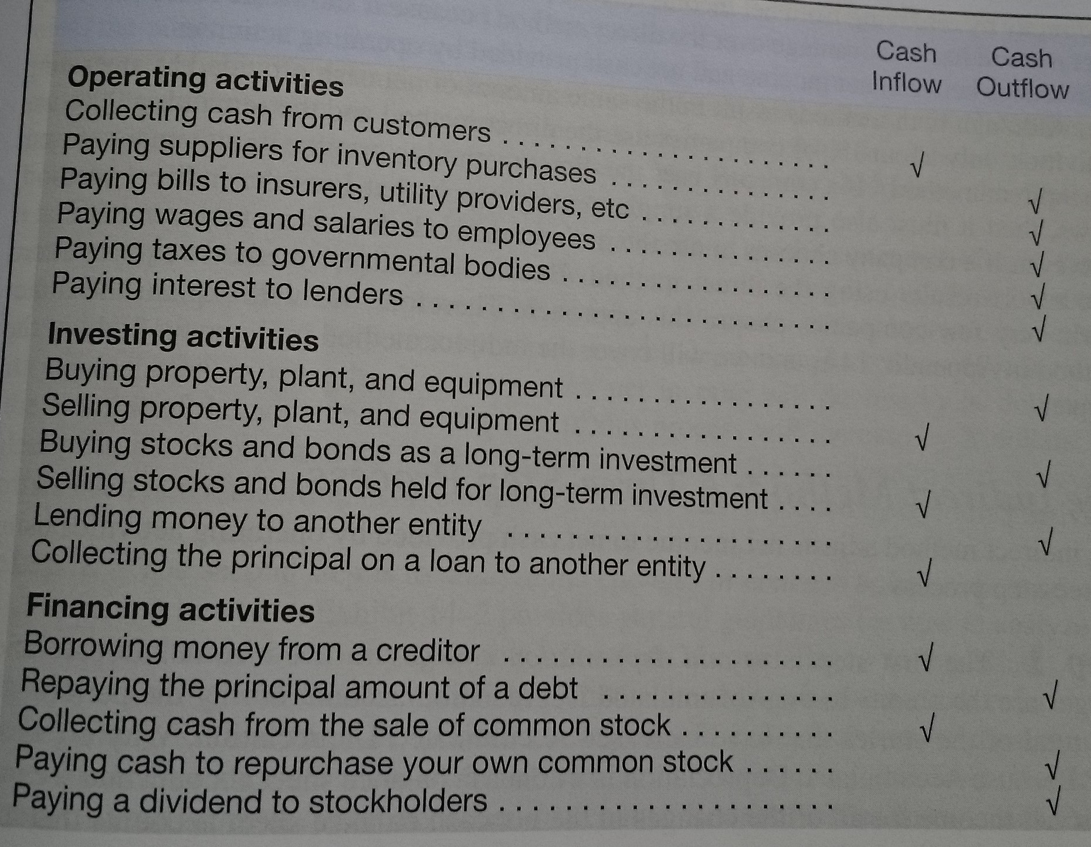
STATEMENT OF CASH FLOWS

Slide 21
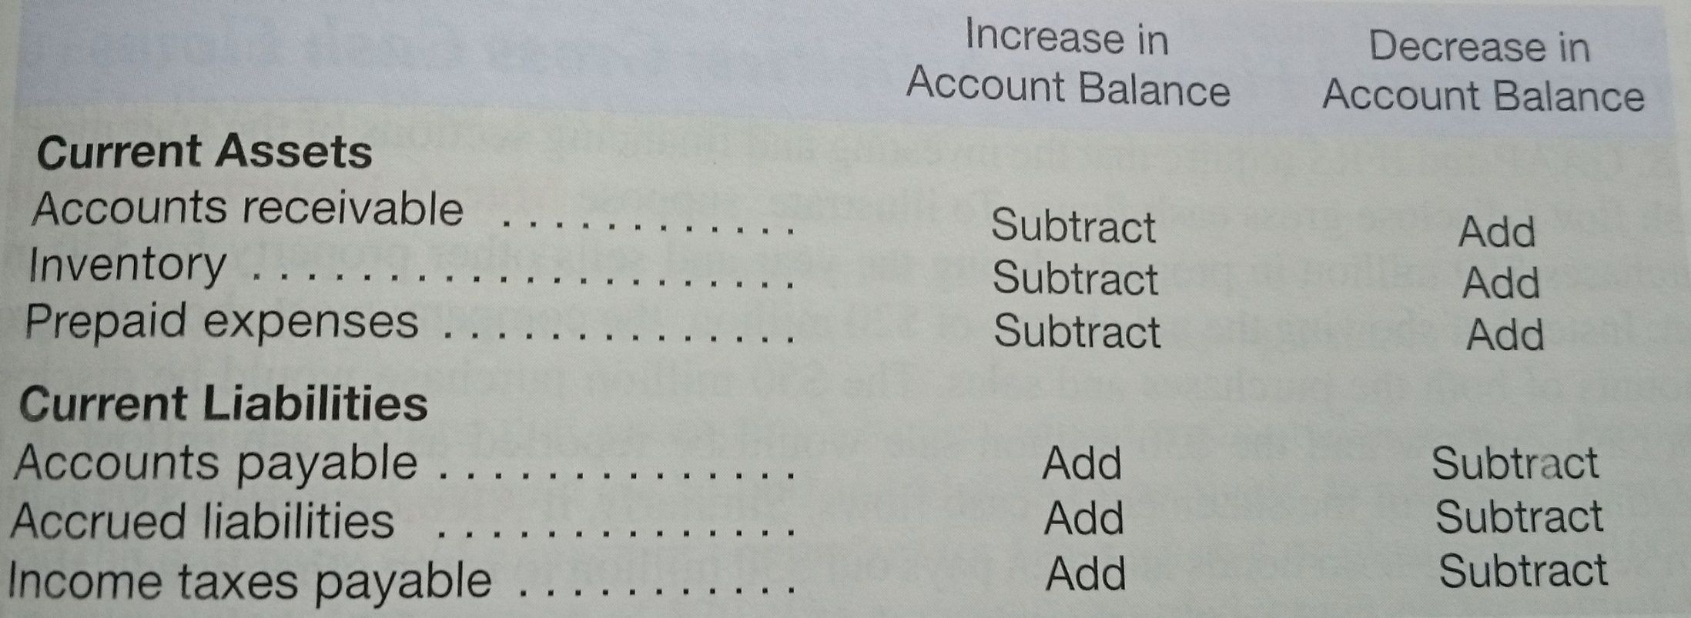
STATEMENT OF CASH FLOWS

Slide 22
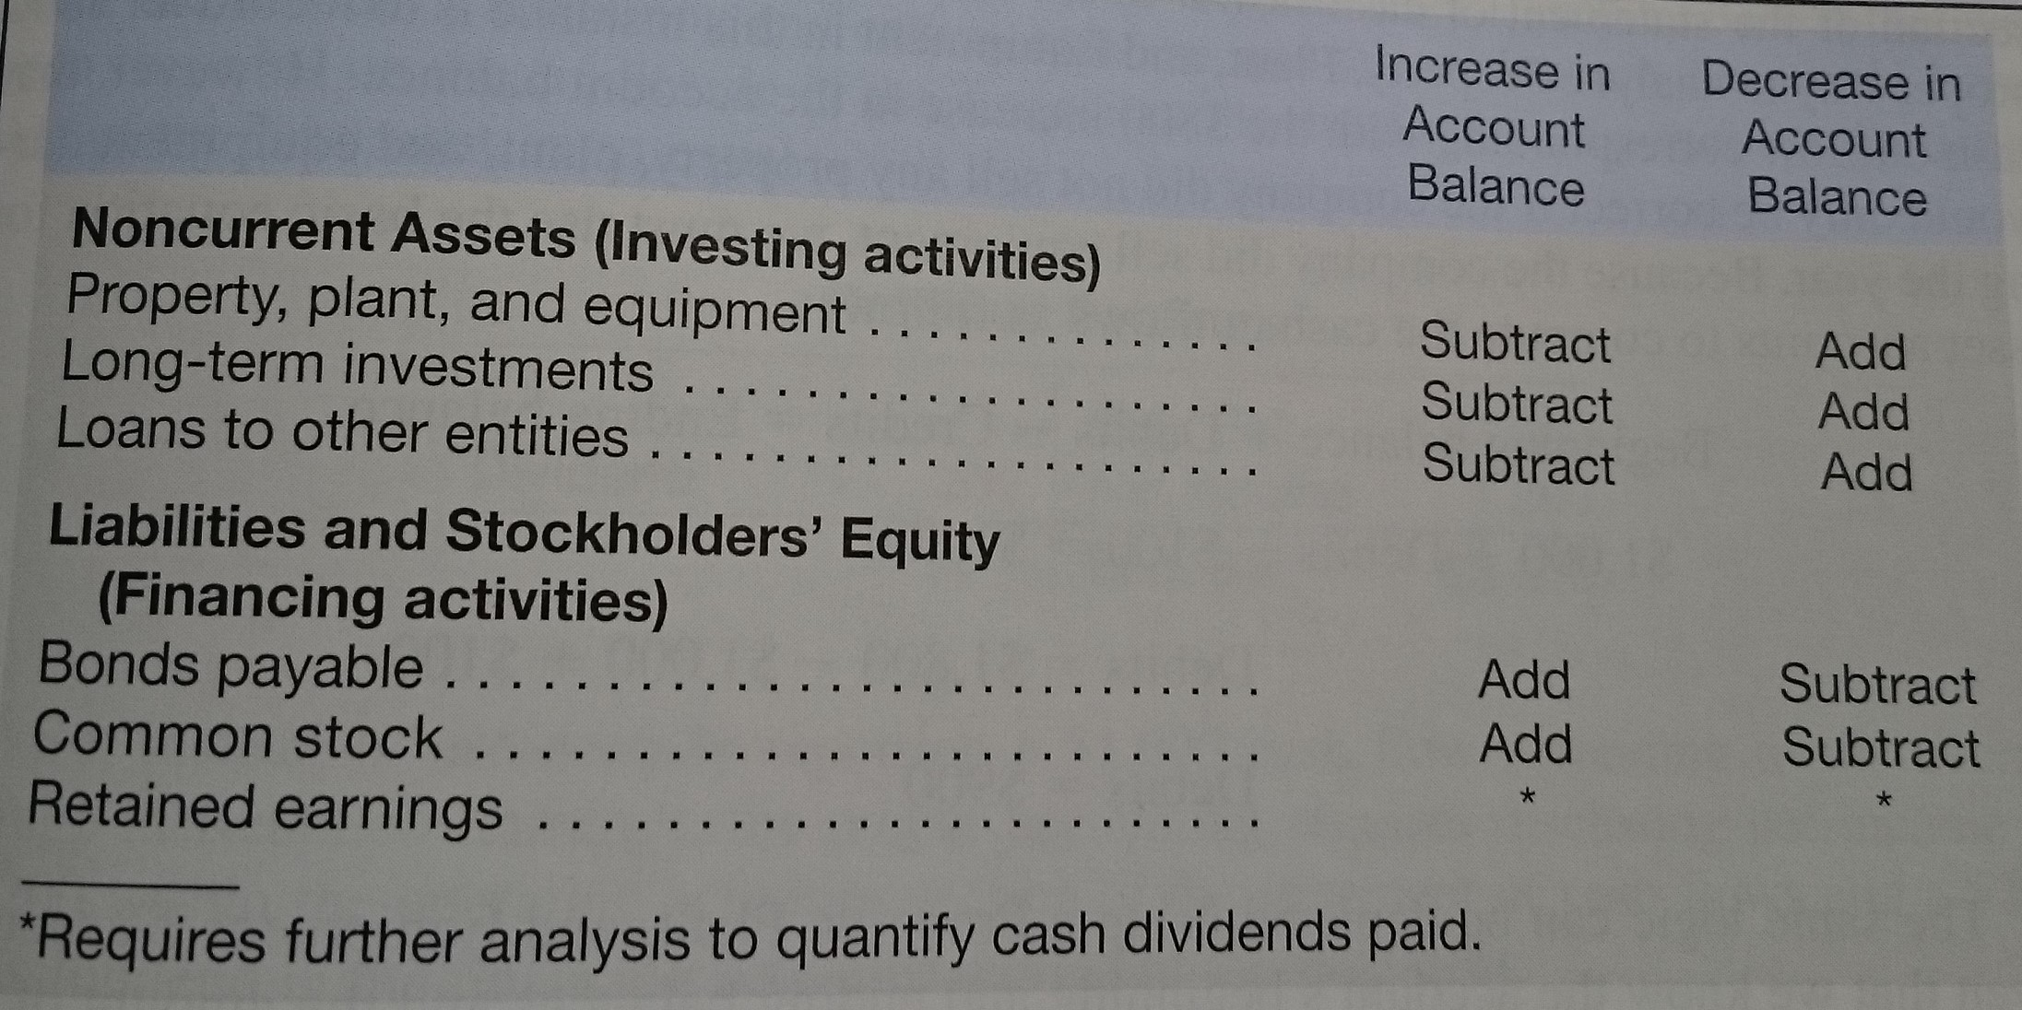
STATEMENT OF CASH FLOWS

Slide 23
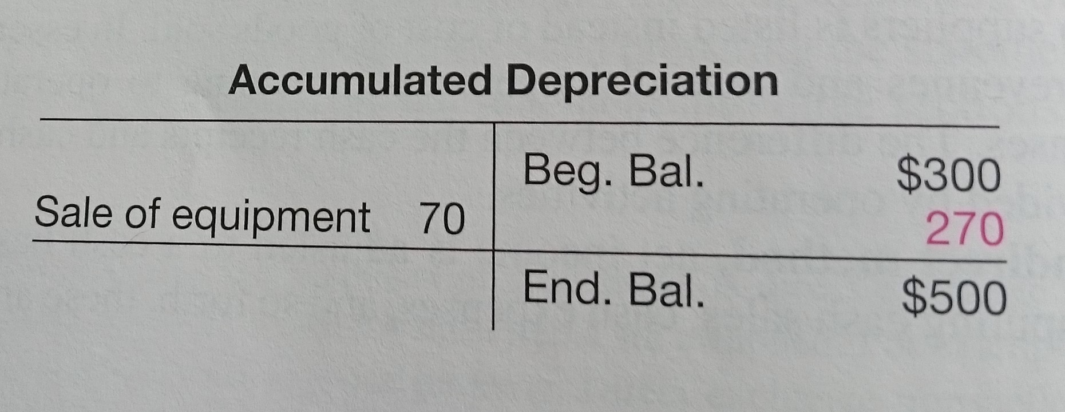
STATEMENT OF CASH FLOWS

Slide 24
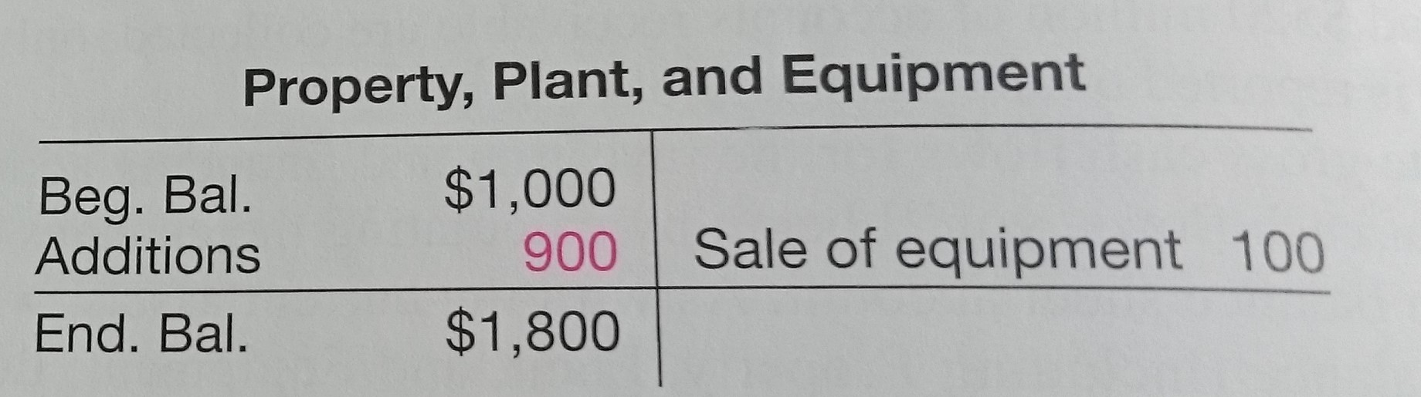
STATEMENT OF CASH FLOWS

Slide 25
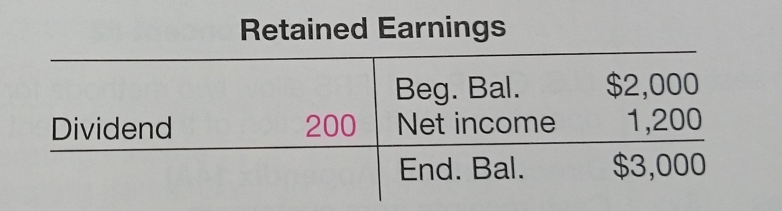
STATEMENT OF CASH FLOWS

