Slide 1
FLEXIBLE BUDGETS, PERFORMANCE ANALYSIS, STANDARD COSTS AND VARIANCES
Ing. Markéta Šeligová, Ph.D.
MANAGERIAL ACCOUNTING/NANMU

Slide 2
FLEXIBLE BUDGETS, PERFORMANCE ANALYSIS, STANDARD COSTS AND VARIANCES
Outline of the lecture
The variance analysis cycle
Characteristics of a flexible budget
The types of variances
The performance reports in cost centers
Standard costs

Slide 3
FLEXIBLE BUDGETS, PERFORMANCE ANALYSIS, STANDARD COSTS AND VARIANCES
THE VARIANCE ANALYSIS CYCLE
companies use the variance analysis cycle to evaluate and improve performance
the cycle begins with the preparation of performance reports in the accounting department
these reports highlight variances, which are the differences between the actual results and what should have occurred according to the budget
the variance analysis cycle should not be used to assign blame for poor performance

Slide 4
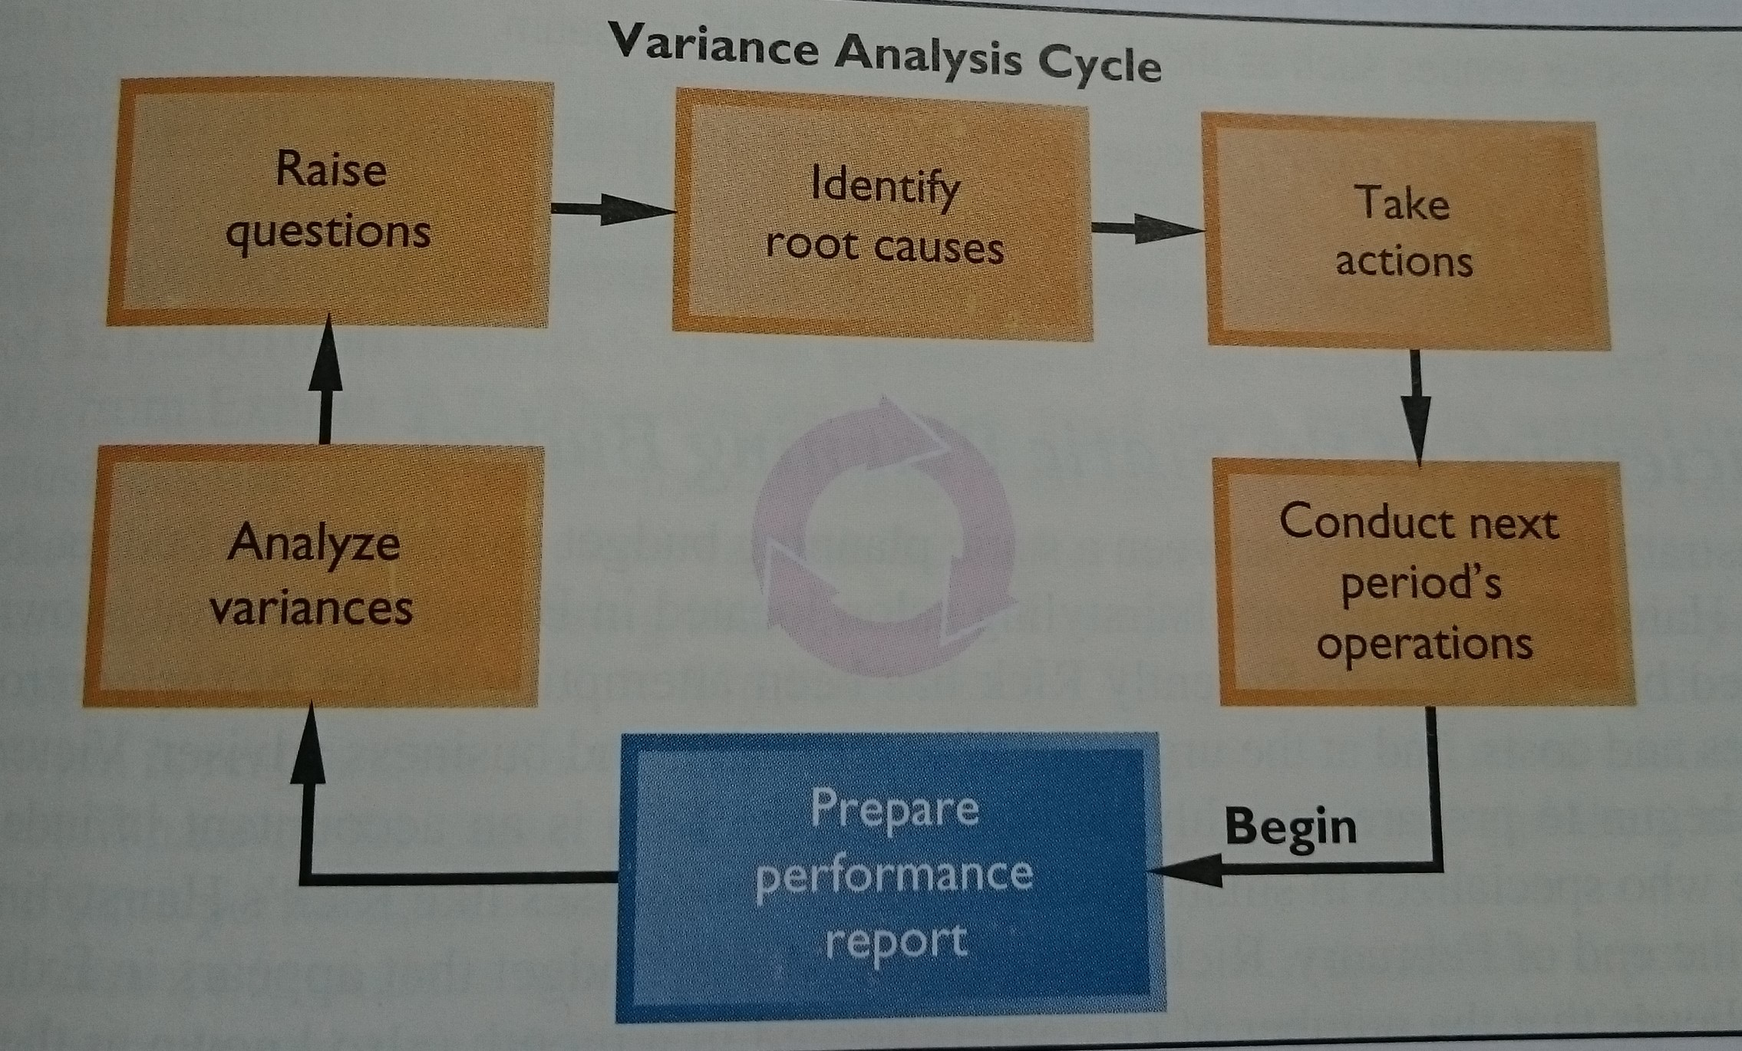
FLEXIBLE BUDGETS, PERFORMANCE ANALYSIS, STANDARD COSTS AND VARIANCES
THE VARIANCE ANALYSIS CYCLE

Slide 5
FLEXIBLE BUDGETS, PERFORMANCE ANALYSIS, STANDARD COSTS AND VARIANCES
CHARACTERISTICS OF A FLEXIBLE BUDGET
flexible budgets take into account how changes in activity affect costs
a flexible budget is an estimate of what revenues and costs should have been, given the actual level of activity for the period
when a flexible budget is used in performance evaluation, actual costs are compared to what the costs should have been for the actual level of activity during the period rather than to the static planning budget
a flexible budget approach recognizes that a budget can be adjusted to show what costs should be for the actual level of activity

Slide 6
FLEXIBLE BUDGETS, PERFORMANCE ANALYSIS, STANDARD COSTS AND VARIANCES
THE TYPES OF VARIANCES
the difference between the actual level of activity and the level of activity in the planning budget from the beginning of the period, they are called activity variances
a revenue variance is the difference between the actual total revenue and what the total revenue should have been, given the actual level of activity for the period
a spending variance is the difference between the actual amount of the cost and how much a cost should have been, given the actual level of activity

Slide 7
FLEXIBLE BUDGETS, PERFORMANCE ANALYSIS, STANDARD COSTS AND VARIANCES
PERFORMANCE REPORTS IN NONPROFIT ORGANIZATIONS
the performance reports in non-profit organizations are basically the same as the performance reports we have considered so far - with one prominent difference
Non-profit organizations usually receive a significant amount of funding from sources other than sales
for example, universities receive their funding from sales, from endowment income and donations, and - in the case of public universities - from state appropriations
this means that, like costs, the revenue in governmental and non-profit organizations may consist of both fixed and variable elements

Slide 8
FLEXIBLE BUDGETS, PERFORMANCE ANALYSIS, STANDARD COSTS AND VARIANCES
THE PERFORMANCE REPORTS IN COST CENTERS
performance reports are often prepared for organizations that do not have any source of outside revenue
in particular, in a large organization a performance report may be prepared for each department - including departments that do not sell anything to outsiders
for example, a performance report is very commonly prepared for production departments in manufacturing companies
because the managers in departments are responsible for costs, but not revenues, they are often called cost centers

Slide 9
FLEXIBLE BUDGETS, PERFORMANCE ANALYSIS, STANDARD COSTS AND VARIANCES
STANDARD COSTS
a standard is a benchmark for measuring performance and are found everywhere
standards are also widely used in managerial accounting where they relate to the quantity and acquisition price of inputs used in manufacturing goods or providing services
quantity standards specify how much of an input should be used to make a product or provide a service
price standards specify how much should be paid for each unit of the input
if either the quantity or acquisition price of an input departs significantly from the standard, managers investigate the discrepancy to find the cause of the problem and eliminate it

Slide 10
FLEXIBLE BUDGETS, PERFORMANCE ANALYSIS, STANDARD COSTS AND VARIANCES
SETTING DIRECT MATERIALS STANDARDS
the standard quantity per unit defines the amount of direct materials that should be used for each unit of finished product, including an allowance for normal inefficiencies, such as spoilage
the standard price per unit defines the price that should be paid for each unit of direct materials and it should reflect the final, delivered cost of those materials

Slide 11
FLEXIBLE BUDGETS, PERFORMANCE ANALYSIS, STANDARD COSTS AND VARIANCES
SETTING DIRECT LABOR STANDARDS
direct labor quantity and price standards are usually expressed in terms of labor-hours or a labor rate
the standard hours per unit defines the amount of direct labor-hours that should be used to produce on unit of finished goods
the standard rate per hours defines the company´s expected direct labor wage rate per hour, including employment taxes and fringe benefits

Slide 12
FLEXIBLE BUDGETS, PERFORMANCE ANALYSIS, STANDARD COSTS AND VARIANCES
SETTING VARIABLE MANUFACTURING OVERHEAD STANDARDS (1)
as with direct labor, the quantity and price standards for variable manufacturing overhead are usually expressed in terms of hours and a rate
the standard hours per unit for variable overhead measures the amount of the allocation base from a company´s predetermined overhead rate that is required to produce on unit of finished goods
the standard rate per unit that a company expects to pay for variable overhead equals the variable portion of the predetermined overhead rate

Slide 13
FLEXIBLE BUDGETS, PERFORMANCE ANALYSIS, STANDARD COSTS AND VARIANCES
SETTING VARIABLE MANUFACTURING OVERHEAD STANDARDS (2)
a standard cost card shows the standard quantity (or hours) and standard price (or rate) of the inputs required to produce a unit of a specific product
the standard cost per unit for all three variable manufacturing costs is computed the same way
the standard quantity (or hours) per unit is multiplied by the standard price (or rate) per unit to obtain the standard cost per unit

Slide 14
FLEXIBLE BUDGETS, PERFORMANCE ANALYSIS, STANDARD COSTS AND VARIANCES
A GENERAL MODEL FOR STANDARD COST VARIANCE ANALYSIS (1)
standard cost variance analysis decomposes spending variances from the flexible budget into two elements - one due to the price paid for the input and the other due to the amount of the input that is used
a price variance is the difference between the actual amount paid for an input and the standard amount that should have been paid, multiplied by the actual amount of the input purchased
a quantity variance is the difference between how much of an input was actually used and how much should have been used and is stated in dollar terms using the standard price of the input

Slide 15
FLEXIBLE BUDGETS, PERFORMANCE ANALYSIS, STANDARD COSTS AND VARIANCES
A GENERAL MODEL FOR STANDARD COST VARIANCE ANALYSIS (2)
the standard quantity allowed (when computing direct materials variances) or standard hours allowed (when computing direct labour and variable manufacturing overhead variances) refers to the amount of an input that should have been used to manufacture the actual output of finished goods produced during the period
the standard quantity allowed for the actual output and its computation can be stated in formula form as follows
Standard quantity allowed for actual output = Actual output X Standard quantity

Slide 16
FLEXIBLE BUDGETS, PERFORMANCE ANALYSIS, STANDARD COSTS AND VARIANCES
USING STANDARD COSTS – DIRECT MATERIALS VARIANCES (1)
a materials price variance measures the difference between an input´s actual price and its standard price, multiplied by the actual quantity purchased
a price variance is labeled unfavorable if the actual purchase price exceeds the standard purchase price
the materials quantity variance measures the difference between the actual quantity of materials used in production and the standard quantity of materials allowed for the actual output, multiplied by the standard price per unit of materials
it is labeled as unfavorable (favorable) when the actual quantity of material used in production is greater than (less than) the quantity of material that should have been used according to the standard

Slide 17
FLEXIBLE BUDGETS, PERFORMANCE ANALYSIS, STANDARD COSTS AND VARIANCES
USING STANDARD COSTS – DIRECT MATERIALS VARIANCES (2)
the labor rate variance measures the difference between the actual hourly rate and the standard hourly rate, multiplied by the actual number of hours worked during the period
the variance is labeled favorable in case the actual hourly rate is less than the standard hourly rate
if the actual hourly rate had been greater than the standard hourly rate, the variance would have been labeled unfavorable
the labor efficiency variance measures the difference between the actual hours used and the standard hours allowed for the actual output, multiplied by the standard hourly rate
possible causes of an unfavorable labor efficiency variance include poorly trained or motivated workers; poor-quality materials, requiring more labor time; faulty equipment, causing breakdowns and work interruptions; poor supervision of workers; and inaccurate standards

Slide 18
FLEXIBLE BUDGETS, PERFORMANCE ANALYSIS, STANDARD COSTS AND VARIANCES
USING STANDARD COSTS – VARIABLE MANUFACTURING OVERHEAD VARIANCES
the variable overhead rate variance measures the difference between the actual variable overhead cost incurred during the period and the standard cost that should have been incurred based on the actual activity of period
the variable overhead efficiency variance measures the difference between the actual level of activity and the standard activity allowed for the actual output, multiplied by the variable part of the predetermined overhead rate

Slide 19
FLEXIBLE BUDGETS, PERFORMANCE ANALYSIS, STANDARD COSTS AND VARIANCES
ADVANTAGES OF STANDARD COSTS (1)
standard cost systems have a number of advantages
Standard costs are a key element in a management by exception approach. If costs conform to the standards, managers can focus on other issues. When costs are significantly outside the standards, managers are alerted that problems may exist that require attention. This approach helps managers focus on important issues.
Standards that are viewed as reasonable by employees can promote economy and efficiency. They provide benchmarks that individuals can use to judge their own performance.

Slide 20
FLEXIBLE BUDGETS, PERFORMANCE ANALYSIS, STANDARD COSTS AND VARIANCES
ADVANTAGES OF STANDARD COSTS (2)
standard cost systems have a number of advantages
Standard costs can greatly simplify bookkeeping. Instead of recording actual costs for each job, the standard costs for direct materials, direct labor, and overhead can be charged to jobs
Standard costs fit naturally in an integrated system of responsibility accounting. The standards establish what costs should be, who should be responsible for them, and whether actual costs are under control

Slide 21
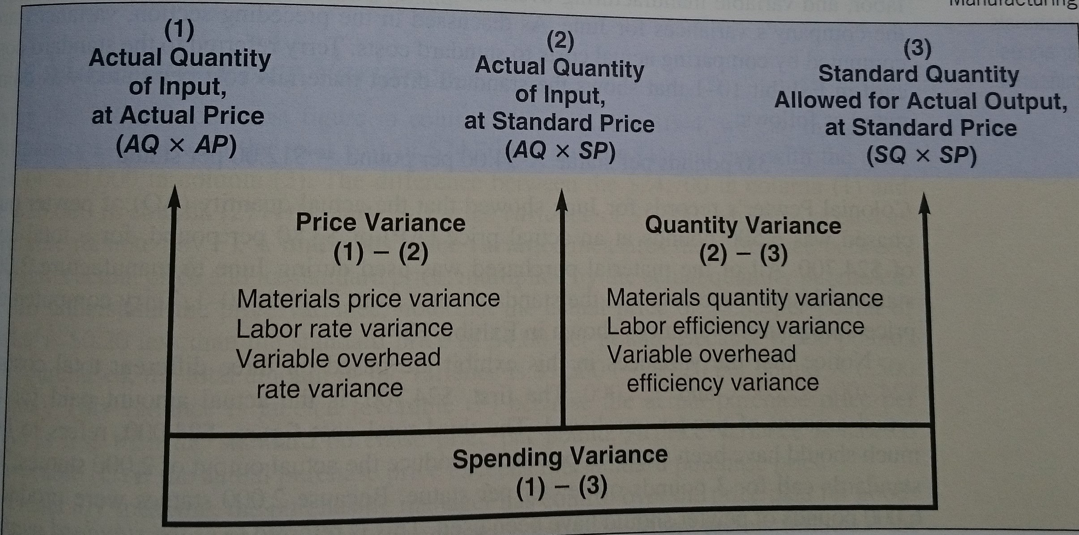
FLEXIBLE BUDGETS, PERFORMANCE ANALYSIS, STANDARD COSTS AND VARIANCES

Slide 22
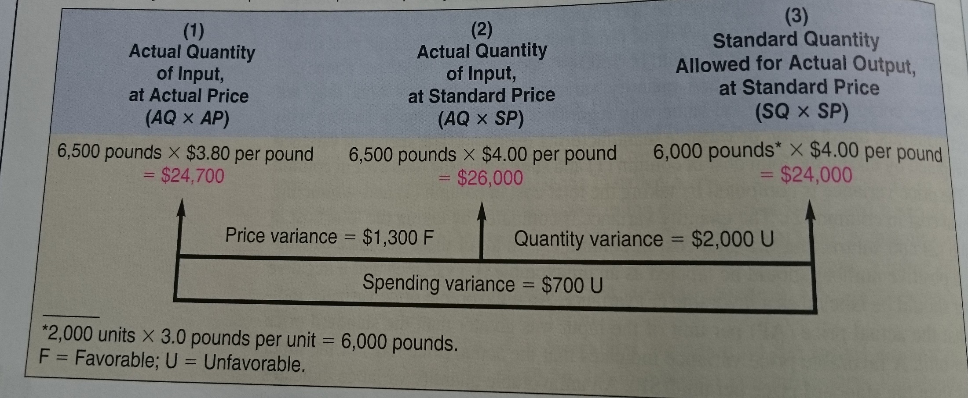
FLEXIBLE BUDGETS, PERFORMANCE ANALYSIS, STANDARD COSTS AND VARIANCES

Slide 23
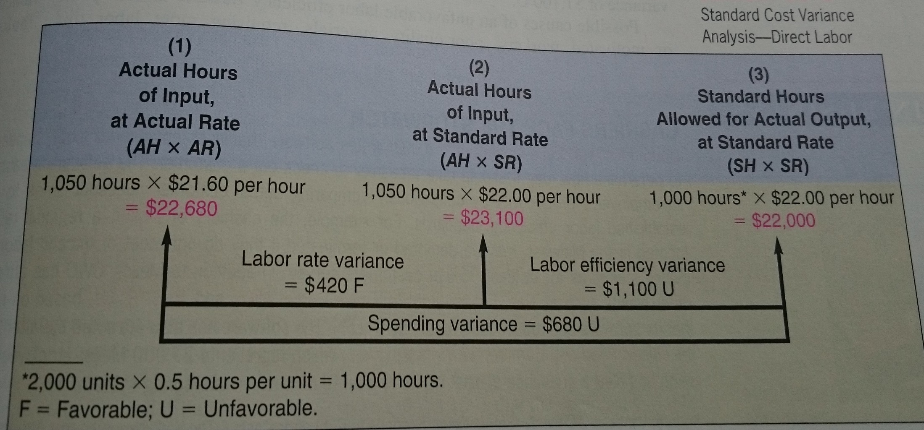
FLEXIBLE BUDGETS, PERFORMANCE ANALYSIS, STANDARD COSTS AND VARIANCES

Slide 24
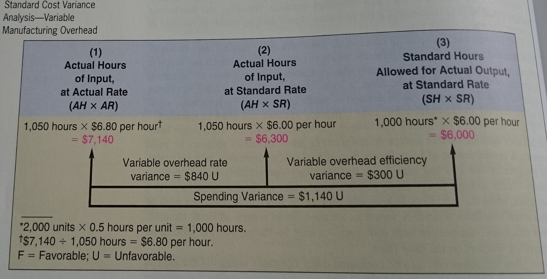
FLEXIBLE BUDGETS, PERFORMANCE ANALYSIS, STANDARD COSTS AND VARIANCES

Slide 25
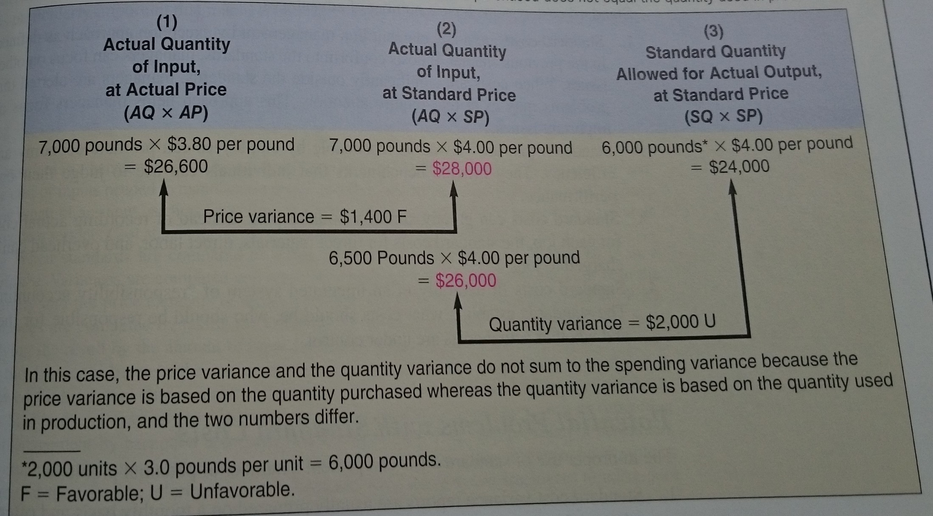
FLEXIBLE BUDGETS, PERFORMANCE ANALYSIS, STANDARD COSTS AND VARIANCES

