Slide 1

Project management evolution and relationship of project
The milestones in development of project management approach
Project, program, portfolio, and operations management
Pavel Adámek
Project management

Slide 2

Outline of the lecture
Project management in period of 1945-1960
Project management in period of 1970-1980
Project management 1985-2003
Relationship of project, program, portfolio, and operations management

Slide 3
Project management growth: concepts
General systems theory is still being taught in graduate programs. Today, project management is viewed as applied systems management.
General systems theory implies the creation of a management technique that is able to cut across many organizational disciplines—finance, manufacturing, engineering,
Today we use the PMBOK®, the Project Management Body of Knowledge, Prince2, or IPMA standard to satisfy need for project management.
The growth and acceptance of project management has changed significantly over the past forty years.
The growth of project management can be traced through topics such as roles and responsibilities, Organizational structures, delegation of authority and decision-making, and especially corporate profitability

Slide 4
Project management 1945-1960
Its slow growth can be attributed mainly to lack of acceptance of the new management techniques necessary for its successful implementation.
Between the middle and late 1960s, more executives began searching for new management techniques and organizational structures that could be quickly adapted to a changing environment.
Companies that have complex tasks and that also operate in a dynamic environment find project management mandatory. Such industries would include aerospace, defines, construction, high-technology engineering, computers, and electronic instrumentation.
Other than aerospace, defence, and construction, the majority of the companies in the 1960s maintained an informal method for managing projects.

Slide 5
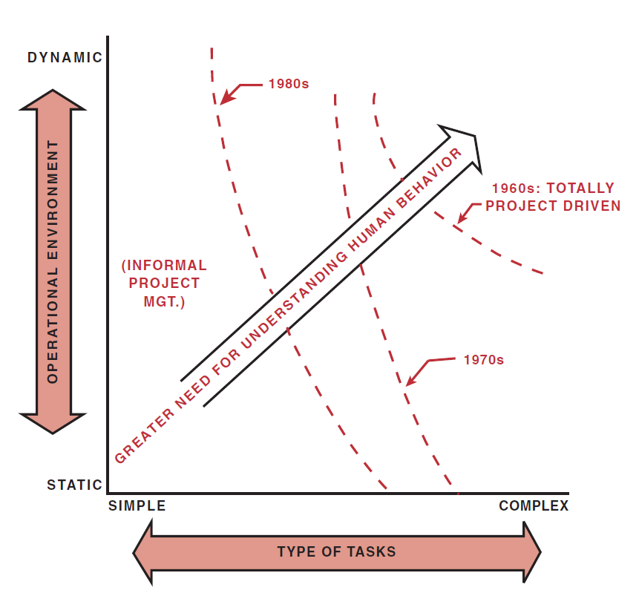
Project management 1945-1960
Matrix implementation scheme
Most projects were handled by functional managers and stayed in one or two functional lines, and formal communications were either unnecessary or handled informally because of the good working relationships between line managers.
Source: Kerzner, H. 2017. Project Management

Slide 6
Project management 1970-1980
By 1970 and again during the early 1980s, more companies departed from informal project management and restructured to formalize the project management process, mainly because the size and complexity of their activities had grown to a point where they were unmanageable within the current structure.
The following five questions help determine whether formal project management is necessary:
  Are the jobs complex?
  Are there dynamic environmental considerations?
  Are the constraints tight?
  Are there several activities to be integrated?
  Are there several functional boundaries to be crossed?
If any of these questions are answered yes, then some form of formalized project management may be necessary.

Slide 7
Project management 1970-1980
Project management restructuring has permitted companies to:
Accomplish tasks that could not be effectively handled by the traditional structure
Accomplish onetime activities with minimum disruption of routine business
Three major problems were identified:
Project priorities and competition for talent may interrupt the stability of the organization and interfere with its long-range interests by upsetting the normal business of the functional organization.
Long-range planning may suffer as the company gets more involved in meeting schedules and fulfilling the requirements of temporary projects.
Shifting people from project to project may disrupt the training of new employees and specialists. This may hinder their growth and development within their fields of specialization.

Slide 8
Project management 1970-1980
According to John Kenneth Galbraith, these forces stem from “the imperatives
of technology.” The six imperatives are:
The time span between project initiation and completion appears to be increasing.
The capital committed to the project prior to the use of the end item appears to be increasing.
As technology increases, the commitment of time and money appears to become inflexible.
Technology requires more and more specialized manpower.
The inevitable counterpart of specialization is organization.
The above five “imperatives” identify the necessity for more effective planning, scheduling, and control.

Slide 9
Project management 1970-1980
Project management became a necessity for many companies as they expanded into multiple product lines, many of which were dissimilar, and organizational complexities grew. This growth can be attributed to:
Technology increasing at an astounding rate
More money invested in R&D
To satisfy the requirements imposed by these four factors, management was “forced” into organizational restructuring; the traditional organizational form that had survived for decades was inadequate for integrating activities across functional “empires.”
By 1970, the environment began to change rapidly. Companies in aerospace, defence, and construction pioneered in implementing project management, and other industries soon followed, some with great reluctance. NASA and the Department of Defence “forced” subcontractors into accepting project management.

Slide 10
Project management 1970-1980
In this period rise three major points:
The final decision for the implementation of project management does (and will always) rest with executive management.
Executives must be willing to listen when middle management identifies a crisis in controlling resources. This is where the need for project management should first appear.
Executives are paid to look out for the long-range interest of the corporation and should not be swayed by near-term growth rate or profitability.
In a real situation, this will not be a smooth transition but more like the erratic line.

Slide 11
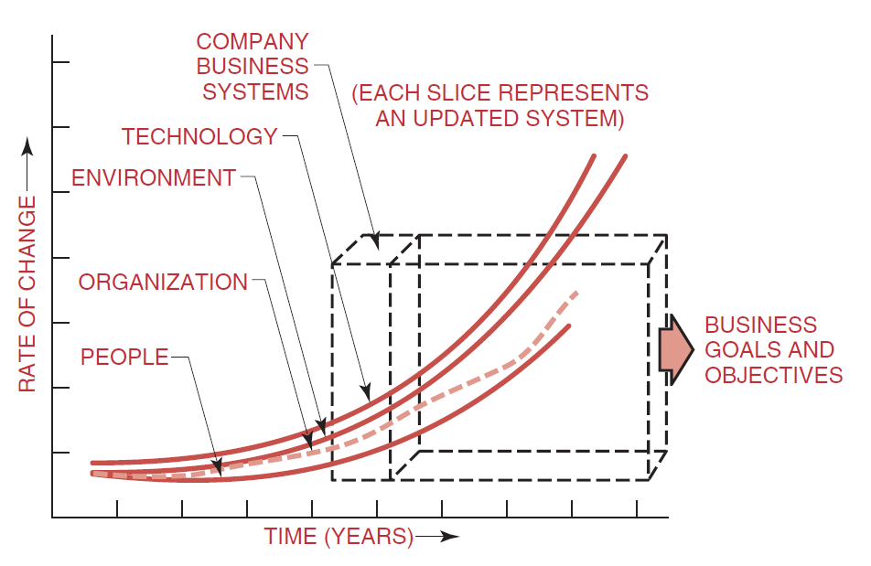
Project management 1945-1960
Systems in changing environment
The erratic line is a trademark or characteristic of the traditional structure. Project management structures, however, can, and often do, adapt to a rapidly changing environment with a relatively smooth transition.
Source: Kerzner, H. 2017. Project Management

Slide 12
Project management 1985-2003
There are six driving forces that lead executives to recognize the need for project management:
Capital projects
Customer expectations
Competitiveness
Executive understanding
New project development
Efficiency and effectiveness
By the 1990s, companies had begun to realize that implementing project management was a necessity, not a choice.
The question was not how to implement project management, but how fast could it be done?

Slide 13
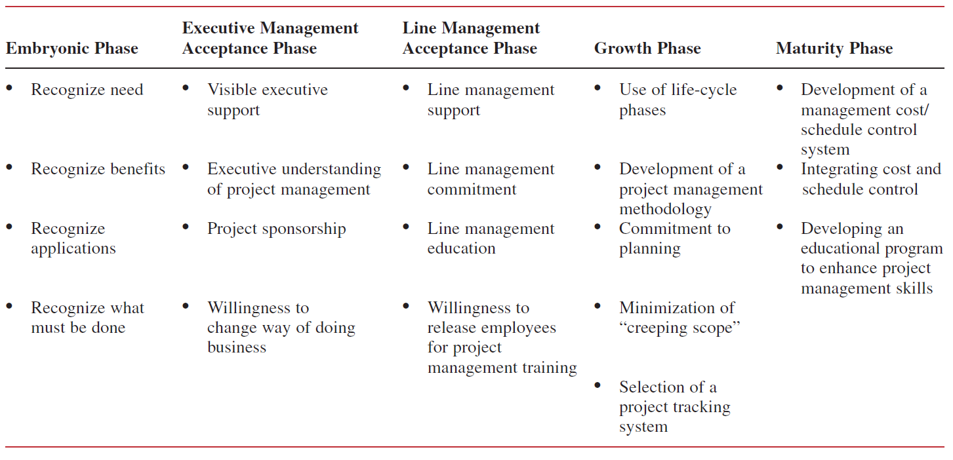
Project management 1985-2003
Life cycle phases for project management maturity
Source: Kerzner, H. 2017. Project Management

Slide 14
Project management 1985-2003
There are two situations where competitiveness becomes the driving force: internal projects and external (outside customer) projects.
Internally, companies get into trouble when the organization realizes that much of the work can be outsourced for less than it would cost to perform the work themselves.
Externally, companies get into trouble when they are no longer competitive on price or quality, or simply cannot increase their market share.
New product development is the driving force for those organizations that are heavily invested in R&D activities.
Efficiency and effectiveness, as driving forces, can exist in conjunction with any other driving forces.

Slide 15
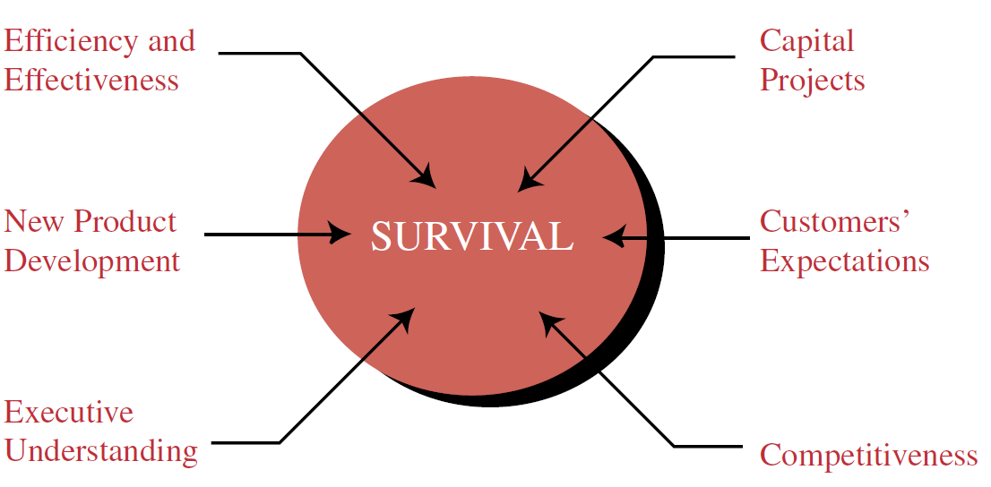
Project management 1985-2003
The concept of survival
The speed by which companies reach some degree of maturity in project management is most often based upon how important they perceive the driving forces to be.
Source: Kerzner, H. 2017. Project Management

Slide 16
Project management 1985-2003
The speed by which companies reach some degree of maturity in project management is most often based upon how important they perceive the driving forces to be.
Non–project-driven and hybrid organizations move quickly to maturity if increased internal efficiencies and effectiveness are needed.
Competitiveness is the slowest path because these types of organizations do not recognize that project management affects their competitive position directly.
By the 1990s, companies finally began to recognize the benefits of project management.
Recognizing that the organization can benefit from the implementation of project management is just the starting point. The question now becomes, “How long will it také us to achieve these benefits?”

Slide 17
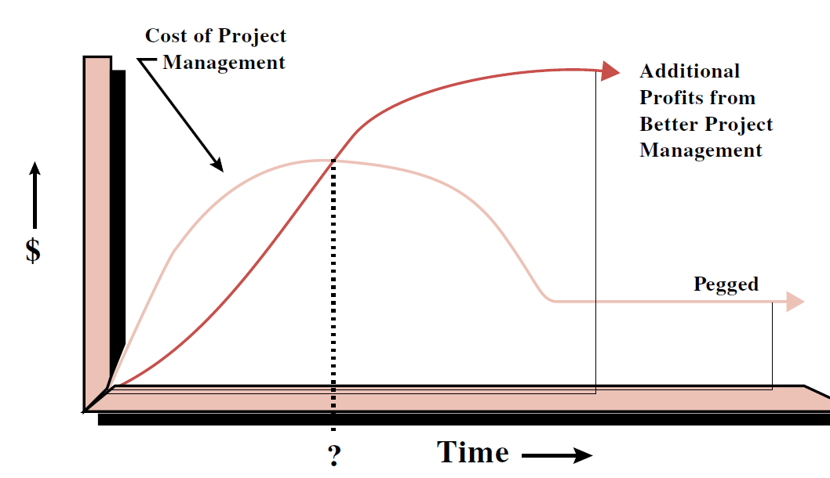
Project management 1985-2003
PM costs versus benefits
In the beginning of the implementation process, there will be added expenses to develop the project management methodology and establish the support systems for planning, scheduling, and control. Eventually, the cost will level off and become pegged.
The question mark in Figure is the point at which the benefits equal the cost of implementation
Source: Kerzner, H. 2017. Project Management

Slide 18
Project management 1985-2003
Benefits of Project management - Past view
Project management will require more people and add to the overhead costs.
Profitability may decrease.
Project management will increase the amount of scope changes.
Project management creates Organizational instability and increases conflicts.
Project management is really “eye wash” for the customer’s benefit.
Project management will create problems.
Only large projects need project management.
Project management will increase quality problems.
Project management will create power and authority problems.
Project management focuses on suboptimization by looking at only the project.
Project management delivers products to a customer.
The cost of project management may make us noncompetitive.
Benefits of Project management - Present view
Project management allows us to accomplish more work in less time, with fewer people.
Profitability will increase.
Project management will provide better control of scope changes.
Project management makes the organization more efficient and effective through better organizational behavior principles.
Project management will allow us to work more closely with our customers.
Project management provides a means for solving problems.
All projects will benefit from project management.
Project management increases quality.
Project management will reduce power struggles.
Project management allows people to make good company decisions.
Project management delivers solutions.
Project management will increase our business..

Slide 19
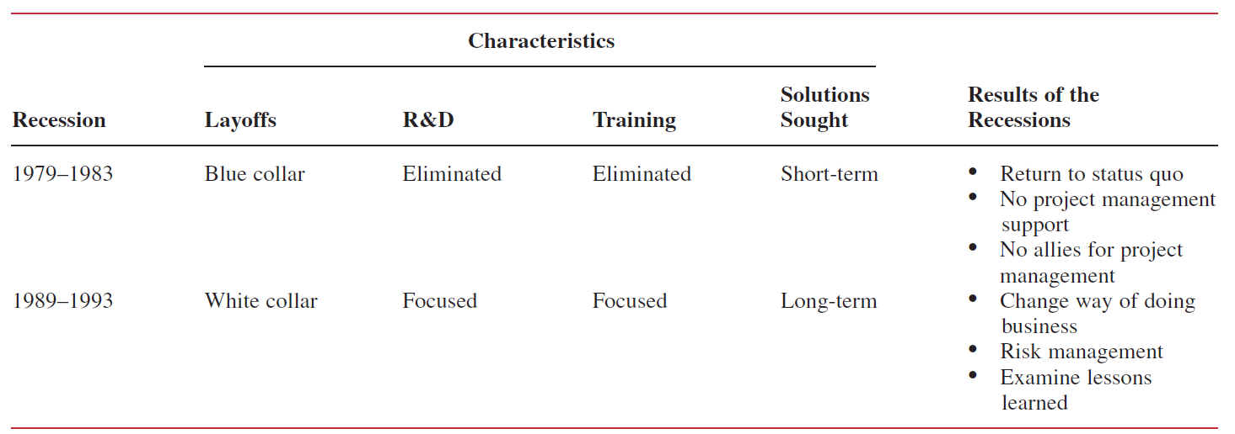
Project management 1985-2003
We can track the recessionary effects in PM evolution
Source: Kerzner, H. 2017. Project Management

Slide 20
Project management 1985-2003
1985: Companies recognize that they must compete on the basis of quality as well as cost. Companies begin using the principles of project management for the implementation of total quality management (TQM). The first ally for project management surfaces with the “marriage” of project management and TQM.
1990: During the recession of 1989–1993, companies recognize the importance of schedule compression and being the first to market. Advocates of concurrent engineering begin promoting the use of project management to obtain better scheduling techniques. Another ally for project management is born.
1991–1992: Executives realize that project management works best if decision making and authority are decentralized, but recognize that control can still be achieved at the top by functioning as project sponsors.
1993: As the recession of 1989–1993 comes to an end, companies begin “reengineering” the organization, which really amounts to elimination of Organizational “fat.” The organization is now a “lean and mean” machine. People are asked to do more work in less time and with fewer people; executives recognize that being able to do this is a benefit of project management.

Slide 21
Project management 1985-2003
1994: Companies recognize that a good project cost control system (i.e., horizontal accounting) allows for improved estimating and a firmer grasp of the real cost of doing work and developing products.
1995: Companies recognize that very few projects are completed within the framework of the original objectives without scope changes. Methodologies are created for effective change management.
1996: Companies recognize that risk management involves more than padding an estimate or a schedule. Risk management plans are now included in the project plans.
1997–1998: The recognition of project management as a professional career path mandates the consolidation of project management knowledge and a centrally located project management group. Benchmarking for best practices forces the creation of centres for excellence in project management.
1999: Companies that recognize the importance of concurrent engineering and rapid product development find that it is best to have dedicated resources for the duration of the project. The cost of over management may be negligible compared to risks of undermanagement. More organizations begin to use collocated teams all housed together.

Slide 22
Project management 1985-2003
2000: Mergers and acquisitions create more multinational companies. Multinational project management becomes a major challenge.
2001: Corporations are under pressure to achieve maturity as quickly as possible. Project management maturity models help companies reach this goal.
2002: The maturity models for project management provide corporations with a basis to perform strategic planning for project management. Project management is now viewed as a strategic competency for the corporation.
2003: Intranet status reporting comes of age. This is particularly important for multinational corporations that must exchange information quickly.
2004: Intranet reporting provides corporations with information on how Resources are being committed and utilized. Corporations develop capacity planning models to learn how much additional work the organization can take on.

Slide 23
Relationship of project, program, portfolio, and operations management
A project may be managed in three separate scenarios: as a stand-alone project (outside of a portfolio or program), within a program, or within a portfolio.
Project managers interact with portfolio and program managers when a project is within a program or portfolio.
For example, multiple projects may be needed to accomplish a set of goals and objectives for an organization. In those situations, projects may be grouped together into a program
Using project management processes, tools, and techniques puts in place a sound foundation for organizations to
achieve their goals and objectives.

Slide 24
Relationship of project, program, portfolio, and operations management
A program is defined as a group of related projects, subsidiary programs, and program activities managed in a coordinated manner to obtain benefits not available from managing them individually. Programs are not large projects. A very large project may be referred to as a megaproject.
Some organizations may employ the use of a project portfolio to effectively manage multiple programs and projects that are underway at any given time.
A portfolio is defined as projects, programs, subsidiary portfolios, and operations managed as a group to achieve strategic objectives.
Program management and portfolio management differ from project management in their life cycles, activities, objectives, focus, and benefits. However, portfolios, programs, projects, and operations often engage with the same stakeholders and may need to use the same Resources, which may result in a conflict in the organization.

Slide 25
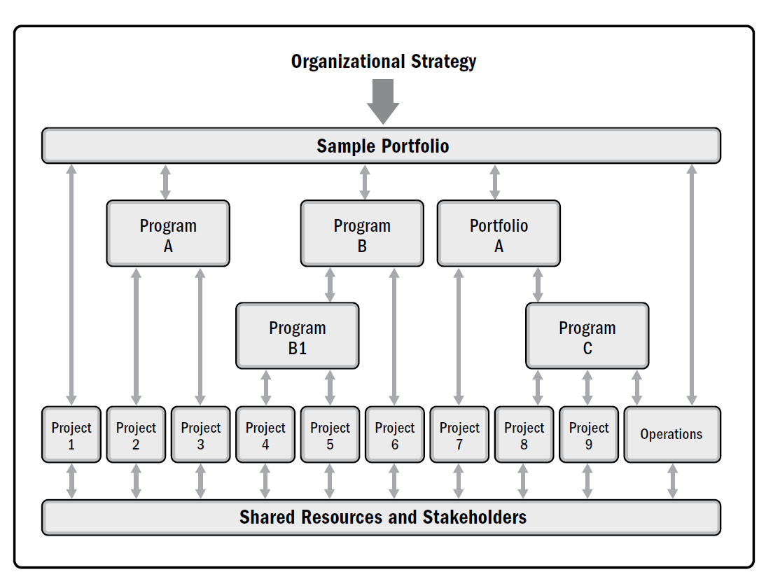
Relationship of project, program, portfolio, and operations management
Portfolio structure
A sample portfolio structure indicating relationships between the programs, projects, shared resources, and stakeholders.
The portfolio components are grouped together in order to facilitate the effective governance and management of the work that helps to achieve organizational strategies and priorities
Source: Kerzner, H. 2017. Project Management

Slide 26
Relationship of project, program, portfolio, and operations management
Operations management is an area that is outside the scope of formal project management as described in this guide.
Operations management is concerned with the ongoing production of goods and/or services.
It ensures that business operations continue efficiently by using the optimal resources needed to meet customer demands.
It is concerned with managing processes that transform inputs (e.g., materials, components, energy, and labour) into outputs (e.g., products, goods, and/or services).
Projects can intersect with operations at various points during the product life cycle, such as;
  When developing a new product, upgrading a product, or expanding outputs;
  While improving operations or the product development process;
  At the end of the product life cycle; and
  At each closeout phase.

Slide 27
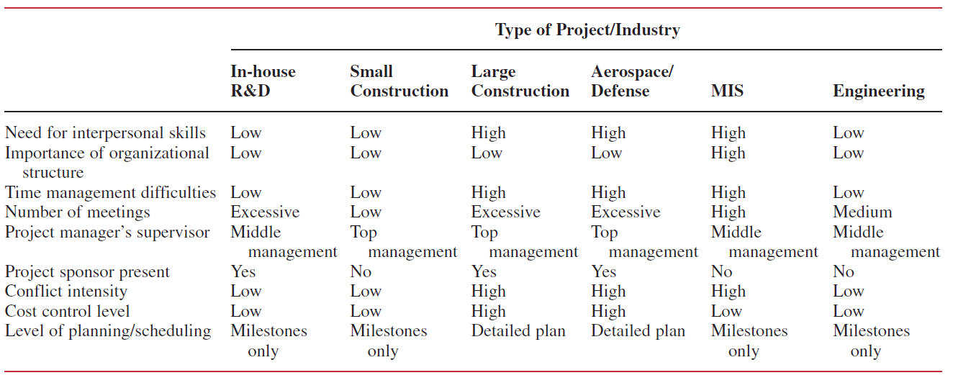
Classification of projects
Difference in classification of project/characteristics
There are the important differences withhin type of the projects.
Source: Kerzner, H. 2017. Project Management

Slide 28
RECAP
The growth of project management can be traced through topics such as roles and responsibilities, organizational structures, delegation of authority and decision-making, and especially corporate profitability.
The evolution and growth of project management from the early days of systems management to what some people call “modern project management“.
Portfolios, programs, and projects are aligned with or driven by organizational strategies and differ in the way each contributes to the achievement of strategic goals:
  Portfolio management aligns portfolios with organizational strategies by selecting the right programs or projects, prioritizing the work, and providing the needed resources.
  Program management harmonizes its program components and controls interdependencies in order to realize specified benefits.
  Project management enables the achievement of organizational goals and objectives.

