Slide 1

Cost Control
Cost management – estimating, accounting
Project cash flow
Pavel Adámek
Project management

Slide 2

Outline of the lecture
Management cost and control system (MCCS)
Understanding control
Budgets
Variances

Slide 3
Introduction
Cost control is equally important to all companies, regardless of size.
Small companies generally have tighter monetary controls because the failure of even one project can put the company at risk, but they have less sophisticated control techniques.
Large companies may have the luxury to spread project losses over several projects, whereas the small company may have few projects.
Cost control is not only “monitoring” costs and recording data, but also analyzing the data in order to take corrective action before it is too late.
Cost control should be performed by all personnel who incur costs, not merely the project office.
Cost control is actually a subsystem of the management cost and control system (MCCS).

Slide 4
Introduction
Cost control implies good cost management, which must include:
Cost estimating
Cost accounting
Project cash flow
Company cash flow
Direct labor costing
Overhead rate costing
Other tactics, such as incentives, penalties, and profit-sharing

Slide 5
Management cost and control system (MCCS)
The MCCS is represented as a two-cycle process: a planning cycle and an operating cycle.
The operating cycle is what is commonly referred to as the cost control system.
Failure of a cost control system to accurately describe the true status of a project does not necessarily imply that the cost control system is at fault.
Cost control is not only “monitoring” costs and recording data, but also analyzing the data in order to take corrective action before it is too late.
Cost control should be performed by all personnel who incur costs, not merely the project office.

Slide 6
Management cost and control system (MCCS)
Any cost control system is only as good as the original plan against which performance will be measured.
Therefore, the designing of a planning system must take into account the cost control system.
For this reason, it is common for the planning cycle to be referred to as planning and control, whereas the operating cycle is referred to as cost and control.
The planning and control system must help management project the status toward objective completion. Its purpose is to establish policies, procedures, and techniques that can be used in the day-to-day management and control of projects and programs

Slide 7
Management cost and control system (MCCS)
MCCS provide information that:
Gives a picture of true work progress
Will relate cost and schedule performance
Identifies potential problems with respect to their sources
Provides information to project managers with a practical level of summarization
Demonstrates that the milestones are valid, timely, and auditable

Slide 8
Management cost and control system (MCCS)
The planning and control system, in addition to being a tool by which objectives can be defined (i.e., hierarchy of objectives and organization accountability), exists as a tool to develop planning, measure progress, and control change. As a tool for planning, the system must be able to:
Plan and schedule work
Identify those indicators that will be used for measurement
Establish direct labor budgets
Establish overhead budgets
Identify management reserve

Slide 9
Management cost and control system (MCCS)
The project budget that results from the planning cycle of the MCCS must be reasonable, attainable, and based on contractually negotiated costs and the statement of work.
The basis for the budget is either historical cost, best estimates, or industrial engineering standards.
The budget must identify planned manpower requirements, contract-allocated funds, and management reserve.
Establishing budgets requires that the planner fully understand the meaning of standards. There are two categories of standards.
Performance results standards are quantitative measurements and include such items as quality of work, quantity of work, cost of work, and time-to-complete. Process standards are qualitative, including personnel, functional, and physical factors relationships.

Slide 10
Management cost and control system (MCCS)
As a tool for measuring progress and controlling change, the systems must be able to:
Measure resources consumed
Measure status and accomplishments
Compare measurements to projections and standards
Provide the basis for diagnosis and replanning
In using the MCCS, the following guidelines usually apply:
The level of detail is specified by the project manager with approval by top management.
Centralized authority and control over each project are the responsibility of the project management division.
For large projects, the project manager may be supported by a project team for utilization of the MCCS.

Slide 11
Management cost and control system (MCCS)
MCCS planning activities include:
Contract receipt (if applicable)
Work authorization for project planning
Work breakdown structure
Subdivided work description
Schedules
Planning charts
Budgets

Slide 12
Management cost and control system (MCCS)
Even with a fully developed planning and control system, there are numerous benefits and costs. The appropriate system must consider a cost-benefit analysis, and include such items as:
Project benefits
  Planning and control techniques facilitate:
    Derivation of output specifications (project objectives)
    Delineation of required activities (work)
    Coordination and communication between organizational units
    Determination of type, amount, and timing of necessary resources
    Recognition of high-risk elements and assessment of uncertainties
    Suggestions of alternative courses of action
    Realization of effect of resource level changes on schedule and output performance
    Measurement and reporting of genuine progress
    Identification of potential problems
    Basis for problem-solving, decision-making, and corrective action
    Assurance of coupling between planning and control

Slide 13
Management cost and control system (MCCS)
The appropriate system must consider a cost-benefit analysis, and include such items as:
Project cost
  Planning and control techniques require:
    New forms (new systems) of information from additional sources and incremental processing (managerial time, computer expense, etc.)
    Additional personnel or smaller span of control to free managerial time for planning and control tasks (increased overhead)
    Training in use of techniques (time and materials)

Slide 14
Understanding control
Effective management of a program during the operating cycle requires that a well organized cost and control system be:
designed,
developed,
and implemented so that immediate feedback can be obtained, whereby the up-to-date usage or resources can be compared to target objectives established during the planning cycle.

Slide 15
Understanding control
The requirements for an effective control system (for both cost and schedule/performance) should include:
Thorough planning of the work to be performed to complete the project
Good estimating of time, labour, and costs
Clear communication of the scope of required tasks
A disciplined budget and authorization of expenditures
Timely accounting of physical progress and cost expenditures
Periodic reestimation of time and cost to complete remaining work
Frequent, periodic comparison of actual progress and expenditures to schedules and budgets, both at the time of comparison and at project completion

Slide 16
Understanding control
Management must compare the time, cost, and performance of the program to the budgeted time, cost, and performance, not independently but in an integrated manner.
Being within one’s budget at the proper time serves no useful purpose if performance is only 75 percent.
Likewise, having a production line turn out exactly 200 items, as planned, loses its significance if a 50 percent cost overrun is incurred.
All three resource parameters (time, cost, and performance) must be analyzed as a group, or else we might “win the battle but lose the war.”

Slide 17
Understanding control
The work breakdown structure therefore serves as the tool from which performance can be subdivided into objectives and subobjectives.
As work progresses, the WBS provides the framework on which costs, time, and schedule/performance can be compared against the budget for each level of the WBS.
The first purpose of control therefore becomes a verification process accomplished by the comparison of actual performance to date with the predetermined plans and standards set forth in the planning phase. The comparison serves to verify that:
  The objectives have been successfully translated into performance standards.
  The performance standards are, in fact, a reliable representation of program activities and events.
  Meaningful budgets have been established such that actual versus planned comparisons can be made.

Slide 18
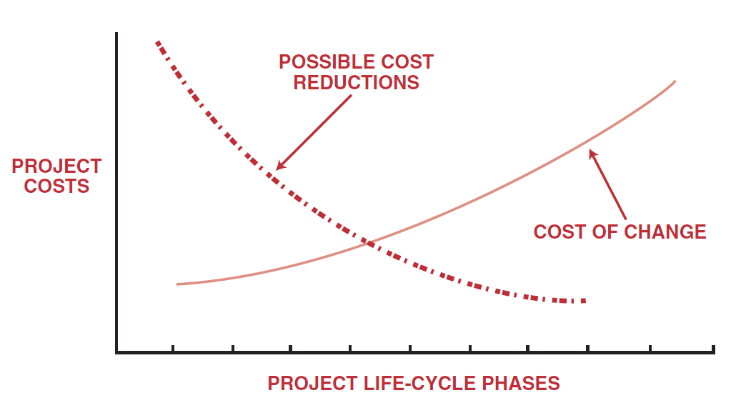
Understanding control
The comparison verifies that the correct standards were selected, and that they are properly used.
Cost reductions are more available in the early project phases, but are reduced as we gofurther into the project life-cycle phases.
Cost reduction analysis
Source: Kerzner, H. 2017. Project Management

Slide 19
Understanding control
The second purpose of control is decision-making. Three useful reports are required by management in order to make effective and timely decisions:
  The project plan, schedule, and budget prepared during the planning phase
  A detailed comparison between resources expended to date and those predetermined.
  This includes an estimate of the work remaining and the impact on activity
  completion.
  A projection of resources to be expended through program completion
  These reports, supplied to the managers and the doers, provide three useful results:
  Feedback to management, the planners, and the doers
  Identification of any major deviations from the current program plan, schedule or budget
  The opportunity to initiate contingency planning early enough that cost, performance, and time requirements can undergo corrected action without loss of resources

Slide 20
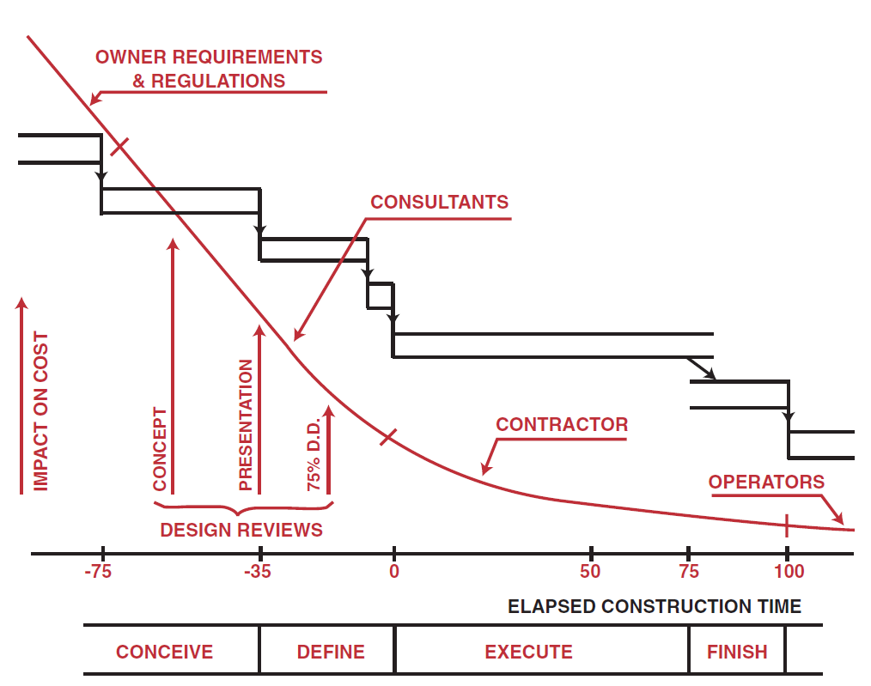
Understanding control
Downstream the cost of changes could easily exceed the original cost of the project.
This is an example of the “iceberg” syndrome, where problems become evident too late in the project to be solved easily, resulting in a very high cost to correct them.
Ability to influence cost
Source: Kerzner, H. 2017. Project Management

Slide 21
Understanding control
Four categories of cost data are normally accumulated:
Labor
Material
Other direct charges
Overhead
Project managers can maintain reasonable control over labour, material, and other direct charges.
Overhead costs, on the other hand, are calculated yearly or monthly and applied retroactively to all applicable programs. Management reserves are often used to counterbalance the effects of adverse changes in overhead rates.

Slide 22
Budgets
The project budget, which is the final result of the planning cycle of the MCCS, must be reasonable, attainable, and based on contractually negotiated costs and the statement of work.
The basis for the budget is either historical cost, best estimates, or industrial engineering standards.
The budget must identify planned manpower requirements, contract allocated funds, and management reserve.

Slide 23
Budgets
All budgets must be traceable through the budget “log,” which includes:
Distributed budget
Management reserve
Undistributed budget
Contract changes
Management reserve is money amount established by the project office to budget for all categories of unforeseen problems and contingencies resulting in out-of-scope work to the performers.

Slide 24
Budgets
The budgeting and scheduling system variance must be compared because:
The cost variance compares deviations only from the budget and does not provide a measure of comparison between work scheduled and work accomplished.
The scheduling variance provides a comparison between planned and actual performance but does not include costs.

Slide 25
Budgets
In order to calculate variances, we must define the three basic variances for budgeting
and actual costs for work scheduled and performed. Archibald defines these variables:
Budgeted cost for work scheduled (BCWS) is the budgeted amount of cost for work scheduled to be accomplished plus the amount or level of effort or apportioned effort scheduled to be accomplished in a given time period.
Budget cost for work performed (BCWP) is the budgeted amount of cost for completed work, plus budgeted for level of effort or apportioned effort activity completed within a given time period. This is sometimes referred to as “earned value.”
Actual cost for work performed (ACWP) is the amount reported as actually expended in completing the work accomplished within a given time period.

Slide 26
Budgets
When permitted variances are exceeded, cost account variance analysis reports are required. Required signatures may include:
The functional employees responsible for the work
The functional managers responsible for the work
The cost accountant and/or the assistant project manager for cost control
The project manager, work breakdown structure element manager, or someone with signature authority from the project office

Slide 27
Budgets
For variance analysis, the goal of the cost account manager (whether project officer or functional employee) is to take action that will correct the problem within the original budget or justify a new estimate.
Five questions must be addressed during variance analysis:
What is the problem causing the variance?
What is the impact on time, cost, and performance?
What is the impact on other efforts, if any?
What corrective action is planned or under way?
What are the expected results of the corrective action?

Slide 28
Recording materiál costs using Earned Value Measurement
Using “earned value” measurement, the actual cost for work performed represents those direct and indirect costs identified specifically for the project (contract) at hand.
Both the recorded and reported costs must relate specifically to this effort. Recording direct labour costs usually presents no problem since lab or costs are normally recorded as the labour is accomplished.
Material costs, on the other hand, may be recorded at various times. Material costs can be recorded as commitments, expenditures, accruals, and applied costs. All provide useful information and are important for control purposes.

Slide 29
RECAP
Approving all estimates, and negotiating all estimates and the definition of work requirements with the respective organizations.
Approving the budget, and directing distribution and budgeting of available funds to all organizational levels by program element.
Defining the work required and the schedule.
Authorizing work release. The manager may not, however, authorize work beyond the scope of the contract.
Approving the program bill-of-materials, detailed plans, and program schedules for need and compliance with program requirements.

Slide 30
RECAP
Approving the procuring work statement, the schedules, the source selection, the negotiated price, and the type of contract on major procurement.
Monitoring the functional organization’s performance against released budgets, schedules, and program requirements.
When cost performance is unacceptable, taking appropriate action with the affected organization to modify the work requirements or to stimulate corrective action within the functional organization so as to reduce cost without changing the contracted scope of work.
Being responsible for all communications and policy matters on contracted programs so that no communicative directives shall be issued without the signature or concurrence of the program manager.

