Slide 1
Lean Canvas Model

Slide 2
Business Model
Business Plan
a diagram or blueprint of how a business works to provide value to its target market and produce profit
a complete view of the business resources,
goals, activities, and strategies aimed at
producing a profit

Slide 3
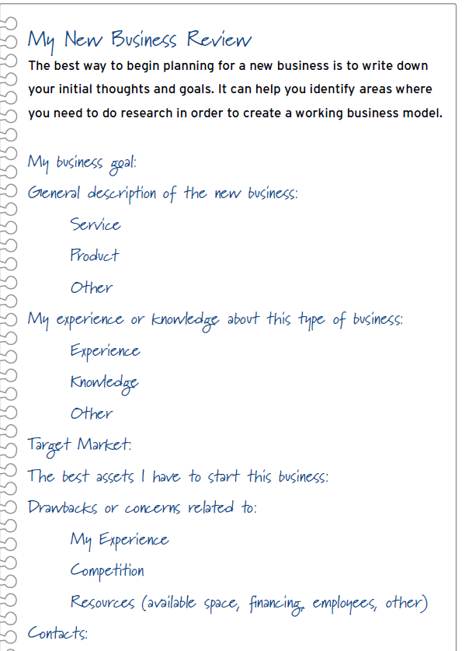

Slide 4
What’s in a Business Model?
Your business model is a map that shows where you are and whereyou are going.
1. Value Proposition
2. Target Market
3. Value Chain
4. Cost Structure and Target Margins
5. Value Network
6. Competitive Advantage

Slide 5
Lean Canvas
Is a framework / tool
Understand the principles behind it
Methodology to think about starting a business
Designed to capture the risks in your startup

Slide 6
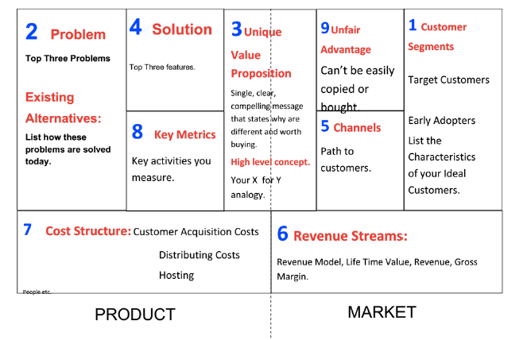
Lean Canvas – basic principles

Slide 7
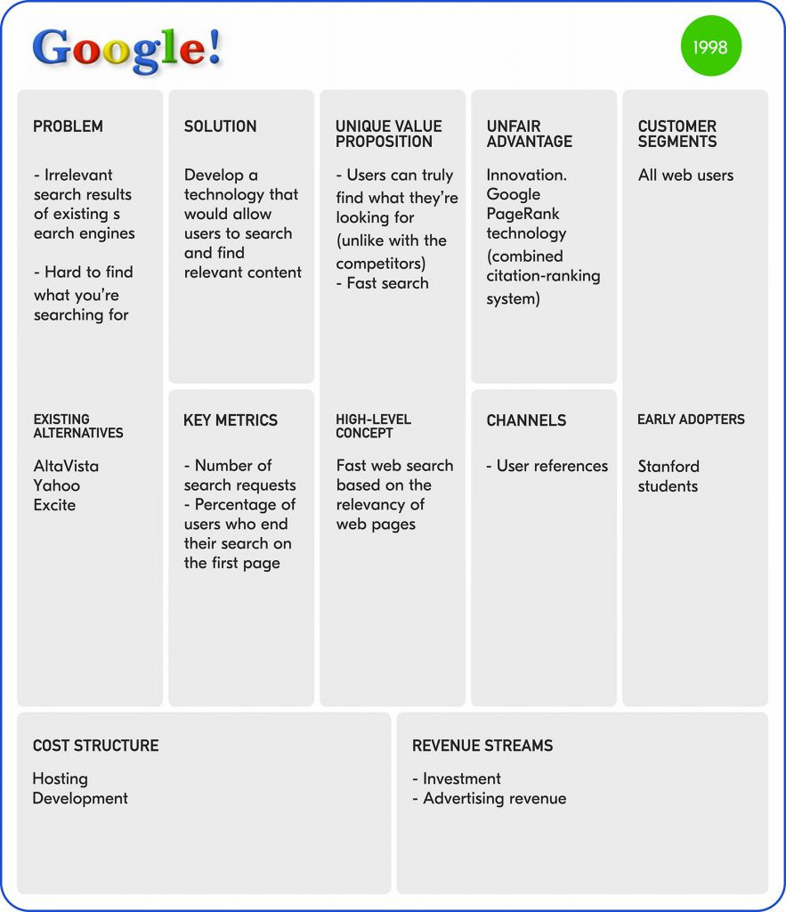

Slide 8
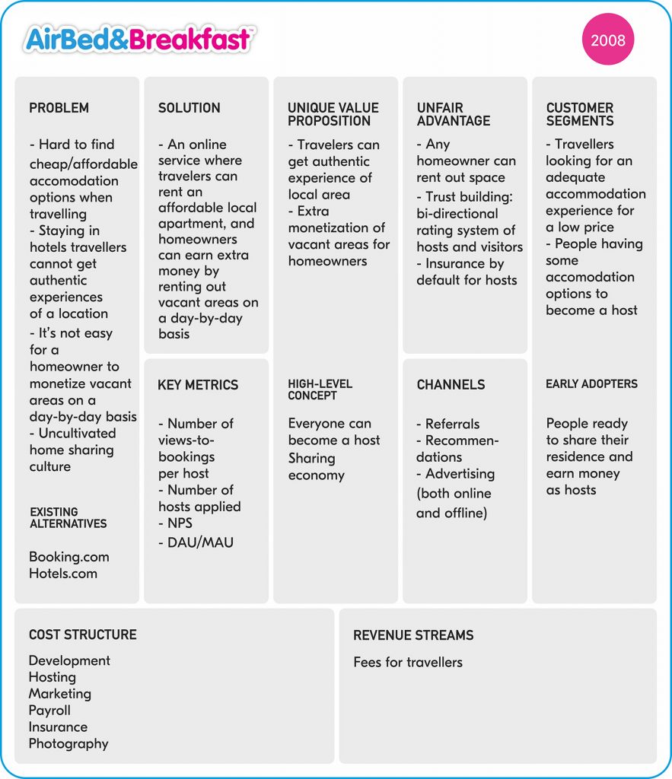

Slide 9
Ask yourself
What types of information we need?
What we know about the industry?

Slide 11
1. Customer segments
Who is the customer?
Target customers
Early Adopters
List the characteristics of your ideal customers

Slide 12
Identify other user roles
Next identify any other user roles that will interact with this customer.
Examples:
1. In a blogging platform, the customer is the blog author while the user is a reader.
2. In a photo sharing service, the customer is the sharer, while users are viewers (family and friends).
Early adopters
With these problems in mind, get more specific on the customer segment.
Narrow down the distinguishing characteristics of your prototypical customer.

Slide 13
2. Problem
What are the top three problems?
Existing alternatives
List how these problems are solved today
Alternatives available

Slide 14
Problem
List top 3 problems
For the customer segment you are working with, describe the top 1-3 problems they need solved.
List existing alternatives
Then document how you think your early adopters address these problems today. Unless you are solving a brand new problem (unlikely), most problems have existing solutions. Many times these may not be a readily obvious competitor.
As an example, the biggest alternative to most online collaboration tools is not another collaboration tool, but email. Doing nothing could also be a viable alternative for a customer if the pain is not acute enough.

Slide 15
3.Unique value proposition
What is your value proposition?
Single, clear, compelling message that states why you are different and worth buying
Example: Help startups raise their odds for building successful products

Slide 16
4. Solution
What are the top three features?
Building only what is necessary to solve the problem
Prioritise
Rank

Slide 17
5. Channels
Path to customers
○ Content marketing
○ Adwords
○ Email
○ Paid installs
○ Mobile and networks

Slide 18
6. Revenue
Revenue streams
Revenue model
Life time value
Gross margin

Slide 19
7. Cost structure
Customer acquisition costs
Distribution costs
Implementation cost
Our major costs

Slide 20
8. Key Metric
Key activities you measure
Pick one metric to start
Metric that will validate or invalidate your assumption
ARPU (average revenue per user)
MAU (monthly active users)
DAU (daily active users)
Time spent per session

Slide 21
9. Unfair Advantage
Can’t be easily copied or bought
Deep industry experience or insight
Unique marketing channel
Existing audience
Difficult to articulate
Work towards and build

Slide 22
Model Patterns

Slide 23
Common models-Essential Product or Service:
built on a product or service that fills a critical need in particular business space, and provides it better than competitors
What critical need would my business fill?
What are the challenges of this business model? How would I deal with them?
+ Advantage: Target market is eager for your innovation.
- Disadvantage: Gaining recognition for your innovation is expensive and can také valuable time while your competition is working to win back your market.

Slide 24
Common models- Loss Leader:
build a need for repeat sales of another product or service.
Eg. razors and razor blades
+ Advantage: The item that is given away or sold at a low price promotes longterm sales.
- Disadvantage: Competitors may develop products that also work with the loss leader; customers may still prefer to buy a competitor’s product, despite the loss leader.
A loss leader is an item given away or sold at low cost to attract customers.

Slide 25
Common models- Pipeline Systems:
You establish or become part of a system and everyone else who distributes or buys a product through your system pays you a fee
Eg. Cosmetics distribution
+ Advantage: You develop a personal loyalty among your target audiences.
- Disadvantage: Costs are established by the pipeline owners or managers, yet you have to charge customers in a competitive environment.

Slide 26
Common models-Auctions:
In this model, buyers and sellers meet or are matched online. Prices are determined by how much a buyer is willing to pay.
Eg. ebay
+ Advantage: Target customers are eager to purchase your products or services.
- Disadvantage: Only the target customers who are available at the moment of sale are able to influence price; you may have to “sell low” when buyers are not interested or available for auction activities.

Slide 27
Common models-Subscriptions:
In this model, a business establishes a set price for a period of service. Magazine, book clubs, insurance policies, lawn care services, cable TV, cell phones are all subscription services.
+ Advantage: The business is paid upfront for services or receives a regular payment, which is a major cash flow advantage.
- Disadvantage: The costs of doing business could increase and have to be absorbed by the business; customers need to be encouraged to “buy beyond” their subscription, such as ordering pay-per-view programs on cable TV.

Slide 28
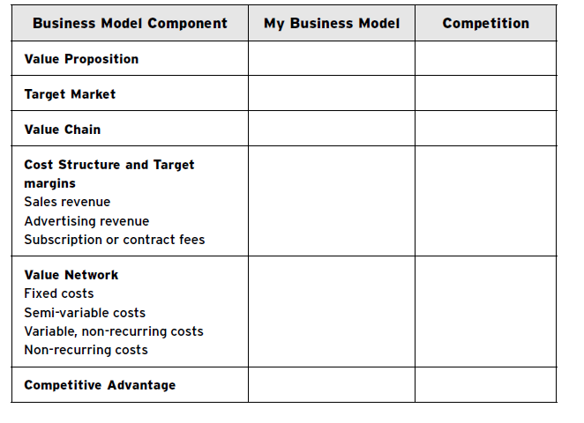
Your business model

Slide 29
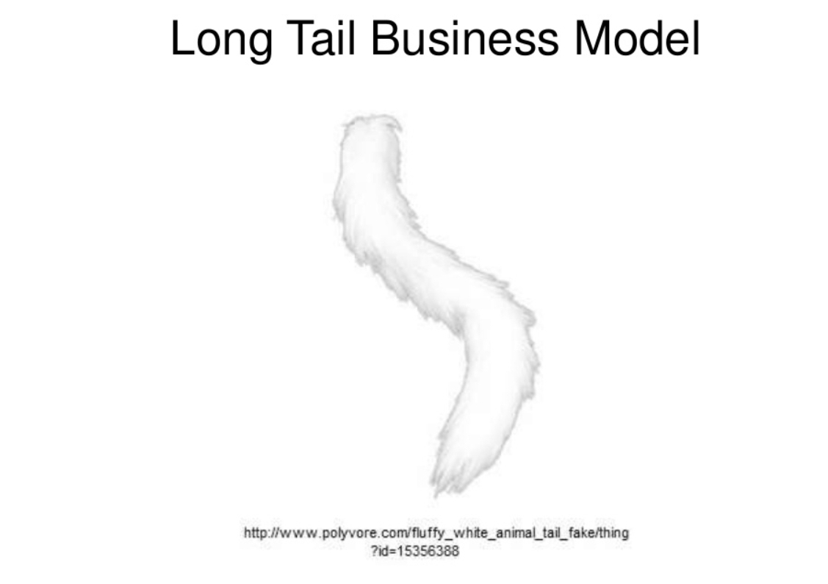

Slide 30
Long Tail
sell a large number of niche products, each of which sells infrequently
e.g. Netflix, eBay, Lego

Slide 31
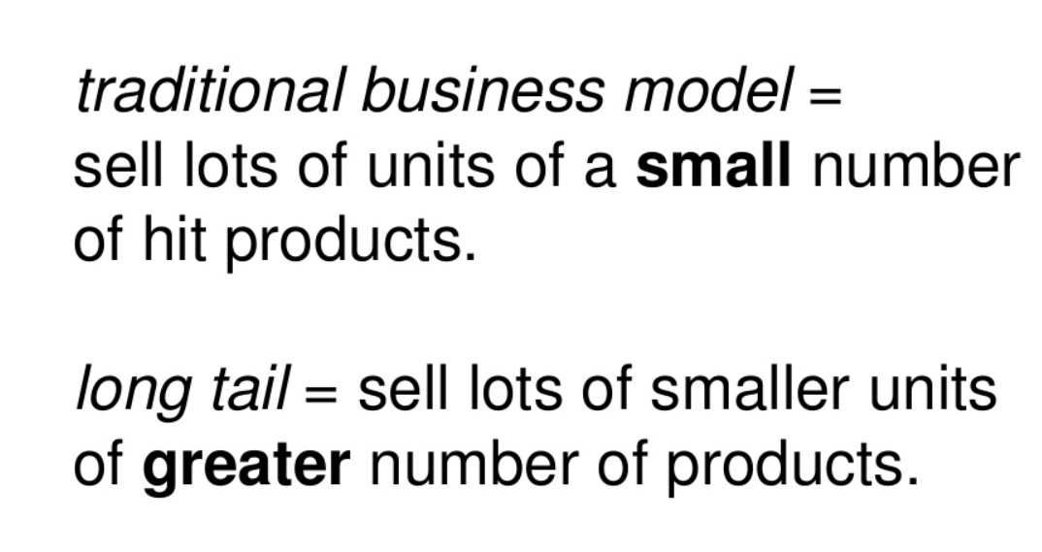

Slide 32
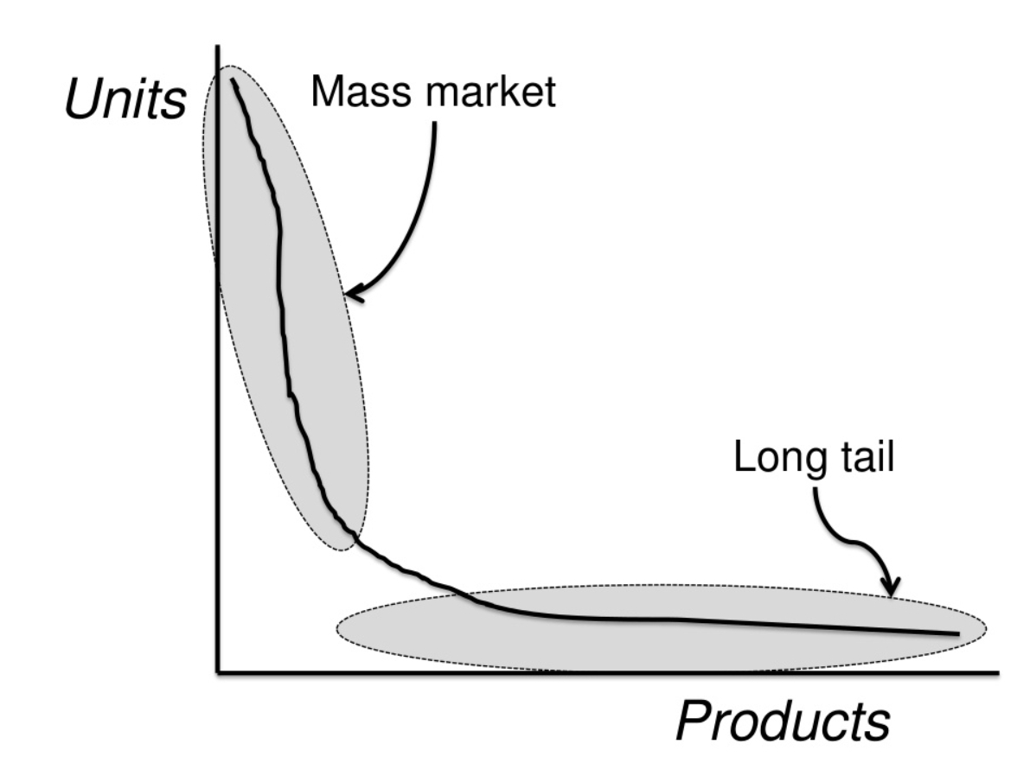

Slide 33
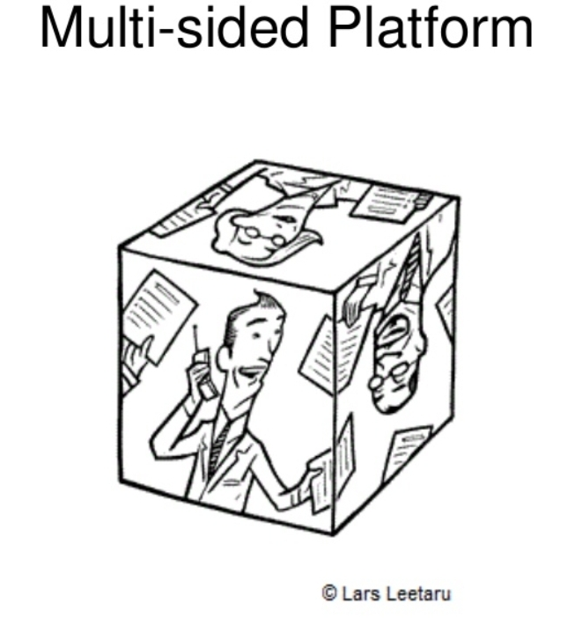

Slide 34
Multi-Sided Platforms
bring together two or more distinct but inter-dependent groups of customers of value to one group of customers only if the other groups of customers are present
Creates value by facilitating interactions between the different groups
Grows in value to the extent that it attracts more users (network effect)
e.g. Visa, Google, eBay, Microsoft Windows

Slide 35
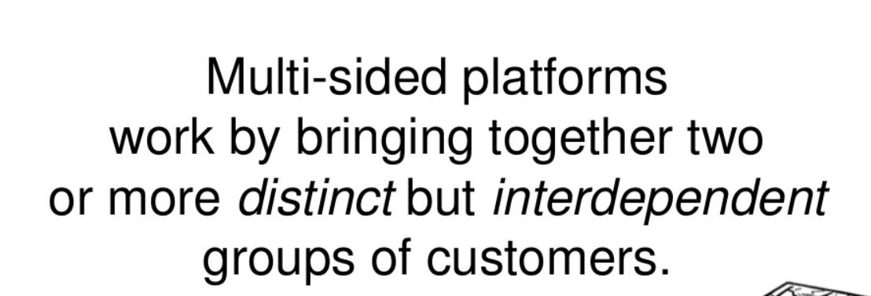

Slide 36
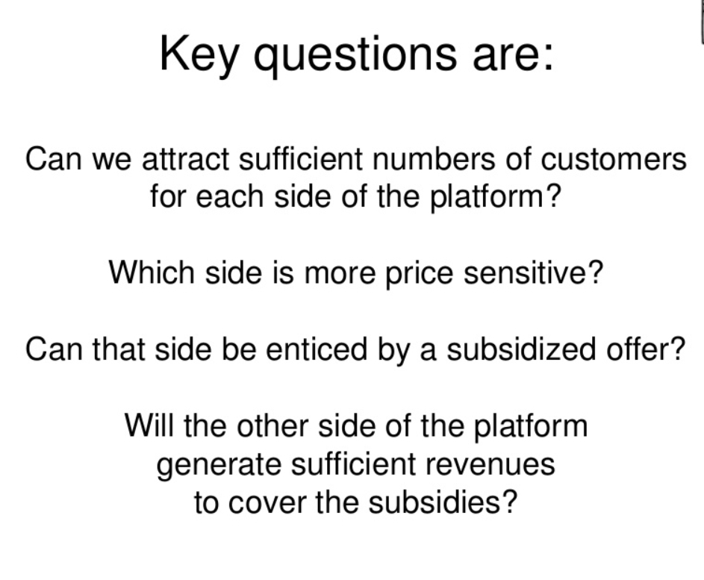

Slide 37
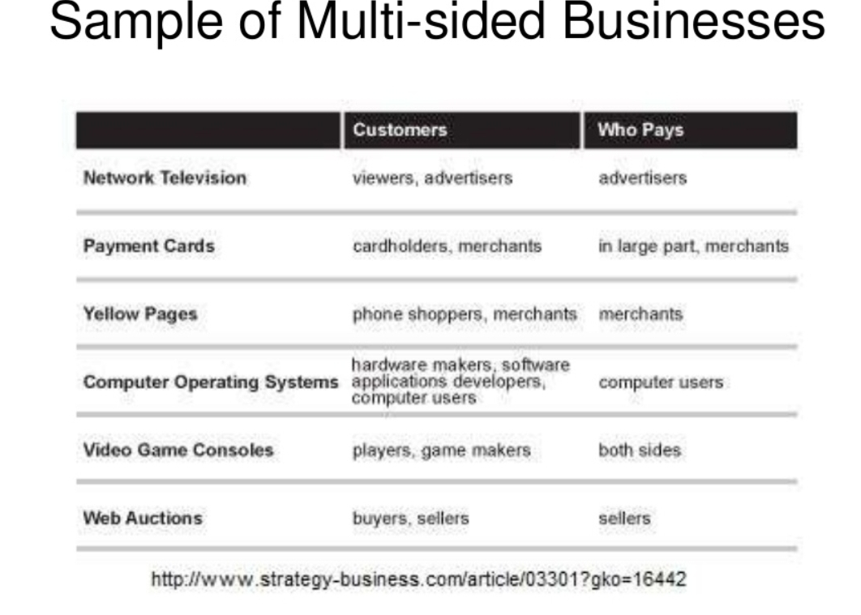

Slide 38
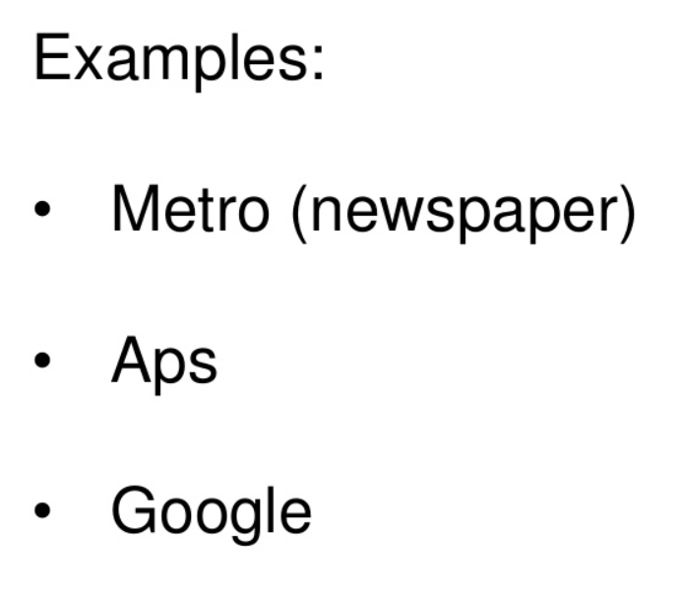

Slide 39


Slide 40
Free
• At least one Customer Segment continuously benefits from a free-of charge (or low cost) offer
Non-paying customers are financed by another part of the business model or by another Customer Segment
e.g. Flickr, Skype, Google, Gillette

Slide 41
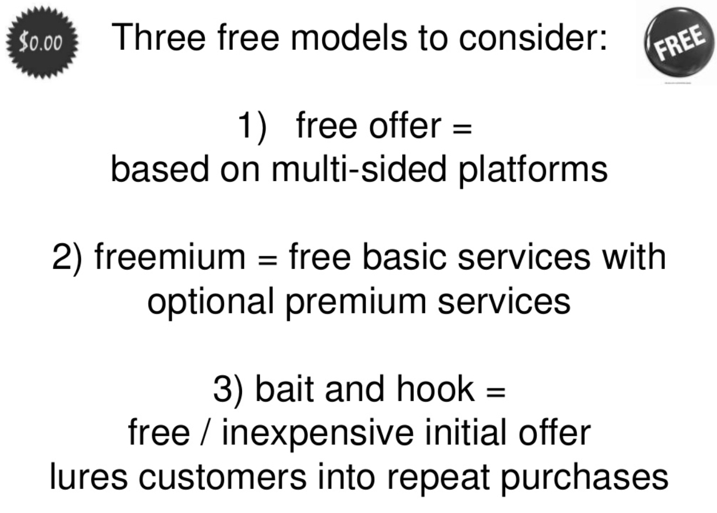

Slide 42
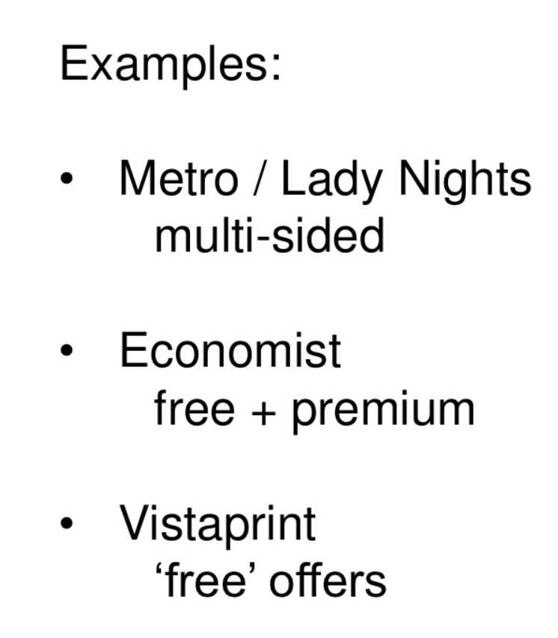

Slide 43
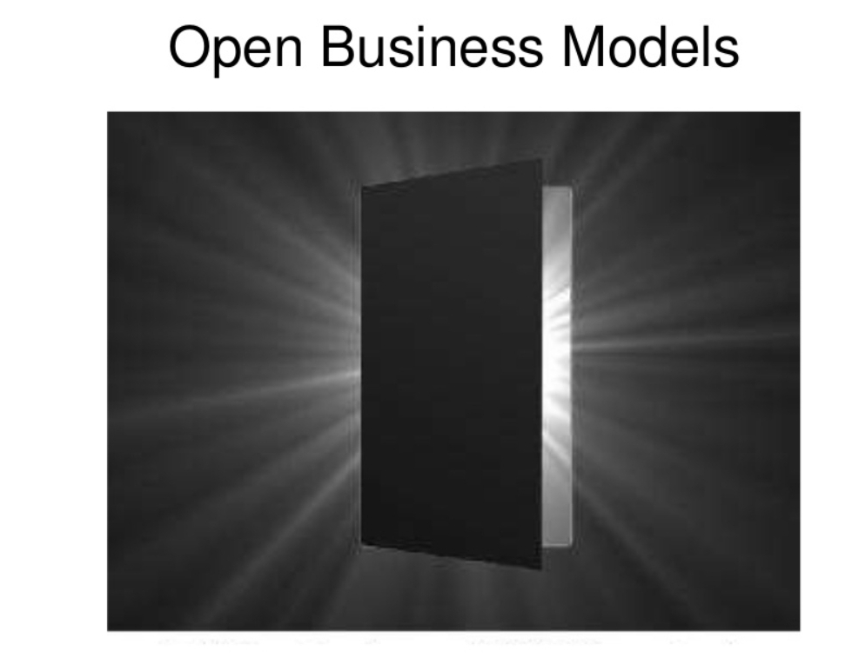

Slide 44
Open Business Models
Create and capture value by systematically collaborating with outside partners
“Outside in” exploits external ideas from within the firm
“Inside out” provides external parties with ideas or assets lying idle within the firm
• e.g. P&G, GlaxoSmithKline, Open Source

Slide 45
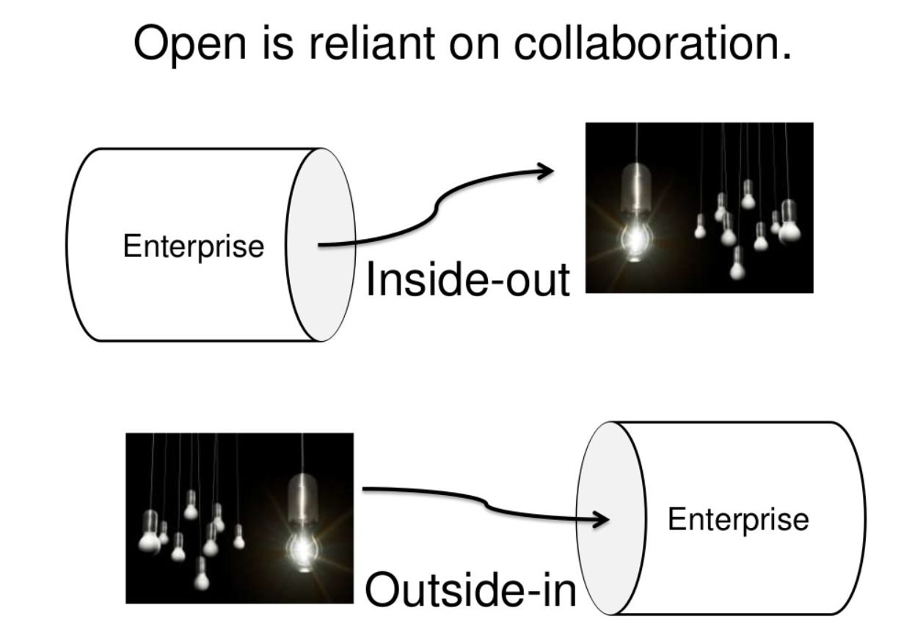

Slide 46
