Slide 1
Small and Medium-Sized Enterpreneurship
Business Environment
Analyses

Slide 2
BUSINESS ENVIRONMENT
INTRODUCTION TO BUSINESS ENVIRONMENT
Organizations don´t operate in vacuum. Each organization operates within a specific environment.
Environment of each organization is unique to it and no two organizations operate in exactly the same environment. Thus the business environment is situational. We are talking about environmental uniqueness.
Business environment becomes more turbulent and unpredictable. It is important to understand the complexity of the business environment.
Understanding of business environment is vital for people or practitioners who wish to gain a fuller understanding of both the context in which business decisions are taken and the major influences in those decisions.

Slide 3
BUSINESS ENVIRONMENT
CHARACTERISTICS OF BUSINESS ENVIRONMENT
Business environment as an „open system“ – the business organization is in constant interaction with its environment.
Interaction between the internal and external environments – various external influences affecting organizations are also frequently interrelated.
The complexity of business environment – external and internal influences are almost infinite in number and variety and no study could hope to consider them all.
Environmental volatility and change – the business environment is further complicated by the tendency towards environmental change. This volatility may be particularly prevalent in some areas or in some markets or in some types of industry or organization.

Slide 4
Types of Business Environment
BUSINESS ENVIRONMENT
TYPOLOGY OF BUSINESS ENVIRONMENT
 |  | Degree of dynamics
 |  | Stable | Dynamic
Degree of complexity | Simple | Stability Small degree of uncertainty | High dynamics of changes High degree of uncertainty
 | Complex | Stability Middle degree of uncertainty | -Turbulent environment -High degree of uncertainty
The degree of complexity
Simple
Complex
The degree of dynamics of changes in environment
Stable
Dynamic

Slide 5
BUSINESS ENVIRONMENT
CONCEPTUALIZING OF THE BUSINESS ENVIRONMENT
Spatial level
Local level;
Regional level;
National level;
Supranational;
International/Global level.
Level of influence
External environment – forces from outside
General environment (also known as environment, contextual environment, macro environment) – forces from the environment have a major impact at the level of the industry.
Immediate environment (also known as task environment, specific environment, near environment, operational environment, micro environment) – forces from the environment relevant to an individual organization within an industry.
Internal environment – forces from inside

Slide 6
Components of Business Environment
BUSINESS ENVIRONMENT
EXTERNAL AND INTERNAL BUSINESS ENVIRONMENT
Components of business environment
 | External | Internal
Macro environment | Micro environment
-Economical -Political -Social -Cultural -Technological -Natural -Demographic -Legal | Costumers Competition Public Intermediaries suppliers | Resources Management Strategy Business culture
External business environment
Macro environment
Micro environment
Internal business environment

Slide 7
BUSINESS ENVIRONMENT
ENVIRONMENTAL FACTORS
Environmental factors are those events or situations that can have either a positive or a negative impact on organizations.
External environmental factors are events that take place outside of the organization and are harder to predict and control. Some examples of external environmental factors are:
Factors from macro environment;
Factors from micro environment (market and industry).
Internal environmental factors – internal environmental factors are events that occur within a organization. Some examples of internal environmental factors are:
Strategy;
Management;
Business culture.

Slide 8
Environmental analyses-External
PEST (political, economic, socio-cultural, technological);
PESTEL (political, economic, socio-cultural, technological, environmental
(or ecological), legal);
PESTLIED (political, economic, socio-cultural, technological, legal,international, environmental (or ecological), demographic);
STEEPLE (socio-cultural, technological, environmental (or ecological), economic, political, legal, ethical).

Slide 9
SLEPT Analysis
Social
Legal
Economic
Political
Technological

Slide 10
Political
Examples of political factors could be a potential change of government, with the corresponding changes to policies and priorities, or the introduction of a new government initiative.

Slide 11
Economic:
Economic factors may also be limited to the home country, but as global trade continues to grow, economic difficulties in one nation
tend to have a broad, often worldwide, impact. Examples of economic factors could be the level of growth within an economy, or market confidence in the economies within which the organisation operates.

Slide 12
Technological
This area covers factors arising from the development of technology. There are two types of technological change: there can be developments in IT, and there can be developments in technology specific to an industry or market, for example enhancements to manufacturing technology.

Slide 13
Legal:
It is vital to consider factors arising from changes to the law, since the last decade has seen a significant rise in the breadth and depth of the legal regulations within which organisations have to operate. Legal compliance has become such an important issue during this period that many business analysis assignments have been carried out for the purpose of ensuring compliance with particular laws or regulations.

Slide 14
Environmental (or Ecological):
Examples of factors arising from concerns about the natural environment, in other words the ‘green’ issues, include increasing concerns about packaging and the increase of pollution.

Slide 15
Mezo-environment

Slide 16
Porter’s 5 Forces
Barriers to Entry:
Economies of scale
Product differentiation
Capital requirements
Legal agreements
Switch costs
Power of Suppliers:
Concentration
Extent of substitutes
Importance of supplier
Extent of differentiation
Forward integration
Competitive rivalry:
Number & size
Industry growth
Extent of differentiation
Capacity increments
Exit barriers
Power of Buyers:
Numbers & concentration
Extent of differentiation
Switch costs
Margin they earn
Backward integration
Threat of substitutes:
Changing technology
Changing market
Changing tastes
Switch costs
Extent of differentiation

Slide 17
Industry : What is the level of competition for the products or services in competitors: this industry? Is the organisation in a good competitive position or is it a minor player? Are there several competitors that hold the power in the industry?
New entrants: Are there barriers to entry, such as the need for large amounts of money or expertise? Is it possible to start up an organisation offering these products or services without much financial support? What is the likelihood of new entrants coming into the industry?
Substitutes: What is the range of substitutes available? What is the position of the organisation when compared to the suppliers of these substitutes?
Buyers: How much choice do buyers have? Can they switch suppliers easily? Do they have the power in the relationship or are they locked in to the supplier?
Suppliers: How many suppliers are available? Is this a competitive situation where the organisation has a choice of suppliers? Do the suppliers have the power in the relationship because they operate in an area of limited supply?

Slide 18
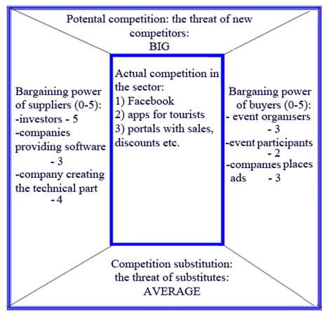
Porter´s analysis- evaluation

Slide 19
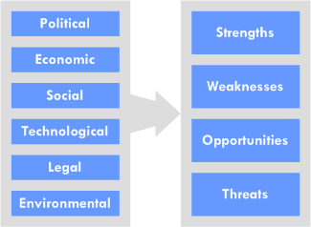
Macro-environment
Micro-environment

Slide 20
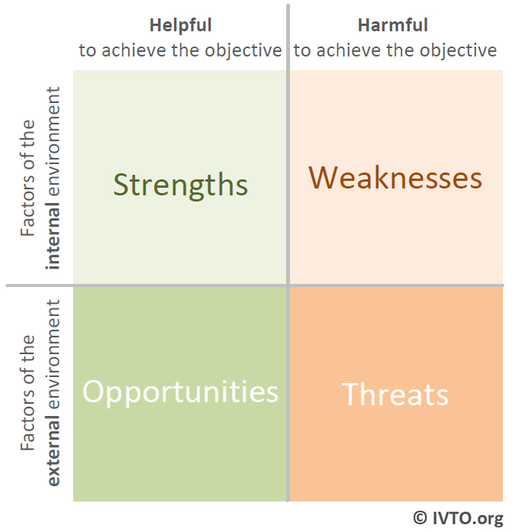

Slide 21
Market structure

Slide 22
A market consists of all the consumers who purchase a particular type of good or service. The market may be sub-divided into separate segments each of which can be considered to be a separate market in its own right. It is very important for a business to be able to define its market:
estimate the size of the market
forecast the growth of the market
identify the competitors in the market
break the market down into relevant segments
To create an appropriate marketing mix to appeal to customers in the market.

Slide 23
Markets are typically structured into segments.
Primary segmentation is between customers buying entirely different products.
The size of the market can be calculated in terms of the number of customers that make up the market, or the value of sales in the market.
A business can then calculate its market share in terms of the number of customers its sells to, or the total value of its sales.
segmentation can be based on demographic and psychographic factors.

Slide 24
Types of market
Business-to-Business (B2B) markets in which a businesses customers are other businesses.
Business to Consumer (B2C) markets in which businesses sell to other customers.
Some markets take place in a physical location e.g. a street market, whereas others may be virtual markets

Slide 25
What type of market structure will your firm operate within? Why?
Which market structure do you think benefits the producer the most? Is there any way that your firm can operate in that type of market structure? Why or why not?

Slide 26
Marketing Mix
Product
Design, sizes, colours
Materials, quality
Specification
After-sales service
Price
List price
Discounts, special offers
Payment terms
Service & spares prices
People
Service
Advice
Support
Relationships
Promotion
Advertising
Point-of-sale displays
Leaflets, brochures etc.
Personal selling
Telephone, internet, post
Place
Location
Layout, design
Channels of distribution
Routes to market: telephone, internet, post

Slide 27
Marketing plan based on Environmental Analysis
Part I
Part II
Based on analysis of Business environment
Market analysis (Environment, Competition, Customer, Company analysis). We need to go through those analyses:
The situation in external environment – PEST analysis
Competition Analysis
SWOT analysis
Customer definition
Marketing goals, Marketing Mix (product, price, promotion, place)
Conclusion : Part III- Strategy, sales plan (quantity of items, customers)

Slide 28
Case study: Mobile application in Poland

Slide 29
PEST
-weights, ratings…

Slide 30
Political factors
No. | Factor | Weight | Rating | W*R
1 | Assistance programs | 0,3 | 3 | 0,9
2 | EU donations | 0,1 | 2 | 0,2
3 | Local regulations | 0,1 | 2 | 0,2
4 | Complicated and high taxation | 0,3 | -4 | -1,2
5 | Constantly changing and complicated law related to SMEs | 0,2 | -3 | -0,6
SUM |  | 1 | - | -0,5
Economic factors
No. | Factor | Weight | Rating | W*R
1 | Possibilities of getting external capital | 0,35 | 4 | 1,4
2 | High costs of running a business | 0,2 | -3 | -0,6
3 | High costs of capital | 0,2 | -2 | -0,4
4 | Possibilities for taking a bank credit | 0,1 | 1 | 0,1
5 | Structure of investments | 0,15 | 2 | 0,3
SUM |  | 1 | - | 0,8
Social factors
No. | Factor | Weight | Rating | W*R
1 | Society's lifestyle | 0,2 | 2 | 0,4
2 | Age structure | 0,2 | -2 | -0,4
3 | Quality of relationships between people | 0,3 | 3 | 0,9
4 | Dependence on technology | 0,1 | 3 | 0,3
5 | Willingness to take part in entertainment events | 0,2 | 3 | 0,6
SUM |  | 1 | - | 1,8
Technological factors
No. | Factor | Weight | Rating | W*R
1 | Speeding the process of information exchange | 0,2 | 4 | 0,8
2 | Changing possibilities of capitalization | 0,2 | 3 | 0,6
3 | Facilitations in creating smart phone application | 0,1 | 1 | 0,1
4 | Common habit of using every-day technological utilities | 0,3 | 4 | 1,2
5 | Evaluating models of smart phones | 0,2 | -2 | -0,4
SUM |  | 1 | - | 2,3

Slide 31
SWOT

Slide 32
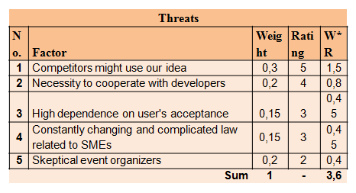
Strengths
No. | Factor | Weight | Rating | W*R
1 | Innovative idea | 0,4 | 5 | 2
2 | "Fresh look" | 0,1 | 3 | 0,3
3 | Proposed solution based on social media network | 0,2 | 3 | 0,6
4 | Motivated team | 0,2 | 4 | 0,8
5 | Independence in decision making process | 0,1 | 3 | 0,3
Sum |  | 1 | - | 4
Weaknesses
No. | Factor | Weight | Rating | W*R
1 | Lack of experience in running a business | 0,25 | 4 | 1
2 | Huge responsibility and commitment | 0,1 | 3 | 0,3
3 | Need for external capital/investments | 0,2 | 4 | 0,8
4 | Dependence on potential investor's conditions | 0,15 | 3 | 0,45
5 | Lack of technical knowledge | 0,3 | 4 | 1,2
Sum |  | 1 | - | 3,75
Opportunities
No. | Factor | Weight | Rating | W*R
1 | Growing market of smart phone applications | 0,2 | 4 | 0,8
2 | Different possibilities to arise the capital | 0,2 | 3 | 0,6
3 | Market niche | 0,25 | 4 | 1
4 | Growing number of smart phones | 0,2 | 5 | 1
5 | Contests for start-up plans | 0,15 | 3 | 0,45
Sum |  | 1 | - | 3,85

Slide 33
Algebraic method of defining the strategy
PR [S/(S+W)]- market's position =4/(4+3,75) | 0,5161
AR [O/(O+T)]- market's attractiveness =(3,85/3,85+3,6) | 0,5168
 | Competitiveness strategy
 | maxi-maxi (S-O) | mini-maxi (W-O) | maxi-mini (S-T) | mini-mini (W-T)
PR's value | > 0,5 | < 0,5 | > 0,5 | < 0,5
AR's value | > 0,5 | > 0,5 | < 0,5 | < 0,5
Probability of strategy success > 0,5;
0,5168+0,5161/2= 0,51645
Means 51.645% probability of success

