Slide 1

Strategy Control
Ing. Šárka Zapletalová, Ph.D.
Department of Business Economics and Management
STRATEGIC MANAGEMENT

Slide 2

Outline of the lecture
Evaluation and control in strategic management
Evaluating an implemented strategy
Measuring performance
Strategic information system
Guidelines for proper control

Slide 3
Introduction
Having strategic management without evaluation and control is like playing football without any goalposts.
Unless strategic management improves performance, it is only an exercise.
In business, the bottom-line measure of performance is making a profit.
Evaluation and control is one of the most difficult parts of strategic management.
That’s why we need to use not only the traditional measures of financial performance, such as net earnings, ROI, and EPS, but we need to consider using EVA or MVA and a balanced scorecard, among other possibilities.
The measurement of performance can and does result in short-term oriented actions and goal displacement.

Slide 4
Evaluation and Control in Strategic Management
Evaluation and control information consists of performance data and activity reports.
It compares performance with desired results and provides the feedback necessary for management to evaluate results and take corrective action, as needed.
If undesired performance results because the strategic management processes were inappropriately used, operational managers must know about it so that they can correct the employee activity.
One of the obstacles to effective control is the difficulty in developing appropriate measures of important activities and outputs.
An application of the control process to strategic management provides strategic managers with a series of questions to use in evaluating an implemented strategy.

Slide 5
Evaluation and Control in Strategic Management
Strategic controls are intended to steer the company towards its long-term strategic direction.
After a strategy is selected, it is implemented over time so as to guide a firm within a rapidly changing environment. Strategies are forward-looking, and based on management assumptions about numerous events that have not yet occurred.
Traditional approaches to control seek to compare actual results against a standard.
The work is done, the manager evaluates the work and uses the evaluation as input to control future efforts. While this approach is not useless, it is inappropriate as a means to control a strategy.

Slide 6
Evaluation and Control in Strategic Management
In business, the bottom-line measure of performance is making a profit.
Evaluation and control is one of the most difficult parts of strategic management.
That’s why we need to use not only the traditional measures of financial performance, such as net earnings, ROI, and EPS, but we need to consider using EVA or MVA and a balanced scorecard, among other possibilities.
The measurement of performance can and does result in short-term oriented actions and goal displacement.

Slide 7
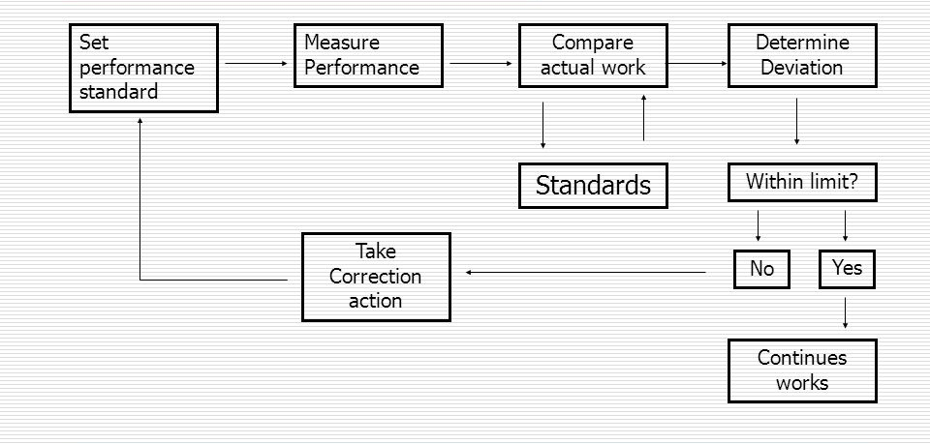
Strategic Evaluation and Control Process

Slide 8
Evaluation and Control in Strategic Management
Once the appropriate performance measurements are taken, it is possible to learn whether the strategy was successful.
The measured results of corporate performance allow us to decide whether we need to reformulate the strategy, improve its implementation, or gather more information about our competition.
  Top executives report that in many situations, they analyze neither the long-term implications of present operations on the strategy they have adopted nor the operational impact of a strategy on the corporate mission. Long-run evaluations may not be conducted because executives:
    don’t realize their importance,
    believe that short-run considerations are more important than long-run considerations,
    aren’t personally evaluated on a long-term basis, or
    don’t have the time to make a long-run analysis.

Slide 9
Evaluation and Control in Strategic Management
The evaluation and control process ensures that a company is achieving what it set out to accomplish. This process can be viewed as a feedback model:
  1. Determine what to measure: Top managers and operational managers need to specify what implementation processes and results will be monitored and evaluated
  2. Establish standards of performance: Standards used to measure performance are detailed expressions of strategic objectives. They are measures of acceptable performance results. Standards can be set not only for final output but also for intermediate stages of production output.
  3. Measure actual performance: Measurements must be made at predetermined times.
  4. Compare actual performance with the standard: If actual performance results are within the desired tolerance range, the measurement process stops here.
  5. Take corrective action

Slide 10
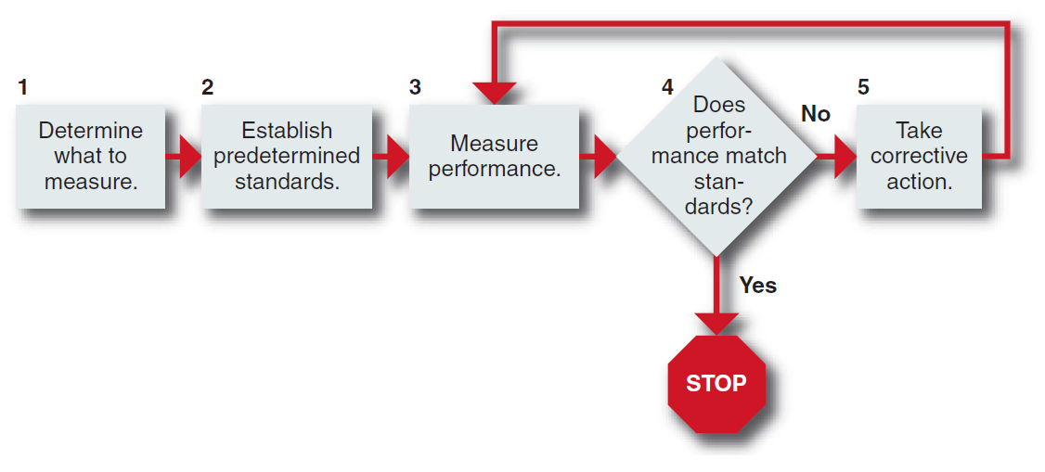
Evaluation and Control in Strategic Management
Such a strategy review is usually initiated when a gap appears between a company’s financial objectives and the expected results of current activities.
Evaluation and Control Process

Slide 11
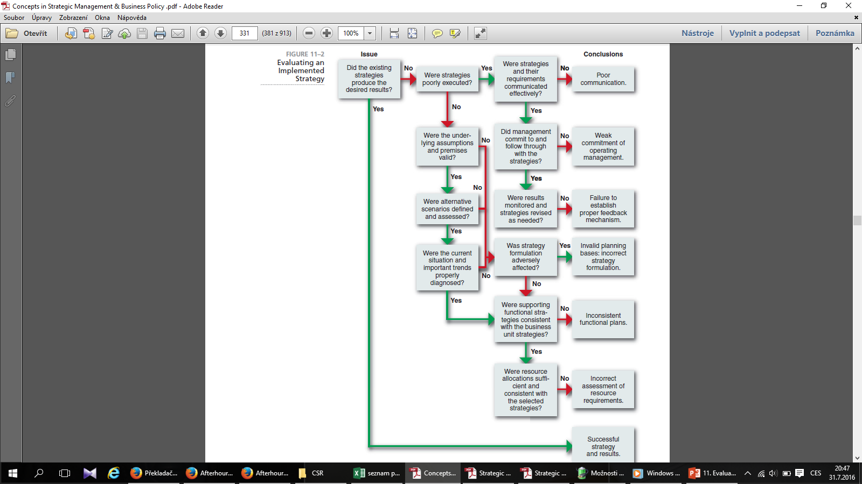
Evaluating an Implemented Strategy
SOURCE: From “The Strategic Review,” Planning Review, Jeffrey A. Schmidt, 1998

Slide 12
Measuring Performance
Performance is the end result of activity. Select measures to assess performance based on the organizational unit to be appraised and the objectives to be achieved.
The objectives that were established earlier in the strategy formulation part of the strategic management process (dealing with profitability, market share, and cost reduction, among others) should certainly be used to measure corporate performance once the strategies have been implemented.
Some measures, such as return on investment (ROI) and earnings per share (EPS), are appropriate for evaluating a corporation’s or a division’s ability to achieve a profitability objective.
  This type of measure, however, is inadequate for evaluating additional corporate objectives such as social responsibility or employee Development.

Slide 13
Measuring Performance
An example of a steering control used by retail stores is the inventory turnover ratio, in which a retailer’s cost of goods sold is divided by the average value of its inventories. This measure shows how hard an investment in inventory is working; the higher the ratio, the better.
Another steering control is customer satisfaction. Research reveals that companies that score high on the American Customer Satisfaction Index (ACSI) have higher stock returns and better cash flows than do those companies that score low on the ACSI.
A change in a firm’s customer satisfaction typically works its way through a firm’s value chain and is eventually reflected in quarterly profits.
  To help executives keep track of important steering controls, Netsuite developed dashboard software that displays critical information in easy-to-read computer graphics assembled from data pulled from other corporate software programs.

Slide 14
Measuring Performance
Types of Control
Controls can be established to focus on actual performance results (output), the activities that generate the performance (behavior), or on resources that are used in performance (input).
  Output controls specify what is to be accomplished by focusing on the end result of the behaviors through the use of objectives and performance targets or milestones.
  Behavior controls specify how something is to be done through policies, rules, standard operating procedures, and orders from a superior.
  Input controls emphasize resources, such as knowledge, skills, abilities, values, and motives of employees.

Slide 15
Measuring Performance
Types of Control
Examples of increasingly popular behavior controls are the ISO 9000 and 14000 Standards Series on quality and environmental assurance, developed by the International Standards Association of Geneva, Switzerland.
Using the ISO 9000 Standards Series (composed of five sections from 9000 to 9004) is a way of objectively documenting a company’s high level of quality operations. Using the ISO 14000 Standards Series is a way to document the company’s impact on the environment.

Slide 16
Measuring Performance
Activity-Based Costing
Activity-based costing (ABC) is a recently developed accounting method for allocating indirect and fixed costs to individual products or product lines based on the value-added activities going into that product.
This accounting method is thus very useful in doing a value-chain analysis of a firm’s activities for making outsourcing decisions.
  Traditional cost accounting, in contrast, focuses on valuing a company’s inventory for financial reporting purposes. To obtain a unit’s cost, cost accountants typically add direct labor to the cost of materials.

Slide 17
Measuring Performance
Primary Measures of Corporate Performance
Analysts now recommend a broad range of methods to evaluate the success or failure of a strategy. Some of these methods are stakeholder measures, shareholder value, and the balanced scorecard approach.
Even though each of these methods has supporters as well as detractors, the current trend is clearly toward more complicated financial measures and an increasing use of non-financial measures of corporate performance.
The most commonly used measure of corporate performance (in terms of profits) is Return On Investment (ROI).
Earnings Per Share (EPS), which involves dividing net earnings by the amount of common stock, also has several deficiencies as an evaluation of past and future performance.

Slide 18
Measuring Performance
Primary Measures of Corporate Performance
Operating cash flow, the amount of money generated by a company before the cost of financing and taxes, is a broad measure of a company’s funds. This is the company’s net income plus depreciation, depletion, amortization, interest expense, and income tax expense.
At the same time, these traditional financial measures are very appropriate when used with complementary financial and non-financial measures.
  For example, some non–financial performance measures often used by Internet business ventures are stickiness (length of Web site visit), eyeballs (number of people who visit a Web site), and mindshare (brand awareness). Mergers and acquisitions may be priced on multiples of MUUs (monthly unique users) or even on registered users.

Slide 19
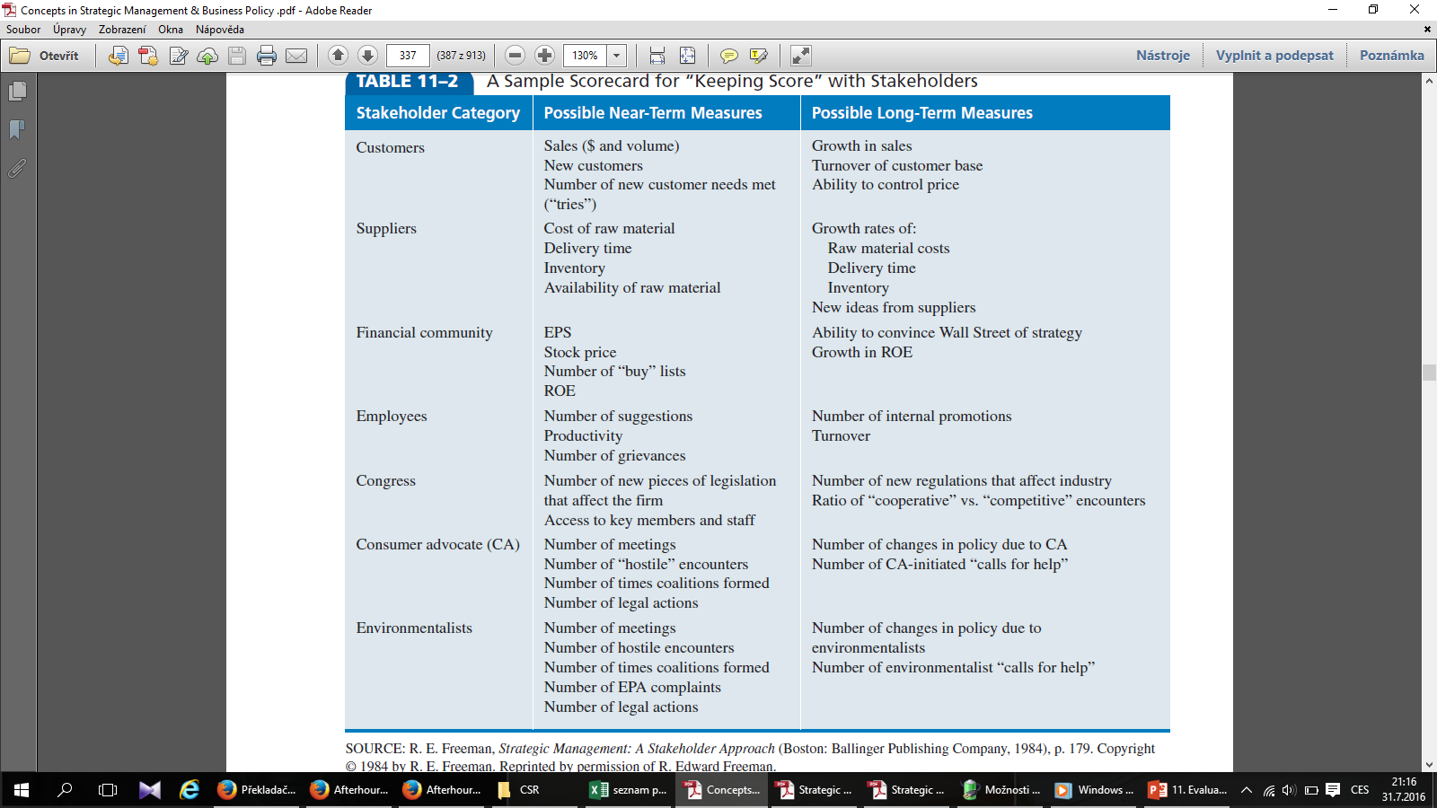
Measuring Performance
A Sample Scorecard for “Keeping Score” with Stakeholders
SOURCE: R. E. Freeman, Strategic Management: A Stakeholder Approach

Slide 20
Measuring Performance
Shareholder Value
Shareholder value can be defined as the present value of the anticipated future stream of ash flows from the business plus the value of the company if liquidated.
Arguing that the purpose of a company is to increase shareholder wealth, shareholder value analysis concentrates on cash flow as the key measure of performance.
The New York consulting firm Stern Stewart & Company devised and popularized two shareholder value measures: economic value added (EVA) and market value added (MVA)

Slide 21
Measuring Performance
Balanced Scorecard Approach: Using Key Performance Measures
Rather than evaluate a corporation using a few financial measures, Kaplan and Norton argue for a “balanced scorecard,” that includes non-financial as well as financial measures.
In the balanced scorecard, management develops goals or objectives in each of four areas:
  Financial: How do we appear to shareholders?
  Customer: How do customers view us?
  Internal business perspective: What must we excel at?
  Innovation and learning: Can we continue to improve and create value?

Slide 22
Measuring Performance
Evaluating Top Management and the Board of Directors
Through its strategy, audit, and compensation committees, a board of directors closely evaluates the job performance of the CEO and the top management team.
  The vast majority of American (91%), European (75%), and Asian (75%) boards review the CEO’s performance using a formalized process.
Objective evaluations of the CEO by the board are very important given that CEOs tend to evaluate senior management’s performance significantly more positively than do other executives.
The board is concerned primarily with overall corporate profitability as measured quantitatively by ROI, ROE, EPS, and shareholder value.

Slide 23
Measuring Performance
Evaluating Top Management and the Board of Directors
Management audits are very useful to boards of directors in evaluating management’s handling of various corporate activities.
Management audits have bee developed to evaluate activities such as corporate social responsibility, functional areas such as the marketing department, and divisions such as the international division.
These can be helpful if the board has selected particular functional areas or activities for improvement.

Slide 24
Measuring Performance
Evaluating Top Management and the Board of Directors
The strategic audit is a type of management audit. The strategic audit provides a checklist of questions, by area or issue, that enables a systematic analysis of various corporate functions and activities to be made.
It is a type of management audit and is extremely useful as a diagnostic tool to pinpoint corporate wide problem areas and to highlight organizational strengths and weaknesses.

Slide 25
Measuring Performance
Primary Measures of Divisional and Functional Performance
Companies use a variety of techniques to evaluate and control performance in divisions, strategic business units (SBUs), and functional areas.
  If a corporation is composed of SBUs or divisions, it will use many of the same performance measures (ROI or EVA, for instance) that it uses to assess overall corporate performance.
During strategy formulation and implementation, top management approves a series of programs and supporting operating budgets from its business units.
  During evaluation an control, actual expenses are contrasted with planned expenditures, and the degree of variance is assessed. This is typically done on a monthly basis.
In addition, top management will probably require periodic statistical reports summarizing data on such key factors.

Slide 26
Measuring Performance
Primary Measures of Divisional and Functional Performance
According to Xerox Corporation, the company that pioneered this concept in the United States, benchmarking is “the continual process of measuring products, services, and practices against the toughest competitors or those companies recognized as industry leaders“.
The benchmarking process usually involves the following steps:
  Identify the area or process to be examined. It should be an activity that has the potential to determine a business unit’s competitive advantage.
  Find behavioral and output measures of the area or process and obtain measurements.
  elect an accessible set of competitors and best-in-class companies against which to benchmark.
  Calculate the differences among the company’s performance measurements and those of the best-in-class and determine why the differences exist.
  Develop tactical programs for closing performance gaps.
  Implement the programs and then compare the resulting new measurements with those of the best-in-class companies.

Slide 27
Strategic Informatin System
Before performance measures can have any impact on strategic management, they must first be communicated to the people responsible for formulating and implementing strategic plans.
Strategic information systems can perform this function. They can be computer based or manual, formal or informal.
Many corporations around the world have adopted enterprise resource planning (ERP) software.
  ERP unites all of a company’s major business activities, from order processing to production, within a single family of software modules. The system provides instant access to critical information to everyone in the organization, from the CEO to the factory floor worker.
  Because of the ability of ERP software to use a common information system throughout a company’s many operations around the world, it is becoming the business information systems’ global standard.
  The major providers of this software are SAP AG, Oracle, Baan, and SSA and other.

Slide 28
Guidelines for Proper Control
  Control should involve only the minimum amount of information needed to give a reliable picture of events: Too many controls create confusion. Focus on the strategic factors by following the 80/20 rule: Monitor those 20% of the factors that determine 80% of the results.
  Controls should monitor only meaningful activities and results, regardless of Measurement difficulty.
  Controls should be timely so that corrective action can be taken before it is too late.
  Long-term and short-term controls should be used: If only short-term measures are emphasized, a short-term managerial orientation is likely.
  Controls should aim at pinpointing exceptions: Only activities or results that fall outside a predetermined tolerance range should call for action.
  Emphasize the reward of meeting or exceeding standards rather than punishment for failing to meet standards.

