Slide 1

DIFFERENTIAL ANALYSIS
THE KEY TO DECISION MAKING
Ing. Markéta Šeligová, Ph.D.
MANAGERIAL ACCOUNTING/NANMU

Slide 2
DIFFERENTIAL ANALYSIS
Outline of the lecture
Differential analysis
Avoidable cost
Sunk costs, future costs, opportunity costs
The make or buy decision
Contribution margin per unit of the constrained resource

Slide 3
DIFFERENTIAL ANALYSIS
DIFFERENTIAL ANALYSIS (1)
managers must decide what products to sell, whether to make or guy component parts, what prices to charge, what channels of distribution to use, whether to accept special orders at special prices, and so forth
making such decisions is often a difficult task that is complicated by numerous alternatives and massive amounts of data, only some of which may be relevant
every decision involves choosing from among at least two alternatives
in making a decision, the costs and benefits of one alternative must be compared to the costs and benefits of other alternatives

Slide 4
DIFFERENTIAL ANALYSIS
DIFFERENTIAL ANALYSIS (2)
the key to making such comparisons is differential analysis - focusing on the costs and benefits that differ between the alternatives
a difference in cost between any two alternatives is known as a differential cost
a difference in revenue between any two alternatives is known as differential revenue

Slide 5
DIFFERENTIAL ANALYSIS
DIFFERENTIAL ANALYSIS (3)
differential costs and revenues are relevant to decision making, whereas costs and revenue that do not differ between alternatives are irrelevant to decision making
because differential costs and differential revenues are the only inputs that are relevant to decision making, they are also often referred to as relevant costs and relevant benefits

Slide 6
DIFFERENTIAL ANALYSIS
AVOIDABLE COST
an avoidable cost is a cost that can be eliminated by choosing one alternative over another
by choosing the alternative of going to the movie, the cost of renting the DVD can be avoided
by choosing the alternative of renting the DVD, the cost of the movie ticket can be avoided
therefore, the cost of the movie ticket and the cost of renting the DVD are both avoidable costs

Slide 7
DIFFERENTIAL ANALYSIS
SUNK COSTS
two broad categories of costs are never relevant in decisions - sunk costs and future costs that do not differ between the alternatives
sunk cost is a cost that has already been incurred and cannot be avoided regardless of what a manager decides to do
For example, suppose a company purchased a five-year-old truck for $12 000. The amount paid for the truck is a sunk cost because it has already been incurred and the transaction cannot be undone. The amount the company paid for the truck is irrelevant in making decisions such as whether to keep, sell, or replace the truck. Furthermore, any depreciation expense related to the truck is irrelevant in making decisions.

Slide 8
DIFFERENTIAL ANALYSIS
FUTURE COSTS
future costs that do not differ between alternatives should also be ignored
continuing with the example discussed earlier, suppose you plan to order a pizza after you go to the movie theater or you rent a DVD
if you are going to buy the same pizza regardless of your choice of entertainment, the cost of the pizza is irrelevant to the choice of whether you go to the movie theater or rent a DVD
notice, the cost of the pizza is not a sunk cost because it has not yet been incurred

Slide 9
DIFFERENTIAL ANALYSIS
OPPORTUNITY COSTS
opportunity costs also need to be considered when making decisions
an opportunity cost is the potential benefit that is given up when one alternative is selected over another
for example, if you were considering giving up a high-paying summer job to travel overseas, the forgone wages would be an opportunity costs of traveling abroad

Slide 10
DIFFERENTIAL ANALYSIS
SUMMARY
only those costs and benefits that differ between alternatives are relevant in a decision
differential costs are also referred to as relevant costs or avoidable costs
the key to successful decision making is to focus on relevant costs and benefits as well as opportunity costs while ignoring everything else - including sunk costs and future costs and benefits that do not differ between the alternatives

Slide 11
DIFFERENTIAL ANALYSIS
THE MAKE OR BUY DECISION
when a company is involved in more than one activity in the entire value chain, it is vertically integrated
An integrated company is less dependent on its suppliers and may be able to ensure a smoother flow of parts and materials for production than a nonintegrated company
a decision to carry out one of the activities in the value chain internally, rather than to buy externally from a supplier, is called a make or buy decision
make or buy decisions also involve decisions concerning whether to outsource development tasks, after-sales service, or other activities

Slide 12
DIFFERENTIAL ANALYSIS
SPECIAL ORDERS
managers must often evaluate whether a special order should be accepted, and if the order is accepted, the price that should be charged
a special order is a one-time order that is not considered part of the company´s normal ongoing business

Slide 13
DIFFERENTIAL ANALYSIS
CONSTRAINT
a constraint is anything that prevents you from getting more of what you want
the constraint, or bottleneck, in the system is determined by the step that limits total output because it has the smallest capacity

Slide 14
DIFFERENTIAL ANALYSIS
CONTRIBUTION MARGIN PER UNIT OF THE CONSTRAINED RESOURCE (1)
managers routinely face the problem of deciding how constrained resources are going to be used
a manufacturer has a limited number of machine-hours and a limited number of direct labour-hours at its disposal
because the company cannot fully satisfy demand, managers must decide which products or services should be cut back

Slide 15
DIFFERENTIAL ANALYSIS
CONTRIBUTION MARGIN PER UNIT OF THE CONSTRAINED RESOURCE (2)
in other words, managers must decide which products or services make the best use of the constrained resource
  fixed costs are usually unaffected by such choices, so the course of action that will maximize the company´s total contribution margin should ordinarily be selected

Slide 16
DIFFERENTIAL ANALYSIS
CONTRIBUTION MARGIN PER UNIT OF THE CONSTRAINED RESOURCE (3)
if some products must be cut back because of a constraint, the key to maximizing the total contribution margin may seem obvious - favor the products with the highest unit contribution
unfortunately, that is not quite correct
rather, the correct solution is to favor the products that provide the highest contribution margin per unit of the constrained resource

Slide 17
DIFFERENTIAL ANALYSIS
MANAGING CONSTRAINTS (1)
effectively managing an organization´s constraints is a key to increased profits
when a constraint exists in the production process, managers can increase profits by producing the products with the highest contribution margin per unit of the constrained resource
they can also increase profits by increasing the capacity of the bottleneck operation
when a manager increases the capacity of the bottleneck, it is called relaxing (or elevating) the constraint

Slide 18
DIFFERENTIAL ANALYSIS
MANAGING CONSTRAINTS (2)
The capacity of a bottleneck can be effectively increased in a number of ways, including:
working overtime on the bottleneck
subcontracting some of the processing that would be done at the bottleneck
investing in additional machines at the bottleneck
shifting workers from processes that are not bottlenecks to the process that is the bottleneck

Slide 19
DIFFERENTIAL ANALYSIS
MANAGING CONSTRAINTS (3)
The capacity of a bottleneck can be effectively increased in a number of ways, including:
focusing business process improvement efforts on the bottleneck
reducing defective units - each defective unit that is processed through the bottleneck and subsequently scrapped takes the place of a good unit that could have been sold

Slide 20
DIFFERENTIAL ANALYSIS
JOINT PRODUCT COSTS AND THE CONTRIBUTION APPROACH (1)
two or more products that are produced from a common input are known as joint products
the split-off point is the point in the manufacturing process at which the joint products can be recognized as separate products
the term joint cost is used to describe the costs incurred up to the split-off point

Slide 21
DIFFERENTIAL ANALYSIS
JOINT PRODUCT COSTS AND THE CONTRIBUTION APPROACH (2)
sell of process further decisions
  it is profitable to continue processing a joint product after the split-off point so long as the incremental revenue from such processing exceeds the incremental processing cost incurred after the split-off point
  joint costs that have already been incurred up to the split-off point are always irrelevant in decisions concerning what to do from the split-off point forward

Slide 22
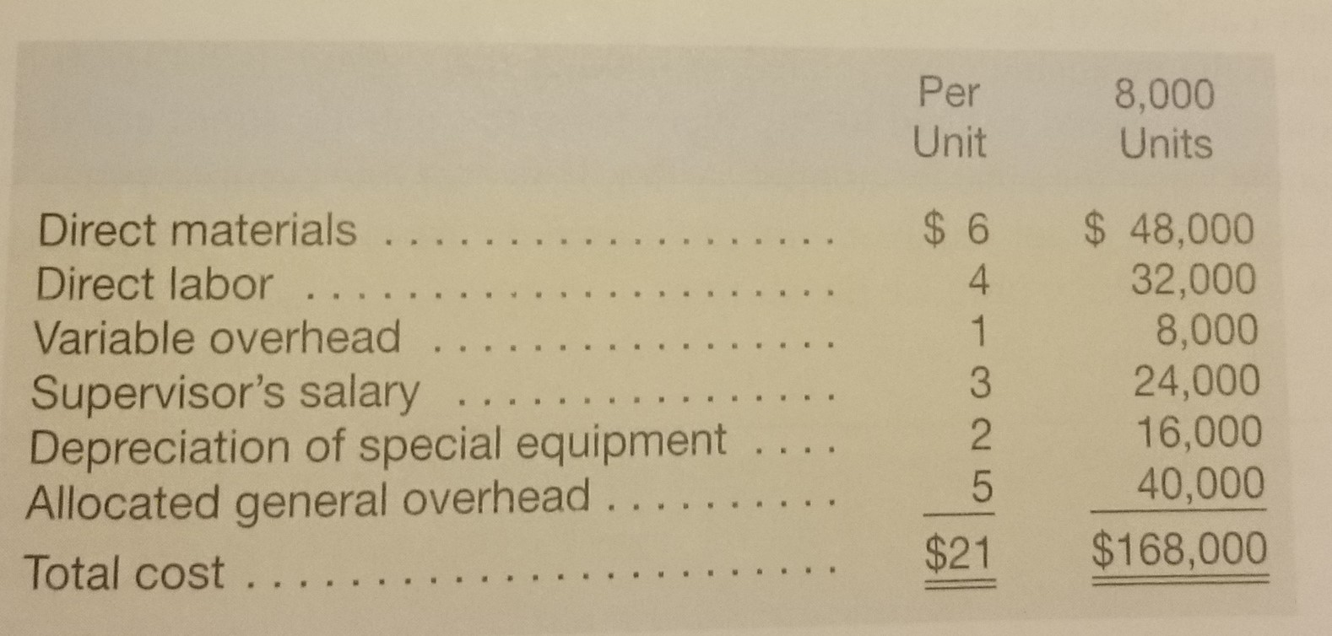
DIFFERENTIAL ANALYSIS

Slide 23
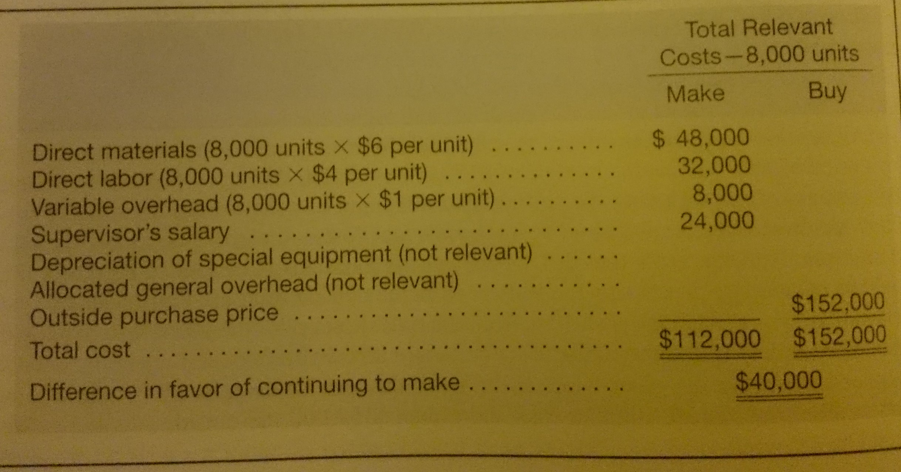
DIFFERENTIAL ANALYSIS

Slide 24
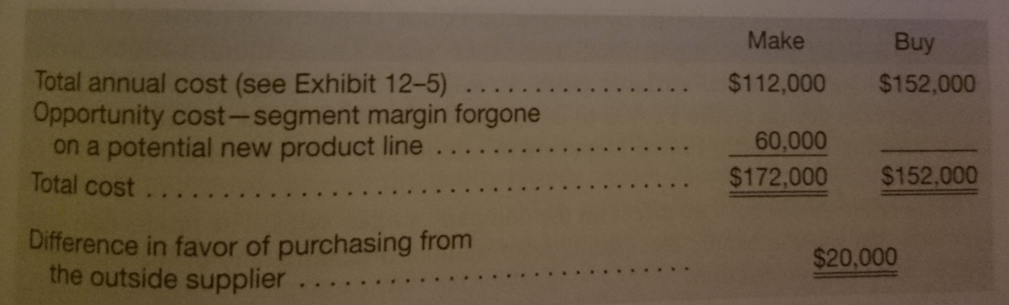
DIFFERENTIAL ANALYSIS

Slide 25
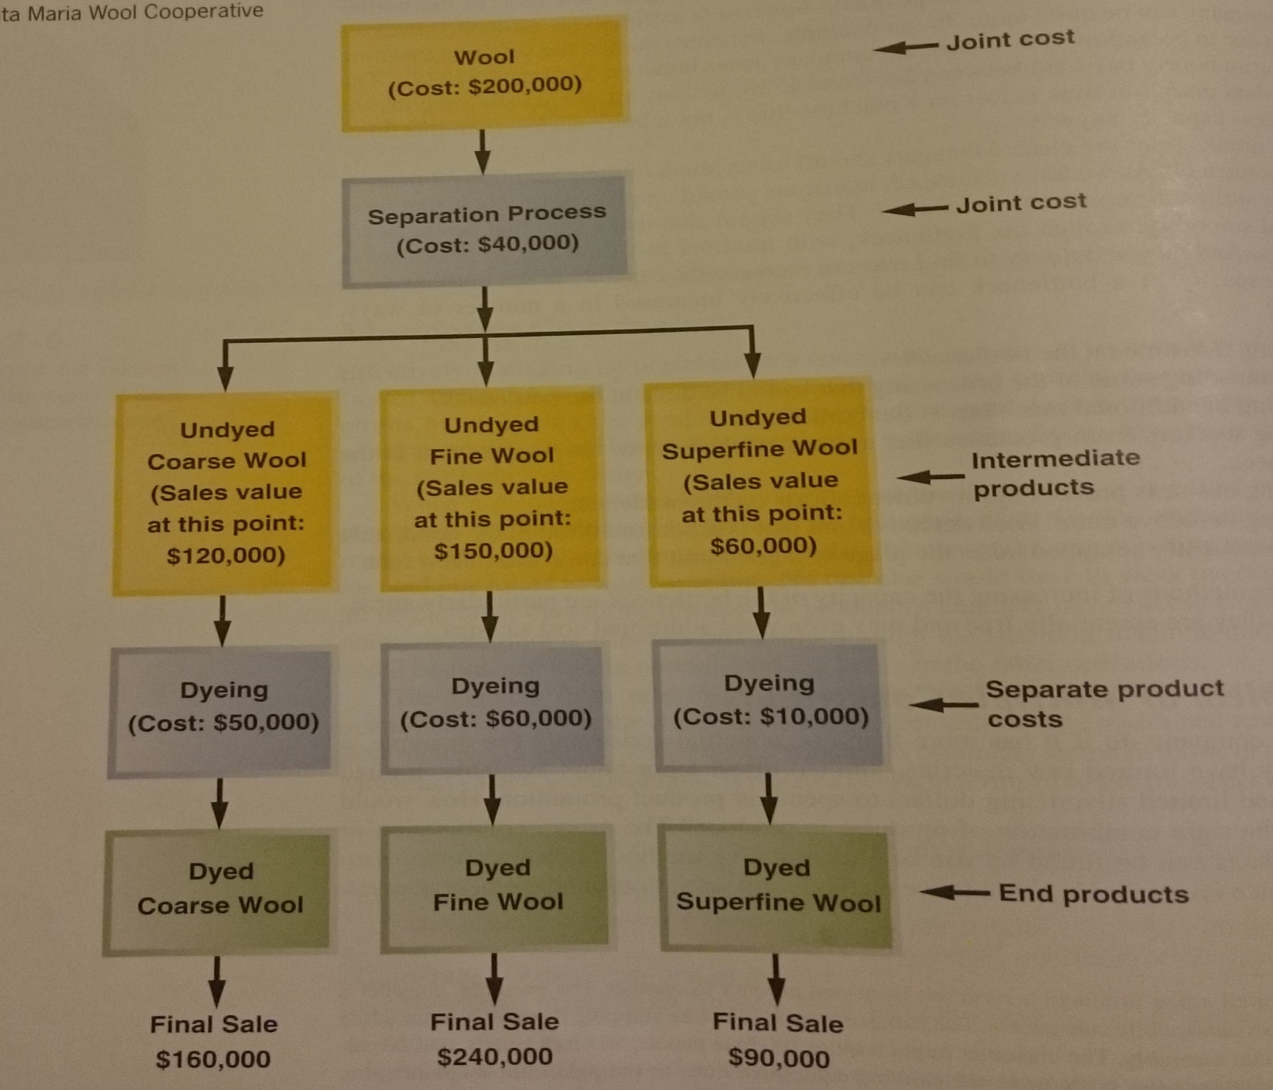
DIFFERENTIAL ANALYSIS

