Slide 1

FINANCIAL STATEMENT ANALYSIS
Ing. Markéta Šeligová, Ph.D.
MANAGERIAL ACCOUNTING/NANMU

Slide 2
FINANCIAL STATEMENT ANALYSIS
Outline of the lecture
Techniques of financial statement analysis
Liquidity
Asset management
Debt management
Profitability

Slide 3
FINANCIAL STATEMENT ANALYSIS
INTRODUCTION
stockholders, creditors, and managers are examples of stakeholders that use financial statement analysis to evaluate a company´s financial health and future prospects
stockholders and creditors analyze a company´s financial statements to estimate its potential for earnings growth, stock price appreciation, making dividend payments, and paying principal and interest on loans; managers use financial statement analysis for two reasons
  first, it enables them to better understand how their company´s financial results will be interpreted by stockholders and creditors for the purposes of making investing and lending decisions
  second, financial statement analysis provides managers with valuable feedback regarding their company´s performance

Slide 4
FINANCIAL STATEMENT ANALYSIS
THREE ANALYTICAL TECHNIQUES OF FINANCIAL STATEMENT ANALYSIS
Three analytical techniques are widely used
dollar and percentage changes on statements (horizontal analysis)
common-size statements (vertical analysis)
ratios

Slide 5
FINANCIAL STATEMENT ANALYSIS
DOLLAR AND PERCENTAGE CHAGNES ON STATEMENTS
horizontal analysis (also known as trend analysis) involves analyzing financial data over time, such as computing year-to-year dollar and percentage changes within a set of financial statements
the dollar changes highlight the changes that are the most important economically
the percentage changes highlight the changes that are the most unusual
horizontal analysis can be even more useful when data from a number of years are used to compute trend percentages
to compute trend percentages, a base year is selected and the data for all years are stated as a percentage of that base year

Slide 6
FINANCIAL STATEMENT ANALYSIS
COMMON-SIZE STATEMENTS
horizontal analysis examines changes in financial statement accounts over time
vertical analysis focuses on the relations among financial statement accounts at a given point in time
a common-size financial statement is a vertical analysis in which each financial statement account is expressed as a percentage
in income statements, all items are usually expressed as a percentage of sales
in balance sheets, all items are usually expressed as a percentage of total assets

Slide 7
FINANCIAL STATEMENT ANALYSIS
RATIO ANALYSIS – LIQUIDITY (1)
liquidity refers how quickly an asset can be converted to cash
liquid assets can be converted to cash quickly, whereas ill-liquid assets cannot
companies need to continuously monitor the amount of their liquid assets relative to the amount that they owe short-term creditors, such as suppliers
if a company´s liquid assets are not enough to support timely payments to short-term creditors, this presents an important management problem that, if not remedied, can lead to bankruptcy

Slide 8
FINANCIAL STATEMENT ANALYSIS
RATIO ANALYSIS – LIQUIDITY (2) – WORKING CAPITAL
the excess of current assets over current liabilities is known as working capital
working capital = current assets - current liabilities
managers need to interpret working capital from two perspectives
on one hand, if a company has ample working capital, it provides some assurance that the company can pay its creditors in full and on time; on the other hand, maintaining large amounts of working capital isn´t free
working capital must be financed with long-term debt and equity - both of which are expensive

Slide 9
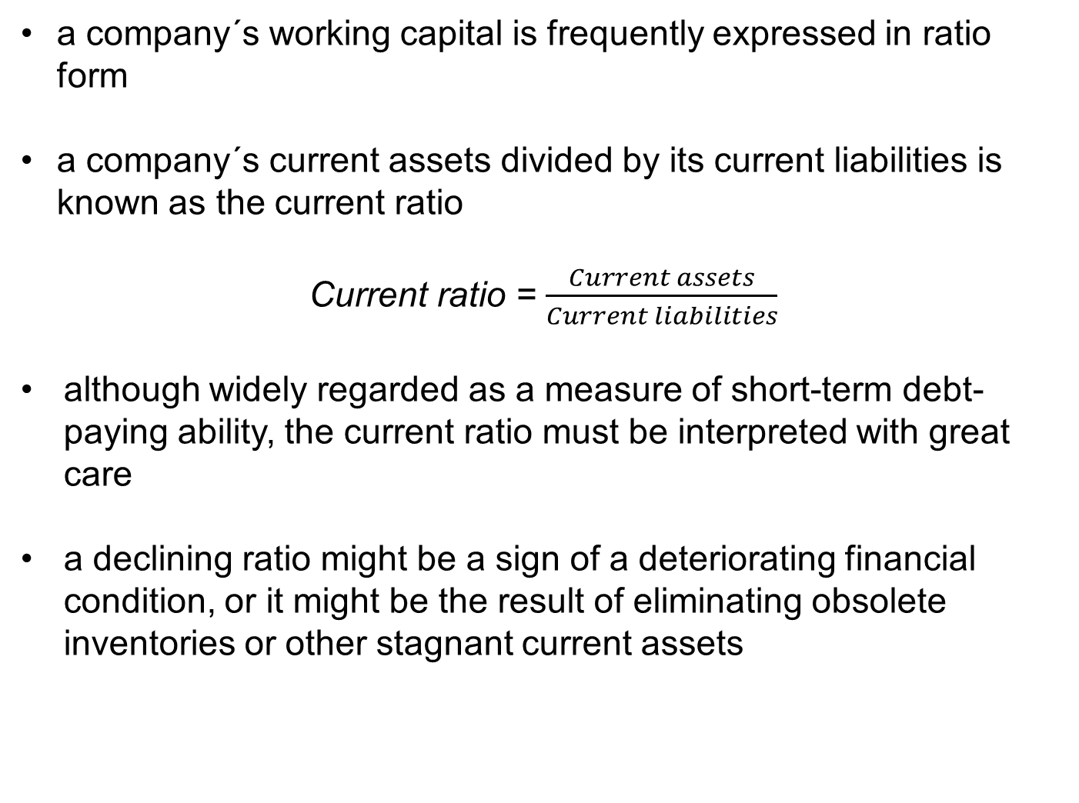
FINANCIAL STATEMENT ANALYSIS
RATIO ANALYSIS – LIQUIDITY (3) – CURRENT RATIO (1)
a company´s working capital is frequently expressed in ratio form
a company´s current assets divided by its current liabilities is known as the current ratio
Current ratio = $\frac{Current assets}{Current liabilities}$
although widely regarded as a measure of short-term debt-paying ability, the current ratio must be interpreted with great care
a declining ratio might be a sign of a deteriorating financial condition, or it might be the result of eliminating obsolete inventories or other stagnant current assets

Slide 10
FINANCIAL STATEMENT ANALYSIS
RATIO ANALYSIS – LIQUIDITY (4) – CURRENT RATIO (2)
an improving ratio might be the result of stockpiling inventory, or it might indicate an improving financial situation
the general rule of thumb calls for a current ratio of at least 2
however, many companies successfully operate with a current ratio below 2
the adequacy of a current ratio depends heavily on the composition of assets

Slide 11
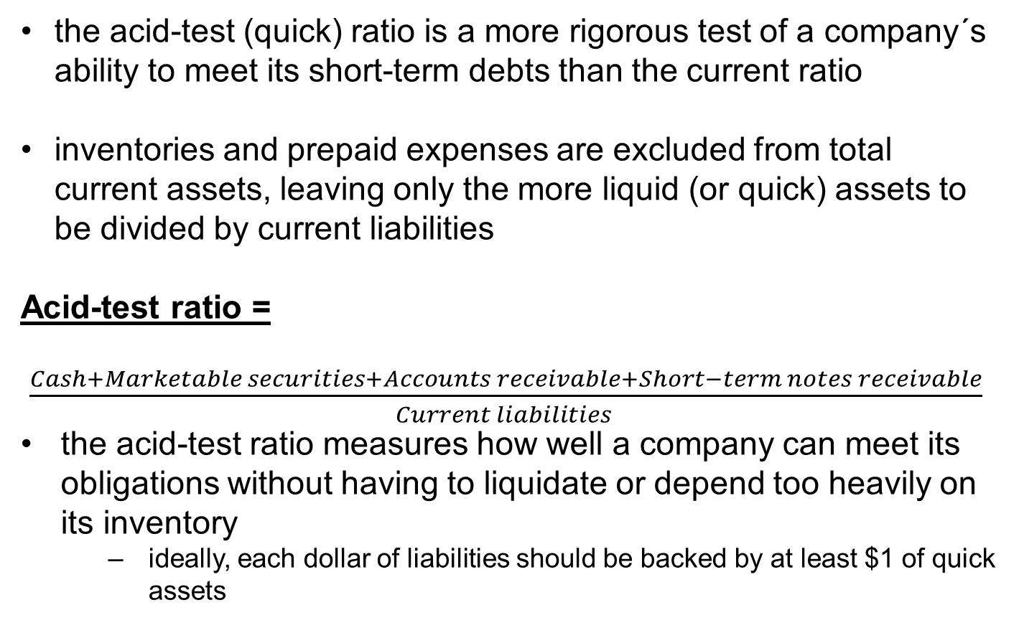
FINANCIAL STATEMENT ANALYSIS
RATIO ANALYSIS – LIQUIDITY (5) - ACID-TEST (QUICK) RATIO
the acid-test (quick) ratio is a more rigorous test of a company´s ability to meet its short-term debts than the current ratio
inventories and prepaid expenses are excluded from total current assets, leaving only the more liquid (or quick) assets to be divided by current liabilities
Acid-test ratio =
$\frac{Cash+Marketable securities+Accounts receivable+Short−term notes receivable}{Current liabilities }$
the acid-test ratio measures how well a company can meet its obligations without having to liquidate or depend too heavily on its inventory
  ideally, each dollar of liabilities should be backed by at least $1 of quick assets

Slide 12
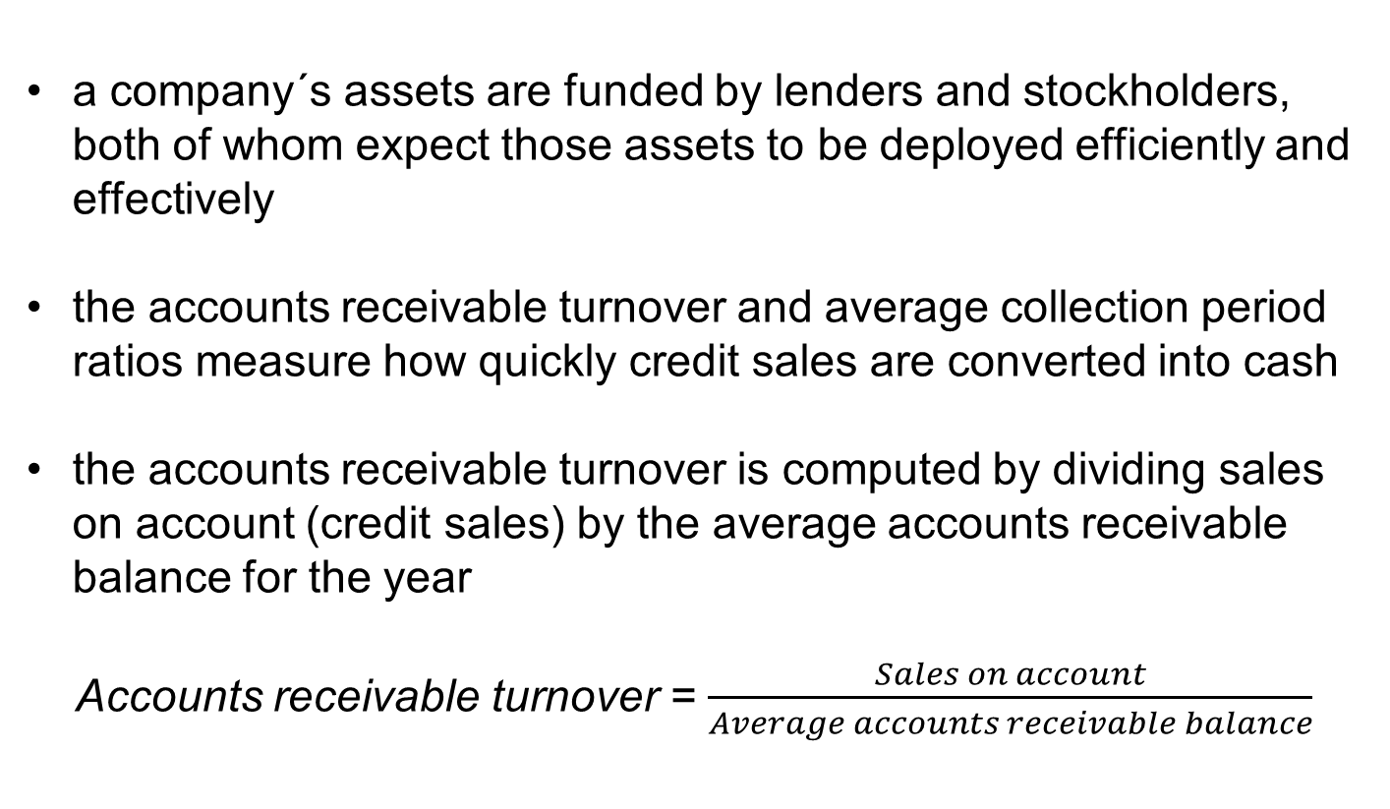
FINANCIAL STATEMENT ANALYSIS
RATIO ANALYSIS – ASSET MANAGEMENT (1) – ACCOUNTS RECEIVABLE TURNOVER (1)
a company´s assets are funded by lenders and stockholders, both of whom expect those assets to be deployed efficiently and effectively
the accounts receivable turnover and average collection period ratios measure how quickly credit sales are converted into cash
the accounts receivable turnover is computed by dividing sales on account (credit sales) by the average accounts receivable balance for the year
Accounts receivable turnover = $\frac{Sales on account}{Average accounts receivable balance}$

Slide 13
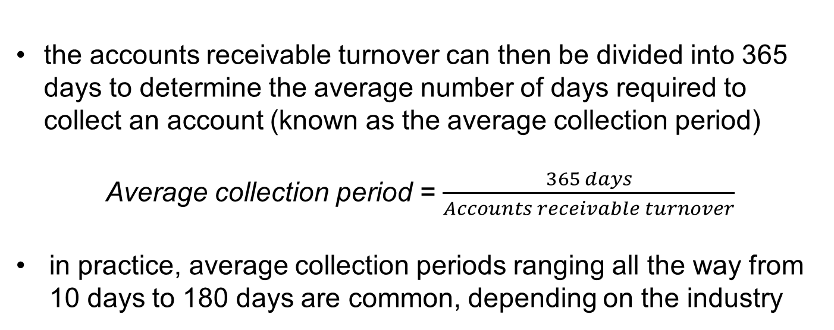
FINANCIAL STATEMENT ANALYSIS
RATIO ANALYSIS – ASSET MANAGEMENT (2) – ACCOUNTS RECEIVABLE TURNOVER (2)
the accounts receivable turnover can then be divided into 365 days to determine the average number of days required to collect an account (known as the average collection period)
Average collection period = $\frac{365 days}{Accounts receivable turnover}$
in practice, average collection periods ranging all the way from 10 days to 180 days are common, depending on the industry

Slide 14
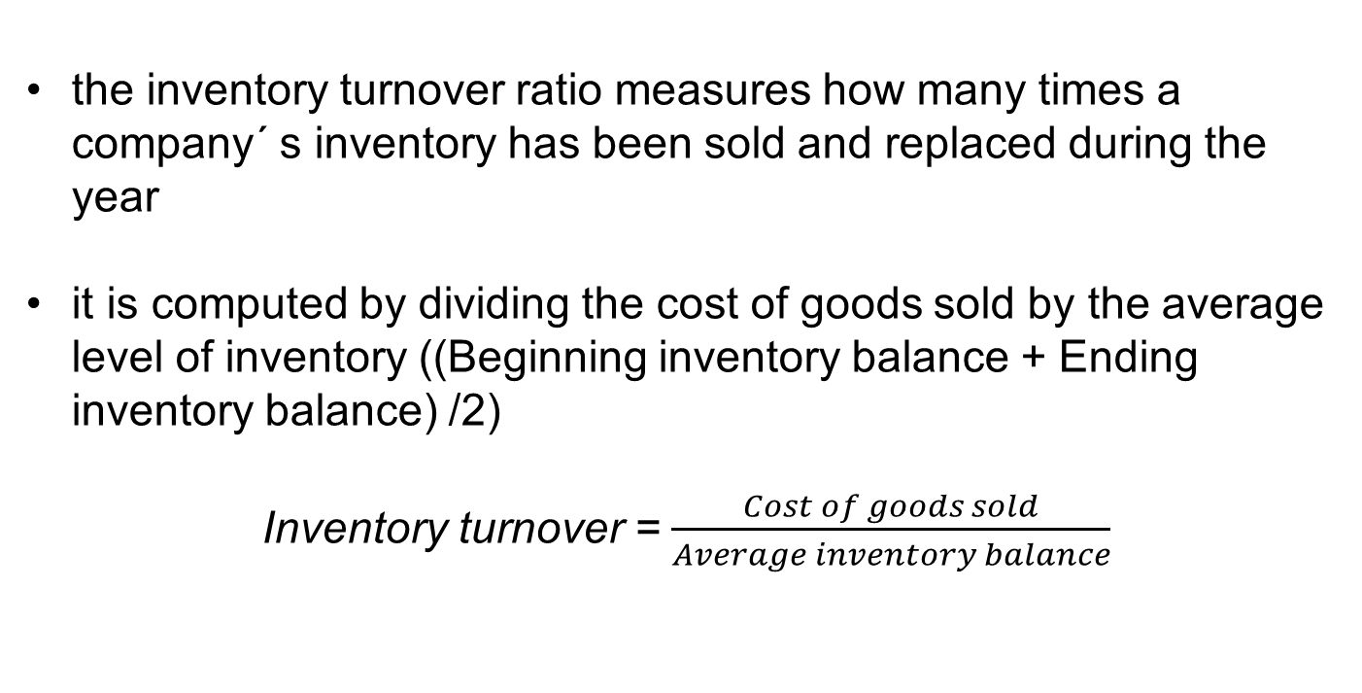
FINANCIAL STATEMENT ANALYSIS
RATIO ANALYSIS – ASSET MANAGEMENT (3) – INVENTORY TURNOVER (1)
the inventory turnover ratio measures how many times a company´ s inventory has been sold and replaced during the year
it is computed by dividing the cost of goods sold by the average level of inventory ((Beginning inventory balance + Ending inventory balance) /2)
Inventory turnover = $\frac{Cost of goods sold}{Average inventory balance}$

Slide 15
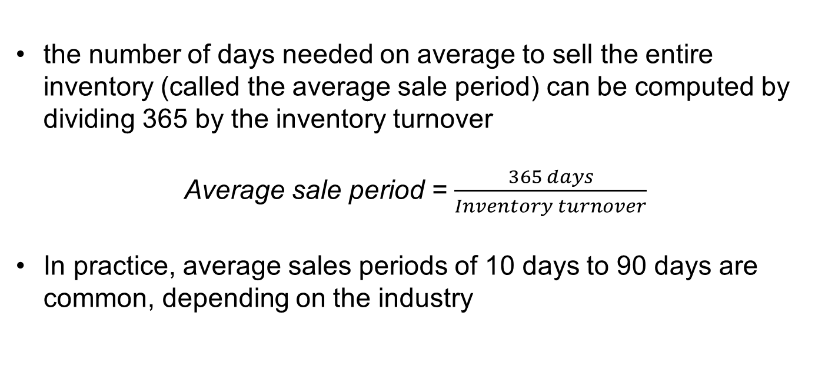
FINANCIAL STATEMENT ANALYSIS
RATIO ANALYSIS – ASSET MANAGEMENT (4) – INVENTORY TURNOVER (2)
the number of days needed on average to sell the entire inventory (called the average sale period) can be computed by dividing 365 by the inventory turnover
Average sale period = $\frac{365 days}{Inventory turnover}$
In practice, average sales periods of 10 days to 90 days are common, depending on the industry

Slide 16
FINANCIAL STATEMENT ANALYSIS
RATIO ANALYSIS – ASSET MANAGEMENT (5) – OPERATING CYCLE (1)
the operating cycle measures the elapsed time from when inventory is received from suppliers to when cash is received from customers
Operating cycle = Average sale period + Average collection period
a manager´s goal is to reduce the operating cycle because it puts cash receipts in the company´s possession sooner
in fact, if a company can shrink its operating cycle to fewer days than its average payment period for suppliers, it means the company is receiving cash from customers before it has to pay suppliers for inventory purchases

Slide 17
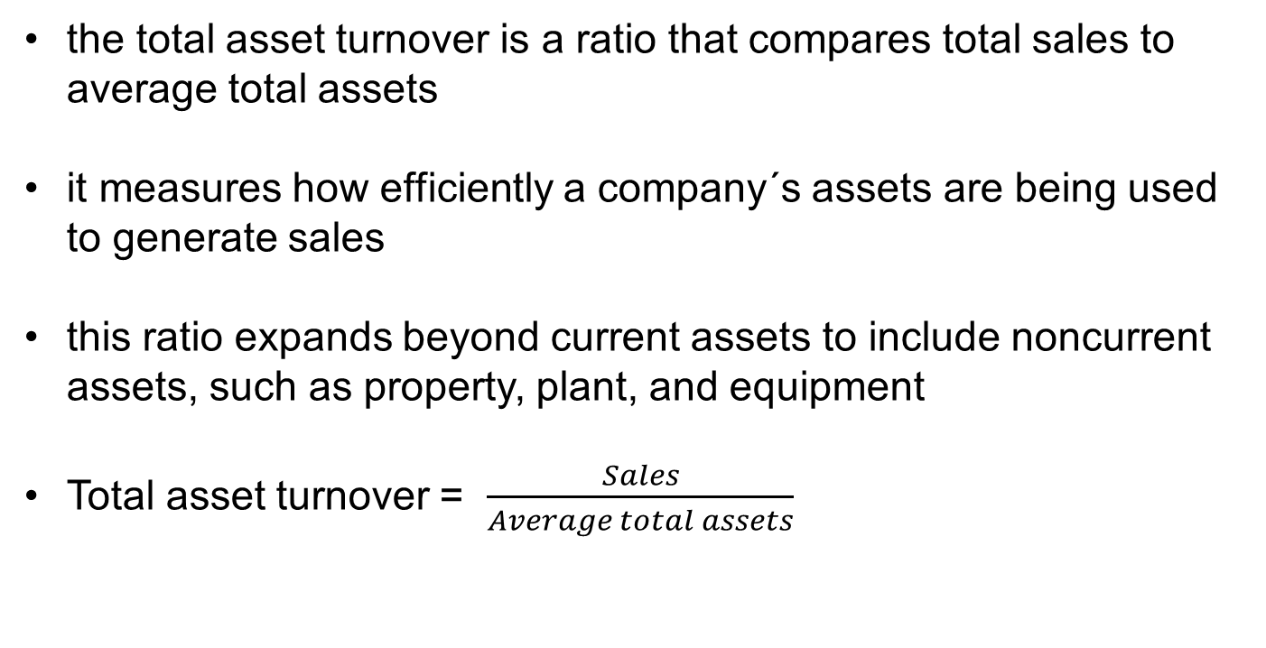
FINANCIAL STATEMENT ANALYSIS
RATIO ANALYSIS – ASSET MANAGEMENT (6) – TOTAL ASSET TURNOVER (1)
the total asset turnover is a ratio that compares total sales to average total assets
it measures how efficiently a company´s assets are being used to generate sales
this ratio expands beyond current assets to include noncurrent assets, such as property, plant, and equipment
Total asset turnover = $\frac{Sales}{Average total assets}$

Slide 18
FINANCIAL STATEMENT ANALYSIS
RATIO ANALYSIS – ASSET MANAGEMENT (7) – TOTAL ASSET TURNOVER (2)
a company´s goal is to increase its total asset turnover
to do so, it must either increase sales or reduce its investment in assets
if a company´s accounts receivable turnover and inventory turnover are increasing but its total asset turnover is decreasing, it suggests the problem may relate to noncurrent asset utilization and efficiency

Slide 19
FINANCIAL STATEMENT ANALYSIS
RATIO ANALYSIS – DEBT MANAGEMENT (1)
managers need to evaluate their company´s debt management choices from the vantage point of two stakeholders - long-term creditors and common stockholders
long-term creditors are concerned with a company´s ability to repay its loans over the long-run.
stockholders look at debt from a financial leverage perspective
financial leverage refers to borrowing money to acquire assets in an effort to increase sales and profits
a company can have either positive or negative financial leverage depending on the difference between its rate of return on total assets and the rate of return that it must pay its creditors

Slide 20
FINANCIAL STATEMENT ANALYSIS
RATIO ANALYSIS – DEBT MANAGEMENT (2)
if the company´s rate of return on total assets exceeds the rate of return the company pays its creditors, financial leverage is positive
if the rate of return on total assets is less than the rate of return the company pays its creditors, financial leverage is negative

Slide 21
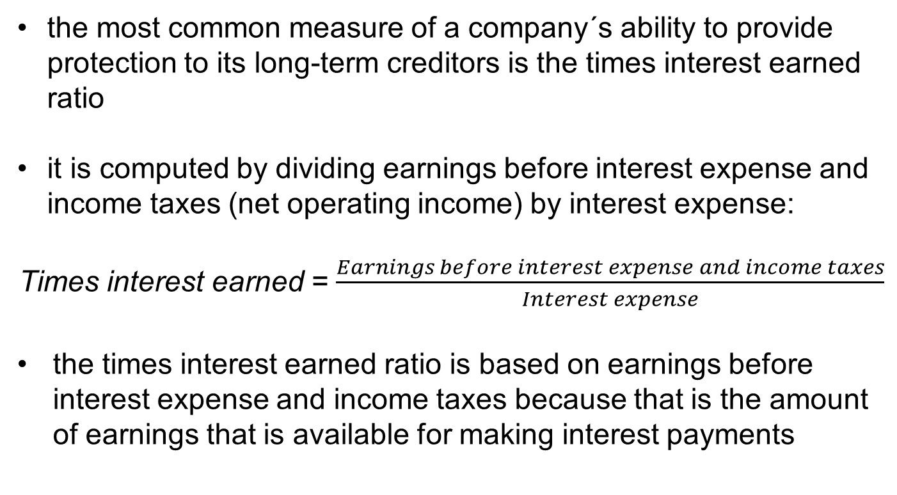
FINANCIAL STATEMENT ANALYSIS
RATIO ANALYSIS – DEBT MANAGEMENT (3) – TIMES INTEREST EARNED RATIO (1)
the most common measure of a company´s ability to provide protection to its long-term creditors is the times interest earned ratio
it is computed by dividing earnings before interest expense and income taxes (net operating income) by interest expense:
Times interest earned = $\frac{Earnings before interest expense and income taxes}{Interest expense}$
the times interest earned ratio is based on earnings before interest expense and income taxes because that is the amount of earnings that is available for making interest payments

Slide 22
FINANCIAL STATEMENT ANALYSIS
RATIO ANALYSIS – DEBT MANAGEMENT (4) – TIMES INTEREST EARNED RATIO (2)
interest expenses are deducted before income taxes are determined; creditors have first claim on the earnings before taxes are paid
a times interest earned ratio of less than 1 is inadequate because interest expense exceeds the earnings that are available for paying the interest
in contrast, a times interest earned ratio of 2 or more may be considered sufficient to protect long-term creditors

Slide 23
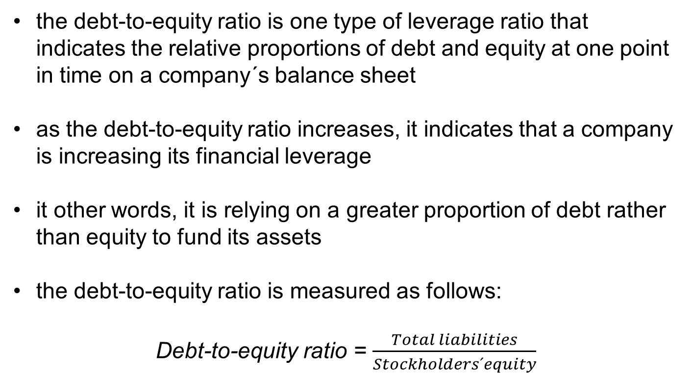
FINANCIAL STATEMENT ANALYSIS
RATIO ANALYSIS – DEBT MANAGEMENT (5) – DEBT-TO-EKVITY RATIO (1)
the debt-to-equity ratio is one type of leverage ratio that indicates the relative proportions of debt and equity at one point in time on a company´s balance sheet
as the debt-to-equity ratio increases, it indicates that a company is increasing its financial leverage
it other words, it is relying on a greater proportion of debt rather than equity to fund its assets
the debt-to-equity ratio is measured as follows:
Debt-to-equity ratio = $\frac{Total liabilities}{Stockholders´equity}$

Slide 24
FINANCIAL STATEMENT ANALYSIS
RATIO ANALYSIS – DEBT MANAGEMENT (6) – DEBT-TO-EKVITY RATIO (2)
creditors and stockholders have different views about the optimal debt-to-equity ratio
ordinarily, stockholders would like a lot of debt to take advantage of positive financial leverage
on the other hand, because equity represents the excess of total assets over total liabilities, and hence a buffer of protection for creditors, creditors would like to see less debt and more equity
in practice, debt-to-equity ratios from 0,0 (no debt) to 3,0 are common
  in industries with little financial risk, managers maintain high debt-to-equity ratios
  in industries with more financial risk, managers maintain lower debt-to-equity ratios

Slide 25
FINANCIAL STATEMENT ANALYSIS
RATIO ANALYSIS – DEBT MANAGEMENT (7) – EQUITY MULTIPLIER (1)
the equity multiplier is another type of leverage ratio that indicates the portion of a company´s assets funded by equity
similar to the debt-to-equity ratio, as the equity multiplier increases, it indicates that a company is increasing its financial leverage
in other words, it is relying on a greater proportion of debt rather than equity to fund its assets

Slide 26
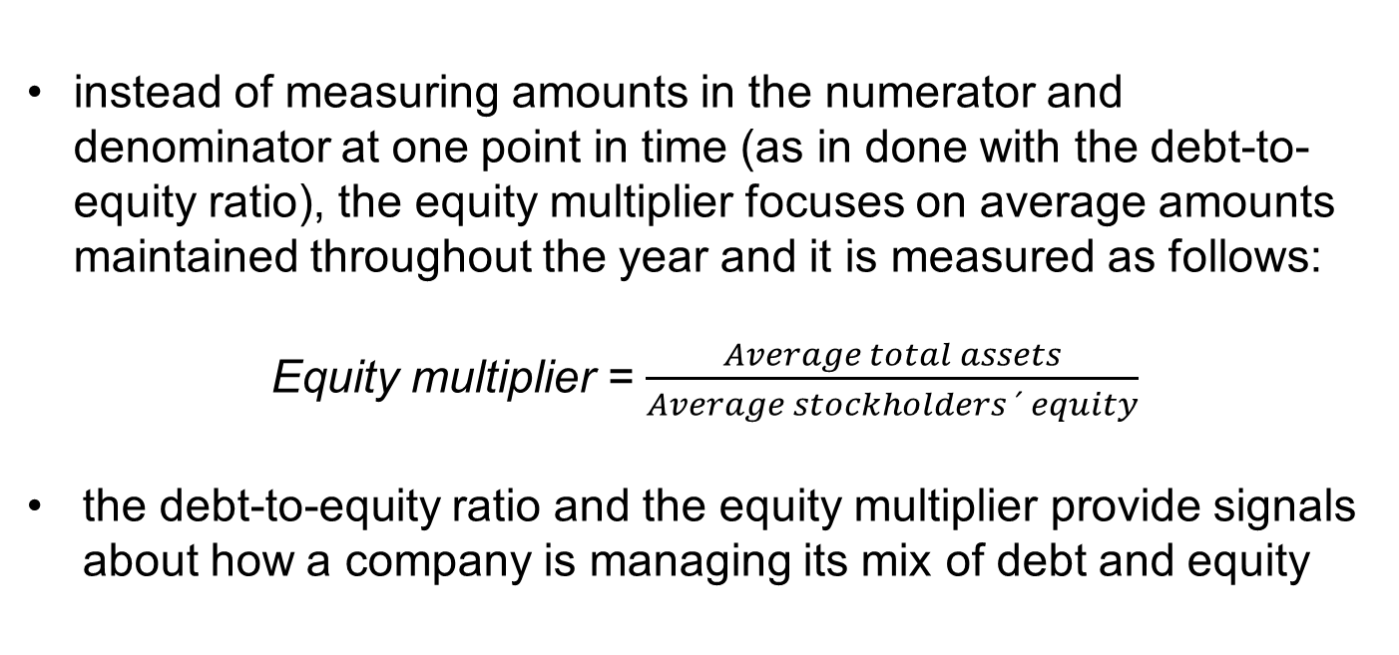
FINANCIAL STATEMENT ANALYSIS
RATIO ANALYSIS – DEBT MANAGEMENT (8) – EQUITY MULTIPLIER (2)
instead of measuring amounts in the numerator and denominator at one point in time (as in done with the debt-to-equity ratio), the equity multiplier focuses on average amounts maintained throughout the year and it is measured as follows:
Equity multiplier = $\frac{Average total assets}{Average stockholders ´ equity}$
the debt-to-equity ratio and the equity multiplier provide signals about how a company is managing its mix of debt and equity

Slide 27
FINANCIAL STATEMENT ANALYSIS
RATIO ANALYSIS – PROFITABILITY (1)
managers pay close attention to the amount of profits that their companies earn
however, when analyzing ratios, they tend to focus on the amount of profit earned relative to some other amount such as sales, total assets, or total stockholder´s equity
when profits are stated as a percentage of another number, such as sales, it helps managers draw informed conclusions about how the organization is performing over time

Slide 28
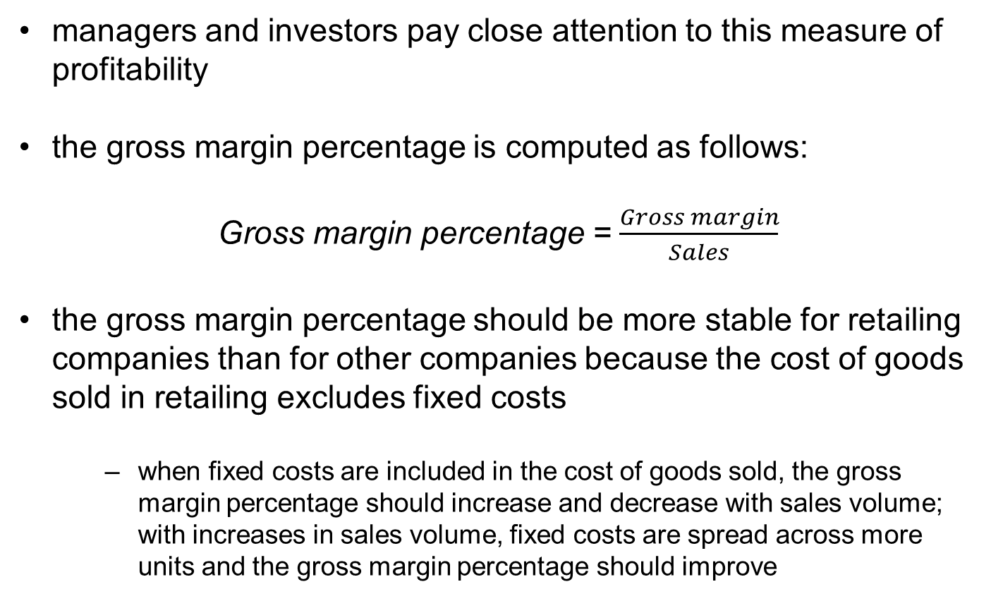
FINANCIAL STATEMENT ANALYSIS
RATIO ANALYSIS – PROFITABILITY (2) – GROSS MARGIN PERCENTAGE
managers and investors pay close attention to this measure of profitability
the gross margin percentage is computed as follows:
Gross margin percentage = $\frac{Gross margin}{Sales}$
the gross margin percentage should be more stable for retailing companies than for other companies because the cost of goods sold in retailing excludes fixed costs
  when fixed costs are included in the cost of goods sold, the gross margin percentage should increase and decrease with sales volume; with increases in sales volume, fixed costs are spread across more units and the gross margin percentage should improve

Slide 29
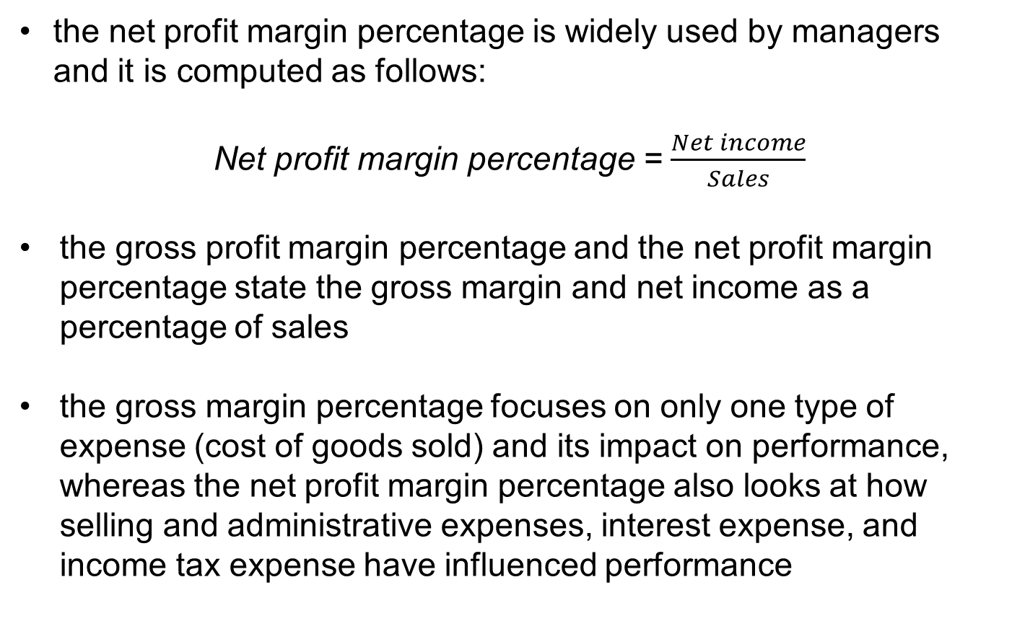
FINANCIAL STATEMENT ANALYSIS
RATIO ANALYSIS – PROFITABILITY (3) – NET PROFIT MARGIN PERCENTAGE
the net profit margin percentage is widely used by managers and it is computed as follows:
Net profit margin percentage = $\frac{Net income}{Sales}$
the gross profit margin percentage and the net profit margin percentage state the gross margin and net income as a percentage of sales
the gross margin percentage focuses on only one type of expense (cost of goods sold) and its impact on performance, whereas the net profit margin percentage also looks at how selling and administrative expenses, interest expense, and income tax expense have influenced performance

Slide 30
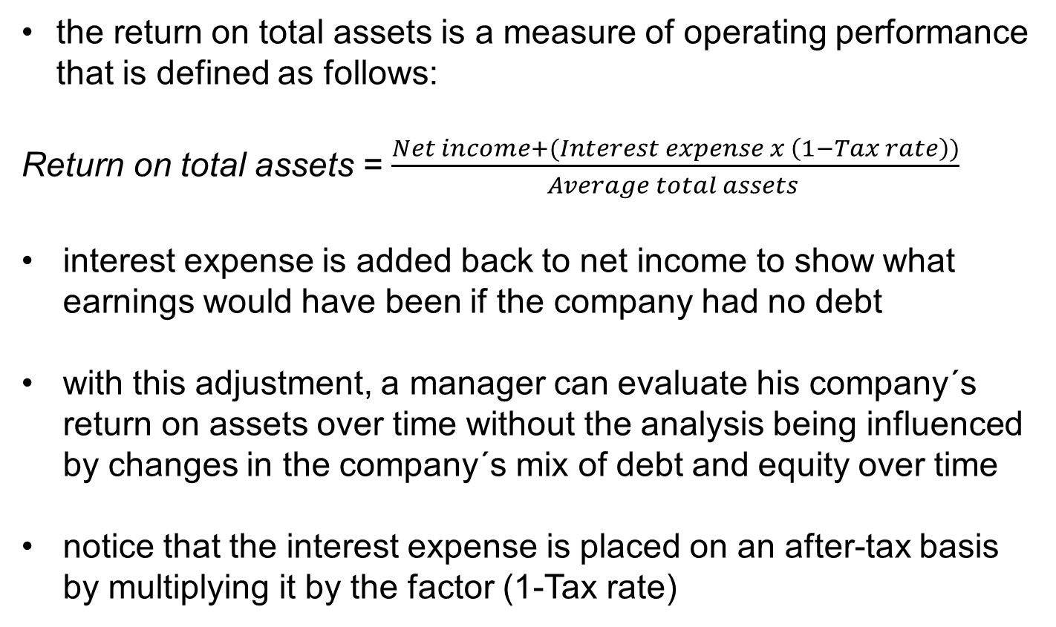
FINANCIAL STATEMENT ANALYSIS
RATIO ANALYSIS – PROFITABILITY (4) – RETURN ON TOTAL ASSETS
the return on total assets is a measure of operating performance that is defined as follows:
Return on total assets = $\frac{Net income+(Interest expense x \left(1−Tax rate\right))}{Average total assets }$
interest expense is added back to net income to show what earnings would have been if the company had no debt
with this adjustment, a manager can evaluate his company´s return on assets over time without the analysis being influenced by changes in the company´s mix of debt and equity over time
notice that the interest expense is placed on an after-tax basis by multiplying it by the factor (1-Tax rate)

Slide 31
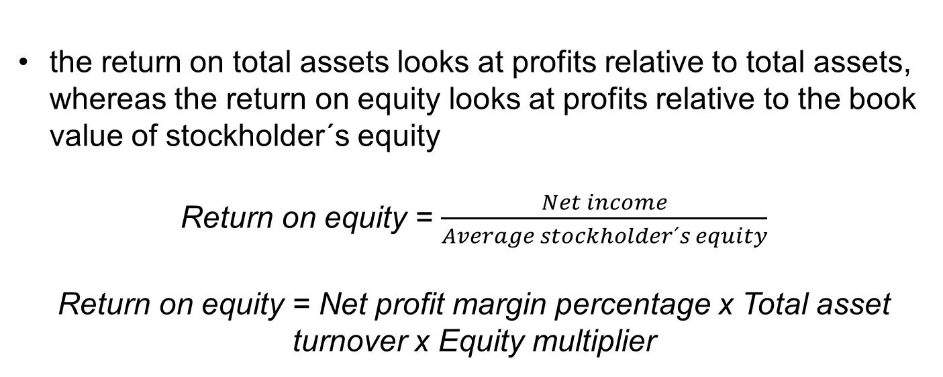
FINANCIAL STATEMENT ANALYSIS
RATIO ANALYSIS – PROFITABILITY (5) – RETURN ON EQUITY
the return on total assets looks at profits relative to total assets, whereas the return on equity looks at profits relative to the book value of stockholder´s equity
Return on equity = $\frac{Net income}{Average stockholder´s equity}$
Return on equity = Net profit margin percentage x Total asset turnover x Equity multiplier

Slide 32
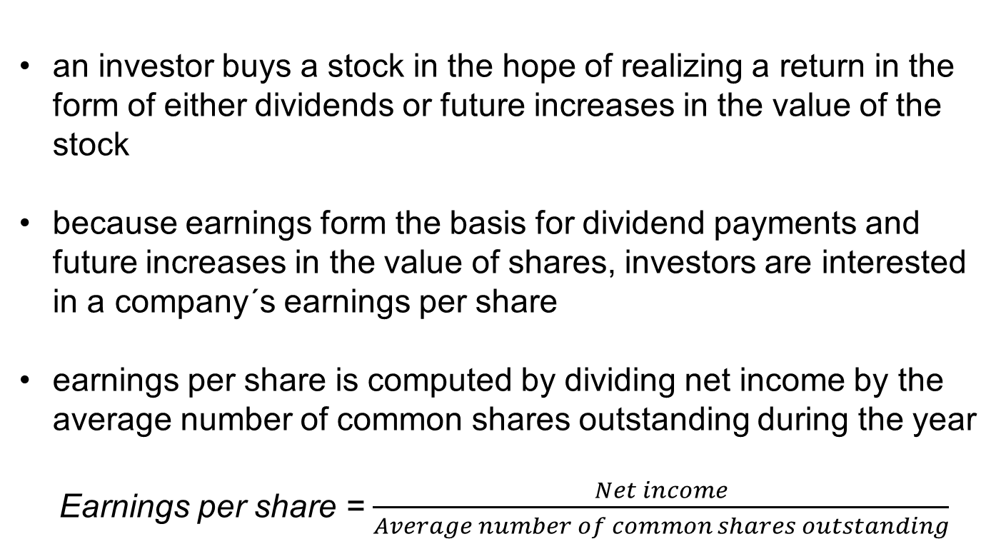
FINANCIAL STATEMENT ANALYSIS
RATIO ANALYSIS – MARKET PERFORMANCE (1) – EARNINGS PER SHARE
an investor buys a stock in the hope of realizing a return in the form of either dividends or future increases in the value of the stock
because earnings form the basis for dividend payments and future increases in the value of shares, investors are interested in a company´s earnings per share
earnings per share is computed by dividing net income by the average number of common shares outstanding during the year
Earnings per share = $\frac{Net income}{Average number of common shares outstanding}$

Slide 33
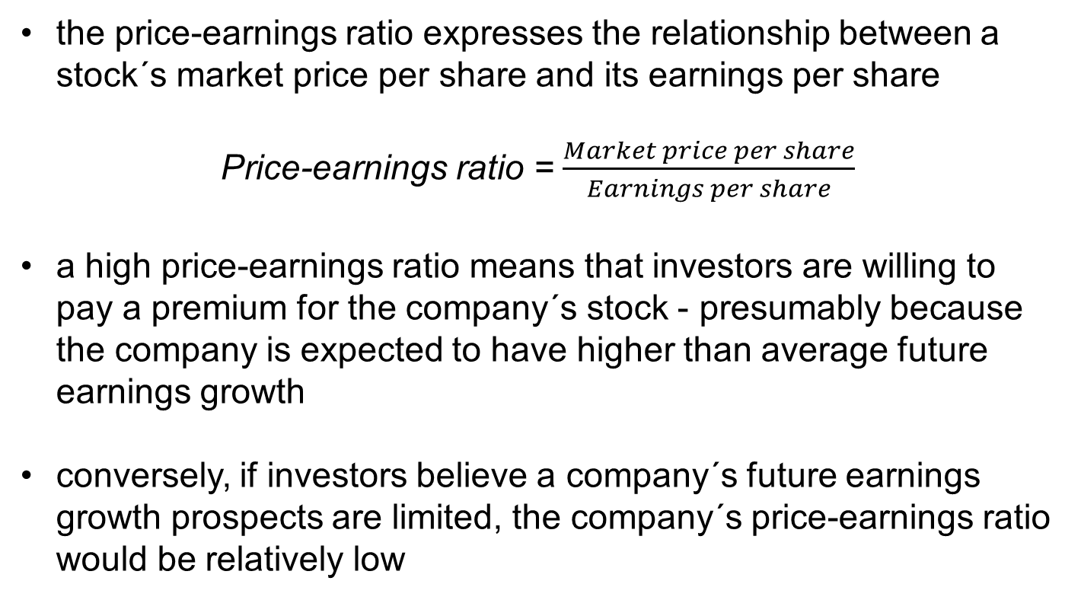
FINANCIAL STATEMENT ANALYSIS
RATIO ANALYSIS – MARKET PERFORMANCE (2) – PRICE-EARNINGS RATIO
the price-earnings ratio expresses the relationship between a stock´s market price per share and its earnings per share
Price-earnings ratio = $\frac{Market price per share}{Earnings per share}$
a high price-earnings ratio means that investors are willing to pay a premium for the company´s stock - presumably because the company is expected to have higher than average future earnings growth
conversely, if investors believe a company´s future earnings growth prospects are limited, the company´s price-earnings ratio would be relatively low

Slide 34
FINANCIAL STATEMENT ANALYSIS
RATIO ANALYSIS – MARKET PERFORMANCE (3) – DIVIDEND PAYOUT AND YIELD RATIOS (1)
investors in a company´s stock make money in two ways - increases in the market value of the stock and dividends
in general, earnings should be retained in a company and not paid out in dividends as long as the rate of return on funds invested inside the company exceeds the rate of return that stockholders could earn on alternative investments ouside the company
companies with excellent prospects of profitable growth often pay little or no dividend
companies with little opportunity for profitable growth, but with steady, dependable earnings, tend to pay out a higher percentage of their cash flow from operations as dividends

Slide 35
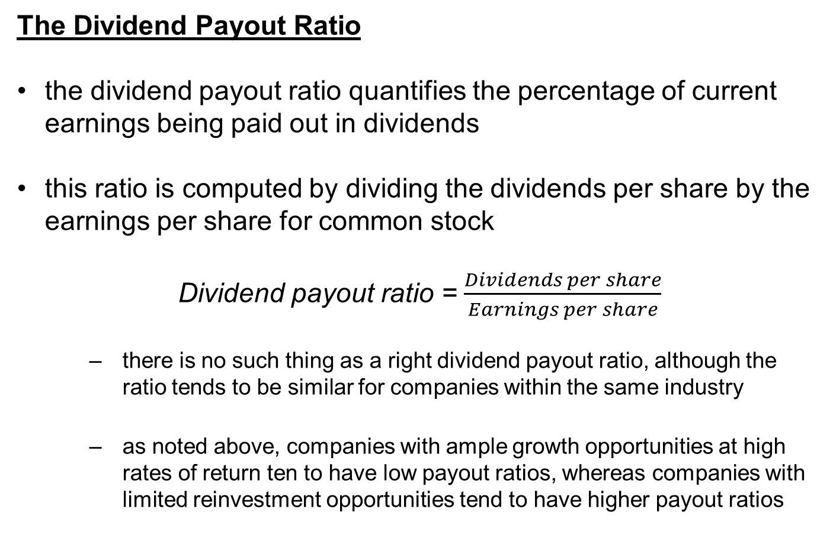
FINANCIAL STATEMENT ANALYSIS
RATIO ANALYSIS – MARKET PERFORMANCE (4) – DIVIDEND PAYOUT AND YIELD RATIOS (2)
The Dividend Payout Ratio
the dividend payout ratio quantifies the percentage of current earnings being paid out in dividends
this ratio is computed by dividing the dividends per share by the earnings per share for common stock
Dividend payout ratio = $\frac{Dividends per share}{Earnings per share}$
  there is no such thing as a right dividend payout ratio, although the ratio tends to be similar for companies within the same industry
  as noted above, companies with ample growth opportunities at high rates of return ten to have low payout ratios, whereas companies with limited reinvestment opportunities tend to have higher payout ratios

Slide 36
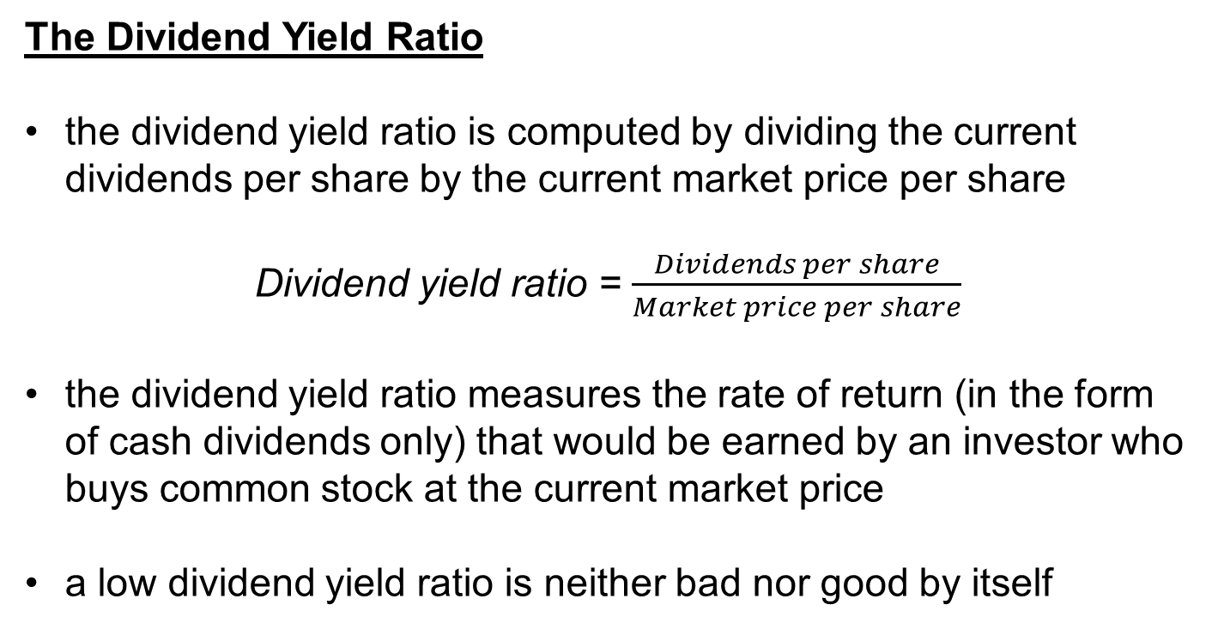
FINANCIAL STATEMENT ANALYSIS
RATIO ANALYSIS – MARKET PERFORMANCE (5) – DIVIDEND PAYOUT AND YIELD RATIOS (3)
The Dividend Yield Ratio
the dividend yield ratio is computed by dividing the current dividends per share by the current market price per share
Dividend yield ratio = $\frac{Dividends per share}{Market price per share}$
the dividend yield ratio measures the rate of return (in the form of cash dividends only) that would be earned by an investor who buys common stock at the current market price
a low dividend yield ratio is neither bad nor good by itself

Slide 37
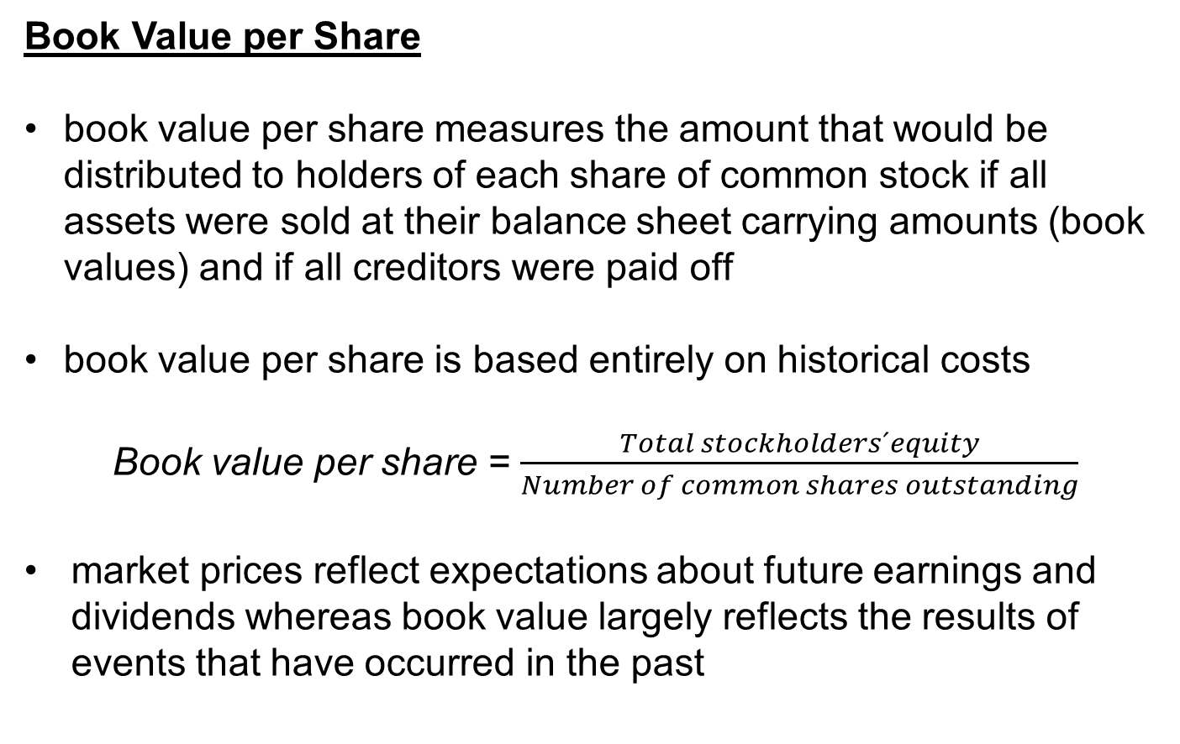
FINANCIAL STATEMENT ANALYSIS
RATIO ANALYSIS – MARKET PERFORMANCE (6) – DIVIDEND PAYOUT AND YIELD RATIOS (4)
Book Value per Share
book value per share measures the amount that would be distributed to holders of each share of common stock if all assets were sold at their balance sheet carrying amounts (book values) and if all creditors were paid off
book value per share is based entirely on historical costs
Book value per share = $\frac{Total stockholders´equity}{Number of common shares outstanding}$
market prices reflect expectations about future earnings and dividends whereas book value largely reflects the results of events that have occurred in the past

