Slide 1
PROCESS COSTING, VARIABLE COSTING AND SEGMENT REPORTING
Ing. Markéta Šeligová, Ph.D.
MANAGERIAL ACCOUNTING/NANMU

Slide 2
PROCESS COSTING, VARIABLE COSTING AND SEGMENT REPORTING
Outline of the lecture
Process costing
Job-order versus process costing
Equation units of production
Variable costing
Break-even analysis

Slide 3
PROCESS COSTING, VARIABLE COSTING AND SEGMENT REPORTING
PROCESS COSTING
job-order costing and process costing are two common methods for determining unit product costs
job order costing is used when many different jobs or products are worked on each period
examples of industries that use job-order costing include furniture manufacturing, special-order printing, shipbuilding, and many types of service organizations
process costing is used most commonly in industries that convert raw materials into homogenous products, such as bricks, soda, or paper, on a continuous basis

Slide 4
PROCESS COSTING, VARIABLE COSTING AND SEGMENT REPORTING
SIMILARITIES BETWEEN JOB-ORDER AND PROCESS COSTING
The similarities between job-order and process costing can be summarized as follows:
both systems have the same basic purposes - to assign material, labor, and manufacturing overhead costs to products and to provide a mechanism for computing unit product costs
both systems use the same basic manufacturing accounts, including Manufacturing Overhead, Raw Materials, Work in Process, and Finished Goods.
the flow of costs through the manufacturing accounts is basically the same in both systems

Slide 5
PROCESS COSTING, VARIABLE COSTING AND SEGMENT REPORTING
DIFFERENCES BETWEEN JOB-ORDER AND PROCESS COSTING (1)
there are three differences between job-order and process costing.
process costing is used when a company produces a continuous flow of units that are indistinguishable from one another. Job-order costing is used when a company produces many different jobs that have unique production requirements
process costing systems compute unit costs by department. This differs from job-order costing where unit costs are computed by job on the job cost sheet

Slide 6
PROCESS COSTING, VARIABLE COSTING AND SEGMENT REPORTING
DIFFERENCES BETWEEN JOB-ORDER AND PROCESS COSTING (2)
there are three differences between job-order and process costing.
under process costing, it makes no sense to try to identify materials, labor, and overhead costs with a particular customer order (as we did with job-order costing) because each order is just one of many that are filled from a continuous flow of virtually identical units from the production line. Accordingly, process costing accumulates costs by department (rather than by order) and assigns these costs uniformly to all units that pass through the department during a period. Job cost sheets (which we used for job-order costing) are not used to accumulate costs

Slide 7
PROCESS COSTING, VARIABLE COSTING AND SEGMENT REPORTING
PROCESSING DEPARTMENTS
A processing department is an organizational unit where work is performed on a product and where materials, labour, or overhead costs are added to the product (potato chip factory – three processing departments for example – one for preparing potatoes, one for cooking and one for inspecting and packaging)

Slide 8
PROCESS COSTING, VARIABLE COSTING AND SEGMENT REPORTING
THE FLOW OF MATERIALS, LABOR AND OVERHEAD COSTS (1)
cost accumulation is simpler in a process costing system than in a job-order costing system.
in a process costing system, instead of having to trace costs to hundreds of different jobs, costs are traced to only a few processing departments
a separate Work in Process account is maintained for each processing department(job-order costing system the entire company may have only one Work in Process account)
the completed production of the first processing department is transferred to the Work in Process account of the second processing department

Slide 9
PROCESS COSTING, VARIABLE COSTING AND SEGMENT REPORTING
THE FLOW OF MATERIALS, LABOR AND OVERHEAD COSTS (2)
After further work in second department, the completed units are then transferred to Finished Goods.
Cost in second department´s Work in Process account consist of the materials, labour, and overhead costs incurred in second department plus the costs attached to partially completed units transferred in from first department (called transferred-in costs)

Slide 10
PROCESS COSTING, VARIABLE COSTING AND SEGMENT REPORTING
MATERIALS COSTS, LABOR, AND OVERHEAD COST ENTRIES
Materials Costs
as in job-order costing, materials are drawn from the storeroom using a materials requisition form
materials can be added only in the first processing department, with subsequent departments adding only labor and overhead costs
Labour Costs
in process costing, labour costs are traced to departments - not to individual jobs
Overhead Costs
in process costing, as in job-order costing, predetermined overhead rates are usually used.
manufacturing overhead cost is applied according to the amount of the allocation base that is incurred in the department

Slide 11
PROCESS COSTING, VARIABLE COSTING AND SEGMENT REPORTING
EQUIVALENT UNITS OF PRODUCTION (1)
equivalent units is the product of the number of partially completed units and the percentage completion of those units with respect to the processing in the department
the equivalent units is the number of complete units that could have been obtained from the materials and effort that went into the partially complete units
Equivalent units = Number of partially completed units x Percentage completion

Slide 12
PROCESS COSTING, VARIABLE COSTING AND SEGMENT REPORTING
EQUIVALENT UNITS OF PRODUCTION (2)
For example, suppose the ABC company has 500 units in its ending work in process inventory that are 60% complete with respect to processing in the department.
These 500 partially complete units are equivalent to 300 fully complete units (500x60% = 300).
Therefore, the ending work in process inventory contains 300 equivalent units.
These equivalent units are added to any units completed during the period to determine the department´s output for the period - called the equivalent units of production

Slide 13
PROCESS COSTING, VARIABLE COSTING AND SEGMENT REPORTING
EQUIVALENT UNITS OF PRODUCTION (3)
equivalent units of production for a period can be computed in different ways such as the weighted-average method and FIFO method.
The FIFO method of process costing is a method in which equivalent units and unit costs relate only to work done during the current period
The weighted average method blends together units and costs from the current period with units and costs from the prior period
In the weighted-average method, the equivalent units of production for a department are the number of units transferred to the next department (or to finished goods) plus the equivalent units in the department´s ending work in process inventory

Slide 14
PROCESS COSTING, VARIABLE COSTING AND SEGMENT REPORTING
EQUIVALENT UNITS OF PRODUCTION (4)
in general, the units in beginning work in process inventory plus the units started into production must equal the units in ending work in process inventory plus the units completed and transferred out
Conversion cost is direct labour cost plus manufacturing overhead cost
in process costing, conversion cost is often treated as a single element of product cost

Slide 15
PROCESS COSTING, VARIABLE COSTING AND SEGMENT REPORTING
VARIABLE COSTING (1)
under variable costing, only those manufacturing costs that vary with output are treated as product costs
this would usually include direct materials, direct labor, and the variable portion of manufacturing overhead
fixed manufacturing overhead is not treated as a product cost under this method

Slide 16
PROCESS COSTING, VARIABLE COSTING AND SEGMENT REPORTING
VARIABLE COSTING (2)
fixed manufacturing overhead is treated as a period cost and, like selling and administrative expenses, it is expensed in its entirety each period
the cost of a unit of product in inventory or in cost of goods sold under the variable costing method does not contain any fixed manufacturing overhead cost
variable costing is sometimes referred to as direct costing or marginal costing

Slide 17
PROCESS COSTING, VARIABLE COSTING AND SEGMENT REPORTING
ABSORPTION COSTING
treats all manufacturing costs as product costs, regardless of whether they are variable of fixed
the cost of a unit of product under the absorption costing method consists of direct materials, direct labor, and both variable and fixed manufacturing overhead
allocates a portion of fixed manufacturing overhead cost to each unit of product, along with the variable manufacturing costs
because absorption costing includes all manufacturing costs in product costs, it is frequently referred to as the full cost method

Slide 18
PROCESS COSTING, VARIABLE COSTING AND SEGMENT REPORTING
SELLING AND ADMINISTRATIVE EXPENSES
are never treated as product costs, regardless of the costing method
variable and fixed selling and administrative expenses are always treated as period costs and are expensed as incurred

Slide 19
PROCESS COSTING, VARIABLE COSTING AND SEGMENT REPORTING
SUMMARY OF DIFFERENCES
the essential difference between variable costing and absorption costing is how each method accounts for fixed manufacturing overhead costs - all other costs are treated the same under the two methods
in absorption costing, fixed manufacturing overhead are included as part of the costs of work in process inventories
when units are completed, these costs are transferred to finished goods and only when the units are sold do these cost flow through to the income statement as part of cost of goods sold
in variable costing, fixed manufacturing overhead costs are considered to be period costs
- just like selling and administrative costs - and are taken immediately to the income statement as period expenses

Slide 20
PROCESS COSTING, VARIABLE COSTING AND SEGMENT REPORTING
RECONCILIATION OF VARIABLE COSTING WITH ABSORPTION COSTING INCOME (1)
in general, when the units produced exceed unit sales and hence inventories increase, net operating income is higher under absorption costing than under variable costing
this occurs because some of the fixed manufacturing overhead of the period is deffered in inventories under absorption costing
in contrast, when unit sales exceed the units produced and hence inventories decrease, net operating income is lower under absorption costing than under variable costing
this occurs because some of the fixed manufacturing overhead of previous periods is released from inventories under absorption costing

Slide 21
PROCESS COSTING, VARIABLE COSTING AND SEGMENT REPORTING
RECONCILIATION OF VARIABLE COSTING WITH ABSORPTION COSTING INCOME (2)
when the units produced and unit sales are equal, no change in inventories occurs and absorption costing and variable costing net operating incomes are the same
variable costing and absorption costing net operating incomes can be reconciled by determining how much fixed manufacturing overhead was deferred in, or released from, inventories during the period
the fixed manufacturing overhead that is deferred in or released from inventories can be determined as follows:
Manufacturing overhead deferred in (released from)inventory = Fixed manufacturing overhead in ending inventories – Fixed manufacturing overhead in beginning inventories

Slide 22
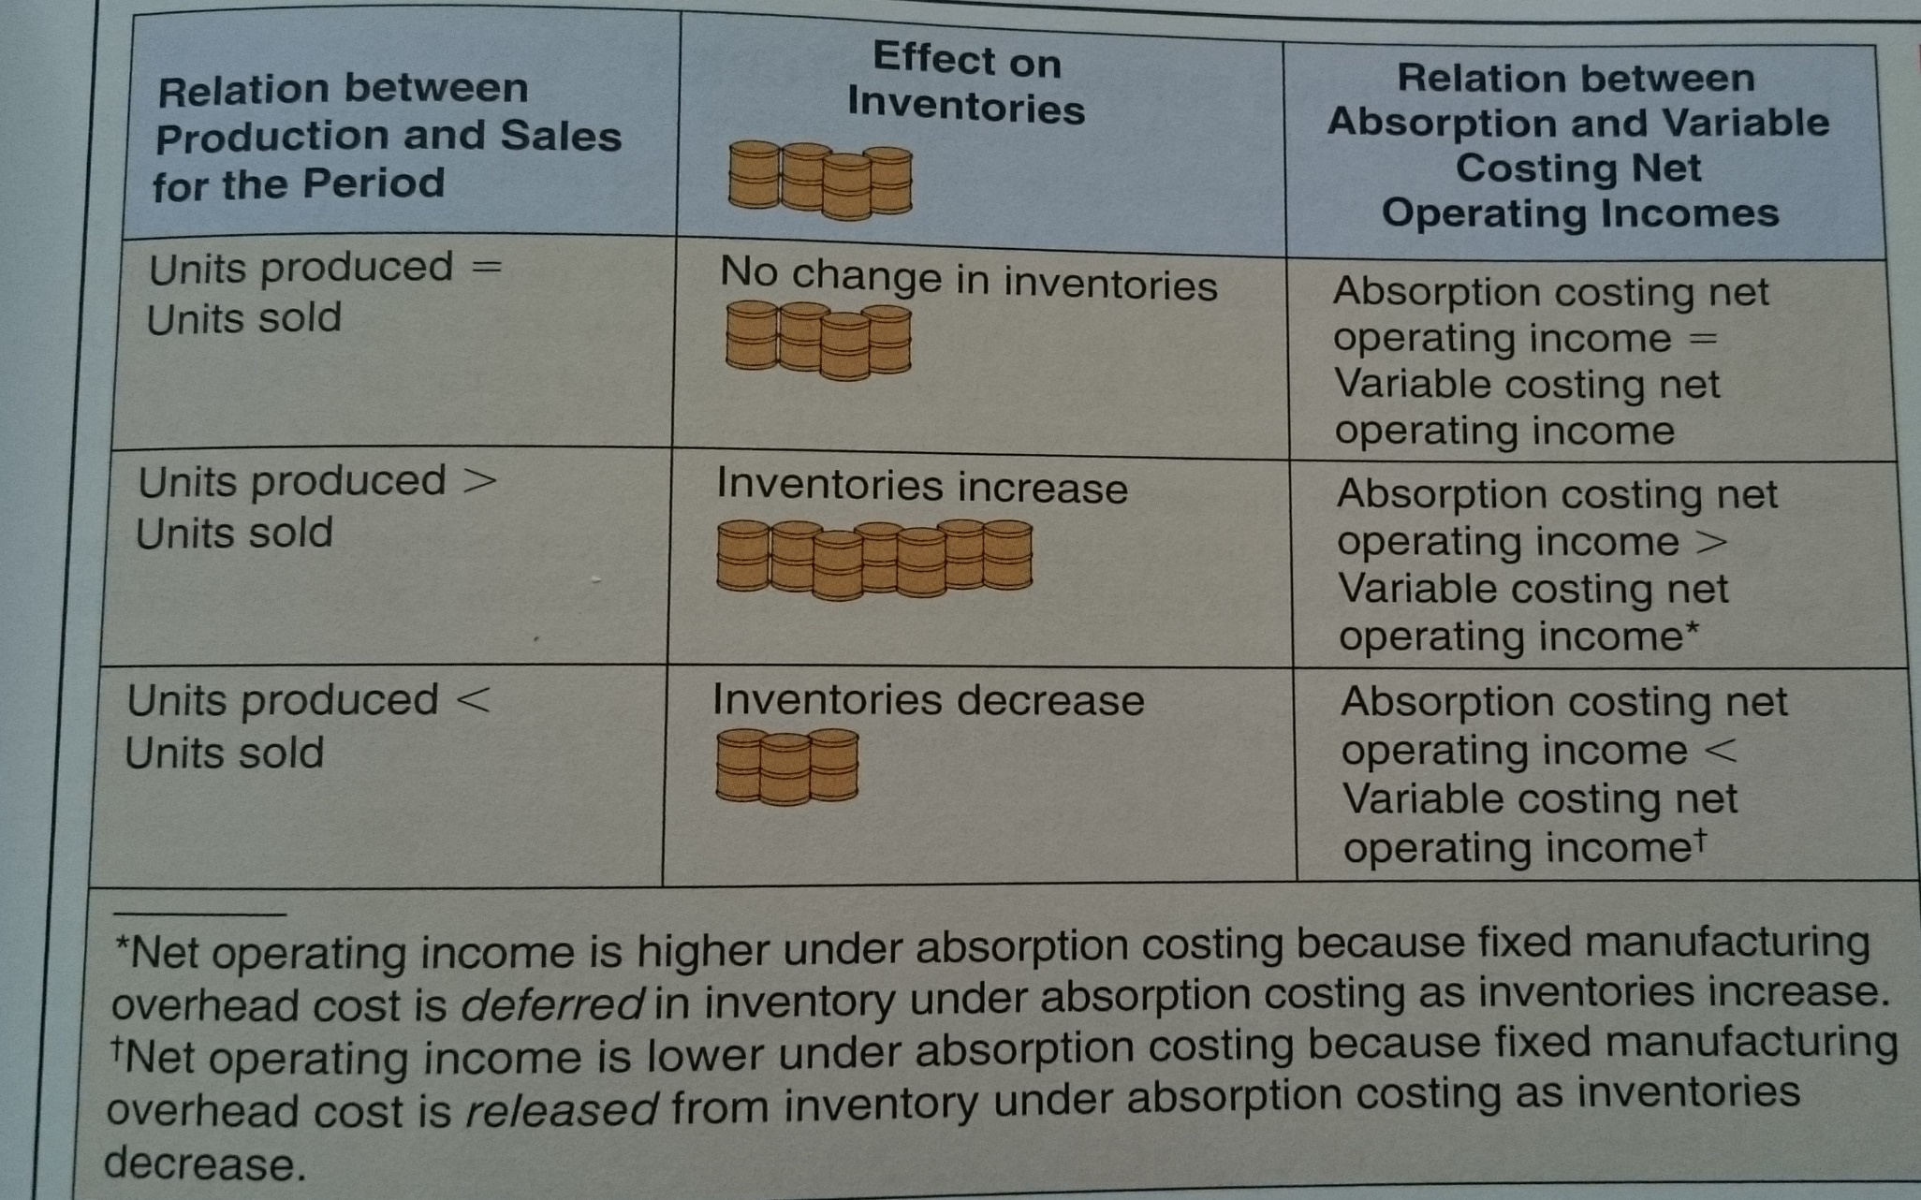
PROCESS COSTING, VARIABLE COSTING AND SEGMENT REPORTING
RECONCILIATION OF VARIABLE COSTING WITH ABSORPTION COSTING INCOME (3)

Slide 23
PROCESS COSTING, VARIABLE COSTING AND SEGMENT REPORTING
TRACEABLE AND COMMON FIXED COSTS AND THE SEGMENT MARGIN (1)
there are three new terms to prepare segmented income statements using the contribution approach - traceable fixed cost, common fixed cost and segment margin
a traceable fixed cost of a segment is a fixed cost that is incurred because of the existence of the segment - if the segment had never existed, the fixed cost would not have been incurred; and if the segment were eliminated, the fixed cost would disappear
a common fixed cost is a fixed cost that supports the operations of more than one segment, but is not traceable in whole or in part to any one segment; even if a segment were entirely eliminated, there would be no change in a true common fixed cost.

Slide 24
PROCESS COSTING, VARIABLE COSTING AND SEGMENT REPORTING
TRACEABLE AND COMMON FIXED COSTS AND THE SEGMENT MARGIN (2)
the segment margin is obtained by deducting the traceable fixed costs of a segment from the segment´s contribution margin. It represents the margin available after a segment has covered all of its own costs.
the segment margin is the best gauge of the long-run profitability of a segment because it includes only those costs that are caused by the segment
if a segment can´t cover its own costs, then that segment probably should be dropped (unless it has important side effects on other segments)

Slide 25
PROCESS COSTING, VARIABLE COSTING AND SEGMENT REPORTING
BREAK-EVEN ANALYSIS
to explain how to compute companywide and segment break-even points for a company with traceable fixed expenses we can use the formula for computing a companywide break-even point is as follows:
Dollar sales for company to break even:
$$\frac{Traceable fixed expenses+Common fixed expenses}{Overall CM ratio}$$
Dollar sales for a segment to break even:
$$\frac{Segment traceable fixed expenses}{Segment CM ratio}$$

