Slide 1

PERFORMANCE MEASUREMENT IN DECENTRALIZED ORGANIZATIONS
Ing. Markéta Šeligová, Ph.D.
MANAGERIAL ACCOUNTING/NANMU

Slide 2
PERFORMANCE MEASUREMENT IN DECENTRALIZED ORGANIZATIONS
Outline of the lecture
Decentralization in organizations
Responsibility accounting – cost center, profit center, investment center
The return on investment (ROI)
Residual income
Economic value added (EVA)

Slide 3
PERFORMANCE MEASUREMENT IN DECENTRALIZED ORGANIZATIONS
DECENTRALIZATION IN ORGANIZATIONS
in a decentralized organization decision-making authority is spread throughout the organization rather than being confined to a few top executives
organizations do differ, however, in the extent to which they are decentralized
in strongly centralized organizations, decision-making authority is reluctantly delegated to lower-level managers who have little freedom to make decisions
in strongly decentralized organizations, even the lowest-level managers are empowered to make as many decisions as possible

Slide 4
PERFORMANCE MEASUREMENT IN DECENTRALIZED ORGANIZATIONS
ADVANTAGES OF DECENTRALIZATION (1)
by delegating day-to-day problem solving to lower-level managers, top management can concentrate on bigger issues, such as overall strategy
empowering lower-level managers to make decisions puts the decision-making authority in the hands of those who tend to have the most detailed and up-to-date information about day-to-day operations
by eliminating layers of decision making and approvals, organizations can respond more quickly to customers and to changes in the operating environment

Slide 5
PERFORMANCE MEASUREMENT IN DECENTRALIZED ORGANIZATIONS
ADVANTAGES OF DECENTRALIZATION (2)
granting decision-making authority helps train lower-level managers for higher-level positions
empowering lower-level managers to make decisions can increase their motivation and job satisfaction

Slide 6
PERFORMANCE MEASUREMENT IN DECENTRALIZED ORGANIZATIONS
DISADVANTAGES OF DECENTRALIZATION (1)
lower-level managers may make decisions without fully understanding the company´s overall strategy
if lower-level managers make their own decisions independently of each other, coordination may be lacking
lower-level managers may have objectives that clash with the objectives of the entire organization. For example, a manager may be more interested in increasing the size of his or her department, leading to more power and prestige, than in increasing the department´s effectiveness

Slide 7
PERFORMANCE MEASUREMENT IN DECENTRALIZED ORGANIZATIONS
DISADVANTAGES OF DECENTRALIZATION (2)
spreading innovative ideas may be difficult in a decentralized organization. Someone in one part organization may have a terrific idea that would benefit other parts of the organization, but without strong central direction the idea may not be shared wit, and adopted by, other parts of the organization

Slide 8
PERFORMANCE MEASUREMENT IN DECENTRALIZED ORGANIZATIONS
RESPONSIBILITY ACCOUNTING (1)
decentralized organizations need responsibility accounting systems that link lower-level managers´ decision-making authority with accountability for the outcomes of those decisions
the term responsibility center is used for any part of an organization whose manager has control over and is accountable for cost, profit, or investments
the three primary types of responsibility centers are cost centers, profit centers, and investment centers

Slide 9
PERFORMANCE MEASUREMENT IN DECENTRALIZED ORGANIZATIONS
RESPONSIBILITY ACCOUNTING – COST CENTER
the manager of a cost center has control over costs, but not over revenue or the use of investment funds
service departments such as accounting, finance, general administration, legal, and personnel are usually classified as cost centers
in addition, manufacturing facilities are often considered to be cost centers
the managers of cost centers are expected to minimize costs while providing the level of products and services demanded by other parts of the organization

Slide 10
PERFORMANCE MEASUREMENT IN DECENTRALIZED ORGANIZATIONS
RESPONSIBILITY ACCOUNTING – COST CENTER
for example, the manager of a manufacturing facility would be evaluated at least in part by comparing actual costs to how much costs should have been for the actual level of output during the period.
standard cost variances and flexible budget variances, such as those discussed in earlier chapters, are often used to evaluate cost center performance

Slide 11
PERFORMANCE MEASUREMENT IN DECENTRALIZED ORGANIZATIONS
RESPONSIBILITY ACCOUNTING – PROFIT CENTER
the manager of a profit center has control over bot costs and revenue, but not over the use of investment funds
profit center managers are often evaluated by comparing actual profit to targeted or budgeted profit

Slide 12
PERFORMANCE MEASUREMENT IN DECENTRALIZED ORGANIZATIONS
RESPONSIBILITY ACCOUNTING – INVESTMENT CENTER
the manager of an investment center has control over cost, revenue, and investments in operating assets
investment center managers are often evaluated using return on investment (ROI) or residual income measures

Slide 13
PERFORMANCE MEASUREMENT IN DECENTRALIZED ORGANIZATIONS
EVALUATING INVESTMENT CENTER PERFORMANCE - RETURN ON INVESTMENT
an investment center is responsible for earning an adequate return on investment
the method for evaluating this aspect of an investment center´s performance is called return on investment (ROI)

Slide 14
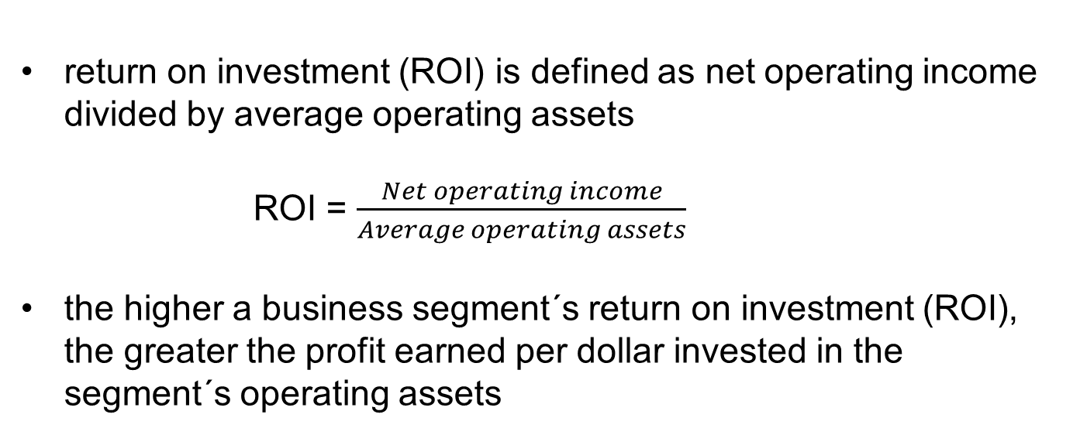
PERFORMANCE MEASUREMENT IN DECENTRALIZED ORGANIZATIONS
THE RETURN ON INVESTMENT (ROI) FORMULA
return on investment (ROI) is defined as net operating income divided by average operating assets
ROI = $\frac{Net operating income}{Average operating assets}$
the higher a business segment´s return on investment (ROI), the greater the profit earned per dollar invested in the segment´s operating assets

Slide 15
PERFORMANCE MEASUREMENT IN DECENTRALIZED ORGANIZATIONS
NET OPERATING INCOME AND OPERATING ASSETS DEFINED (1)
net operating income, rather than net income, is used in the ROI formula
net operating income is income before interest and taxes and is sometimes referred to as EBIT (earnings before interest and taxes)
net operating income is used in the formula because the base (denominator) consist of operating assets
to be consistent, we use net operating income in the numerator

Slide 16
PERFORMANCE MEASUREMENT IN DECENTRALIZED ORGANIZATIONS
NET OPERATING INCOME AND OPERATING ASSETS DEFINED (2)
operating assets include cash, accounts receivable, inventory, plant and equipment, and all other assets held for operating purposes
examples of assets that are not included in operating assets include land held for future use, an investment in another company, or a building rented to someone else
these assets are not held for operating purposes and therefore are excluded from operating assets
the operating assets base used in the formula is typically computed as the average of the operating assets between the beginning and the end of the year

Slide 17
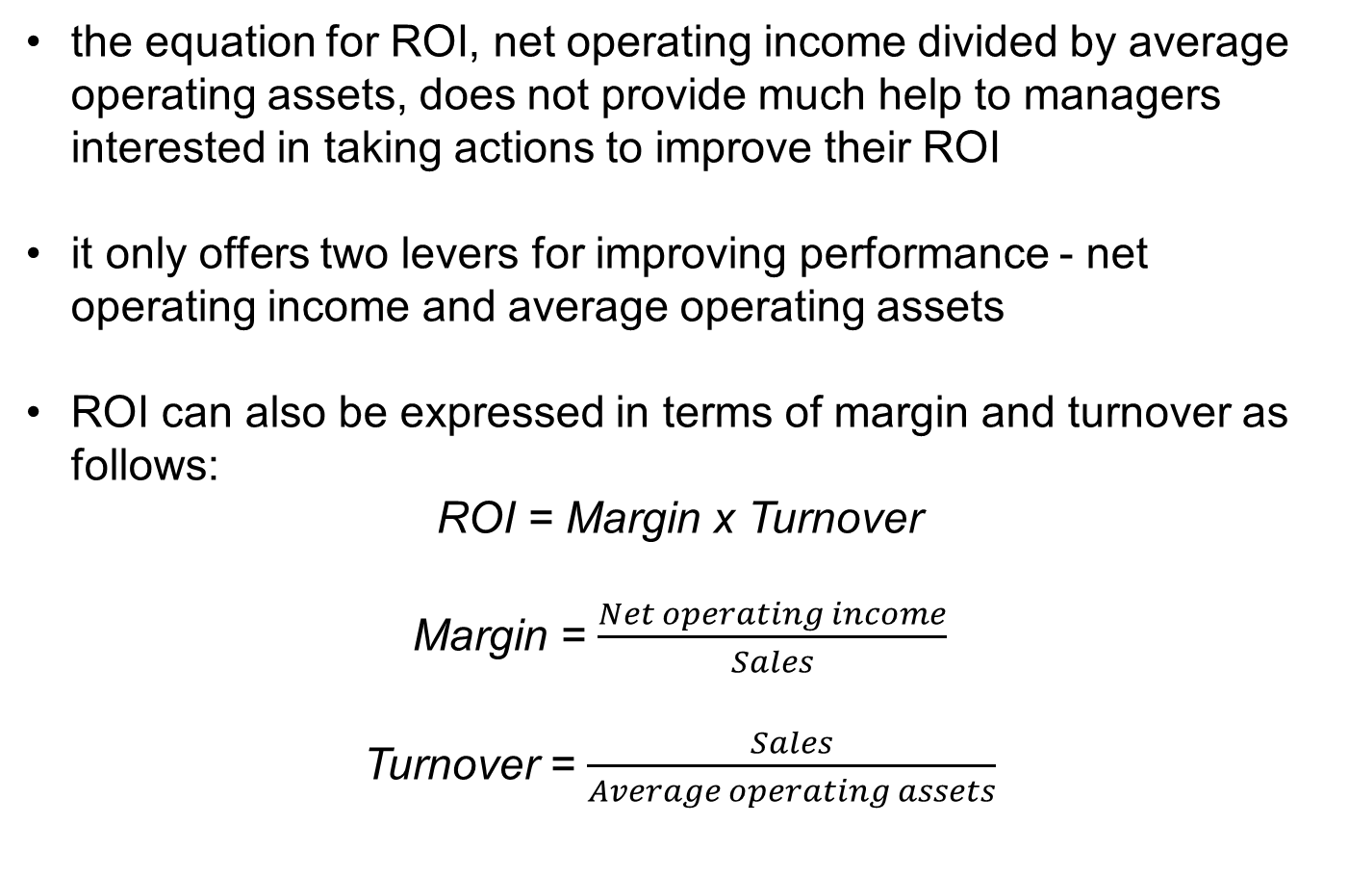
PERFORMANCE MEASUREMENT IN DECENTRALIZED ORGANIZATIONS
UNDERSTANDING ROI
the equation for ROI, net operating income divided by average operating assets, does not provide much help to managers interested in taking actions to improve their ROI
it only offers two levers for improving performance - net operating income and average operating assets
ROI can also be expressed in terms of margin and turnover as follows:
ROI = Margin x Turnover
Margin = $\frac{Net operating income}{Sales}$
Turnover = $\frac{Sales}{Average operating assets}$

Slide 18
PERFORMANCE MEASUREMENT IN DECENTRALIZED ORGANIZATIONS
CRITICISMS OF ROI (1)
although ROI is widely used in evaluating performance it is subject to the following criticisms:
just telling managers to increase ROI may not be enough. Managers may not know how to increase ROI; they may increase ROI in a way that is inconsistent wit the company´s strategy; or they may take actions that increase ROI in the short run but harm the company in the long run (such as cutting back on research and development). This is why ROI is best used as part of a balance scorecard. A balanced scorecard can provide concrete guidance to managers making it more likely that their actions are consistent with the company´s strategy and reducing the likelihood that they will boost short-run performance at the expense of long-term performance.

Slide 19
PERFORMANCE MEASUREMENT IN DECENTRALIZED ORGANIZATIONS
CRITICISMS OF ROI (2)
a manger who takes over a business segment typically inherits many committed costs over which the manager has no control. These committed costs may be relevant in assessing the performance of the business segment as an investment but they make it difficult to fairly assess the performance of the manager
a manager who is evaluated based on ROI may reject investment opportunities that are profitable for the whole company but would have a negative impact on the manager´s performance evaluation

Slide 20
PERFORMANCE MEASUREMENT IN DECENTRALIZED ORGANIZATIONS
RESIDUAL INCOME
residual income is another approach to measuring an investment center´s performance
residual income is the net operating income that an investment center earns above the minimum required return on its operating assets
in equation form, residual income is calculated as follows:
Residual income = Net operating income – (Average operating assets x Minimum required rate of return)

Slide 21
PERFORMANCE MEASUREMENT IN DECENTRALIZED ORGANIZATIONS
ECONOMIC VALUE ADDED (EVA)
economic value added (EVA) is an adaptation of residual income that has been adopted by many companies
under EVA, companies often modify their accounting principles in various ways
  for example, funds used for research and development are often treated as investments rather than as expenses
when residual income or EVA is used to measure performance, the objective is to maximize the total amount of residual income or EVA, not to maximize ROI - this is an important distinction
if the objective were to maximize ROI, then every company should divest all of its products except the single product with the highest ROI

Slide 22
PERFORMANCE MEASUREMENT IN DECENTRALIZED ORGANIZATIONS
MOTIVATION AND RESIDUAL INCOME AND ROI
generally, a manager who is evaluated based on ROI will reject any project whose rate of return in below the division´s current ROI even if the rate of return on the project is above the company´s minimum required rate of return
in contrast, managers who are evaluated using residual income will pursue any project whose rate of return is above the minimum required rate of return because it will increase their residual income
because it is in the best interests of the company as a whole to accept any project whose rate of return is above the minimum required rate of return, managers who are evaluated based on residual income will tend to make better decisions concerning investment projects than managers who are evaluated based on ROI

Slide 23
PERFORMANCE MEASUREMENT IN DECENTRALIZED ORGANIZATIONS
DELIVERY CYCLE TIME
the amount of time from when a customer order is received to when the completed order is shipped is called delivery cycle time
this time is an important concern to many customers, who would like the delivery cycle time to be as short as possible
cutting the delivery cycle time may give a company a key competitive advantage - and may be necessary for survival
the formula for computing delivery cycle time is as follows:
Delivery cycle time = Wait time + Throughput time

Slide 24
PERFORMANCE MEASUREMENT IN DECENTRALIZED ORGANIZATIONS
THROUGHPUT (MANUFACTURING CYCLE) TIME (1)
the amount of time required to turn raw materials into completed products is called throughput time, or manufacturing cycle time
the throughput time, or manufacturing cycle time, is made up of process time, inspection time, move time, and queue time
  process time is the amount of time work is actually done on the product
  inspection time is the amount of time spent ensuring that the product is not defective
  move time is the time required to move materials or partially completed products from workstation to workstation
  queue time is the amount of time a product spends waiting to be worked on, to be moved, to be inspected, or to be shipped

Slide 25
PERFORMANCE MEASUREMENT IN DECENTRALIZED ORGANIZATIONS
THROUGHPUT (MANUFACTURING CYCLE) TIME (2)
only one of these four activities adds value to the product – process time
the other three activities - inspecting, moving, and queuing - add no value and should be eliminated as much as possible
the formula for computing throughput (manufacturing cycle) time is as follows:
Throughput (manufacturing cycle) time = Process time + Inspection time + Move time + Queue time

Slide 26
PERFORMANCE MEASUREMENT IN DECENTRALIZED ORGANIZATIONS
MANUFACTURING CYCLE EFFICIENCY (MCE) (1)
through concerted efforts to eliminate the on-value-added activities of inspecting, moving, and queuing, some companies have reduced their throughput time to only a fraction of previous levels
in turn, this has helped to reduce the delivery cycle time from months to only weeks or hours
throughput time, which is a key measure in delivery performance, can be put into better perspective by computing the manufacturing cycle efficiency (MCE)
the MCE is computed by relating the value-added time to the throughput time

Slide 27
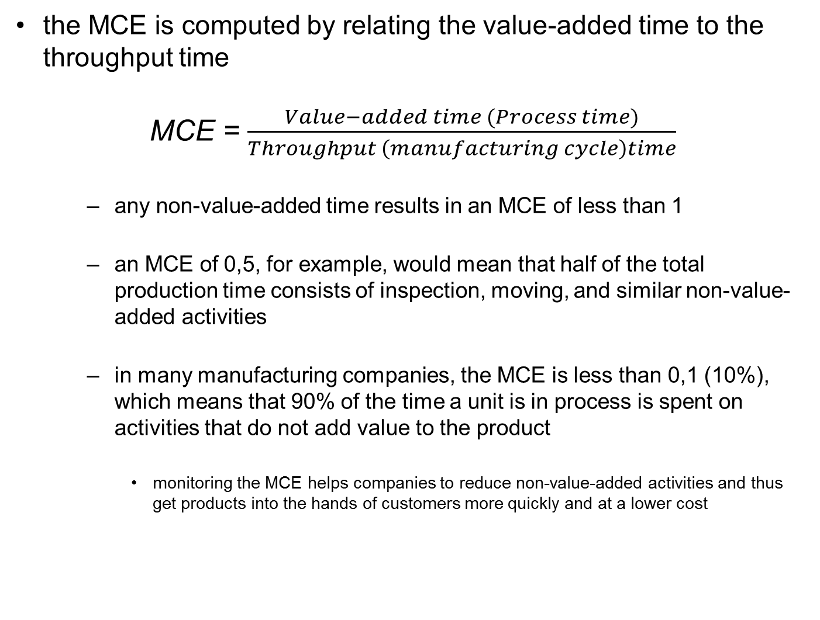
PERFORMANCE MEASUREMENT IN DECENTRALIZED ORGANIZATIONS
MANUFACTURING CYCLE EFFICIENCY (MCE) (2)
the MCE is computed by relating the value-added time to the throughput time
MCE = $\frac{Value−added time (Process time)}{Throughput \left(manufacturing cycle\right)time}$
  any non-value-added time results in an MCE of less than 1
  an MCE of 0,5, for example, would mean that half of the total production time consists of inspection, moving, and similar non-value-added activities
  in many manufacturing companies, the MCE is less than 0,1 (10%), which means that 90% of the time a unit is in process is spent on activities that do not add value to the product
    monitoring the MCE helps companies to reduce non-value-added activities and thus get products into the hands of customers more quickly and at a lower cost

Slide 28
PERFORMANCE MEASUREMENT IN DECENTRALIZED ORGANIZATIONS
BALANCED SCORECARD
financial measures, such as ROI and residual income, and operating measures, may be included a balanced scorecard
a balanced scorecard consists of an integrated set of performance measures that are derived from and support a company´s strategy
a strategy is essentially a theory about how to achieve the organization´s goals
under the balanced scorecard approach top management translates its strategy into performance measures that employees can understand and influence

Slide 29
PERFORMANCE MEASUREMENT IN DECENTRALIZED ORGANIZATIONS
COMMON CHARACTERISTICS OF BALANCED SCORECARDS (1)
Performance measures used in balanced scorecards tend to fall into the four groups:
financial
customer
internal business process
learning and growth
internal business processes are what the company does in an attempt to satisfy customers
  for examples, in a manufacturing company, assembling a product is an internal business process

Slide 30
PERFORMANCE MEASUREMENT IN DECENTRALIZED ORGANIZATIONS
COMMON CHARACTERISTICS OF BALANCED SCORECARDS (2)
the emphasis is on improvement - not on just attaining some specific objective (such as profits of $10 million)
in the balanced scorecard approach, continual improvement is encouraged
if an organization does not continually improve, it will eventually lose out to competitors that do

