Slide 1

Linear Programming II
Ing. Radomír Perzina, Ph.D.
Operational Analysis for Economists
INMBAOAE

Slide 2
Outline of the lecture
Transform the economical model to the mathematical model
Compounds of mathematical model
Basic terms concerning the Linear Programming (LP)
Graphically depict the set of feasible solutions of the LP problem with two variables
Solving the LP problem

Slide 3
Solution of LP tasks
Simplex method
Described by G. Danzig in 1950s
In mathematical optimization, Dantzig's simplex algorithm (or simplex method) is a popular algorithm for linear programming.
The algorithm needs constraints in equational forms

Slide 4
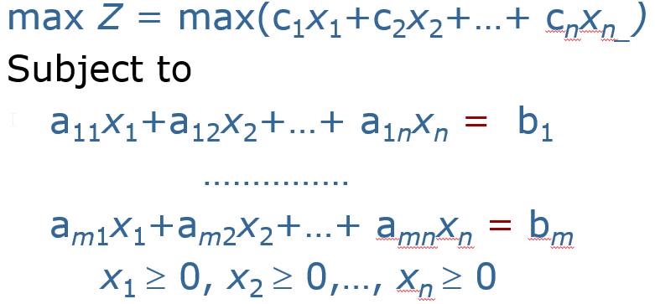
Simplex algorithm
The simplex algorithm operates on linear programs in standard form:

Slide 5
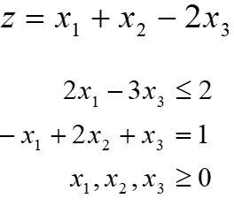
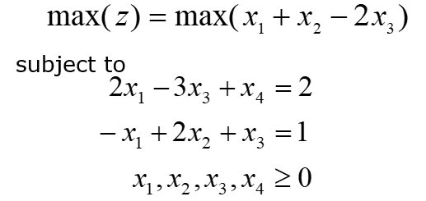
Example
Maximize
Transform to the linear problem into standard form:

Slide 6
Standard form
All constraints are transformed to equalities; therefore they are in a form:
Where a^{i} are row vectors of the matrix A (composed from structural coefficients).
a¹x₁ + a²x₂ +...+ a^{n}x_{n} = b

Slide 7
Example
From the problem
Describe matrix A and vectors a^{i} .

Slide 8
Solution
Constraints:
Matrix of structural coefficients (LHS):

Slide 9
Basic (base) solution of LP
Feasible solution x = (x₁,x₂,…,x_{n}) of the LP problem is called base solution under the condition that vectors a^{i} of matrix A from a respective elements x_{i} are creating a set of linear independent set of vectors.
Should be a feasible solution of the LP problem; that means vector x = (x₁,x₂,…,x_{n}) satisfies all constraint conditions
Vectors ai of the matrix A of respective positive elements x_{i} are linear independent
Maximal number of positive elements x = (x₁,x₂,…,x_{n}) is m (all above this number are zero)
Geometric explanation of the base solution: intersection of bounded polyhedron of the set of all feasible solutions.

Slide 10
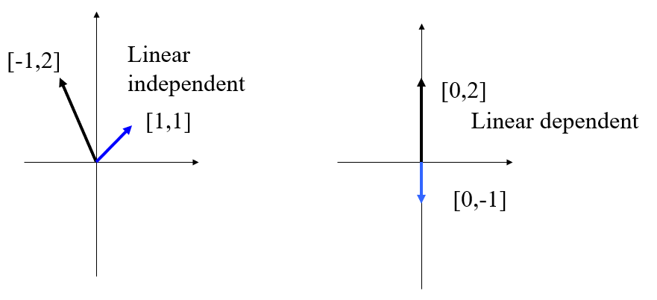
Linear dependent and independent vectors in two-dimensional space

Slide 11
Maximal number of base solutions of a LP problem
When m ≤ n, then the number of all base solutions will be max
When m > n, then the number of all base solutions will be max

Slide 12
Example
Maximize
Additional variable x₄:

Slide 13
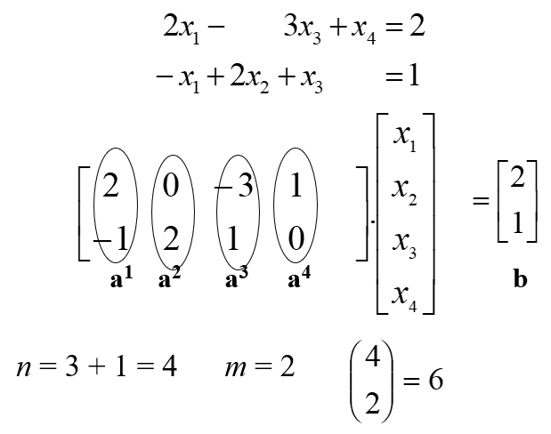
Example (cont)

Slide 14
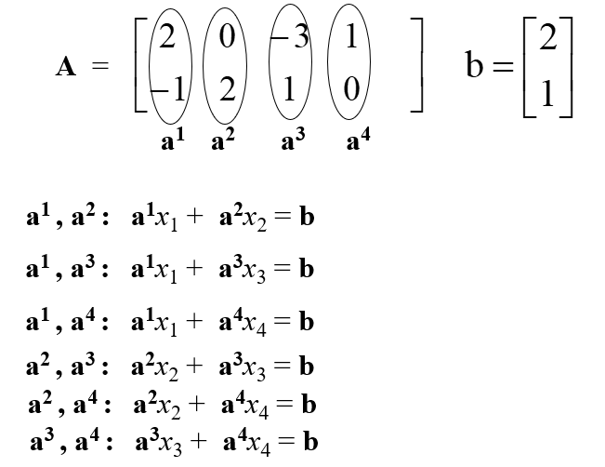
Example (cont)

Slide 15
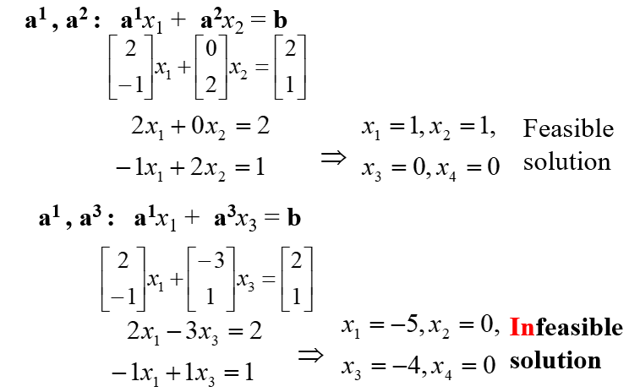
Example (cont)

Slide 16
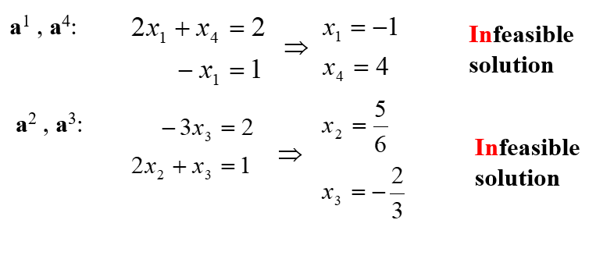
Example (cont)

Slide 17
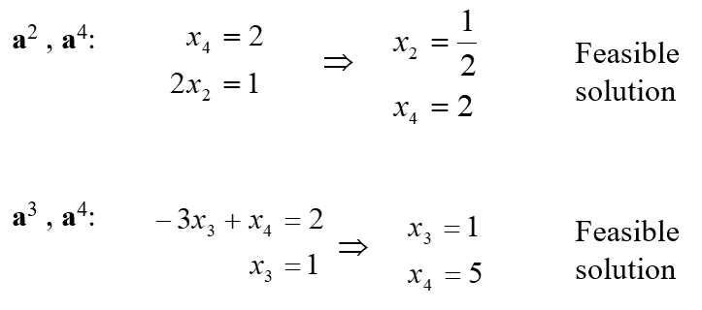
Example (cont)

Slide 18
Example (cont)
Result:
There are only 3 feasible base solutions out of 6 theoretically possible base solutions.

Slide 19
Fundamental theorem of linear programming
Fundamental theorem of linear programming, in a weak formulation, states that the maxima and minima of a linear function over a convex polygonal region occur at the region's corners. Further, if an extreme value occurs at two corners, then it must also occur everywhere on the line segment between them.

Slide 20
How to use the calculated base solutions?
Fundamental theorem of LP:
Among all feasible base solutions of the LP problem there exists an optimal solution.
Implication:
The LP problem can be solved by choosing the base solution with the highest value of the objective function = optimal solution.

Slide 21
Problems connected with LP
How to find all base solutions?
Possible huge amount of base solutions
n=100, m=50, ≈10³⁰
If 1 base solution takes computer time 10⁻¹⁰ s., then looking up 10³⁰ base solutions would take about 90 000 years!)
Better method: Simplex method
(G. Danzig, 1950s)

Slide 22
Principles of simplex metod
x^{(opt)}
Increase of objective function
x⁽³⁾
x⁽²⁾
x⁽¹⁾

Slide 23
Algorithm of the simplex method
Z
Starting Base Solution
Is the solution optimal?
Yes
End
No
Set a way of improvement
Transformation of imprvement

Slide 24
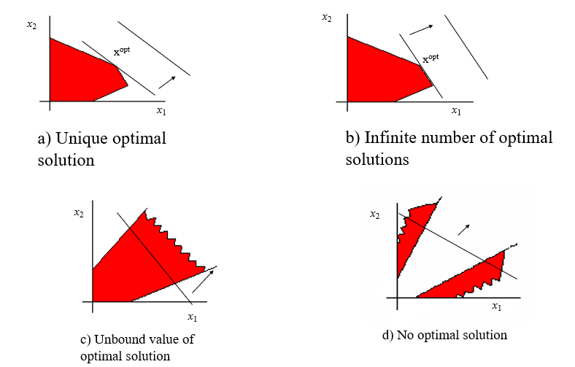
Types LP problem solution

Slide 25
To remember
base solution
linear independent vectors
fundamental theorem of LP
simplex method
algorithms of the simplex method
types of LS optimal solutions

Slide 26
Thank you for your attention

