Slide 1

Applications of Linear Programming I
Ing. Radomír Perzina, Ph.D.
Operational Analysis for Economists
INMBAOAE

Slide 2
Outline of the lecture
Product mix problem
Cutting problem
Interpretation of the results

Slide 3
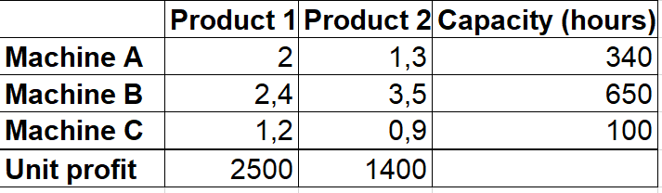
The Product Mix Problem
The company produces 2 products. For each one 3 machines are necessary, with working time in the table.
Calculate how many pieces of product 1 and 2 should the company produce in order to maximize profit.
Notice: Produced number of pieces of each product must be integer.

Slide 4
The Product Mix Problem – Mathematical Model
z = 2500x₁ + 1400x₂ → max
Subject to
2x₁ + 1.3x₂ ≤ 340
2.4x₁ + 3.5x₂ ≤ 650
1.2x₁ + 0.9x₂ ≤ 100
x₁, x₂ ≥ 0
x₁, x₂ – integer

Slide 5
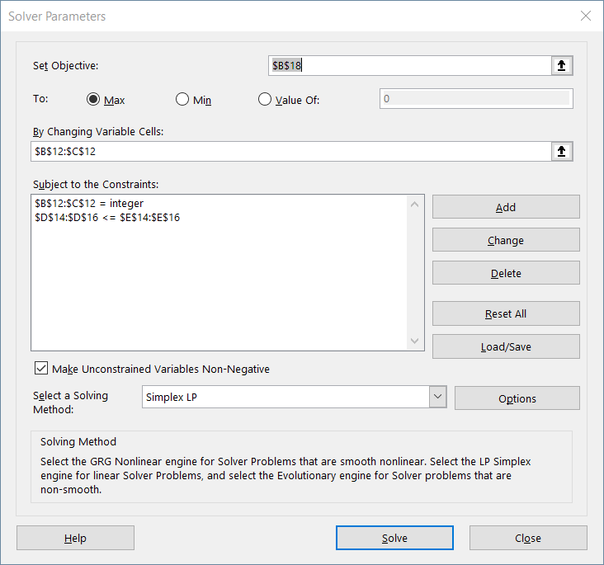
The Product Mix Problem – Solver Parameters

Slide 6
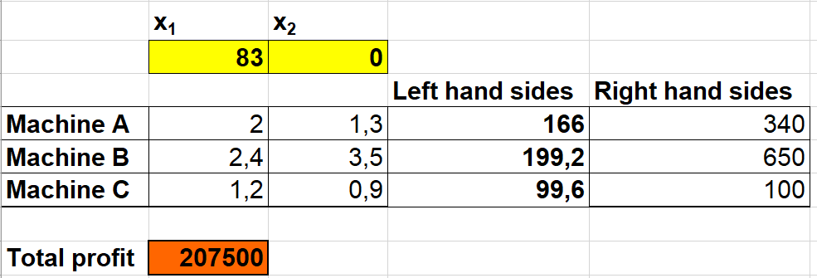
The Product Mix Problem - Solution

Slide 7
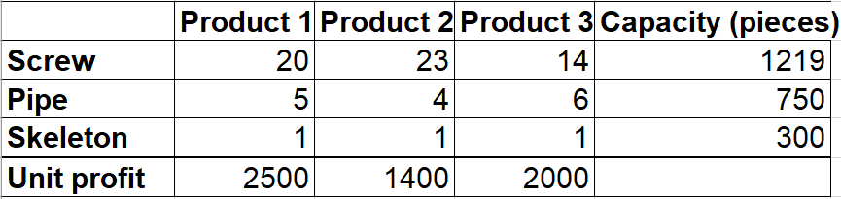
The Product Mix Problem 2
Company XYZ produces 3 products. Each product is composed of 3 compositions as written in the table.
Calculate how many pieces of each product should the company produce in order to maximize profit.
Notice: Produced number of pieces of each product must be integer.

Slide 8
The Product Mix Problem 2 – Mathematical Model
z = 2500x₁ + 1400x₂ + 2000x₃ → max
Subject to
20x₁ + 23x₂ + 14x₃ ≤ 1219
5x₁ + 4x₂ + 6x₃ ≤ 750
x₁ + x₂ + x₃ ≤ 300
x₁, x₂ , x₃ ≥ 0
x₁, x₂, x₃ – integer

Slide 9

The Product Mix Problem 2 – Solver Parameters

Slide 10
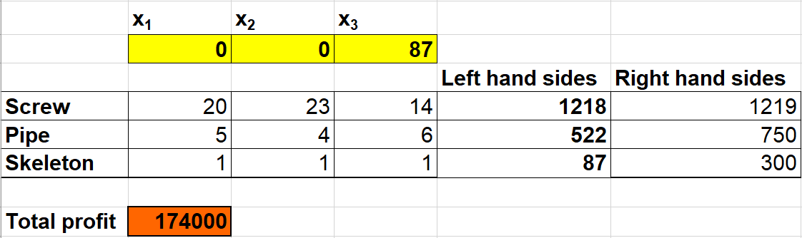
The Product Mix Problem 2 - Solution

Slide 11
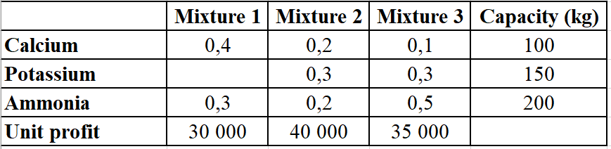
The Product Mix Problem 3
Company ABC produces 3 mixtures. Each mixture is composed of 3 compositions as written in the table.
Calculate how much of each mixture should the company produce in order to maximize profit.

Slide 12
The Product Mix Problem 3 – Mathematical Model
z = 30000x₁ + 40000x₂ + 35000x₃ → max
Subject to
0.4x₁ + 0.2x₂ + 0.1x₃ ≤ 100
0.3x₂ + 0.3x₃ ≤ 150
0.3x₁ + 0.2x₂ + 0.5x₃ ≤ 200
x₁, x₂ , x₃ ≥ 0

Slide 13
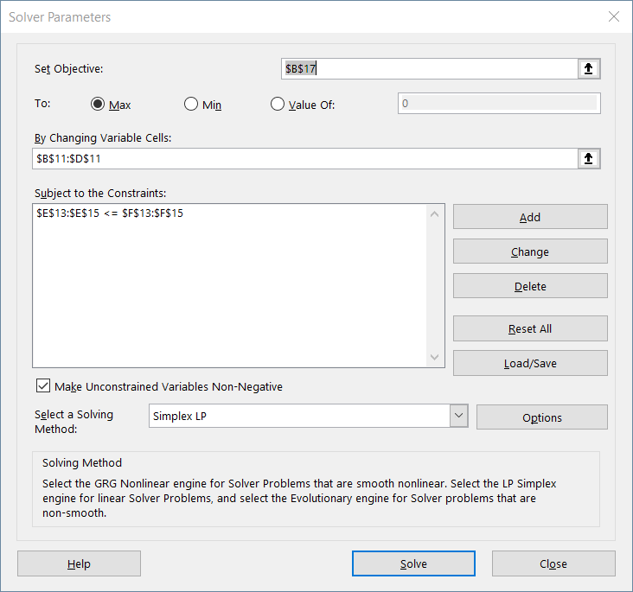
The Product Mix Problem 3 – Solver Parameters

Slide 14
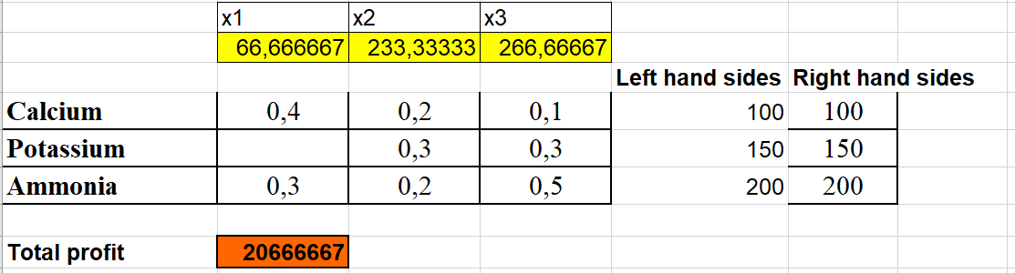
The Product Mix Problem 3 - Solution

Slide 15
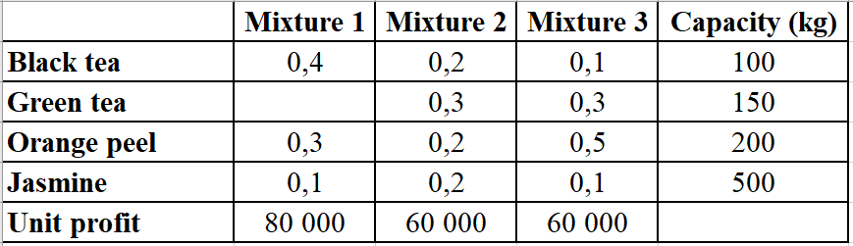
The Product Mix Problem 4
Company XYZ produces 3 tea mixtures. Each mixture is composed of 3 substances as written in the table.
Calculate how much of each tea mixture should the company produce in order to maximize profit.

Slide 16
The Product Mix Problem 4 – Mathematical Model
z = 80000x₁ + 60000x₂ + 60000x₃ → max
Subject to
0.4x₁ + 0.2x₂ + 0.1x₃ ≤ 100
0.3x₂ + 0.3x₃ ≤ 150
0.3x₁ + 0.2x₂ + 0.5x₃ ≤ 200
0.1x₁ + 0.2x₂ + 0.1x₃ ≤ 500
x₁, x₂ , x₃ ≥ 0

Slide 17

The Product Mix Problem 4 – Solver Parameters

Slide 18
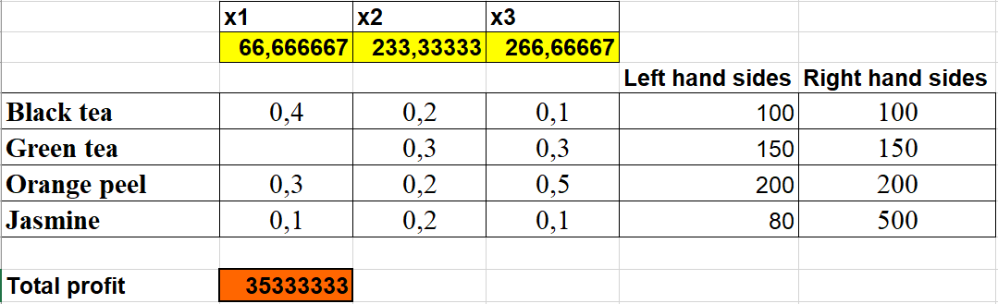
The Product Mix Problem 4 - Solution

Slide 19
The Cutting Problem
The company produces steel pipes of constant length 12m. The company has obtained a special demand for pipes of these lengths and numbers.
1300 pieces of length 8m,
600 pieces of length 6m,
2000 pieces of length 4m.

Slide 20
The Cutting Problem
How to cut the pipes in order to the number of the original pipes were minimal. For simplicity suppose that there is no lost of material when cutting a pipe.
Make the cutting plan that minimize the waste of material.
Compare both optimal cutting plans.

Slide 21
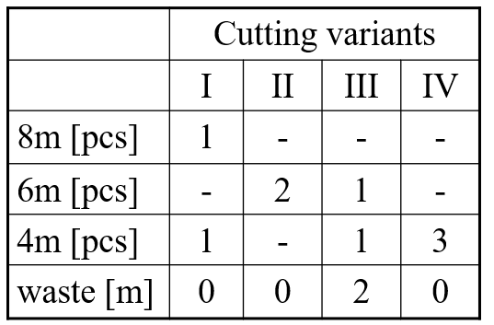
The Cutting Problem Solving
Find all possibilities of cutting the original 12m pipes:

Slide 22
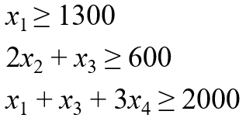
The Cutting Problem Solving
Variables x_{i} express the numbers of pieces cut by i^{th} variant → x_{i} must be nonnegative and integer.
The constraints must satisfy production of desired number of pipes, i.e. 1300, 600 a 2000 pieces.

Slide 23
The Cutting Problem Solving
The objective function:
1st task: minimization the number of used pipes
z = x₁ + x₂ + x₃ + x₄
2nd task: minimization the waste
z = 2x₃
3rd task: compare the results

Slide 24
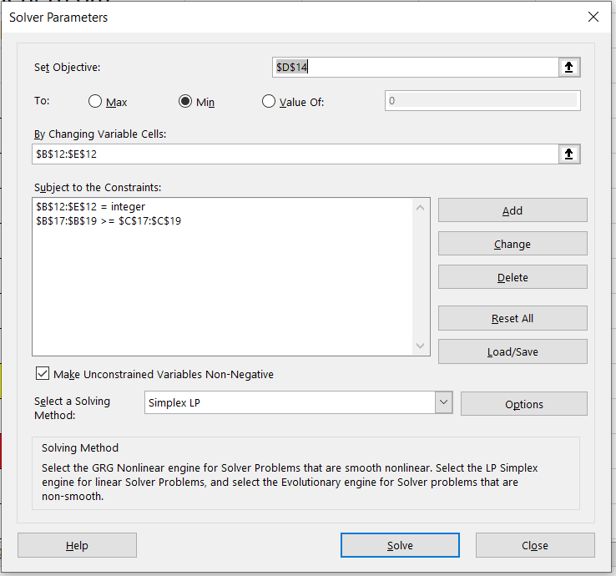
The Cutting Problem Solver Parameters

Slide 25
The Cutting Problem Solution
1st task: x₁ = 1300, x₂ = 300, x₃ = 0, x₄ = 234,
z = 1834, i.e. 1300 pieces cut by the 1st variant, 300 pieces cut by the 2nd variant and 234 pieces cut by the 4th variant, together 1834 pieces.
2nd task: only variants x₁, x₂, x₄ will be used and the problem has infinity number of optimal solutions.
3rd task: different objective functions → different optimal solutions

Slide 26
To remember
Product mix problem
Cutting problem
Objective function
Constraints
Conditions of non-negativity

Slide 27
Thank you for your attention

