Slide 1
Applications of Linear Programming II
Ing. Radomír Perzina, Ph.D.
Operational Analysis for Economists
INMBAOAE

Slide 2
Outline of the lecture
Nutrition problem
Portfolio problem
Investment problem
Interpretation of the results

Slide 3
The Nutrition Problem
Daily meal for a person should contain at least 8000 kJ of energy, 80 g of proteins, 15 mg ferrum and 200 mg vitamin C. There are 4 kinds of food available. Their composition as well as price per 100g is given in the table.

Slide 4
The Nutrition Problem – Solving
Variables x_{j}, j = 1,2,3,4 – the amount of food (pork, bread, potatoes, apples) x₁, x₂, x₃, x₄ ≤ 0
Constraints – requirements for the energy and composition of elements.

Slide 5
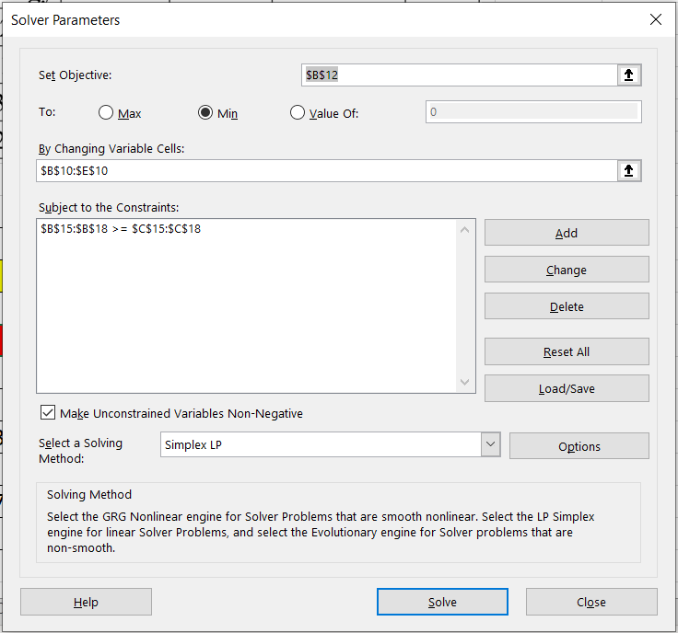
The Nutrition Problem – Solver Parameters

Slide 6
The Nutrition Problem – Solving
Goal: The cheapest structure of daily meal - the objective function:
minimize
The optimal solution: x₁= 2.609, x₂= 0, x₃= 20, x₄= 0, z = 43.91

Slide 7
The Nutrition Problem 2
Daily feeding for a cow should contain at least 60000 kJ of energy, 5.4 kg of proteins, 3.3 kg fat and 6.7 kg fiber.
There are 3 kinds of feeding available. Their composition as well as price per kg is given in the table.
Find the cheapest daily mixture for cow.

Slide 8
The Nutrition Problem 2 – Mathematical Model
z = 11x₁ + 19x₂ + 29x₃ → min
Subject to
3000x₁ + 7500x₂ + 12300x₃ ≥ 60000
0.2x₁ + 0.3x₂ + 0.4x₃ ≥ 5.4
0.1x₁ + 0.2x₂ + 0.5x₃ ≥ 3.3
0.4x₁ + 0.9x₂ + 0.6x₃ ≥ 6.7
x₁, x₂ , x₃ ≥ 0

Slide 9
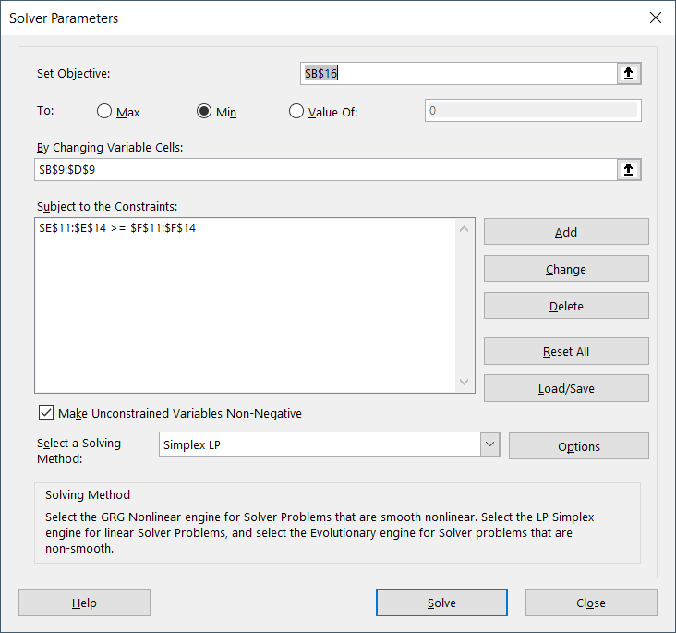
The Nutrition Problem 2 – Solver Parameters

Slide 10
The Nutrition Problem 2 - Solution

Slide 11
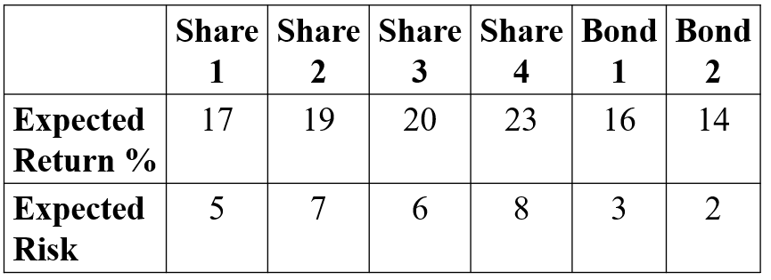
The Portfolio Problem
You want to invest 1mil. Euro on the stock market. You have selected shares of 4 companies and 2 bonds. These shares are characterized by the expected return and the risk.

Slide 12
The Portfolio Problem
Your investment strategy suppose that:
To each share or bond invest at least 5% of the whole amount.
To bonds invest at least 30% of the whole amount.
Weighted sum of the risk must be less then 6.
Task:
Find optimal structure of the portfolio to maximize the expected return of the portfolio such that all constraints of the investment strategy are satisfied.

Slide 13
The Portfolio Problem – Solving
Variables a1, a2, a3, a4, o1, o2, - amount invested to shares 1, 2, 3 and 4 and bonds 1 and 2.
Goal – maximize expected return → the objective function:
maximize

Slide 14
The Portfolio Problem – Solving
Constraints:
Available 1 mil. Euro:
a1 + a2 + a3 + a4 + o1 + o2 = 1 000 000
To each share or bond invest at least 5%:
a1,a2,a3,a4,o1,o2 ≥ 0,05·1 000 000
To bonds invest at least 30% :
o1 + o2 ≥ 0,3·1 000 000

Slide 15
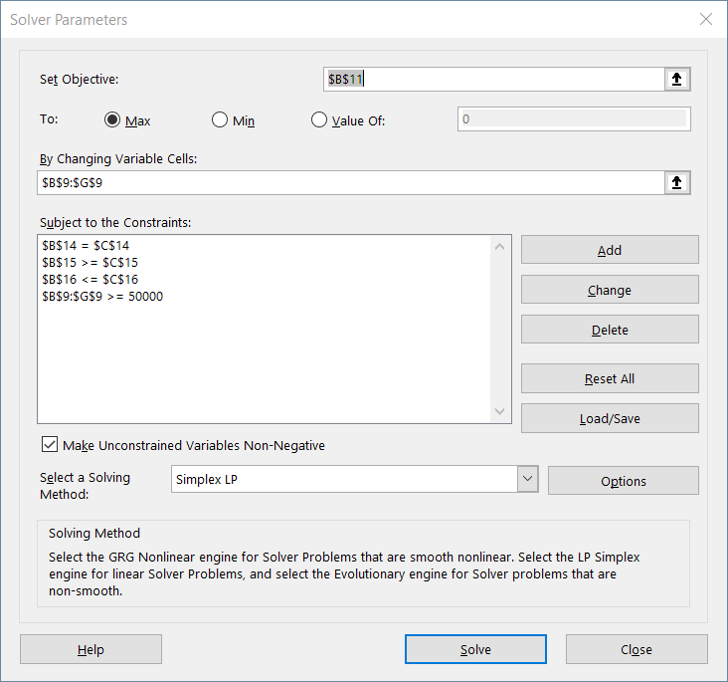
The Portfolio Problem – Solver Parameters

Slide 16
The Portfolio Problem – Solution
The risk of the portfolio must be less or equal than 6:
(5a1 + 7a2 + 6a3 + 8a4 + 3o1 + 2o2 ) / 1 000 000 ≤ 6
The optimal solution:
a1 = a2 = a3 = 50 000, a4 = 520 000, o1=280 000 , o2 = 50 0 00, z = 199 400.

Slide 17
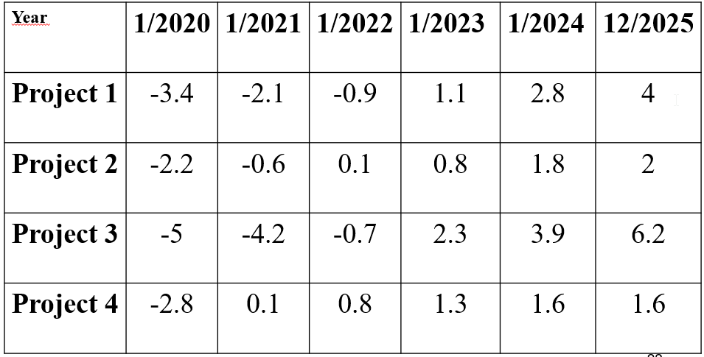
The Investment Problem
The company management wants to invest 10mil Euro. The amount can be invested to the bank account with fixed interest rate of 6% or it can be invested to four financial projects with 5 years investment horizon. The cost and revenue of the projects are summarized in the table.

Slide 18
The Investment Problem
Task:
Suggest the invest strategy in order to maximize the total amount at the end of the investment period.

Slide 19
The Investment Problem – Solving
Investing to all project requires 13.4 mil. Euro.
Available only 10 mil. Euro → partial investing (e.g. 10% participation means 10% of investment costs and 10% of revenues).
Variables x1, x2, x3, x4 – ratio of participation on projects 1, 2, 3 a 4:
0 ≤ x1, x2, x3, x4 ≤ 1

Slide 20
The Investment Problem – Solving
Constraints – balance of cost and available amount.
Year 2020 - 10 mil. Euro available
3.4x1 + 2.2x2 + 5x3 + 2.8x4 ≤ 10
Note. p1 as amount invested to the bank account:
3.4x1 + 2.2x2 + 5x3 + 2.8x4 + p1 = 10
Year 2021 – available the amount from the bank account increased by the interest, i.e. 1.06p1 and revenues from the 4th project
2.1x1 + 0.6x2 + 4.2x3 + p2 = 0.1x4 + 1.06p1

Slide 21
The Investment Problem – Solving
Year 2022:
0.9x1 + 0.7x3 + p3 = 0.1x2 + 0.8x4 + 1.06p2
Year 2023:
p4 = 1.1x1 + 0.8x2 + 2.3x3 + 1.3x4 + 1.06p3
Year 2024:
p5 = 2.8x1 + 1.8x2 + 3.9x3 + 1.6x4 + 1.06p4
p1, p2 , p3 , p4 , p5 ≥ 0

Slide 22
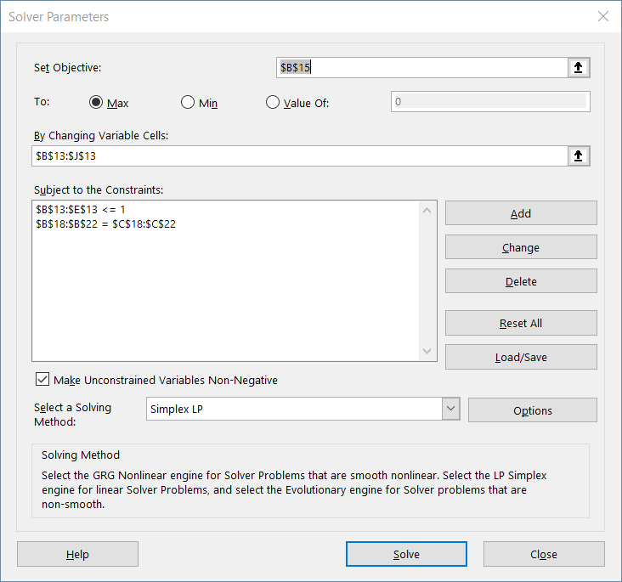
The Investment Problem – Solver Parameters

Slide 23
The Investment Problem – Solving
Goal: maximize the amount at the end of 5 year investment period
Objective function:
maximize
4x1 + 2x2 + 6.2x3 + 1.6x4 + 1.06p5
Optimal solution:
x1= x3= 0, x2= x4= 1, p1= 5, p2= 4.8, p3= 5.99, p4= 8.45, p5= 12.35, z = 23.367.

Slide 24
To remember
Nutrition problem
Investment problem
Portfolio problem

Slide 25
Questions
Do you know any real-life applications of a cutting problem?
What represent variables in a nutrition problem?

Slide 26
Thank you for your attention

