Slide 1

Duality in Linear Programming
Ing. Radomír Perzina, Ph.D.
Operational Analysis for Economists
INMBAOAE

Slide 2
Outline of the lecture
Definition
Symmetric duality
Asymmetric duality
Relationship between the primal and the dual problem
Interpretation
Stability intervals

Slide 3
Duality in the linear programming problems
Mutual defined relation between two linear programming problems.
Every linear programming problem is connected by so-called „shadow prices“ with another linear programming problem. The original problem is called a primal problem; the connected problem is called a dual problem.

Slide 4
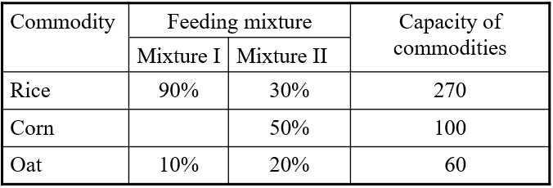
Example
The firm plan production of two kinds of feeding mixtures. The capacity of rice is 270 tons, corn 100 tons and oat 60 tons. It is necessary to abide the ratio of the compounds according to the following table:
The profit from selling 1 ton of mixture I is 2000 Euro and for the mixture II the profit is 3000 Euro/t. How much of each mixture should the firm produce to maximize the profit?

Slide 5
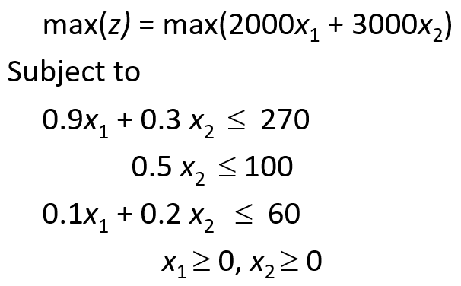
Example – mathematical model

Slide 6
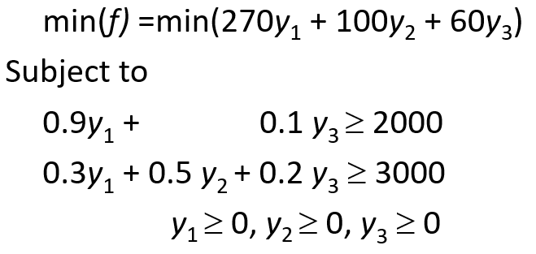
Example – dual model

Slide 7
Duality as a relation between two linear programming models
Duality = precisely defined mutual relationship between two problems of linear programming.
Every linear programming problem, referred to as a primal problem, can be converted into a dual problem (thus there are always two symmetric problems).
The dual of a dual linear program is the original primal linear program.
The form of a dual problem depends on the form of primal problem – symmetric and asymmetric duality

Slide 8
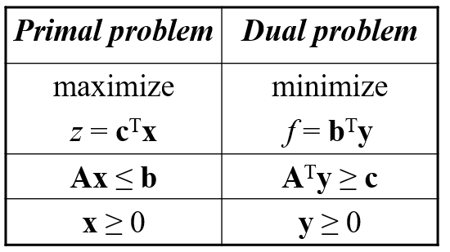
Symmetric duality – matrix form

Slide 9
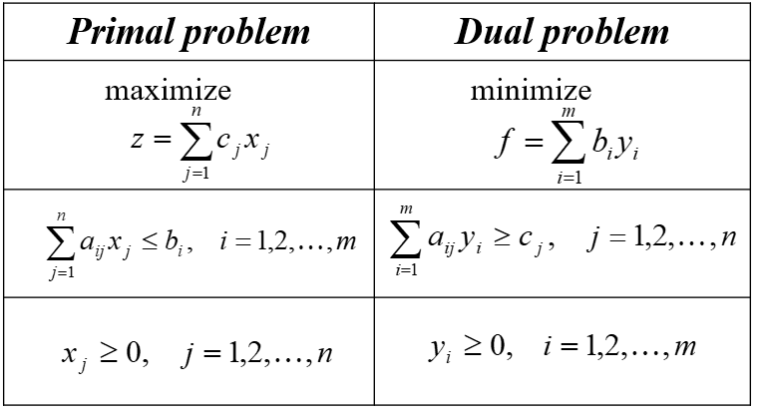
Symmetric duality – summation form

Slide 10
Symmetric duality – transformation
Maximization of the objective function transforms into the minimization and vice versa,
One dual variable is assigned to each primal problem constraint (variables y_{i}, i = 1,2,…,m , and condition y_{i} ≥ 0),
One dual constraint is assigned to each primal problem variable x_{j}, j = 1,2,…,n,

Slide 11
Symmetric duality – transformation
Matrix of structural coefficients of the dual problem is equal to the transposed matrix of structural coefficients of the primal problem
This assures that all structural coefficients are used in both primal and dual problem
Right hand side dual model coefficients are equal to objective function coefficients of the primal problem and vice versa
Inequality signs change.

Slide 12
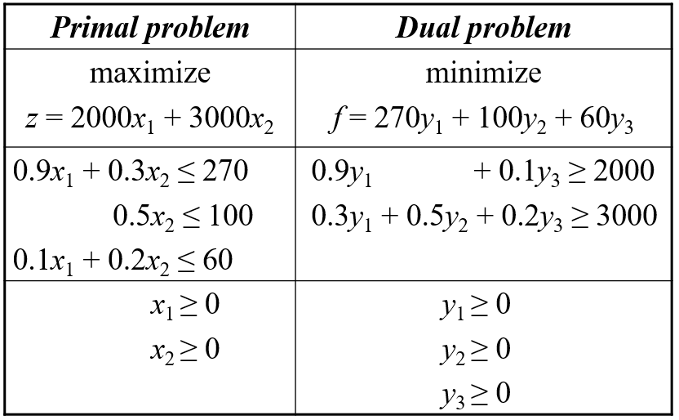
Symmetric duality – example

Slide 13
Asymmetric duality
Symmetric duality: primal function - maximization of the objective function and all constraints with inequality sign ≤ , as well as the nonnegativity conditions valid for all variables
Not the case of real linear programming problems

Slide 14
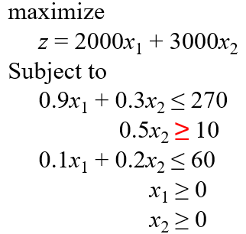
Asymmetric duality – Example 1
The second condition can be multiplied by -1, and the inequality can be changed into ≤
Then apply the symmetric duality

Slide 15
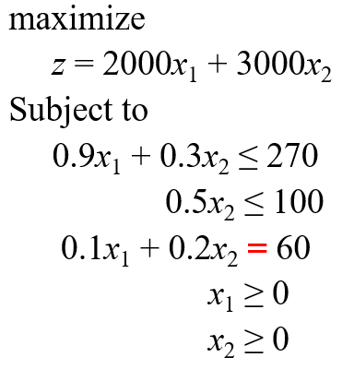
Asymmetric duality – Example 2

Slide 16
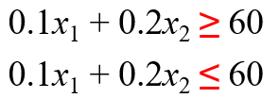

Asymmetric duality – Example 2
The third condition can be rewritten using two weak inequality conditions:
The first constraint can be multiplied by -1

Slide 17
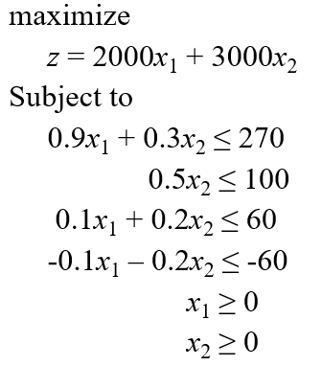
Asymmetric duality – Example 2
The primal problem was transformed into:
4 constraints - 4 dual variables y₁, y₂, y₃´, y₃´´

Slide 18
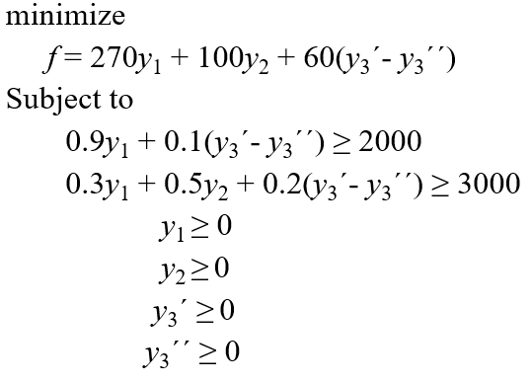
Asymmetric duality – Example 2
Dual problem:

Slide 19
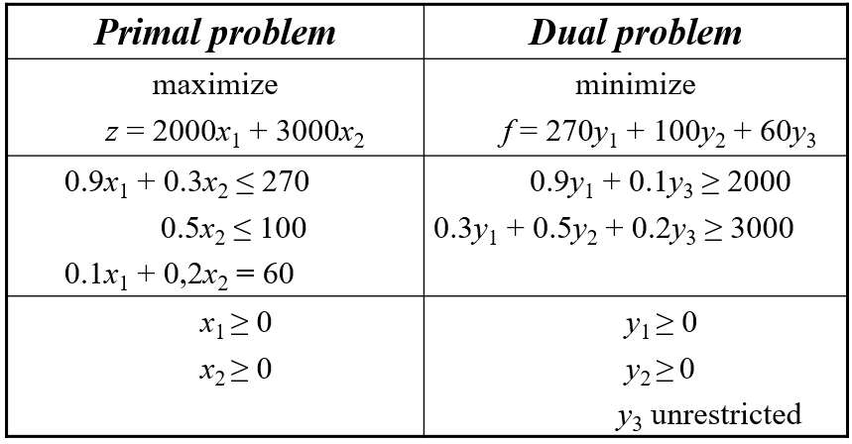
Asymmetric duality – Example 2
Let y₃ = y₃´- y₃´´ , then the dual problem can be simplified
Variable y₃ = y₃´- y₃´´ is not necessarily nonnegative

Slide 20
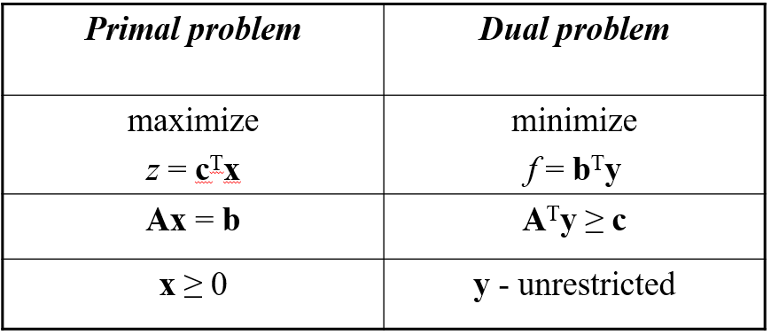
Asymmetric duality with equalities in constraints – matrix form

Slide 21
Relationship between the primal and the dual problem
The dual of a dual linear program is the original primal linear program.
If both primal and dual problems have feasible solution, then they have an optimal solution.
The value of the objective function for any feasible solution to the primal maximization problem is bounded from above by the value of the objective function for any feasible solution to its dual. Similarly, the value of the objective function for its dual is bounded from below by the value of the objective function of the primal:
c^{T}x ≤ b^{T}y.

Slide 22
Relationship between the primal and the dual problem
If x is a feasible solution to the primal problem and y is a feasible solution to the dual problem, and, further, c^{T}x = b^{T}y, then x is an optimal solution to the primal problem and y optimal solution to the dual problem.
If primal (or dual) problem has a feasible solution, but no optimal solution, then the corresponding dual (or primal) problem has no feasible solution.

Slide 23
Strong Duality Property
If the primal (dual) problem has a finite optimal solution, then so does the dual (primal) problem, and their values of optimal objective functions are equal.

Slide 24
Duality interpretation
x₁ amount of produced mixture I
x₂ amount of produced mixture II
z optimal profit, z = 1 020 000,-
b₁ disposable capacity of rice, b₁ = 270
b₂ disposable capacity of wheat, b₂ = 100
b₃ disposable capacity of oats, b₃ = 60
x* optimal production program x* = (240,180)
y* optimal solution of the dual problem:
y* = (2000/3;0;14000)

Slide 25
Duality interpretation
According to the strong duality property:
z = c^{T}x* = b^{T}y*,
z = 270·2000/3 + 100·0 + 60·14000 = 1020000.
Dual variables can be viewed as price of one unit of the source – so called „shadow prices“.
Marginal price of capacities, that means the highest price of the source suitable for increased profit „shadow price“

Slide 26
Complementary Slackness Property
If, in an optimal solution of a linear program, the value of the dual variable (shadow price) associated with a constraint is nonzero, then that constraint must be satisfied with equality.
Further, if a constraint is satisfied with strict inequality, then its corresponding dual variable must be zero.

Slide 27
Example 1
One unit of rice contributes to overall profit by the 666.67 Euro.
(y₁ = 2000/3 = 666.67)
y₂ = 0 means, that adding the second source (wheat) would not increase the profit.
How much increases the value of the objective function (profit), if the capacity of rice increases by 1?
Result: The objective function increase is given by the value of the respective dual variable y₁ = 2000/3.
y₂ = 0 - change in the second source has no influence on the profit . IS IT TRUE?!!!
If the capacity of wheat (2nd source) deeply decreased, it would be crucial to production of mixtures; thus the profit would decrease as well. → values of dual variables should be taken into account inside so-called stability intervals.

Slide 28
Stability intervals
Stability intervals (Excel Solver program):
Stability interval for b₁ - rice: [240;540]
Stability interval for b₂ - wheat: [90;∞]
Stability interval for b₃ - oats: [30;63.333]

Slide 29
Thank you for your attention

