Slide 1

Transportation Problem
Ing. Radomír Perzina, Ph.D.
Operational Analysis for Economists
INMBAOAE

Slide 2
Outline of the lecture
The economic model of transportation problem
Mathematical model of the transportation problem
Initial solution of the transportation problem
Problem solution

Slide 3
Definition
The basic transportation problem was originally developed by F.L. Hitchcockin 1941 in his study entitled “The distribution of a product from several sources to numerous locations”.
To find out optimum transportation schedule keeping in mind cost of transportation to be minimized.
The transportation problem is a special type of LPP where the objective is to minimize the cost of distributing a product from a number of sources or origins to a number of destinations.
Because of its special structure the usual simplex method is not suitable for solving transportation problems. These problems require special method of solution.

Slide 4
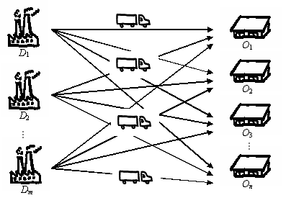
Transportation Problem

Slide 5
Economical and Mathematical Model of the Transportation Problem
The transportation problem elements:
m sources (depots, suppliers), denote S₁, S₂, …, S_{m}
n destinations (customers), denote D₁, D₂, …, D_{n}
Capacities of sources denote a₁, a₂, …, a_{m}
Demand of targets denote b₁, b₂, …, b_{n}
Costs of transporting one unit of goods from the source S_{i} to the destination D_{j} , denote c_{i,j}
Objective:
Find the volumes of shipments x_{i,j} between S_{i} a D_{j} to minimize the total transportation costs

Slide 6
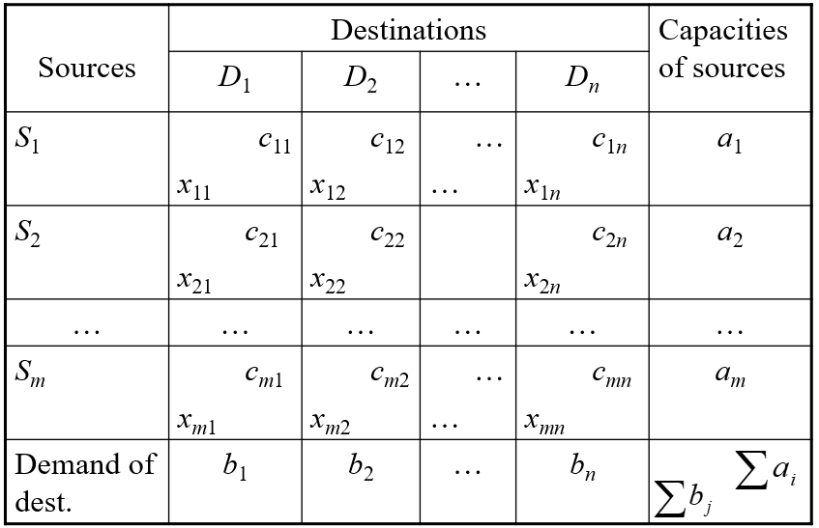
Economical and Mathematical Model of the Transportation Problem

Slide 7
Economical and Mathematical Model of the Transportation Problem
Balanced transportation problem
Unbalanced transportation problem
Every unbalanced TP is possible to transform to the balanced TP!

Slide 8
Balancing of the TP
Exceed of Supply:
Dummy destination D_{f}, with demand b_{f} which is equal the difference, i.e.
Exceed of Demand:
Dummy Source S_{f}, with capacity a_{f} which is equal the difference, i.e.

Slide 9
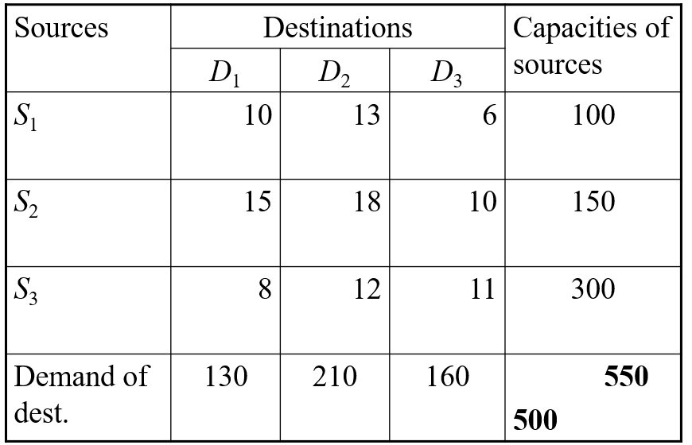
Balancing of the TP

Slide 10
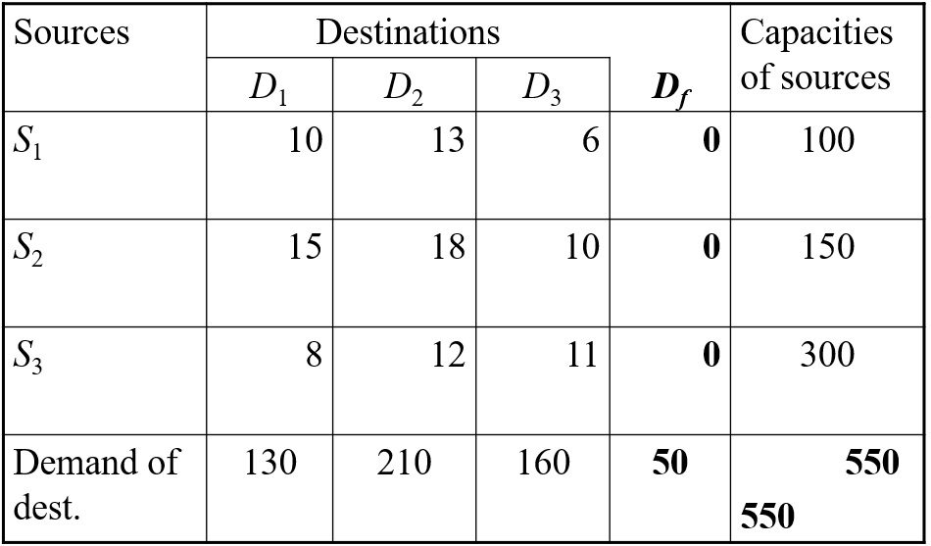
Balancing of the TP

Slide 11
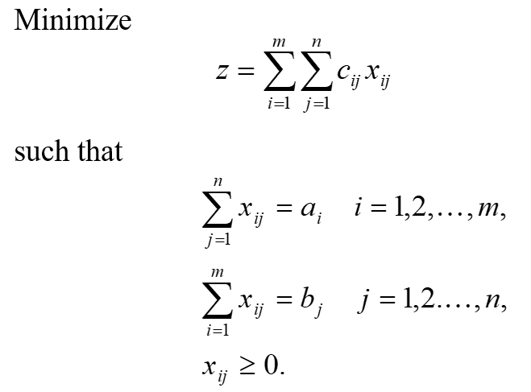
Mathematical Model of the balanced Transportation Problem

Slide 12
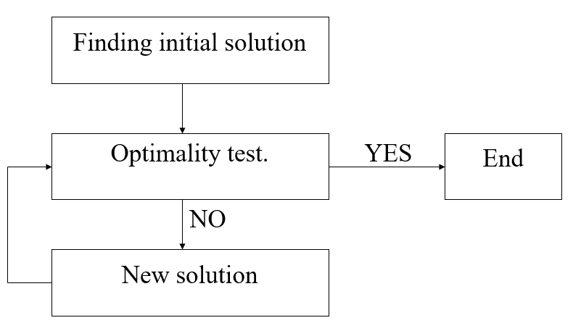
Solving of the Balanced TP

Slide 13
Finding an Initial Solution - Northwest Corner Method
Start at the cell in the upper left-hand corner of the transportation table for a shipment, i.e., cell (1,1).
Compare available supply and demand for this cell. Allocate smaller of the two values in this cell. Encircle this allocation. Reduce the available supply and demand by this vale.
Move to the next cell according to the following scheme:
  If the supply exceeds the demand, the next cell is the adjacent cell in the row, i.e., c(1,1) c(1,2).
  If the demand exceeds supply, the next cell is the adjacent cell in the column, i.e., c(1,1) c(2,1).
  If the demand equals supply, (in other words there is a tie) the next cell is the adjacent cell diagonally, i.e., c(1,1) c(2,2).
Return to step 1.
Repeat the process until all the supply and demand restrictions are satisfied

Slide 14
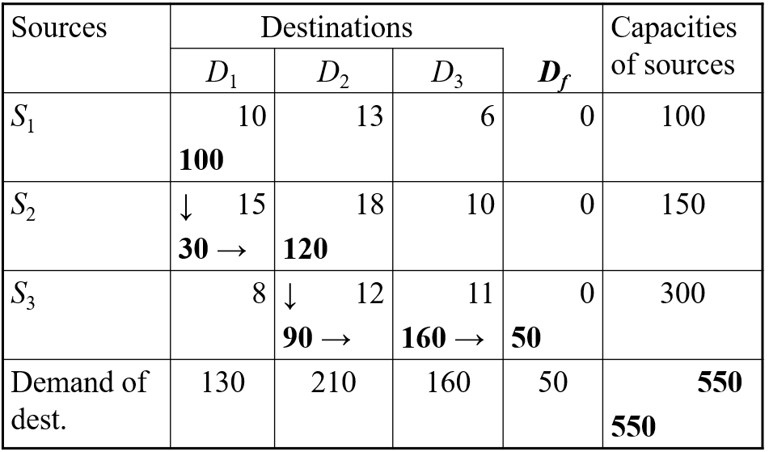
Finding an Initial Solution - Northwest Corner Method

Slide 15
Finding an Initial Solution - Minimum Cost Method
Start at the cell with the least transportation cost. If there is a tie, choose a cell between the tied cells arbitrarily.
Compare the available supply and demand for this cell. Allocate the smaller of these two values to this cell. Encircle this allocation. Subtract this value from available supply and demand. If either the supply or demand remaining equals zero, no allocation is to be made. Go to next step.
Move to the next cell with the least transportation cost. If there is a tie, choose the next cell arbitrarily between the tied cells.
Go to step 2.
Repeat the process until all the supply and demand restrictions are satisfied.

Slide 16
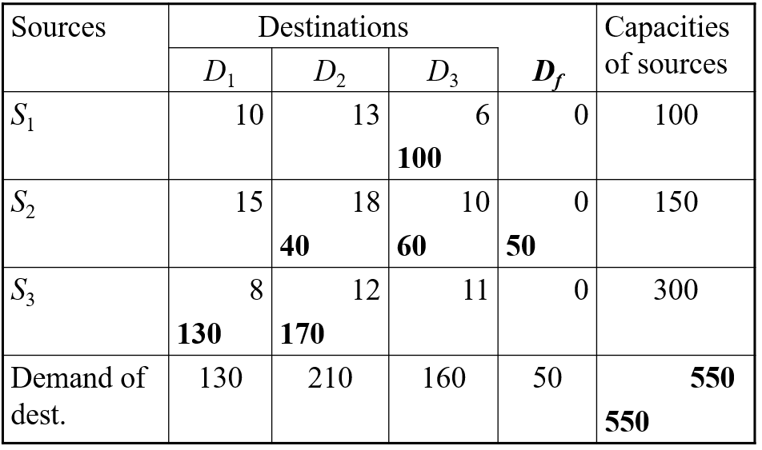
Finding an Initial Solution - Minimum Cost Method

Slide 17
Finding an Initial Solution – Vogel’s Approximation Method
Calculate a penalty for each row (column) by subtracting the smallest cost element in the row (column) from the next smallest cost element in the same row (column).
Identify the row or column with the largest penalty. If there are ties, break ties arbitrarily. However, it is recommended to break the tie is to select the value that has the lowest cost entry in its row or column.
Allocate as many units as possible to the variable with the least cost in the selected row (column). The maximum amount that can be allocated is the smaller of the supply or demand.

Slide 18
Finding an Initial Solution – Vogel’s Approximation Method
Adjust the supply and demand to show the allocation made. Eliminate any row (column) that has just been completely satisfied by the allocation just made.
  If the supply is now zero, eliminate the source.
  If the demand is now zero, eliminate the destination.
  If both the supply and demand are zero, eliminate both the source & destination.
Compute the new penalties for each source & destination in the revised transportation tableau formed by step–4.
Repeat step–2 through 5 until all supply availability has been exhausted and all demand requirements have been met. It means that the initial feasible solution is obtained.

Slide 19
Finding the Optimal Solution – Stepping Stone Method
Select an unused square (Non–BasicVariable) to evaluate
Beginning at this square, trace a closed path back to the original square via squares that are currently being used with only horizontal or vertical moves allowed
Beginning with a plus (+) sign at the unused square, place alternate minus (–) signs and plus signs on each corner square of the closed path just traced
Calculate an improvement index by adding together the unit cost figures found in each square containing a plus sign and then subtracting the unit costs in each square containing a minus sign
Repeat steps 1 to 4 until an improvement index has been calculated for all unused squares. If all indices computed are greater than or equal to zero, an optimal solution has been reached. If not, it is possible to improve the current solution and decrease total shipping costs.

Slide 20
Finding the Optimal Solution – MODI Method
The MODI (modified distribution) method allows us to compute improvement indices quickly for each unused square without drawing all of the closed paths
Because of this, it can often provide considerable time savings over the stepping-stone method for solving transportation problems
If there is a negative improvement index, then only one stepping-stone path must be found
This is used in the same manner as before to obtain an improved solution

Slide 21
Applications of the transportation problem – production scheduling
Example:
Brewery produces 9°, 10° beer and 12° pale lager and dark lager beer in three factories, each of them producing two types of bottles – ½ and ⅓ liter. Weekly production capacities in three factories A, B, and C are 25800, 24600 and 27000 bottles, respectively. Expected weekly production: 21600 bottles of 9° beer in ½ l bottles, 22800 bottles of 10° beer in ½ l bottles, 3600 bottles of 12° dark lager in ½ l bottles, 20400 bottles of 12° pale lager in ½ l bottles, and 3000 pieces of 2° pale lager in ⅓l bottles. Production costs of beer are in table.

Slide 22
Production plan
Aim: Plan production such that the production costs are minimized.

Slide 23
Production plan - solution
Factories – sources
Requests for special types of beer – destinations
Transportation problem with three sources and five destinations.
(Capacity of factories is higher than requests for production – unbalanced transportation problem)

Slide 24
Production plan – optimal solution
Total production costs 18 870,-.

Slide 25
Points to remember
Sources
Destinations
Initial solution
Optimal solution
Production scheduling

Slide 26
Thank you for your attention

