Slide 1

Project planing
The milestones in development of project management approach
Project, program, portfolio, and operations management
Pavel Adámek
Project management

Slide 2

Outline of the lecture
Project and development life-cycles
Project planning
Detailed schedules and charts
Configuration management

Slide 3
Project and development life cycles
The integration of the planning activities is necessary because each Functional unit may develop its own planning documentation with little regard for other functional units.
Planning, in general, can best be described as the function of selecting the enterprise objectives and establishing the policies, procedures, and programs necessary for achieving them.
Project planning must be systematic, flexible enough to handle unique activities, disciplined through reviews and controls, and capable of accepting multifunctional inputs.
The most important responsibilities of a project manager are planning, integrating, and executing plans.

Slide 4
Project and development life-cycles
Consequences of poor planning include:
Project initiation without defined requirements
Wild enthusiasm
Disillusionment
Chaos
Search for the guilty
Punishment of the innocent
Promotion of the nonparticipants
There are four basic reasons for project planning:
To eliminate or reduce uncertainty
To improve efficiency of the operation
To obtain a better understanding of the objectives
To provide a basis for monitoring and controlling work

Slide 5
Project and development life-cycles
Major components of the planning phase:
Objective: a goal, target, or quota to be achieved by a certain time
Program: the strategy to be followed and major actions to be taken in order to achieve or exceed objectives
Schedule: a plan showing when individual or group activities or accomplishments will be started and/or completed
Budget: planned expenditures required to achieve or exceed objectives
Forecast: a projection of what will happen by a certain time
Organization: design of the number and kinds of positions, along with corresponding duties and responsibilities, required to achieve or exceed objectives
Policy: a general guide for decision-making and individual actions
Procedure: a detailed method for carrying out a policy
Standard: a level of individual or group performance defined as adequate or acceptable

Slide 6
Project and development life-cycles
Project planning takes place at two levels. The first level is the corporate cultural approach; the second method is the individual’s approach. The corporate cultural approach breaks the project down into life-cycle phases.
Life—cycle phases – to provide a methodology for uniformity in project planning.
At the end of each phase there is a meeting of the project manager, sponsor, senior management, and even the customer, to assess the accomplishments of this life-cycle phase and to get approval for the next phase.
Life-cycle phases can be used for manpower deployment and equipment/facility utilization.

Slide 7
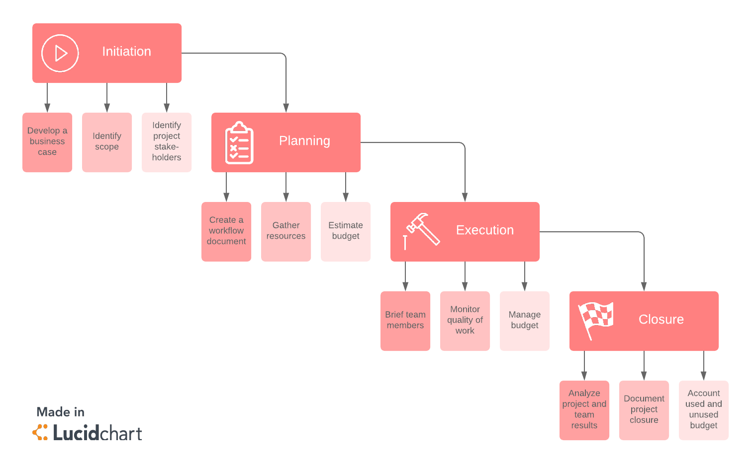
Project and development life-cycles

Slide 8
Project and development life-cycles
Consider a company that utilizes the following life-cycle phases:
Conceptualization
Feasibility
Preliminary planning
Detail planning
Execution
Testing and commissioning

Slide 9
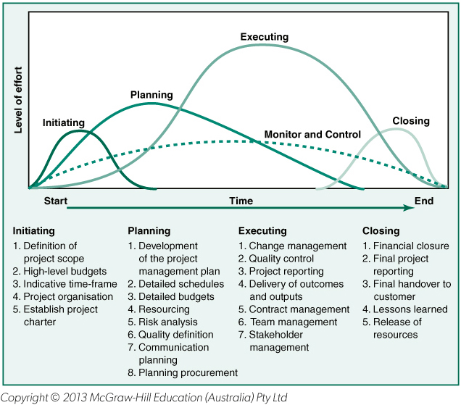
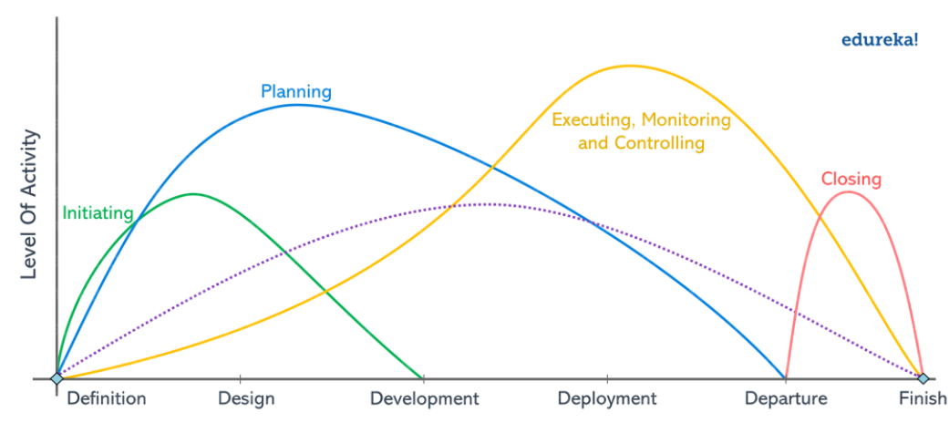
Project and level of activity in the phases

Slide 10
Project and development life-cycles
Proposal preparation
Project manager prepares entire proposal. This occurs frequently in small companies. In large organizations, the project manager may not have access to all available data, some of which may be company proprietary, and it may not be in the best interest of the company to have the project manager spend all of his time doing this.
Proposal manager prepares entire proposal. This can work as long as the project manager is allowed to review the proposal before delivery to the customer and feels committed to its direction.
Project manager prepares proposal but is assisted by a proposal manager. This is common, but again places tremendous pressure on the project manager.
Proposal manager prepares proposal but is assisted by a project manager. This is the preferred method. The proposal manager maintains maximum authority and control until such time as the proposal is sent to the customer, at which point the project manager takes charge.

Slide 11
Project and development life-cycles
Understanding participants´role
The responsibilities of the major players are as follows:
Project manager will define:
Goals and objectives
Major milestones
Requirements
Ground rules and assumptions
Time, cost, and performance constraints
Operating procedures
Administrative policy
Reporting requirements

Slide 12
Project and development life-cycles
Understanding participants´role
The responsibilities of the major players are as follows:
Line manager will define:
Detailed task descriptions to implement objectives, requirements, and milestones
Detailed schedules and manpower allocations to support budget and schedule
Identification of areas of risk, uncertainty, and conflict
Senior management (project sponsor) will:
Act as the negotiator for disagreements between project and line management
Provide clarification of critical issues
Provide communication link with customer’s senior management

Slide 13
Project planing
What are the major elements of the work required to satisfy the objectives, and, how are these elements interrelated?
Which functional divisions will assume responsibility for accomplishment of these objectives and the major-element work requirements?
Are the required corporate and organizational resources available?
What are the information flow requirements for the project?
The first step is understanding the
project objectives. These goals may be to develop expertise in a given area, to become competitive,
to modify an existing facility for later use, or simply to keep key personnel employed.

Slide 14
Project planning
Typical problems with developing objectives include:
Project objectives/goals are not agreeable to all parties.
Project objectives are too rigid to accommodate changing priorities.
Insufficient time exists to define objectives well.
Objectives are not adequately quantified.
Objectives are not documented well enough.
Efforts of client and project personnel are not coordinated.
Personnel turnover is high.

Slide 15
Project planning
These information requirements are:
The statement of work (SOW)
The project specifications
The milestone schedule
The work breakdown structure (WBS)
The statement of work (SOW) is a narrative description of the work to be accomplished. It includes the objectives of the project, a brief description of the work, the funding constraint if one exists, and the specifications and schedule.

Slide 16
Project planning
The successful accomplishment of both contract and corporate objectives requires a plan that defines all effort to be expended, assigns responsibility to a specially identified
Organizational element, and establishes schedules and budgets for the accomplishment of the work.
Development of the work breakdown structure (WBS). A WBS is a product-oriented family
tree subdivision of the hardware, services, and data required to produce the end product.
Preparation of the WBS also considers other areas that require structured data, such as scheduling, configuration management, contract funding, and technical performance parameters.

Slide 17
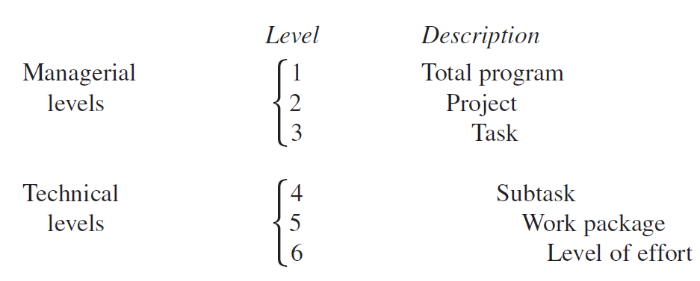
Project planning
Although a variety of work breakdown structures exist, the most common is the six-level indented structure.
The work breakdown structure can be used to provide the basis for:
  The responsibility matrix
  Network scheduling
  Costing
  Risk analysis
  Organizational structure
  Coordination of objectives
  Control (including contract administration

Slide 18
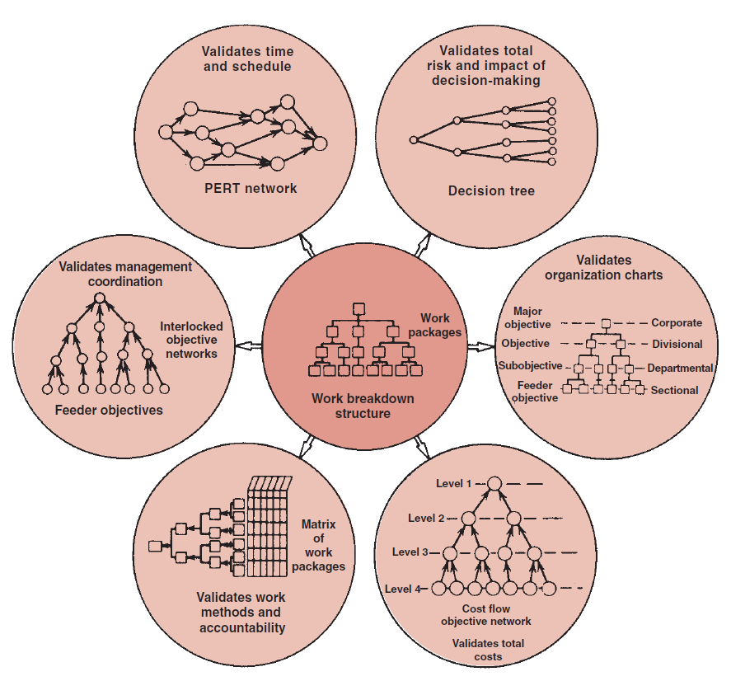
Project planning
Work breakdown structure for objective control and evaluation
The WBS must be accompanied by a description of the scope of effort required, or else only those individuals who issue the WBS will have a complete understanding of what work has to be accomplished.
Source: Kerzner, H. 2017. Project Management

Slide 19
Project planning
In setting up the work breakdown structure, tasks should:
Have clearly defined start and end dates
Be usable as a communications tool in which results can be compared with expectations
Be estimated on a “total” time duration, not when the task must start or end
Be structured so that a minimum of project office control and documentation (i.e., forms) is necessary
For large projects, planning will be time phased at the work package level of the WBS.
The work package has the following characteristics:
Represents units of work at the level where the work is performed
Clearly distinguishes one work package from all others assigned to a single Functional group
Contains clearly defined start and end dates that are representative of physical accomplishment
Specifies a budget in terms of dollars, man-hours, or other measurable units

Slide 20
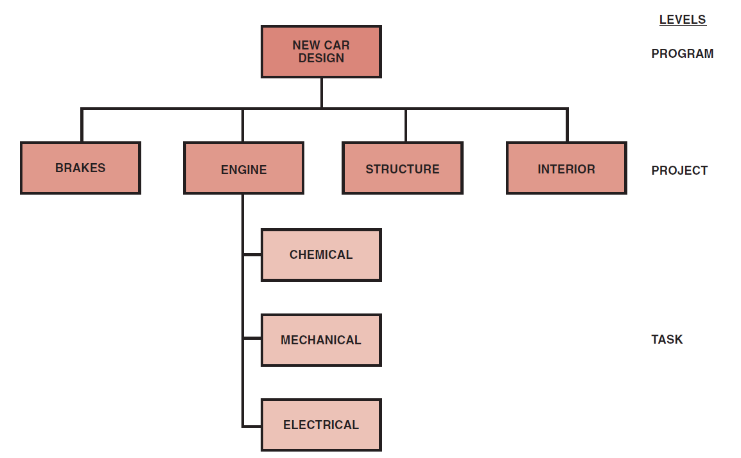
Project planning
On simple projects, the WBS can be constructed as a “tree diagram” or according to the logic flow.
The second method is to create a logic flow and cluster certain elements to represent tasks and projects.
In the tree method, lower-level functional units may be assigned to one, and only one, work element, whereas in the logic flow method the lower level functional units may serve several WBS elements.
Source: Kerzner, H. 2017. Project Management

Slide 21
Detailed schedules and charts
Activity scheduling is probably the single most important tool for determining how company resources should be integrated.
The primary objective is usually to coordinate activities to complete the project with the:
  Best time
  Least cost
  Least risk
There are also secondary objectives of scheduling:
  Studying alternatives
  Developing an optimal schedule
  Using resources effectively
  Communicating
  Refining the estimating criteria
  Obtaining good project control
  Providing for easy revisions
The scheduling of activities is the first major requirement of the program office after program go-ahead.
The program office normally assumes full responsibility for activity scheduling if the activity is not too complex.

Slide 22
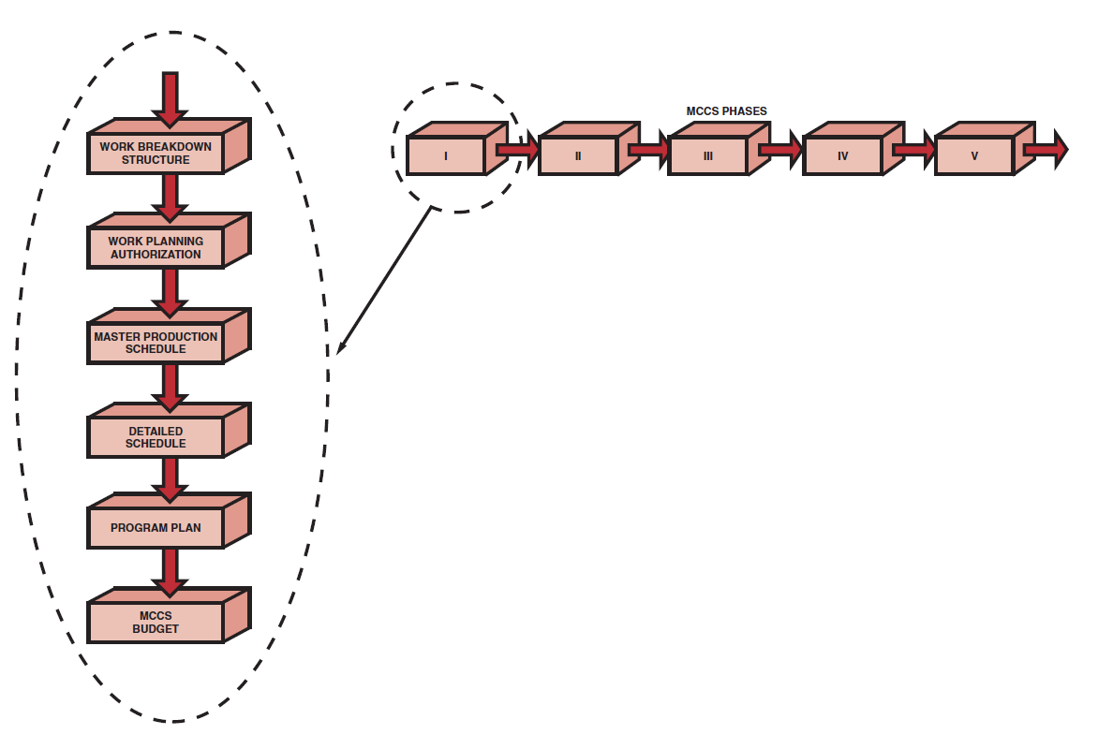
Detailed schedules and charts
Detailed schedules are prepared for almost every activity. It is the responsibility of the program office to marry all of the detailed schedules into one master schedule to verify that all activities can be completed as planned.
Before the schedules are submitted to publications, rough drafts of each schedule and plan should be reviewed with the customer. This procedure accomplishes the following:
  Verifies that nothing has fallen through the cracks
  Prevents immediate revisions to a published document and can prevent embarrassing moments
  Minimizes production costs by reducing the number of early revisions
Source: Kerzner, H. 2017. Project Management

Slide 23
Program plan
The program plan provides the following framework:
Eliminates conflicts between functional managers
Eliminates conflicts between functional management and program management
Provides a standard communications tool throughout the lifetime of the program (It should be geared to the work breakdown structure)
Provides verification that the contractor understands the customer’s objectives and requirements
Provides a means for identifying inconsistencies in the planning phase
Provides a means for early identification of problem areas and risks so that no surprises occur downstream
Contains all of the schedule
The program plan then serves as a guideline for the lifetime of the program and may be revised as often as once a month, depending on the circumstances and the type of program (i.e., research and development programs require more revisions to the program plan than manufacturing or construction programs).

Slide 24
Types of plans
Budget How much money is allocated to each event?
Configuration management How are technical changes made?
Facilities What facilities resources are available?
Logistics support How will replacements be handled?
Management How is the program office organized?
Manufacturing What are the time-phase manufacturing events?
Procurement What are my sources? Should I make or buy? If vendors are not qualified,
how shall I qualify them?
Quality assurance How will I guarantee specifications will be met?
Research/development What are the technical activities?
Scheduling Are all critical dates accounted for?
Tooling What are my time-phased tooling requirements?
Training How will I maintain qualified personnel?
Transportation How will goods and services be shipped?

Slide 25
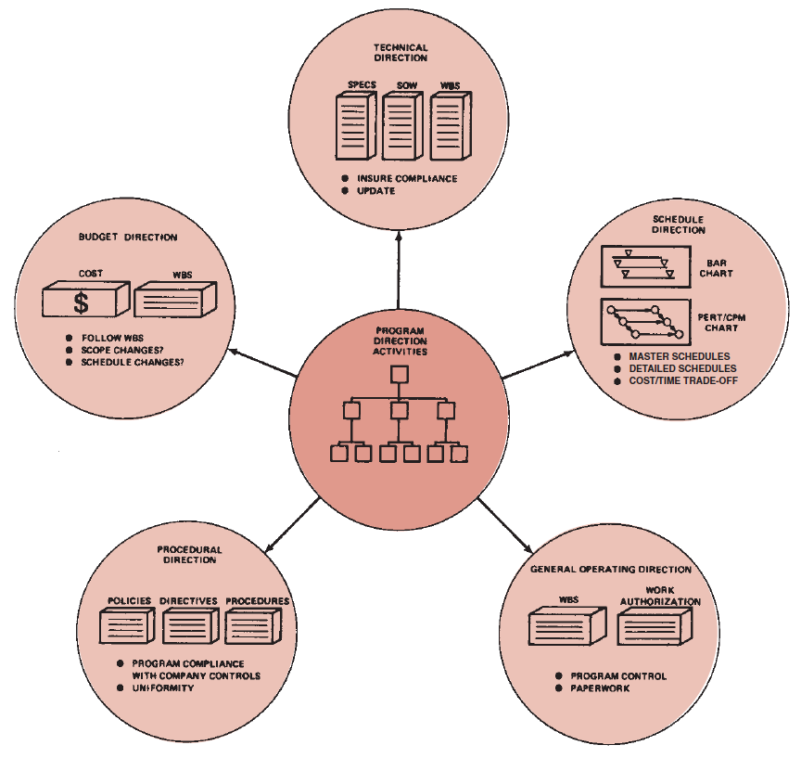
Program plan
Program direction activities
Program plan consist from all these activities:
Budget direction
Technicl direction
Procedural direction
Schedule direction
General operating direction
Source: Kerzner, H. 2017. Project Management

Slide 26
Configuration management
A critical tool employed by a project manager is configuration management or configuration change control.
As projects progress downstream through the various life-cycle phases, the cost of engineering changes can grow boundlessly.
It is not uncommon for companies to bid on proposals at 40 percent below their own cost hoping to make up the difference downstream with engineering changes.
It is also quite common for executives to “encourage” project managers to seek out engineering changes because of their profitability.

Slide 27
Configuration management
Configuration management is a control technique, through an orderly process, for formal review and approval of configuration changes. If properly implemented, configuration management provides:
Appropriate levels of review and approval for changes
Focal points for those seeking to make changes
A single point of input to contracting representatives in the customer’s and contractor’s office for approved changes
At a minimum, the configuration control committee should include representation from the customer, contractor, and line group initiating the change. Discussions should Answer the following questions:
What is the cost of the change?
Do the changes improve quality?
Is the additional cost for this quality justifiable?
Is the change necessary?
Is there an impact on the delivery date?

Slide 28
RECAP
The project manager is the key to successful project planning. It is desirable that the project manager be involved from project conception through execution.
Project planning must be systematic, flexible enough to handle unique activities, disciplined through reviews and controls, and capable of accepting multifunctional inputs. Successful project managers realize that project planning is an iterative process and must be performed throughout the life of the project.
One of the objectives of project planning is to completely define all work required (possibly through the development of a documented project plan) so that it will be readily identifiable to each project participant. This is a necessity in a project environment because:
  If the task is well understood prior to being performed, much of the work can be preplanned.
  If the task is not understood, then during the actual task execution more knowledge is gained that, in turn, leads to changes in resource allocations, schedules, and priorities.
  The more uncertain the task, the greater the amount of information that must be processed in order to ensure effective performance.

