Slide 1

Risk management
Risk Identification and Analysis
Ing. Šárka Zapletalová, Ph.D.
Katedra Podnikové ekonomiky a managementu
KRIZOVÝ MANAGEMENT

Slide 2
Risk
Risk (Italian risico) - the risk of damage, injury, loss or destruction, or business failure. Historical term dating from the 17th century.
Risk is:
  a combination of the probability or frequency of occurrence and consequences of a particular dangerous event;
  probability or possibility of failure (loss);
  variability of possible results or uncertainty of their achievement; deviation of actual and expected results;
  the probability of any result other than expected; the possibility of loss or profit.
Risk management - a systematic and coordinated way of working with risk and uncertainty applied throughout the company and including all types of risks.
Prostor pro doplňující informace, poznámky

Slide 3
Risk Classification
Internal and external economic risks
Production (technological) and technical risks
Social work risks
Information risks
Supplier risks
Political risks
Market risks
Legislative risks
Natural hazards
Prostor pro doplňující informace, poznámky

Slide 4
Risk Management
Risk management is an area of management focused on analyzing and reducing risk, using a variety of risk prevention methods and techniques that eliminate existing or reveal future risk-increasing factors. Risk is a ubiquitous and characteristic accompanying phenomenon of the functioning of organizations in today's turbulent environment.
Risk management is a systematic, repetitive set of interrelated activities aimed at managing potential risks, ie reducing the likelihood of their occurrence or reducing their impact on the organization and its goals.
The purpose of risk management is to prevent problems or negative phenomena, to avoid crisis management and to prevent problems from arising.
Prostor pro doplňující informace, poznámky

Slide 5
Risk Management
Crisis management works with negative developments that are already being implemented. Risk management is trying to capture all possible variants at a time when they are so far only theoretical.
And it is at this point that crisis management and risk management are connected.
The issue of risk management, control and regulation is a complex matter. Therefore, it is beyond the power of the individual, however active, to cover this whole set of problems. For this reason, crisis management and risk management teams began to emerge in companies
Risk and crisis management consists in the fact that by fully understanding it and capturing it in time, we can redirect negative developments through appropriate interventions through its stabilization to their full management. In this way we can save many values, which will be saved by well-applied interventions.
Prostor pro doplňující informace, poznámky

Slide 6
Risk Management
Risk management consists of several interrelated phases - according to various methodologies. 5 basic phases are most often used, namely:
risk identification
risk analysis
risk evaluation
risk mitigation
risk monitoring and review
Prostor pro doplňující informace, poznámky

Slide 7
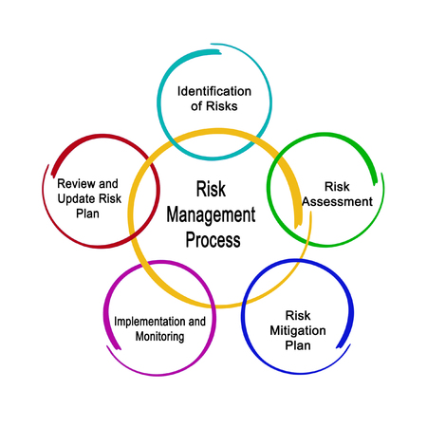
Risk Management Process
Prostor pro doplňující informace, poznámky

Slide 8
Risk Management
Risk identification
Crisis management, together with unreliability, deals with the possible emergence of a risky situation. In order for this to be recognized, it is necessary to be able to properly describe the risk and define it.
The first step in the risk reduction process is to know their properties.
To identify hazards and hazard scenarios, a good imagination and the ability to predict even such phenomena, or events about which little or nothing is known so far. This applies in particular to objects or processes where new technological processes, new materials or new technologies are to be applied in the implementation.
However, attention must also be paid to objects, or processes which, under normal conditions, are not exposed to any danger, but in specific conditions may become significant recipients of risk.
Prostor pro doplňující informace, poznámky

Slide 9
Risk Management
Risk identification
The concept of danger has two basic features:
  it relates to the future - it is necessary to think about the danger that arises, not about what could have happened;
  it is vague - an adverse event that is known to occur is certainly not a danger but a fact that can be actively or passively dealt with.
Both of these features manifest themselves in the identification of hazards and hazard scenarios, depending on the context in which the identification takes place.
The context is the relationship of the hazard assessor to the object or process. The hazard assessor will have a different relationship to the risk of fire and collapse of the industrial production plant if he is in the position of: top management, building manager, engineer who designed the plant, construction contractor who carried out the plant, local politician before the election, local politician after elections, a disabled worker in the factory, other employees of the company, etc.
Prostor pro doplňující informace, poznámky

Slide 10
Risk Management
Risk identification
Different perceptions of danger have a significant influence on people's decisions and behavior. There are many different situations where people perceive danger only partially or do not perceive it at all.
The perception of danger can be relatively easily influenced by different means in different circumstances and, of course, with different goals.
The area of serious influence includes information to the recipients, or risk holders about the danger, its manifestations, the consequences of implementation, prevention, etc.
The opposite of this influence is, for example, the spread of alarming messages and intimidation of the population aimed at causing panic, political, religious, commercial propaganda, etc.
Prostor pro doplňující informace, poznámky

Slide 11
Risk Management
Risk identification
The result of the perception of danger is the degree of tolerance of people to danger or risk. As hazard identification (also hazard classification and risk quantification) is not an independent process for humans, the very perception of danger must be taken into account when making decisions. Above all, it is necessary to consider what analysts and experts consider to be an acceptable hazard, ie to estimate an acceptance threshold.
There are three basic levels of risk tolerance.
  Risk aversion. The person is interested in suppressing all dangers so that losses from their implementation are minimal. He is often even so interested at the cost of increased non-refundable costs. (Risk aversion is a necessary condition for the creation of an insurance contract.)
Prostor pro doplňující informace, poznámky

Slide 12
Risk Management
Risk identification
Prone to risk. The person is interested in entering the danger, because he is interested in using the risks offered. The propensity for risk leads a person to look for highly risky variants that have a hope of a good result.
Neutral attitude to risk. For a person with a risk-neutral attitude, risk aversion and propensity are in balance.
Prostor pro doplňující informace, poznámky

Slide 13
Risk Management
Risk identification
The following questions should be asked at the beginning of each risk identification:
What adverse events can occur? (radical interruption of the company's operation caused by sabotage, strike, flood, fire, insolvency of customers, non-application of products / services on the market, etc.)
What is the probability of adverse events? (the six adverse events defined above are classified in the company from least probable to most probable)
If an adverse event occurs, what are the consequences? (damage to property, interruption of activities in selected establishments of the company, destruction of production, lack of funds, imposition of bankruptcy).
Prostor pro doplňující informace, poznámky

Slide 14
Risk Management
Risk identification
In order to facilitate the identification of hazards and a more effective understanding of risk analysis procedures, it is useful to organize hazards into groups, the criterion for classification being primarily the source from which the hazard originates.
Several basic hazard groups can be distinguished:
  Technological dangers. (Industrial, transport, energy, chemical, electrical, nuclear, electronic, communication, etc.)
  Economic dangers. (Insolvency of debtors, obsolescence of technology, volatility of markets, general changes in values ​​in society, collapse of financial institutions, privatization, scarcity, overproduction, etc.)
  Political dangers. (Violent changes in the political system, civil unrest, occasional initiatives, terrorism, demographic development, nationalism, totalitarian regime, etc.)
  Social danger. (Crime, fraud, sabotage, squatters, vandalism, unemployment, etc.)
  Legal and regulatory dangers. (Laws, standards, contracts, lawyers, courts, arbitrators, experts, etc.)
Prostor pro doplňující informace, poznámky

Slide 15
Risk Management
Risk identification
Climatic hazards. (Short - term weather events, long - term fluctuations in weather conditions, climate change, etc.)
Geological hazards (Seismicity, landslides, sedimentation of soils, groundwater, undermining, etc.)
Environmental hazards. (Acid rain, biological damage, electric shocks, meteorites, etc.)
Physiological hazards. (Epidemics, pandemics, human and animal health, excrement of living organisms, etc.)
Psychological dangers. (Subconscious fear, panic, perceived fear, influence by unscientific theories, etc.)
Prostor pro doplňující informace, poznámky

Slide 16
Risk Management
Risk identification
Furthermore, it is possible to group risks according to the general classification into groups and mark them as critical, important and less important (common):
critical risk - all threats, the potential losses of which are of such an order that they will result in the bankruptcy of the company (war conflict, change of legislation);
important risk - a threat, the potential losses of which will not result in bankruptcy, but further operation will require the company to borrow funds (natural disaster, embezzlement, collapse of financial markets);
common risk - a threat whose potential losses can be covered by the company's current assets or current income without undue financial pressure (employee strike, lightning strike, short circuit).
Prostor pro doplňující informace, poznámky

Slide 17
Risk Management
Risk analysis
Risk analysis is usually understood as the process of defining threats, the probability of their realization and the actual impact of risk realization, ie the determination of risks and their severity.
The risk usually does not exist in isolation, but it is usually certain combinations of risks that may pose a threat to the company in their impact.
Given the number of risks, priorities need to be identified in terms of impact and likelihood of their occurrence, and focus on key risk areas.
It can be said that the risk is greater in some situations than in others. The level of risk arises from the value of the affected assets, persons, processes, the level of threat and vulnerability.
Prostor pro doplňující informace, poznámky

Slide 18
Risk Management
Risk analysis
Risk analysis works with variables that in many cases cannot be accurately measured and the determination of their size is often based on a qualified estimate by a specialist, expressed only on the basis of his experience (usually terms such as "small", "medium", "large" or scale). 1 to 10).
In the case of an individual, we measure the risk according to the probability of an unfavorable deviation from the result we hope for.
In the case of a large number of units exposed to risk, estimates can be made of the probability of occurrence of a given number of losses.
Based on these estimates, it is possible to formulate a forecast. The expectation here is that a predicted amount of losses will occur.
Prostor pro doplňující informace, poznámky

Slide 19
Risk Management
Risk analysis
In practice, two basic approaches to risk analysis are promoted:
Quantitative methods are characterized by the fact that the risks are expressed to a certain extent (for example, they are scored <1 to 10>, or determined by the probability <0; 1> or verbally <small, medium, large>).
Qualitative methods are simpler and faster, but more subjective. It usually presents problems in the area of risk management, in assessing the acceptability of financial costs necessary to eliminate the threat, which can be characterized by a qualitative method, such as "large to critical".
The lack of a clear financial statement makes it cost-effective to control cost-effectiveness.
Prostor pro doplňující informace, poznámky

Slide 20
Risk Management
Risk analysis
Quantitative methods are based on a mathematical calculation of the risk and frequency of the threat and its impact.
They usually express the impact in financial terms as thousands of CZK. The risk is most often expressed in the form of an annual expected loss, which is expressed as a financial amount.
Quantitative methods are more accurate; Although their implementation requires more time and effort, they provide a risk statement that is more beneficial for their management.
To support the implementation of quantitative risk analysis, special tools are usually used, usually in the form of programs, often with a database of information, in which the methodology and procedure for performing risk analysis is already in place. There are currently a number of these tools.
Prostor pro doplňující informace, poznámky

Slide 21
Risk Management
Risk analysis
Semi-quantitative assessment uses qualitatively described scales, which are assigned numerical values, the combination of which determines the degree of risk.
It serves as a starting point for safety measures in operation (eg point method).
The result of the risk analysis is the determination of the degree of individual risks, represented by a combination (product) of the severity of the consequences (N) and its probability (P).
Prostor pro doplňující informace, poznámky

Slide 22
Risk Management
Risk analysis
Risk analysis with different number of parameters
A. method with two parameters:
1. evaluation of the probability of the incident and its impact (only 2 PI parameters - probability of incident and D - impact)
2. calculation of the risk level R according to the relation R = PI x D P –
Probability of origin and existence of risk
1) Random
2) Unlikely
3) Probable
4) Very likely
5) Permanent
Prostor pro doplňující informace, poznámky

Slide 23
Risk Management
Risk analysis
Risk analysis with different number of parameters
B. method with three parameters
1. construction of the vulnerability matrix (value of asset A depending on the probability of threat T)
2. calculation of the risk level R according to the relation R = T x A x V, where V is the vulnerability
3. preparation of the risk matrix from the calculated values (value of asset A depending on the probability of threat T)
4. setting boundaries for different degrees of risk R –
Risk level
0 - 10: Insignificant risk
11 - 20: Acceptable risk
21 - 30: Moderate risk
31 - 60: Undesirable risk
61 - 120: Unacceptable risk
Prostor pro doplňující informace, poznámky

Slide 24
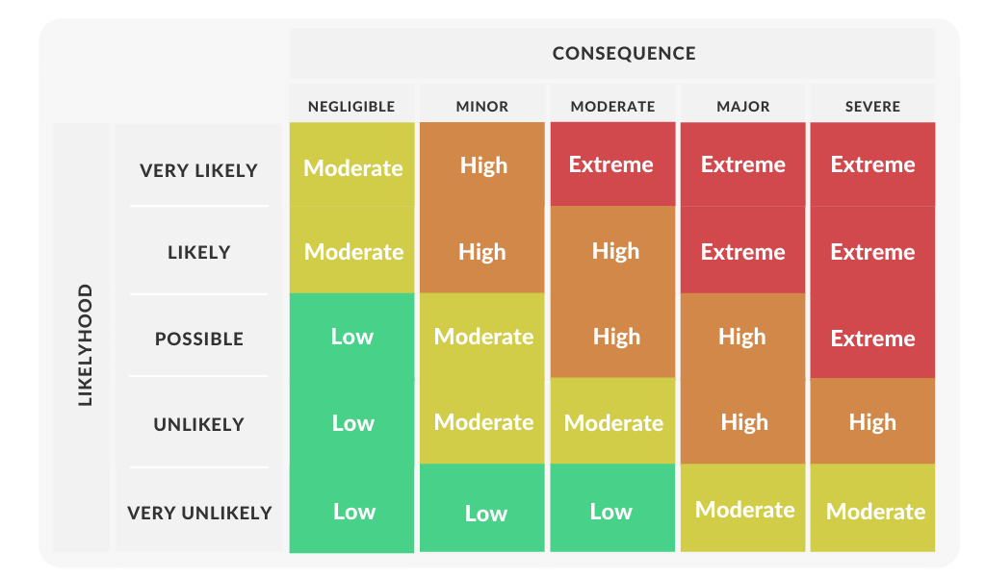
Risk Management – Risk Matrix
Prostor pro doplňující informace, poznámky

Slide 25
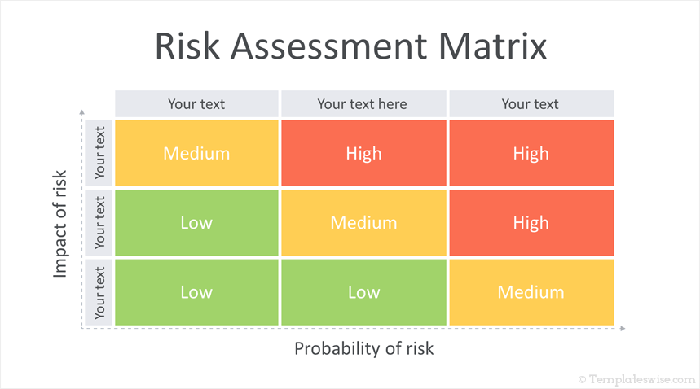
Risk Management – Risk Matrix
Prostor pro doplňující informace, poznámky

