Slide 1
Introduction to Strategies
Ing. Michal Stoklasa, Ph.D.
Strategic Marketing/subject code

Slide 2
Introduction to Strategies
Outline of the lecture
Strategic and marketing objectives and strategy formulation.
The list of generic strategies.
Specific general strategies.

Slide 3
Introduction to Strategic Marketing
STRATEGIC PROCESS
Vision, Mission
The strategic process has these steps.
Analysis
Strategic goals
Strategy formulation
generating strategy
analyzing alternatives
choosing optimal strategy
Strategy implementation
organizational structure
company culture
motivational system
planning
source allocation
information system
Evaluation and Control

Slide 4
Introduction to Strategies
1. STRATEGIC AND MARKETING OBJECTIVES
Strategic objectives are the big main objectives for longer period of time (5 years). These guide our efforts.
Marketing objectives specify what the company wants to achieve - within the real possibilities.
Specific marketing objectives have to be based on the situation analysis, which enables us to identify what sources the company has for fulfillment or non-fulfillment of tasks.
Marketing objectives often cited in the literature include market share (turnover / sales), margin, market share growth and continuity. These objectives must be quantified, expressed in the form of marketing categories and measurable (SMART).

Slide 5
Introduction to Strategies
FORMULATION OF TOP STRATEGIC GOALS
BUT! Often we meet with the fact that there are overall objectives of the entire company and then there are goals for specific tasks - strategy. (company goal, division goal, strategic goals of each division, marketing goals connected with each strategic goal)
Parent company strategy goals are seen rather as a kind of guiding line for the process of creation and selection of strategic alternatives, typical is a higher level of abstraction (the farther in time the goal targets – the more abstract it is).
Specific implementation goals are formed in relation to a chosen strategy and specific situation, they are subject to frequent changes in response to adverse conditions.

Slide 6
Introduction to Strategies
POSSIBLE GOALS
Goals relating to the status of the enterprise on the market: market share, turnover size, position (significance) of the enterprise on the market, new markets.
Targets for profitability: profit, return on sales, return on equity and total capital.
Financial goals: liquidity, capital structure, credit confidence, self-financing capacity.
Social objectives: economic and social security of employees, job satisfaction, personal development.
Targets for market prestige and status: the independence of the company, image and prestige, social and regional influence, political influence etc.

Slide 7
Introduction to Strategies
MORE POSSIBLE GOALS
Market leadership: competitive position, degree of innovation, technology advances.
Market spread: number of markets, customer groups, industries, countries.
Customer service: product utility, product quality, product reliability.
Growth: sales revenue, volume output, profit margin contribution.
Profitability: return on capital employed, stock on assets, profit markgin on sales revenue, return on shareholders funds.
Efficiency: sales on total assets, stock turnover, credit period liquidity, department costs on sales.
Personnel: employee relations and morale, personal development, renumeration, revenue per employee.
Social responsibility: corporate image, public aktivity, welfare.

Slide 8
Introduction to Strategies
FORMULATING MARKETING STRATEGY 1
On the basis of marketing objectives we can formulate marketing strategy, which determines the basic directions of management to achieve the target goals.
It presents the means and procedures by which the goals are achieved.
The basic procedure for formulating marketing strategy lies in the fact that the mission of the company is respected and observed basic corporate strategic direction, which covers all units and operations.
It is further assumed that the key point is good knowledge of the results of the situational analysis.

Slide 9
Introduction to Strategies
FORMULATING MARKETING STRATEGY 2
Clash of view of marketing vs. management! In practice, the managerial perspective wins by the shear number, marketing wins hands down by the success (Apple, Google, startups).
No one can give exact instructions on how to do it. Option is to offer all possible approaches and choose based on the situation of the company.
Formulating marketing strategy is based on the company's marketing mix. Every company should be able to determine the future benefits of their supply in different market segments.
The original definition of marketing mix: marketer blends ingredients (4P / 7P) to make a tasty dish for the customer.
For each activity (P), there must be partial goal specified, with estimated costs and profits.

Slide 10
Introduction to Strategies
STRATEGY HIERARCHY
Corporate strategy defines the scope of the company in terms of sectors and markets in which it operates. Strategy at this level involves decisions about diversification, vertical integration, acquisitions, allocation of resources etc.
SBU strategy (business) focuses on the company effect within the entire sector or market. We need competitive advantage if we want to succeed in a particular sector.
Functional strategies are concrete and specific operations determining the activity of sub-processes and organizational structures. It is e.g. strategy for research and development, sales, production, etc.
Marketing strategy is top management decisions about when, where and how to get these competitive advantages. It has two lines of interdependence; one on corporate strategy that defines the strategic direction, resource allocation and identify constraints, the other on the executive management, which deals with the choice of marketing strategies to market changes, opportunities and threats for the company.

Slide 11
Introduction to Strategies
IMPLEMENTATION, MANAGEMENT AND ADAPTATION
Marketing budget specifies how the above plans, in effect, lead to a detailed statement of costs for the planned marketing activities for the period to which the plan relates. (old approach)
(new approach) Budget for the strategy specifies what resources the company has available to pursue specific objective.
Plan of specific activities provides who (or what department) is responsible for that activity and in which period.
Management and adaptation: it applies only if the marketing plan contains resources listed above, i.e. targets, budgets, financial results and business plans; then it is possible to control and adjust the plan during its implementation.

Slide 12
Introduction to Strategies
MARKETING STRATEGY CAN BE BROADLY DESCRIBED AS THESE STEPS
Target market - for which is our offer addressed. Basicaly a choice of a segment.
Main presentation - it is the intended positioning that our customers should connect with our offer / company.
The total value proclamation - what value we offer. Product value is perceived differently by different customers (segmentation). (this is Product)
Price presentation - based on the positioning, it should support it, see below.
Distribution strategy - shows how we operate at the target market (what is our availability).
Communication strategy - what tools and media we use.

Slide 13
Introduction to Strategies
2. GENERIC MARKETING STRATEGY
There are countless strategies! We are unable to list all (impossible), but we are able to present the basic (generic) types and then apply those to the specific situation of the company.
Generic (general / universal) strategy describes several main types of procedures. So it's not always a specific strategy with all the steps, but possible type of procedure, within which there are a number of specific strategies. They are applicable for all companies after adaptation. (originally Porter created generic strategies, but we use this word as a general strategy)

Slide 14
Introduction to Strategies
GENERIC MARKETING STRATEGIES ACCORDING TO PORTER
Companies that do not differ neither by price nor by quality (are in the middle - average), should strive for one or the other.
A. Strategy of minimum cost – primary goal are low costs. Can be applied to companies operating on an extensive and mass market. The emphasis is on purchasing, manufacturing and distribution.
B. Product differentiation strategy – i.e. the differentiation of a product by its uniqueness (services, quality, design, technology).
C. Strategy of market orientation - means that the product satisfies the need of a particular market segment. Company does not seek to dominate the entire market with this product.

Slide 15
Introduction to Strategies
A. OVERALL COST LEADERSHIP
The title is missleading, nowadays we would name it „leading with price“.
The aim is low price and therefore the lowest cost.
The pursuit of the lowest costs of production and distribution of products.
The subsequent reduction in prices compared to the competition and dominating the market.
Key skills: purchasing, production, physical distribution. Less key: marketing.
However, when the low costs are the only competitive advantage - dangerous. Unsustainable.
Paradoxically, in times of crisis also works the opposite strategy - high prices („look, I can afford this").

Slide 16
Introduction to Strategies
B. DIFFERENTIATION
The company seeks to distinguish its products in a specific area / way.
Tries to bring something extra to the customer, something better, more functional, more accessible.
For example, best service, best quality, best style or design, best technology.
Striving for dominance in one area but not in all.
The difference of the product or service can be so big that the competitors simply can not imitate or copy (if we have specific technology, patents, human capital).

Slide 17
Introduction to Strategies
C. FOCUS
Targeting one or more small segments.
Accurate knowledge of the segment and the subsequent selection of the strategy tailored to this segment.
Similar to the niche strategy.
The needs of these narrow segments are often too different (special) to attract competition.
The key is detailed knowledge of the target group. And the ability to provide "something extra".
Focusing on a niche - possible alternative, nowadays it works perfectly.

Slide 18
Introduction to Strategies
GENERIC MARKETING STRATEGIES ACCORDING TO PORTER
Different strategies can not be combined, since they require different methods of organization of the company !!!
Research shows that companies that are fully focused on one specific strategy were more successful than those that combined between two or more strategies.
"The biggest benefit of generic strategies nowadays probably is the fact that it forces you to think about your true competitive advantage and on how you maintain it in the future." (Businessvize.cz)

Slide 19
Introduction to Strategies
COMPETITION POSITION BY KOTLER
Kotler approaches the problem of competitive strategy from the point of view of market position, which the company defines for itself.
Kotler recognizes four positions of competition and four corresponding strategies:
A. Market Leader.
B. Market Challenger.
C. Market Follower.
D. Market Nicher.

Slide 20
Introduction to Strategies
A. MARKET LEADER
Market leader is the dominant supplier with a large market share, which usually leads the others in launching new products, pricing, distribution and promotion strategies.
A leading company in the market benefits most in either period of market growth, when the growth in the number of users of the product requires higher sales volumes, or expansion in a market segment (increasing its market share).
Its strategy is to build and strengthen the competitive position. Market leaders may opt for a defensive strategy, i.e. maintain its competitive position, e.g. by strengthening loyalty of customers.

Slide 21
Introduction to Strategies
B. MARKET CHALLENGER
Market challenger is the supplier on the second, third or fourth position, which also has a large share mostly at attractive market.
The challenger – attacker (we are second, trying hard) usually uses an offensive strategy. Looking for weaknesses in services or prices of other suppliers in the market to attack the rival and overtake some of its market share.
Selects the strategy of strengthening its market position. Sometimes this strategy is focused on the leading company, but usually rather on the small and medium suppliers.
Choice for the challenger is the strategy of maintaining its competitive position. If the market is attractive enough, rather focuses on imitating marketing efforts of the market leader.

Slide 22
Introduction to Strategies
C. MARKET FOLLOWER
Follower is a supplier with a smaller market share, compared with a leader or challenger.
These suppliers are trying to avoid conflicts with the competition, while their business strategy is based on copying and imitation of successful activities of the previous two types of suppliers.
If the market has lost its attractiveness, then a strategic choice for followers is either try to build (strengthen) their competitive position, or leave the markets with these activities - get rid of them.

Slide 23
Introduction to Strategies
D. MARKET NICHER
Nicher is a supplier that concentrates on market niches.
It also avoids battles and downright focuses on a particular segment, geographically defined group of customers, or on a specific type of product.
Market nicher has to offer incredibly specific value to the customers that is not obtainable from other big suppliers. This specialization may be a benefit or a burden (acquiring and maintaining it is a problém).

Slide 24
Introduction to Strategies
GENERAL STRATEGIES
Growth strategy - securing growth of the business as a whole, for example through the redistribution of profits, market share growth, sales growth.
Stabilization strategy - maintaining the state of the turnover in the business, stabilization of assortment, adapting to the competition.
Reduction strategy - products and turnover reduction phase, increasing competitive pressure, the impending crisis, either reduce production or to dampen activity in the activity.
Combined strategy - uses more options, e.g. termination of certain product because of lack of demand, but the introduction of a new product or service, finding a new position in the market.

Slide 25
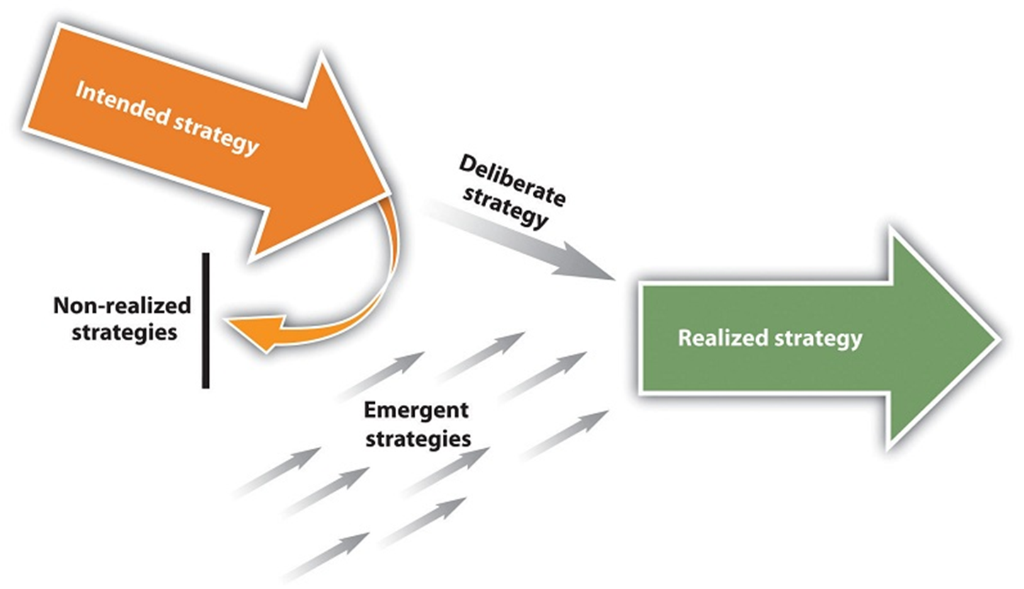
Introduction to Strategies
MINTZBERG STRATEGY (5/10/11P)

Slide 26
Introduction to Strategies
PARTIAL COMPANY STRATEGIES
The partial company strategies are also sometimes called functional strategies, because they focus almost exclusively on one function of the company (department) that is stronger than competitors.
The strategy may focus on the strengths of the company in terms of its organization and functioning:
Economic - financial strategy.
Marketing (the old approach = selling) - business strategy.
Technological development strategy.
Quality policy and ecology.
Personnel policy.
Communication strategy.

Slide 27
Introduction to Strategies
STRATEGIES BASED OND BCG MATRIX 1
Results of the analysis will help us determine what role will individual business units play in future development. The company's management should seek to ensure that its portfolio was balanced, both in terms of the SBU in each quadrant of the matrix, and in terms of their position within the matrix.
For example, too many SBU in the position of the stars and the position of dogs means problems with their financing, because the existing cash cows are not able to cover all the necessary investments in all SBUs. The company must consider which SBU in its portfolio has to be discarded, in order to effectively invest in the promotion of promising SBUs.
Prevalence of reliable and strong SBUs in the position of the cows is positive, but it is necessary to consider the question of their stability in the future.

Slide 28
Introduction to Strategies
STRATEGIES BASED ON BCG MATRIX 2
Strategy of increasing market share by creating new SBUs in promising sectors. This strategy is especially recommended for SBUs, which have become a question mark if they have the prerequisite to become a star. It requires strong financial support from the company.
Strategy of maintaining existing market share without significant changes in raising funds. This strategy is often applied for cash cows that produce significant amounts of cash, and the company would like to maintain this position for the future. Cash cows fund the preparation and development of new products, ensuring both growth and dividends, helping to foster the stars and question marks. The company expects them to be the main source of profit. This strategy is also applied for some stars, which the company wants to maintain or to improve their position. Its based on the assumption that the market eventually slows the growth and the star moves into position of cash cows.

Slide 29
Introduction to Strategies
STRATEGIES BASED ON BCG MATRIX 3
Strategies to reduce the market share in order to gain immediately or within a very short timeframe increased cash revenue, regardless of the possible consequences. This strategy is used both for cash cows, and with question marks, and hungry dogs, if their future is unclear. Acquired cash is then invested in the stars, or promising question marks.
Exit strategy from the market means the disposal of business units. These can be discarded (terminated), or sold and funds raised from the sale are reinvested elsewhere. In this connection, particularly dogs and in some cases the question marks, if they require for the continued existence too many resources that can not be in the current point of time dedicated for this purpose.

Slide 30
Introduction to Strategies
STRATEGIES BASED ON BCG MATRIX 3
Strategies to reduce the market share in order to gain immediately or within a very short timeframe increased cash revenue, regardless of the possible consequences. This strategy is used both for cash cows, and with question marks, and hungry dogs, if their future is unclear. Acquired cash is then invested in the stars, or promising question marks.
Exit strategy from the market means the disposal of business units. These can be discarded (terminated), or sold and funds raised from the sale are reinvested elsewhere. In this connection, particularly dogs and in some cases the question marks, if they require for the continued existence too many resources that can not be in the current point of time dedicated for this purpose.

Slide 31
Introduction to Strategies
STRATEGIES BASED ON SWOT MATRIX
Strategies can be based on the combination of the prevailing internal and external factors.
We can distinguish four basic types of strategic situations:
combinations of W-T = mini-mini dominated by weaknesses within the company and threats in the external environment,
combinations of W-O = mini-maxi dominated by weaknesses and opportunities,
the combination of S-T = maxi-mini dominated by strengths and threats,
the combination of S-O = maxi-maxi dominated by strengths and opportunities.

Slide 32
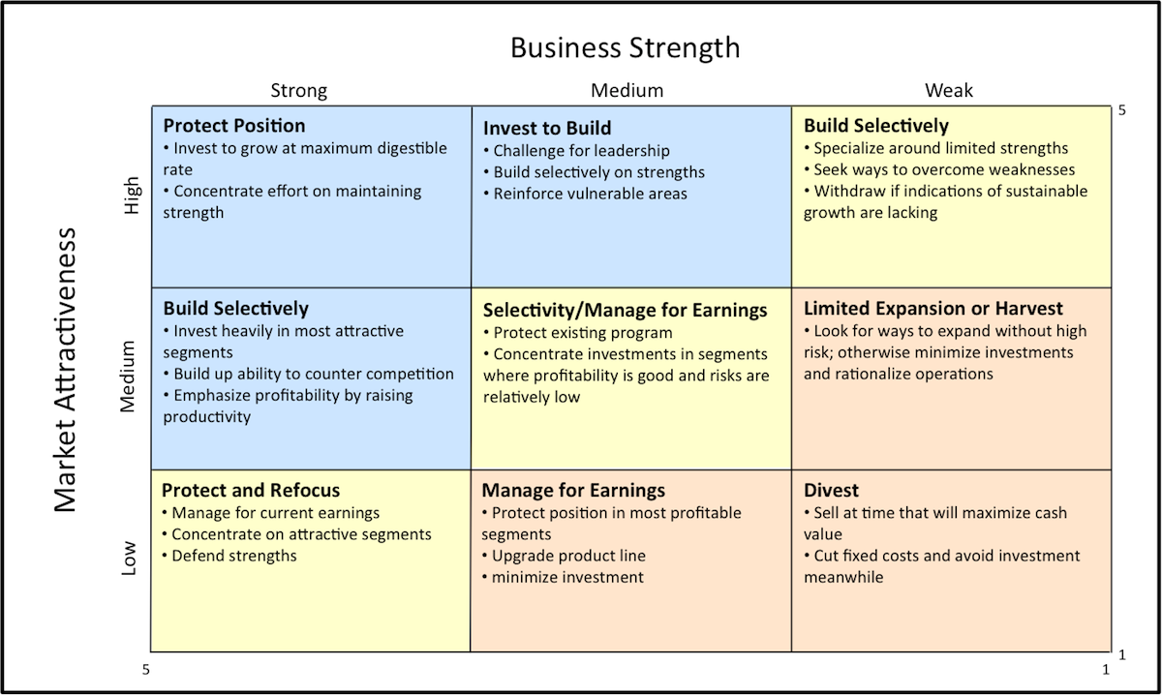
Introduction to Strategies
STRATEGIES BASED ON GE MATRIX

Slide 33
Introduction to Strategies
STRATEGIES BASED ON SEGMENTATION
Past approach used: several products, uniform product version, mass production, mass distribution, mass communication.
New approach uses strategy based on one of the following: geographic segmentation (geographic segment - sales area), demographic segmentation (for a number of projects it indicates customer need / wanted benefit), socio-economic segmentation (income and social class), on the basis of psychological description (personality determinants), psychographic segmentation ( lifestyle - how people spend their time and money), by purchase motives (perceived value, frequency of use).

Slide 34
Introduction to Strategies
STRATEGIES BASED ON TARGETING
OLD theory, do NOT use, just know that it is not working today.
Undifferentiated marketing
The market is one unit. We serve a particular feature (not segment, we are targeting masses) of the entire market.
The primary goal is to reduce costs through standardization and an emphasis on low price of product.
Differentiated marketing
We work with the entire market, but it is divided into segments, for which we have different strategies, mktg. mix etc.
We realize a greater or lesser volume of production and why?
How the change from undifferentiated mktg. to differentiated affects cost and how to reduce its influence in the transition to a product for another segment?
Concentrated marketing
From the market we pick narrowly defined segmetns and adapt production to those. We are talking about the search for market niches.
What are the pitfalls of such an approach?
What are the costs of concentrated mktg. compared with other forms?

Slide 35
Introduction to Strategies
STRATEGIES BASED ON POSITIONING
Positioning based on: the specific characteristics of the product, value added, the specific needs, or solutions, the specific mode of operation, positioning against competing product, the principles of cultural symbols.
Functional positioning:
We solve the problem.
We provide a particular advantage to the customer.
Symbolic positioning:
Enhance image.
Supporting own ego.
Belonging to a group, fulfillment.
Emotional satisfaction.
Experiential positioning:
It provides sensory stimulation.
It provides cognitive stimulation.

Slide 36
Introduction to Strategies
STRATEGIES BASED ON VALUE PROPOSITION 1
According to Kotler, we define 5 value propositions, based on a comparison of prices and benefits.
Greater benefits for higher price - this positioning utilizes prestigious luxury brands that offer their customers high quality and exceptional benefits, for which they demand even higher price. (Ritz-Carlton, Rolex watches, champagne Moet & Chandon)
Greater benefits for the same price - a strategy in which a company attacks on competitors who have chosen a strategy of greater benefit for higher price – by saturating the market with products that are comparable to the competition, but at lower prices.

Slide 37
Introduction to Strategies
STRATEGIES BASED ON VALUE PROPOSITION 2
The same benefits at a lower price - positioning based on a range of products with identical benefit at lower prices than competitors. These are discount retailerers or online stores.
Lower benefits at a much lower price - limited range of services, or a smaller selection offered, but at very reasonable prices. Used by cheap hotels or airlines. They offer the customer only what they want to pay for: the journey or the bed (no food on board, extra equipment in rooms, etc.).
Greater benefits at lower cost - a company is offering better products than competitors and at a lower cost. It is rather a short-term strategy, in the long term, this strategy is hardly sustainable.

Slide 38
Introduction to Strategies
STRATEGIES BASED ON BRAND 1
The brand is a product or service and its features differentiate it in some way from other products or services that are designed to satisfy the same needs. The terms trademark/brand/marking are in certain situations nearly interchangeable.
The American Marketing Association defines a brand as follows "Brand name, title, character, artistic expression, or a combination of the foregoing criteria. Its purpose is to distinguish the goods or services of one seller or group of sellers of goods or services from competing vendors."
Brand value is the added value of products and services. This value can be reflected in how consumers think, feel and behave in regard to a particular brand, as well as it may be reflected in prices, market share and profitability of the brand.

Slide 39
Introduction to Strategies
BRAND VALUE BY AAKER 1
Brand awareness - comprises of two categories, brand recognition and brand recall. Brand recognition is the ability to confirm an earlier acquaintance with the brand, if the customer is given the necessary impulse, also called the brand identification. Brand recall is the ability to recall a brand for a product category.
Brand loyalty - the value of the brand is largely made up of customer loyalty and brand loyalty. „The true value of the brand is a reality only when the customer purchases the brand and is loyal to it, we can say that the real asset for the company is the loyalty to the brand." There are 5 categories of customers according to their loyalty: non-customers (buying competitors’ goods or not interested in the product line at all), price sensitive customers (the price is critical), passively loyal customers (buying brand because of habit), customers on tilt (randomly buying more brands), loyal customers (with high loyalty).

Slide 40
Introduction to Strategies
BRAND VALUE BY AAKER 2
Perceived Quality - it can be defined as the overall level of product quality, perceived by the customer compared to adequate alternative. It is an important category, even though the perceived quality of the product is related to the brand associations.
Associations connected with the brand - "brand value is also largely supported by the associations, which customers connect with the brand. In the background of these associations is the brand identity - that is, what the brand has to create in the customer's mind." There are 6 categories of associations connected with the brand: the specific qualities, abstract qualities, functional benefits, psychosocial benefits, value, final value.

Slide 41
Introduction to Strategies
BRAND BENEFITS FOR VARIOUS TARGET GROUPS
Brand offers many benefits to consumers, traders and producers. The brand can facilitate buying decisions by reducing the time and reducing the risk of purchases.
For consumers, brands offer a significant decrease in product search cost.
For traders, brands are important because a strong brand attracts customers and enhances the traders’ image. The contribution to traders is in increased customer confidence, and also in reduced risk from buying products of famous brands, which creates good distribution relationships.
For producers, brands are again significant in terms of reducing the risk, because the consumer purchases the known product again. There is an opportunity to create a market entry barrier for other companies with a strong brand, which is a significant competitive advantage.

Slide 42
Introduction to Strategies
COMPREHENSIVE STRATEGY DIVISION BY SOUČEK
Competitive strategy focused on the customer.
Strategy focused on competition.
Strategies aimed at sales intermediary.
Strategies aimed at interest groups.
Strategy in emerging markets.
Strategy on global markets.
Strategy in services markets.
Market-oriented environmental strategy.
Strategy based on marketing mix.

Slide 43
Introduction to Strategies
COMPREHENSIVE STRATEGY DIVISION BY HORÁKOVÁ
According to market trends - strategies based on growth, maintenance, retreat.
According to the approach to market segments - strategy offensive and defensive.
Based on behavior to competition – strategy of cooperation and conflict.
According to specific customer groups - strategy for the mass market, major segments, adjacent segments, small segments, market niche.
According to the life cycle of market - strategy for new markets, growing markets, for saturated markets and declining markets.
According to the spectrum of decision-making - strategies partial and integral.

Slide 44
Introduction to Strategies
COMPREHENSIVE STRATEGY DIVISION BY BLAŽKOVÁ
According to the marketing mix - product strategies, pricing, distribution and communication.
Growth Strategy - by Ansoff, to select the segment, integration.
Aimed at the competition - according to Porter, Bowman's strategic clock.
According to the size of the market share and the rate of innovation - according to Kotler, innovative strategies.
According to the life cycle of the market - implementation (for entry into new markets), growth (for growing markets), maturity (for saturated markets), decrease (for declining markets).
According to the trend of the market - a strategy for growth, maintenance and retreat.
According to the behavior of the market - a strategy offensive, defensive, expansive, evasive, combative.
According to behavior towards the environment, competition - cooperative and confrontational strategy.
Other types of strategies - positioning, focusing on the customer, for global markets, focusing on special interest groups, Internet, in extreme situations.

Slide 45
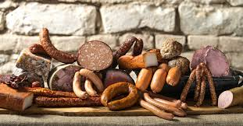
Introduction to Strategies
TASKS FOR ONLINE SEMINAR
Create a strategy for Footshop.
You are selling meat products like salami, sausages, etc. and a new competitor from Poland invades your market – they are claiming to offer the same quality and are cheaper. Propose a strategy.

Slide 46
Introduction to Strategies
THE END
Thank you for your attention.
☺

