Slide 1

STATE BUDGET
Professional English language
Klára Kajfoszová, Tereza Grygerková a Aneta Cieslarová
Public Economics and Administration
3. year

Slide 2

Content
State budget
Income and costs
Budget cycle and phases
Compare of state budget between 2015-2021
Structure of expenses and income of the 2021 budget
State budget for 2023

Slide 3
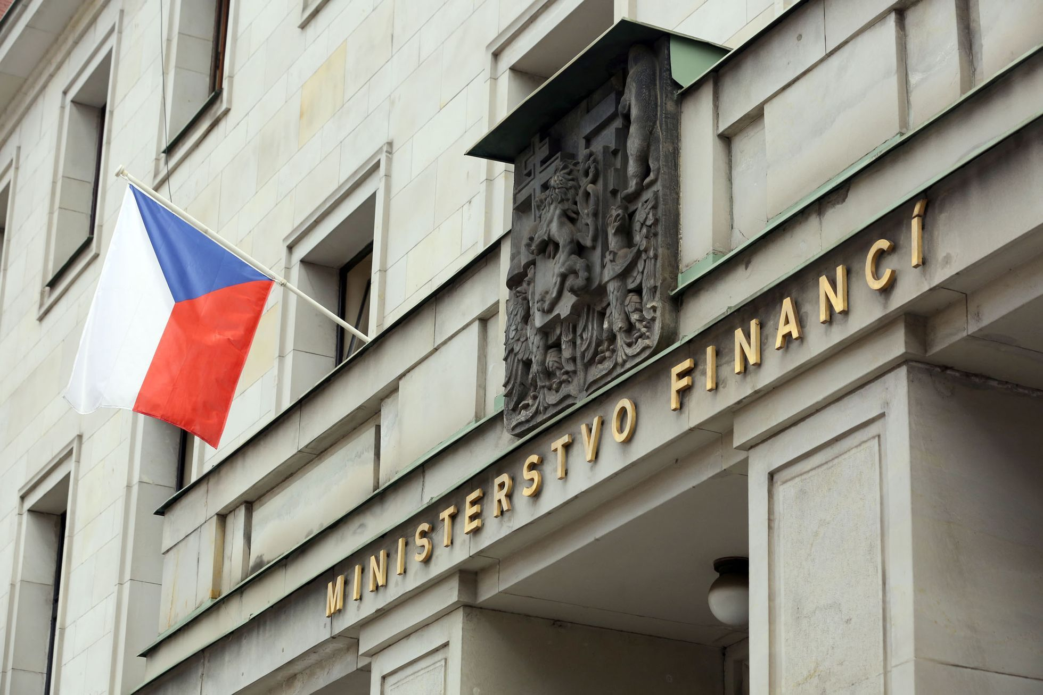
STATE BUDGET
State financial management plan
Usually planned for 1 year
Economic, social and political functions of the state
Estimation of income from various sources and distribution of expenses
3 types : deficit
  : balanced
  : redundant
The proposal is submitted by the government and the Ministry of Finance
The Chamber of Deputies approves the state budget
Zdroj: https://www.aktualne.cz/wiki/politika/ministerstvo-financi/r~i:wiki:3626/

Slide 4

REVENUES AND EXPENSES
STATE BUDGET
Taxes
Customs duties
Fees
Subsidies, supports, donations
Loans from the state
Social insurance
Mandatory (required)
- insurance, benefits, support
- EU levies
Quasi mandatory (necessary)
- salaries of civil servants
- the army
Non-mandatory (unnecessary)
- transport, education, sport

Slide 5
BUDGET CYCLE AND PHASES
1. Preparation
January - September
2. Approval
October - December
3. Realization
January - December
4. Evaluation
January - April
1. Ministry of Finance
2. Chamber of Deputies
3. Ministries and central authorities
4. Ministry of Finance, Government, Supreme audit Office

Slide 6
Comparison of the state budget in the years 2015 - 2021
Surplus budget
-2016 - 2018
deficit budget
- 2015 - 2017
- 2019 - 2020 - 2021
year
2015
2016
2017
2018
2019
2020
2021
2021
amendment
INCOMES
costs
budget balance
mld. Kč
Bill.

Slide 7
Were you paying attention?
Who accepts the budget of the Czech Republic?
When was the Czech Republic in surplus?

Slide 8
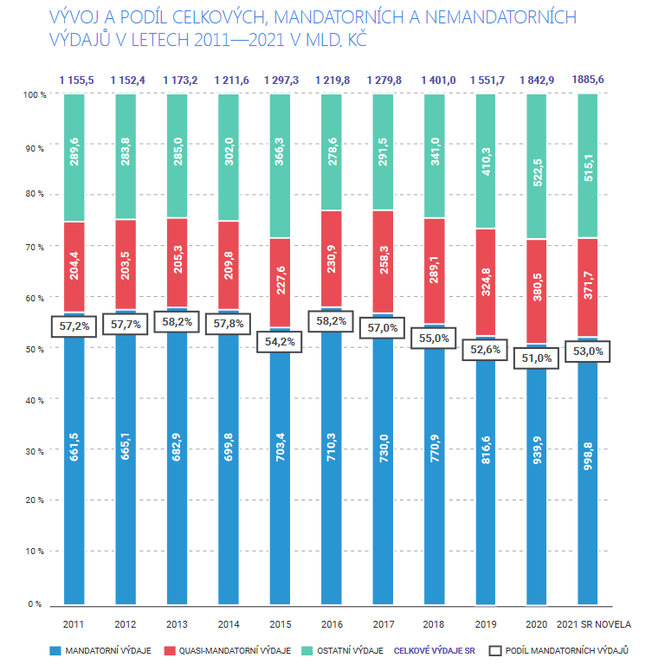
Development and share of total mandatory and NON-mandatory expenditures
Amendment
Mandatory costs
Quash mandatory costs
Other costs
Total costs of the SB
Share of mandatory costs
Zdroj: Webový portál Evropské unie [online] [vid. 7. října 2022]. Dostupné z https://www.mfcr.cz/assets/cs/media/Informacni-letak_2021_Statni-rozpocet-v-kostce_v01.pdf

Slide 9
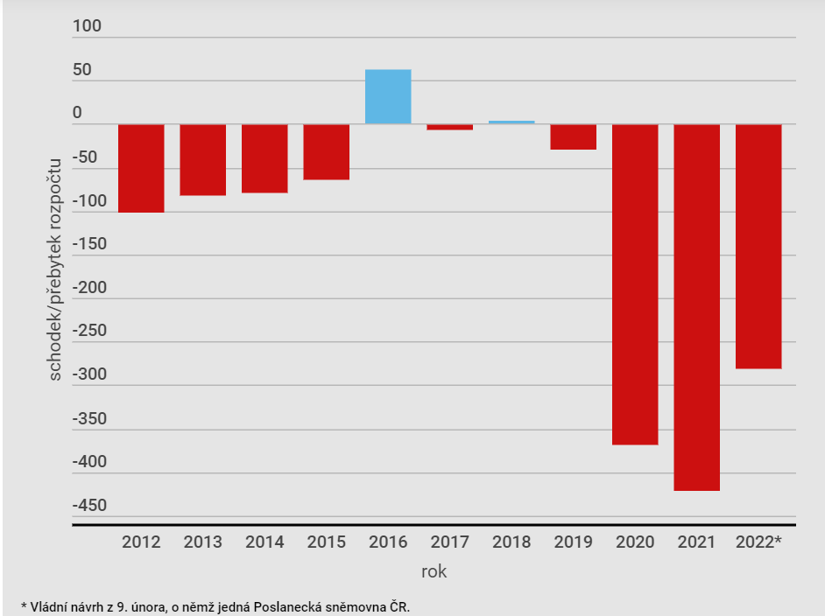
Development of the state budget deficit
SINCE 2012 TO 2022
budget deficit/surplus
The government's proposal from February 9, which is discussed by the Chamber of Deputies
Zdroj: Webový portál Evropské unie [online] [vid. 7. října 2022]. Dostupné z https://www.denik.cz/ekonomika/tripartita-statni-rozpocet-20220209.html

Slide 10
The structure of the income of the state budget for 2021
Webový portál Evropské unie [online] [vid. 7. října 2022]. Dostupné z https://www.mfcr.cz/assets/cs/media/Informacni-letak_2021_Statni-rozpocet-v-kostce_v01.pdf

Slide 11
State budget for 2023
During the reign of Petr Fiala
Projected incomes 1.928 billion
295 billion planned costs
The deficit is planned – 2.223 billion
In our opinion, everything depends on how the war in Ukraine will end
We also going through the energy crisis, which will affect our state budget too

Slide 12
Thank you for your attention

Slide 13
resources
Webový portál Evropské unie [online] [vid. 7. října 2022]. Dostupné z https://www.mfcr.cz/assets/cs/media/Informacni-letak_2021_Statni-rozpocet-v-kostce_v01.pdf
JUREČKA , V. a kolektiv, 2017. Makroekonomie. 3., aktualizované a rozšířené vydání. Praha: Grada Publishing a.s.
Webový portál svetbank [online] [vid. 7. října 2022]. Dostupné z https://www.svetbank.cz/statni-rozpocet-kolik-cini-a-kdo-ho-schvaluje/#Kdo_schvaluje_statni_rozpocet

