Slide 1

BASIC TERMS
AND CONTEXT
OF ECONOMICS
LESSON I
Dr. Ingrid Majerova
Basic Microeconomics
EVS/xxxx

Slide 2

First….
Name: Ingrid Majerova
Office: A 203
E-mail: majerova@opf.slu.cz
Consultation hours: …….
Info: Moodle
IS SU

Slide 3
Outline of the Lecture
What is Economics?
Two Branches and Kinds of Economics
Factors of Production
Returns of Scale
Models in Economics

Slide 4
GENERAL ECONOMIC THEORY
WHAT IS ECONOMICS …
Introduction to the study of economic disciplines is a general economic theory
  deals with the regularities of society´s economic life,
  describes abstract mechanisms of their functioning that help to understand the logic of real economic processes.
Economics therefore examines how scarce resources are used to produce useful commodities
ECONOMICS IS SCIENCE, ECONOMY IS REALITY

Slide 5
GENERAL ECONOMIC THEORY
TWO BRANCHES OF ECONOMICS
Mathematical branch - asserts that the criterion of truthfulness is the possibility of mathematical proof:
PROFIT = ...
Social branch - rejects mathematics in economics, economics is a science of human behavior and production
UNABLE TO WRITE INTO FORMULAS….

Slide 6
GENERAL ECONOMIC THEORY
TWO KINDS OF ECONOMICS
Positive economics - accepts the economic reality as it is. Its aim is to describe this reality and find in it regularities of the functioning:
INFLATION IS 1%.
Normative economics - exploring of reality is just the starting point. It evaluates the established facts and evaluates them usually critically. The aim of normative economics is to construct a prototype of more perfect economic system, play an active role in the development of human society.
NATIONAL BANK ANNOUNCED 2% INFLATION.

Slide 7
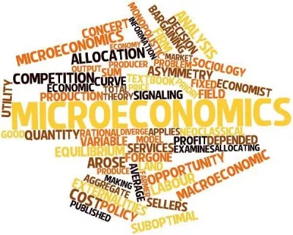
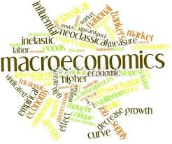
GENERAL ECONOMIC THEORY
TWO KINDS OF ECONOMICS
Positive economics is divided into:
  Microeconomics - examines the behavior of individual economic entities (individuals, households, firms), the state and development of individual markets
  PRICES ON MOBILE PHONE MARKET
  Macroeconomics - deals with the economy as a whole and is the basis
  of economic policy
INFLATION IN THE ECONOMY

Slide 8


SOME IMPORTANT TERMS
INPUTS AND OUTPUTS
Inputs - goods or services which are used by companies in manufacturing
FLOUR
Outputs - goods or services that are either consumed or used for further production

Slide 9

SOME IMPORTANT TERMS
ECONOMIC RARENESS
Economic goods - items that man needs or she desires
- Economic goods are characterized by their rarity
All goods are characterized by two properties
  usefulness (satisfies the needs)
  availability (scarcity)
Rare good - a subject that is useful, but it is shortcoming to satisfy the needs.
Free good - a subject that is useful and also freely available

Slide 10

SOME IMPORTANT TERMS
PRODUCTION
Production - the process of transformation of natural resources (through factors of production) to economic goods that satisfy needs
Man must produce most of the goods from natural sources, which can be found in nature in limited or unlimited amount
  but these resources by themselves are useless

Slide 11
SOME IMPORTANT TERMS
FACTORS OF PRODUCTION
In the production of economic goods human uses rare goods - Factors of Production - F:
Land - A - is a product of nature, but it is not a free good. Land rent is a revenue from the land. Land is a part of natural resources.
PRIMARY PRODUCTION FACTOR
Labor - L - is a human activity, the holder is human. The result of the use of labor is wage.
PRIMARY PRODUCTION FACTOR
Capital - K - goods that were made to participate in the production of other goods.

Slide 12

SOME IMPORTANT TERMS
FACTORS OF PRODUCTION
Capital - is not made for immediate consumption, but to become a production factor. Capital can also be called capital goods. The result of using capital is profit or interest.
SECONDARY PRODUCTION FACTOR
Technology - a special form of capital, which has no material form (thoughts, ideas, original approach). Can significantly multiply the effects of labor and capital.
Income from the production factors have motivational character
driving force of the economic system.

Slide 13
SOME IMPORTANT TERMS
RETURNS OF SCALE
High production efficiency is conditioned by high returns of production factors.
The Law of Diminishing Returns - return of one factor, whose volume increases, will decrease.
Valid only assuming that output is increasing due to the growth of a one factor of production, when volume of other factors is unchanged.

Slide 14
SOME IMPORTANT TERMS
THREE TYPES OF RETURNS OF SCALE
Increasing Returns of Scale - growth in the volume of used production factors leads to more rapid growth of revenues from them.
Constant Returns of Scale - income from production factors increases proportionally with the growth of the scale of their involvement in the production.
Diminishing Returns of Scale - revenue growth in factors of production is lower than the growth of these factors.

Slide 15
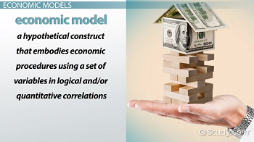
SOME IMPORTANT TERMS
MODELS IN ECONOMICS
The economic relations are displayed by the models
The economic model is a (non)formalized displaying of real functioning economy, whose main aim is to simplify the described economic system, keeping its essential characteristics.
It can be formulated:
  verbally,
  graphically,
  mathematically.

Slide 16
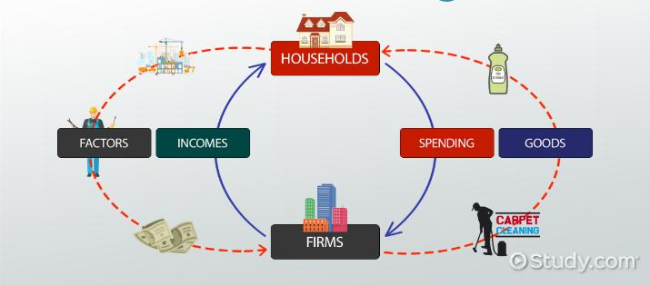
SOME IMPORTANT TERMS
MODEL IN ECONOMICS

Slide 17
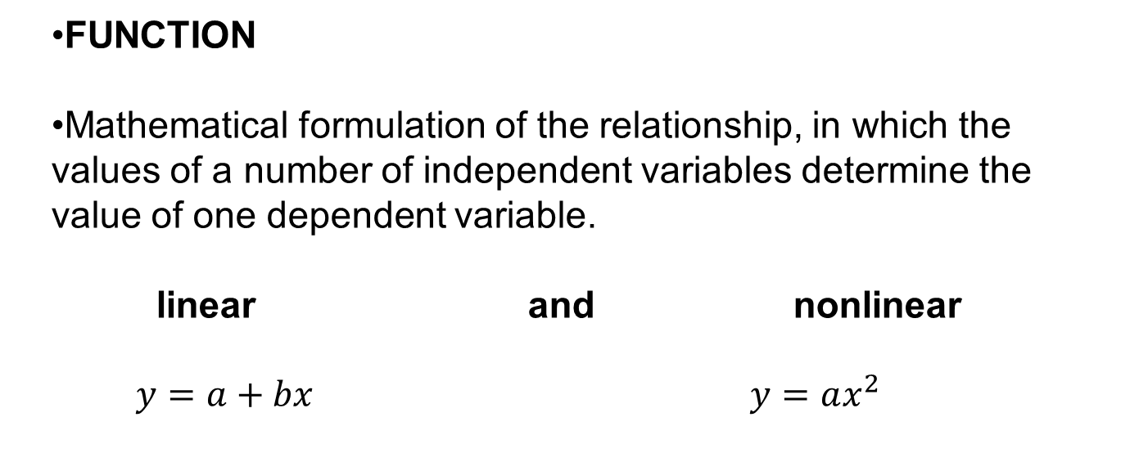
SOME IMPORTANT TERMS
ECONOMIC ANALYSIS

Slide 18
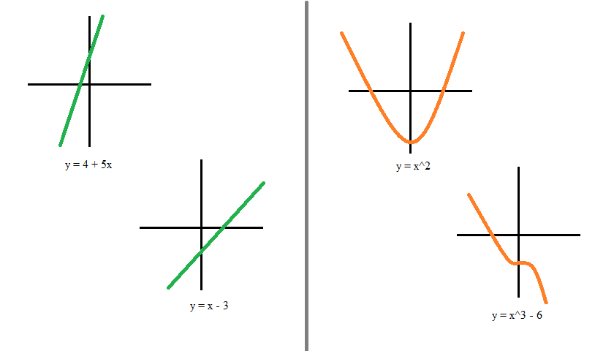
SOME IMPORTANT TERMS
GRAPH
graphical representation of the function
alteration of function is expressed with slope
The slope of the linear function graph is expressed mathematically by first derivative
Figure 1 Linear and nonlinear function

Slide 19
SOME IMPORTANT TERMS
ECONOMIC ANALYSIS
The derivative is changing of the dependent variable related to infinitely small change in the independent variable.
Economics interprets the first derivative of the total variable function as its (total) marginal variable.
Marginal value expresses increase in the dependent variable due to changes in the independent variable by one unit.
We also determine the average value (the share of dependent variable per unit of the independent variable).

Slide 20
THE END
THANK YOU FOR YOUR ATTENTION . . .

