Slide 1

REVENUES, OUTPUT AND SUPPLY OF THE FIRM IN PERFECT COMPETITION
LESSON VII
Dr. Ingrid Majerova
Basic Microeconomics
EVS/xxxx

Slide 2

Outline of the Lecture
Perfect Competition
Firm Revenues in Perfect Competition
Firm Supply in Short Run
Elasticity of Supply
Firm Output in Long Run

Slide 3

REVENUES, OUTPUT AND SUPPLY OF THE FIRM
FIRM REVENUES AND THE MARKET STRUCTURE
Firm revenues = the sum of money received from the sale of firm production (sales)
Maximum of profit can also be achieved by maximizing of income
Revenues development is influenced by the type of market structure in the industry, or by the price elasticity of demand for production companies
perfect and imperfect competition

Slide 4
REVENUES, OUTPUT AND SUPPLY OF THE FIRM
PERFECT COMPETITION
A large number of buyers and sellers in each market
Nobody is strong enough to affect the price or output of sector
All goods are homogeneous
There are no barriers to entry and exit on any market
All producers and consumers are fully informed about prices and quantities on the market
Companies seeking to maximize profits, consumers to maximize their utility

Slide 5
REVENUES, OUTPUT AND SUPPLY OF THE FIRM
FACTS BASED ON ASSUMPTION
Firm is so called "price taker" - the price is objectively determined by market
Market share of each firm is minimal
Individual demand of firm (demand for the production of one firm) is infinitely elastic - parallel line to the axis "x" at market price
Curves of average and marginal revenues are identical and coincide with the curve of individual demand

Slide 6
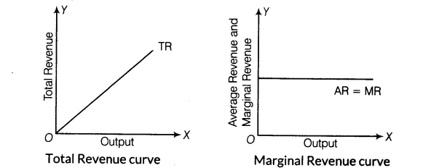
REVENUES, OUTPUT AND SUPPLY OF THE FIRM
TOTAL REVENUES IN PERFECT COMPETITION
Production is constant
→
Total revenues grow linearly

Slide 7
REVENUES, OUTPUT AND SUPPLY OF THE FIRM
AVERAGE AND MARGINAL REVENUES IN PERFECT COMPETITION
Costs of production are objectively determined by the market and do not change with the change of sales volumes
Average and marginal revenues are identical to the price level - AR and MR curves are also the demand curve for production of one firm

Slide 8

REVENUES, OUTPUT AND SUPPLY OF THE FIRM
ELASTICITY OF DEMAND
Elasticity of demand - the relationship between price and marginal cost of production - Inverse Elasticity Pricing Rule
With the increase of price elasticity decreases the difference between price of production and marginal cost
MR = P + Q. ΔP/ ΔQ
= P (1+ Q/P . ΔP/ΔQ)
= P (1 + 1/ PED)
don’t forget PED = Q/P . ΔP/ΔQ)
Profit maximum occurs when MR = MC
Therefore P (1 + 1/ PED) = MC
(P-MC) / P = – 1/ PED

Slide 9
REVENUES, OUTPUT AND SUPPLY OF THE FIRM
FIRM OUTPUT IN SHORT RUN
The firm chooses its output at which maximizes profit, ie where:
the maximum difference between total revenues and total costs, or:
marginal revenue and marginal cost are equal
The golden rule of profit maximization:
MR = MC

Slide 10
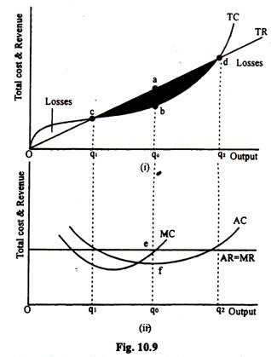
REVENUES, OUTPUT AND SUPPLY OF THE FIRM
FIRM OUTPUT IN SHORT RUN
Q1 and Q2 the firm reaches the zero conomic profit
Qo MR = MC – maximum of economic profit
Optimal output in short run

Slide 11
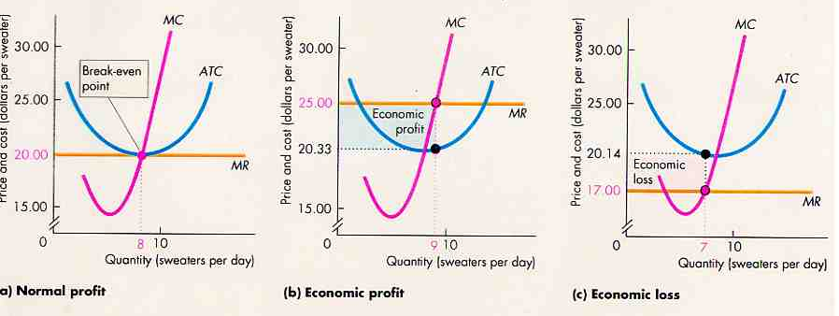
REVENUES, OUTPUT AND SUPPLY OF THE FIRM
SITUATION IN SHORT RUN

Slide 12
REVENUES, OUTPUT AND SUPPLY OF THE FIRM
SUPPLY OF THE FIRM
Individual supply curve (supply of the firm) is formed by rising part of the SMC curve, bounded point min. AVC
The firm must cover at least the short-term variable costs (to pay wages, energy, etc.)
Fixed costs (amortization rule) may not be covered in the short run
P≤ AVC - SHUTDOWN point, the firm minimizes the loss if it does not continue in production

Slide 13
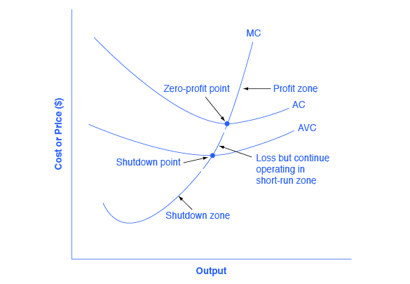
REVENUES, OUTPUT AND SUPPLY OF THE FIRM
SITUATION IN SHORT RUN – SHUTDOWN POINT

Slide 14
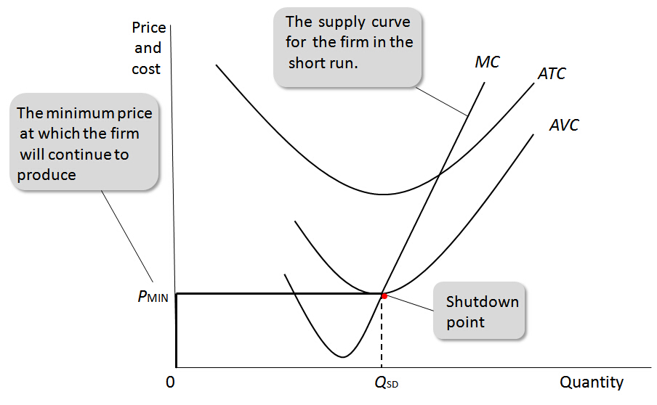
REVENUES, OUTPUT AND SUPPLY OF THE FIRM
SUPPLY OF THE FIRM
Individual supply curve of the firm = increasing part of the curve SMC bounded with minimum AVC
WHY minimum AVC?

Slide 15
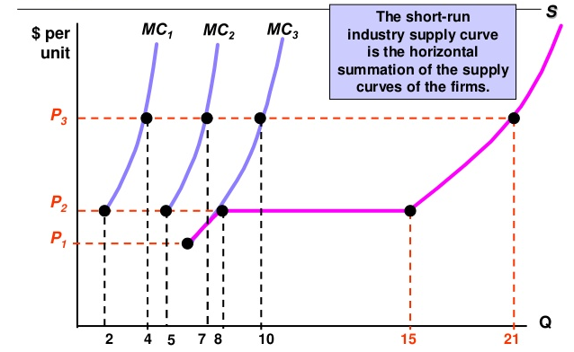
REVENUES, OUTPUT AND SUPPLY OF THE FIRM
SUPPLY OF THE INDUSTRY IN PERFECT COMPETITION – SHORT RUN
Industry supply curve = MARKET SUPPLY
S = ∑ MC

Slide 16

REVENUES, OUTPUT AND SUPPLY OF THE FIRM
ELASTITICTY OF SUPPLY
The price elasticity of supply affects the slope of the market supply curve
rate of sensitivity of the market supply to change of the product offered price
percentage change of the output caused by one percent change in the price of output
Price elastic supply (eps ˃ 1) ↑ P ˂ ↑ Q
Unitary elastic supply (eps = 1) ↑ ↑ P = Q
Price inelastic supply (eps ˂ 1) ↑ P ˃ ↑ Q

Slide 17
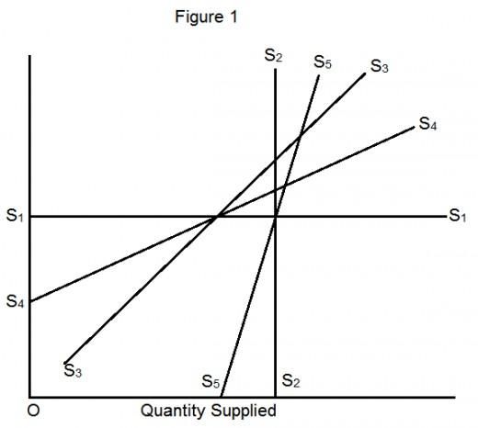
REVENUES, OUTPUT AND SUPPLY OF THE FIRM
ELASTICITY AND MARKET SUPPLY
S1 TOTALLY ELASTIC
S2 TOTALLY INELASTIC
S3 UNITARY ELASTIC
S4 ELASTIC
S5 INELASTIC

Slide 18
REVENUES, OUTPUT AND SUPPLY OF THE FIRM
FIRM OUTPUT IN LONG RUN
The FIRM may change the volume of all factors of production in the long run
Optimal output when P = MR = LMC
Influenced by free access and output into the industry
Firm in pefect competition has zero long-term economic profit - long-term optimum of firm
P = MR = SMC = LMC = SAC = LAC

Slide 19
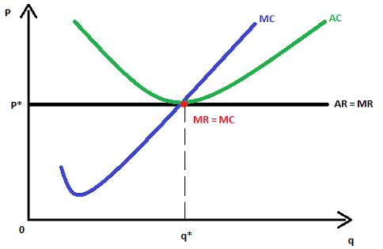
REVENUES, OUTPUT AND SUPPLY OF THE FIRM
FIRM OUTPUT IN LONG RUN
Perfectly competitive firm is in long run equilibrium, there is no reason to enter the or to exit the industry

Slide 20
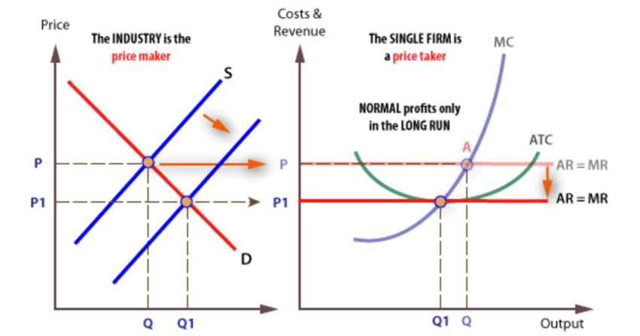
REVENUES, OUTPUT AND SUPPLY OF THE FIRM
SITUATION IN LONG RUN
If the market price is higher than the AC, the firm reaches economic profit - only short-term equilibrium (curve S)
Profit industry will attract other firms (shift from S to S1),
  decline in market prices
  the equilibrium: point whit the normal profit

Slide 21
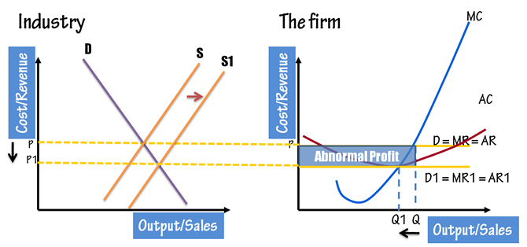
REVENUES, OUTPUT AND SUPPLY OF THE FIRM
SITUATION IN LONG RUN
If the market price is lower than the AC, the firm reaches economic losses
Firms leave the industry (shift from S to S1)
  Industry price begin to rice
  the equilibrium: point where the normal profit is

Slide 22
REVENUES, OUTPUT AND SUPPLY OF THE FIRM
FIRM SUPPLY IN LONG RUN
Is the following statement correct?
„Firm supply curve in LR is identical with the rising part of the curve LMC bounded minimum of LAC."
Industry supply = a set of long-term equilibrium points of industry = a set of intersections shifting market demand curves and short-term market supply
Long Industry Supply curve (LIS)
Shape of the LIS curve depends on the prices of inputs, respectively whether and how the input prices are changing

Slide 23
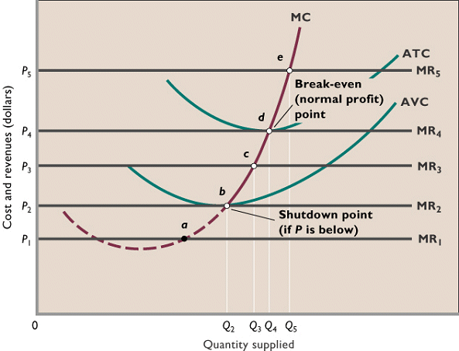
REVENUES, OUTPUT AND SUPPLY OF THE FIRM
SITUATION IN SHORT AND LONG RUN

Slide 24
REVENUES, OUTPUT AND SUPPLY OF THE FIRM
EFFICIENCY OF PERFECT COMPETITION
Productive and allocative efficiency:
Productive efficiency: the firm produces output with minimal LAC - in the short term the company has not produce with minimal AC
Allocative efficiency: such an output is produced that consumers want the most - the reallocation of resources will not increase the firm's output nor consumer benefit (absence of expenses deadweight)
P = MC

Slide 25
THE END
THANK YOU FOR YOUR ATTENTION . . .

