Slide 1

The Financial Statements
Lecture of Corporate Finance
Ing. Tomáš Heryán, Ph.D.
Mgr. Tetiana Konieva, Ph.D
Corporate Finance
FIU/BAFIK

Slide 2

Outline of the lecture
Financial statements: forms
Balance Sheet
Income Statement
Income Statement: Accrual Basis of Accounting
Cost of production manufactured
Types of costs
Types of profits
Cash Flow Statement
Cash Flow Statement: types of activities
Objective and main reasons for preparing of financial statement
Financial statement – consolidated, individual and separate
Qualitative characteristics of financial statement
Limitations of the financial statements

Slide 3
Financial statements: forms
Financial Statements represent a formal record of the financial activities of an entity.
These are written reports that quantify the financial strength, performance and liquidity of a company. Financial Statements reflect the financial effects of business transactions and events on the entity.
The objective of financial statements is to provide information about the financial position, performance and changes in financial position of an entity that is useful to a wide range of users in making economic decisions.
Financial statement
Balanced sheet (statement of financial position)
Profit and loss statement (income statement)
Cash flow statement
Statement of changes in ekvity
Notes, comprising a summary of significant accounting policies
Comparative information prescribed by the standard

Slide 4
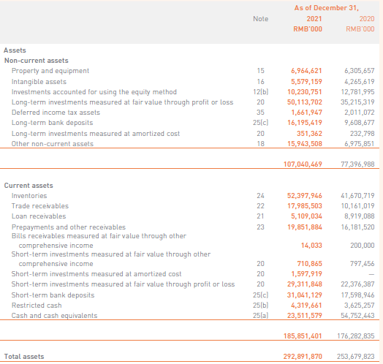
Balance Sheet:
Fundamental accounting equation :
Equity (Net Assets) = Assets – Liabilities Or Assets = Equity + Liabilities
Balance Sheet (Assets) of XIAOMI CORPORATION:

Slide 5

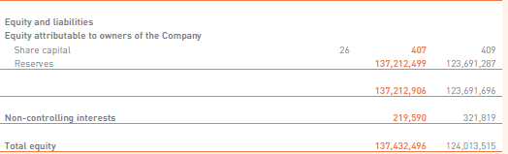
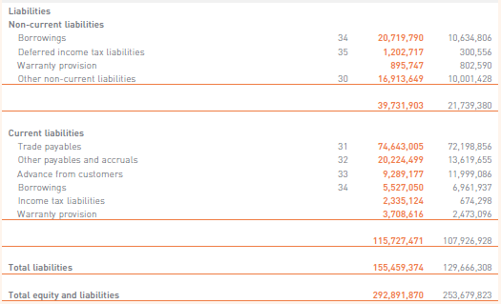
Balance Sheet:
Fundamental accounting equation :
Equity (Net Assets) = Assets – Liabilities Or Assets = Equity + Liabilities
Balance Sheet (Equity and Liabilities) of XIAOMI CORPORATION:

Slide 6
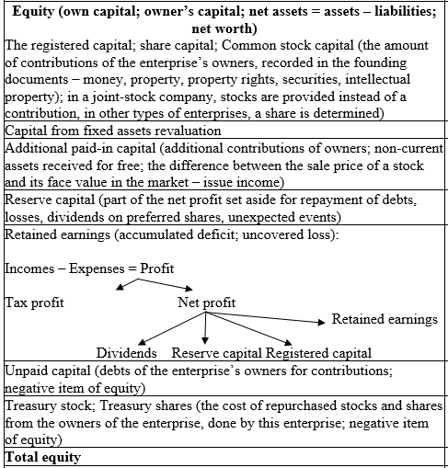
Balance Sheet: Equity

Slide 7
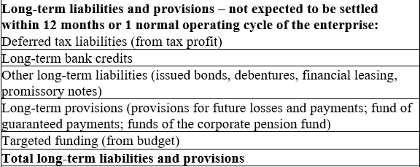
Balance Sheet: Long-term liabilities (International Accounting Standard
IAS 1 – Presentation of Financial Statements)

Slide 8
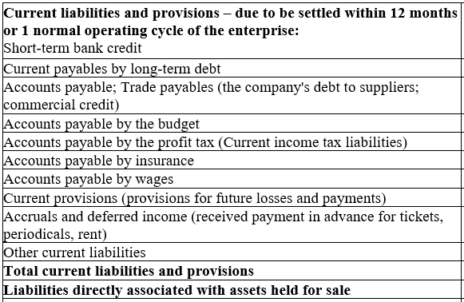
Balance Sheet: Current liabilities

Slide 9
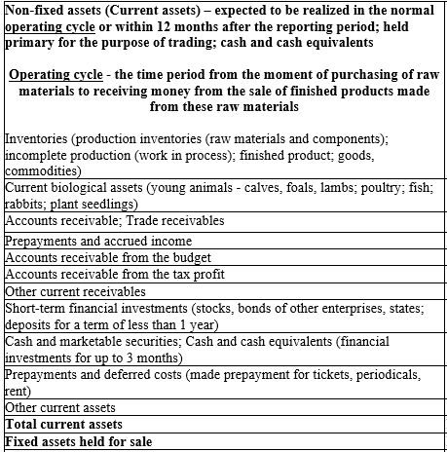
Balance Sheet: Current assets (non-fixed assets)

Slide 10
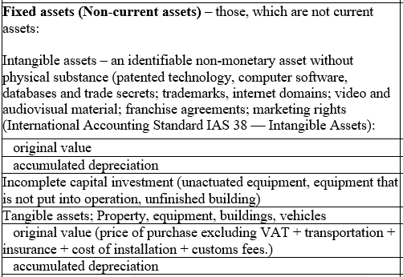
Balance Sheet: Fixed assets (non-current assets)

Slide 11
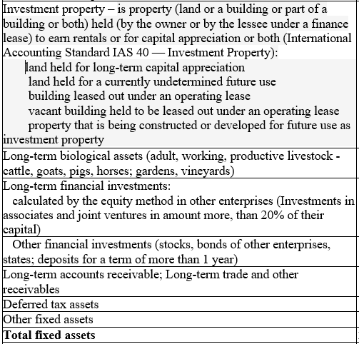
Balance Sheet: Fixed assets (non-current assets)

Slide 12
Double accounting
Double entry (double accounting) - a fundamental concept underlying present-day bookkeeping and accounting, states that every financial transaction has equal and opposite effects in at least two different accounts. It is used to satisfy the fundamental accounting equation :
Assets = Equity + Liabilities
In the double-entry system, transactions are recorded in terms of debits and credits. Since a debit in one account offsets a credit in another, the sum of all debits must equal the sum of all credits.
There are seven different types of accounts that all business transactions can be classified:
Assets (normal balance on Debit)
Liabilities (normal balance on Credit)
Equities (normal balance on Credit)
Revenue (normal balance on Credit)
Expenses (normal balance on Debit)
Gains (normal balance on Credit)
Losses (normal balance on Debit)

Slide 13
Double accounting (continuation)
Types of the transactions:
1. Assets +, Assets –
Example: payment 2000 from buyers for the delivered production to the banking account
2. (Equity/Liabilities) +, (Equity/Liabilities) –
Example: direction of reserved capital 3000 to uncovered losses in amount 3000
Assets | Equity + Liabilities
+ Banking account 2000
- Accounts receivable (debt of the buyers for delivered production) 2000
Assets | Equity + Liabilities
 | - Reserved capital 3000
 | + Uncovered losses 3000

Slide 14
Double accounting (continuation)
Types of the transactions:
3. Assets +, (Equity/Liabilities) +
Example: Receiving of bank credit 10000
4. Assets – , (Equity/Liabilities) –
Example: Repayment of trade payable to the suppliers 15000
Assets | Equity + Liabilities
+ Banking account 2000 | + Bank credit 10000
Assets | Equity + Liabilities
- Banking account 15000 | - Trade payable 15000

Slide 15
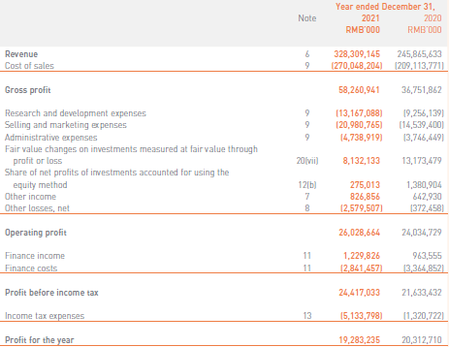
Income Statement
Income Statement of XIAOMI CORPORATION :

Slide 16
Income Statement: Accrual Basis of Accounting
Income (Revenue) – growing of economic benefits in the form of assets increasing or liabilities decreasing,
that leads to increasing in equity, other than increasing relating to contributions from owners
Expenses (costs, expenditures) – reducing of economic benefits in the form of assets decreasing or liabilities increasing, that leads to
decreasing in equity, other than decreasing because of repurchasing stocks or reducing the quantity of owners
Profit = Incomes – Costs
Loss = Incomes – Costs (in case Costs > incomes)
Accrual basis of accounting:
Under the accrual basis of accounting, revenues are reported on the income statement when they are earned. When the revenues are earned but cash is not received, the asset accounts receivable will be recorded.
Recognition of revenue (International Accounting Standard 18 – Revenue):
the seller has transferred to the buyer the significant risks and rewards of ownership
the seller retains neither continuing managerial involvement to the degree usually associated with ownership nor effective control over the goods sold
the amount of revenue can be measured reliably
it is probable that the economic benefits associated with the transaction will flow to the seller, and
the costs incurred or to be incurred in respect of the transaction can be measured reliably
Expenses are reported on the income statement when they match up with the revenues being reported, or when a cost has no future benefit that can be measured. When an expense occurs and cash has not yet been paid, a liability account will also be recorded.

Slide 17
Accrual Basis of Accounting (continuation)
Transaction | Revenue, income | Cash inflow
1. Delivered production to buyers and received cash from them 20000 | 20000 | 20000
2. Delivered production to buyers with payment delay 20000 | 20000 | -
3. Received prepayment 20000 from the buyers for production, that have not been delivered yet | - | 20000
4. Received bank credit 30000 | - | 30000
5. Company issued shares and sold them at exchange market 15000 | - | 15000
6. Company received cash dividends from financial investments on the declaration date 1400 | 1400 | 1400
7. Company is declared cash dividends 1400 from financial investments in September, that will be paid in October | 1400 (September) - (October) | - 1400 (October)

Slide 18
Accrual Basis of Accounting (continuation)
Transaction | Expenses | Cash outflow
1. Company paid in advance for inventories 23000 | - (the price of bought inventories will be expenses after the manufacturing the production from them and its selling) | 23000
2. Returning bank credit 30000 | - | 30000
3. Salary is calculated for September 42000, it will be paid at the beginning of October | 42000 | - 42000 (in October)
4. Made prepayment for annual rent 56000 | - (56000/12 – will be cost at the end of every month of the year ) | 56000
5. Company paid dividend for owners 4000 | - (dividends are not expenses, because they are paid from net profit after all expenses) | 4000
6. Company calculated depreciation of equipment 1200 | 1200 | -

Slide 19
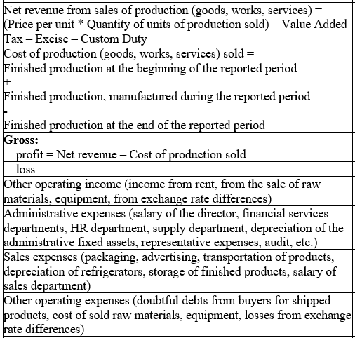
Income Statement

Slide 20
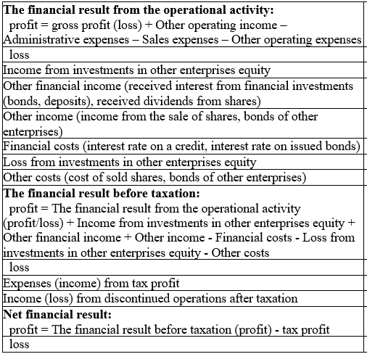
Income Statement

Slide 21
Cost of production manufactured:
direct material costs (materials, energy, gas, water, spent
for the manufacturing of the production) +
direct labor costs (salary of employees, that manufacture the production) +
Cost of spoiled production +
depreciation of equipment, that takes part in manufacturing process +
general production costs (for maintaining the workshop, where production manufactured; salary of the workshop director, workshop cleaners; heating and lightening of the workshop)

Slide 22
Types of costs
Fixed costs
Costs independent of the quantity produced
Variable costs
Costs dependent on the quantity produced
Marginal costs
The cost of the last produced unit
Opportunity costs
The cost of sacrificing opportunities
Indirect costs
Costs that can not be assigned directly to a particular performance
An increase in the total cost of producing one extra product
It is necessary to budget them in a certain way

Slide 23
Types of profits:
Gross profit = net revenue – cost of production sold
Operating profit (The financial result from the operational activity) = gross profit (loss) + Other operating income – Administrative expenses – Sales expenses – Other operating expenses
Profit from the investing activity = Income from investments in other enterprises equity + Other financial income +Other income - Loss from investments in other enterprises equity- Other costs
Loss from the financing activity = Financial costs (financing activity does not bring any incomes)
EBITDA (earning before depreciation and amortization, interest rate and tax profit) = EBT + interest rate (financial costs) + depreciation of tangible assets + amortization of intangible assets
EBIT (earning before interest rate and tax profit) = EBT + interest rate (financial costs)
EBT (earning before taxation (tax profit)) = The financial result from the operational activity (profit/loss) + Income from investments in other enterprises equity + Other financial income + Other income - Financial costs - Loss from investments in other enterprises equity - Other costs
Net profit (profit after all expenses and taxation) = EBT – tax profit
Retained earning – net profit after dividends, contributions to reserve capital and registered capital

Slide 24
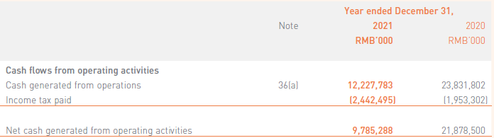
Cash Flow Statement
Cash Flow Statement (operating activity) of XIAOMI CORPORATION:

Slide 25
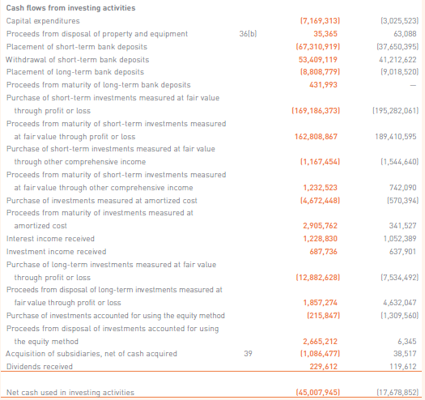
Cash Flow Statement (continuation)
Cash Flow Statement (investing activity) of XIAOMI CORPORATION:

Slide 26
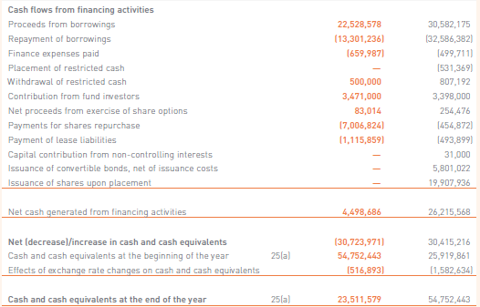
Cash Flow Statement (continuation)
Cash Flow Statement (financing activity) of XIAOMI CORPORATION:

Slide 27
[IAS 7.6]
Cash Flow Statement: types of activities
International Accounting Standard 7 — Statement of Cash Flows:
operating activities are the main revenue-producing activities of the entity that are not investing or financing activities, so operating cash flows include cash received from customers and cash paid to suppliers, employees, taxes. Cash flow from operating activities allows to determine to what extent profit from ordinary activities to truly earned money and how money influenced the production of changes in working capital and its components.
investing activities are the acquisition and disposal of long-term assets and other investments that are not considered to be cash equivalents. Examples of investing activities are cash outflow for the purchase of fixed assets and financial investments, securities issued by other entities; cash inflow from the sale of the fixed assets, financial investments, received dividends, interest rate
financing activities are activities that alter the equity capital and borrowing structure of the entity. Examples are: cash inflows (the sale of company shares, bonds, getting loans) and cash outflows (the repurchase of shares, bonds, returning the credit, interest rate and dividend payments).

Slide 28
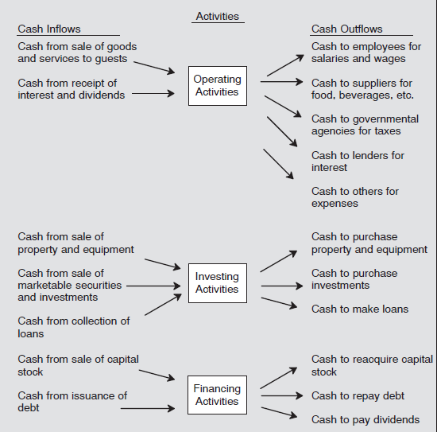
[IAS 7.6]
Cash Flow Statement: types of activities

Slide 29
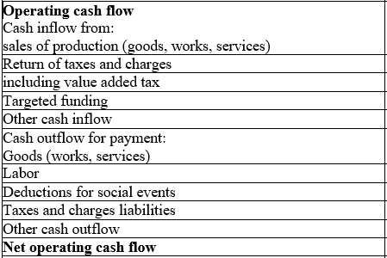
[IAS 7.6]
Cash Flow Statement: Operating cash flow (direct method)

Slide 30
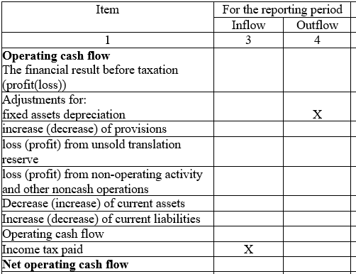
[IAS 7.6]
Cash Flow Statement: Operating cash flow (indirect method)

Slide 31
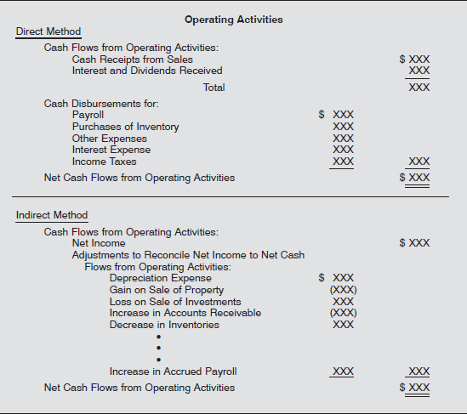
[IAS 7.6]
Cash Flow Statement: Operating cash flow (direct and indirect method)

Slide 32
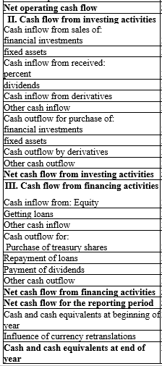
[IAS 7.6]
Cash Flow Statement: Cash Flows from investing and financing activities

Slide 33
Objective and main reasons for preparing of financial statement
The objective of the financial statements is to provide information on the financial position, performance and changes in the financial position of the entity that are useful to a wide range of users in making economic decisions.
The main reasons for the preparation of the financial statements are:
  The liability to prepare the financial statements imposes legislation on the entity.
  Presentation of the financial statements is a condition of the exchange in the issue of securities of the company.
  An enterprise shall present its financial statements in public, in particular to shareholders / investors.
Entities that are issuers of securities registered in a regulated securities market in the Member States of the European Union shall use the accounting and financial statements for the entity and the consolidated IFRS financial statements.

Slide 34
Financial statement – consolidated, individual and separate
Consolidated financial statements are the financial statements of a group of enterprises that combine the assets and liabilities and the results of the parent's holding with its interest in other entities that control or have a significant influence or controlling interest within the meaning of the Commercial Code, has significant or decisive influence.
The objective of the consolidated financial statements is to provide the shareholders of the parent and the professional public with comprehensive information on the total assets, liabilities, equity, costs and revenues of the economic and economic groupings of the enterprises that are linked to the capital.
Individual (unconsolidated) financial statements are compiled by enterprises that do not have subsidiaries to be consolidated.
Separate financial statements are prepared by an enterprise at the request of an institution (for example, a country's accounting regulator) or by its own will.

Slide 35
Qualitative characteristics of financial statement
The four principal qualitative characteristics are:
Understandability - it is essential that the information provided in financial statements is readily understandable by users. Users are assumed to have a reasonable knowledge of business and economic activities and accounting, and a willingness to study the information with reasonable diligence. Information on complex matters should not be omitted from financial statements merely on the grounds that some users may find it difficult to understand.
Relevance - information has the quality of relevance when it influences the economic decisions of users by helping them evaluate past, present or future events or confirming, or correcting, their past evaluations. Information has a predictive role in helping users to look to the future. Predictive value does not necessarily require a forecast.
Reliability - Information has the quality of reliability when it is free from material error and bias and can be depended upon by users to represent faithfully what it either purports to represent or could reasonably be expected to represent.
Comparability - means that users must be able to compare the financial statements of an enterprise over time to identify trends in its financial position and performance. Users must also be able to compare the financial statements of different enterprises to evaluate their relative financial position, performance and changes in financial position. Financial statements should show corresponding information for the previous period.

Slide 36
Limitations of the financial statements:
Indifferent to Market Values; heavy reliance on historical costs makes the financial statement less reliable and more misleading
Financial statements do not consider the effects of inflation on the assets and liabilities shown in the balance sheet
does not work with the time value of money; it does not affect exactly the present value of assets and liabilities
Specific Time Period; could be misleading because of seasonal impact on businesses, economic ups and downs, daily changes
Not Comparable; financial statement just gives an indication and does not facilitate true comparison between the two or more companies
Only some intangible assets are presented in the balance sheet, despite the real costs, spent on them
Does not reflect human resource investments
Possibility of financial statement manipulation
Environmental, sociological, political factors, competitive position, contribution towards local communities etc are ignored in the financial statements
UnAudited Financial Statements
There is no express indication by the financial statements about the future.
Financial statements highly focus on quantitative data and thus misses out on qualitative information
Represents absolute values

Slide 37
Thank you for your attention!

