Slide 1

Fixed assets: meaning, structure, depreciation, sources of financing
Lecture for Corporate Finance
Mgr. Tetiana Konieva, Ph.D
Corporate Finance
FIU/BAFIK

Slide 2

Outline of the lecture
Structure of fixed assets
Investing activity
Examples of tangible and intangible assets of Xiaomi
Distribution of depreciation of tangible and intangible assets by costs
Distribution the value of fixed assets
Tax saving effect
Terms of depreciation
The Four Basic Methods of Depreciation
Forming of depreciation fund
Sources for fixed assets financing

Slide 3
Structure of fixed assets:
Fixed assets (Non-current assets) – those, which are not current assets:
Intangible assets – an identifiable non-monetary asset without physical substance (patented technology, computer software, databases and trade secrets; trademarks, internet domains; video and audio-visual material; franchise agreements; marketing rights (International Accounting Standard IAS 38 — Intangible Assets) = original value - accumulated amortisation:
original value
accumulated amortisation
Incomplete capital investment (unactuated equipment, equipment that is not put into operation, unfinished building)
Tangible assets; Property, equipment, buildings, vehicles = original value - accumulated depreciation
original value (price of purchase excluding VAT + transportation + insurance + cost of installation + customs fees.)
accumulated depreciation
Investment property – is property (land or a building or part of a building or both) held (by the owner or by the lessee under a finance lease) to earn rentals or for capital appreciation or both (International Accounting Standard IAS 40 — Investment Property): land held for long-term capital appreciation land held for a currently undetermined future use building leased out under an operating lease vacant building held to be leased out under an operating lease property that is being constructed or developed for future use as investment property Investment property is property (land or a building or part of a building or both) held (by the owner or by the lessee under a finance lease) to earn rentals or for capital appreciation or both.
Long-term biological assets (adult, working, productive livestock - cattle, goats, pigs, horses; gardens, vineyards)
Long-term financial investments: calculated by the equity method in other enterprises (Investments in associates and joint ventures in amount more, than 20% of their capital)
Other financial investments (stocks, bonds of other enterprises, states; deposits for a term of more than 1 year)
Long-term accounts receivable; Long-term trade and other receivables
Deferred tax assets
Other fixed assets
Total fixed assets

Slide 4
Investing activity
International Accounting Standard 7 — Statement of Cash Flows:
investing activities are the acquisition and disposal of long-term assets and other investments that are not considered to be cash equivalents. Examples of investing activities are cash outflow for the purchase of fixed assets and financial investments, securities issued by other entities; cash inflow from the sale of the fixed assets, financial investments, received dividends, interest rate
II. Cash flow from investing activities
Cash inflow from sales of: financial investments
fixed assets
Cash inflow from received: percent
dividends
Cash inflow from derivatives
Other cash inflow
Cash outflow for purchase of: financial investments
fixed assets
Cash outflow by derivatives
Other cash outflow
Net Cash flow from investing activities

Slide 5
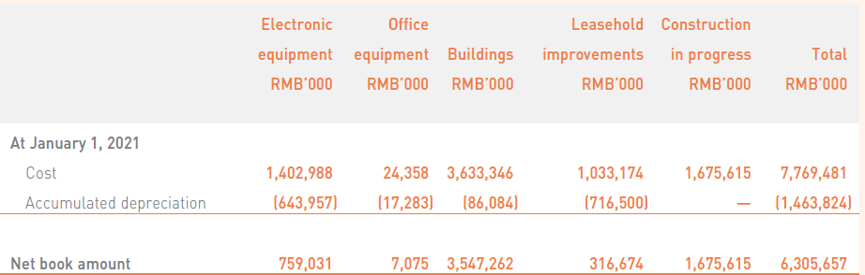
Examples of tangible assets of Xiaomi

Slide 6
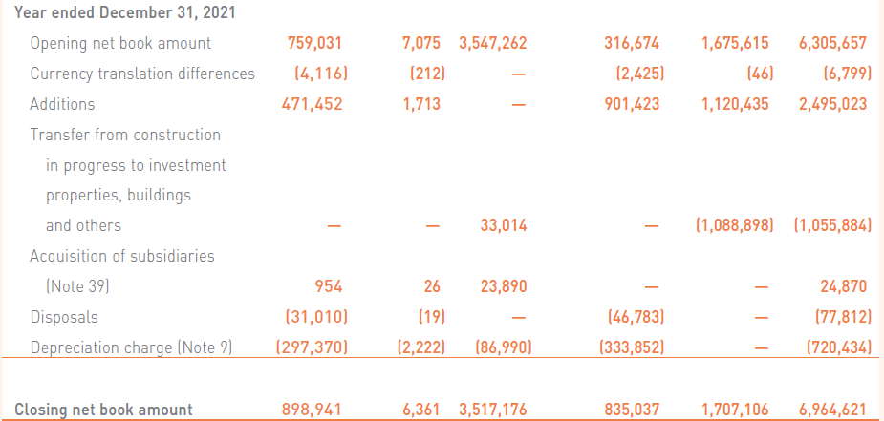
Examples of tangible assets of Xiaomi

Slide 7
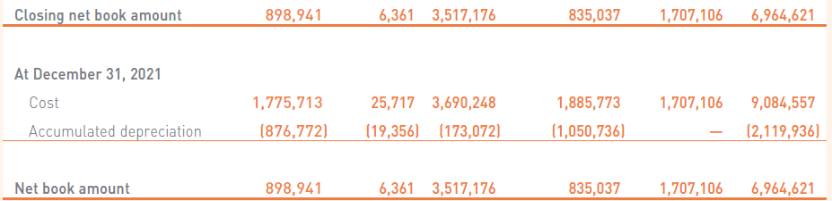
Examples of tangible assets of Xiaomi

Slide 8
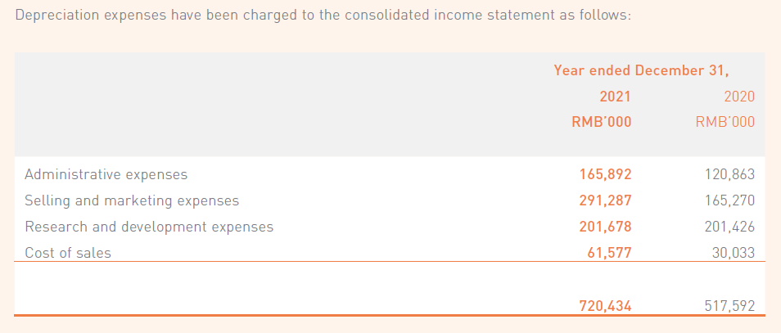
Distribution of depreciation of tangible assets by costs

Slide 9
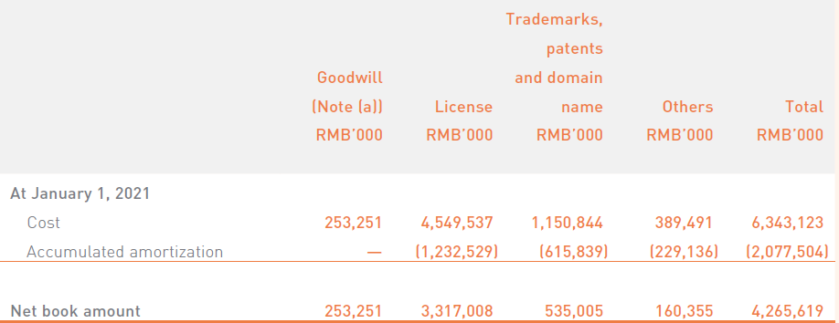
Examples of intangible assets of Xiaomi

Slide 10
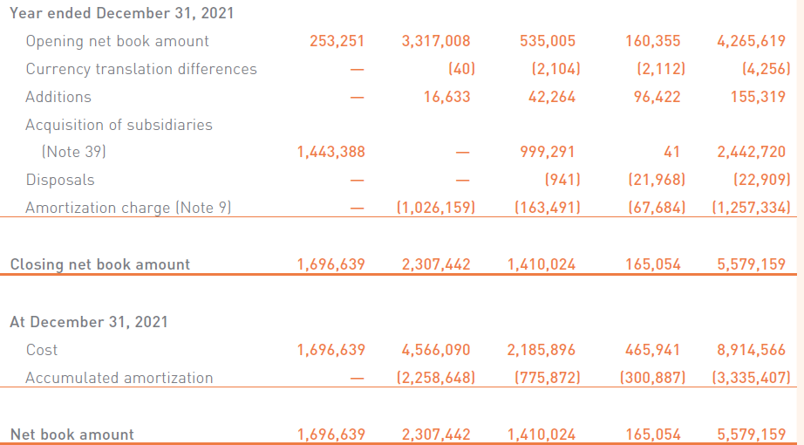
Examples of intangible assets of Xiaomi

Slide 11
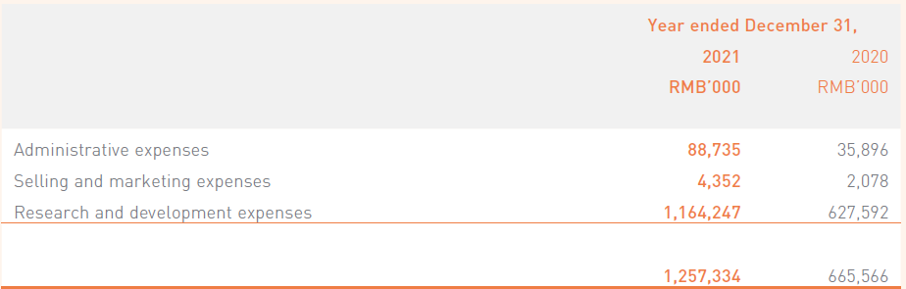
Distribution of depreciation of intangible assets by costs

Slide 12
Advantages of fixed assets:
• practically do not feel the impact of inflation, they are better protected from it
• they are characterized by a lower commercial risk of losses in the course of the company's operational activities;
they are practically protected from unscrupulous actions of partners
• these assets are able to generate a stable profit, ensuring the release of various types of products according to the conditions of the commodity market
• they contribute to the prevention (or significant reduction) of the loss of inventories in the process of their storage
• they are characterized by greater reserves for a significant expansion of the volume of operational activity during the period of growing in the commodity market

Slide 13
Disadvantages of fixed assets:
• subjected to material and moral wear (aging) (especially the active part of production fixed assets and intangible operating assets)
• these assets are difficult to manage operationally, since they change weakly in the structure in the short term
• weakly liquid assets (can be quickly transformed into cash), that cannot serve as a means of ensuring the flow of payments serving operational activities

Slide 14
Distribution the value of fixed assets
Original (beginning) value= Price of purchase without Value Added Tax + Freight (transportation) charges + Installation, testing + Insurance + Custom duties +Registration fees……..
Original value (for example, equipment = $100000; Useful life = 5 years (period, during which the assets serve)
$100000 = cash outflow from investing activity ≠ costs at once;
it is distributed during useful life; monthly part will be the cost
First year | Second year | Third year | Forth year | Fifth year
$100000/5 years/12 months=$1667= costs per month | $100000/5 years/12 months=$1667= costs per month | $100000/5 years/12 months=$1667= costs per month | $100000/5 years/12 months=$1667= costs per month | $100000/5 years/12 months=$1667= costs per month

Slide 15
Tax saving effect:
Tax profit = 18% * (incomes – costs)
Depreciation (amortization) is cost for the company, that decrease Tax profit, but doesn’t lead to cash outflow (spending money )
Depreciation (amortization) as cost can be included into the:
cost of production (direct material costs (materials, energy, gas, water, spent for the manufacturing of the production) + direct labor costs (salary of employees, that manufacture the production) + Cost of spoiled production + depreciation of equipment, that takes part in manufacturing process + general production costs (for maintaining the workshop, where production manufactured; salary of the workshop director, workshop cleaners; heating and lightening of the workshop) +
administrative costs (salary of the director, financial services departments, HR department, supply department, depreciation of the administrative fixed assets, representative expenses, audit, etc.),
sales costs (packaging, advertising, transportation of products, depreciation of refrigerators, storage of finished products, salary of sales department)
Example of Xiomi

Slide 16
Terms of depreciation
Original value= Price of purchase without Value Added Tax + Freight charges + Installation, testing + Insurance + Custom duties +Registration fees
Depreciation – distribution of original value of tangible assets during their useful life
Amortization – distribution of original value of intangible assets during their useful life
Useful life – period, during which the assets serve
Book value = original value – accumulated depreciation
Salvage (residual) value – price of asset’s selling at the end of useful life (0, >0……)
Depreciated value = original value – salvage value

Slide 17
The Four Basic Methods of Depreciation
Straight-line
Sum-of-the-years’ digits
Double declining balance
Units of production

Slide 18
The Four Basic Methods of Depreciation
Straight-line method:
Annual depreciation = (original value – salvage value)
useful life
Double declining balance:
Annual depreciation = Book value *2
useful life
Depreciation per month = Annual depreciation/12

Slide 19
The Four Basic Methods of Depreciation
Sum-of-the-years’ digits:
Annual depreciation =
(original value – salvage value) * quantity of years up to the end of useful life
1+2+3+4+5+6+……+10useful life
Units of production:
Annual depreciation = Annual amount of production from asset * (original value – salvage value)
total amount of production from asset
Depreciation per month = Annual depreciation/12

Slide 20
Forming of depreciation fund
Price of the unit of production $1000=
cost of production (direct material costs (materials, energy, gas, water, spent for the manufacturing of the production) + direct labor costs (salary of employees, that manufacture the production) + Cost of spoiled production + depreciation of equipment, that takes part in manufacturing process + general production costs (for maintaining the workshop, where production manufactured; salary of the workshop director, workshop cleaners; heating and lightening of the workshop)
+
profit (administrative costs (salary of the director, financial services departments, HR department, supply department, depreciation of the administrative fixed assets, representative expenses, audit, etc.), sales costs (packaging, advertising, transportation of products, depreciation of refrigerators, storage of finished products, salary of sales department), profit, tax profit, dividends)
+
Excise
+
custom duty
+
VAT value added tax
$1000 cash from the buyer (profit + depreciation )
Achieved money as depreciation should be accumulated into the depreciation fund for repairing, reconstruction, modernization, buying (building) new fixed assets
This fund is formed by byers, that is why original value should be calculated properly, including all costs, connected with fixed assets
The task of the company is selling the production, collecting money from buyers and forming the depreciation fund

Slide 21
Sources for fixed assets financing:
Depreciation funds
(Financial) Leasing
Long-term bank credit
Issued bonds
Equity (issued shares)

Slide 22
Thank you for your attention!

