Slide 1

Current assets: meaning, structure, evaluating, sources of financing
Lecture for Corporate Finance
Mgr. Tetiana Konieva, Ph.D
Corporate Finance
FIU/BAFIK

Slide 2

Outline of the lecture
Structure of current assets
Production cycle, operating cycle, cash conversion (financial) cycle
Variants of cash conversion (financial) cycle
Operating activity
Examples of current assets of Xiaomi
Examples of inventories of Xiaomi
Structure of trade receivables of Xiaomi by the term of payment
Structure of cash and cash equivalents of Xiaomi by the currency
Advantages of current assets
Disadvantages of current assets
Original value of inventories
Inventory valuation methods
Transportation (shipping, freight ) costs
Optimal inventories: The ABC approach
Optimal inventories: The economic order quantity (EOQ) model
Optimal cash balance: The Baumol–Allais–Tobin (BAT) model
Optimal cash balance: The Miller–Orr Model
Ways to minimize the operating cycle
Sources for current assets financing

Slide 3
Structure of current assets:
Non-fixed assets (Current assets) – expected to be realized in the normal operating cycle or within 12 months after the reporting period; held primary for the purpose of trading; cash and cash equivalents: Operating cycle - the time period from the moment of purchasing of raw materials to receiving money from the sale of finished products made from these raw materials
Inventories (production inventories (raw materials and components); incomplete production (work in process); finished product; goods, commodities)
Current biological assets (young animals - calves, foals, lambs; poultry; fish; rabbits; plant seedlings)
Accounts receivable; Trade receivables
Prepayments and accrued income
Accounts receivable from the budget
Accounts receivable from the tax profit
Other current receivables
Short-term financial investments (stocks, bonds of other enterprises, states; deposits for a term of less than 1 year)
Cash and marketable securities; Cash and cash equivalents (financial investments for up to 3 months)
Prepayments and deferred costs (made prepayment for tickets, periodicals, rent)
Other current assets
Total current assets

Slide 4
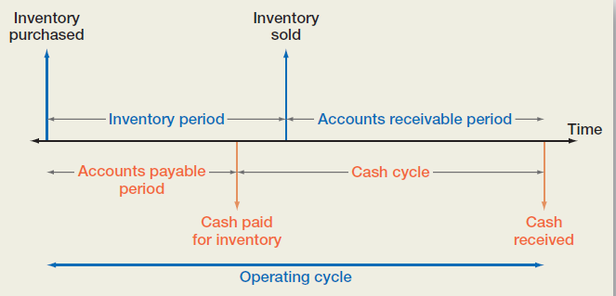
Production cycle, operating cycle, cash conversion (financial) cycle

Slide 5
Production cycle, operating cycle, cash conversion (financial) cycle
Inventory period (production cycle; Days inventory outstanding, DIO) – period of time from inventories purchase to selling of finished production, made from these inventories
DIO, days = 360 /(Cost of production sold / Average inventories)
Accounts receivable period (Days Sales Outstanding, DSO) - time between sale of finished production, collection of the receivable and receiving money from buyers.
DSO, days = 360 /(net revenue / average accounts receivable)
Operating cycle - the time period from the moment of purchasing of raw materials to receiving money from the sale of finished products, made from these raw materials
Operating cycle, days = DIO + DSO
Accounts payable period (Days Payable Outstanding, DPO) - time between receipt of inventory and payment for it.
DPO, days = 360 / (Cost of production sold / average accounts payable)
Cash conversion cycle (CCC, financial cycle) - time between cash disbursement (payment for inventories) and cash collection for finished production.
CCC = DIO + DSO – DPO = Operating cycle - DPO

Slide 6
Variants of cash conversion (financial) cycle:
CCC (cash conversion cycle) = DIO + DSO – DPO
CCC = 20 days+ 10 days – 5 days = 25 days
CCC = 10 days + 20 days – 5 days = 25 days
CCC = 20 days + 10 days – 10 days = 20 days
CCC = 20 days + 10 days – 15 days = 15 days
CCC = 20 days + 10 days – 30 days = 0 days
CCC = 20 days + 10 days – 45 days = -15 days
CCC of Xiaomi = 62.7 days + 15.4 days – 97.9 days = -19.8 days

Slide 7
Operating activity
International Accounting Standard 7 — Statement of Cash Flows:
operating activities are the main revenue-producing activities of the entity that are not investing or financing activities, so operating cash flows include cash received from customers for finished production and cash paid to suppliers for inventories, employees, taxes. Cash flow from operating activities allows to determine to what extent profit from ordinary activities to truly earned money and how money influenced the production of changes in working capital and its components.

Slide 8

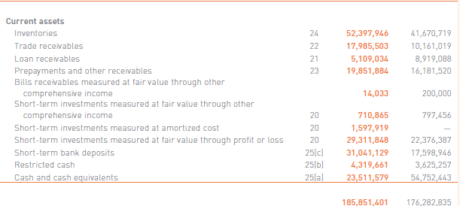
Examples of current assets of Xiaomi:

Slide 9
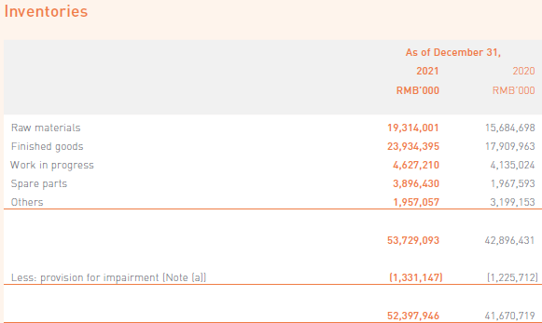
Examples of inventories of Xiaomi:

Slide 10
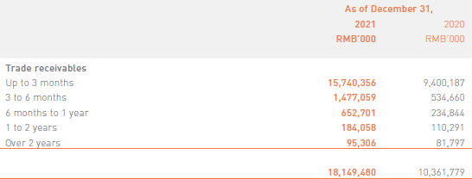
Structure of trade receivables of Xiaomi by the term of payment:

Slide 11
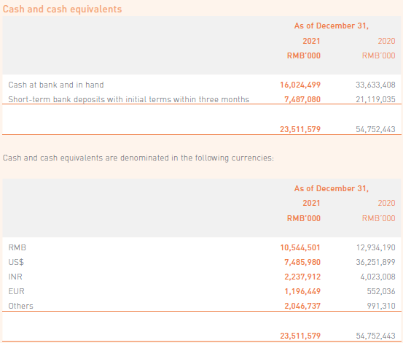
Structure of cash and cash equivalents of Xiaomi by the currency:

Slide 12
Advantages of current assets:
• high degree of structural transformation, as a result of which they can easily be transformed from one form to another
• quick adaptation to changes in commodity and financial market conditions, easily subject to changes in the process of diversification of operational activities
• high liquidity, if necessary, a significant part of them can be preserved in monetary assets, necessary for the current maintenance of operational activities
ease of management

Slide 13
Disadvantages of current assets:
• cash, cash equivalents, accounts receivable are subjected to inflation
• temporarily free (excessively formed) current assets practically do not generate profit (except for investments of monetary assets in short-term financial investments),
moreover, excess inventories do not generate profit, but also cause additional operating costs for their storage
• inventories are subjected to constant natural losses
• significant part of current assets has a risk of loss due to dishonesty of partners or own personnel
Losses due to obsolescence, deterioration, or theft.
The opportunity cost of capital on the invested amount

Slide 14
Original value of inventories
Original value of inventories =
Price of purchase without Value Added Tax +
cost of services of middlemen +
Freight charges (cost of transportation) +
Loading (unloading)+
Insurance +
Custom duties + Excise +
Registration fees +
Cost of preparation of inventories for production process

Slide 15
Inventory valuation methods:
Specific identification method - assessment of the value of each individual unit of inventory. This method applies to inventory that is released for special orders and projects, as well as inventory that is not interchangeable. The disadvantage of this method is its high labor intensity, especially in the conditions of a wide nomenclature of stocks
Weighted average method
First-in First-out FIFO – inventories, that are the first to arrive and are released into production are valued at first-in cost
Last-in First-out LIFO - inventories are used in the reverse sequence of their arrival at the enterprise. That is, the inventories that are the first to be released into production are valued at the cost price of the last ones at the time of receipt.

Slide 16
Transportation (shipping, freight ) costs:
FOB – free on board:
FOB destination – seller (supplier) delivers production free of any freight charges; destination specified by the buyer; items in transit do not belong to buyer yet, until items reach buyer; items in transit are included in seller’s (supplier) balance sheet
FOB shipping point – buyer must pay transportation charges; items in transit already belong to buyer; items in transit are included in buyer’s balance sheet

Slide 17
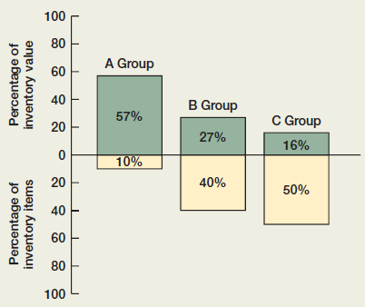
Optimal inventories: The ABC approach
A Group constitutes only 10 percent of inventory by item count, but it represents over half of the value of inventory. The A Group items are thus monitored closely, and inventory levels are kept relatively low.
At the other end, basic inventory items, such as nuts and bolts, also exist; but, because these are crucial and inexpensive, large quantities are ordered and kept on hand. These would be C Group items.
The B Group is made up of in-between items.

Slide 18
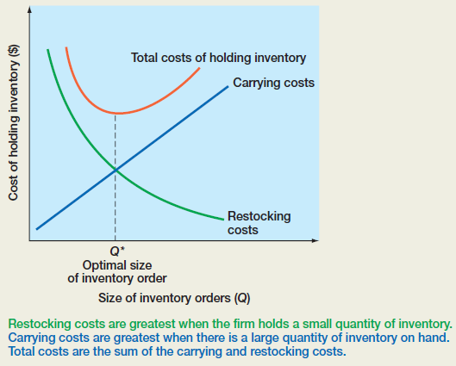
Optimal inventories: The economic order quantity (EOQ) model
Q* - the restocking quantity that minimizes the total inventory costs

Slide 19
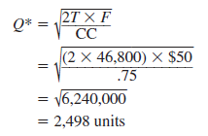
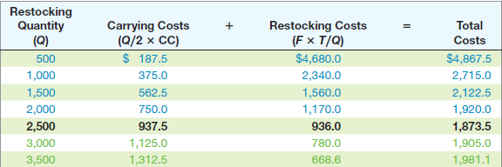
Optimal inventories: The economic order quantity (EOQ) model
T - total annual sales are 46,800 units
carrying costs (CC) of $0.75 per unit per year,
fixed costs ( F ) of $50 per order,
The restocking quantity Q*, that minimizes the total inventory costs =

Slide 20
Optimal cash balance: The Baumol–Allais–Tobin (BAT) model
F = The fixed cost of making a securities trade to replenish cash.
T = The total amount of new cash needed for transaction purposes over the relevant planning period - say, one year.
R = The opportunity cost of holding cash. This is the interest rate on marketable securities
Example: The Vulcan Corporation has cash outflows of $100 per day, seven days a week. The interest rate is 5%, and the fixed cost of replenishing cash balances is $12 per transaction. What is the optimal initial cash balance? What is the total cost?
The total cash needed for the year is 365 days * $100 = $36,500.
From the BAT model, we have that the optimal initial balance is:
C* = √(2T * F )/R)= √(2 * $36,500 * $12)/0.05)=$4,186
3. The average cash balance is $4,186/2 = $2,093
4. The opportunity cost = $2,093 * 0.05 = $104.65
5. Because Vulcan needs $100 per day, the $4,186 balance will last $4,186/100= 41.86 days.
6. The firm needs to resupply the account 365/41.86 = 8.7 times per year,
so the trading (order) cost = 8.7 times * $12 per transaction = $104.4.
7. The total cost = The opportunity cost $104.65 + Trading (order) cost $104.4 = $209.05.

Slide 21
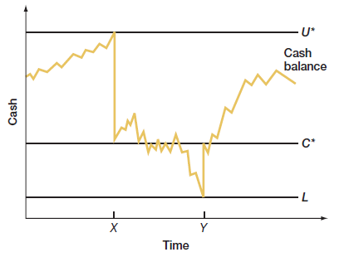
Optimal cash balance: The Miller–Orr Model
U* is the upper control limit. L is the lower control limit. The target cash balance is C*.
The firm allows its cash balance to wander around between the lower and upper limits.
When the cash balance reaches the upper limit ( U *), as it does at point X , the firm moves
U* - C* dollars out of the account and into marketable securities. This action moves the cash balance down to C *.
In the same way, if the cash balance falls to the lower limit ( L ), as it does at point Y , the firm will sell C* - L worth of securities and deposit the cash in the account. This action takes the cash balance up to C *.

Slide 22

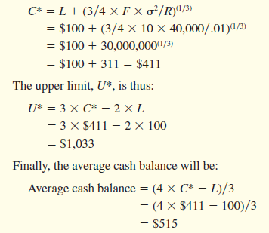
Optimal cash balance: The Miller–Orr Model
Given F (the fixed cost of making a securities trade to replenish cash), R (the opportunity cost of holding cash. This is the interest rate on marketable securities), L (the lower control limit of cash), which is set by the firm, Miller and Orr show that the cash balance target, C*, and the upper limit, U*, that minimize the total costs of holding cash are:
Also, the average cash balance = (4 * C* - L )/3
For example, suppose F = $10, the interest rate is 1% per month, minimum cash balance of L = $100 and the standard deviation of the monthly net cash flows is $200.
The variance of the monthly net cash flows =
cash balance target =

Slide 23
Ways to minimize the operating cycle:
determine the required amount of inventory the volume of spending (production) item per day must be multiplied on rate (as days for delivery, documentation, discharge, storage of materials, preparing them for production etc.).
Monitoring of inventories in warehouses will timely detect surplus that can be sold and will lead to increasing of other operating income of a company.
There are specialized middlemen that deal with information collection about the remains of materials in different companies and find potential buyers for them. Such materials can be bought at discounted prices, which is beneficial and reduces costs for customers.
consolidation of warehouses for the following particular products; planning of time and volume of material use to avoid excess purchase; clear specification of materials and components in production
Implementation of new resource-saving technologies, which will minimize spoilage of raw materials, focus on waste-free production or recycling of production waste
production flexibility, when some tools (equipment, production line) can be quickly replaced by others in market demand;
effective system of receiving and unloading materials; staff motivation in the implementation of such recommendations
Company has to review its assortment of finished products and goods to determine top positions, because focusing on them and avoiding others can often increase business efficiency
increasing sales depends on marketing policy of a company, advertising, promotions, discount schemes, after-sale customer service

Slide 24
Ways to minimize the operating cycle:
avoid mediation between suppliers and direct consumers of raw materials, which will help reducing transaction errors and costs and would provide better control over prices
guaranteed sales agreements – arrangement under which a manufacturer or a supplier takes back goods that remain unsold after a specified period
consignment agreements (sale or return, or goods on consignment) – a trading arrangement in which a seller sends goods to a buyer or reseller who pays the seller only when goods are sold. The seller remains the owner (title holder) of the goods until they are paid for in full and, after a certain period, takes back the unsold. It is profitable, because one side does not spend money for shop, realty, and another side of agreement – for buying products, only allocating them on its territory for payment.
To shortage the operating cycle a company may pass sales function for outsourcing to specialized firms or sell their products wholesale to small commercial agents, dealers, who will deal with retail customers
practice of production and supply on the principles of "just-in-time“, when suppliers ship raw materials at a certain time in the required amount directly to the workplace
electronic commerce, that can help: attract buyers from around the world, offer the widest range of products, out sales staff, avoid goods’ excess, accelerate the date of payment, create and manage an electronic database of customers and suppliers
system of discounts to customers for early payment; analysis of customer payment history and credit policy adjustments in this regard;
automation of collection of accounts receivable; differentiation accounts receivable by amount; early billing of customers under long-term cooperation agreement;

Slide 25
Ways to minimize the operating cycle:
changing in conditions of commission payment to staff, when salary does not depend on sales, but on the volume of cash inflows from customers
advanced forms of payment in relations between suppliers and buyers. use of such documents as: payment request-orders, settlement check, letter of credit
acquiring –technological, information service of transactions carried out using electronic means of payment in the payment system – is also one of the major tools to strengthen the payment discipline of enterprises
operation of purchase-sale may be executed by a promissory note. The advantages for the supplier in this case are the abilities: to discount it at a bank, to pay partners with its help, to take a credit with a promissory note as a pledge, to receive debts back guaranteed in case of buyer’s bankruptcy etc.
factoring service (forfeiting) – transfer the right of firm’s debt collection to a bank (factoring company) in order to receive credit for current activity financing.
In the extreme case supplier can apply to the Commercial Court with a claim for enforcement of debts returning from the buyer or start a bankruptcy procedure.
In case of contract violation and failure to pay for delivered products, the supplier is entitled to a reduction of income tax by writing off the costs of doubtful (hopeless) debts that are calculated and confirmed appropriately under domestic legislation

Slide 26
Sources for current assets financing:
Net working capital = Equity + Long-term debts – Fixed assets or
Net working capital = Current assets – Current liabilities
Trade payable
Other accounts payable
Consignment
Factoring
Sort-term bank credit
Other current liabilities
Profit, Equity

Slide 27
Thank you for your attention!

