Slide 1
Working capital management: investment and financing policies
Lecture for Corporate Finance
Mgr. Tetiana Konieva, Ph.D
Corporate Finance
FIU/BAFIK

Slide 2
Outline of the lecture
Working capital
Net working capital
Working capital investment policies
Working capital investment policy of Xiaomi
Sources of long-term financing
Sources for short-term financing
Working capital financing policies
Working capital financing policy of Xiaomi

Slide 3
Working capital & Net working capital:
Working capital = Current assets, that expected to be realized in the normal operating cycle or within 12 months after the reporting period; held primary for the purpose of trading; cash and cash equivalents
Permanent Working capital – amount of current assets at the lowest point of the operating cycle (inventories, accounts receivable, cash, short-term financial investments)
Temporary Working capital – those current assets (inventories, accounts receivable, cash, short-term financial investments), that fluctuating during the operating cycle because seasonality, peculiarities of the production process …..
Net working capital = Current assets – Current liabilities
Or
Net working capital = Equity + Long-term financing – Fixed assets

Slide 4
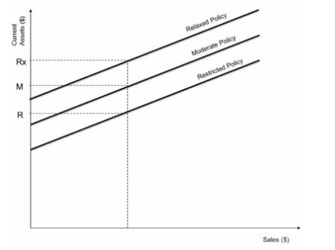
Working capital investment policies:
The investment policy is about how many resources invests the company into the current assets (inventories, accounts receivable, cash, financial investments) in order to provide the targeted sales.

Slide 5
Relaxed working capital investment policies:
Relaxed Policy: the estimation of current assets for achieving the targeted revenue is prepared after carefully considering uncertain events such as seasonal fluctuations, a sudden change in the level of activities or sales, etc. After the reasonable estimates, a cushion to avoid unforeseen circumstances is left to prevent the maximum possible risk. The diagram represents the point Rx which uses the highest level of current assets for achieving the same level of sales.
Companies with relaxed working capital policies assume the advantage of almost no risk or low risk. This policy guarantees the entrepreneur of the smooth functioning of the operating cycle. We know that earnings are more important than higher earnings. On the other hand, there is a disadvantage of lower return on investment because higher investment in the current assets attracts higher interest costs, reducing profitability.
Profit = Incomes – Costs (including interest costs)
Return on investments (assets or current assets or equity or …) = Profit \ investments

Slide 6
Restricted working capital investment policies:
Restricted Policy – the estimation of current assets for achieving targeted revenue is done very aggressively without considering any contingencies and provisions for any unforeseen event. After deciding, these policies are forcefully implemented in the organization without tolerating any deviations. In the diagram, point R represents the restricted policy that attains the same revenues level with the lowest current assets.
Adopting this policy would benefit the lower working capital requirement due to the lower level of current assets. This saves the interest cost to the company, which produces higher profitability, i.e., higher return on investment (ROI). On the other hand, there is a disadvantage in the form of high risk due to a very aggressive policy.
Profit = Incomes – Costs (including interest costs)
Return on investments (assets or current assets or equity or …) = Profit \ investments

Slide 7
Moderate working capital investment policies:
Moderate Policy
The moderate policy balances the two policies, i.e., restricted and relaxed. It assumes the characteristics of both policies. To strike a balance, moderate policy assumes the risk to be lower than restricted and higher than conservative. In the profitability front also, it lies between the two.

Slide 8
Working capital investment policies:
Policy | Relaxed | Moderate | Restricted
Sales | 1000 | 1000 | 1000
Current assets | 500 | 400 | 300
Ratio of current assets outstanding = sales \ current assets | 1000\500 = 2 times per year current assets transfer into the revenue (sales) | 2.5 times per year current assets transfer into the revenue (sales) | 3.33 times per year current assets transfer into the revenue (sales)

Slide 9
Working capital investment policy of Xiaomi:

Slide 10
Sources of long-term financing:
Depreciation funds
(Financial) Leasing
Long-term bank credit
Issued bonds
Equity (issued shares)

Slide 11
Sources for short-term financing:
Net working capital = Equity + Long-term debts – Fixed assets or
Net working capital = Current assets – Current liabilities
Trade payable
Other accounts payable
Consignment
Factoring
Sort-term bank credit
Other current liabilities

Slide 12
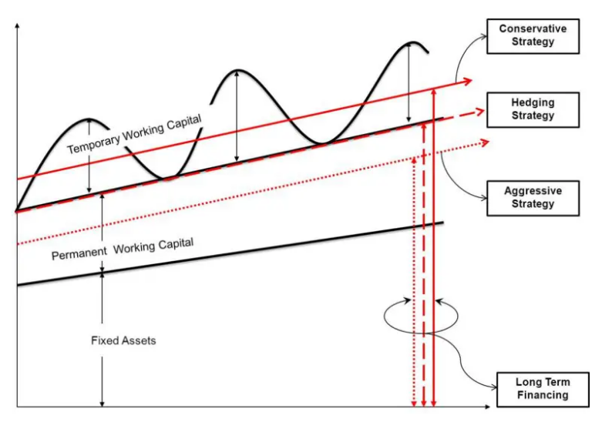
Working capital financing policies:
Working capital financing policy - is about what type of capital and how many of it we attracted in order to finance company’s assets.
Conservative Strategy:
Long Term Funds will Finance >>
Fixed Assets + Permanent Working capital + Part of Temporary Working capital
Short Term Funds will Finance >>
Remaining Part of Temporary Working capital
Hedging (Maturity Matching) Strategy:
Long Term Funds will Finance >>
Fixed Assets + Permanent Working capital
Short Term Funds will Finance >>
Temporary Working capital
Aggressive Strategy:
Long Term Funds will Finance >>
Fixed Assets + Part of Permanent Working capital
Short Term Funds will Finance >>
Remaining Part of Permanent Working capital
+ Temporary Working capital
Working capital = Current assets

Slide 13
Conservative financing policies:
Temporary Working capital TWC = 200 | Short Term Funds (current liabilities: short-term bank credit, account payable) = 90
 | Long Term Funds = 1010 = Equity 700 + Long term debts 310
Permanent Working capital PWC = 400
Fixed Assets FA = 500
Long Term Funds will Finance >> Fixed Assets FA + Permanent Working capital PWC + Part of Temporary Working capital TWC
Short Term Funds will Finance >> Remaining Part of Temporary Working capital
Net working capital = Current assets – current liabilities = 400+200 – 90 = 510 or
Net working capital = Equity + Long term debts - Fixed Assets = 700+310 – 500 = 510

Slide 14
Moderate financing policies:
Temporary Working capital TWC = 200 | Short Term Funds (current liabilities: short-term bank credit, account payable) = 200
Permanent Working capital PWC = 400 | Long Term Funds = 900 = Equity 700 + Long term debts 200
Fixed Assets FA = 500
Long Term Funds will Finance >> Fixed Assets + Permanent Working capital
Short Term Funds will Finance >> Temporary Working capital
Net working capital = Current assets – current liabilities = 400+200 – 200 = 400 or
Net working capital = Equity + Long term debts - Fixed Assets = 700+ 200 – 500 = 400

Slide 15
Aggressive financing policies:
Temporary Working capital TWC = 200 | Short Term Funds (current liabilities: short-term bank credit, account payable) = 500
Permanent Working capital PWC = 400
 | Long Term Funds = 600 = Equity 400 + Long term debts 200
Fixed Assets FA = 500
Long Term Funds will Finance >> Fixed Assets + Part (small or even 0) of Permanent Working capital
Short Term Funds will Finance >> Remaining Part of Permanent Working capital + Temporary Working capital
Net working capital = Current assets – current liabilities = 400+200 – 500 = 100 or
Net working capital = Equity + Long term debts - Fixed Assets = 400 +200 – 500 = 100

Slide 16
Working capital financing policies:
Factors | Conservative | Aggressive | Hedging
Liquidity = Current assets \ Current liabilities | Liquidity is high because of the heavy usage of long-term funds. It can take advantage of sudden opportunities. Current ratio = (400+200)\90 = 6.7 | Liquidity is low due to greater dependability on short-term funds, even for a part of long-term assets. It does not keep idle funds and therefore saves interest costs on them. Current ratio = 1.2 | Liquidity is balanced, i.e., neither high nor low. It attempts to strike a balance between liquidity and the cost of idle funds. Current ratio = 3
Profitability | Under normal circumstances, profitability is less in this strategy because of too much idle and costly funds. Higher rates and a bigger magnitude of interest costs reduce the profitability. | Higher profitability is obtained since the interest cost is minimized in this approach. | Because of cut to cut management, a balance is achieved between interest cost and loss of profitability. Moderate profitability is maintained here. It is greater than conservative and lesser than aggressive
Risk | There is a very low risk of bankruptcy as this approach maintains a higher level of liquidity in the business. | There is a high risk of bankruptcy due to maintaining an extremely tight liquidity position. | The risk is balanced here. The firm will bow down to bankruptcy only in an extremely bad situation
Asset Utilization | Too high level of current assets makes its utilization ratio low. | Similarly, too low a level of current assets makes the utilization ratio high. | Moderate
Net Working Capital = Current assets – Current liabilities | There is a requirement for more working capital to execute the conservatism. Higher working capital avoids all risks. NWC = 510 | Very low working capital is maintained. Low working capital increases risk but saves the interest cost. NWC = 100 | Moderate working capital is maintained to stay somewhere between conservative and aggressive strategies NWC = 400

Slide 17
Working capital financing policy of Xiaomi

