Slide 1

Borrowed financial resources (debts, liabilities)
Lecture for Corporate Finance
Mgr. Tetiana Konieva, Ph.D
Ing. TomášHeryán, Ph.D.
Corporate Finance
FIU/BAFIK

Slide 2

Outline of the lecture
Types of the activities
Sources of long-term financing
Sources for short-term financing
Bank credit
Discount rate
Example of credit payments
Overdraft (short-term bank credit)
Factoring
Types of factoring
Commercial credit (accounts receivable\account payable)
Cost of Commercial credit
Note receivable (interest-bearing note):
Discounting a Note Receivable
Consignment as a type of commercial credit
Leasing as long-term rent, long-term debt
Operating and financial lease
Structure of leasing payment
Non-interest bearing liabilities

Slide 3
Reasons for borrowing money:
Gap between cash outflow and cash inflow as a result, for example, of payment delay of the clients, favourable credit policy, provided by supplier, difference between short Days Payable outstanding and long Days sales outstanding
Long operating cycle
Seasonality
Unfavourable stage of business cycle
Need of development, applying of new technologies, modernization, reconstruction
Inefficient financial management, absence of financial planning at the firm
Amount of current assets, that exceed the defined norms
Attracting the debt can increase return on equity (ROE), that is important for owners. This is due financial leverage effect:
I variant: net profit 20, total capital 100, including equity 100 and debt 0. ROE = 20\100 = 20%
II variant: net profit 20, total capital 100, including equity 50 and debt 50. ROE = 20\50 = 40%
Attracting debt increases ROE up to the moment, when profitability of assets is more than interest rate of such debt:
EFL effect of financial leverage = (1 – tax profit)*(profitability of assets ROA – interest rate)*(Debt\Equity)

Slide 4
Types of the activities:
International Accounting Standard 7 — Statement of Cash Flows:
operating activities are the main revenue-producing activities of the entity that are not investing or financing activities, so operating cash flows include cash received from customers and cash paid to suppliers, employees, taxes, utility bills; operations, connected with selling the production and other inventories as well as purchasing the raw materials, energy; changing accounts receivable and accounts payable
investing activities are the acquisition and disposal of long-term assets and other investments that are not considered to be cash equivalents. Examples of investing activities are cash outflow for the purchase of fixed assets and financial investments, securities issued by other entities; cash inflow from the sale of the fixed assets, financial investments, received dividends, interest rate from deposit, other financial investments
financing activities are activities that alter the equity capital and borrowing structure of the company. Examples are: cash inflows (the sale of company’s shares, bonds, getting loans) and cash outflows (the repurchase of shares, bonds, returning the credit, interest rate and dividend payments).

Slide 5
Sources of long-term financing > 1 year:
Long-term liabilities and provisions – not expected to be settled within 12 months or 1 normal operating cycle of the enterprise:
Deferred tax liabilities (from tax profit)
Long-term bank credits
Other long-term liabilities (issued bonds, debentures, financial leasing, promissory notes)
Long-term provisions (provisions for future losses and payments; fund of guaranteed payments; funds of the corporate pension fund)
Targeted funding (from budget)

Slide 6
Sources for short-term financing < 1 year :
Net working capital = Equity + Long-term debts – Fixed assets or
Net working capital = Current assets – Current liabilities
Trade payable
Other accounts payable
Consignment
Factoring
Sort-term bank credit
Overdraft
Other current liabilities

Slide 7
Bank credit:
Short-term bank credit (< 1 year) is attracted in order to finance current activity or\and current assets (purchasing raw material, inventories, energy; financing day-to day operations, covering cash deficit). The collateral for such credit can be accounts receivable (in some term company will receive money from buyers and will be able to return bank credit); current financial investments (company can sell financial investments in order to return bank credit); future harvest or offspring of animals; stable cash inflows of the company…..
Long-term bank credit (> 1 year) is attracted in order to finance investment activity (modernization, reconstruction of the equipment, building, other fixed assets; constructing and buying new equipment, building; other fixed assets, which are returning their value step by step during useful life). There is a need to provide bank with business plan (information about using credit money, possibilities and speed of their returning, calculating future cash inflows and outflows). The collateral for such credit can be existing fixed assets, which will be evaluated by experts (usually the value od such collateral must be several times more, than amount of attracted credit)
The company during credit period (usually monthly) pays\returning part of attracted credit (principal, body of credit) and interest rate (the price of using the bank credit)
Interest rate depends on: discount rate, inflation, currency of credit, purpose of credit, type of collateral, credit period, credit history of client, bank profit, monetary policy provided by central bank of the country (increasing or decreasing money supply), access of the business to alternative financing resources inside the country and abroad…..
https://archive.doingbusiness.org/en/rankings

Slide 8
Discount rate :
the interest rate that the central banks charge commercial banks and other financial institutions
Commercial banks borrow money for short-term operating requirements from the central bank
The bank uses such loan for funding shortfalls, address any liquidity issue and more
Such a facility is known as discount window, and the funds are generally given for 24-hours or less
It is not the market rate, rather it is set by central bank mostly, and thus, serves as a benchmark for other interest rates in the economy

Slide 9
Example of credit payments:
Company borrowed 18000 of long-term bank credit (principal) for 3 years, interest rate 11%. Credit payments are:
1 year: 18000\3 (part of principal) + 18000*0.11 = 6000 + 1980 = 7980
2 year: 18000\3 (part of principal) + (18000 – 6000)*0.11 =
6000 + 1320 = 7320
3 year: 18000\3 (part of principal) + (18000 – 6000 – 6000)*0.11 =
6000 + 660 = 6660
Interest rate is usually calculated from the amount of debt, which have not been paid yet. Total amount of interest rate, paid by the company = 1980 + 1320 + 660 = 3960. This amount is interest expenses (financial costs) for company
Principal 18000 is only cash outflow, but not cost for company, because it only returns money, that have been earlier borrowed
Total cash outflow for company = 18000 (principal) + 3960 (interest expenses) = 21960

Slide 10
Overdraft (short-term bank credit):
An overdraft or an OD is a line of credit provided by banks to individual and business houses. This facility allows the account holder to use more funds than what is effectively available in their current account with the bank.
user can draw cash as and when he requires up to the amount he requires.
Interest on overdraft facility is charged only on the amount drawn by the user.
It is necessary to have an operational account in the bank to use an overdraft facility.
It is temporary facility extended by a bank to corporates and other clients to withdraw funds from their account in excess of the balance. This facility is provided by the bank for a fee and interest is charged on the excess amount that is withdrawn for the length of the time
There is usually a limit on the amount that can be overdrawn from the account. The overdraft limit is usually set by the bank basis the amount of working capital and creditworthiness of the facility taker

Slide 11
Overdraft: example
Suppose Company has a current account with Bank. It deposits 10000.00 in its current account on 1st January 2018. Company has done some analysis and forecasts that it will need extra cash over and above10000.00 in some time during the year. So it applies to Bank for an overdraft facility up to 15000.00, which is granted by the bank at 5% rate of interest per annum.
On 15th January 2018, Company is due to pay 13000.00 to its creditor. As it doesn’t have extra cash available, it utilizes the bank overdraft facility and makes the payment.
Company used only 13000.00 – 10000.00 = 3000 from overdraft facility. The interest rate will be charged on 3000.00 only despite the fact, that arranged overdraft facility was up to 15000.00
Going further on 1st February 2018, Company receives a payment of 4000.00 from its debtor (buyer) in the company’s current account. The overdraft cycle is completed here. Company now has an ability to return borrowed 3000 to the bank. So the company returned the 3000.00 that it had withdrawn from the bank over and above the balance available in its current account.
Interest rate calculation will be on 3000.00 for 17 days (starting from 15th January 2018 to 1st February 2018 both days inclusive) = 3000.00 (amount overdrawn) * 0.05 (rate of interest) * 17/365 (number of days overdrawn = 6.98

Slide 12
Overdraft: advantages
an overdraft facility allows managing cash flow gaps that might arise due to timing mismatch.
overdraft facility allows for a better payment history.
It also ensures timely payments and avoidance of late payments penalties as payments can be made even if there is lack of sufficient balance in the account
It requires less paperwork that would usually be required I bank credit as overdraft facility is easy to avail
Overdraft facility has the advantage of flexibility as one may take it at any time, for any amount (up to the limit allotted), and for even as less as one or two days
The interest is calculated only on the amount of funds used
Overdraft facility can be used for any purpose and not necessarily for business.

Slide 13
Overdraft: disadvantages
Higher interest rates, higher than the other sources of borrowing
Risk of reduction in limit
Company may not be too much on their feet to collect payments from debtors (buyers), as immediate payment outflows can be managed by overdraft facility
Overdraft facility is allowed for a very short duration at times

Slide 14
Factoring
Factoring, also known as invoice factoring, is a financial transaction in which a company sells its accounting receivables. It is sold to a finance company, also known as the factor, at a discounted price for cash. Factoring is also known as, accounts receivable factoring or account receivable financing
Accounts receivable appears in the balance sheet of the company, when it delivered the production to buyer without the prepayment.
Accounts receivable is a way to attract buyers, to provide their flexible credit policy, to increase the sales, especially in terms of competition in the market
Unfortunately, accounts receivable are rather negative item: company delivered the production, but has no money yet for it, so can not pay its own bills; accounts receivable are subjected to inflation; accounts receivable can transform into doubtful debts, then into hopeless (bad) debts, so there is a possibility do not receive money from the buyers at all
Factoring is a way to reduce and\or overcome the problems with account receivable
Factoring is a credit for the company-supplier

Slide 15
Procedure of factoring
Company (supplier) sighed the factoring agreement with the bank or factoring company. Such a way Company (supplier) sells to the bank the right to withdraw its future accounts receivable from its buyer
Company (supplier) delivered the production to the buyer without the prepayment. As a result Company (supplier) has accounts receivable into the balance sheet
In order to provide smooth financing of its activity Company (supplier) should cover cash deficit as a result of accounts receivable
Company (supplier) applies to the bank for factoring credit
According to the agreement Bank can give 0-90% from accounts receivable to Company (supplier) at once. This money will be the credit to Company (supplier)
During agreed period (up to 1 year) bank applies to the buyer and with the help of different methods provides the returning money. In case of factoring money will be paid by the buyer to the bank, not to the supplier
Bank returns to Company (supplier) the rest of accounts receivable (100-10%, see 5) minus commission and interest rate from credit (see 5)

Slide 16
Types of factoring
Open and closed (buyer up to the last moment does not know about factoring)
Without prepayment (bank does not give any money to the company-supplier until the bank does not withdraw accounts receivable from the buyer, see 5) and with prepayment (0-90% from accounts receivable )
When bank promised to withdraw money from the buyer
With regression right – when bank has the right to stop factoring agreement, because of some obstacles, that make it impossible to withdraw money from the buyer

Slide 17
Commercial credit (accounts receivable\account payable)
When company-buyer received the ordered production from supplier without prepayment (with payment delay), buyer automatically attracts accounts payable (commercial credit)
It is pay-free, any interest rate, any collateral. Buyer can use delivered production freely, but during agreed with supplier period (usually short-term). At the end of this period buyer should pay the amount of delivered production
To provide early payment supplier can propose the discount to the buyer, that will be applied during first days after the delivery
“4/7 netto 30” means, that supplier gives 4% of discount to the buyer from the amount of delivered production. This discount is applied during first 7 days after the moment of production. On the 8-th day buyer will not be already able to get the discount. “netto 30” means, that total payment delay, agreed between buyer and supplier is 30 days; in a month after the delivery buyer should pay any way, but already without any discount.
Discount is always a method to economies financial resources, cash outflow, costs. Saved money, such a way, can be transferred to another purposes of the company.
In order to make the decision to use the discount and pay earlier or refuse it, company can compere the cost of commercial credit with interest rate of usual bank credit, that can be attracted for providing the payment

Slide 18
Cost of Commercial credit
Cost of commercial credit = [discount\(1 – 0.01*discount)] +
[360\(payment delay, days – period of discount, days)]
If Cost of commercial credit < interest rate of bank credit, there is no point to borrow money in the bank to provide early payment; discount is to low
If Cost of commercial credit > interest rate of bank credit, company-buyer should borrow money in the bank to provide early payment and getting the discount. Saved money from the discount will cover interest rate and bring positive result

Slide 19
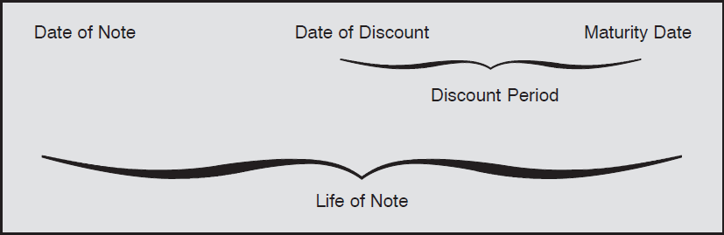
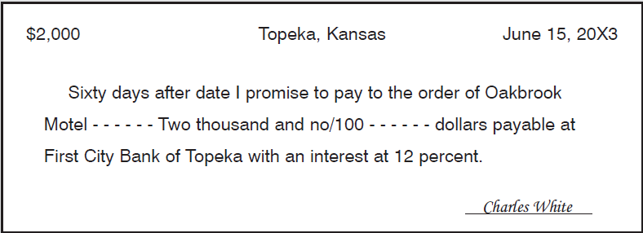
Note receivable (interest-bearing note):

Slide 20
Note receivable & accounts receivable:
Accounts receivable is a situation, when company-supplier delivered the production and waits for money from buyer. This debt is not proved by anything, there is no collateral at all
Note receivable is a security. This is written promise (registered document) of the buyer to pay to supplier (or another business entity) exactly amount of money, at exactly time and place
Note receivable gives the supplier the possibility to pay with its help for raw materials, energy……
Note receivable can be the collateral, if supplier wants to attract bank credit
Note receivable can be discounted in bank (cashing before it is due). Supplier can receive cash quicker before the maturity day of the note
In case of bankruptcy of the buyer, supplier will receive his money back any way and he will be out if queue of other creditors of the buyer
Issuing of note can take the time

Slide 21
Discounting a Note Receivable:
Written promise of the client to pay in the future; maker of the Note; company, which gives Note
Payee – expects for payment (company, that receive Note)
Principal – amount of debt according to the Note
Interest-bearing note provides some additional annual interest rate over the Principal;
Principal + Interest rate = Maturity Value
Maturity date – final date of the Note, Date of payment
Life of Note – period of time from Date of Note to Maturity Date
Dishonored Note – maker fails to pay, when due
Discounting of the Note – cashing the note in bank before it is due, before Maturity date; as a result of discounting Payee usually receives less than maturity value
Discount rate – price of the Bank for cashing a note
Proceeds = Maturity value – Discount rate;
Company, discounting a note receives Proceeds, which is less than Maturity value
Contingent liability: firm, which discounted a Note, has Contingent liability to the bank for the Note until it is finally paid by the maker

Slide 22
Consignment as a type of commercial credit:
Consignment is a business arrangement between a consignor (owner) and a third party (consignee)
The consignee agrees to sell the goods handed over to him by the consignor for a fee. For the consignor, it is outward consignment and for the consignee, it is inward consignment. Also, there is another similar term called consignment shop. The consignment shop is a retail store which displays goods for the buyers for sale
Example:
Giving the right to sell some inventory, owned by company A to company B
Are shelved but never owned by the company B
Are not included in balance sheet of company B
Company B cares about inventories, provides promotional actions to sell them
Are shipped by company A to company B but not paid for until they are sold
After selling company B paid money to company A and received in turn some commission
If goods are not sold, they returned to owner – company A

Slide 23
Features of consignment:
The possession of the goods transfers from one party to another.
The consignor is responsible for all the risks, expenses and damages associated with the consigned goods.
The relation of the persons in the consignment is that of consignor (principal) and the consignee (agent) and not of the buyer and seller.
Only the possession of the goods is with the consignee and not the ownership.
Profit or loss on the sale of the goods belongs to the consignor.
Objectives of consignment:
To make large consignments and increase sales volume by attracting customers.
To launch a new product and create and capture the market for the same.
Earning higher revenue from a different geographical area for the same product.
To grow and expand the business.
Sustainment in the domestic and international market.
To increase sales by utilizing the talent and expertise of the consignee

Slide 24
ADVANTAGES OF CONSIGNMENT:
ADVANTAGES FOR CONSIGNOR
Increased sales and margin if the consignor is assigning the responsibility of the goods to a skilled and experienced consignee.
Since the ownership is with the consignor, he may at any time reclaim those goods in the case of any default from the consignee’s end.
Inventory holding costs are lessened as the goods are sent to the consignee and are in his possession.
If the sellers want to increase their sales and do not have time to promote their product or look after the customers, they prefer hiring an agent to look after the same.
If the consignee is well versed with the buyers, market, product, etc. he may sell the product very fast. Hence this would lead to product expansion, better market share, increased sales, etc.
ADVANTAGES FOR CONSIGNEE
The consignee has to pay for only those goods that are sold.
The consignee sometimes doesn’t have to pay for some expenses if it agreed as per the agreement.
If the consignee is well versed with the product, he may sell the goods faster thereby increasing his share of revenue.
In the case of huge demand, he may earn higher revenue. As he need not incur any expense of the shipping also not to worry about the lead time.

Slide 25
DISADVANTAGES OF CONSIGNMENT:
DISADVANTAGES FOR CONSIGNOR
Since the consignee is not the owner and doesn’t face any monetary risk, he may not take this agreement seriously. Hence, he may not promote sales.
Sometimes the consignor pays huge shipping charges by shipping a large amount of inventory instead of paying for smaller inventories to the consignee. However, the goods may or may not sell. So, if the goods don’t sell, he suffers a huge loss as he remains to be the owner and they still have to count it as a part of his cost assessment.
The consignor has to keep waiting for the payment creating uncertainty in regards to when and how much will be receipt of the sales proceeds from the consignee. So, until there is a sale of all or some of the goods, the consignor has to wait for the payment leading to an imbalance in cash flows.
If the consignor sells the product directly into the market, he may earn comparatively higher revenue by removing the excess profit of the consignee.
DISADVANTAGES FOR CONSIGNEE
If the consignee carries a bad reputation in a particular market, he may not be able to sell the goods so easily.
The biggest con for the consignee is that he incurs a holding cost for that inventory either in his godown or in his store. That inventory may or may not sell. So, in the case of unsold goods, he suffers a loss.
If the consignee repeatedly fails to sell the goods in time, he may either be discarded as an agent or would receive a lesser commission.
If in the case of no sale of the goods and there is a possibility of it getting deteriorated, the consignee may have to buy them.

Slide 26
Leasing as long-term rent, long-term debt
A famous quote by Donald B. Grant says, “Why own a cow when the milk is so cheap? All you really need is milk and not the cow.” The concept of Lease is influenced by this quote. We can compare ‘milk’ with the ‘rights to use an asset’ and ‘cow’ with the ‘asset’ itself. Ultimately, a person who wants to manufacture a product using machinery can get to use that machinery under a leasing arrangement without owning it.
A lease can be defined as an arrangement between the lessor (owner of the asset) and the lessee (user of the asset) whereby the lessor purchases an asset for the lessee and allows him to use it in exchange for periodical payments called lease rentals or minimum lease payments
Leasing is appropriate for an individual or business which cannot raise money through other means of finance like debt or term loan because of the lack of funds. The business or lessee cannot even arrange the down payment money to raise debt. The lease works best for him. On the other hand, the lessor, who wants to invest his money efficiently, becomes the financier for the lessee and earns the interest.
There are four different things possible post-termination of the leasing:
The lease is renewed by the lessee perpetually or for a definite period of time.
The asset goes back to the lessor.
The asset comes back to the lessor and he sells it off to a third party.
Lessor sells to the lessee.

Slide 27
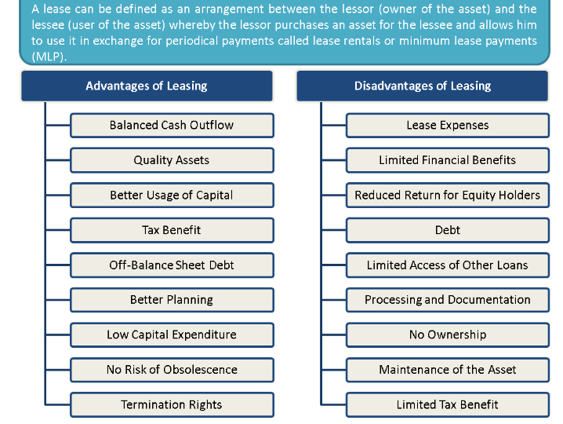
Leasing: advantages and disadvantages

Slide 28
Operating and financial lease:
Aspects of Difference | Operating Lease | Financial Lease
DEFINITION | A lease in which all risks and rewards related to asset ownership remain with the lessor for the leased asset is called operating lease. The company does not have to buy it, but only lease it for several years and repeat it. In this lease, the asset is returned by the lessee after using it for lease term agreed upon. An operative leasing is short-term leasing used often for buying equipment, or devices, which could become quite quick very old | In financial lease (Also known as a capital lease), the risks and rewards related to ownership of asset leased are transferred to the lessee. After the contract expires the lessee buys the subject for a lower price By leasing it is possible to finance up to 100 % of subject value from external (foreign) financial source Payments are usually paid after placing equipment in operation and they are fixed
OWNERSHIP | The ownership of the asset remains with the lessor for the entire lease period. | Ownership transfer option at the end of the lease period is there with the lessee. The title might or might not be transferred eventually.
ACCOUNTING EFFECT | Operating lease is treated generally like renting. That means, the lease payments are treated as operating expenses and the asset does not show on the balance sheet. | A financial lease is treated like loan generally. Here, the asset ownership is considered by the lessee and so asset appears on the balance sheet.

Slide 29
Operating and financial lease:
Aspects of Difference | Operating Lease | Financial Lease
PURCHASE OPTION | In operating lease, the lessee does not have an option to buy the asset during the lease period. | A financial lease allows the lessee to have a purchase option at less than the fair market value of the asset.
LEASE TERM | Lease term extends to less than 75% of the projected useful life of the leased asset. | Lease term is generally more than or equal to the estimated economic life of the asset leased.
EXPENSES BORNE | Lessee pays only the monthly lease payment in operating lease. | In a financial lease, lessee bears insurance, maintenance, and taxes.
TAX BENEFIT | Since operating lease is as good as renting, the lease payment is considered an expense. No depreciation can be claimed. | The lessee can claim interest and depreciation both as a financial lease is treated as a loan.
RUNNING COST | In operating lease, no running or administration costs are to be borne. For example, registration, repairs etc. since it gives only right to use the asset. | In a financial lease, running cost and administration expenses are higher.
EXAMPLE | Normally, A Projector, Computers, Laptops, Coffee Dispensers etc | Normally, Plant and Machinery, Land, Office Building etc

Slide 30
Structure of leasing payment:
Depreciation of fixed assets
Insurance
Margin of owner of the leasing equipment (lessor)
Additional cost for studying the personal, installing
Interest rate of the lessor, who attracts bank credit to purchase equipment in order to give it to rent

Slide 31
Non-interest bearing liabilities :
Accounts payable by the budget
Accounts payable by the profit tax (Current income tax liabilities)
Accounts payable by insurance
Accounts payable by wages
Current provisions (provisions for future losses and payments)
Accruals and deferred income (received payment in advance for tickets, periodicals, rent)
Other

Slide 32
Thank you for your attention!

