Slide 1

COST-VOLUME-PROFIT RELATIONSHIPS
Ing. Markéta Šeligová, Ph.D.
MANAGERIAL ACCOUNTING/NANMU

Slide 2
COST-VOLUME-PROFIT RELATIONSHIPS
Outline of the lecture
Cost-volume-profit (CVP) analysis
Contribution margin
Applications of CVP concepts
Target profit analysis
Sales mix

Slide 3
COST-VOLUME-PROFIT RELATIONSHIPS
COST-VOLUME-PROFIT (CVP) ANALYSIS (1)
helps managers make many important decisions such as what products and services to offer, what prices to charge, what marketing strategy to use, and what cost structure to maintain
its primary purpose is to estimate how profits are affected by the following five factors:
  1. selling prices
  2. sales volume
  3. unit variable costs
  4. total fixed costs
  5. mix of product sold

Slide 4
COST-VOLUME-PROFIT RELATIONSHIPS
COST-VOLUME-PROFIT (CVP) ANALYSIS (2)
to simplify CVP calculations, managers typically adopt the following assumptions with respect these factors
  selling price is constant. The price of a product or service will not change as volume changes
  costs are linear and can be accurately divided into variable and fixed element. The variable element is constant per unit. The fixed element is constant in total over the entire relevant range
  in multiproduct companies, the mix of products sold remains constant

Slide 5
COST-VOLUME-PROFIT RELATIONSHIPS
CONTRIBUTION MARGIN
contribution margin is the amount remaining from sales revenue after variable expenses have been deducted
thus, it is the amount available to cover fixed expenses and then to provide profits for the period
contribution margin is used first to cover the fixed expenses, and then whatever remains goes toward profits
if the contribution margin is not sufficient to cover the fixed expenses, then a loss occurs for the period

Slide 6
COST-VOLUME-PROFIT RELATIONSHIPS
CVP RELATIONSHIPS IN EQUATION FORM (1)
the contribution format income statement can be expressed in equation form as follows:
Profit = (Sales - Variable expenses) - Fixed expenses
When a company has only a single product, we can further refine the equation as follows:
Sales = Selling price per unit X Quantity sold = P x Q
Variable expenses = Variable expenses per unit X Quantity sold = V x Q
Profit = (P x Q – V x Q) - Fixed expenses

Slide 7
COST-VOLUME-PROFIT RELATIONSHIPS
CVP RELATIONSHIPS IN EQUATION FORM (2)
it is often useful to express the simple profit equation in terms of the unit contribution margin (Unit CM) as follows:
Unit CM = Selling price per unit - Variable expenses per unit = P – V
Profit = (P x Q - V x Q) - Fixed expenses
Profit = (P - V) x Q - Fixed expenses
Profit = Unit CM x Q - Fixed expenses

Slide 8
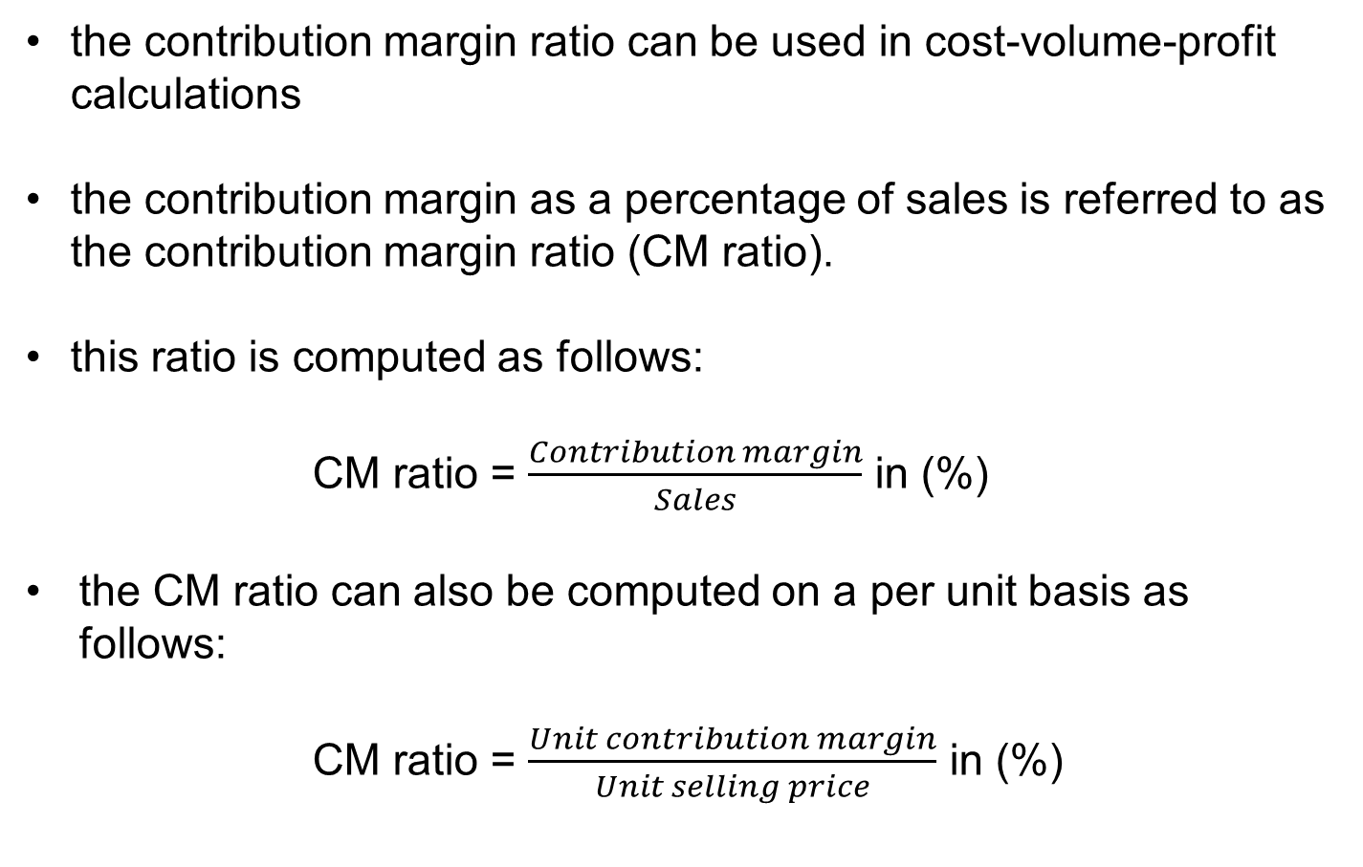
COST-VOLUME-PROFIT RELATIONSHIPS
CONTRIBUTION MARGIN RATIO (CM RATIO) (1)
the contribution margin ratio can be used in cost-volume-profit calculations
the contribution margin as a percentage of sales is referred to as the contribution margin ratio (CM ratio).
this ratio is computed as follows:
CM ratio = $\frac{Contribution margin}{Sales}$ in (%)
the CM ratio can also be computed on a per unit basis as follows:
CM ratio = $\frac{Unit contribution margin}{Unit selling price}$ in (%)

Slide 9
COST-VOLUME-PROFIT RELATIONSHIPS
CONTRIBUTION MARGIN RATIO (CM RATIO) (2)
the CM ratio shows how the contribution margin will be affected by a change in total sales
for example, CM ratio of 40% means that for each dollar increase in sales, total contribution margin will increase by 40 cents ($1 sales x CM ratio of 40%)
net operating income will also increase by 40 cents, assuming that fixed costs are not affected by the increase in sales
Generally, the effect of a change in sales on the contribution margin is expressed in equation form as:
Change in contribution margin = CM ratio x Change in sales

Slide 10
COST-VOLUME-PROFIT RELATIONSHIPS
CONTRIBUTION MARGIN RATIO (CM RATIO) (3)
the relation between profit and the CM ratio can also be expressed using the following equations:
Profit = CM ratio x Sales – Fixed expenses
Or, in terms of changes,
Change in profit = CM ratio x Change in sales – Change in fixed expenses

Slide 11
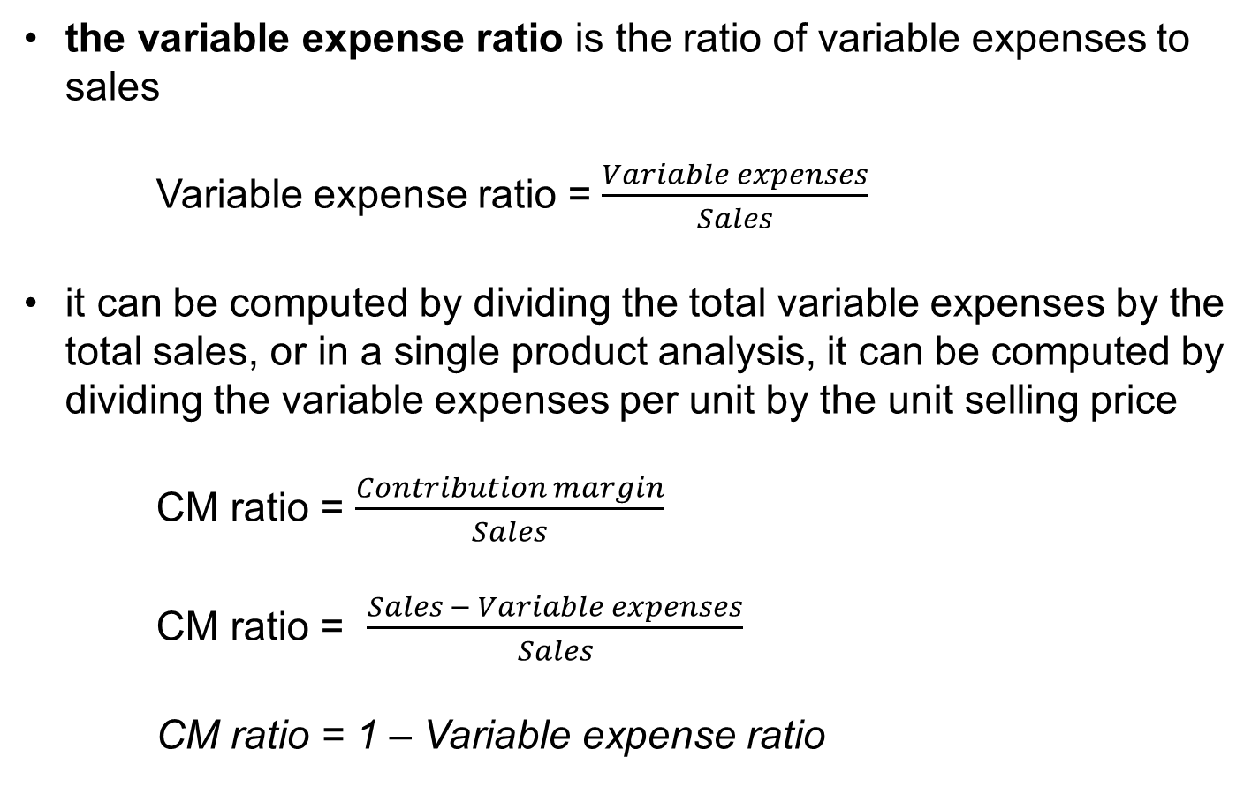
COST-VOLUME-PROFIT RELATIONSHIPS
APPLICATIONS OF CVP CONCEPTS
the variable expense ratio is the ratio of variable expenses to sales
Variable expense ratio = $\frac{Variable expenses}{Sales}$
it can be computed by dividing the total variable expenses by the total sales, or in a single product analysis, it can be computed by dividing the variable expenses per unit by the unit selling price
CM ratio = $\frac{Contribution margin}{Sales}$
CM ratio = $\frac{Sales − Variable expenses}{Sales}$
CM ratio = 1 – Variable expense ratio

Slide 12
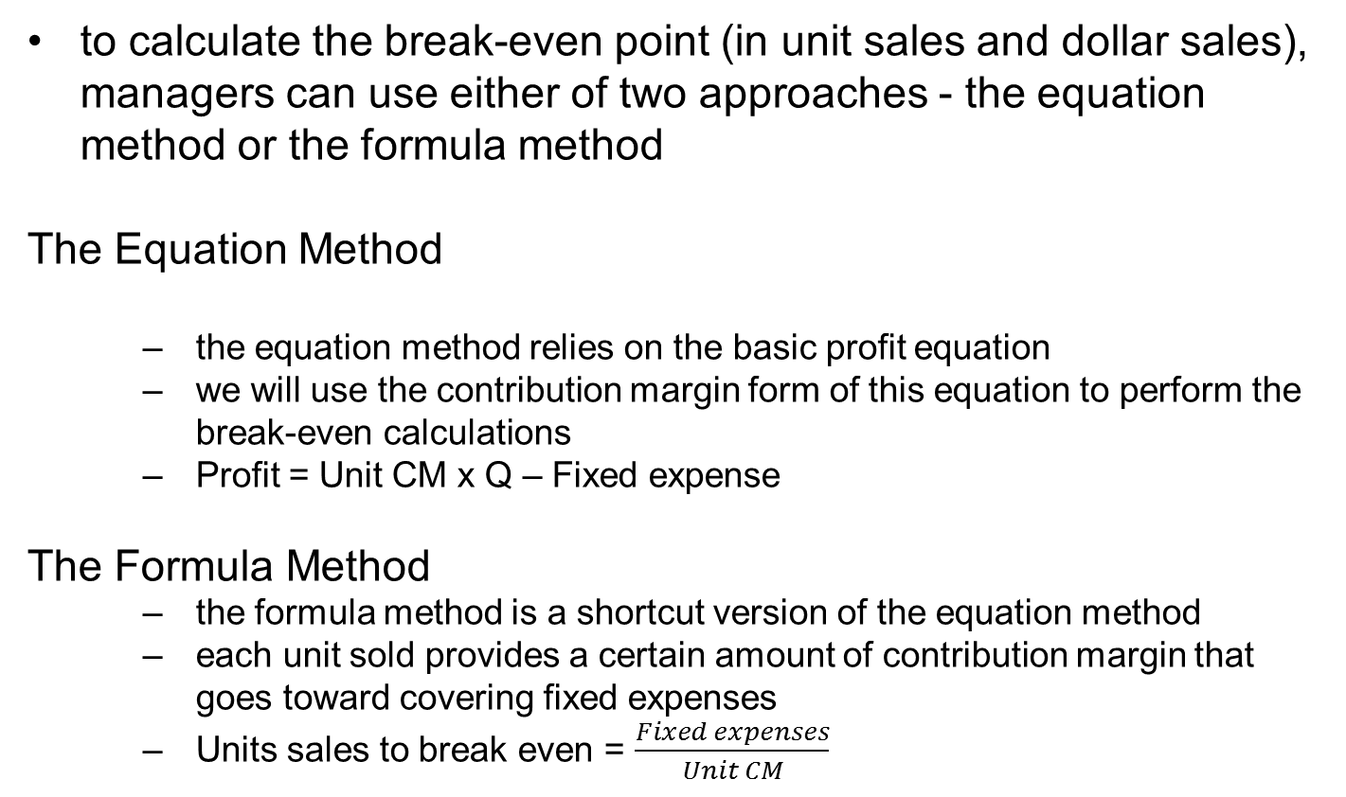
COST-VOLUME-PROFIT RELATIONSHIPS
BREAK - EVEN ANALYSIS
to calculate the break-even point (in unit sales and dollar sales), managers can use either of two approaches - the equation method or the formula method
The Equation Method
  the equation method relies on the basic profit equation
  we will use the contribution margin form of this equation to perform the break-even calculations
  Profit = Unit CM x Q – Fixed expense
The Formula Method
  the formula method is a shortcut version of the equation method
  each unit sold provides a certain amount of contribution margin that goes toward covering fixed expenses
  Units sales to break even = $\frac{Fixed expenses}{Unit CM}$

Slide 13
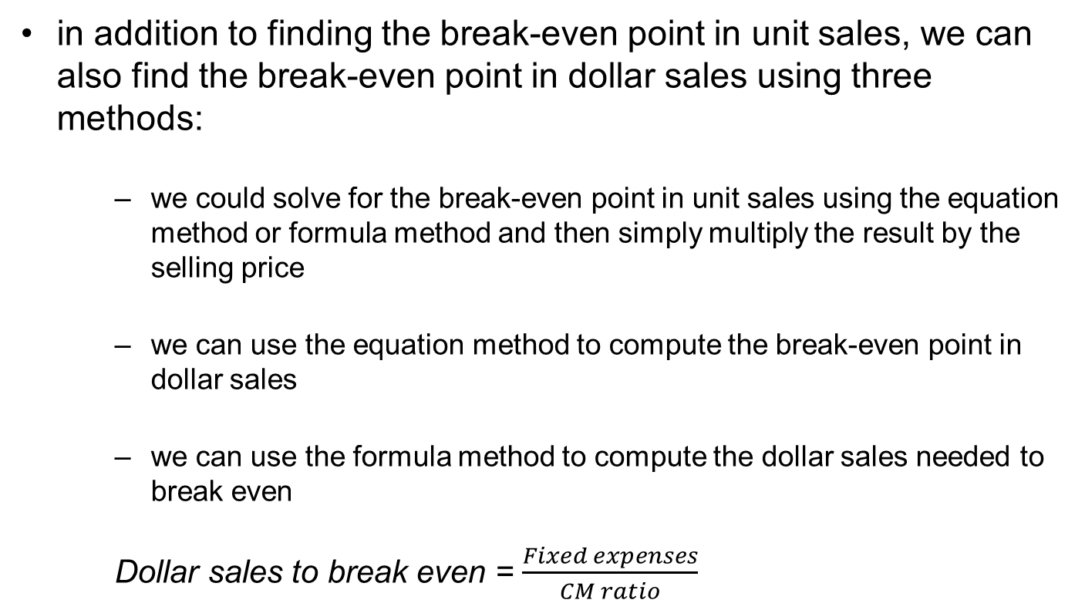
COST-VOLUME-PROFIT RELATIONSHIPS
BREAK-EVEN IN DOLLAR SALES
in addition to finding the break-even point in unit sales, we can also find the break-even point in dollar sales using three methods:
  we could solve for the break-even point in unit sales using the equation method or formula method and then simply multiply the result by the selling price
  we can use the equation method to compute the break-even point in dollar sales
  we can use the formula method to compute the dollar sales needed to break even
  Dollar sales to break even = $\frac{Fixed expenses}{CM ratio}$

Slide 14
COST-VOLUME-PROFIT RELATIONSHIPS
TARGET PROFIT ANALYSIS (1)
target profit analysis is one of the key uses of CVP analysis.
In target profit analysis, we estimate what sales volume is needed to achieve a specific target profit
to determine the unit sales and dollar sales needed to achieve a target profit, we can rely on the same two approaches - the equation method or the formula method
The Equation Method
  Profit = Unit CM x Q – Fixed expense

Slide 15
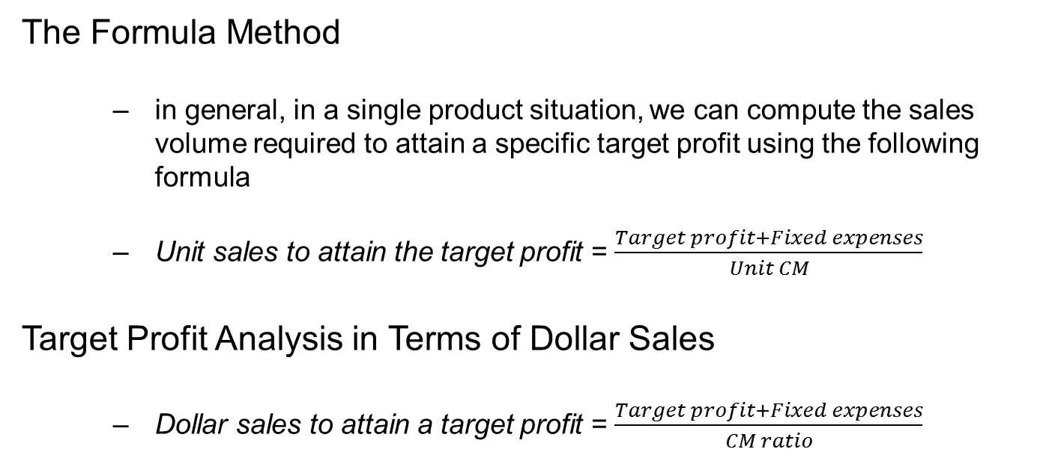
COST-VOLUME-PROFIT RELATIONSHIPS
TARGET PROFIT ANALYSIS (2)
The Formula Method
  in general, in a single product situation, we can compute the sales volume required to attain a specific target profit using the following formula
  Unit sales to attain the target profit = $\frac{Target profit+Fixed expenses}{Unit CM}$
Target Profit Analysis in Terms of Dollar Sales
  Dollar sales to attain a target profit = $\frac{Target profit+Fixed expenses}{CM ratio}$

Slide 16
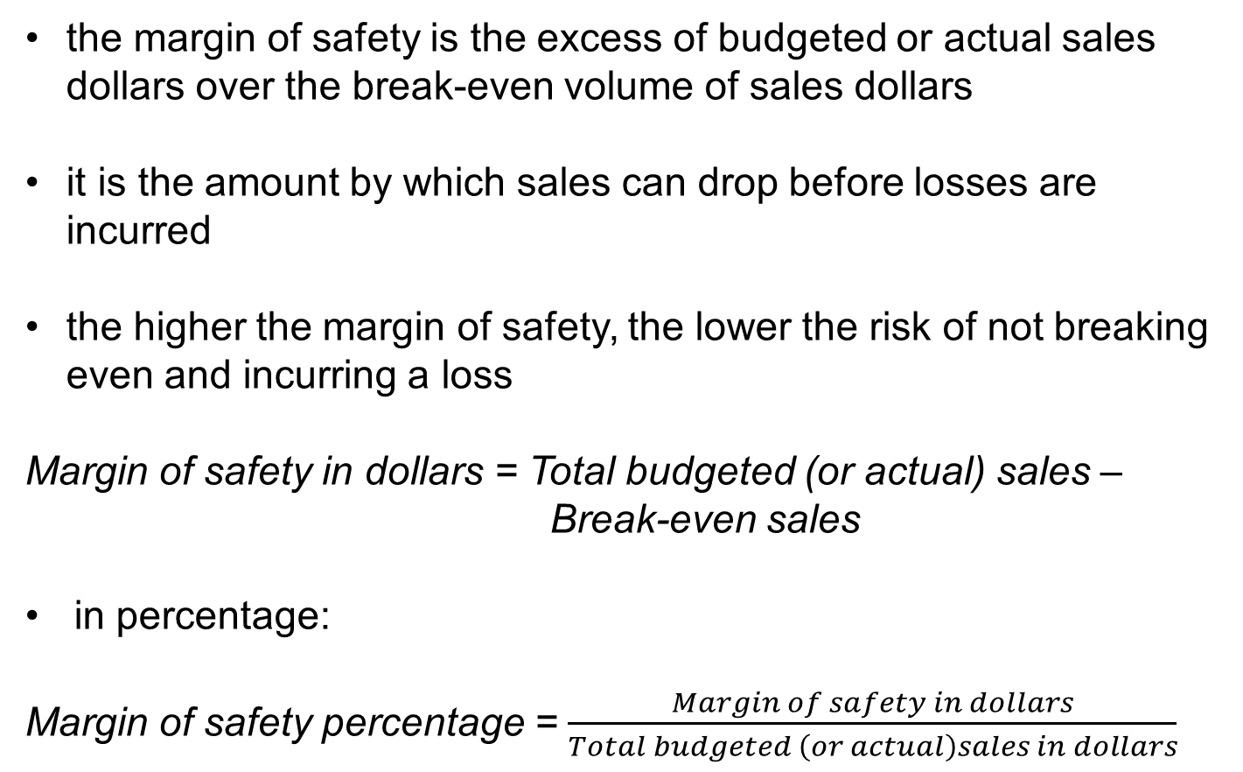
COST-VOLUME-PROFIT RELATIONSHIPS
THE MARGIN OF SAFETY
the margin of safety is the excess of budgeted or actual sales dollars over the break-even volume of sales dollars
it is the amount by which sales can drop before losses are incurred
the higher the margin of safety, the lower the risk of not breaking even and incurring a loss
Margin of safety in dollars = Total budgeted (or actual) sales – Break-even sales
in percentage:
Margin of safety percentage = $\frac{Margin of safety in dollars}{Total budgeted \left(or actual\right)sales in dollars}$

Slide 17
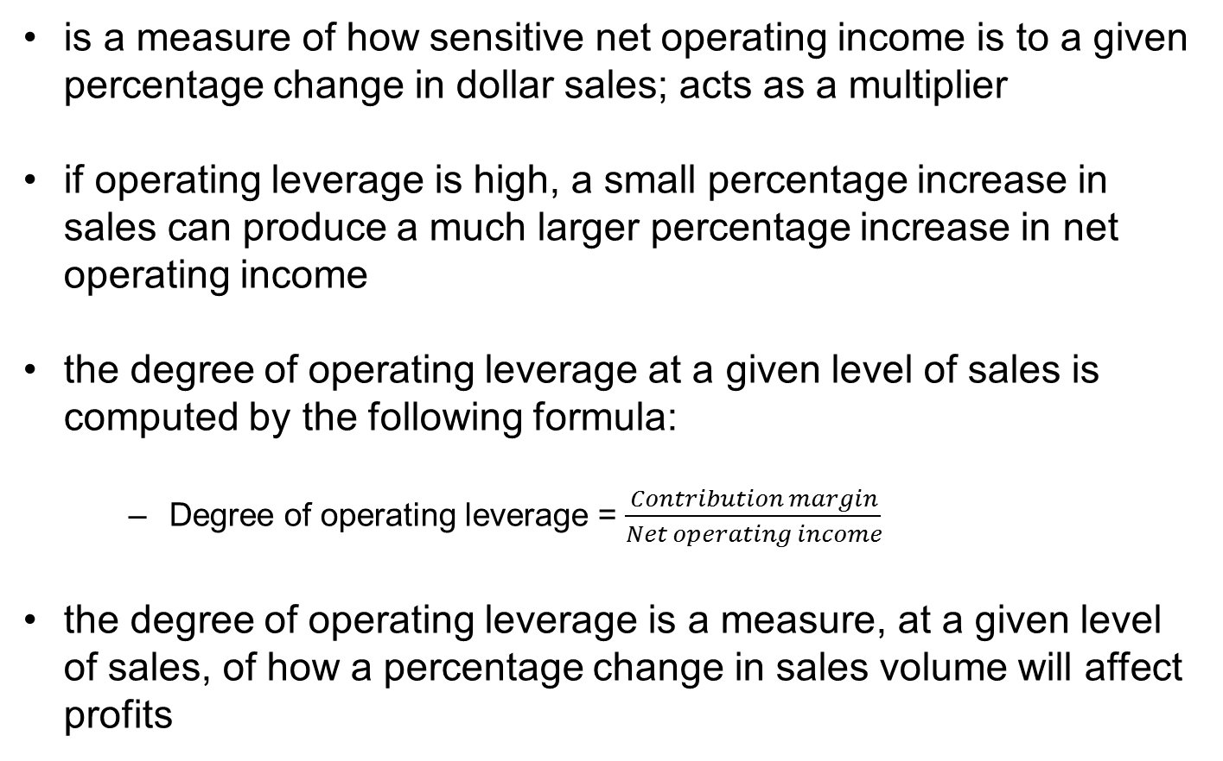
COST-VOLUME-PROFIT RELATIONSHIPS
OPERATING LEVERAGE
is a measure of how sensitive net operating income is to a given percentage change in dollar sales; acts as a multiplier
if operating leverage is high, a small percentage increase in sales can produce a much larger percentage increase in net operating income
the degree of operating leverage at a given level of sales is computed by the following formula:
  Degree of operating leverage = $\frac{Contribution margin}{Net operating income}$
the degree of operating leverage is a measure, at a given level of sales, of how a percentage change in sales volume will affect profits

Slide 18
COST-VOLUME-PROFIT RELATIONSHIPS
THE DEFINITION OF SALES MIX (1)
refers to the relative proportions in which a company´s products are sold
the idea is to achieve the combination, or mix, that will yield the greatest profit
most companies have many products, and often these products are not equally profitable
profits will depend to some extent on the company´s sales mix
profits will be greater if high-margin rather than low-margin items make up a relatively large proportion of total sales
  changes in the sales mix can cause perplexing variations in a company´s profits

Slide 19
COST-VOLUME-PROFIT RELATIONSHIPS
THE DEFINITION OF SALES MIX (2)
a shift in the sales mix from high-margin items to low-margin items can cause total profits to decrease even though total sales may increase
a shift in the sales mix from low-margin items to high-margin items can cause the reverse effect - total profits may increase even though total sales decrease
it is one thing to achieve a particular sales volume; it is quite another to sell the most profitable mix of products

Slide 20
COST-VOLUME-PROFIT RELATIONSHIPS
SALES MIX AND BREAK-EVEN ANALYSIS
if a company sells more than one product, break-even analysis is more complex than discussed to this point
the reason is that different products will have different selling prices, different costs, and different contribution margins
the break-even point depends on the mix in which the various products are sold
If the sales mix changes, then the break-even point will also usually change

Slide 21
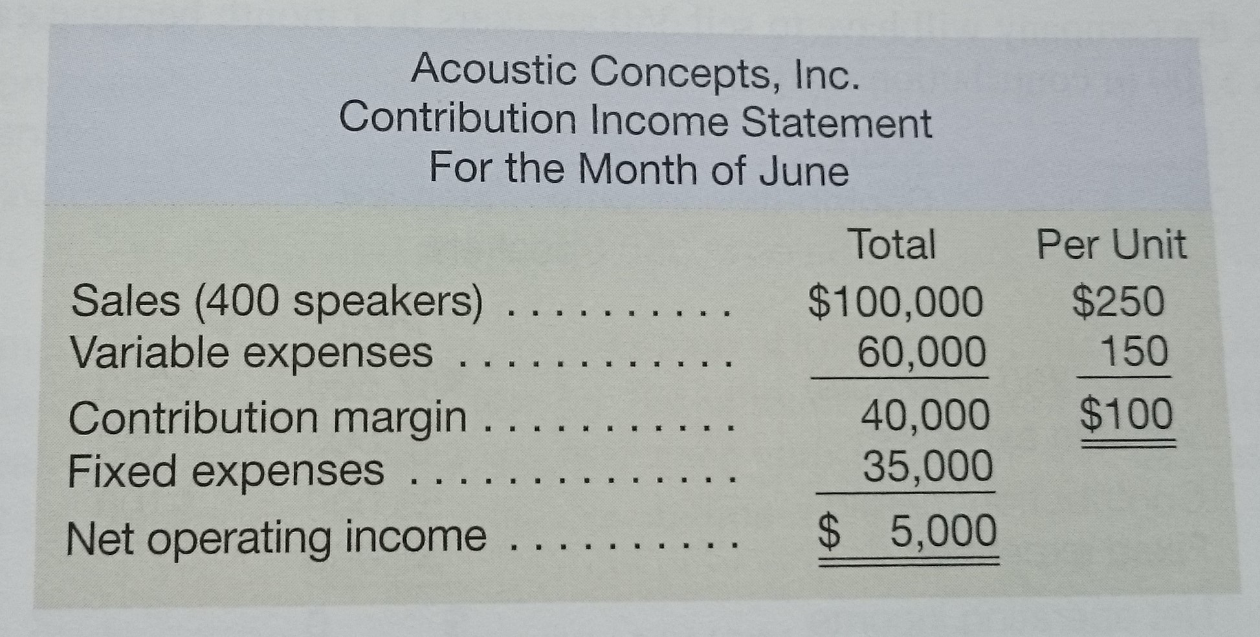
COST-VOLUME-PROFIT RELATIONSHIPS

Slide 22
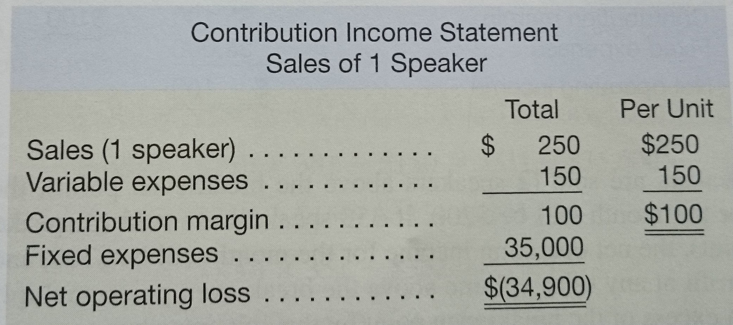
COST-VOLUME-PROFIT RELATIONSHIPS

Slide 23
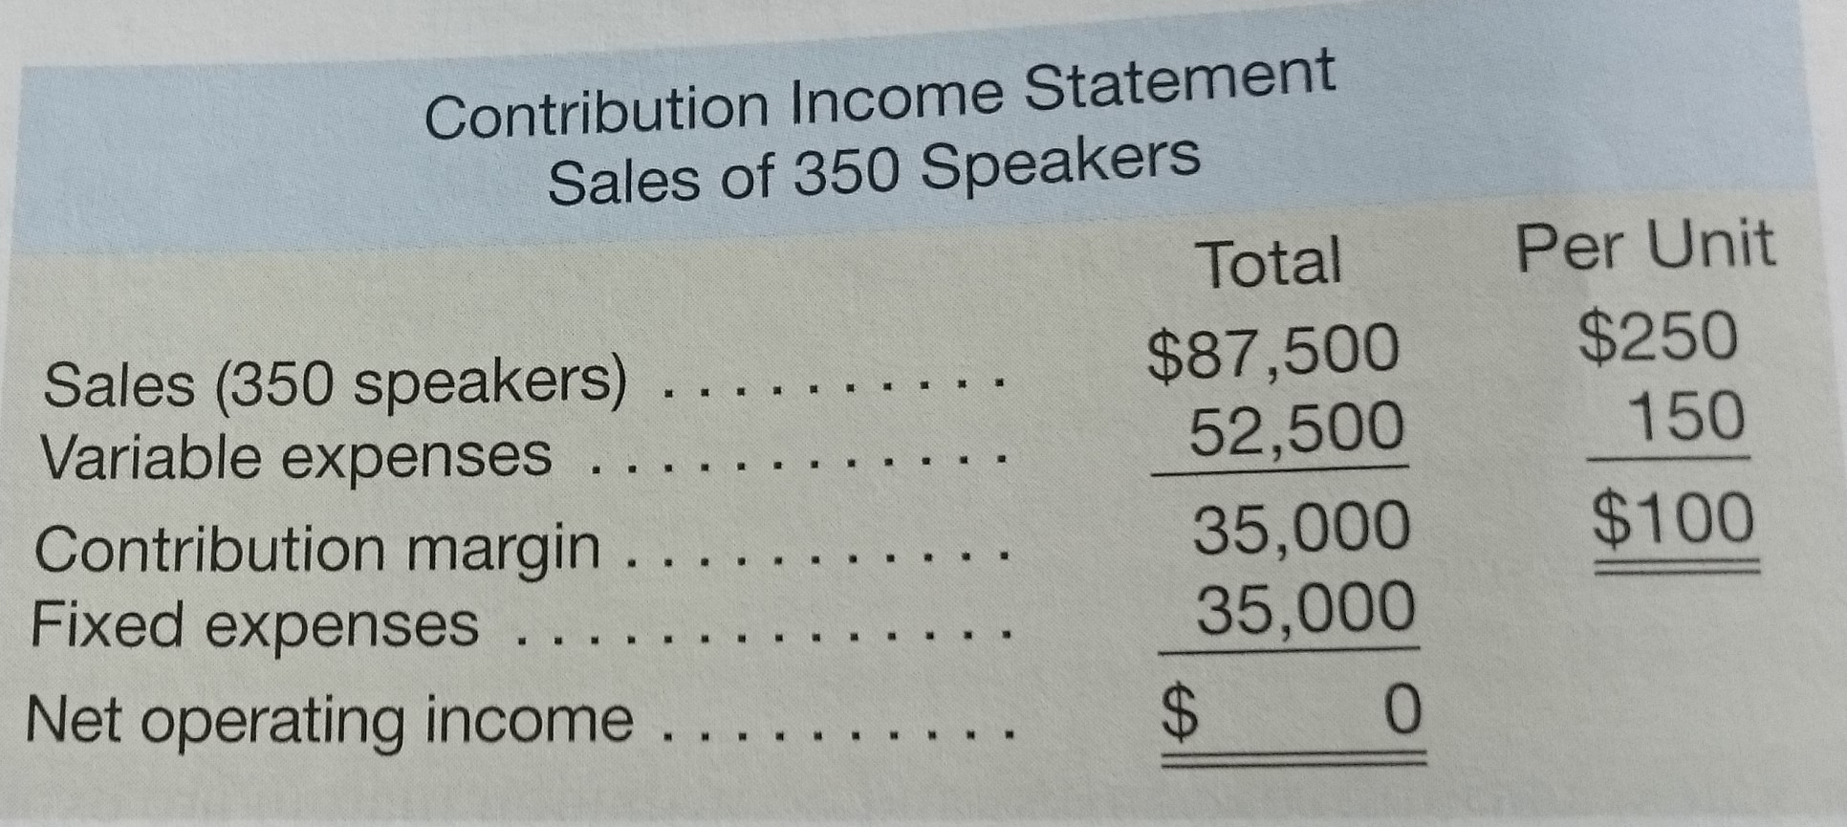
COST-VOLUME-PROFIT RELATIONSHIPS

Slide 24
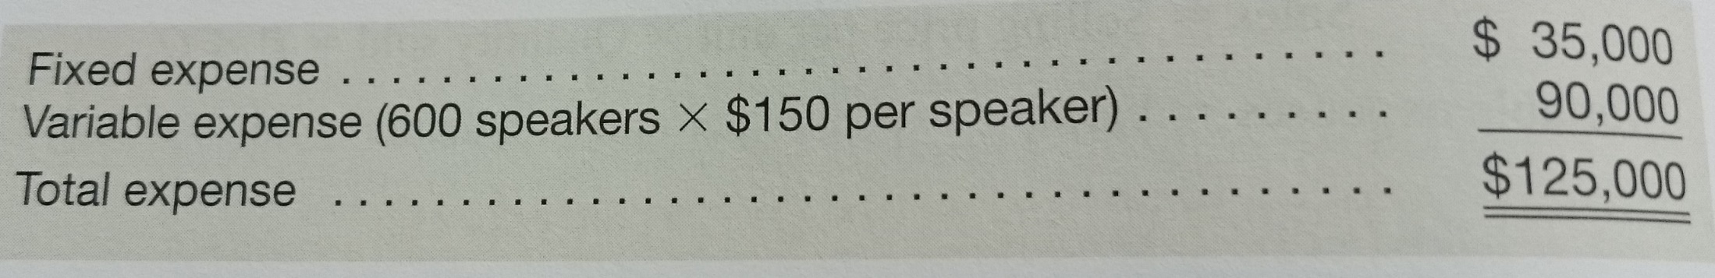
COST-VOLUME-PROFIT RELATIONSHIPS

Slide 25
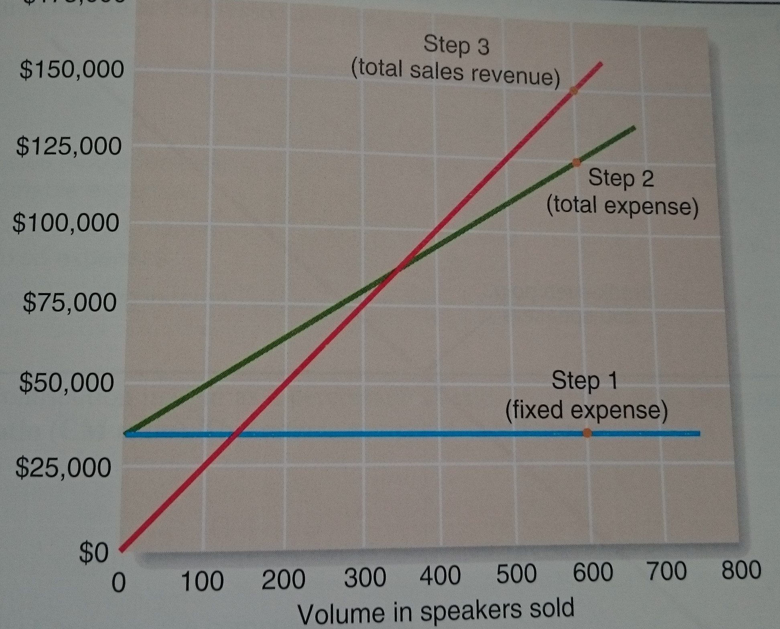
COST-VOLUME-PROFIT RELATIONSHIPS

Slide 26
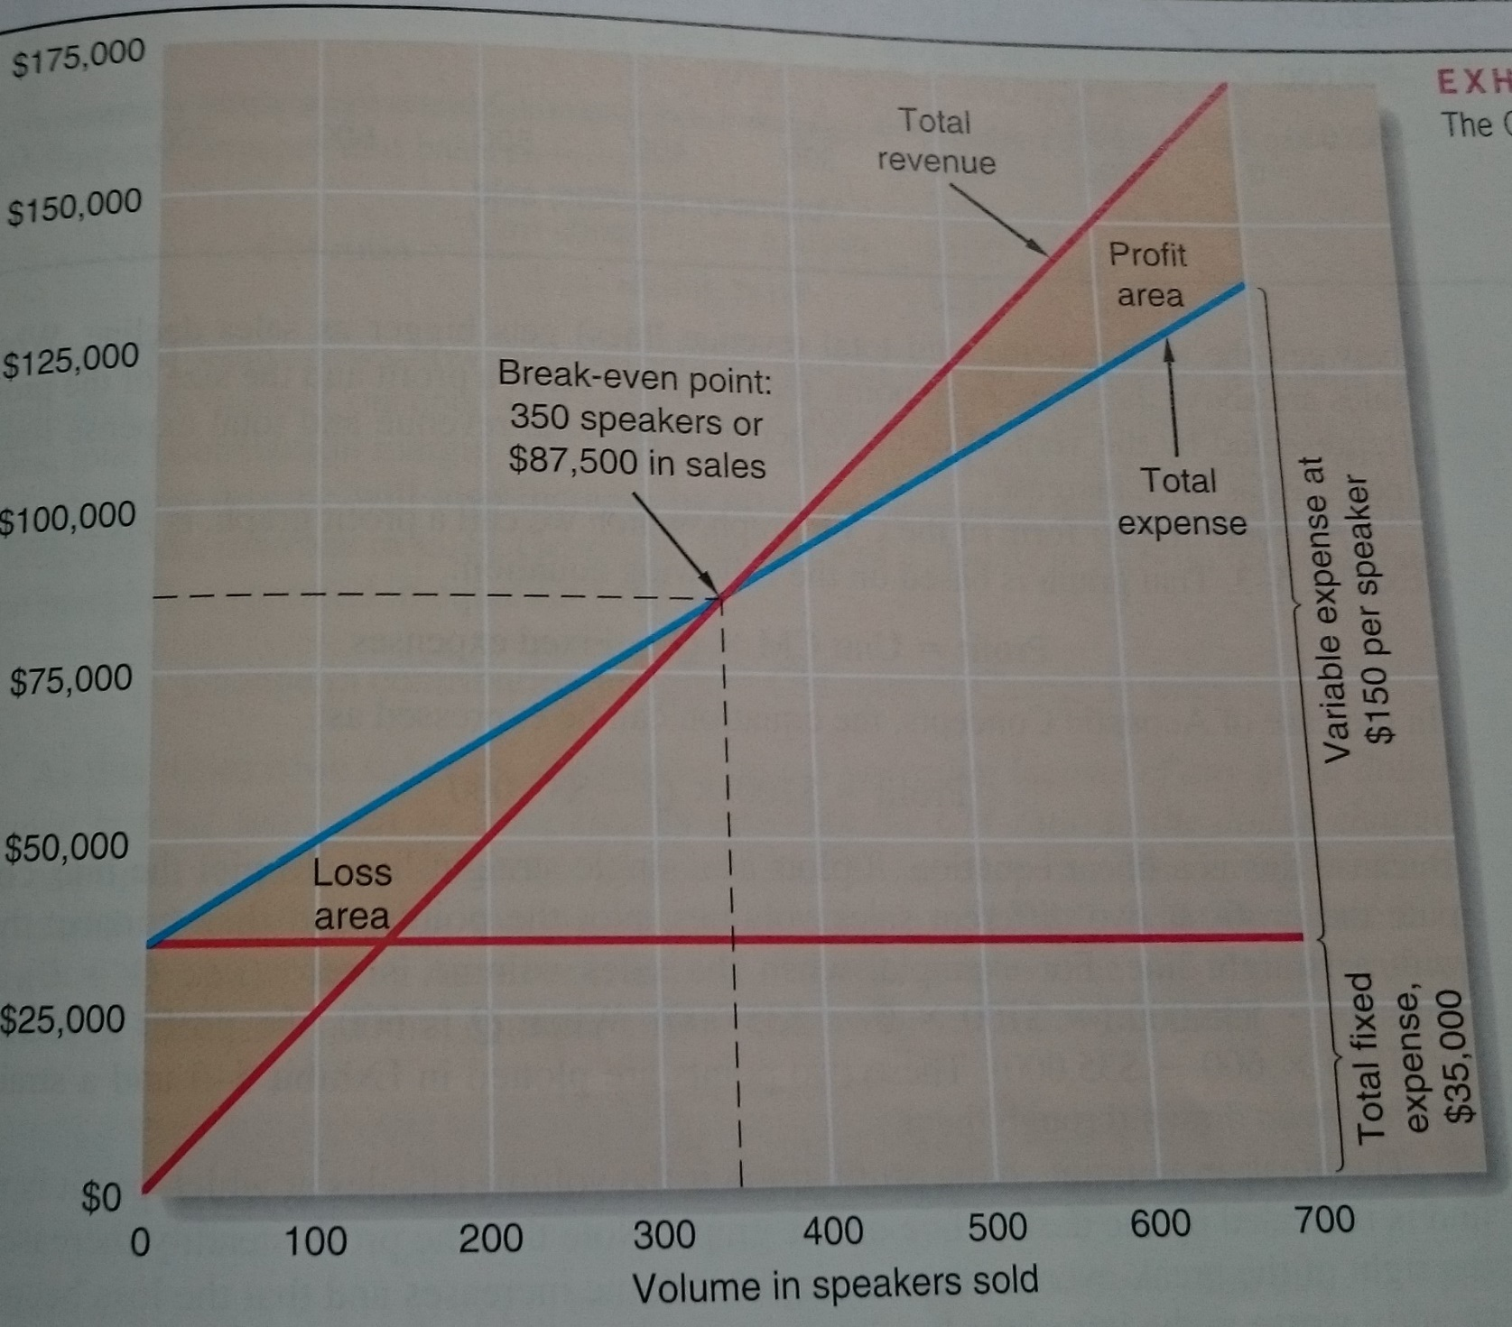
COST-VOLUME-PROFIT RELATIONSHIPS

Slide 27
Thank you for your attention.

