Slide 1

ACTIVITY-BASED COSTING
A TOOL TO AID DECISION MAKING
Ing. Markéta Šeligová, Ph.D.
MANAGERIAL ACCOUNTING/NANMU

Slide 2
ACTIVITY-BASED COSTING
Outline of the lecture
Activity-based costing
Nonmanufacturing costs and activity-based costing
Manufacturing costs and activity-based costing
Steps for implementing activity-based costing
The limitations of activity-based costing

Slide 3
ACTIVITY-BASED COSTING
ACTIVITY-BASED COSTING (ABC) (1)
is a costing method that is designed to provide managers with cost information for strategic and other decisions that potentially affect capacity and therefore fixed as well as variable costs
is ordinarily used as a supplement to, rather than as a replacement for, a company´s usual costing system
most organizations that use activity-based costing have two costing systems - the official costing system that is used for preparing external financial reports and the activity-based costing system that is used for internal decision making and for managing activities

Slide 4
ACTIVITY-BASED COSTING
ACTIVITY-BASED COSTING (ABC) (2)
traditional absorption costing is designed to provide data for external financial reports
activity-based costing is designed to be used for internal decision making
activity-based costing differs from traditional absorption costing in three ways:
  1. nonmanufacturing as well as manufacturing costs may be assigned to products, but only on a cause-and effect basis
  2. some manufacturing cost may be excluded from product costs
  3. numerous overhead cost pools are used, each of which is allocated to products and other cost objects using its own unique measure of activity

Slide 5
ACTIVITY-BASED COSTING
NONMANUFACTURING COSTS AND ACTIVITY-BASED COSTING (1)
in traditional absorption costing, manufacturing costs are assigned to products and nonmanufacturing costs are not assigned to products
in activity-based costing, many nonmanufacturing costs relate to selling, distributing, and servicing specific products
ABC includes manufacturing and nonmanufacturing costs when calculating the entire cost of a product rather than just its manufacturing cost

Slide 6
ACTIVITY-BASED COSTING
NONMANUFACTURING COSTS AND ACTIVITY-BASED COSTING (2)
There are two types of nonmanufacturing costs that ABC systems assign to products:
  1. ABC systems trace all direct nonmanufacturing costs to products. Commissions paid to salespersons, shipping costs, and warranty repair costs are examples of nonmanufacturing costs that can be directly traced to individual products.
  2. ABC systems allocate indirect nonmanufacturing cost to products whenever the products have presumably caused the costs to be incurred.
ABC product cost calculations include all direct costs that can be traced to products and all indirect costs that are caused by products

Slide 7
ACTIVITY-BASED COSTING
MANUFACTURING COSTS AND ACTIVITY-BASED COSTING (1)
in traditional absorption costing systems, all manufacturing costs are assigned to products - even manufacturing costs that are not caused by the products
activity-based costing systems purposely do not assign two types of manufacturing overhead costs to products
  manufacturing overhead includes costs such as the factory security guard´s wages, the plant controller´s salary, and the cost of supplies used by the plant manager´s secretary
these types of costs are assigned to products in a traditional absorption costing system even though they are totally unaffected by which products are made during a period

Slide 8
ACTIVITY-BASED COSTING
MANUFACTURING COSTS AND ACTIVITY-BASED COSTING (2)
in contrast, activity-based costing systems do not arbitrarily assign these types of costs, which are called organization-sustaining costs, to products
activity-based costing treats these types of costs as period expenses rather than product cost
additionally, in a traditional absorption costing system, the costs of unused, or idle, capacity are assigned to products
  if the budgeted level of activity declines, the overhead rate and unit product costs increase as the increasing costs of idle capacity are spread over a smaller base

Slide 9
ACTIVITY-BASED COSTING
MANUFACTURING COSTS AND ACTIVITY-BASED COSTING (3)
in contrast, in activity-based costing, products are only charged for the costs of the capacity they use - not for the costs of capacity they don´t use
  this provides more stable unit product costs and is consistent with the goal of assigning to products only the costs of the resources that they use

Slide 10
ACTIVITY-BASED COSTING
MANUFACTURING COSTS AND ACTIVITY-BASED COSTING (4)
traditional absorption costing treats all manufacturing costs as product costs and all nonmanufacturing costs as period costs
activity-based costing expands the definition of overhead to include all indirect costs - manufacturing and nonmanufacturing
the overhead costs that are caused by products are allocated to them, whereas any overhead costs that are not caused by products are treated as period costs
ABC treats direct nonmanufacturing costs as product costs rather than period costs

Slide 11
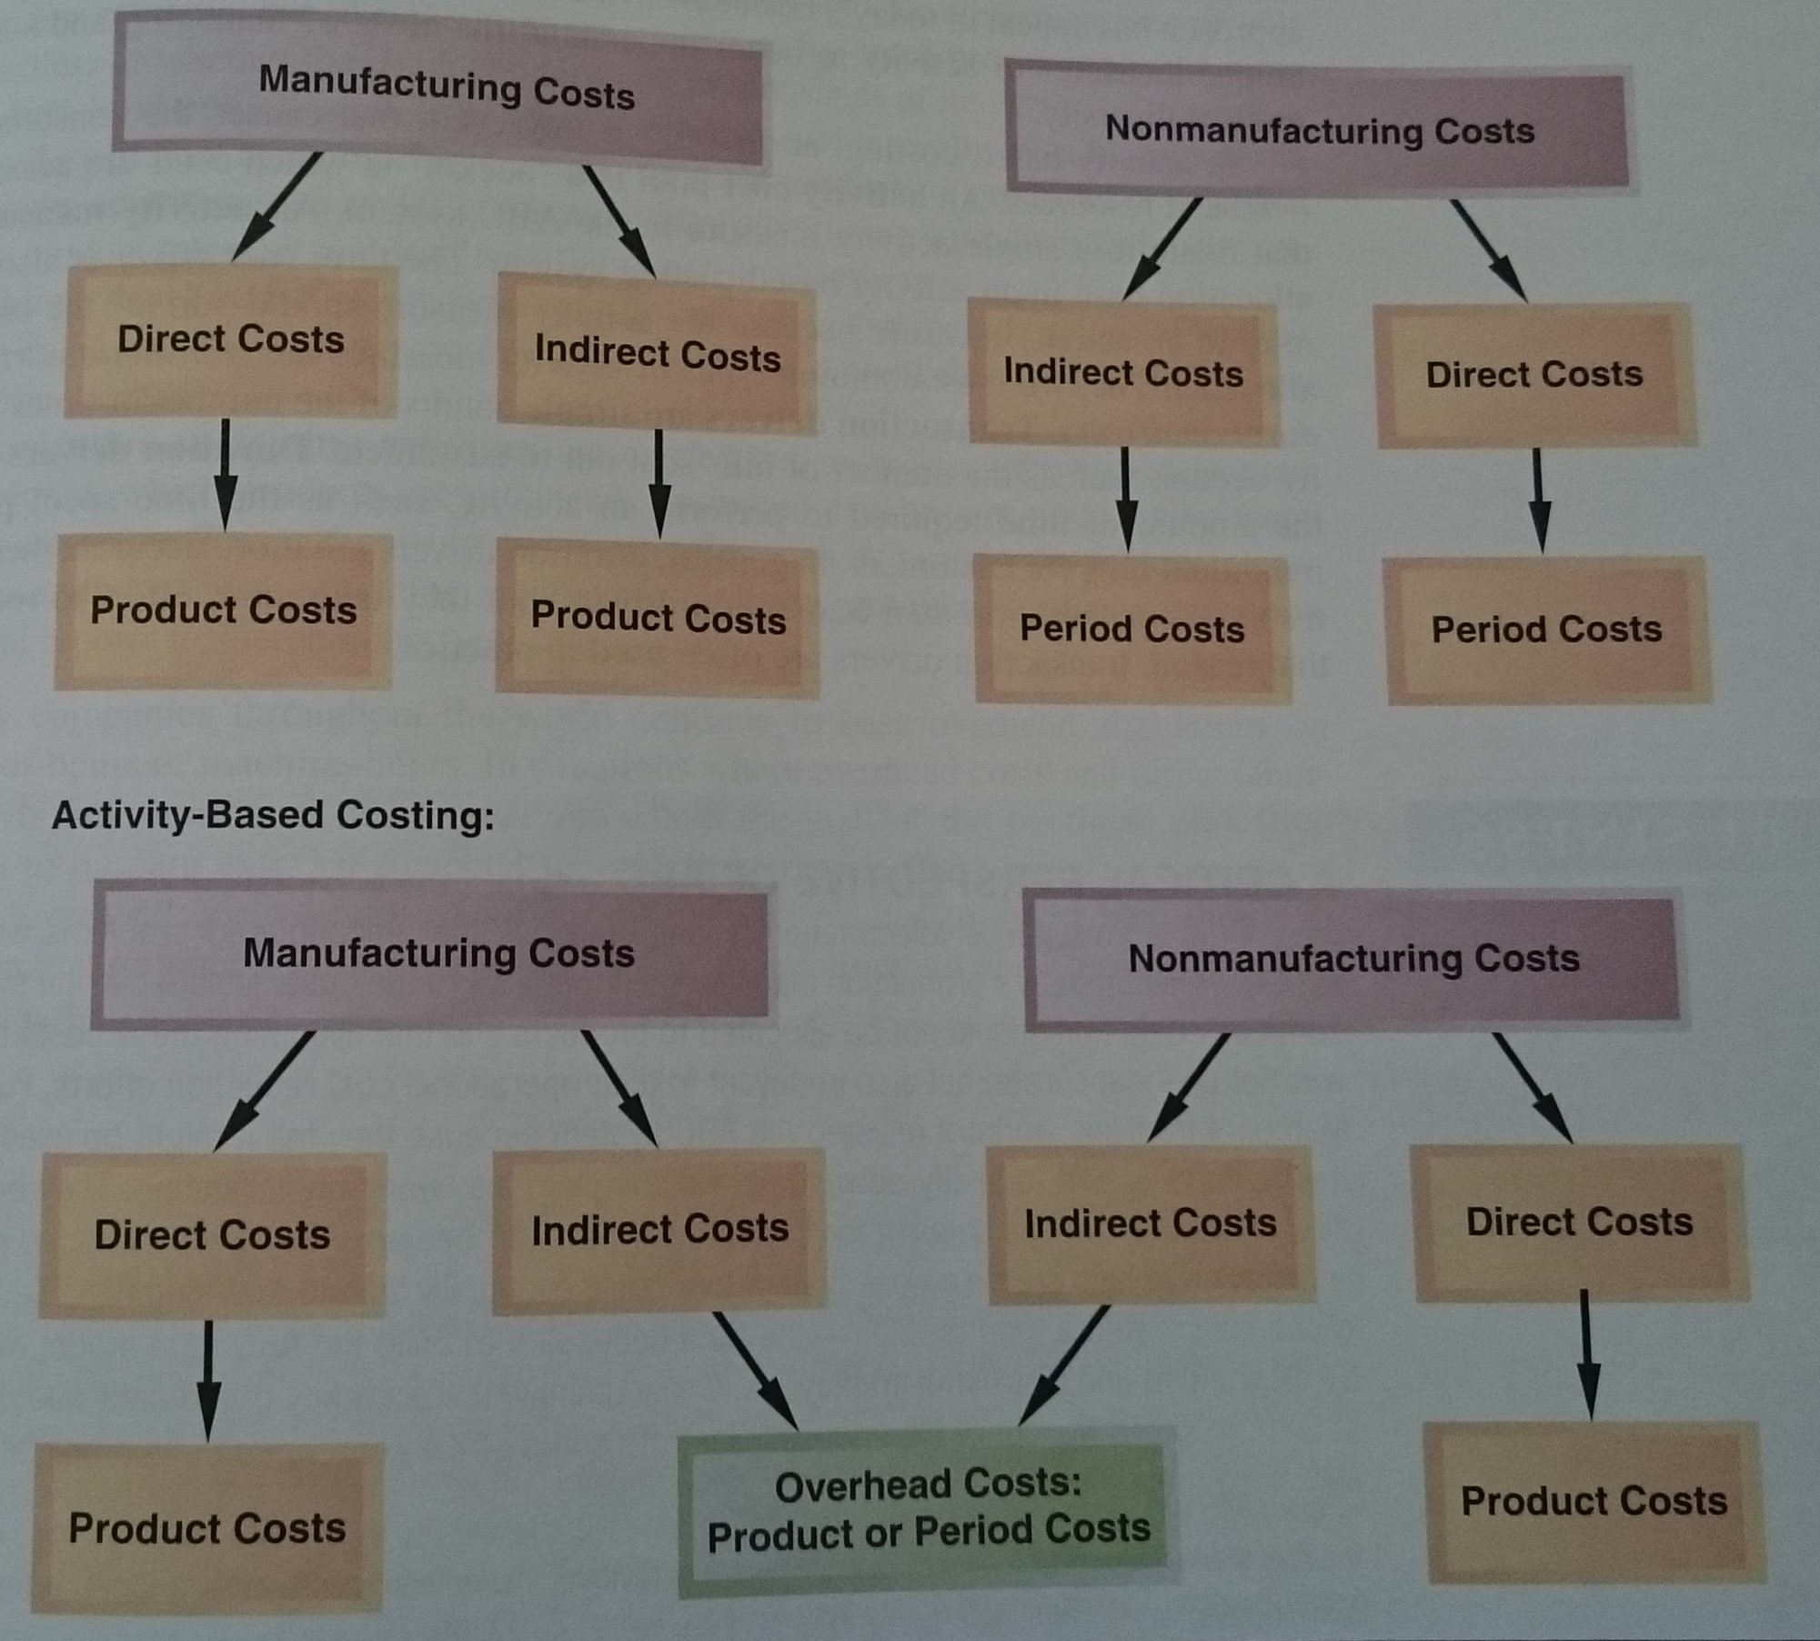
ACTIVITY-BASED COSTING

Slide 12
ACTIVITY-BASED COSTING
COST POOLS, ALLOCATION BASES, AND ACTIVITY-BASED COSTING (1)
typically, either one plantwide overhead cost pool or a number of departmental overhead cost pools were used to assign overhead costs to products
the plantwide and departmental approaches always had one thing in common - they relied on allocation bases such as direct labour-hours and machine-hours for allocating overhead costs to products
activity-based costing provides an alternative to the traditional plantwide and departmental approaches to defining cost pools and selecting allocation bases
  the activity-based approach has appeal in today´s business environment because it uses more cost pools and unique measures of activity to better understand the costs of managing and sustaining product diversity

Slide 13
ACTIVITY-BASED COSTING
COST POOLS, ALLOCATION BASES, AND ACTIVITY-BASED COSTING (2)
in activity-based costing, an activity is any event that causes the consumption of overhead resources
an activity cost pool is a bucket in which costs are accumulated that relate to a single activity measure in the ABC system
an activity measure is an allocation base in an activity-based costing system
the term cost driver is also used to refer to an activity measure because the activity measure should drive the cost being allocated

Slide 14
ACTIVITY-BASED COSTING
COST POOLS, ALLOCATION BASES, AND ACTIVITY-BASED COSTING (3)
the two most common types of activity measures are transaction drivers and duration drivers
transaction drivers are simple counts of the number of times an activity occurs, such as the number of bills sent out to customers
duration drivers measure the amount of time required to perform an activity, such as the time spent preparing individual bills for customers
in general, duration drivers are more accurate measures of resource consumption than transaction drivers, but they take more effort to record - for that reason, transaction drivers are often used in practice

Slide 15
ACTIVITY-BASED COSTING
COST POOLS, ALLOCATION BASES, AND ACTIVITY-BASED COSTING (4)
traditional cost systems rely exclusively on allocation bases that are driven by the volume of production
on the other hand, activity-based costing defines five levels of activity
  1. unit level
  2. batch-level
  3. product-level
  4. customer-level
  5. organization-sustaining
the costs and corresponding activity measures for unit-level activities do relate to the volume of units produced; however, the remaining categories do not

Slide 16
ACTIVITY-BASED COSTING
COST POOLS, ALLOCATION BASES, AND ACTIVITY-BASED COSTING (5)
Unit-level activities are performed each time a unit is produced. The costs of unit-level activities should be proportional to the number of units produced
  For example, providing power to run processing equipment would be a unit-level activity because power trends to be consumed in proportion to the number of units produced

Slide 17
ACTIVITY-BASED COSTING
COST POOLS, ALLOCATION BASES, AND ACTIVITY-BASED COSTING (6)
Batch-level activities are performed each time a batch is handled or processed, regardless of how many units are in the batch
  For example, tasks such as placing purchase orders, setting up equipment, and arranging for shipments to customers are batch-level activities. They are incurred once for each batch (or customer order).
  Costs at the batch level depend on the number of batches processed rather than on the number of units produced, the number of units sold, or other measures of volume
  For example, the cost of setting up a machine for batch processing is the same regardless of whether the batch contains one or thousands of items

Slide 18
ACTIVITY-BASED COSTING
COST POOLS, ALLOCATION BASES, AND ACTIVITY-BASED COSTING (7)
Product-level activities relate to specific products and typically must be carried out regardless of how many batches are run or units of product are produced or sold
  For example, activities such as designing a product, advertising a product, and maintaining a product manager and staff are all product-level activities.
Customer-level activities relate to specific customers and include activities such as sales calls, catalog mailings, and general technical support that are not tied to any specific product

Slide 19
ACTIVITY-BASED COSTING
COST POOLS, ALLOCATION BASES, AND ACTIVITY-BASED COSTING (8)
Organization-sustaining activities are carried out regardless of which customers are served, which products are produced, how many batches are run, or how many units are made
  This category includes activities such as heating the factory, cleaning executive offices, providing a computer network, arranging for loans, preparing annual reports to shareholders, and so on.

Slide 20
ACTIVITY-BASED COSTING
STEPS FOR IMPLEMENTING ACTIVITY-BASED COSTING
1. define activities, activity cost pools, and activity measure
2. assign overhead costs to activity cost pools
3. calculate activity rates
4. assign overhead costs to cost objects using the activity rates and activity measures
5. prepare management reports

Slide 21
ACTIVITY-BASED COSTING
COMPARISON OF TRADITIONAL AND ABC PRODUCT COSTS
the ABC team used a two-step process to compare its traditional and ABC product costs
first, the team reviewed the product margins reported by the traditional cost system
then, it contrasted the differences between the traditional and ABC product margins

Slide 22
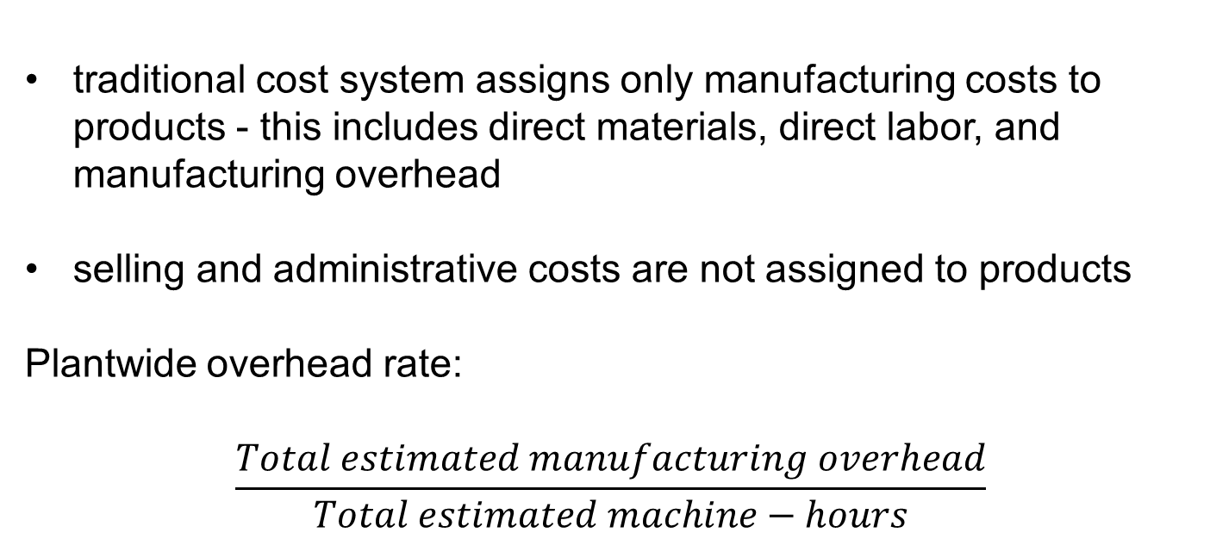
ACTIVITY-BASED COSTING
PRODUCT MARGINS COMPUTED USING THE TRADITIONAL COST SYSTEM
traditional cost system assigns only manufacturing costs to products - this includes direct materials, direct labor, and manufacturing overhead
selling and administrative costs are not assigned to products
Plantwide overhead rate:
$$\frac{Total estimated manufacturing overhead}{Total estimated machine−hours}$$

Slide 23
ACTIVITY-BASED COSTING
TARGETING PROCESS IMPROVEMENTS (1)
activity-based costing can also be used to identify activities that would benefit from process improvements
when used in this way, activity-based costing is often called activity-based management
activity-based management involves focusing on activities to eliminate waste, decrease processing time, and reduce defects
activity-based management is used in organizations as diverse as for example manufacturing companies

Slide 24
ACTIVITY-BASED COSTING
TARGETING PROCESS IMPROVEMENTS (2)
the first step in any improvement program is to decide what to improve
benchmarking is another way to leverage the information in activity rates
benchmarking is a systematic approach to identifying the activities with the greatest room for improvement
  it is based on comparing the performance in an organization with the performance of other, similar organizations know for their outstanding performance.
  if a particular part of the organization performs far below the world-class standard, managers will be likely to target that area for improvement

Slide 25
ACTIVITY-BASED COSTING
THE LIMITATIONS OF ACTIVITY-BASED COSTING (1)
implementing an activity-based costing system is a major project that requires substantial resources
and once implemented, an activity-based costing system is more costly to maintain than a traditional costing system - data concerning numerous activity measures must be periodically collected, checked, and entered into the system
the benefits of increased accuracy may not outweigh these costs
activity-based costing produces numbers, such as product margins, that are at odds with the numbers produced by traditional costing systems

Slide 26
ACTIVITY-BASED COSTING
THE LIMITATIONS OF ACTIVITY-BASED COSTING (2)
managers are accustomed to using traditional costing systems to run their operations and traditional costing systems are often used in performance evaluations
if activity-based costing is viewed as an accounting initiative that does not have the full support of top management, it is doomed to failure
most managers insist on fully allocating all costs to products, customers, and other costing objects in an activity-based costing system-including the costs of idle capacity and organization sustaining costs
  this results in overstated costs and understated margins and mistakes in pricing and other critical decisions

Slide 27
ACTIVITY-BASED COSTING
THE LIMITATIONS OF ACTIVITY-BASED COSTING (3)
activity-based costing data can easily be misinterpreted and must be used with care when used in making decisions
costs assigned to products, customers, and other cost objects are only potentially relevant
before making any significant decisions using activity-based costing data, managers must identify which costs are really relevant for the decision at hand
an organization involved in activity-based costing should have two cost systems - one for internal use and one for preparing external reports
  this is costlier than maintaining just one system and may cause confusion about which system is to be believed and relied on

Slide 28
Thank you for your attention.

