Slide 1

MASTER BUDGETING
Ing. Markéta Šeligová, Ph.D.
MANAGERIAL ACCOUNTING/NANMU

Slide 2
MASTER BUDGETING
Outline of the lecture
Budget
Advantages of budgeting
Choosing a budget period
The master budget
Preparing the master budget

Slide 3
MASTER BUDGETING
BUDGET (1)
a budget is a detailed plan for the future that is usually expressed in formal quantitative terms
once the budget is established, actual spending is compared to the budget to make sure the plan is being followed
budgets are used for two distinct purposes - planning and control
planning involves developing goals and preparing various budgets to achieve those goals

Slide 4
MASTER BUDGETING
BUDGET (2)
control involves gathering feedback to ensure that the plan is being properly executed or modified as circumstance change
  to be effective, a good budgeting system must provide for both planning and control
good planning without effective control is a waste of time and effort

Slide 5
MASTER BUDGETING
ADVANTAGES OF BUDGETING (1)
budgets communicate management´s plans throughout the organization
budgets force managers to think about and plan for the future. In the absence of the necessity to prepare a budget, many managers would spend all of their time dealing with day-to-day emergencies
the budgeting process provides a means of allocating resources to those parts of the organization where they can be used most effectively

Slide 6
MASTER BUDGETING
ADVANTAGES OF BUDGETING (2)
the budgeting process can uncover potential bottlenecks before they occur
budgets coordinate the activities of the entire organization by integrating the plans of its various parts.
  Budgeting helps to ensure that everyone in the organization is pulling in the same direction
budgets define goals and objectives that can serve as benchmarks for evaluating subsequent performance

Slide 7
MASTER BUDGETING
RESPONSIBILITY ACCOUNTING
the basic idea underlying responsibility accounting is that a manager should be held responsible for those items and only those items that manager can actually control to a significant extent
each line item in the budget is the responsibility of a manager who is held responsible for subsequent deviations between budgeted goals and actual results
in effect, responsibility accounting personalizes accounting information by holding individuals responsible for revenues and costs
this concept is central to any effective planning and control system

Slide 8
MASTER BUDGETING
CHOOSING A BUDGET PERIOD (1)
operating budgets ordinarily cover a one-year period corresponding to the company´s fiscal year
many companies divide their budget year into four quarters
the first quarter is then subdivided into months, and monthly budgets are developed
the last three quarters may be carried in the budget as quarterly totals only
as the year progresses the figures for the second quarter are broken down into monthly amounts, then the third-quarter figures are broken down, and so forth

Slide 9
MASTER BUDGETING
CHOOSING A BUDGET PERIOD (2)
this approach has the advantage of requiring periodic review and reappraisal of budget data throughout the year
continuous or perpetual budgets are sometimes used
a continuous or perpetual budget is a 12-month budget that rolls forward one month (or quarter) as the current month (or quarter) is completed
in other words, one month (or quarter) is added to the end of the budget as each month (or quarter) comes to a close
this approach keeps managers focused at least one year ahead so that they do not become too narrowly focused on short-term results

Slide 10
MASTER BUDGETING
THE SELF-IMPOSED BUDGET (1)
many managers believe that being empowered to create their won self-imposed budgets is the most effective method of budget preparation
a self-imposed budget or participative budget is a budget that is prepared with the full cooperation and participation of managers at all levels

Slide 11
MASTER BUDGETING
THE SELF-IMPOSED BUDGET (2) – ADVANTAGES (1)
Individuals at all levels of the organization are recognized as members of the team whose views and judgments are valued by top management.
Budget estimates prepared by front-line managers are often more accurate and reliable than estimates prepared by top managers who have less intimate knowledge of markets and day-to-day operations.
Motivation is generally higher when individuals participate in setting their own goals than when the goals are imposed from above. Self-imposed budgets create commitment.

Slide 12
MASTER BUDGETING
THE SELF-IMPOSED BUDGET (3) – ADVANTAGES (2)
A manager who is not able to meet a budget that has been imposed from above can always say that the budget was unrealistic and impossible to meet. With a self-imposed budget, this claim cannot be made.

Slide 13
MASTER BUDGETING
THE SELF-IMPOSED BUDGET (3)
self-imposed budgeting has two important limitations
  lower-level managers may make suboptimal budgeting recommendations of they lack the broad strategic perspective possessed by top managers
  self-imposed budgeting may allow lower-level managers to create too much budgetary slack
because the manager who creates the budget will be held accountable for actual results that deviate from the budget, the manager will have a natural tendency to submit a budget that is easy to attain
for this reason, budgets prepared by lower-level managers should be scrutinized by higher levels of management
  many companies divide their budget year into four quarters

Slide 14
MASTER BUDGETING
THE MASTER BUDGET
the master budget consists of a number of separate but interdependent budgets that formally lay out the company´s sales, production, and financial goals
the master budget culminates in a cash budget, a budgeted income statement, and a budgeted balance sheet

Slide 15
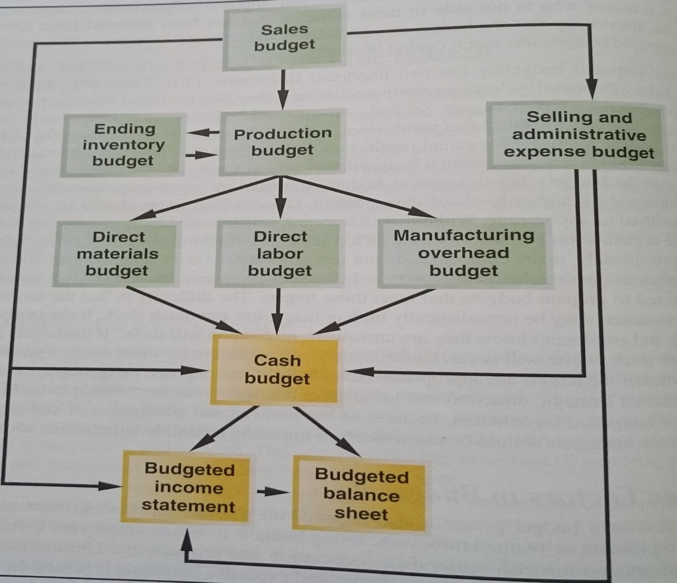
MASTER BUDGETING

Slide 16
MASTER BUDGETING
THE MASTER BUDGET - SALES BUDGET (1)
the first step in the budgeting process is the preparation of the sales budget, which is a detailed schedule showing the expected sales for the budget period
an accurate sales budget is the key to the entire budgeting process
all other parts of the master budget depend on the sales budget
if the sales budget is inaccurate, the rest of the budget will be inaccurate
the sales budget is based on the company´s sales forecast

Slide 17
MASTER BUDGETING
THE MASTER BUDGET - SALES BUDGET (2)
the sales budget influences the variable portion of the selling and administrative expense budget and it feeds into the production budget, which defines how many units need to be produced during the budget period
the production budget in turn is used to determine the direct materials, direct labor, and manufacturing overhead budgets
once a company has prepared these three manufacturing cost budgets, it can prepare the ending finished goods inventory budget

Slide 18
MASTER BUDGETING
THE MASTER BUDGET (3)
the master budget concludes with the preparation of a cash budget, income statement, and balance sheet
information from the sales budget, selling and administrative expense budget, and the manufacturing cost budgets all influence the preparation of the cash budget
A cash budget is a detailed plan showing how cash resources will be acquired and used
the budgeted income statement provides an estimate of net income for the budget period and it relies on information from the sales budget, ending finished goods inventory budget, selling administrative expense budget, and the cash budget

Slide 19
MASTER BUDGETING
THE MASTER BUDGET AND 10 KEY QUESTIONS
a master budget for a manufacturing company is designed to answer 10 key questions as follows:
  How much sales revenue will we earn?
  How much cash will we collect from customer?
  How much raw material will we need to purchase?
  How much manufacturing cost (including direct materials, direct labor, and manufacturing overhead) will we incur?
  How much cash will we pay to our suppliers and our direct laborers, and how much will we pay for manufacturing overhead resources?
  What is the total cost that will be transferred from finished goods inventory to cost of goods sold?
  How much selling and administrative expense will we incur and how much cash will we pay related to those expenses?
  How much money will we borrow from or repay to lenders - including interest?
  How much net operating income will we earn?
  What will our balance sheet look like at the end of the budget period?

Slide 20
MASTER BUDGETING
PREPARING THE MASTER BUDGET (1)
The production budget is prepared after the sales budget. The production budget lists number of units that must be produced to satisfy sales needs and to provide for the desired ending finished goods inventory
A merchandise purposes budget showing the amount of goods to be purchased from suppliers during the period
A direct materials budget is prepared after the production requirements have been computed. The direct materials budget details the raw materials that must be purchased to fulfill the production budget and to provide for adequate inventories.

Slide 21
MASTER BUDGETING
PREPARING THE MASTER BUDGET (2)
The direct labor budget shows the direct labor-hours required to satisfy the production budget. By knowing in advance how much labor time will be needed throughout the budget year, the company can develop plans to adjust the labor force as the situation requires.
The manufacturing overhead budget list all costs of production other than direct materials and direct labor.
The cost of unsold units is computed on the ending finished goods inventory budget.

Slide 22
MASTER BUDGETING
PREPARING THE MASTER BUDGET (3)
The selling and administrative expense budget lists the budgeted expenses for areas other than manufacturing. In large organizations, this budget would be a compilation of many smaller, individual budgets submitted by department heads and other persons responsible for selling and administrative expenses.

Slide 23
MASTER BUDGETING
THE CASH BUDGET (1)
The cash budget is composed of four major sections:
the receipts section
the disbursements section
the cash excess or deficiency section
the financing section

Slide 24
MASTER BUDGETING
THE CASH BUDGET (2)
The receipts section
the receipts section lists all of the cash inflows, except from financing, expected during the budget period
the major source of receipts is from sales
The disbursements section
the disbursements section summarizes all cash payments that are planned for the budget period
these payments include raw materials purchases, direct labour payments, manufacturing overhead costs, and so on, as contained in their respective budgets

Slide 25
MASTER BUDGETING
THE CASH BUDGET (3)
The cash excess or deficiency section
if a cash deficiency exists during any budget period or if there is a cash excess during any budget period that is less than the minimum required cash balance, the company will need to borrow money
if there is a cash excess during any budget period that is greater than the minimum required cash balance, the company can invest the excess funds or repay principal and interest to lenders

Slide 26
MASTER BUDGETING
THE CASH BUDGET (4)
The financing section
the financing section of the cash budget details the borrowings and principal and interest repayments projected to take place during the budget period
to calculate borrowings and interest payments, you will need to pay attention to the company´s desired minimum cash balance and to the terms of the company´s loan agreement with the bank
The cash balances at both the beginning and end of the year may be adequate even though a serious cash deficit occurs at some point during the year. The cash budget should be broken down into time periods that are short enough to capture major fluctuations in cash balances. While a monthly cash budget is most common, some organizations budget cash on a weekly or even daily basis.

Slide 27
Thank you for your attention.

