Slide 1

Overview of e-commerce in Czechia
Radim Dolák

Slide 2

Outline of the lecture
Introduction to e-commerce
E-commerce statistics in the Czech Republic
TOP samples of Czech e-shops
E-shop business plan
Examples of tools to create an e-shop
Overview of e-commerce in Czechia

Slide 3
Introduction to e-commerce
The history of ecommerce begins with the first ever online sale: on the August 11, 1994 a man sold a CD by the band Sting to his friend through his website NetMarket, an American retail platform. This is the first example of a consumer purchasing a product from a business through the World Wide Web—or “ecommerce” as we commonly know it today.
According to (Velmurugan & Narayanasamy, 2008) e-commerce is defined as an attempt to increase transactional efficiency and effectiveness in all aspects of the design, production, marketing and sales of products or services for existing and developing marketplaces through the utilization of current and emerging electronic technologies.
Overview of e-commerce in Czechia

Slide 4
Introduction to e-commerce
Major Ecommerce Business Classifications
B2B: Business to Business Ecommerce
B2C: Business to Consumer Ecommerce
C2C: Consumer to Consumer Ecommerce
C2B: Consumer to Business Ecommerce
Government / Public Administration Ecommerce
Overview of e-commerce in Czechia

Slide 5
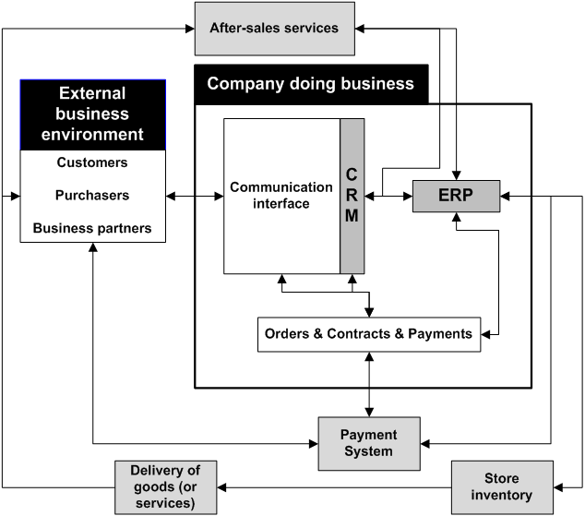
Introduction to e-commerce
Overview of e-commerce in Czechia

Slide 6
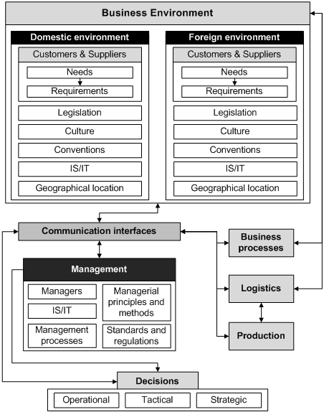
Introduction to e-commerce
Overview of e-commerce in Czechia

Slide 7
E-commerce statistics in the Czech Republic
Ecommerce in the Czech Republic is doing quite well.
There are nearly 6 million Czechs who are doing shopping online.
his means that user penetration in this market is 54% in 2020 and is predicted to reach 65.1% by 2025.
All top ecommerce sites are based in the Czech domain.
Overview of e-commerce in Czechia

Slide 8
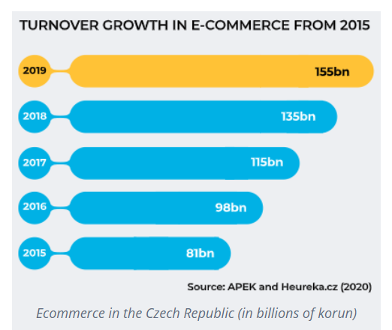
E-commerce statistics in the Czech Republic
Overview of e-commerce in Czechia

Slide 9
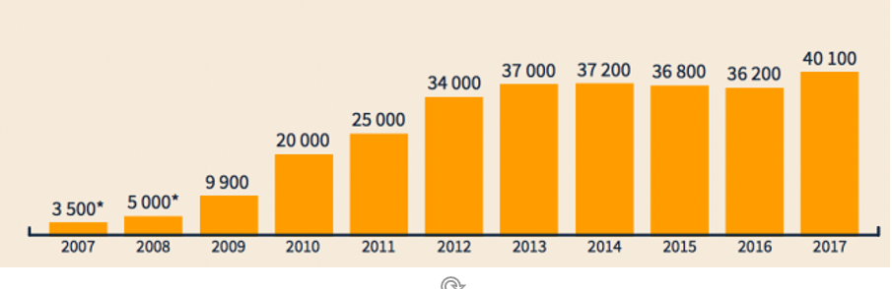
E-commerce statistics in the Czech Republic
NUMBER OF E-SHOPS
Overview of e-commerce in Czechia

Slide 10
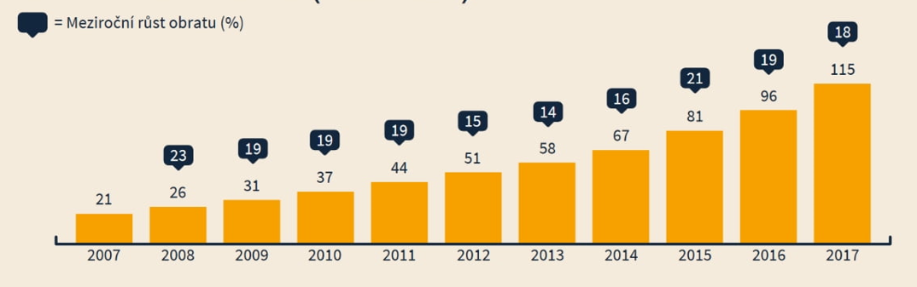
E-commerce statistics in the Czech Republic
TURNOVER GROWTH
Overview of e-commerce in Czechia

Slide 11
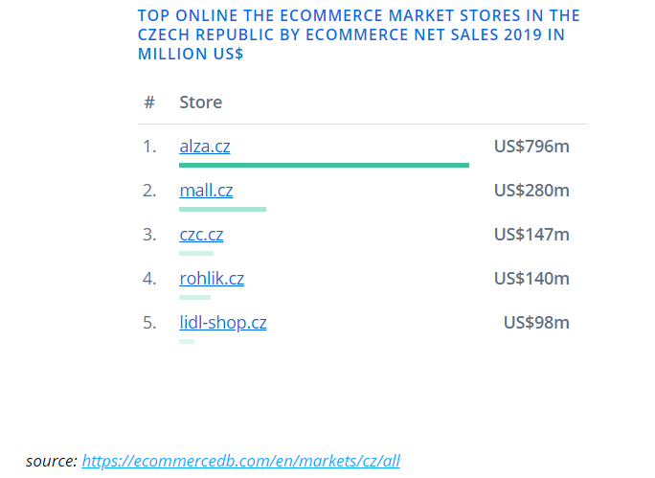
E-commerce statistics in the Czech Republic
Overview of e-commerce in Czechia

Slide 12
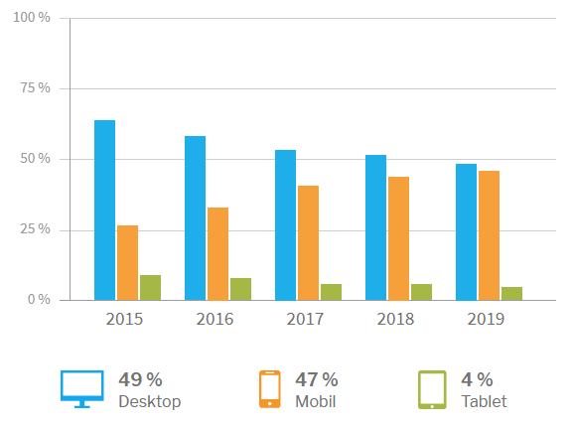
E-commerce statistics in the Czech Republic
Overview of e-commerce in Czechia

Slide 13
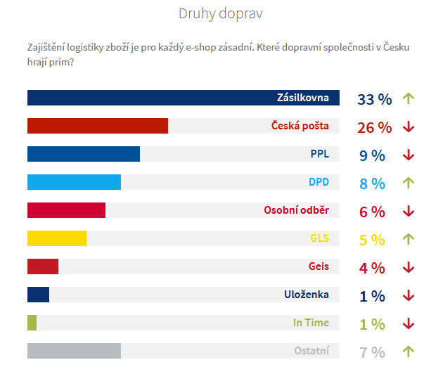
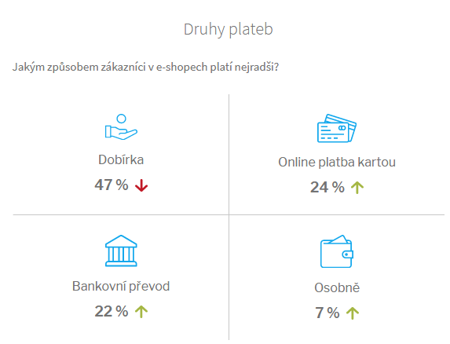
E-commerce statistics in the Czech Republic
Source: https://www.ceska-ecommerce.cz/
Overview of e-commerce in Czechia

Slide 14
E-commerce statistics in the Czech Republic
Overview of e-commerce in Czechia

Slide 15

TOP samples of Czech e-shops
Overview of e-commerce in Czechia

Slide 16
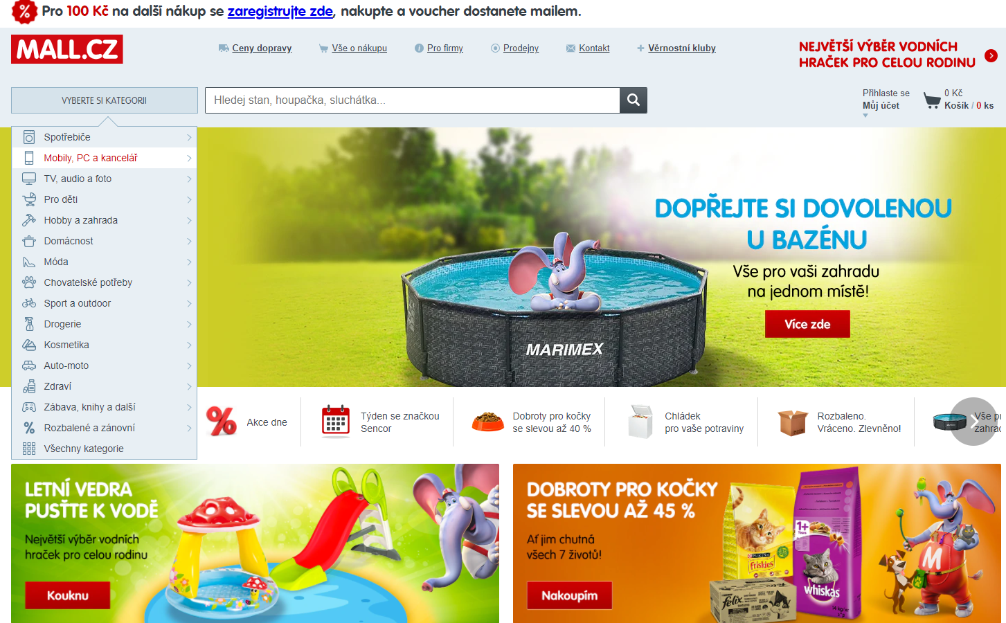
TOP samples of Czech e-shops
Overview of e-commerce in Czechia

Slide 17
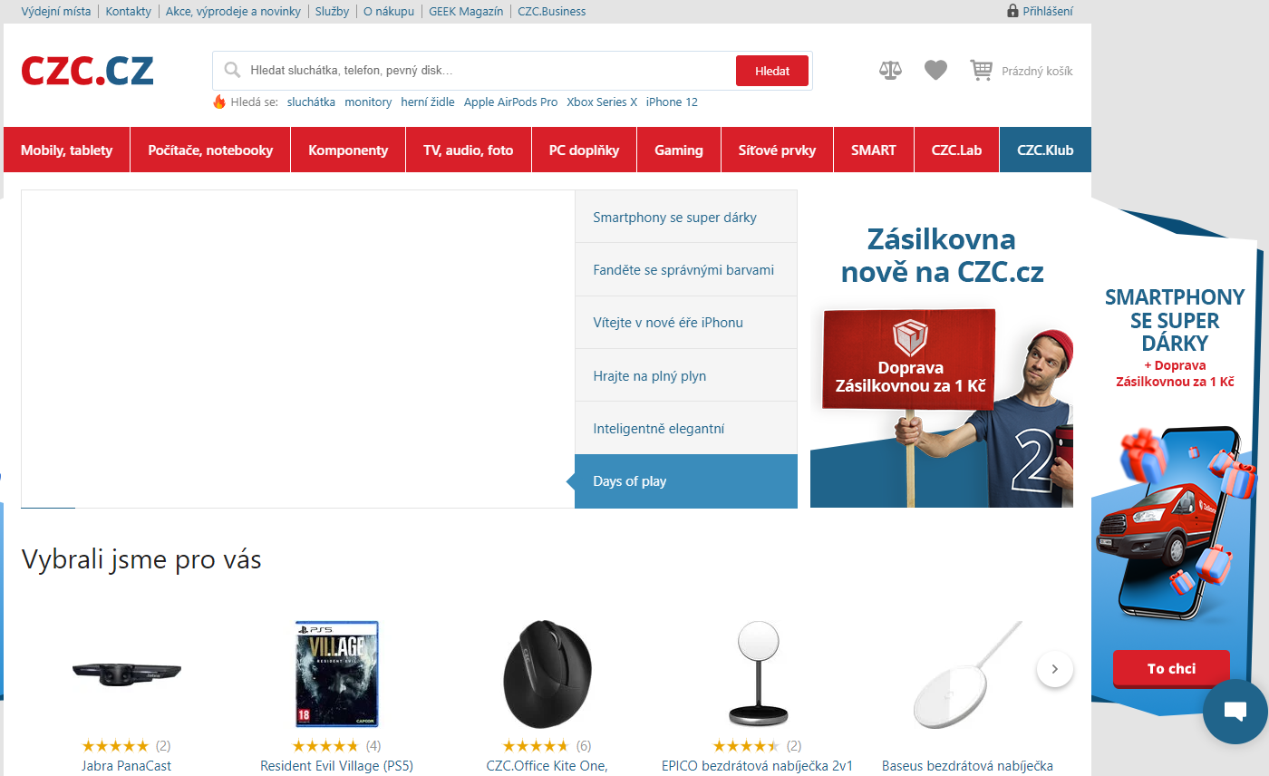
TOP samples of Czech e-shops
Overview of e-commerce in Czechia

Slide 18
e-shop business plan
The e-shop business plan should include the following information:
business plan definition, strategy
target groups and their needs
SWOT analysis
financial plan
choosing an e-shop creation tool
Overview of e-commerce in Czechia

Slide 19
e-shop business plan
In the initial phase of creating a new e-shop, it is necessary to reflect and clarify:
Who the site is intended for
What a potential customer will find on it
The following basic questions are also asked:
Why should a customer buy a given product?
Why would he buy it from you?
Target group analysis may also be performed on the basis of available statistics.
Overview of e-commerce in Czechia

Slide 20
e-shop business plan
A great tool for understanding the current situation is the so-called SWOT analysis:
Strengths - price, product quality, excellent logistics, strong suppliers, etc.
Weaknesses - limited budget, narrow choice, unknown brand
Opportunities - investment partner, expansion abroad, acquisition of a new range
Threats - entry of strong foreign players, state regulation, inexperienced personnel
Overview of e-commerce in Czechia

Slide 21
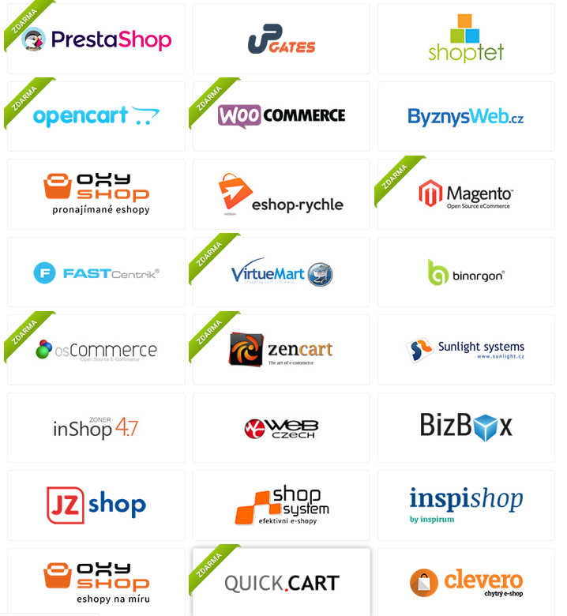
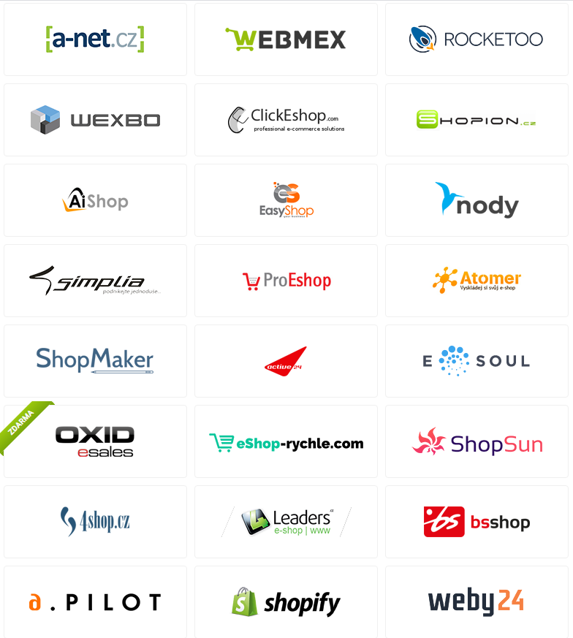
Examples of tools to create an e-shop
Overview of e-commerce in Czechia

Slide 22
THANK YOU FOR YOUR ATTENTION

Slide 23


