Slide 1
Master thesis seminar (3)
Information about description of FT
IS SU explanation
Insertion description into IS
Iveta Palečková
Vice-dean for Science and Research Department of Finance and Accounting

Slide 2
Dean‘s instruction
Dean's Instruction No. x/2022 - The Implementation Procedure for the Description of the Final Theses
Dean's Instruction No. 5/2020 - Description of Final Theses (SFE in winter semester)
https://www.slu.cz/opf/en/file/cul/a429fe31-9e9d-4cdc-9a66-110feecf31d1
Dean's Instruction No. x/2022 - Editing, Publishing and Storing Final Theses

Slide 3
Schedule of Master’s thesis elaboration and defense
till October 31 - filling in the data for the description of the Master’s thesis in the IS SU, student after consultation with a supervisor must complete and insert FT description into IS
till May 4 - students have to upload digital version of the final thesis into IS SU.
This schedule is valid for the students graduating in summer semester.
June 2022 – state final exam and defense of the thesis

Slide 4
Schedule of Master’s thesis elaboration

Slide 5
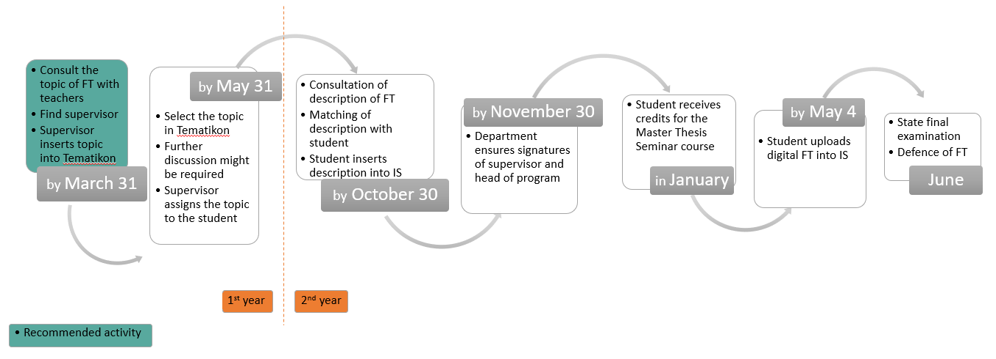
Final theses roadmap - examinations in June

Slide 6
Schedule of Master’s thesis elaboration and defense
till March 31, student after consultation with a supervisor must complete and insert FT description into IS
till December - students have to upload digital version of the final thesis into IS SU
This schedule is valid for the students graduating in February.
February – state final exam and defense of the thesis

Slide 7
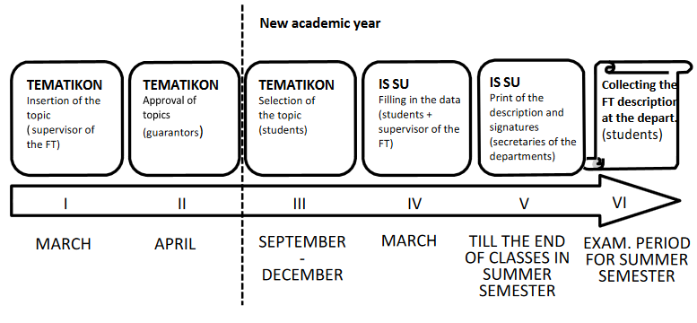
Schedule of Master’s thesis elaboration

Slide 8
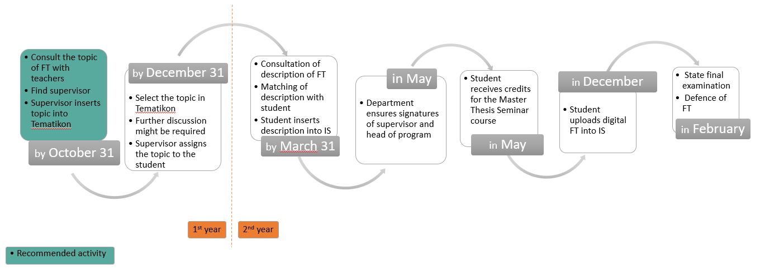
Final theses roadmap - examinations in February

Slide 9
Content of the FT description
Title in English
Schedule of elaboration including the day of submitting
Aim of the thesis (aim of the thesis is to evaluate, compare, create etc.)
Subject of the thesis – e. g. Thesis will focus on marketing mix of company XY (future time)
Data and methods – e. g. Questionnaire survey will be employed to evaluate the level of customer satisfaction with products of company XY … or…. Secondary data from Czech statistical office will be applied.
Structure – e.g. Theoretical part of the thesis will focus on determination of fundamental terms and relationships in the field of strategic management and main indicators applied in empirical part will be also defined … In empirical part, the use of marketing mix measures in the company XY will be evaluated.

Slide 10
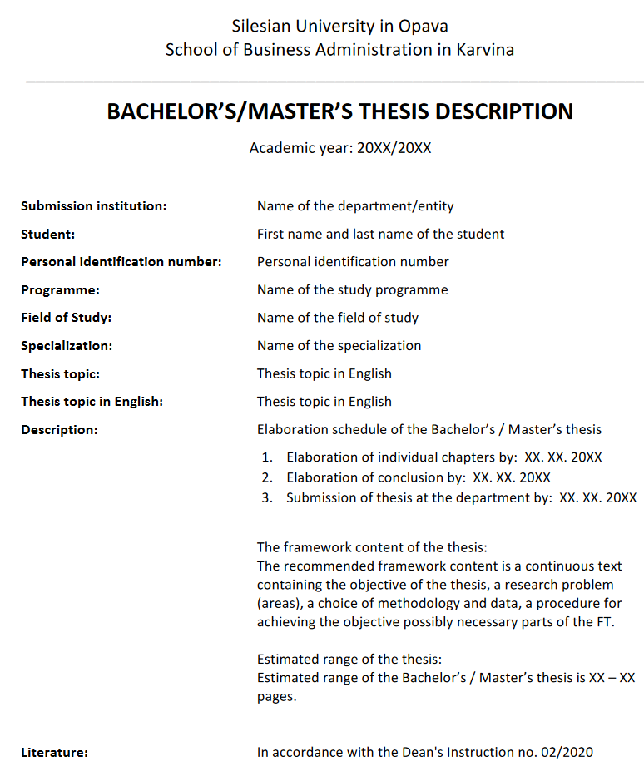
Sample of the structure of the documents for the description of the FT

Slide 11
Elaboration schedule - example
1. Elaboration of individual chapters by: 15. 3. 2023
2. Elaboration of conclusion by: 10. 4. 2023
3. Submission of thesis at the department by: 4. 5. 2023

Slide 12
The scope of the FT
The scope of the BT (not including Annexes) is set at 35 - 45 pages.
The scope of the MT is set at 45 - 65 pages.

Slide 13
The example of the structure of the description of FT
Title: Methods of evaluating the efficiency of the company
The aim of the master thesis is to evaluate the economic efficiency of the selected company. The annual reports of FIRM and industry values available at the portal of the Ministry of Industry and Trade of the Czech Republic will be used to prepare the master thesis. The data set will cover the period 2015-2020. The introductory part of the master thesis will describe the methods of evaluating the efficiency of the company. In the next part of the thesis the literature review regarding the firm‘s efficiency will be presented. Moreover, the financial statements will be explained. In the practical part of the master thesis will be evaluated the FIRM. The evaluation will be complemented by the recommendations to improve the firm‘s efficiency.

Slide 14
The example of the structure of the description of FT
Setting the aim of the master thesis is very important part of the description.
The aim is the answer to the question, ‘What are you doing?’
1. You need to clearly describe what your intentions are and what you hope to achieve. This is the aim.
2. Be very explicit. In the opening paragraphs, say, in simple terms, ‘the aim of the master thesis is to…’

Slide 15
The example of the structure of the description of FT
Methodology – used methods
Data – data collection:
primary data - one which is collected for the first time by the researcher through direct efforts and experience,
secondary data - the data already collected or produced by others.

Slide 16
Literature in the description
The minimum is 7 sources of literature in the description of FT.
Everything must be according to the citation standard!

Slide 17
Literature
[1] FORET, M., 2018. Marketing research: we know our customers. Brno: Computer Press. ISBN 978-80-251-2183-2.
[2] HINDLS, R., S. HRONOVA, J. SEGER and J. FISCHER, 2017. Statistics for Economists. 8th ed. Prague: Professional Publishing. ISBN 978-80-86946-43-6.
[3] JOBBER, D., 2015. Principles and Practice of Marketing. 6th ed. London: McGraw-Hill Education. ISBN 978-0-07-712330-7.
[4] KLUSOŇ, V., 2019. Ownership Dimension of Social Responsibility. Political Economy, 47 (6), 797-810. ISSN 0032-3233.
[5] KOZEL, R., L. MLYNÁŘOVÁ and H. SVOBODOVÁ, 2018. Modern methods and techniques of marketing research. Prague: Grada Publishing. ISBN 978-80-247-3527-6.
[6] VAŠTÍKOVÁ, M., 2018. Marketing of services - effectively and modernly. Prague: Grada Publishing. ISBN 978-80-247-2721-9.
[7] VYSEKALOVÁ, J., 2017. Customer Behavior: How to Uncover the Secrets of a Black Box. Prague: Grada Publishing. ISBN 978-80-247-3528-3.

Slide 18
Log in to the topic

Slide 19
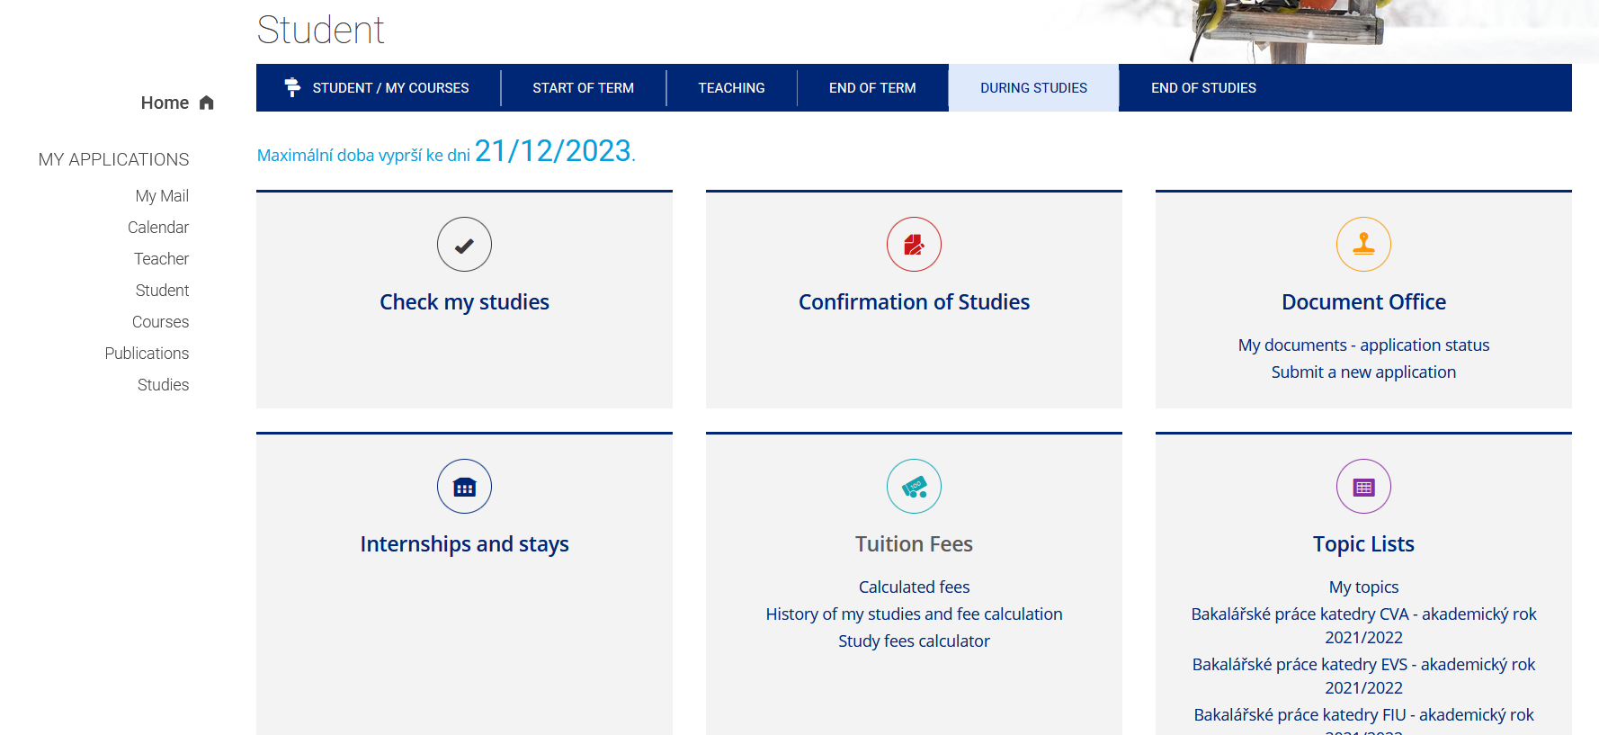
The student clicks on the selection of works of the department under which his / her supervisor belongs
Notes:
csvukrs

Slide 20
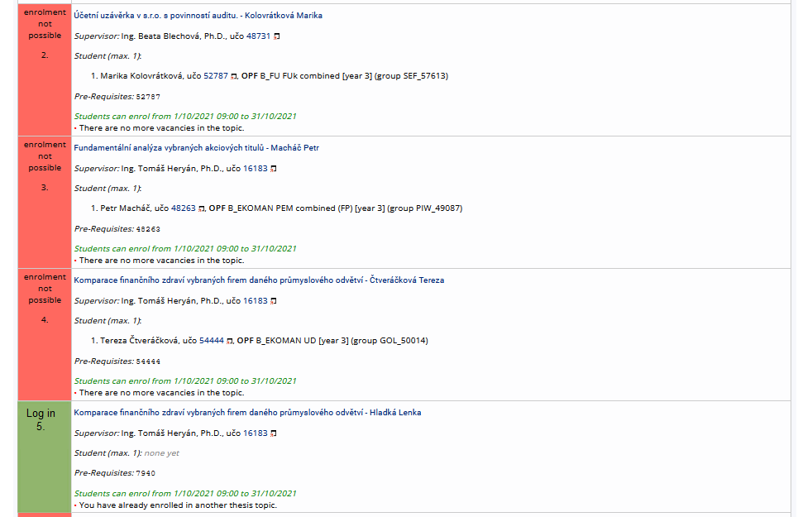
The list of topics will be shown and then it is necessary to search your topic (and your name).
Then you just click on „log in“
Notes:
csvukrs

Slide 21
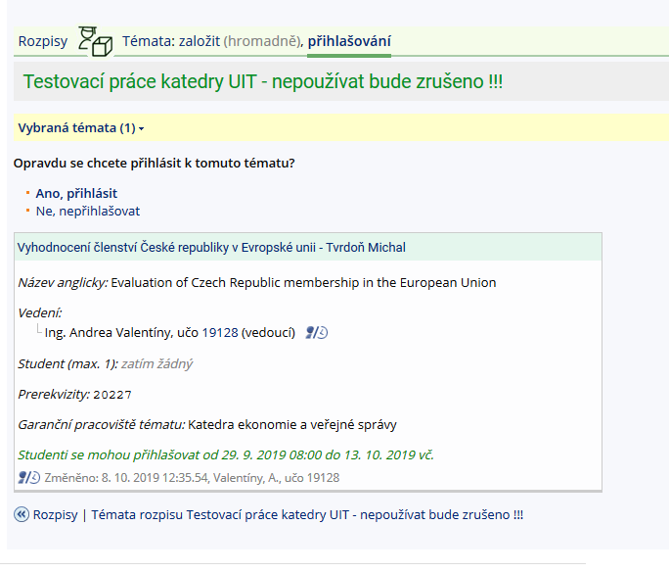
Then select, „Yes, log in“.
Notes:
csvukrs

Slide 22
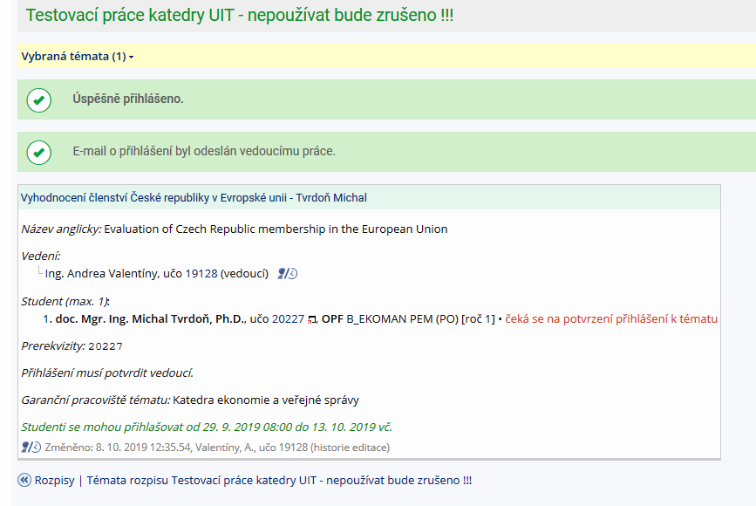
After clicking, these confirmations are displayed and the login confirmation of the supervisor must be waited, who will receive an email about the student's registration on the given topic (until the supervisor confirms the login, the assignment cannot be edited!)
Notes:
csvukrs

Slide 23
After approval by your supervisor, „edit“ is displayed.
Notes:
csvukrs

Slide 24
Insertion the description into IS

Slide 25
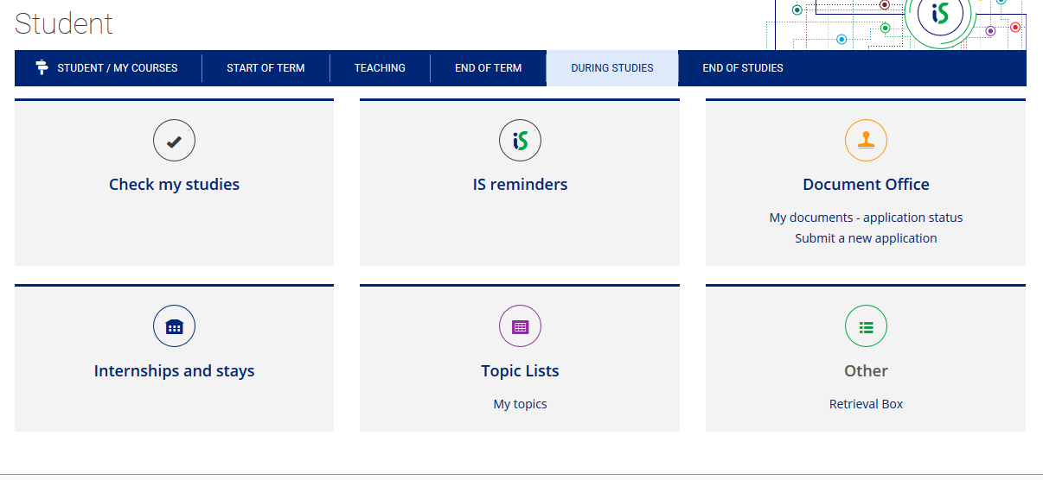
Work in IS
Select from menu
„my topics“

Slide 26
Work in IS
Student can see the topic of the thesis and his/her name
Now you can click on „display operations“ and after that you can edit title, content or literature

Slide 27
Work in IS
Now, you can see all available operations, most important is EDIT

Slide 28
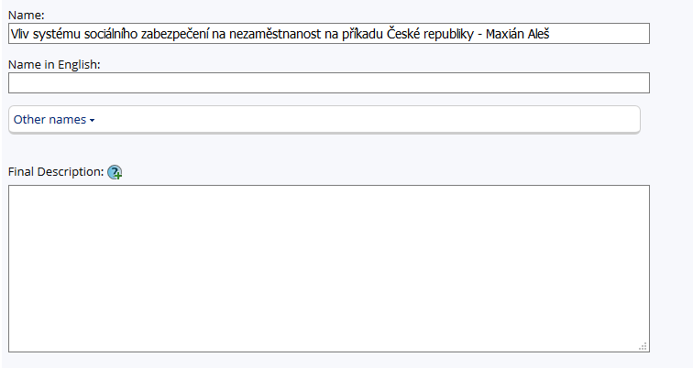
Work in IS
You can accommodate title of your thesis + please erase your name from the title
Same as previous
Window for editing the content of the thesis and elaboration schedule. BE CAREFUL! This new system requires HTML format!!!!!
However, we have created useful application for transformation of normal text to html format ☺

Slide 29
Zadání podkladů do IS SU
You can find the application on web pages of Institute of Information Technologies
https://uit.opf.slu.cz/zadani_zp
Please click on this link, than download and launch the app
https://uit.opf.slu.cz/tematator

Slide 30
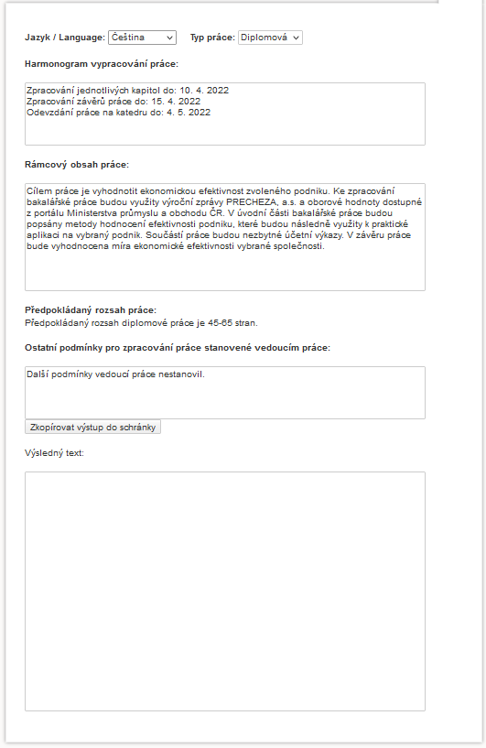
Workflow on this app:
Choose English as language of this application
Notes:
csvukrs

Slide 31
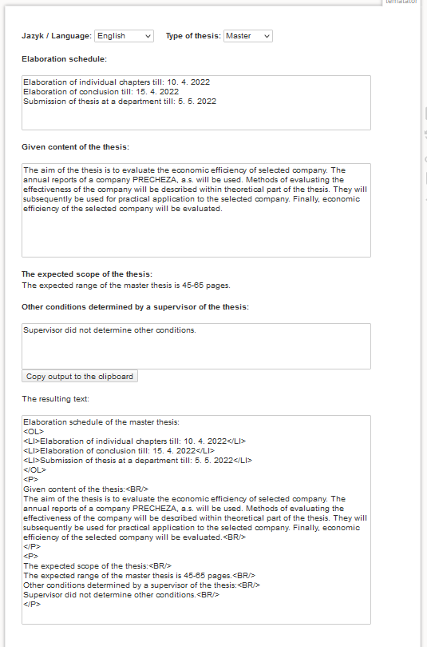
Workflow on this app:
Choose type of the thesis (MASTER)
After consultation with supervisor you can adjust your Elaboration schedule - !!!deadline for master thesis submission is 7. 5.
After consultation with your supervisor you can edit content of your thesis (aim, methods, structure or data)
Finally, click on „copy output to the clipboard“ . If you want to save as TXT file, please click on this folder
Notes:
csvukrs

Slide 32
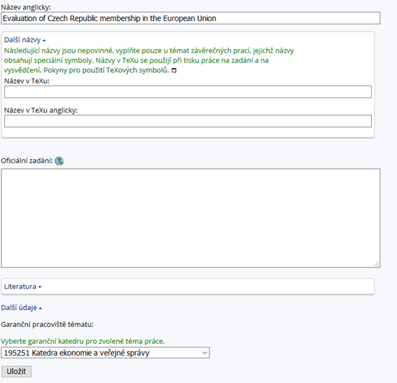
Work in IS
Return to IS and use CTRL+V to insert text from the app in a form of html format
Notes:
csvukrs

Slide 33
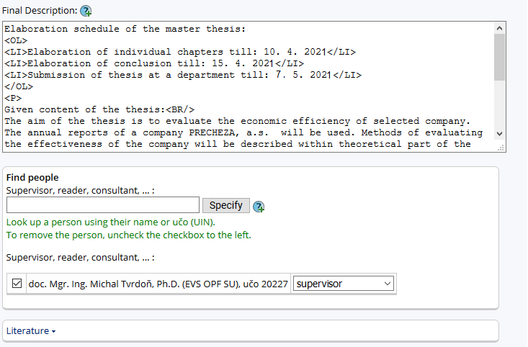
Work in IS
BE CAREFUL – as html format consists of specific orders all changes is good to make in app and again insert as a whole
Next step is to click on „Literature“
Notes:
csvukrs

Slide 34
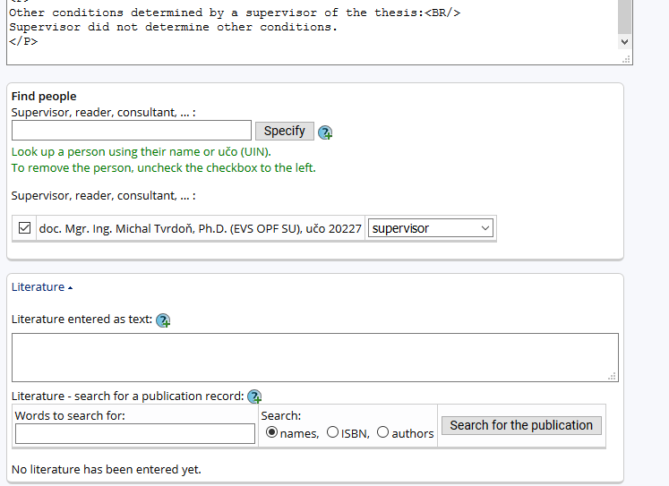
Work in IS
Literature must be inserted
DO NOT USE the app for searching because of different citations
List of references according to the Dean’s Instruction No.02/2020
ATTENTION!!! AFTER EACH SOURCE YOU MUST STATE <BR/>
LOOK AT NEXT SLIDE
Notes:
csvukrs

Slide 35
Work in IS
[1] FORET, M., 2018. Marketing research: we know our customers. Brno: Computer Press. ISBN 978-80-251-2183-2. ˂br/>
[2] HINDLS, R., S. HRONOVA, J. SEGER and J. FISCHER, 2017. Statistics for Economists. 8th ed. Prague: Professional Publishing. ISBN 978-80-86946-43-6. ˂br/>
[3] JOBBER, D., 2015. Principles and Practice of Marketing. 6th ed. London: McGraw-Hill Education. ISBN 978-0-07-712330-7. ˂br/>
[4] KLUSOŇ, V., 2019. Ownership Dimension of Social Responsibility. Political Economy, 47 (6), 797-810. ISSN 0032-3233. ˂br/>
[5] KOZEL, R., L. MLYNÁŘOVÁ and H. SVOBODOVÁ, 2017. Modern methods and techniques of marketing research. Prague: Grada Publishing. ISBN 978-80-247-3527-6. ˂br/>
[6] VAŠTÍKOVÁ, M., 2018. Marketing of services - effectively and modernly. Prague: Grada Publishing. ISBN 978-80-247-2721-9. ˂br/>
[7] VYSEKALOVÁ, J., 2017. Customer Behavior: How to Uncover the Secrets of a Black Box. Prague: Grada Publishing. ISBN 978-80-247-3528-3. ˂br/>
You should elaborate your list of references
(after consultation with your supervisor) - e.g. in MS Office or other program and then insert this list to the system
(do not forget <BR/> )

Slide 36
Work in IS
If you enter your list of references correctly it looks like this (if you do not insert <BR/> all sources will be in one paragraph (without brake)
Final step: you should click on „SAVE“, after this operation, an email to your supervisor is automatically sent, your MT topic is still possible to edit (+the topic can be edited by your supervisor)

Slide 37
Citation methods in the text of the FT
All that is stated in the References in the wording of full bibliographic citations, must be continuously cited in the text, and the student uses the abbreviated citation method (the Harvard citation system), i.e. the surname of the author or authors (year of publication, in the case of direct or indirect citations the page or the range of pages, is stated).

Slide 38
Citation methods in the text of the FT
Smith (2020)
Smith (2020, p. 125)
Smith (2020, pp. 125-127)
Differences?

Slide 39
Citation methods in the text of the FT
The taken text can be cited in the following forms:
a) Direct citation - the text is taken literally from the original work and is in quotation marks.
b) Indirect citation (paraphrase) - the text is interpreted from the original work in own words, without changing the meaning of the text.
c) Citation for the entire work - only given if the author refers to the whole original work.

Slide 40
Citation methods in the text of the FT
Direct citation:
Novák (2010, p. 26) states that "the main drivers of the financial crisis were the US real estate price bubble, the lack of regulation of financial market supervision and the failure of credit rating agencies."
According to Pokorný and Polák (2007, p. 29), "the most significant risk for the Chinese economy for the next decade is the possibility of a sharp rise in inflation."
"The economic recession is usually accompanied by a decline in economic performance and an increase in the unemployment rate." (Novotný 2009, p. 297).

Slide 41
Citation methods in the text of the FT
Indirect citation:
As stated by Vančurová (2010, p. 96), the entry price is the value from which the assets are depreciated.
Significant factors of the economic recession in the Czech Republic included lower economic activity of companies due to the fall in exports and insufficient household consumption (Novák 2010, pp. 25-70).

Slide 42
Citation methods in the text of the FT
Citation for the whole work
The theory of macroeconomic shocks is described by Novotný (2009).
The most important contemporary textbook on marketing management is considered to be the textbook by Kotler and Keller (2013).
Janáček et al. (2004) believe that the socialist economy showed a slowdown in the 1980s.

Slide 43
Dean’s Instruction No. 02/2020 - Editing, Publishing and Storing Final Theses
https://www.slu.cz/opf/en/file/cul/3b2545b6-e660-4b0b-93a9-14c082877e86

Slide 44
Thank you for your attention
Contact me:
Iveta Palečková
paleckova@opf.slu.cz
MS Teams – Iveta Palečková
Office: A403

