Slide 1
Project Quality Management (PQM)
How to create WBS of your project
Taks, durations and linkages between tasks
Time estimations for project activities
Project Management

Slide 2
How the lecture will be conducted?
The lecture is divided into three blocks, where each block introduces an issue (1. Defining project quality management, 2. Planning and Controlling Project Quality, 3. Trends and emerging practices in project quality management)
After each block there is a quiz for feedback on whether you have understood everything.
We use MS Teams, a shared whiteboard for your engagement and reactions. Also we are working with MS Project.
The class is supplemented with quizzes in vevox, the link is always in the presentation.

Slide 3
Lecture Outline
Defining project quality management
Relevance of Quality Programs to Project Quality
Project quality management processes
Planning and Controlling Project Quality
Project quality management techniques
Trends and emerging practices

Slide 4
Contents
PART (30 min.)
Defining project quality management
Relevance of Quality Programs to Project Quality
Project quality management processes
2. PART (30 min.)
Planning and Controlling Project Quality
Project quality management techniques
3. PART (20 min.)
Trends and emerging practices

Slide 5
Learning objectives
On the end of this lecture you should be able to understand and explain:
What is quality management and how it is connected to the project management
The processes of project quality management
The techniques used for project quality management
What are the trends in project quality management

Slide 6
Key readings
You can find support in the following sources:
Chapter 10 Managing project quality
Darnall, R. W. and Preston, J. M. (2012) Beginning Project Management.
Chapter 8 Project quality management
Institute, P. M. (2017). A guide to the project management body of knowledge (PMBOK® guide)–Sixth edition (Sixth ed.). Project Management Institute.

Slide 7
PART 1
Defining project quality management
Project Quality Management includes the processes for incorporating the organization’s quality policy regarding planning, managing, and controlling project and product quality requirements in order to meet stakeholders’ objectives.
Project Quality Management also supports continuous process improvement activities as undertaken on behalf of the performing organization.

Slide 8
Relevance of Quality Programs to Project Quality
Project quality refers to two distinct aspects of the project.
Project quality can refer to the quality of the product or service delivered by the project.
Example: Does the end product meet client specifications? For example, does a software development project develop a program that performs to the client’s requirements? A software program that performs the basic work functions but does not integrate with existing software would not be considered a quality product, as long as the client specified that the software must interface with existing software.

Slide 9
Relevance of Quality Programs to Project Quality
Project quality refers to two distinct aspects of the project.
2. Project quality can also refer to managing the project efficiently and effectively.
Examples: Meeting project deliverables within the time and resource constraints is also a measure of project quality.
Developing a project execution plan that matches the complexity level of the project is the most critical aspect in developing a project plan that meets project specifications within the time frame and at the lowest costs.
These two aspects of project quality have similarities and differences to quality as applied to parent organizations.

Slide 10
Relevance of Quality Programs to Project Quality
Similarities:
All successful quality programs have (1) a requirement for commitment to quality by all the employees and their partners and (2) an emphasis on error prevention and client satisfaction.
Differences:
Because projects are temporary, spotting trends in samples produced by repetitive
processes is not as important as considering quality in the planning of the project.
Instead, the project manager must be able to provide documentation that
demonstrates that the correct processes are in place to prevent quality failures.

Slide 11
Project quality management processes
Plan Quality Management—The process of identifying quality requirements and/or standards for the project and its deliverables, and documenting how the project will demonstrate compliance with quality requirements and/ or standards.
Manage Quality—The process of translating the quality management plan into executable quality activities that incorporate the organization’s quality policies into the project.
Control Quality—The process of monitoring and recording the results of executing the quality management activities to assess performance and ensure the project outputs are complete, correct, and meet customer expectations.

Slide 12
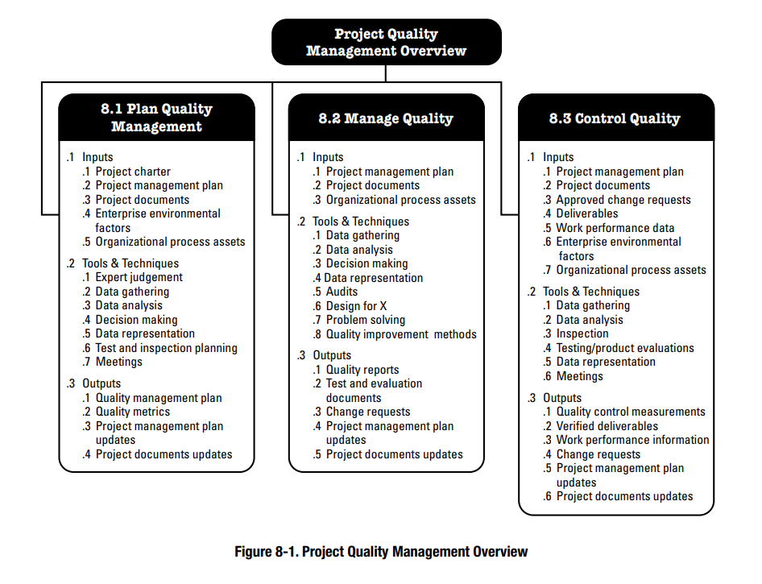
Project quality management processes

Slide 13
Vevox questions

Slide 14
PART 2
Planning and Controlling Project Quality
Planning for quality is part of the initial planning process. The early scope, budget, and schedule estimates are used to identify processes, services, or products where the expected grade and quality should be specified.
Risk analysis is used to determine which of the risks the project faces could affect quality.
High quality is achieved by planning for it rather than by reacting to problems after they are identified. Standards are chosen and processes are put in place to achieve those standards.
The quality plan specifies the control limits of the product or process; the size of the range between those limits is the tolerance.

Slide 15
Planning and Controlling Project Quality
Tolerances are often written as the mean value, plus or minus the tolerance. The plus and minus signs are written together, ±.
The choice of tolerance directly affects the cost of quality (COQ). In general, it costs more to produce and measure products that have small tolerances.
Clients provide specifications for the project that must be met for the project to be successful. Meeting project specifications is one definition of a project success.
Listening to the client and developing an understanding of the expectations that are not easily captured in specifications is important to meeting the client’s expectations.

Slide 16
Project quality management techniques
Several different tools and techniques are available for planning and controlling the quality of a project. The extent to which these tools are used is determined by the project complexity and the quality management program in use by the client.
Quality Management Methodology
Flowcharting
Benchmarking
Cost-to-Benefit Analysis
Design of Experiments
Control Charts
Cause and Effect Diagrams
Check Sheets, Histograms, and Pareto Charts

Slide 17
Project quality management techniques
Quality Management Methodology
The quality management methodology required by the client is used. The project manager must provide the documentation the client needs to prove compliance with their methodology. There are several different quality management methodologies, but they usually have characteristics that are similar to the ones described previously in the text.
Flowcharting
Many processes are more complicated than a simple sequence of related events that include several different paths. A flowchart uses standard symbols to diagram a process that has branches or loops. Diamonds indicate decisions, and arrows indicate the direction of the flow of the process.

Slide 18
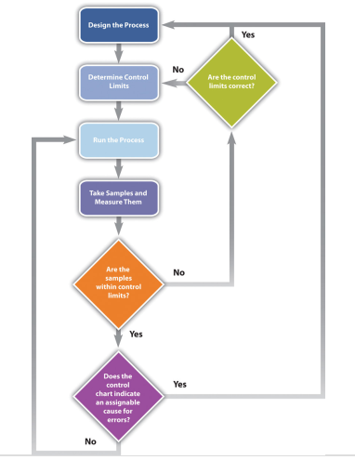
Project quality management techniques

Slide 19
Project quality management techniques
Benchmarking
When products like shoes were made by hand, artisans would seek some degree of standardization by marking standard lengths for different parts of the product on their workbench. In modern management practice, if a particular method or product is a standard of quality, comparing your organization’s quality plan to it is called benchmarking30. If a product or service is similar to something that is done in another industry or by a competitor, the project planners can look at the best practices that are used by others and use them as a comparison.

Slide 20
Project quality management techniques
4. Cost-to-Benefit Analysis
Because the cost of prevention is more often part of the project budget, the case must be made for increasing the project budget to raise quality. Some quality management programs, like Six Sigma, require that expenditures for quality are justified using a cost-to-benefit analysis that is similar to calculating the cost of quality, except that it is a ratio of cost of increasing quality to the resulting benefit.
A cost-benefit analysis in some quality programs can take into account nonfinancial factors such as client loyalty and improvements to corporate image and the cost-to benefit analysis takes the form of a written analysis rather than a simple numeric ratio. It is similar to determining the cost of quality (COQ).

Slide 21
Project quality management techniques
5. Design of Experiments
Measuring for quality of manufactured products or use of repetitive processes requires taking samples. Specialists in quality control design a test regimen that complies with statistical requirements to be sure that enough samples are taken to be reasonably confident that the analysis is reliable. In project management, the testing experiments are designed as part of the planning phase and then used to collect data during the execution phase.

Slide 22
Project quality management techniques
6. Control Charts
If some of the functions of a project are repetitive, statistical process controls can be used to identify trends and keep the processes within control limits.
Part of the planning for controlling the quality of repetitive processes is to determine what the control limits are and how the process will be sampled.
7. Cause and Effect Diagrams
When control charts indicate an assignable cause for a variation, it is not always easy to identify the cause of a problem.
Discussions that are intended to discover the cause can be facilitated using a cause-and-effect or fishbone diagram where participants are encouraged to identify possible causes of a defect.
Check Sheets, Histograms, and Pareto Charts

Slide 23
Project quality management techniques
8. Check Sheets, Histograms, and Pareto Charts
When several quality problems need to be solved, a project manager must choose which ones to address first.
One way to prioritize quality problems is to determine which ones occur most frequently.
This data can be collected using a check sheet, which is a basic form on which the user can make a check in the appropriate box each time a problem occurs or by automating the data collection process using the appropriate technology.
Once the data are collected, they can be analyzed by creating a type of frequency distribution chart called a histogram.

Slide 24
Project quality management techniques
Histogram
A histogram is a column chart where the width of the columns fill the available space on the horizontal axis and are proportional to the category values displayed on the x axis, while the height of the columns is proportional to the frequency of occurrences. Most histograms use one width of column to represent a category, while the vertical axis represents the frequency of occurrence.

Slide 25
Vevox questions

Slide 26
PART 3
Trends and emerging practices in
project quality management
Modern quality management approaches seek to minimize variation and to deliver results that meet defined stakeholder requirements. Trends in Project Quality Management include but are not limited to:
Customer satisfaction. Understand, evaluate, define, and manage requirements so that customer expectations are met. This requires a combination of conformance to requirements (to ensure the project produces what it was created to produce) and fitness for use (the product or service needs to satisfy the real needs). In agile environments, stakeholder engagement with the team ensures customer satisfaction is maintained throughout the project.

Slide 27
Trends and emerging practices in project quality management
Continual improvement. The plan-do-check-act (PDCA) cycle is the basis for quality improvement as defined by Shewhart and modified by Deming. In addition, quality improvement initiatives such as total quality management (TQM), Six Sigma, and Lean Six Sigma may improve both the quality of project management, as well as the quality of the end product, service, or result.
Management responsibility. Success requires the participation of all members of the project team. Management retains, within its responsibility for quality, a related responsibility to provide suitable resources at adequate capacities.

Slide 28
Trends and emerging practices in project quality management
Mutually beneficial partnership with suppliers. An organization and its suppliers are interdependent.
Relationships based on partnership and cooperation with the supplier are more beneficial to the organization and to the suppliers than traditional supplier management.
The organization should prefer long-term relationships over short-term gains.
A mutually beneficial relationship enhances the ability for both the organization and the suppliers to create value for each other, enhances the joint responses to customer needs and expectations, and optimizes costs and resources.

Slide 29
Time for recap – Vevox quiz

Slide 30
Vevox questions

