Slide 1
Project LifeCycles
Project Management

Slide 2
How the lecture will be conducted?
The lecture is divided into three blocks, where each block introduces an issue (1. What is a project and project management, Who is project manager and their role 2. Project management evolution 3. The main elements of a project, types of projects)
After each block there is a quiz for feedback on whether you have understood everything.
We use MS Teams, a shared whiteboard for your engagement and reactions. Also we are working with MS Project.
The class is supplemented with quizzes in vevox, the link is always in the presentation.

Slide 3
Contents
PART (20 min.)
Project lifecycle definition and phases
2. PART (30 min.)
The types of project lifecycles
3. PART (30 min.)
Significance of the project lifecycle
Limitations of project lifecycle

Slide 4
Learning objectives
On the end of this lecture you should be able to understand and explain:
What is project lifecycle and its phases
The types of project lifecycles
Why project lifecycles are important for project management
What are the limitations of project licycles

Slide 5
Key readings
You can find support in the following sources:
Chapter 2. Projec Management Growth: Concepts and Definitions
Kerzner, H. (2017). Project Management: A Systems Approach to Planning, Scheduling, and Controlling. Hoboken, New Jersey: John Wiley & Sons, Inc. ISBN 978-1-119-16535-4.
Chapter 1
Grit, R. (2021). Project management : A practical approach. Taylor & Francis Group.

Slide 6
PART 1
What is project lifecycle
Every program, project, or product has certain phases of development known as life-cycle phases. A clear understanding of these phases permits managers and executives to better control resources to achieve goals.
The goal of a project is to achieve a specific goal.
However, the end result is often only temporary.
Example: The results of reorganising a car factory or manufacturing a new car model, will lose their value in the long term. After a number of years, the car factory will start up a new project in order to manufacture an even newer car model.
The entire process from start to finish of a project is called the ‘project lifecycle’.

Slide 7
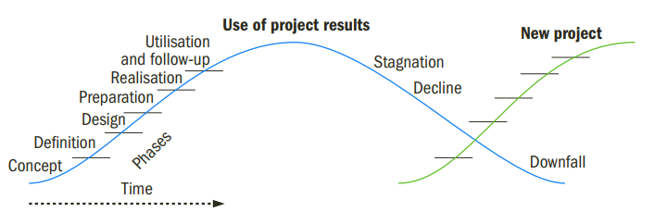
Project lifecycle phases

Slide 8
Project lifecycle phases
At the start of the project - the phases of concept, definition, preliminary design, detailed design and production.
At the end of the production phase, the end result is accomplished and subsequently used – this is also called ‘utilisation’ phase.
During the utilisation phase, follow-up and maintenance are required to maintain the results and keep them up to date.
After some time, follow-up might be insufficient, and stagnation will occur.

Slide 9
Project lifecycle example
Example for car factory:
sales of the model start slowing down, or the factory becomes obsolete from a technical perspective.
A decline then follows, and the project result is no longer useful.
In the meantime, a new project might be started up to manufacture an even newer model or build a new factory, and the lifecycle of a new project begins.

Slide 10
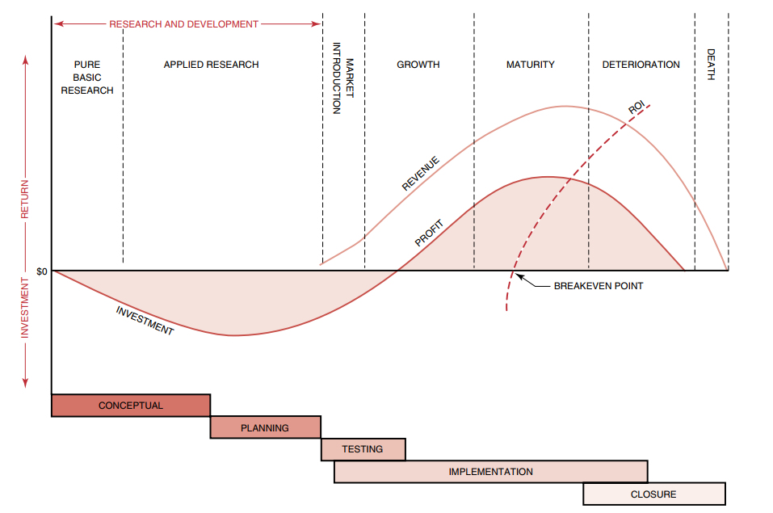
System/product lifecycles

Slide 11
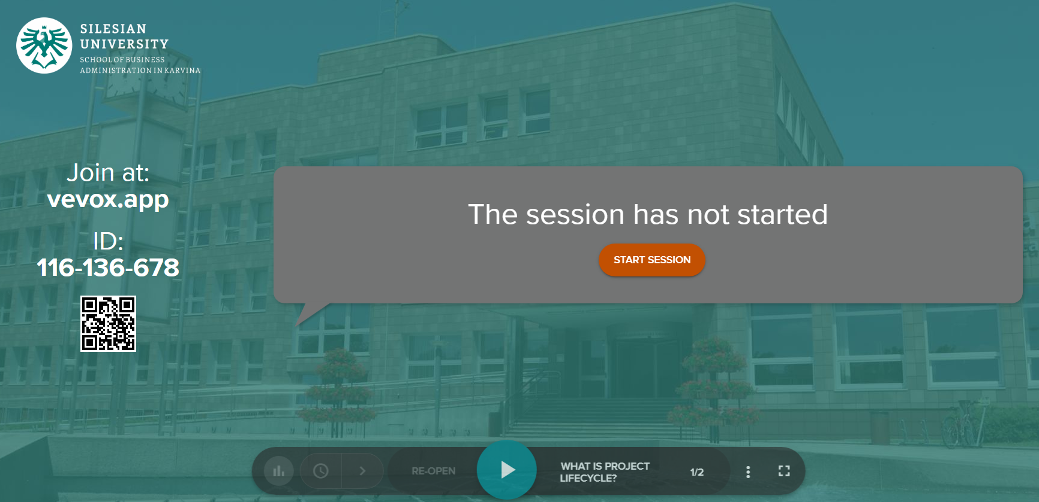
Vevox questions

Slide 12
PART 2
Types of Project Life Cycle
A project can have one of the following life cycles:
Predictive Life Cycle
Adaptive Life Cycle
Iterative Life Cycle
Incremental Life Cycle
Hybrid Life Cycle

Slide 13
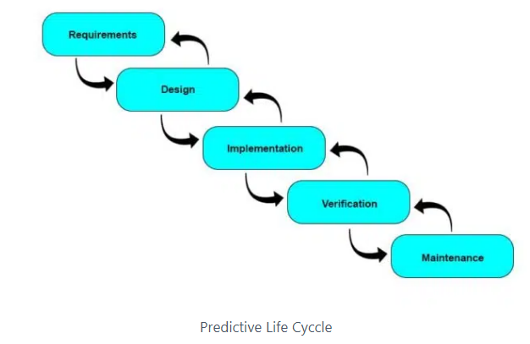
Predictive Life Cycle
Also known as the waterfall life cycle.
Traditional form of project management
Project manager develops the complete project management plan at the beginning and then follows it until the project completes.
You plan the work and then work the plan.
The scope of work is fixed.
The chances of changes are low.
Notes:
https://pmstudycircle.com/project-life-cycle/

Slide 14
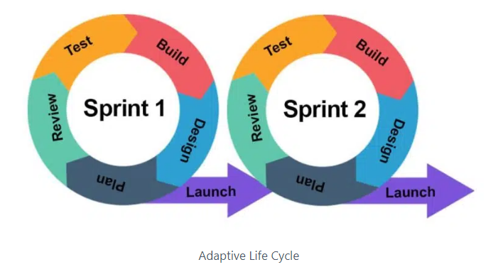
Adaptive Life Cycle
Also known as a change-driven life cycle.
This life cycle welcomes changes.
The project is divided into increments, and deliverables are delivered and refined until the client is satisfied.
All activities are performed multiple times.
It is easy to make changes to the deliverable and incorporate clients’ feedback.
Notes:
https://pmstudycircle.com/project-life-cycle/

Slide 15
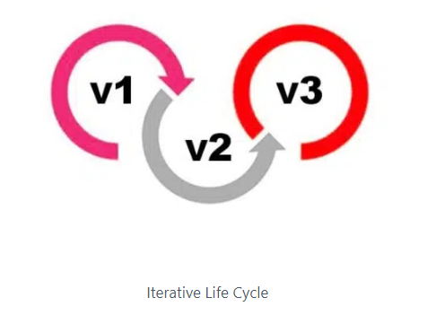
Iterative Life Cycle
The iterative and predictive life cycles are comparable.
The project management team creates the plan in advance and iterates it to account for adjustments.
The first iteration aims to create a basic product with minimal viability, and the following iteration enhances it further.
Notes:
https://pmstudycircle.com/project-life-cycle/

Slide 16
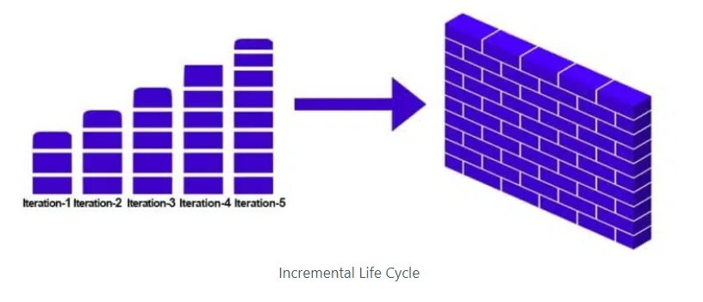
Incremental Life Cycle
Is similar to the adaptive life cycle.
The project manager delivers small, usable pieces of deliverables to the client, and based on the feedback; the product is refined and developed.
All increments are added in the final iteration to deliver the complete product.
Notes:
https://pmstudycircle.com/project-life-cycle/

Slide 17
Hybrid Life Cycle
The hybrid life cycle is a hybrid of life cycles discussed in this post.
It can be any combination of life cycles.
A project manager is responsible for selecting the life cycle best suited for their project.
Notes:
https://pmstudycircle.com/project-life-cycle/

Slide 18
Vevox questions

Slide 19
PART 3
Significance of the Project Life Cycle
Offers a Framework to Execute Projects
Enhances Team Communication
Helps Measure Progress and Development
Allows Project’s Evolution
Helps Organize Reviews and Improve Governance

Slide 20
Significance of the Project Life Cycle
Offers a Framework to Execute Projects
Enhances Team Communication
Helps Measure Progress and Development
Allows Project’s Evolution
Helps Organize Reviews and Improve Governance

Slide 21
Significance of the Project Life Cycle
Offers a Framework to Execute Projects
Provides a systematic method for project delivery.
This allows to track the project’s progress and determine the issues with deliverables or a process.
A project life cycle framework provides teams with a uniform road plan to follow.
It helps define each phase’s tasks, results, and allocated duties.

Slide 22
Significance of the Project Life Cycle
Enhances Team Communication
it helps facilitate communication and define roles and responsibilities in the project.
Team members easily comprehend what they should do throughout each step.
Resource planning avoids wasted and ensures its availability whenever they are required.
Most resources are required in the third stage of the project life cycle.

Slide 23
Significance of the Project Life Cycle
Helps Measure Progress and Development
Plans, benchmarks, key performance indicators, project metrics, etc., will be available.
You can check the status and determine whether the progress is on track by comparing it to the project baselines.

Slide 24
Significance of the Project Life Cycle
Allows Project’s Evolution
The stages of the project life cycle give insight into how the project progresses, and
enable the identification of areas that need special attention, such as risk management in the early phases and project evaluation in the execution stage.
The project details expand every next step.
As the project moves forward, the plans are developed and elaborated, and the cost baseline, schedule baseline, and scope baseline are improved.

Slide 25
Significance of the Project Life Cycle
Helps Organize Reviews and Improve Governance
Since the project lifecycle will outline when the Project Evaluation Review takes place, the project manager can schedule the performance reports’ completion before the reviews.
It permits people who must attend in advance, enabling quick “go or no go” decisions on product development.
The project is feasible and on time, and these monthly evaluations reassure stakeholders that early accomplishments have been validated.

Slide 26
Limitations of Project Life Cycle
The works conclude after the completion of the final stage.
High risks and uncertainty.
It is not the best choice for tricky and complicated projects.
It is not a correct framework for object-oriented projects.
Implementing the project life cycle for longer projects is challenging and out of place.
The progress is challenging to measure at every stage as the project progresses.

Slide 27
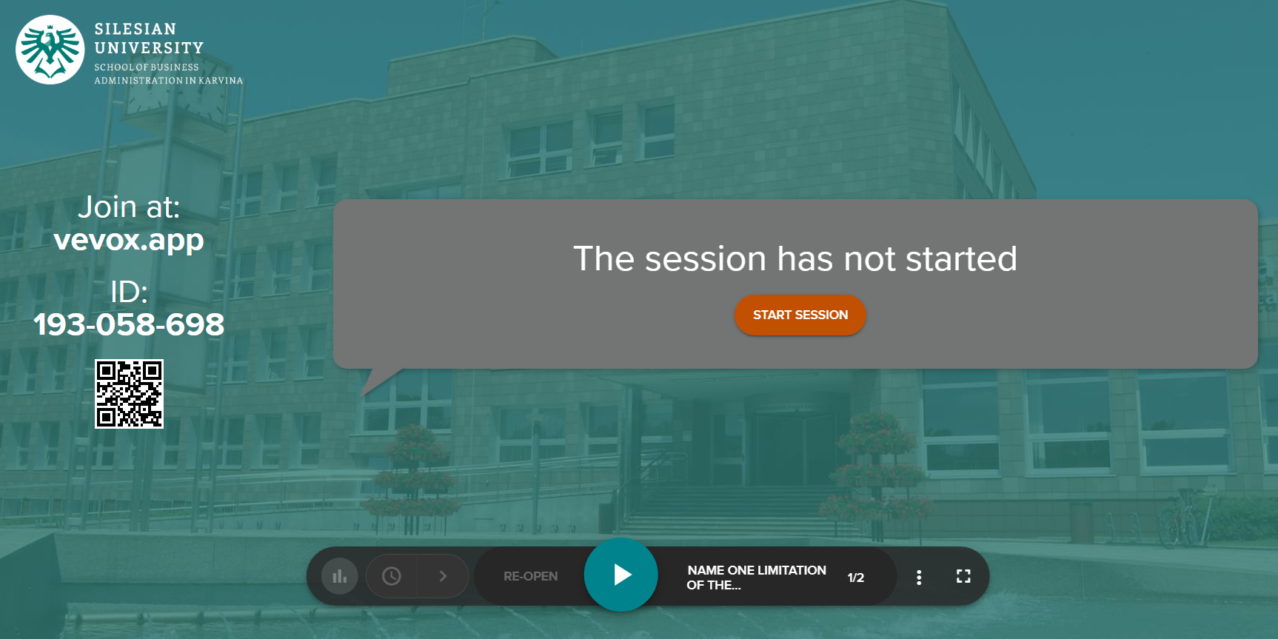
Vevox questions

Slide 28
References
Grit, R. (2021). Project management : A practical approach. Taylor & Francis Group.
Kerzner, H. (2017). Project Management: A Systems Approach to Planning, Scheduling, and Controlling. Hoboken, New Jersey: John Wiley & Sons, Inc. ISBN 978-1-119-16535-4.
https://pmstudycircle.com/project-life-cycle/

