Slide 1

Project Budget
What is project budgeting?
How to use resources in MS Project?
Risk budget, tolerance budget, change budget
Project Management

Slide 2

How the lecture will be conducted?
The lecture is divided into three blocks, where each block introduces an issue (1. Project budgeting, 2. MS Project resource, 3. Risk budget, tolerance budget, change budget)
After each block there is a quiz for feedback on whether you have understood everything.
We use MS Teams, a shared whiteboard for your engagement and reactions. Also we are working with MS Project.
The class is supplemented with quizzes in vevox, the link is always in the presentation.

Slide 3
Contents
PART (30 min.)
Project budgeting, theoretical overview.
2. PART (40 min.)
MS Project resources (work, cost, material types, asignment of resources, reporting, total cost budget).
3. PART (20 min.)
Different forms of budget and their importance (cost, change, tolerance).

Slide 4
Learning objectives
After studying this topic, you should be able to:
To recognise different types of budgets and cost structures.
Gain an overview of project cost estimating Methods.
Using MS Project, you will learn how to create resources in a project.
Use the knowledge to build a complete project budget and its possible methods of creation.

Slide 5
Key readings
You can find support in the following sources:
Book – Chatfield and Johnson (2016). MS Project 2016 Step by Step (Part 5 Set up resource, Part 6 Assign resources to tasks)
Book – PMBOK Guide . Chapter 7 (p. 231 Project Cost Management)

Slide 6
The budget for a project is the combined costs of all activities, tasks, and milestones that the project must fulfil. In short: it’s the total amount of money you’ll need to finish the project that should be approved by all the stakeholders involved.
A meticulously planned project budget is the holy grail of the current economy where scaling smoothly and sustainably is critical to company survival.
A project budget is the total estimated cost of completing each project activity over each phase of a project. It’s important as it helps set expenditure expectations and is critical in getting project approval, ensuring funds are ready at the right time, and measuring performance. It’s a dynamic document, continuously monitored, reviewed, and updated throughout the project
PART 1
Project Budgeting
„Every project, no matter how big or small, involves costs.“

Slide 7

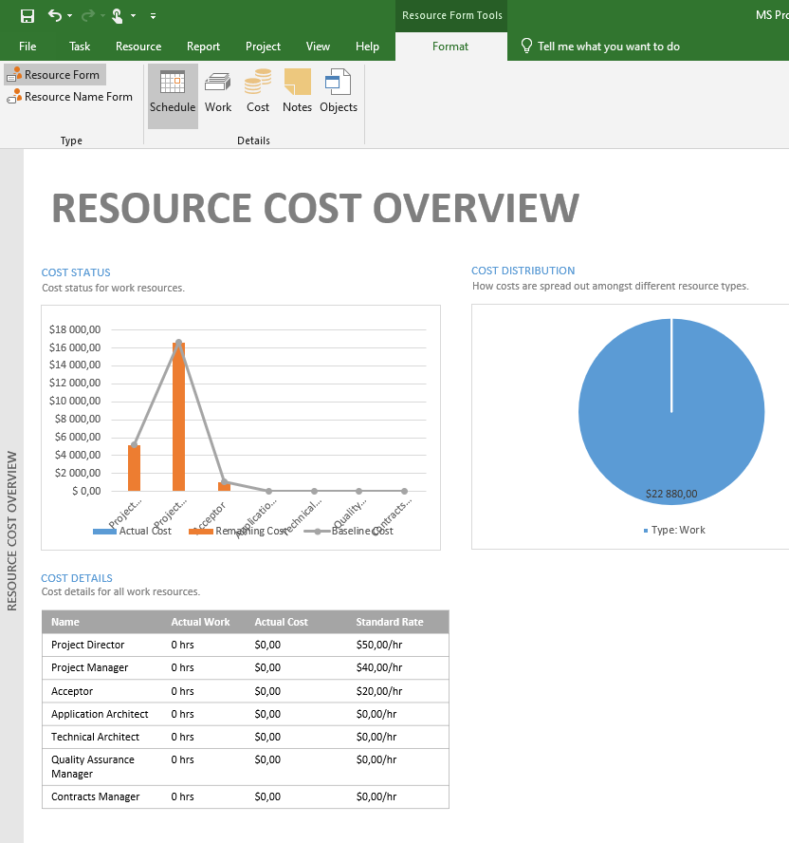
Why a project budget is important?
First, it’s an essential part of securing project funding. The numbers will tell stakeholders exactly how much money is needed to button up the project and when the money is needed.
Second, a well-planned budget provides the basis for project cost control. Having an end budget estimate helps you measure the project’s actual cost against the approved budget and see how much costs you’ve burned already. It will give you an understanding of how the project is progressing and if any changes need to be made to the plan.
Third, a project budget has a direct effect on the company's financial viability. When calculated feasibly and with resource constraints in mind, a project budget will increase the operating margin and improve overall project success.

Slide 8
Typical project cost categories
Project cost category | Example
Human resources | Salary rates of full-time and temporary workers
Travelling spendings | Anyone who travels from one location to another to do project work (including budget for meals and lodging)
Training fees | Conferences, workshops, outside contractors
Material resources | All the items your team might need to perform the work, including software, equipment, or other unique materials
Research expenses | Studies or data to support your project and deliver the best value
Professional services | Legal advice, consultants, market research firms, etc.
Capital expenditures | Equipment or technical upgrades to complete the project
Contingency reserves | Contingency funds to allow for flexibility and reduce risks of budget overruns, usually 5-10% of the budget
Planning project costs is an essential step in mapping out a project budget.
To do so, you’ll need to create a list of timely line items that are relevant for the project.
Some of the costs, such as training costs to teach users to use a product or maintenance costs, are often overlooked by managers, so it’s important to think ahead if there are costs related to the project that will come up once it’s complete.

Slide 9
Approaches to estimating a project budget
The first type of estimate is an order-of-magnitude analysis, which is made without any detailed engineering data. The order-of-magnitude analysis may have an accuracy of 35 percent within the scope of the project. This type of estimate may use past experience (not necessarily similar), scale factors, parametric curves, or capacity estimates (i.e., $/# of product or $/kW electricity).
There is the approximate estimate (or top-down estimate), which is also made without detailed engineering data, and may be accurate to 15 percent. This type of estimate is prorated from previous projects that are similar in scope and capacity, and may be titled as estimating by analogy, parametric curves, rule of thumb, and indexed cost of similar activities adjusted for capacity and technology. In such a case, the estimator may say that this activity is 50 percent more difficult than a previous (i.e., reference) activity and requires 50 percent more time, man-hours, dollars, materials, and so on.
The definitive estimate, or grassroots build-up estimate, is prepared from well-defined engineering data including (as a minimum) vendor quotes, fairly complete plans, specifications, unit prices, and estimate to complete. The definitive estimate, also referred to as detailed estimating, has an accuracy of 5 percent.

Slide 10
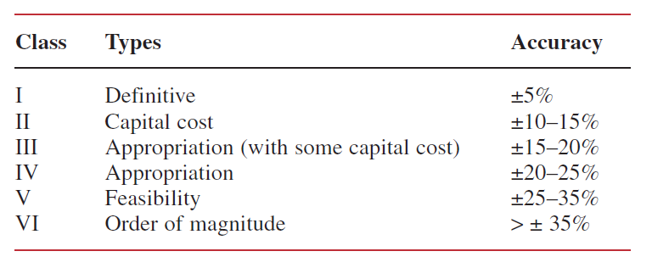
Types of estimates
Learning curves are graphical representations of repetitive functions in which continuous operations will lead to a reduction in time, resources, and money. The theory behind learning curves is usually applied to manufacturing operations.
During competitive bidding, it is important that the type of estimate be consistent with the customer’s requirements. For in-house projects, the type of estimate can vary over the life cycle of a project:
  Conceptual stage: Venture guidance or feasibility studies for the evaluation of future work. This estimating is often based on minimum-scope information.
  Planning stage: Estimating for authorization of partial or full funds. These estimates are based on preliminary design and scope.
Classes of estimates
Source: Kerzner, H. Project Management

Slide 11
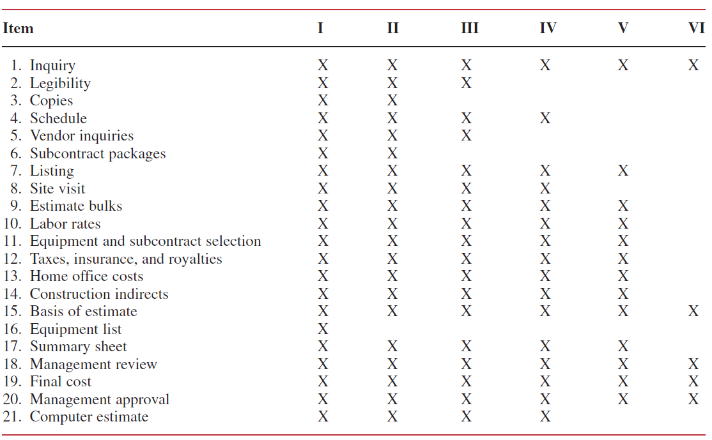
Types of estimates
Checklist for work normally required for the various classes (I-VI)
Classes of estimates
Source: Kerzner, H. 2017. Project Management
Source: Kerzner, H. 2017. Project Management

Slide 12
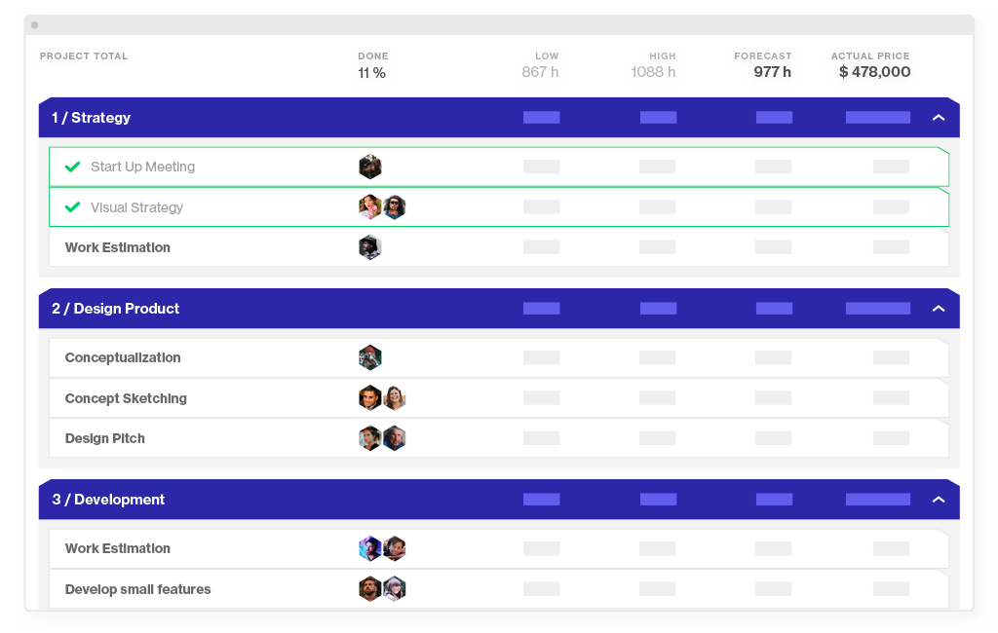
Approaches to estimating a project budget
Bottom-up estimation
Rate the individual parts of the project plan and tot them up
Bottom-up estimation is one of the best and fool proof ways to prepare a project budget. It anticipates estimating individual parts of the project, such as tasks, milestones, or phases, and totalling them to get project cost.
This method can be applied if you’re at the point of creating a statement of work. If you’re sure you know every grain of the project, bottom-up estimating is the way to go.
The downside of the bottom-up approach is that it takes plenty of time to go down to the smallest detail of the project. Additionally, our in-house research has shown that 71% of tasks are created after the project’s start date. In reality, project requirements change even before the ink is dry on your statement of work. Also, because it’s very granular, at some point you might suffer from inflation affecting the cost of your estimates.

Slide 13
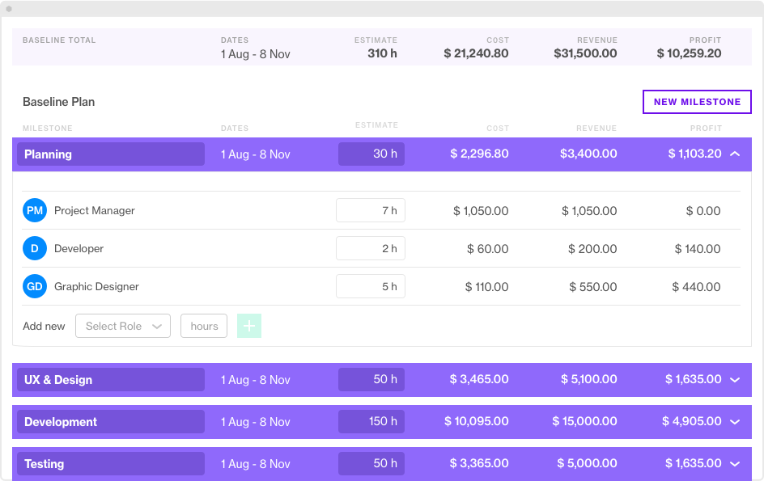
Approaches to estimating a project budget
Top-down estimation
Figure out the total, and then split it into tasks or milestones
Top-down estimation is opposite to the bottom-up approach mentioned above and a completely different ball game. It starts with the project budget total and involves breaking it down into smaller chunks. Top-down estimation is typically used when you have a fixed price project with the budget set in stone.
The main disadvantage of this approach is loose estimations at the project initiation phase. It is difficult to accurately predict the budget before you understand the scope of work and have a project plan. This process might turn very challenging, especially when you can’t measure the accuracy of the initial quote against final project delivery.

Slide 14
Approaches to estimating a project budget
Analogous estimation
Analyze the data in similar projects to decide the cost.
If you’re not totally new to project management, you’ve probably managed a few projects before and can tell what works and what doesn’t. Using analogous estimation, you would rely on the budget data and best practices from your previous projects to form an opinion about how much the current one could cost the client.
Analogous estimation can sometimes be a back-and-forth task, but why not do it the smart way by using project management software?
In Forecast, you can easily duplicate one of the past projects to create another one with the same tasks. Then in an instant, you can adjust it to make a better, more situational estimate.

Slide 15
Approaches to estimating a project budget
Parametric estimation
Using data and project variables to suggest the total
In contrast to analogous estimation, parametric approach is more accurate. It takes cost variables or data points from specific parts of specific projects and applies them to the current project, so you make more decisions based on data.
The advantage of this process is that it’s more accurate than the analogous estimation because it employs more than one data set and uses the statistical relationship between historical data and variables.
Three-point estimation
Take the best, worst, and most likely case estimates to do the average
Three-point estimation is one of the most sensible and pragmatic techniques as it takes into account a weighted average based on the best, worst, and most likely case budget scenarios and encourages you to think from multiple perspectives. Thus you can figure out a realistic cost estimation.
The upside of the three-point estimation technique is that you can reduce the risk of going over budget, as it will be indicated in your plan, and eventually deliver on expectations.

Slide 16
How to create a basic project budget in five easy steps
Break down your project into tasks and milestones. Working with your task list will give you an understanding of what you’ll need to accomplish and help you with project cost management. If you already have a task list, that’s fine, and you can start right off. But if you don’t, start creating a scope and writing down everything that your team needs to do.
Estimate each item in the task list. Now it’s time to give each item that you’ve written down an optimistic estimation. At this point, identify all the resources and materials you’ll need to perform well and include them into your estimate when calculating the price.
Add your estimates together. This is probably one of the easiest parts of the project budgeting process, especially if you have a spreadsheet with two columns: Tasks and Costs. Then, you’ll be able to calculate the total fast.
Add contingency and taxes. Better safe than sorry. Of course, you can’t be 100% confident about the final estimate, as things change all the time. By adding contingency and taxes, you make sure that the project doesn’t go over budget and your estimate number is closer to the final costs you eventually spend. If you don’t know how much contingency to add, project management experts recommend going for 10% of the total.
Get approval. Talking to your manager to approve project costs would be the last thing in the project budget creation process.

Slide 17
A checklist of things to create a project budget
Make sure you can answer the following questions:
Can I define the project and its end goal?
Are there any ground rules, constraints, and assumptions I should consider?
Do I have sources of data (Task List, WBS, Cost Estimates, Schedule) to rely on?
Is the estimating methodology in use acceptable?
Do I know who is going to work on the project?
Do I have a list of resources and their rates to complete the project?
Can I compare my estimate against the best practices industry standard?
Do I have contingency reserves to account for risk?
Who are the key project team members to help me in estimating/budgeting process?
Am I on the same page with Project Stakeholders?
Can I compare the budget with original estimates and reconcile differences?

Slide 18
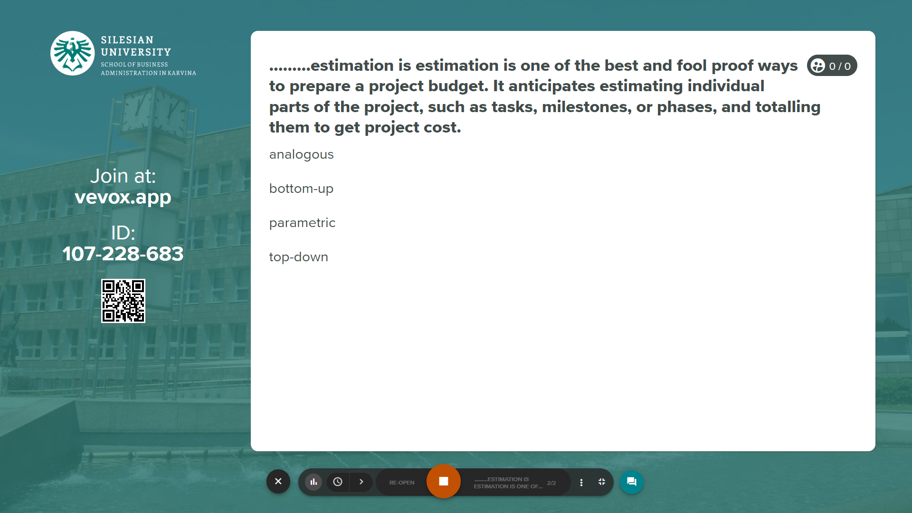
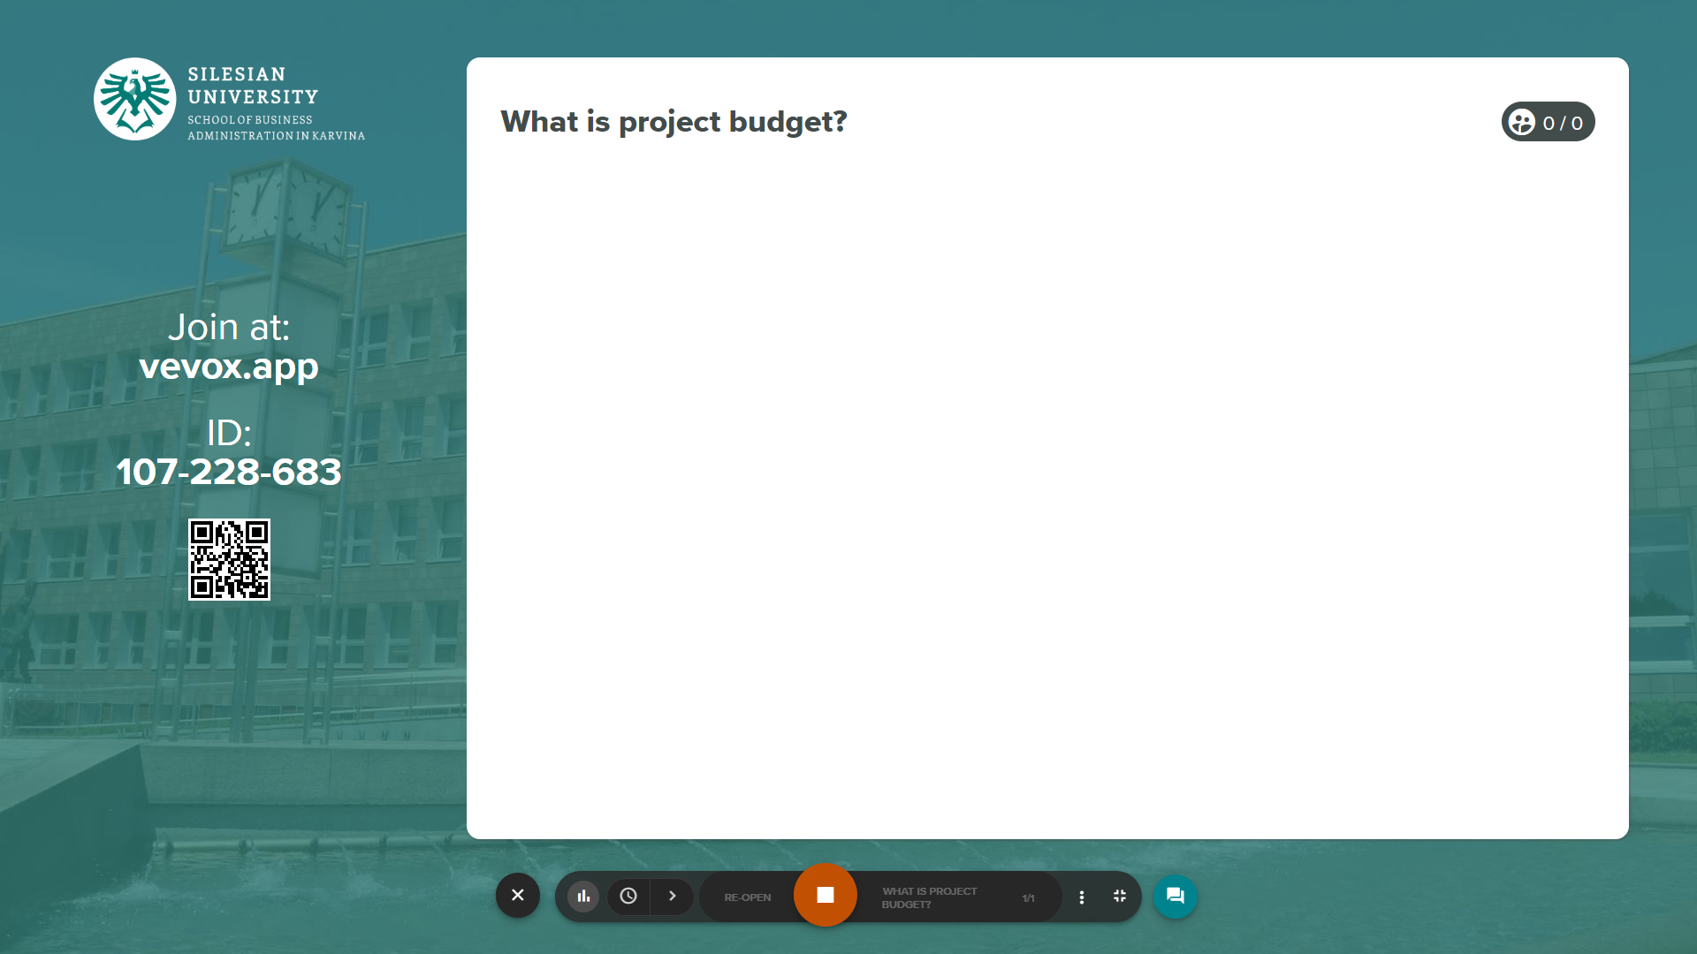
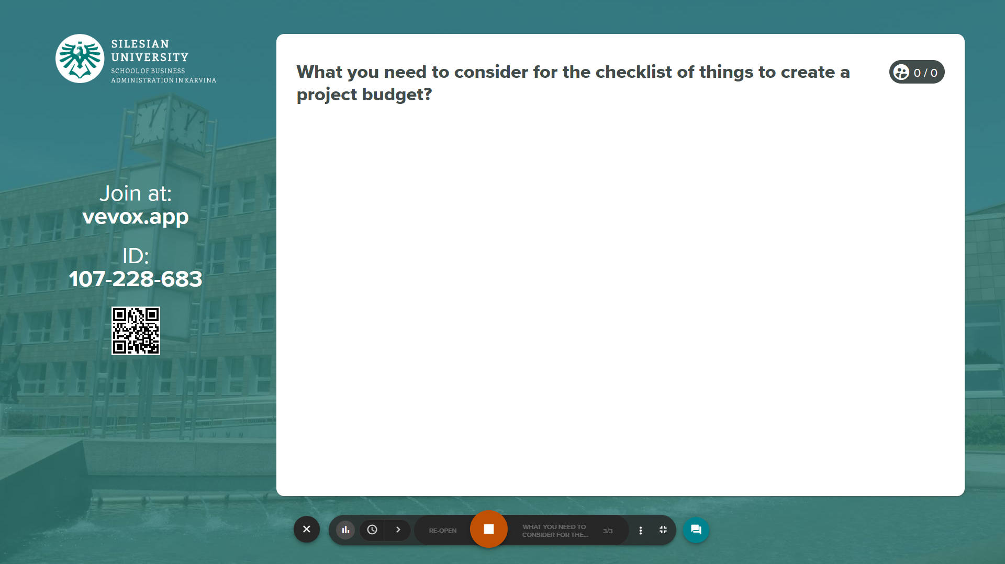
Vevox questions
https://silesianuniversity.vevox.com/#/meeting/449455/polls

Slide 19
Resources include the people, equipment, and material needed to complete the work of a project. Effective resource management is one of the most significant advantages of using MS Project.
You can manage three types of resources in Project—work resources and two special purpose resources: cost and material. Work resources include the people and equipment needed to complete the tasks in a project’s plan.
PART 2
MS Project resources
Using resources in tasks for project budget.

Slide 20
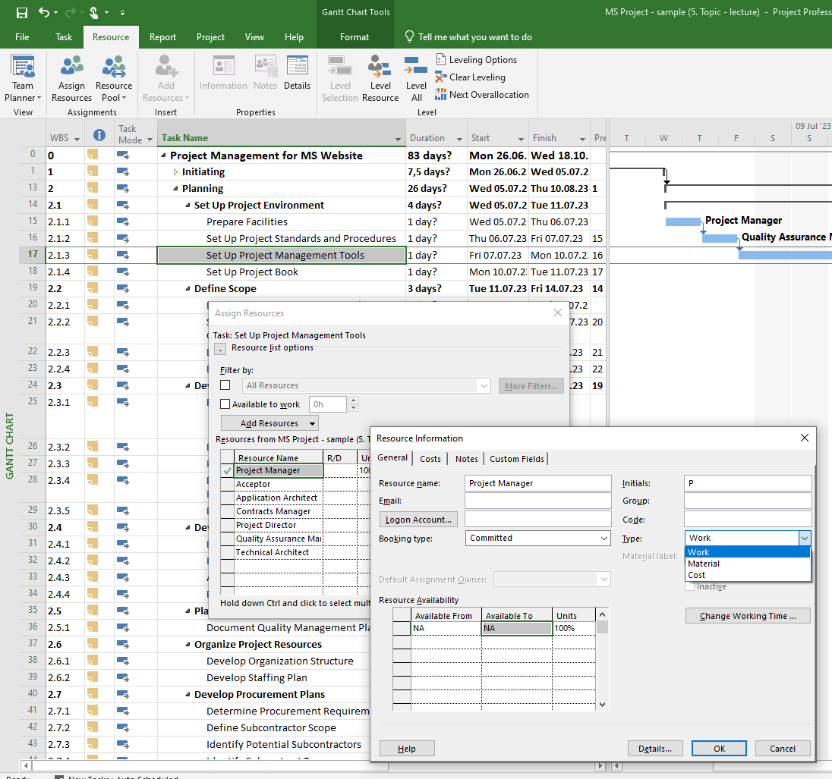
MS Project set up resources
Cost resources represent categories of financial costs, derived from specific tasks, that you need to account for in the plan.
Examples include categories of expenses like travel and entertainment.
Material resources are consumables that get used up as the project proceeds. For example, a construction project might need to track steel or concrete as it is used throughout the project.
Work resources – mainly all people involved in project.

Slide 21
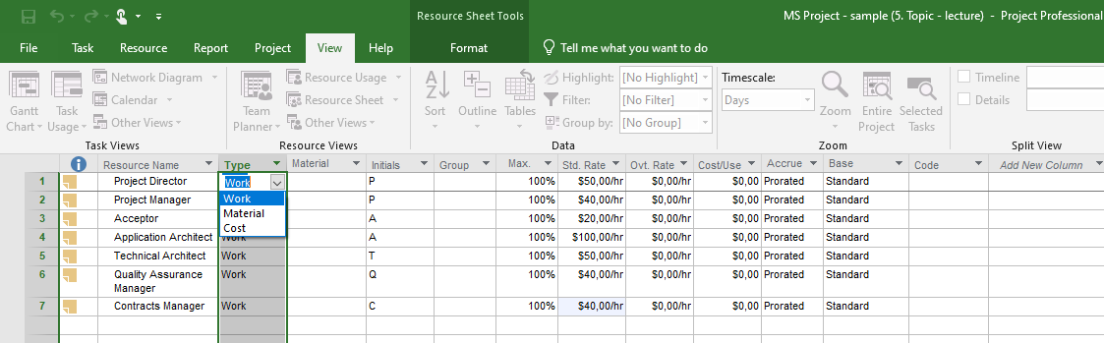
MS Project set up resources
Work resources
Work resources are the people and equipment doing the work of the project. Project focuses on two aspects of work resources: their availability and their costs. Availability pertains to when specific resources can work on tasks and how much work those resources can perform.
A resource might refer to somebody who is already on staff, or to a position to be filled later. If you have not yet filled all the resource positions required, you might not have the names of specific people to enter
To enter work resource names
1. On the View tab, in the Resource Views group, click Resource Sheet to display the Resource Sheet view.
Click an empty cell in the Resource Name column.
Enter your resource names, pressing the Enter key after each one.
Project applies the default Work resource type in the Type field.

Slide 22
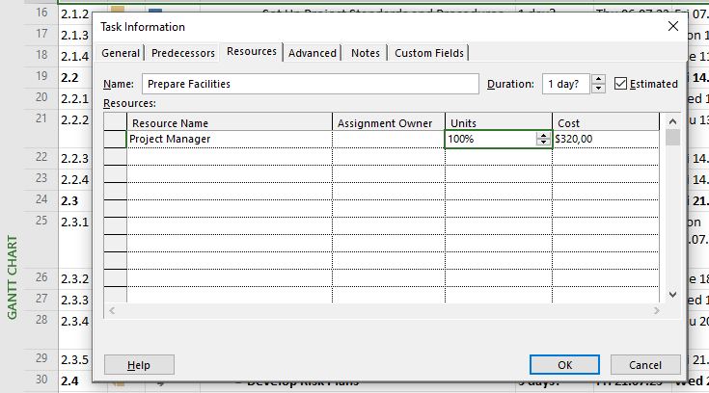
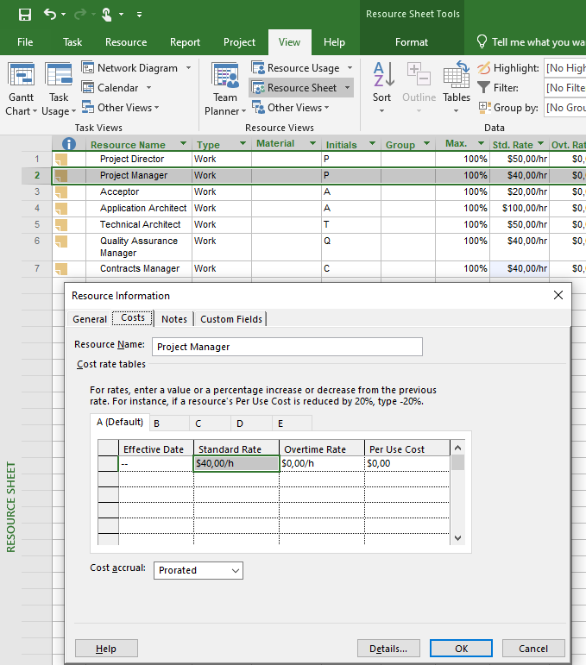
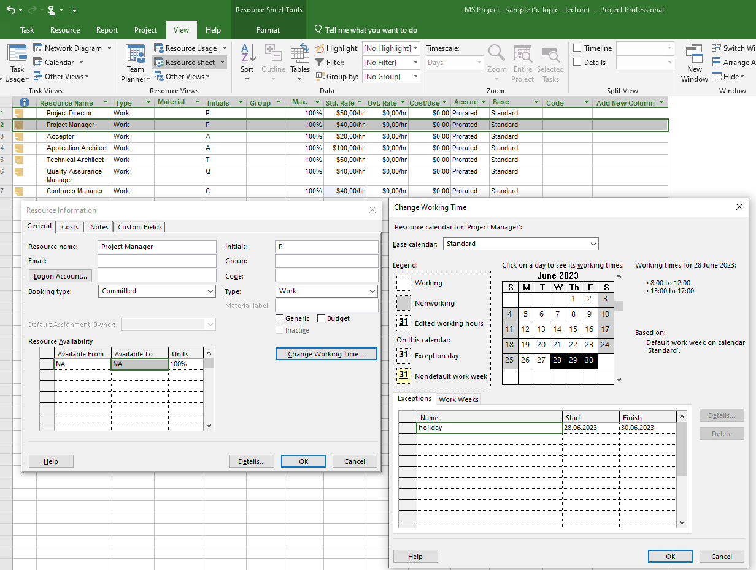
MS Project set up resources
Work resources
Work resources do not have unlimited capacity within the limited duration of a plan, and Project helps you manage this. The Max. Units field represents the maximum capacity of a resource to work on the tasks assigned to that resource. Specifying that a resource has 100% maximum units means that 100 percent of that resource’s working time is Available work on assigned tasks in the plan.
Project will alert you with an indicator and formatting if you assign the resource to more tasks than the resource can accomplish.
For example, a resource will be overallocated if it is assigned to two or more tasks at 100% capacity each and the tasks overlap. 100% is the default Max. Units value for new work resources.

Slide 23
MS Project set up resources
Work resources
Work resources do not have unlimited capacity within the limited duration of a plan, and Project helps you manage this. The Max. Units field represents the maximum capacity of a resource to work on the tasks assigned to that resource. Specifying that a resource has 100% maximum units means that 100 percent of that resource’s working time is Available work on assigned tasks in the plan.
Project will alert you with an indicator and formatting if you assign the resource to more tasks than the resource can accomplish.
For example, a resource will be overallocated if it is assigned to two or more tasks at 100% capacity each and the tasks overlap. 100% is the default Max. Units value for new work resources.

Slide 24
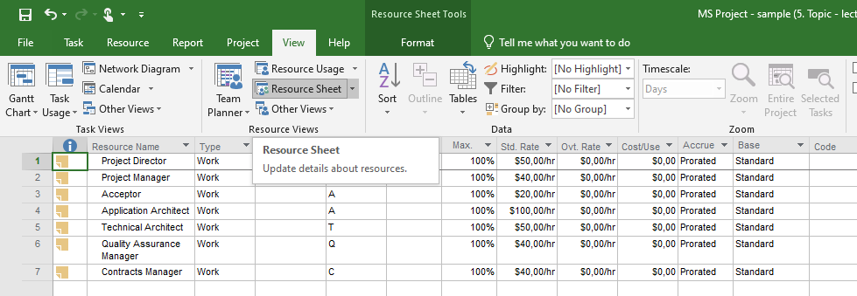
MS Project set up resources
Work resources
You can enter pay rates with a variety of time bases—per minute, hourly (the default), daily, weekly, monthly, or yearly. You enter rates in the format of rate/period—for example, 30/h for $30 per hour. Period abbreviations are /m for minutes, /h for hours, /d for day, /w for week, /mo for month and /y for year.
When a work resource has a standard pay rate entered and is assigned to a task, Project calculates the cost of the assignment. Project does so by multiplying the resource’s assigned work value by his or her pay rate—both using a common increment of time (such as hours). You can then see the cost per resource, cost per assignment, and cost per task (and also costs rolled up to summary tasks and the entire plan).

Slide 25
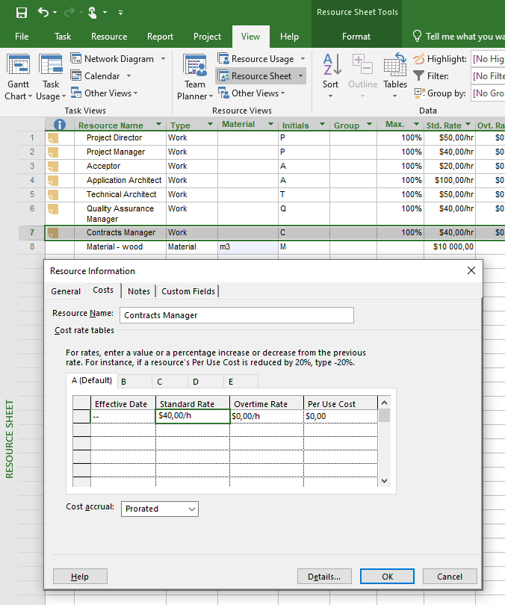
MS Project set up resources
Set up cost resources
You can use a cost resource to represent a financial cost associated with a task in a plan. Although work resources (people and equipment) can have associated costs (hourly rates and fixed costs per assignment), the sole purpose of a cost resource is to associate a particular type of cost with one or more tasks.
Common types of cost resources might include categories of expenses you want to track in a plan for accounting or financial reporting purposes, such as travel, entertainment, or training.
Cost resources do no work and have no effect on the scheduling of a task.

Slide 26
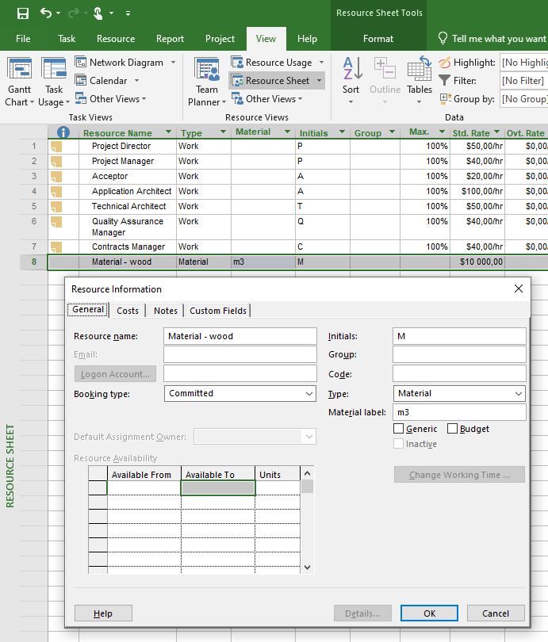
MS Project set up resources
Set up cost resources
To add a cost resource
On the View tab, in the Resource Views group, click Resource Sheet.
In the Resource Sheet view, click in the Resource Name column where you want to add the cost resource.
On the Resource tab, in the Insert group, click Add Resources, and then click Cost Resource. Project inserts a row for the new cost resource. Project names the new cost resource <New Resource>.
With <New Resource > selected, enter the cost resource name, and then press Enter.

Slide 27
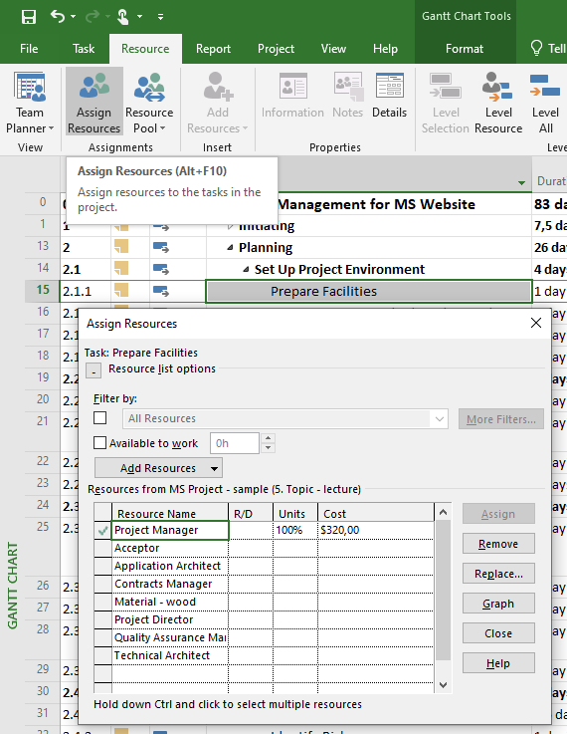
MS Project set up resources
Assign resources to tasks
An assignment is the matching of a resource to a task to do work. The process of assigning a resource might be called a task assignment or a resource assignment, depending on the perspective.
A task plus a resource equals an assignment.
When you assign resources to tasks, you can answer questions such as the following:
  Who should be working on what tasks, and when?
  Do we have the correct number of resources to accomplish the scope of work that our project requires?
  Are we expecting a resource to work on a task at a time when that resource will not be available to work?
  Have we assigned a resource to so many tasks that we have overallocated the resource?

Slide 28
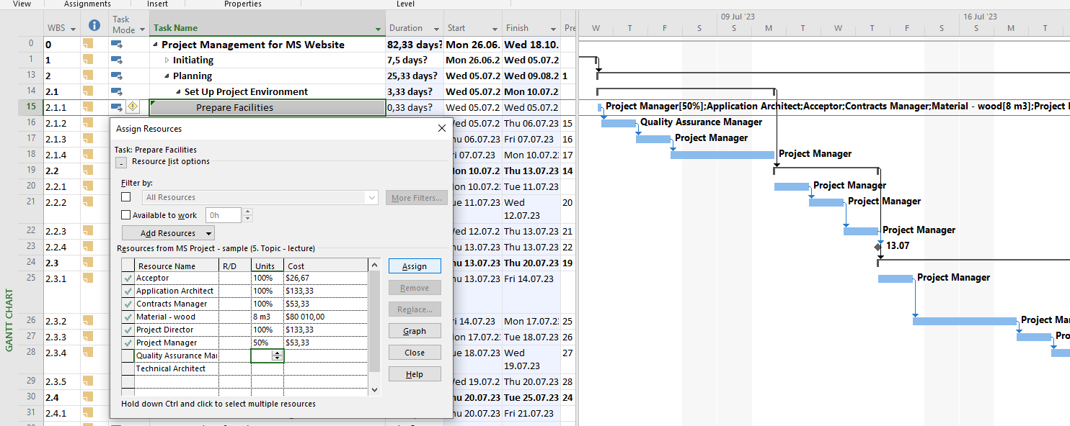
MS Project set up resources
Assign resources to tasks
Project calculates work by using this formula:
Duration × Assignment Units = Work
Here’s a simple example:
40 hours task duration × 100% assignment units = 40 hours of work
Here’s a slightly more complicated example. If you assign two resources to a task that has a three-day duration, the result is:
24 hours (that’s three 8-hour days) task duration × 200% (for two resources) assignment units = 48 hours of total work
The 48 hours of work is the sum of each of the two resources’ 24 hours of work. In other words, both resources will work full time on the task in parallel for its three-day duration.

Slide 29
MS Project set up resources
Assign resources to tasks
Project management focus: When should effort-driven scheduling apply?
You should consider the extent to which effort-driven scheduling should apply to the tasks in your projects. For example, if one resource should take 10 hours to complete a task, could 10 resources complete the task in 1 hour?
How about 20 resources in 30 minutes? Probably not—the resources would likely get in each other’s way and require additional coordination to complete the task.
No single rule exists about when you should apply effort-driven scheduling and when you should not. As the project manager, you should analyze the nature of the work required for each task in your project and use your best judgment.
To manage effort-driven scheduling for a specific task or tasks
1. Select the task or tasks you want.
2. On the Task tab, in the Properties group, click Information.
3. On the Advanced tab of the Task Information dialog box, select or clear the
Effort Driven check box.
To turn on effort-driven scheduling for all new tasks in a plan
1. On the File tab, click Options.
2. In the Project Options dialog box, click Schedule.
3. Under Scheduling Options For This Project, select the New Tasks Are Effort
Driven check box.

Slide 30
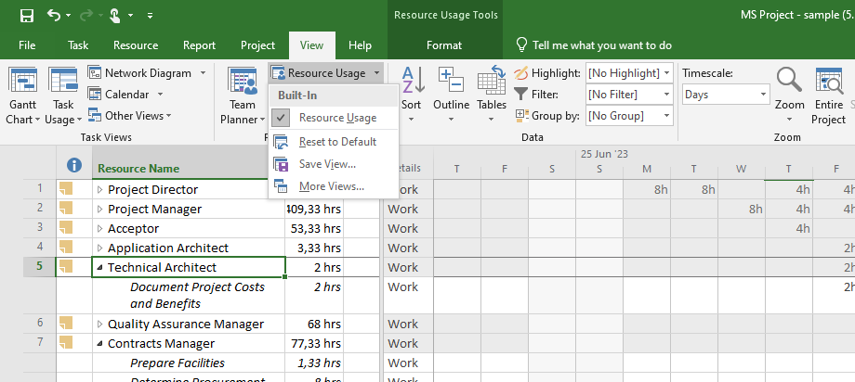
MS Project set up resources
The Resource Usage view
The Resource Usage view groups the assigned tasks below each resource—this is the same assignment information as is shown in the Task Usage view, but grouped by resources rather than tasks.
To check the plan’s costs per task
1. On the View tab, in the Task Views group, click Other Views, and then click Task
Sheet.
2. On the View tab, in the Data group, click Tables, and then click Cost. The Cost
table appears, replacing the Entry table.
To check the plan’s costs per resource
1. On the View tab, in the Resource Views group, click Resource Sheet.
2. On the View tab, in the Data group, click Tables, and then click Cost. The Cost
table appears, replacing the Entry table.
To see resource assignment and other details grouped by task
1. On the View tab, in the Task Views group, click Task Usage. The Task Usage view
appears.
2. On the View tab, in the Data group, click Tables, and then click Summary. The
Summary table appears, replacing the Entry table.

Slide 31
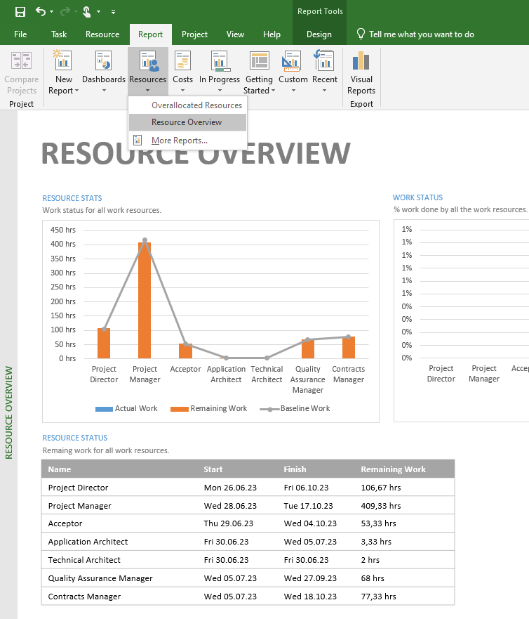
MS Project set up resources
Reports
You can use Project reports to see details of your plans in a variety of ways. Project includes several built-in reports, and you can customize those or create your own for the unique information needs of your project’s stakeholders.
Some of the useful things you can do are:
  Create graphical reports within Project rather than exporting the Project data to another program.
  Include colorful charts and images, in addition to tables, in your reports.
  Print reports or copy them to other programs.

Slide 32
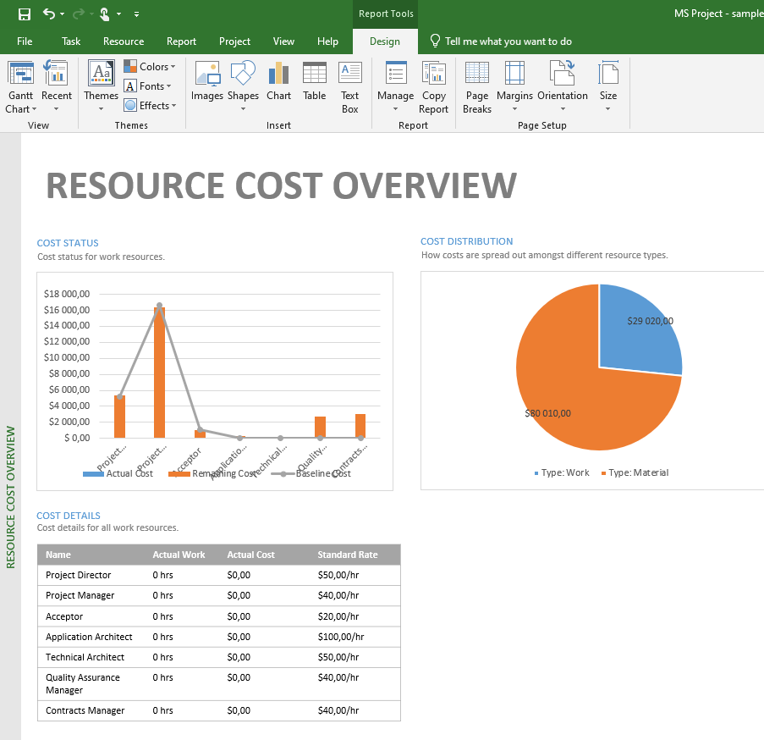
MS Project set up resources
Reports
You can make different filters in the Report tab to show the total budget of the project, you can divide the types of resources, you can select them according to assignments, tasks, etc.
You can generate a complex report (also in excel) and then work with the budget values.
Explore the "Report" tab

Slide 33
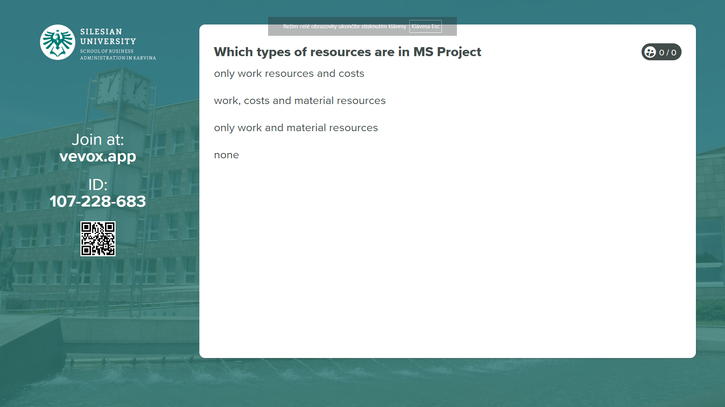
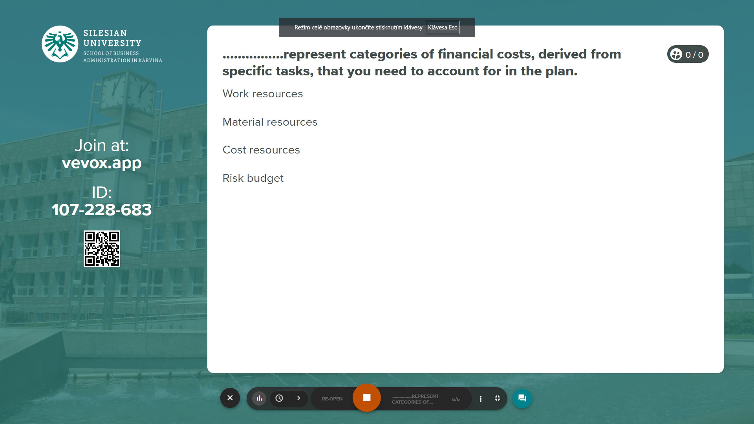
Vevox questions

Slide 34
Cost risk is one of the most common project risks. It can arise from poor budget planning and inaccurate cost estimation.
Cost risk is the risk of exceeding the budget for a project or failing to deliver fair value to offset costs. In addition, you may face higher costs due to internal or external factors. But what exactly are those?
PART 3
Risk budget, tolerance budget, change budget

Slide 35
Risk budget
Internal risks occur due to inner actions within the business. For example, underestimating the amount of work needed for a project is likely to result in an extended schedule, which adds to the project’s cost.
The longer the project is, the more it costs. That also means this risk is related to not only schedule but also performance and quality.
External cost risks include risks that occur outside of the business. That may include changes to regulations or industry standards, or banking charges. Although you can’t control these issues, you can mitigate their impact on your project.
The biggest problem with these risks is that you can’t predict their likelihood of occurrence. Sub-groups of external cost risks include economic, political, and natural risks.
According to PMI’s 2021 study, 38% of projects don’t stay within their planned budget range and 35% of projects fail because of a budget loss.

Slide 36
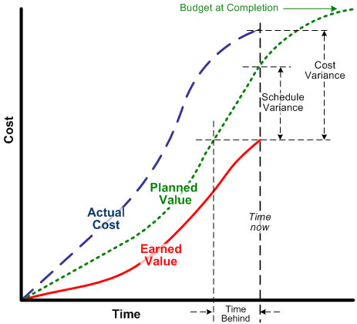
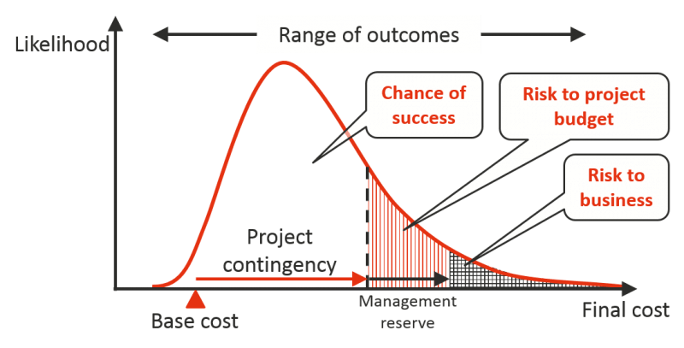
Risk budget -10 Effective tips to manage project cost risks
Pay attention to the areas where costs may increase (direct, indirect, overhead costs)
Include contingencies in your project budget
Create a thorough risk management plan
Start a project risk register to track risks
Determine the likelihood and impact of each risk
Outline the Work Breakdown Structure (WBS)
Measure performance with Earned Value Management (EVM)
Compare vendors and suppliers for the project
Avoid increasing the scope of the project
Use project management software to monitor costs

Slide 37
Budget tolerance
A budget tolerance is a range within which you can spend without having to report back to your sponsor or ask for more money.
Budget tolerance is particularly useful at the end of a project as you near the delivery date. If you have a budget of £80,000 with a tolerance of 10 per cent and you complete the project for £85,000 you have still delivered within the parameters set by your sponsor. A budget tolerance of 10 per cent means you can deliver the project 10 per cent over cost without having to get special permission to do so.
Tolerance is a range, normally specified as a +/- percentage of total program (or stage) budget, which you can spend without needing to return to the steering group to ask for further funds. If needed, the contingency budget is always consumed at the end of a project (or stage) to ensure successful completion of the program (or stage). You always need to seek steering group approval to spend any of the contingency budget.
NOT A PENNY MORE…

Slide 38
Change budget
If your budget is the roadmap to completing the project, what happens when the destination changes?
Change orders in projects are the norm, not the exception, so the seasoned project manager won’t be stumped by recasting the budget to account for altered objectives. How well you can adjust your budget to a scope change depends on how well you budgeted the project in the first place.
The reason why many teams use earned value management methods is that they give accurate performance management information about a project. The metrics integrate schedule and budget to provide a rounded way of looking at progress, far more accurate than a simple percent complete could ever be.

Slide 39
Change budget
Here are four project management events that prompt a change to the budget.
RE-BASELINING IS REQUIRED - If the scope changes, or the project management approach changes during the work, there might be a significant enough impact on the performance measurement baseline to warrant a re-forecast of the budget.
SCOPE CHANGES - A change to requirements is very likely to mean a change to the budget. The financial impact of the change should be considered as part of the change control process. By the time the change is approved, the project team should have a good idea of what the difference that will make to the forecasted costs. The easiest thing to do when a work package is removed from scope is to adjust the budget down based on the budget allocated to that work package.
CONTRACT CHANGES - Contracts may evolve over the life of the project.
CHANGE TO MANAGEMENT RESERVE´- The management reserve budget exists to address risks and offset the impact of uncertainty. It isn’t there to pad the amount allocated to work that was poorly estimated. That said, if management reserves are required – for example to fund a period of rework that results from a realized risk – it is appropriate to amend the budget.

Slide 40
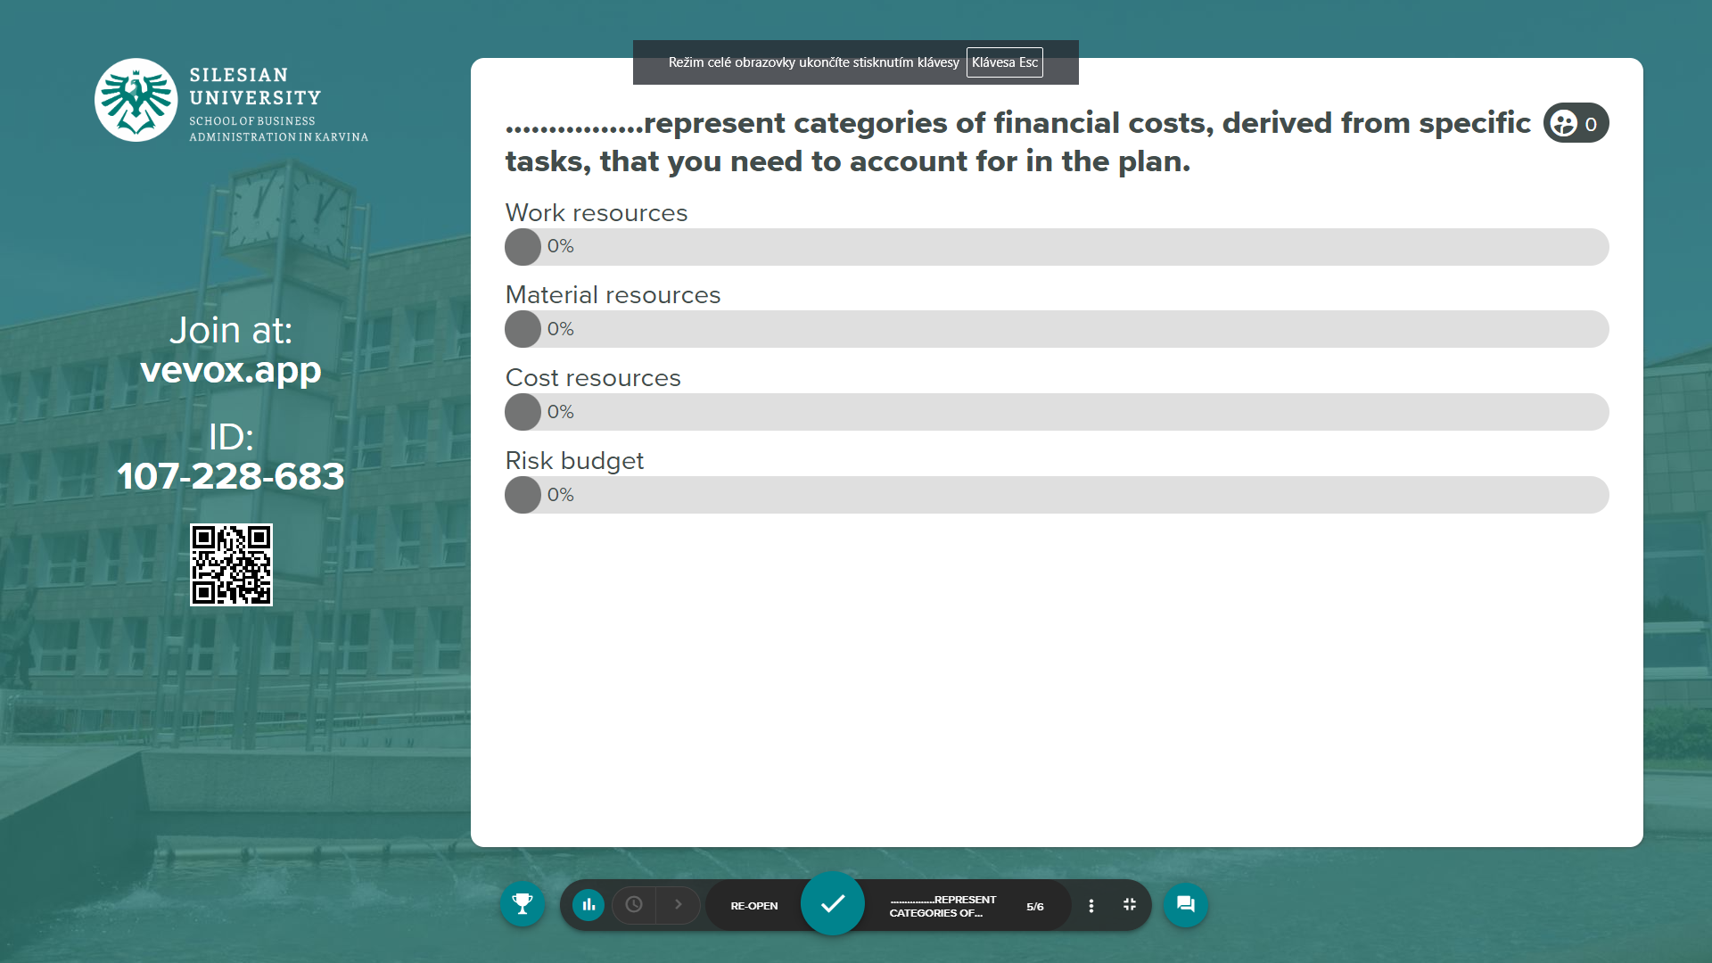
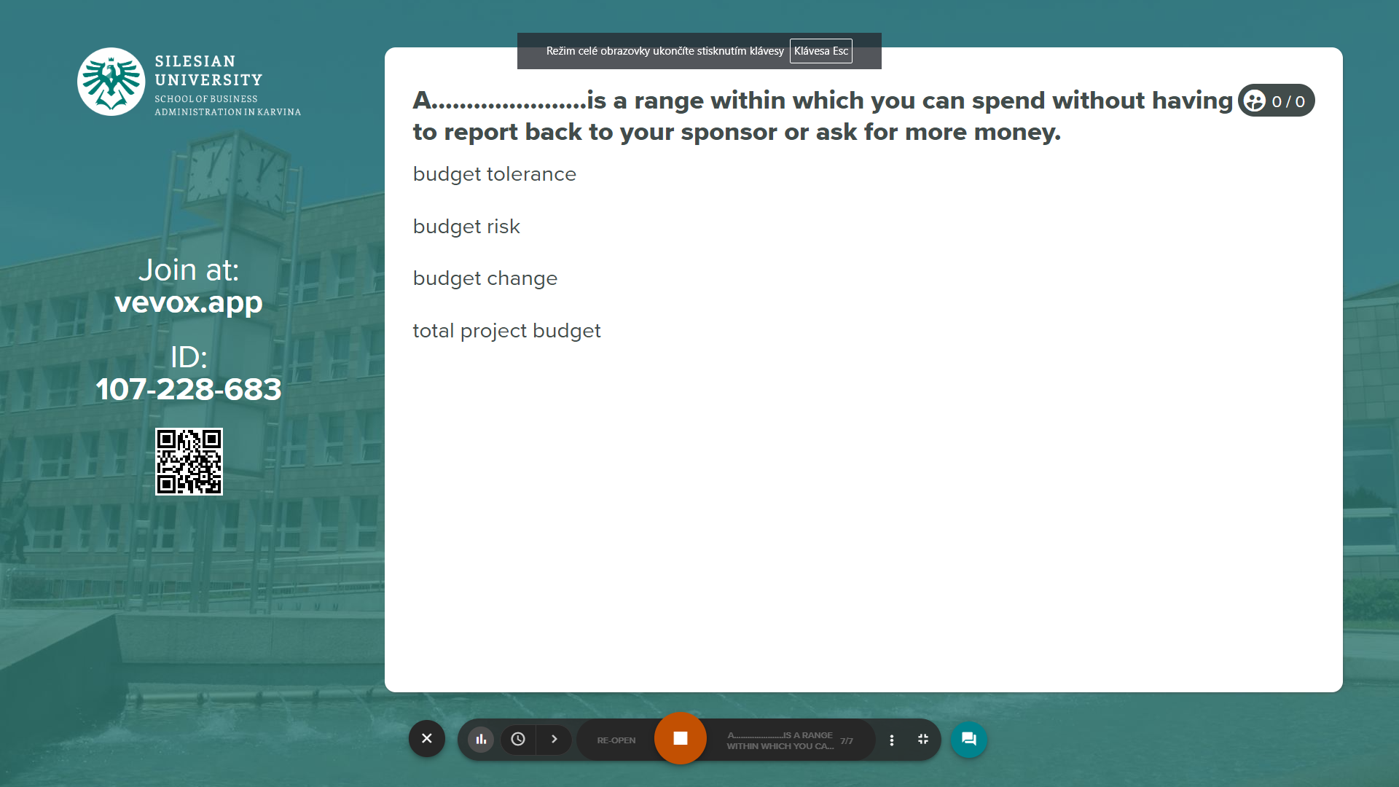
Vevox questions
https://silesianuniversity.vevox.com/#/meeting/449455/polls

Slide 41
RECAP
Make sure you can answer the following questions:
Can I define the project and its end goal?
Are there any ground rules, constraints, and assumptions I should consider?
Do I have sources of data (Task List, WBS, Cost Estimates, Schedule) to rely on?
Is the estimating methodology in use acceptable?
Do I know who is going to work on the project?
Do I have a list of resources and their rates to complete the project?
Can I compare my estimate against the best practices industry standard?
Do I have contingency reserves to account for risk?
Who are the key project team members to help me in estimating/budgeting process?
Am I on the same page with Project Stakeholders?
Can I compare the budget with original estimates and reconcile differences?

Slide 42
RECAP
You need to be clear about how you're going to estimate costs, what approach you're going to take. You need to be clear how you can then manage the costs. Use of software support helps in planning and managing costs.
Resources include the people, equipment, and material needed to complete the work of a project.
There are other budgets you need to set - risk, tolerance and change budgets.

