Slide 1
Customer expectations – The project product
Points 3.5. – 3.8 of the project template
Seminar 11
[ENTER NAME AND DATE]

Slide 2
Seminar Outline
The seminar will be delivered through MS Team - sharing all tutor's material for the seminar
Main communication with remote students will be through MS Teams
Using whiteboard for working as a class together
Using MS Teams breakout rooms and whiteboard for team work on projects. The tutor will visit each breakout room for check up and for feedback during the group work
Using Vevox for recap
Any questions and discussions will also be carried out through MS Teams

Slide 3
Seminar Outline
Feedback, answering any questions, and discussion on section 3.1 to 3.4 Project product description (10 - 20mis according to the size of the class)
Working together – example on customer’s expectations, acceptance criteria, quality tolerances, and responsibility for acceptance (20mins)
Working in project groups – project product description sections 3.5 to 3.8 (50mins)
Section 3.5 - Customer expectations for quality
Section 3.6 - Acceptance criteria
Section 3.7 – Quality tolerances
Section 3.8 – Responsibility for acceptance
Vevox quiz (5mins)
There will be feedback as needed during the time of the groups working on each section of their project and according to the needs of each group/students)

Slide 4
Learning outcomes
On the end of this seminar you should be able to:
understand what customers expect from your final product
understand how your value proposition meets your customers
understand what quality is still acceptable
understand who is going to assess the quality of your product

Slide 5
Feedback, answering any questions, and discussion
on section 3.1 – 3.4
3.1. Project product name: (this is, for example, the final product, service, innovation, etc.)
3.2. The purpose of this project product - the purpose that the project product as a whole is to achieve and who will use it.
3.3. Composition - a list of the main products or groups of products to be delivered by the project (e.g. for a car - tires, equipment, model line, etc.)
3.4. Derivation - are there starting materials from which this product is derived? E.g. there are products that will be modified by the project, etc.

Slide 6
Working together – example on Project products description 3.5 - 3.8
We will define each section of customer expectations (3.5 – 3.8) working together on example.
We will use a white board shared through MS Teams
We will be sharing ideas and filling them in the whiteboard.

Slide 7
Working in project groups – Project product description – Section 3.5
3.5. Customer expectations for quality - a description of the expected quality of the project product from the user's point of view, including determination of the standard (specific characteristics of product quality, meeting e.g. testing, functionality, time of use, etc.)
You can use Empathy map to help generate ideas
You can use: https://web.mindonmap.com/create to create your own map

Slide 8
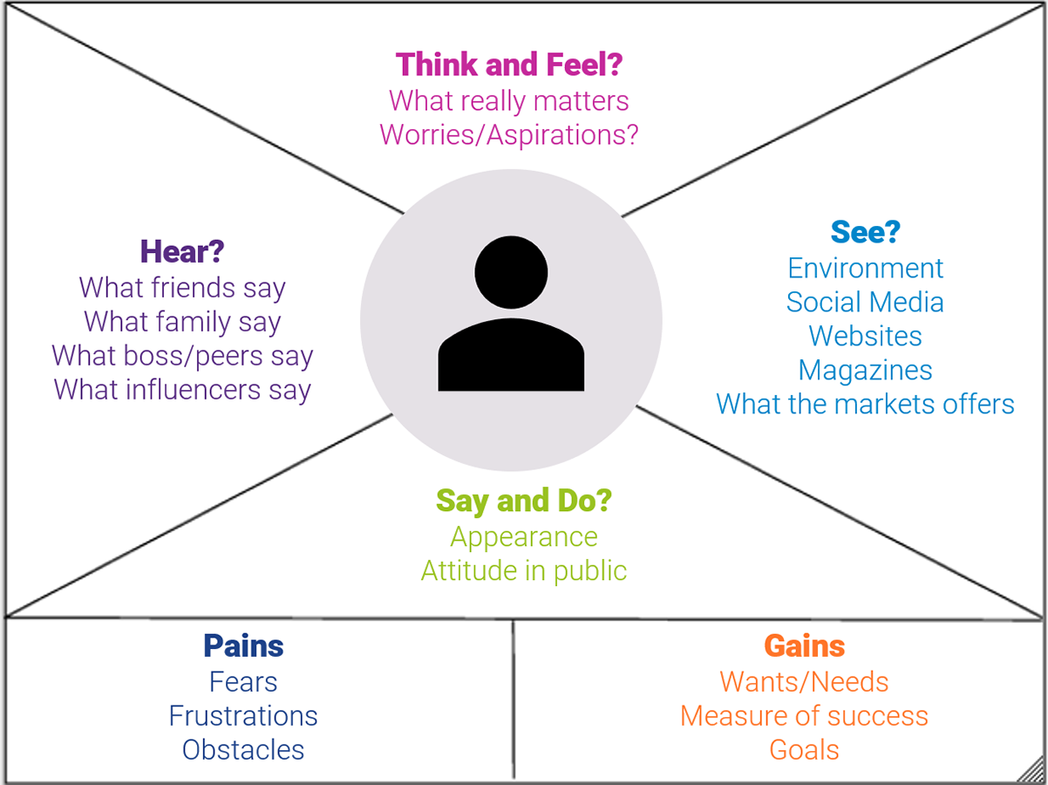
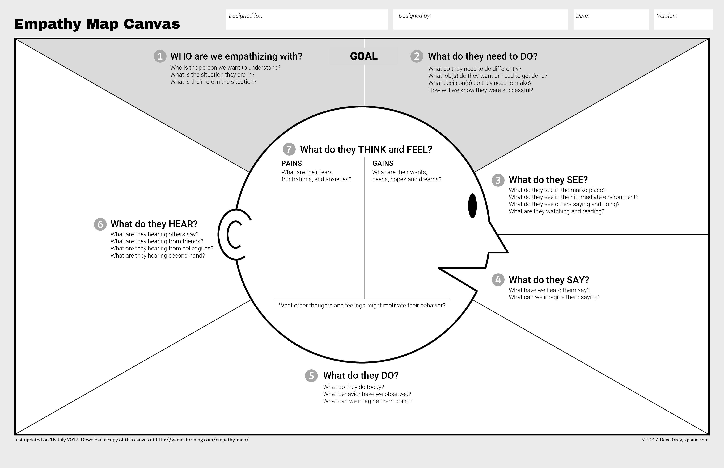
Working in project groups - Project product description – Section 3.5

Slide 9
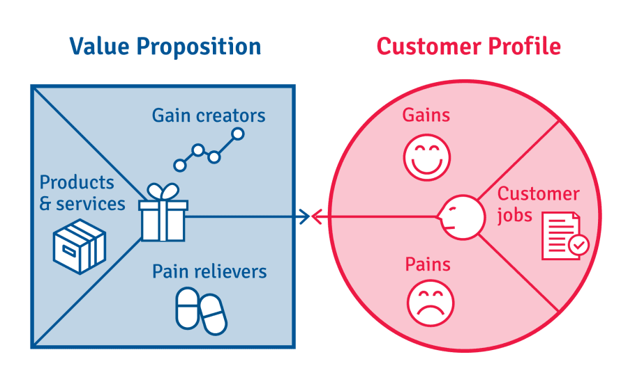
Working in project groups - Project product description – Section 3.6
3.6. Acceptance criteria - a prioritized list of measurable criteria to be met in order for the final product of the project to be accepted / accepted.
You can use Value proposition canvas to generate acceptance criteria

Slide 10
Working in project groups - Project product description – Section 3.7
3.7. Quality tolerances - any tolerances that can be applied to the acceptance criteria

Slide 11
Working in project groups - Project product description – Section 3.8
3.8. Responsibility for acceptance - who is responsible for acceptance

Slide 12
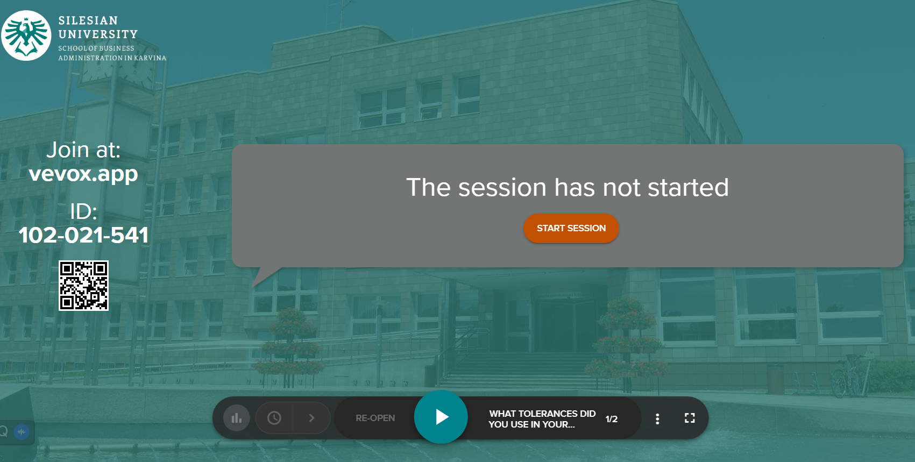
Time for recap – Vevox quiz

