Slide 1
Project Structure
Point 2.1. – 2.4 of the project template
Project Management

Slide 2
Seminar Outline
The seminar will be delivered through MS Team - sharing all tutor's material for the seminar
Main communication with remote students will be through MS Teams
Using whiteboard for working as a class together
Using MS Teams breakout rooms and whiteboard for team work on projects. The tutor will visit each breakout room for check up and for feedback during the group work
Using Vevox for recap
Any questions and discussions will also be carried out through MS Teams

Slide 3
Content
PART (30 min.)
Feedback on section 1.6 Logical Framework Matrix, check if the group completed the section from previous seminar (10mins according to the size of the class)
Working in project teams on section 2.1 and 2.2. (20mins)
2. PART (55 min.)
Working together with the tutor - Decision making process (15mins)
Working in project teams on section 2.3 Variants (solution options) - 2.3.1. Do nothing - the current situation, 2.3.2. Doing a minimum - minimal change, 2.3.3. Do something (30mins)
Working in project teams on section 2.4 Expected disadvantages (10mins)
3. PART (5 min.)
Vevox quiz (5mins)
There will be feedback as needed during the time of the groups working on each section of their project and according to the needs of each group/students)

Slide 4
Learning and practice objectives
On the end of this seminar, you should be able to:
highlight the benefits and ROI of your project,
what are the reasons to implement the project,
identify options of your project and justify why doing your project will bring incremental change,
explain what are the disadvantages of the chosen option.

Slide 5
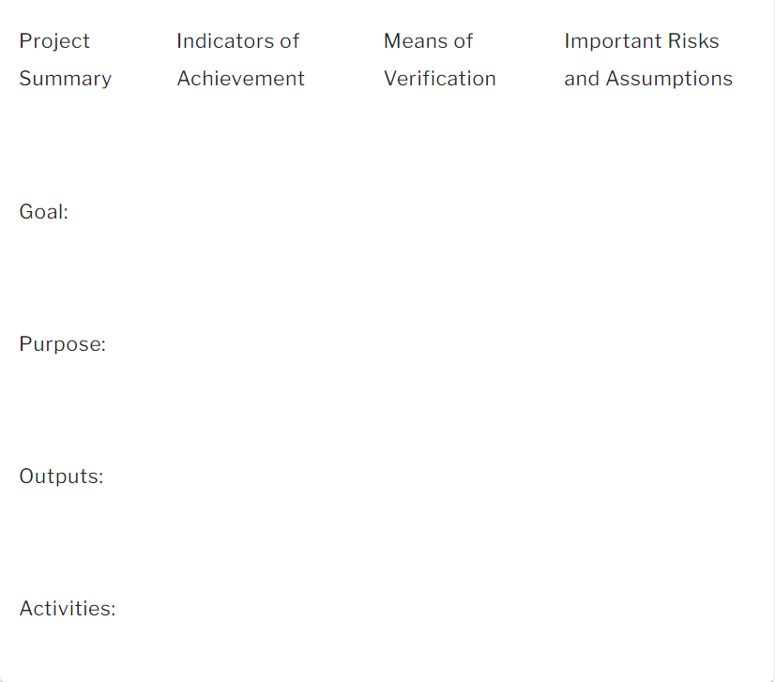
Feedback, answering any questions, and discussion on section 1.6. LFM
What assumptions underlie the structure of our project and what is the risk they will not prevail?
How will we know we've been successful?
How will we check our reported results?
What results do we expect?
Why are we doing this?
What are the deliverables?
What will we do to deliver the outputs?

Slide 6
Working in project groups Project Structure – Section 2.1-2.2

Slide 7
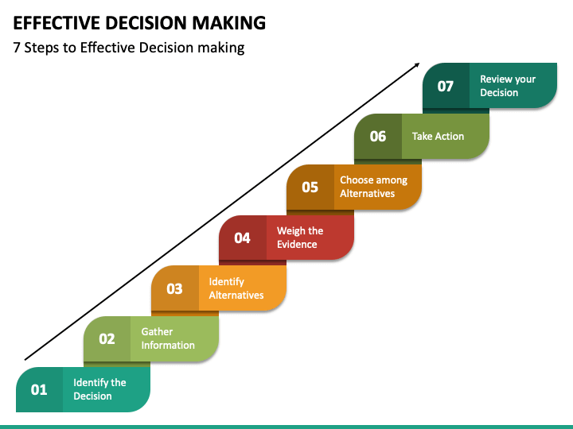
Working together with the tutor Decision-making process
Step 1: Identify the decision
You realize that you need to make a decision.
Try to clearly define the nature of the decision you must make.
This first step is very important.
Step 2: Gather relevant information
Collect some pertinent information before you make your decision: what information is needed, the best sources of information, and how to get it. This step involves both internal and external “work.” Some information is internal: you’ll seek it through a process of self-assessment. Other information is external: you’ll find it online, in books, from other people, and from other sources.
Step 3: Identify the alternatives
As you collect information, you will probably identify several possible paths of action, or alternatives. You can also use your imagination and additional information to construct new alternatives. In this step, you will list all possible and desirable alternatives.

Slide 8
Working together with the tutor Decision-making process
Step 4: Weigh the evidence
Draw on your information and emotions to imagine what it would be like if you carried out each of the alternatives to the end. Evaluate whether the need identified in Step 1 would be met or resolved through the use of each alternative. As you go through this difficult internal process, you’ll begin to favor certain alternatives: those that seem to have a higher potential for reaching your goal. Finally, place the alternatives in a priority order, based upon your own value system.
Example of the evaluation criteria (basic PROS and CONS with values on the scale can be used) or financial indicators - ROA, ROE, ROS; payback period, CBA analysis, etc.)
Step 5: Choose among alternatives
Once you have weighed all the evidence, you are ready to select the alternative that seems to be best one for you. You may even choose a combination of alternatives. Your choice in Step 5 may very likely be the same or similar to the alternative you placed at the top of your list at the end of Step 4.

Slide 9
Working together with the tutor Decision-making process
Step 6: Take action
You’re now ready to take some positive action by beginning to implement the alternative you chose in Step 5.
Step 7: Review your decision & its consequences
In this final step, consider the results of your decision and evaluate whether or not it has resolved the need you identified in Step 1. If the decision has not met the identified need, you may want to repeat certain steps of the process to make a new decision. For example, you might want to gather more detailed or somewhat different information or explore additional alternatives.

Slide 10
Working together with the tutor Decision-making tree

Slide 11
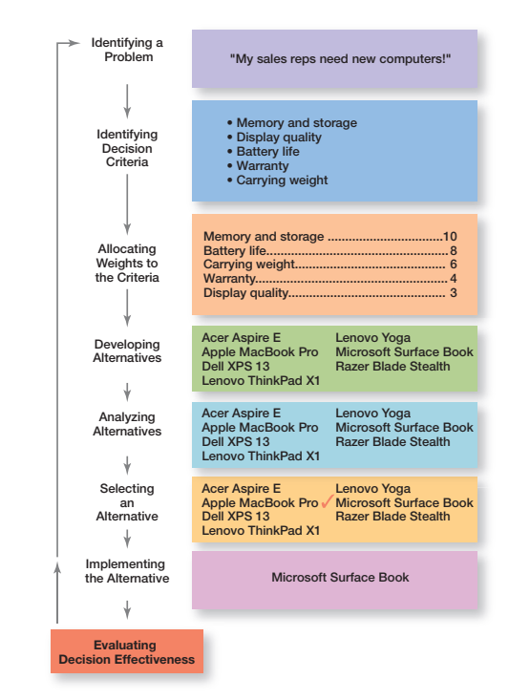
Working together with the tutor Decision-making matrix
Weight assigned according to importance of the decision criteria

Slide 12
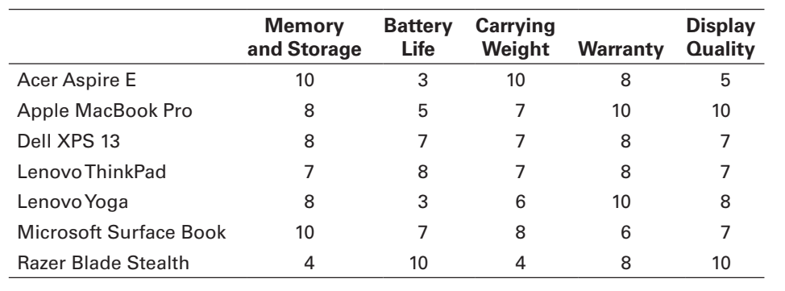
Working together with the tutor Decision-making matrix
Giving points to each criteria according to what do you think is better quality/performance/etc. for each alternative
Criteria
Alternatives

Slide 13
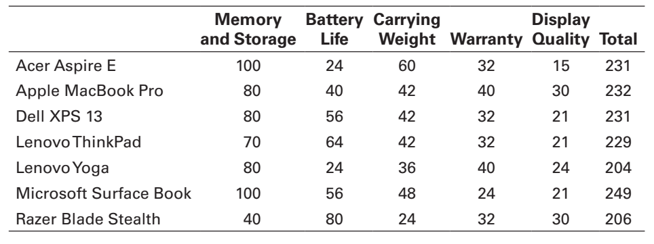
Working together with the tutor Decision-making matrix
Total = points from previous table x assigned weight according to importance
The highest score in the total column is the most favourable option.

Slide 14
Working in project groups - Project Structure – Section 2.3

Slide 15
Working in project groups - Project Structure – Section 2.4

Slide 16
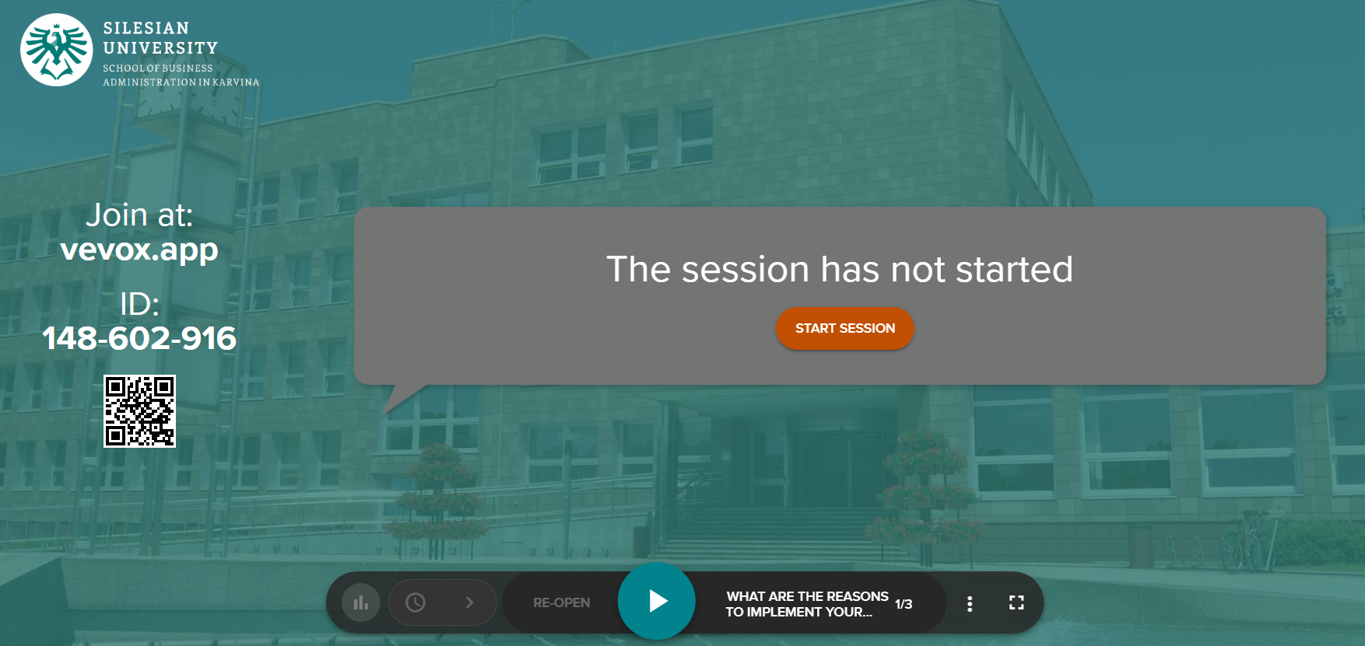
Vevox questions

