Slide 1
Project Budget
Resources in project
Project budget, risk budget, change budget
Project Management

Slide 2
Project budget
Today's task is to develop a project budget, which also includes a risk budget, a change budget. You will complete the risk budget after the risk analysis has been completed (it is an output of the risk analysis). We are working on (parts from seminar template):
2.6. Project costs - overview of project costs (start-up costs, operation, reserves, changes and risks)
2.6.1. Project budget - suitable tabular form, e.g. according to individual stages of the project or according to direct / indirect costs, etc. You use MS Project to determine the costs (resources)
2.6.2. Tolerance budget (reserves)
2.6.3. Change budget (for possible changes during project management)
2.6.4. Risk budget

Slide 3
Contents
PART (10 min.)
Short introduction – work with MS Project - creating resources, modifying them (labor, material, cost). Example of creating resources and costs and assigning them to activities (tasks).
2. PART (70 min.)
Student teams work on their projects in MS Project where they sequentially enter all resources required for the implementation of activities (individual tasks in the project). The objectives are to achieve the filling of the column (Resource Names) for tasks, to define the resource correctly and its financial requirements - it varies according to the type of resource.
3. PART (10 min.)
Feedback and checking the progress of the project budget, whether the resources make sense and are set adequately.

Slide 4
Learning and practice objectives
You should be able to:
Understand the importance of the change budget, i.e. the anticipated possible future change requirements.
Determine the type of resource and establish cost requirements.
Understand the significance of the project budget and financial requirements by activity.

Slide 5
What you are working with today
Use a seminar paper template that includes section „2.6. Project costs - overview of project costs“
Use a MS Project for this part, MS Excel can also be used to provide clear spreadsheets of financial budget amounts (available in IS).
Apply your knowledge of 7. topic – lecture.
Use the supporting document Related to 7. Topic.
All materials are available in the IS.

Slide 6
You can find support in the following sources:
Book – Chatfield and Johnson (2016). MS Project 2016 Step by Step (Part 5 Set up resource, Part 6 Assign resources to tasks)
Book – PMBOK Guide . Chapter 7 (p. 231 Project Cost Management)

Slide 7
MS Project – resources
Today's steps:
Create a list of resources (add them to the database gradually), whenever they can be added/deleted/edited.
After creating a resource, it is necessary to define the resource type - WORK, COST, MATERIAL.
Then, for each resource, indicate the cost intensity, e.g. for workers it is hourly rate, for material it is price per unit of measure, for costs it is one-time items (I purchase assets, equipment, pay invoices, etc.).
Resources must then be assigned to the tasks (activities) you have created from previous workshops.
Today's output is the tasks that contain the required resources. (Resources are also displayed in the Gantt chart). The output is then spreadsheets (reports from MS Project - all budgets).
Don't forget to save!!!

Slide 8
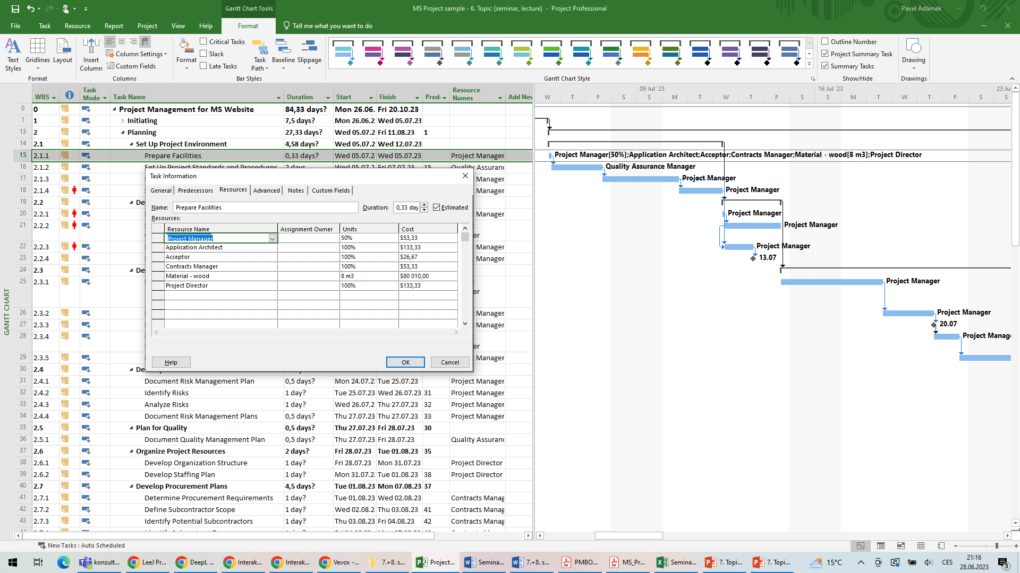
MS Project – resources creating

Slide 9
MS Project – assign resources, resource type

Slide 10
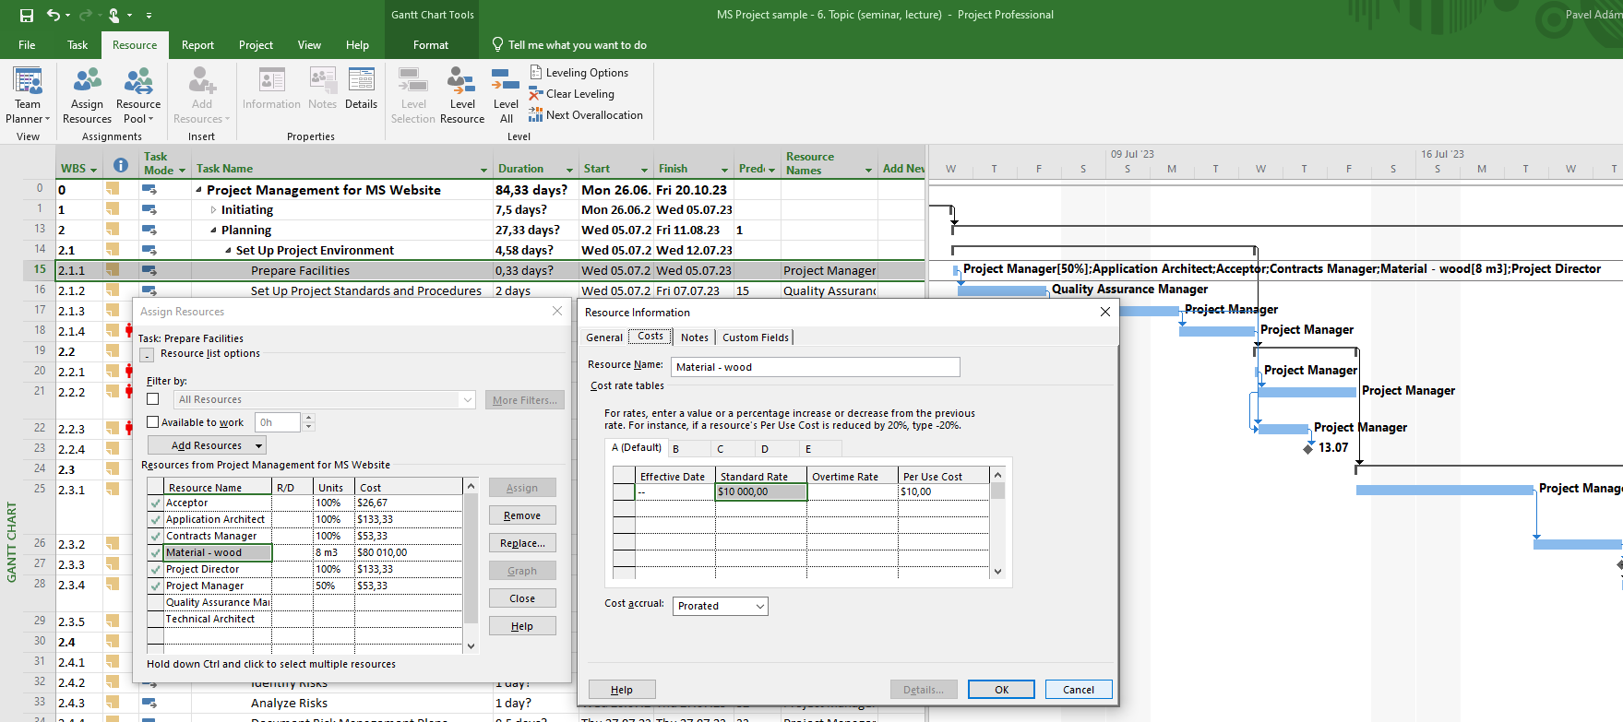
MS Project – resources type – material

Slide 11
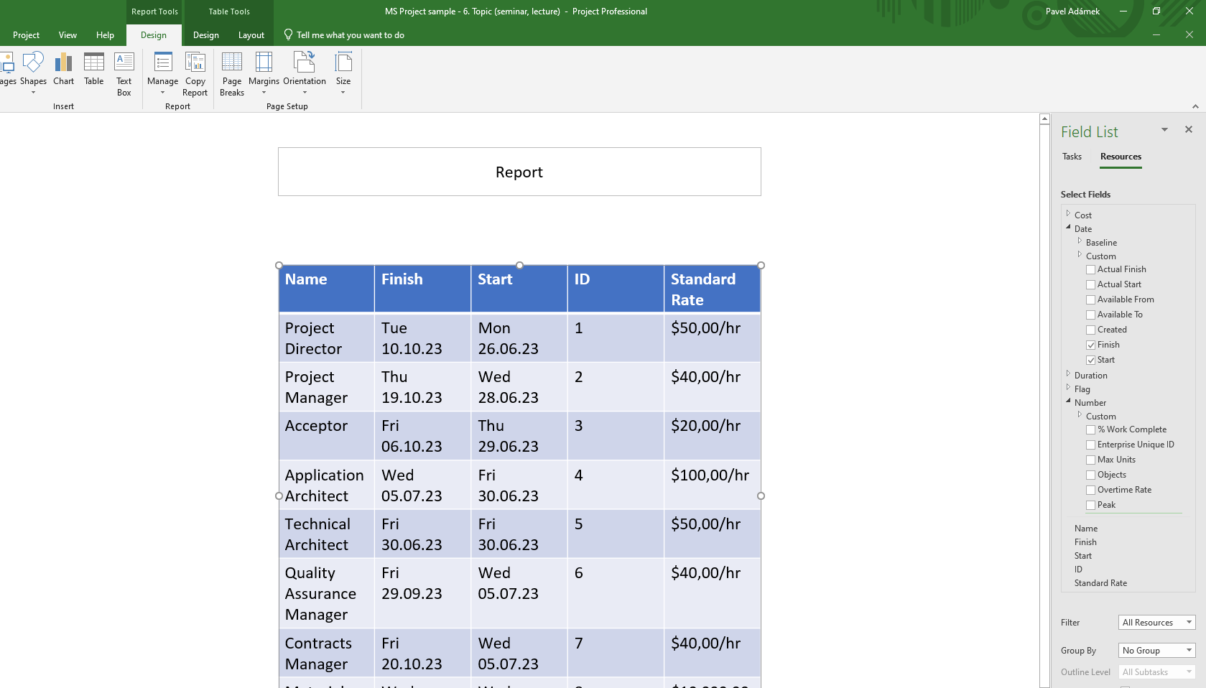
MS Project – resources (view reports)

Slide 12
Questions…
How is your progress with costs and resources in the project?
How are you doing with budgets?
Do you have any questions??

Slide 13
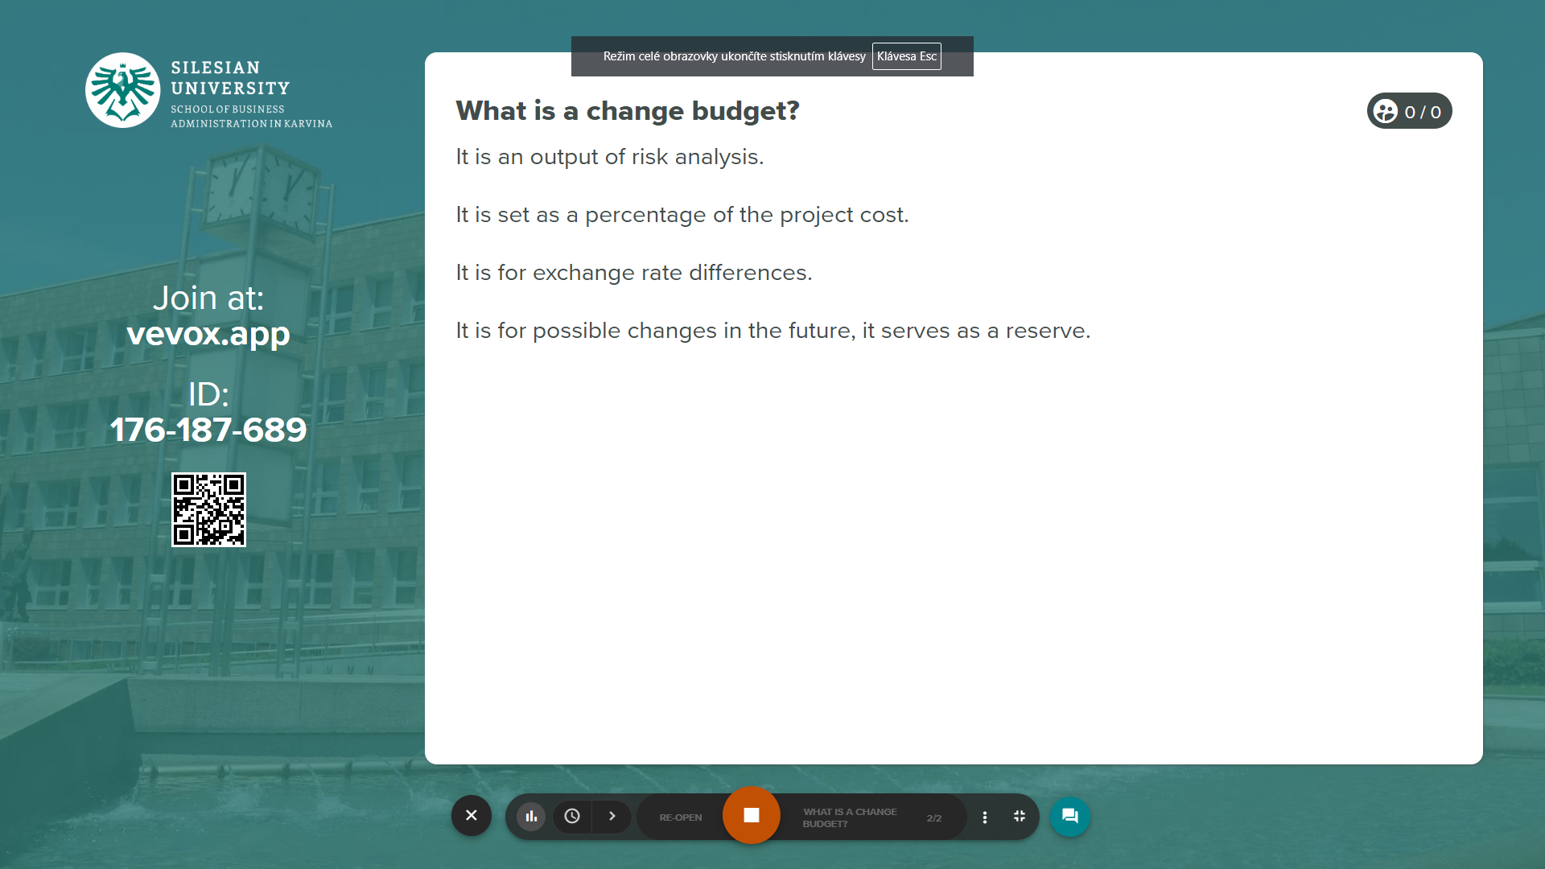
Vevox questions

Slide 14
Summary of today's seminar, what should be done
You will have resources entered for all activities in MS Project.
You will generate a total project budget.
You will set a budget for changes (these can be financial items listed as resources for selected tasks in Project).
You also have a budget for any tolerances (as per the project customer's acceptance criteria).

