Slide 1

Crisis
Presentation subtitle
Ing. Šárka Zapletalová, Ph.D.
Department of Business Economics and Management
CRISIS MANAGEMENT

Slide 2

Basic information
Course: Crisis Management
Tutor: Šárka Zapletalová
Office: building B202
Consultation hours: Wednesday 10,00 – 12,00
Contact: zapletalova@opf.slu.cz
Requirements on students (total sum of points 100)
Active participation in seminars– 10% of points
Seminar paper – 20% of points
Final written exam – 70% of points

Slide 3
Crisis
The world crisis comes from two Chinese words – Danger and Opportunity.
Crisis is any event that is expected to lead to, and unstable and dangerous situation affecting an individual, group, or whole organization.
A crisis is a complex crisis situation in which the balance between the basic characteristics of the system (mission, philosophy, values, goals, style of functioning of the system) is significantly disturbed on the one hand and the attitude of the environment towards the system on the other.

Slide 4
Crisis
A crisis situation is generally considered to be an unpredictable or unpredictable course of events after the disruption of the equilibrium of natural, technical, environmental, economic, social and societal systems, which endangers the lives, health or property of citizens, the environment, public order, internal or external security of the state, and common competencies and common available resources are not enough to solve these problems.
The crisis can be caused artificially and can serve as a tool for solving the internal problems of the subject, or as part of tactics or strategies in a competitive environment. However, it can also arise from its very nature without the intention of causing a crisis.

Slide 5
Characteristics of the Crisis
The crisis is almost always decomposing. Until it is resolved, it blocks the organization's activities.
The crisis is almost always negative. It distracts from important everyday tasks and disturbs the focus on work and its goals. It creates a tense atmosphere in the company and casts a shadow of doubt on the credibility of the organization in the eyes of the public.
The crisis divides the organization. Employees, including managers, choose the party to which they join based on the facts or interests of their own or the organization.
The crisis can create distorted or incorrect impressions. The impression can then be considered a fact and possibly encourage negative public sentiment towards the organization.
The crisis usually surprises, even if the company's management takes into account certain risks.

Slide 6
Typology of the Crises
Natural crisis
Ecological crisis
Technological crisis
Confrontational crisis
Illegal crisis
Psychological crisis
Economic crisis
Financial crisis
Business crisis

Slide 7
Typology of Crises in the Organizations
Who is affected by the crisis - organization / state / world
How big will be the impact of the crisis - local / global
From the point of view of the causes - internal / external, objective / subjective, random / lawful
In terms of estimation rate - unexpected / predicted
From the point of view of obviousness - obvious / latent
Danger level - deep / shallow
From the point of view of long-term - short-term / long-term

Slide 8
Development of the Crisis in the Organization
Every business, regardless of its size, goes through its own development, which we call the business life cycle. During this process, the company goes through certain stages of development, which require a specific approach to business management.
Stage of symptoms (signs of abnormal behavior, imbalance, cracks in the system) including
  Signals weak, poorly structured where the crisis potential is growing slowly and can only be detected by experts;
  Signals strong, complete, structured fast-growing - it is necessary to act immediately;
  Signals very strong they can be practically distinguished even by a layman, the possibility of a response - the reaction is practically no, the crisis potential is at a critical point and it is too late for interventions.

Slide 9
Development of the Crisis in the Organization
Acute stage (threat to the future of the company, a significant decrease in interest in the future, exacerbation of threats), non-compliance means damage, escalation of risk. At this stage, it is necessary to identify the center of gravity of the crisis and get it under control. The aim is to reduce the extent of damage and minimize the duration of this stage.
Chronic stage (period of reaction to the acute stage, efforts to regain balance, correction of business activities) ends with succumbing or the way of resolving the crisis.
Stage resolution crisis (means the acquisition of the balance of the enterprise in the phase of resumption of activities).

Slide 10
Development of the Crisis in the Organization
Each phase of the crisis is therefore individual and the entrepreneur should set a few basic points and goals to pursue. These points are called:
Alignment limit - a limit beyond which the situation is already considered disharmonious and is only permissible for a limited time - for example, the loss of a key supplier until I find a new one, or the company's pricing policy for a certain zero-profit product or service, for example in the context of introducing a service in an oversaturated market, can be called an acceptable level of risk.
The limit of endurance - the limit at which disharmony acquires the maximum value, the loss (expressed in financial indicators, units), which we are willing to sacrifice in the event of an unsuccessful attempt to save the company, it is a sharpened situation of confrontation, struggle. We can call it the "threshold of catastrophe", when there is a risk of permanent damage to the company, if the basic values ​​of the company are not preserved, it disappears.

Slide 11
Crisis of the „Quick Death“ Type
The roots of the problem are too deep and were discovered too late, the symptoms persisted in the company for a very long time, unfortunately no one paid attention to them, the early warning system failed or was not set up at all.
The acute stage was rapid and exceeded the limit of tolerance, so sacrificed losses. Therefore, the crisis is gaining momentum and the company is disappearing.
The analysis of the company did not find a single healthy place that could be operational and could generate value and help save at least part of the company and gain time for further action.

Slide 12
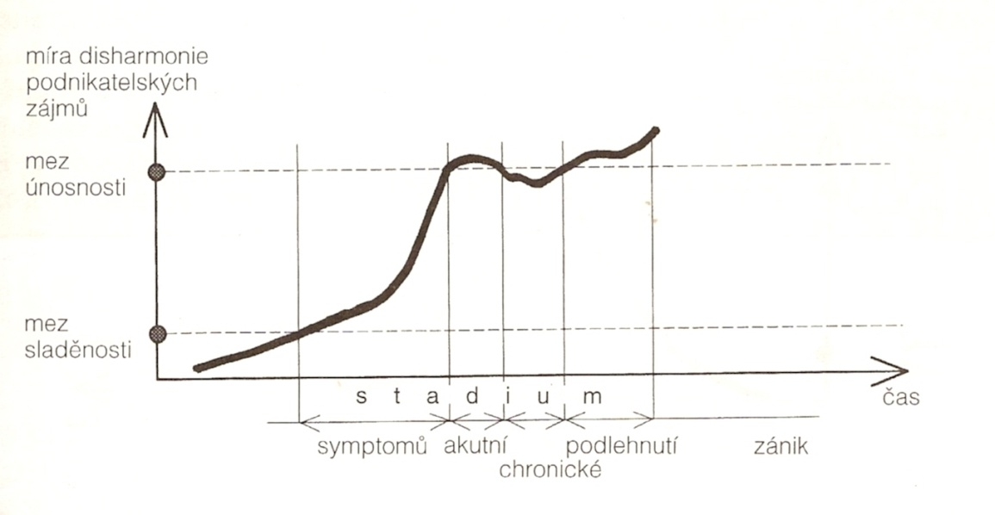
Crisis of the „Quick Death“ Type

Slide 13
Crisis of the „Slow Dying“ Type
The onset of the crisis is the same as in the previous crisis, but with the difference that the acute phase is managed and the first anti-crisis measures bring results.
This may be due, for example, to the sale of part of the business, when the entrepreneur obtains short-term funds and pays the necessary liabilities.
Then the crisis breaks out again with greater intensity.
However, the entrepreneur is instructed from the previous situation and takes similar restrictive measures again, leaving only a small part of the company, but surviving.
Over time, however, it is discovered that he sold far more profitable, lucrative parts of the business and they become its competitors.
He has to outsource the necessary services he had in his portfolio, the crisis reappears and the company is already so weak that it does not have the strength to fight and is subject to.

Slide 14
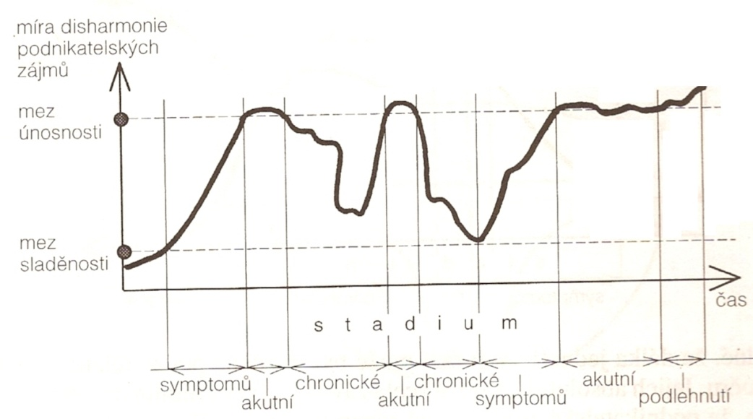
Crisis of the „Slow Dying“ Type

Slide 15
A Completely Controlled Crisis
This crisis breaks out suddenly, with an overall shorter course, an almost instantaneous, almost unrecognized acute stage, as it is done quickly and convincingly with the aim of pushing the manifestations of the crisis below the limit of endurance and ending it below the limit of alignment as a solution to the crisis.
An example might be a large order for a major client. We take the input raw material from our proven supplier. It is a raw material imported by only three companies in the country that meet our quality certificates. The car is demolished to the supplier with a load of our raw material, which becomes unusable and the replacement is not in stock.
The symptom was that we should already have an experienced emergency replacement.
The acute stage is very short - it calls the second and third suppliers and arranges a test delivery, I test and select a replacement delivery so that the order for my customer is not delayed.
The length of raw material testing and business negotiations - this will be the length of the chronic period of crisis.
The solution and lesson for me is a new tested supplier - a substitute who shares the risk of not delivering the raw material on time.

Slide 16
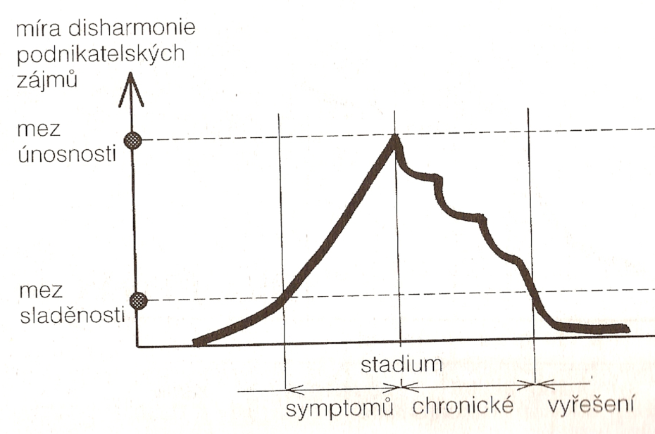
A Completely Controlled Crisis

Slide 17
Suppression of the Crisis in the Symptom Phase
This type of crisis is characterized by the fact that instead of the acute phase, the prevention of its occurrence is solved, therefore the solution of symptoms, a new stage arises - the elimination of causes.
The already mentioned feedback tools such as reporting, controlling, audit or random interviews are used to find out the causes.
It is used in situations where the manifestations of the crisis are visible, but we do not know why it arose, we want to take action and we want to carefully consider all the consequences that it will bring.
Crisis management involves active change.
The principle of change management is, among other things, the identification of resistance to change and the conversion of this energy into positive energy, which will not only accelerate the process of change and its course, but also ensure the successful effect of change.
The change therefore leads to a new level that is qualitatively higher than the previous state.

Slide 18
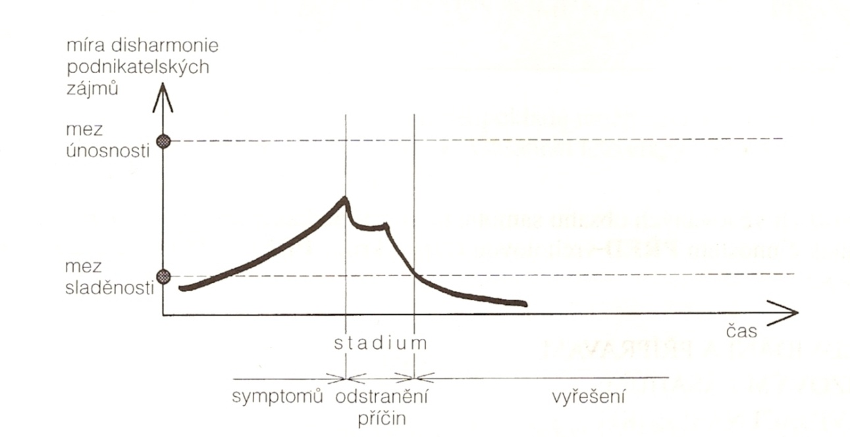
Suppression of the Crisis in the Symptom Phase

Slide 19
Conclusion
The crisis can affect any entity, regardless of its size. An individual, an organization, a political party, a society, a continent, our entire globe, and perhaps the entire universe, in a few million or billions of years, may be in crisis.
Everyone can imagine the crisis of an individual, organization and society, and at the same time they are able to understand the process of possible emergence from this crisis. In general, anything that has the potential to significantly affect or even jeopardize the integrity and viability of a business can be considered a crisis.

