Slide 1

Trade Organisations
Marketing communication and branding

Slide 2
Lecture content
Marketing communication
STP proces
Branding

Slide 3
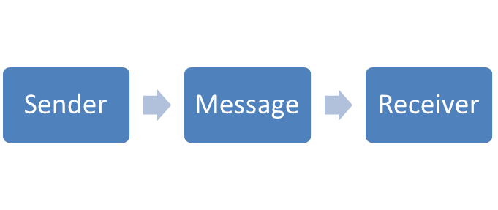
One way communication

Slide 4
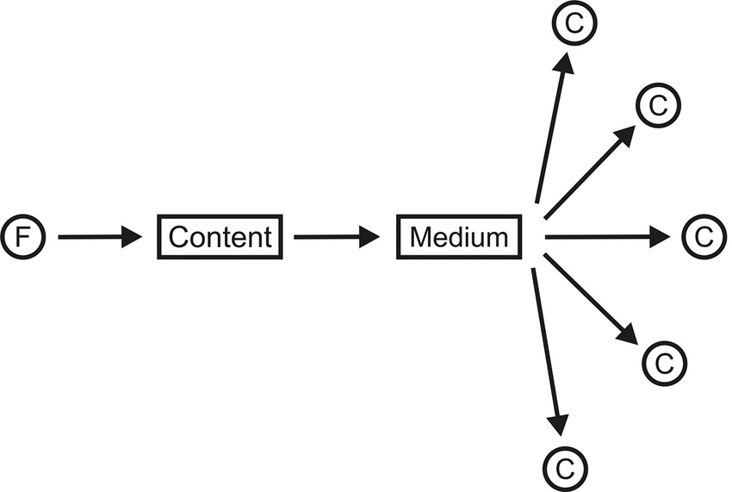
Mass one way communication

Slide 5
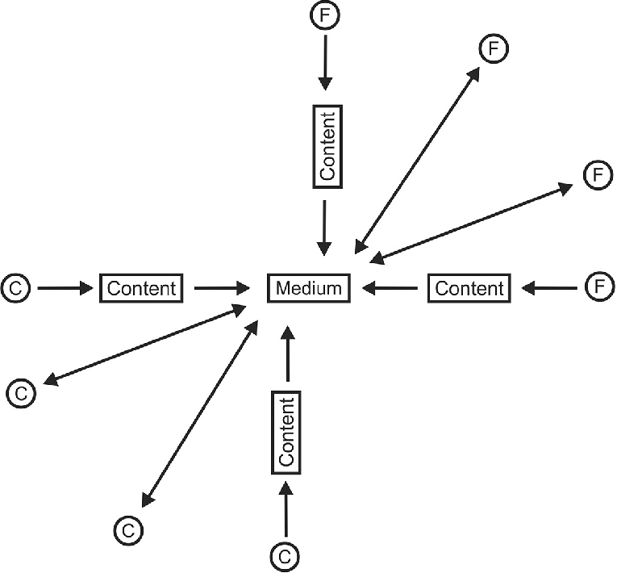
Mass communication many-to-many

Slide 6
Communication mix
?
Advertising
Public Relations
Personal selling
Direct marketing
Sales promotion

Slide 7
Advertising
Paid form of promotion.
Impersonal media presentations.
The advertiser is clearly identified.
Control over the content of the message.

Slide 8
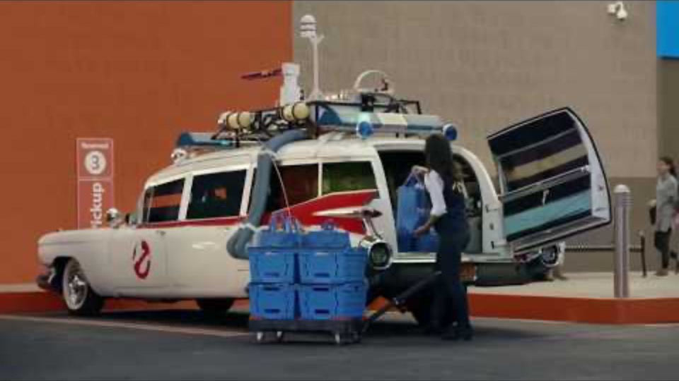
Advertising goals
Identify
Inform
Persuade
Remind

Slide 9
5M of advertising
Mission - the answer to a goal that a campaign has, what should an ad change in consumer attitudes or behavior.
Money - how much we invest in the campaign.
Message - the message alerts the recipient beforehand so that the campaign objectives can be met.
Media - a selection of media that could be available to meet your goals as effectively as possible.
Measurement - determination of the values according to which the results will be measured.

Slide 10


Media types
Internet
TV
Radio
Newspappers
Magaznes
OOH

Slide 11
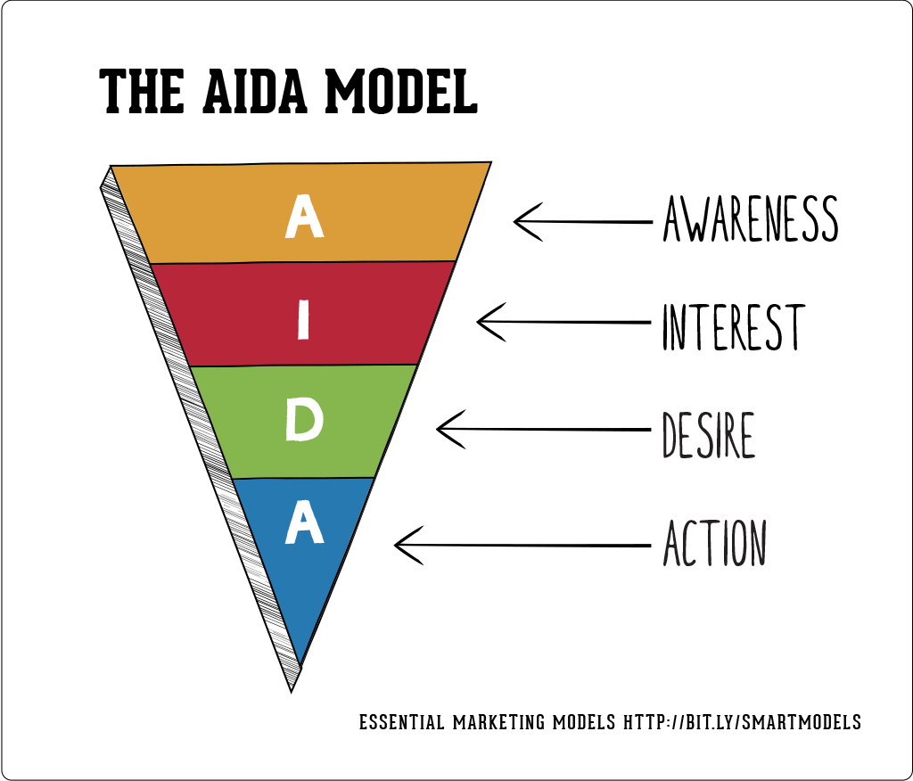
How advertising works?

Slide 12
Sales promotion
A set of short-term incentives designed to rapidly increase demand for specific products.
It must always be limited in time and create a purchase order.
The aim is for consumers to buy more, or products that they do not normally buy.
The great danger of discounts as a form of sales promotion is when it becomes a pricing strategy by using this tool too often.

Slide 13
Sales promotion
Short-term increase in sales
If a business needs to clean up warehouses due to product obsolescence,
fulfil the set annual sales plan,
sell out the old model before the new,
to force consumers or buyers to buy a business product just before launching a competing product.

Slide 14
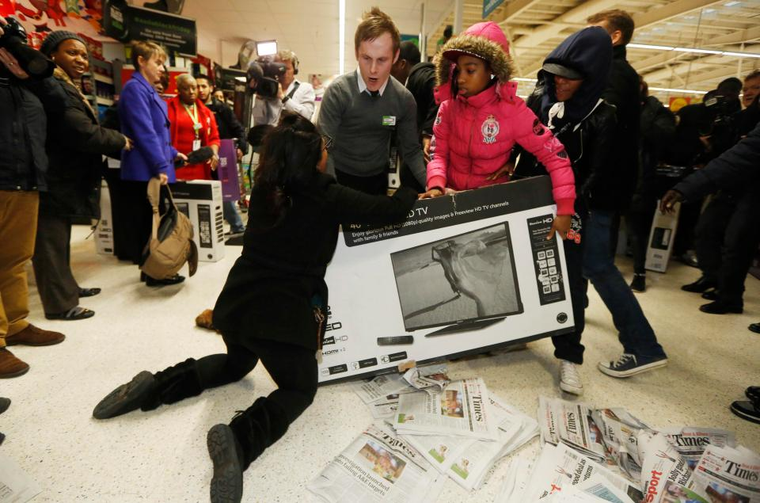

Slide 15
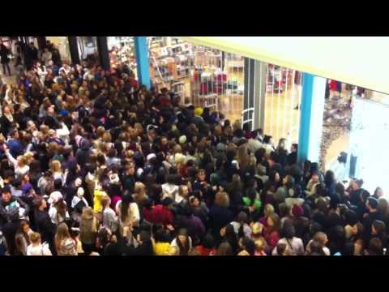

Slide 16
Sales promotion
Testing the product by the customer
Most often distribution of product samples at the beginning of the life cycle.
Other methods of sales promotion would be less functional here, such as larger package actions, one plus one for free and so on.
The customer does not know the product and is in some uncertainty.
He will not respond to these essentially quantity discounts, as he has not yet created trust in the brand.

Slide 17
Sales promotion
Support for repeat purchase
In this case, there is a loyalty program, bonus point cards and various actions between the tools.
It is an attempt to induce a certain habitual or customary behavior in customers.
Typically, they are goods of frequent consumption or frequently used services.

Slide 18
Public Relations
Unpaid form of promotion through a medium.
The message is more trustworthy than advertising
  Because the recipient acts as produced by the media, regardless of the company.
It does not include the direct cost of displaying the message
  The company does not have to pay time and space in the media;
The company has no control over the message
  It is purely up to the media or the public whether to attend a press conference, whether a journalist publishes an article, whether the editor of a magazine decides to review a product.

Slide 19
Personal selling
It represents a presentation made by the company's dealers in order to sell and build customer relationships.
It raises specific demands on workers who make personal sales, in particular sales agents and dealers.

Slide 20
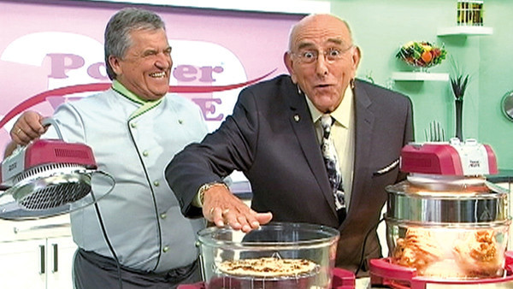
Direct marketing
It means using direct channels to reach customers and deliver products and services without the need for marketing intermediaries.
Direct mail
Catalogues
Telemarketing
Teleshopping
Notes:
Teleshopping umírá. http://zpravy.e15.cz/byznys/obchod-a-sluzby/teleshoppingova-jednicka-skoncila-v-konkurzu-doplatila-na-to-nova-a-csob-1326820

Slide 21
Other communication techniques
?
Guerilla marketing
Product placement
Viral marketing

Slide 22
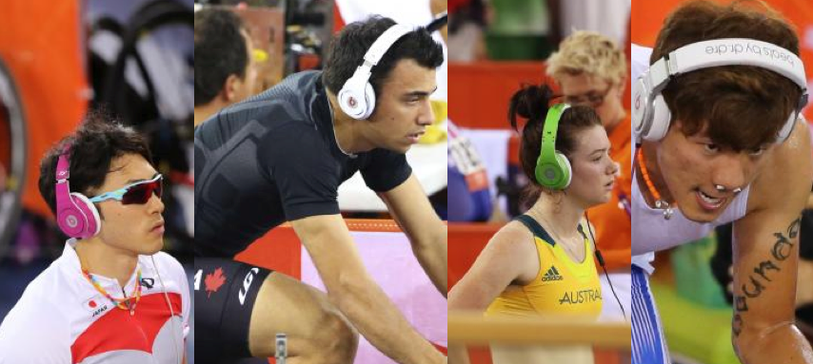
Ambush marketing

Slide 23
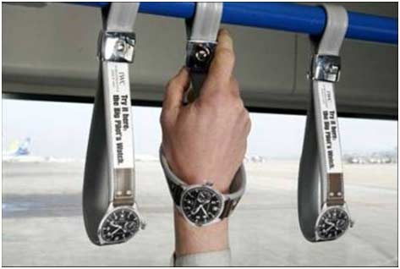
Presence marketing

Slide 24
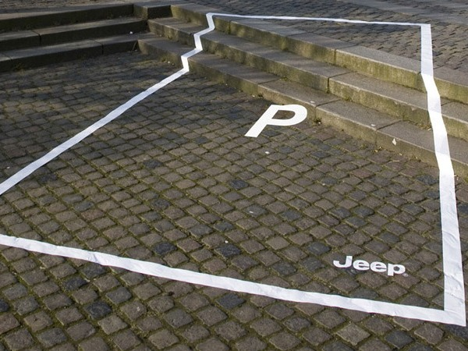
Street marketing

Slide 25
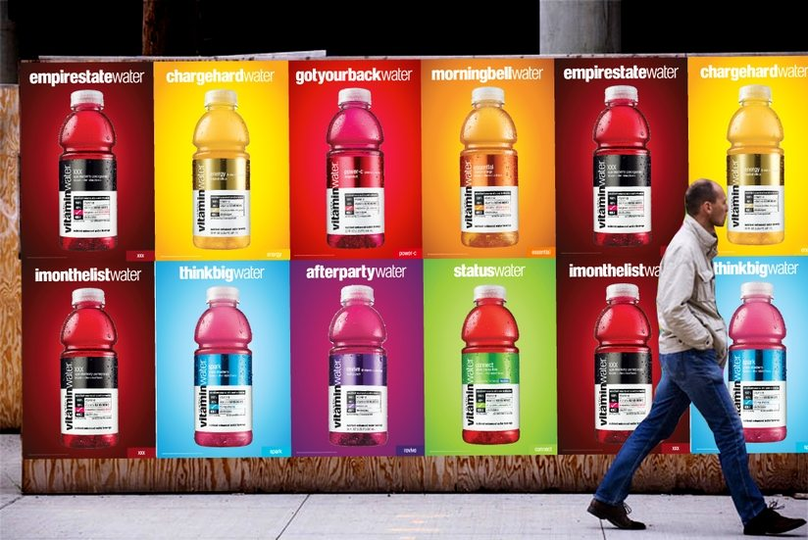
Wild posting

Slide 26
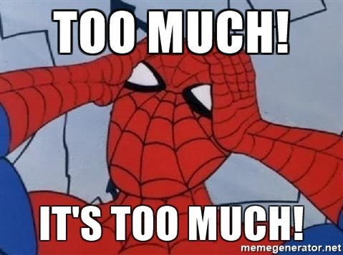
How many marketings?

Slide 27
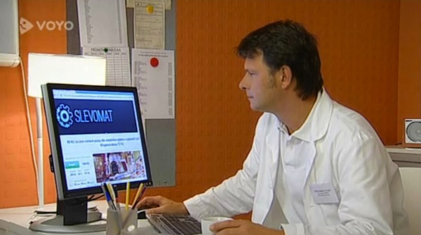
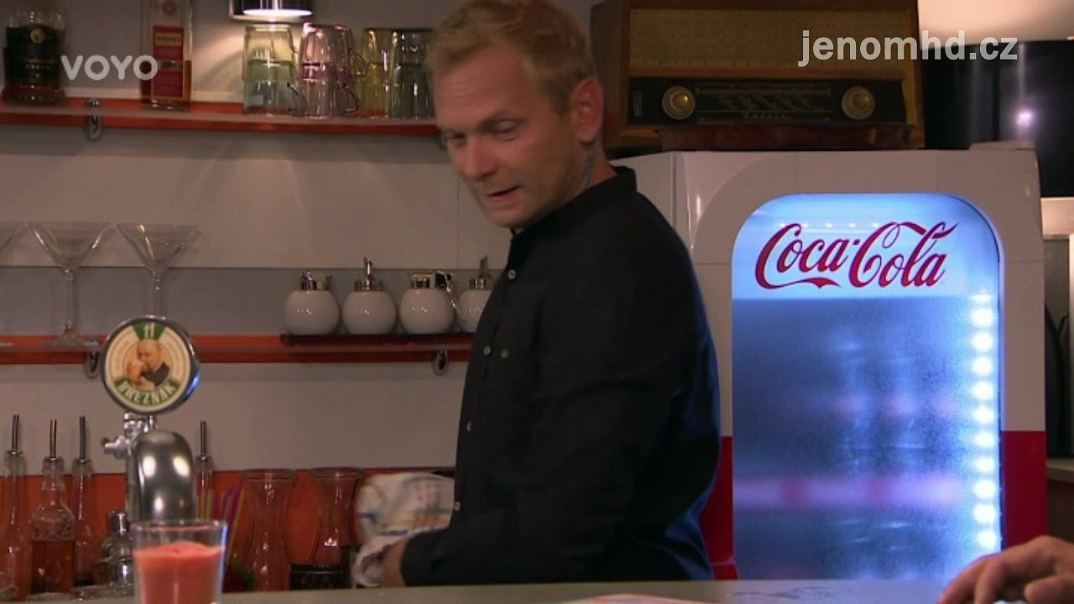
Product placement
Active
Passive
Part of the story
Part of environment

Slide 28
Viral marketing
The form of marketing communication (especially) on the Internet.
It consists of creating an interesting creative (image, video, application), which is then forwarded to Internet users themselves.
The creative is usually humorous, sexually suggestive, shocking (harsh), with an original idea or beautiful (animals, etc.)

Slide 29
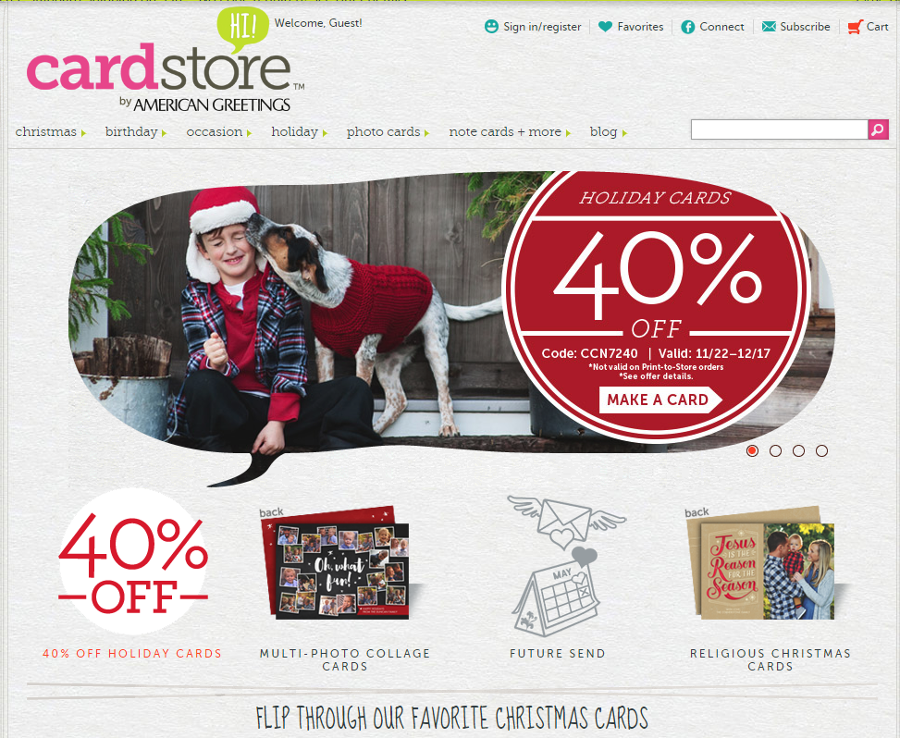
Cardstore
https://www.youtube.com/watch?v=HB3xM93rXbY
https://www.digitalstrategyconsulting.com/content/online-video-research-tips-and-news-for-marketers/case-study-how-cardstore-got-22m-views-with-a-surprise-ending/12111/
Notes:
http://www.digitalstrategyconsulting.com/intelligence/2014/11/case_study_how_cardstore_got_22m_views_with_a_surprise_ending.php

Slide 30
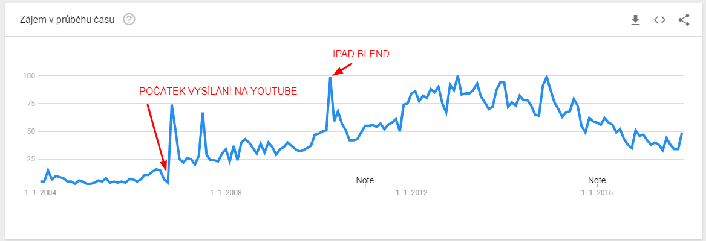
Will it blend?
https://www.youtube.com/watch?v=lAl28d6tbko&t=6s

Slide 31
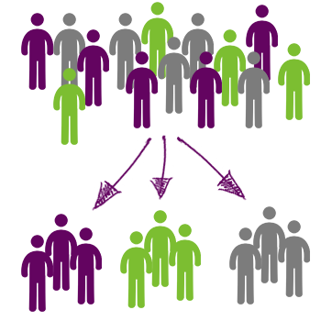
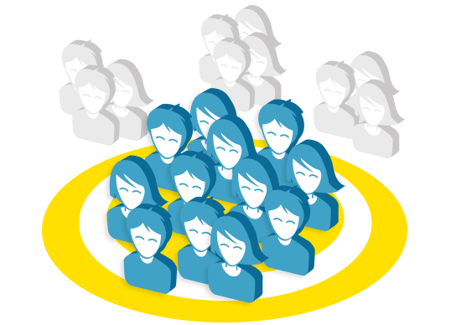


Slide 32
Segmentation
Segments must be graspable
Different - different responses to the marketing mix
Identity - the possibility to determine who falls into a particular segment
Adequate size - economically acceptable

Slide 33
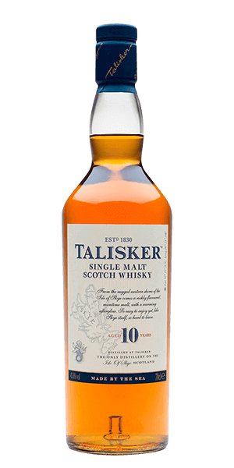
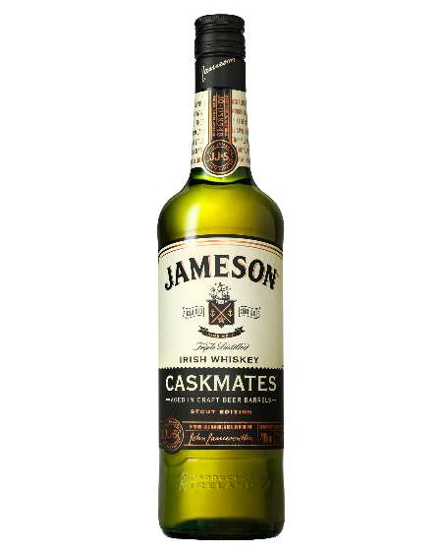
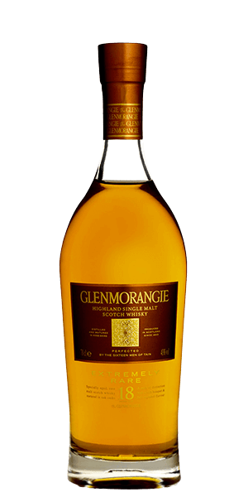
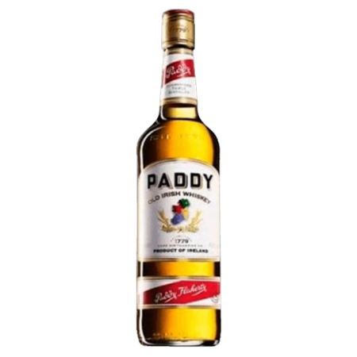
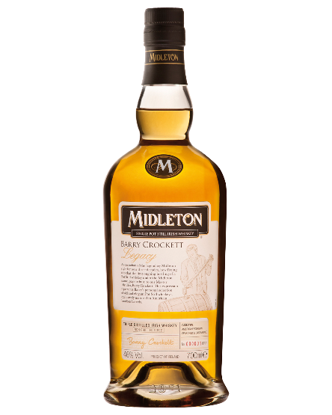
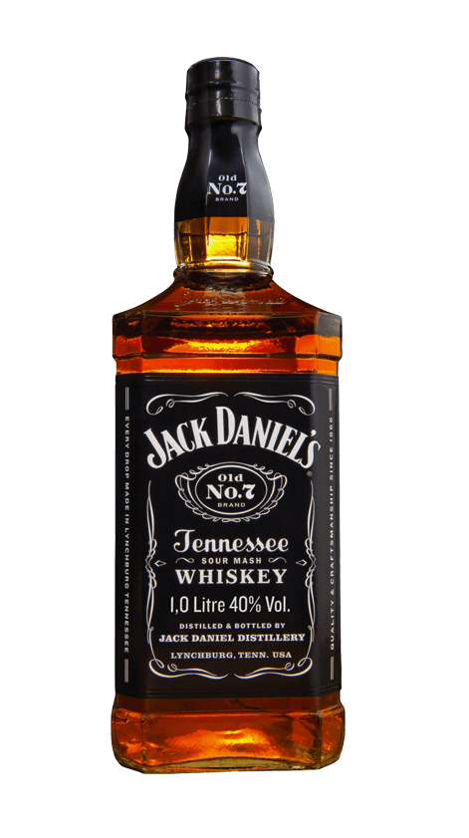
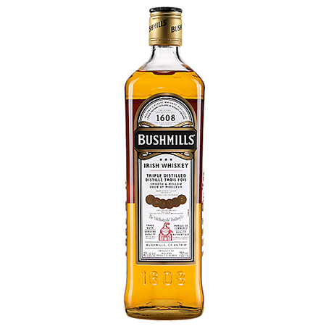
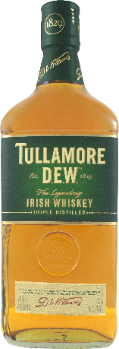
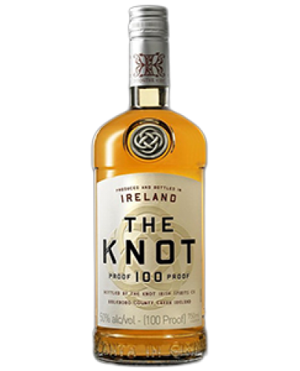
Segmentation limits
Not all categories can be easily segmented!
Research has shown that whiskey customers are similar across brands:
  The only difference was between single malt and blended whiskey.
  However, there were no significant differences between the brands in terms of demographic, psychographic and reaction specifics.

Slide 34
Segmentation
Frequency of use
Markets can also be segmented based on whether they are occasional, regular, or frequent users of the product.
Frequent users represent only a small fraction of all customers, but usually account for a significant proportion of total consumption.
Frequent users are a very good source of feedback.
As a rule, they are much more demanding on product quality.

Slide 35
Segmentation
Loyalty status
This type of segmentation assumes that some consumers are:
completely loyal - they still buy the same brand,
loyal to two or three brands and occasionally buying another,
and others show no loyalty and always buy something else.
In English we talk about brand switches and brand loyals.
Loyalty programs are often used to increase loyalty.

Slide 36
Loyalty and intesity relationship
 | Low intensity | Medium intensity | High intensity
High loyalty
Medium loyalty
Low loyalty

Slide 37
 | Low intensity | Medium intensity | High intensity
High loyalty
Medium loyalty
Low loyalty

Slide 38
Intenity and loyalty matrix | Low Intensity 10pcs | Medium intensity 50pcs | High Intensity 90pcs
High loyalty 90% | 9 | 45 | 81
Medium loyalty 50% | 5 | 25 | 45
Low loyalty 10% | 1 | 5 | 9

Slide 39
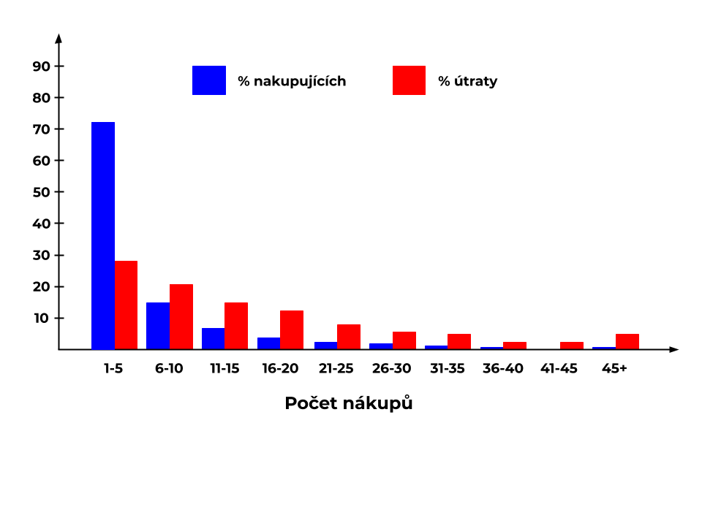
Segmentation by loyalty
Notes:
https://mumbrella.com.au/the-unbearable-lightness-of-buying-as-told-by-an-old-jar-of-pesto-550525

Slide 40
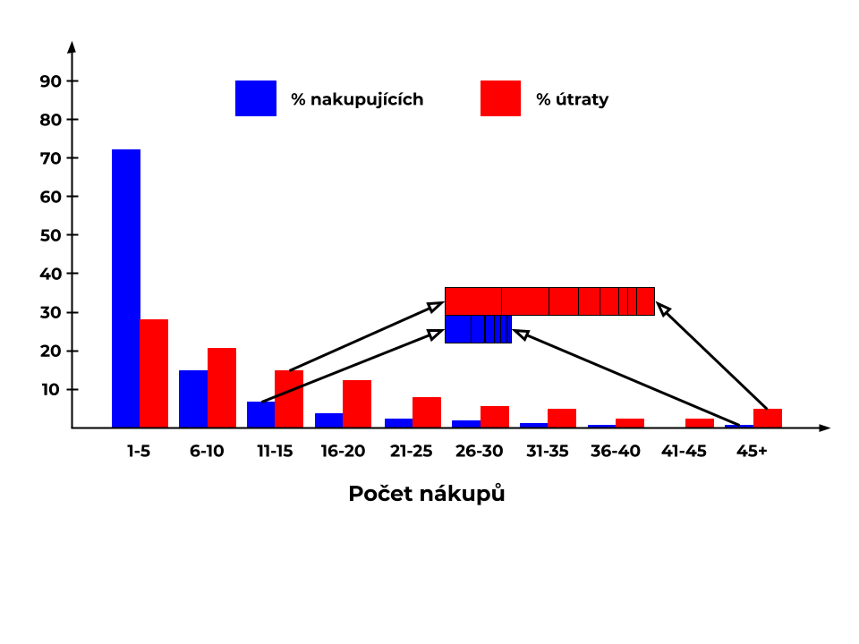
Segmentation by loyalty
Notes:
https://mumbrella.com.au/the-unbearable-lightness-of-buying-as-told-by-an-old-jar-of-pesto-550525

Slide 41
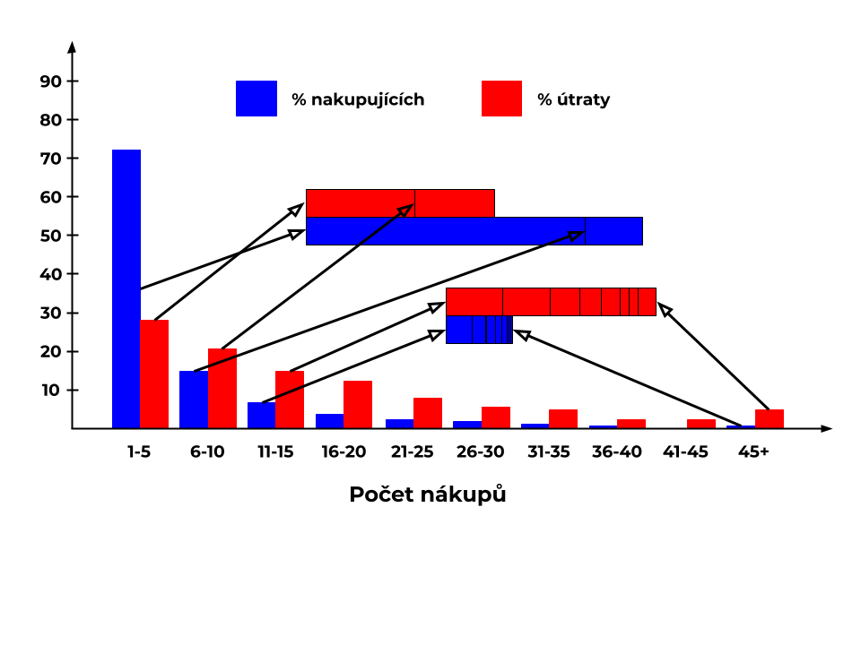
Segmentation by loyalty
Notes:
https://mumbrella.com.au/the-unbearable-lightness-of-buying-as-told-by-an-old-jar-of-pesto-550525

Slide 42
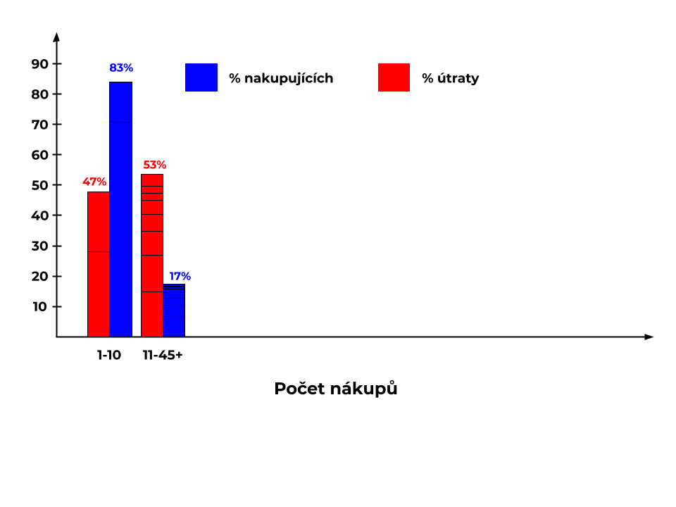
Segmentation by loyalty
Notes:
https://mumbrella.com.au/the-unbearable-lightness-of-buying-as-told-by-an-old-jar-of-pesto-550525

Slide 43
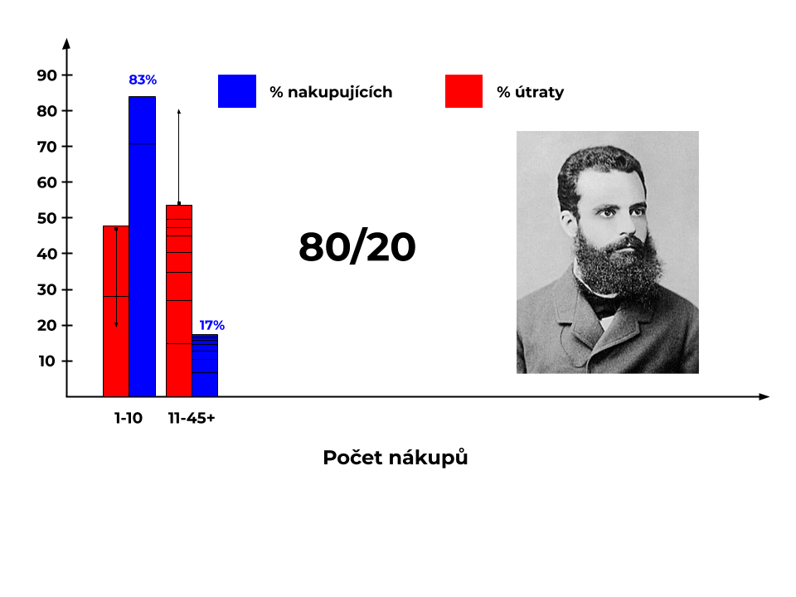
Segmentation by loyalty
X
Notes:
https://mumbrella.com.au/the-unbearable-lightness-of-buying-as-told-by-an-old-jar-of-pesto-550525

Slide 44

Segmentation by loyalty
Over 83% of the brand's customers accounted for almost half of sales.
Andrew Ehrenberg presented these conclusions as early as the 1960s.
Pareto's division in marketing does not apply, instead of 20/80 it is rather 20 / 50-60.
Notes:
https://mumbrella.com.au/the-unbearable-lightness-of-buying-as-told-by-an-old-jar-of-pesto-550525

Slide 45
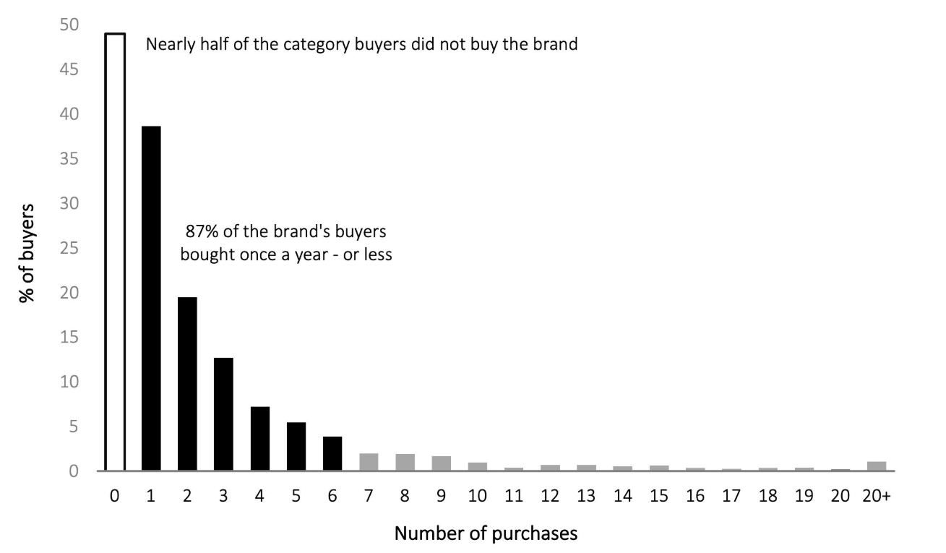

Segmentation by loyalty
Notes:
https://mumbrella.com.au/the-unbearable-lightness-of-buying-as-told-by-an-old-jar-of-pesto-550525

Slide 46
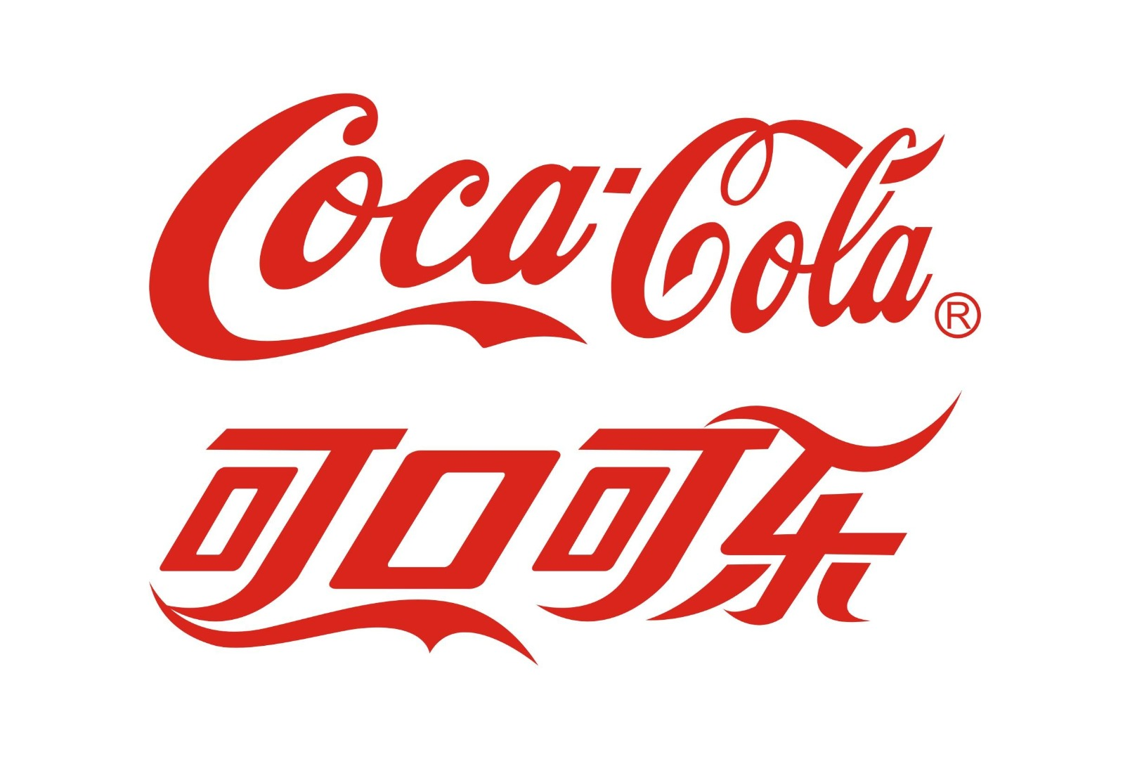

Slide 47
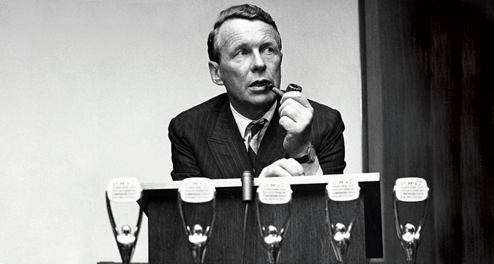
Brand
Brand is what remains when your factory burns down
Notes:
David Ogilvy

Slide 48
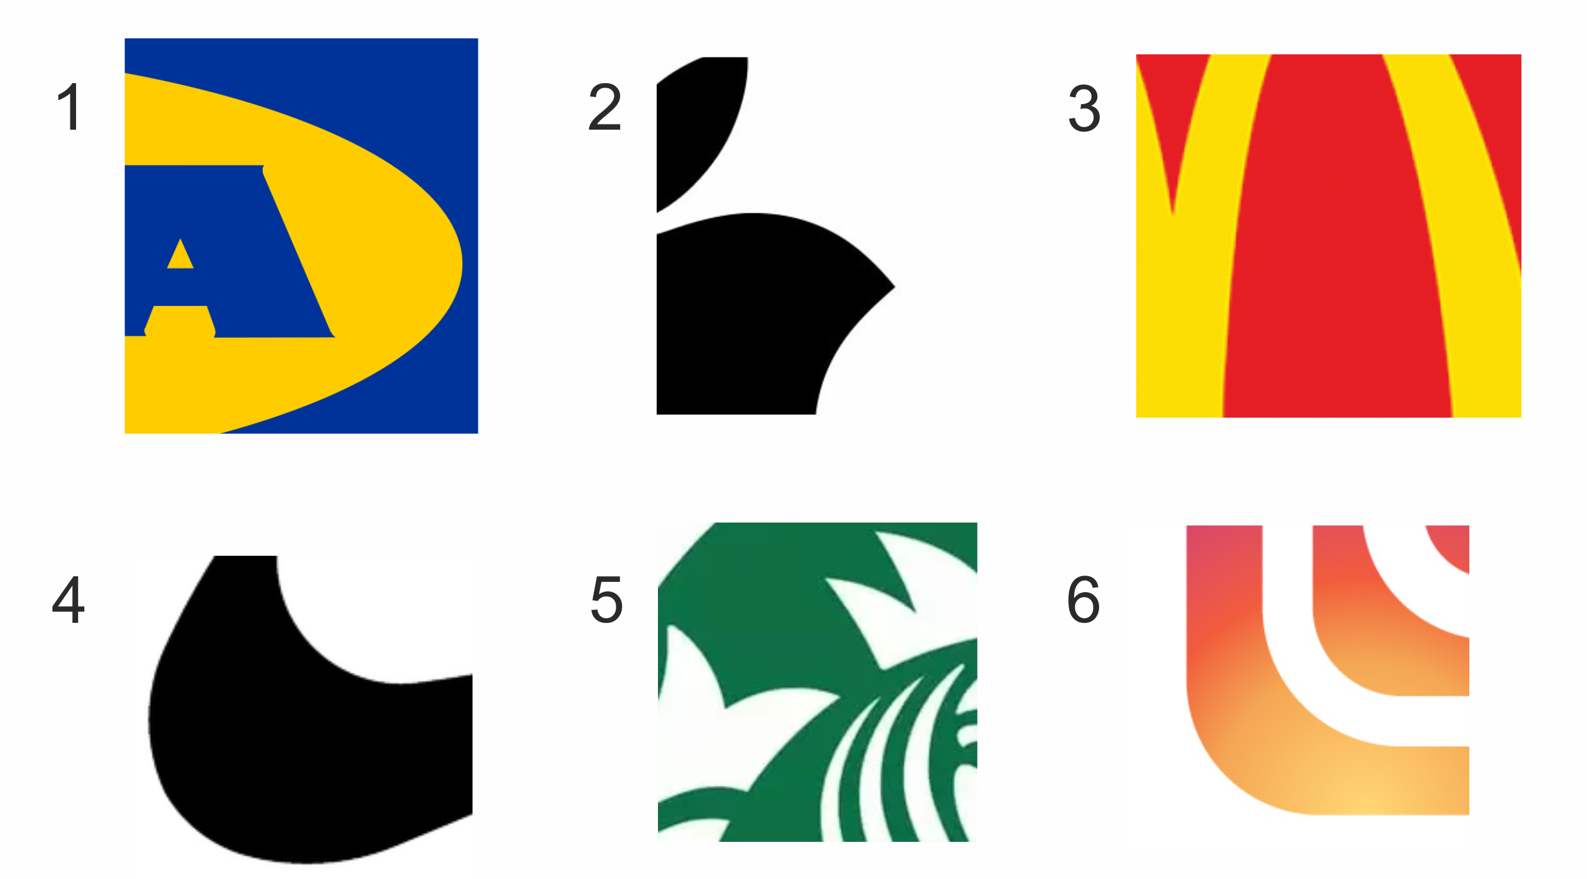

Slide 49


Brand characteristics
Brand assets
  Tangible
    Logo
    Name
    Colours
    Font
  Intangible
    Brand promise
    Brand story
Brand awarness
  Brand recall
  Brand recognition
Brand image
  Number of associations
  Strenght of associations

Slide 50

Simplicity
Availibility
Brand associations
Lower quality
Casual clothes
Auntie Emily
All the time the same
Nicky Minaj

Slide 51
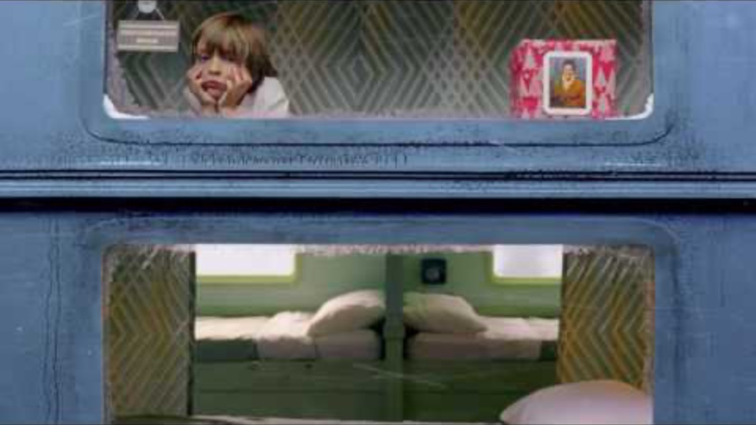

Slide 52
Adrien Brody
Simplicity
Availibility
Brand associations
Lower quality
Casual clothes
Auntie Emily
All the time the same
Nicky Minaj

Slide 53
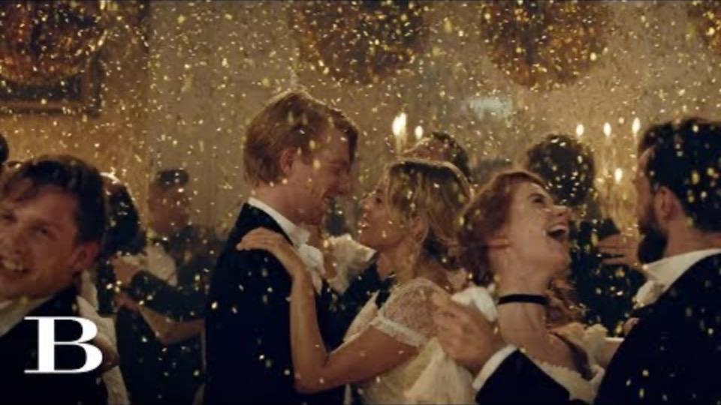

Slide 54










Slide 55
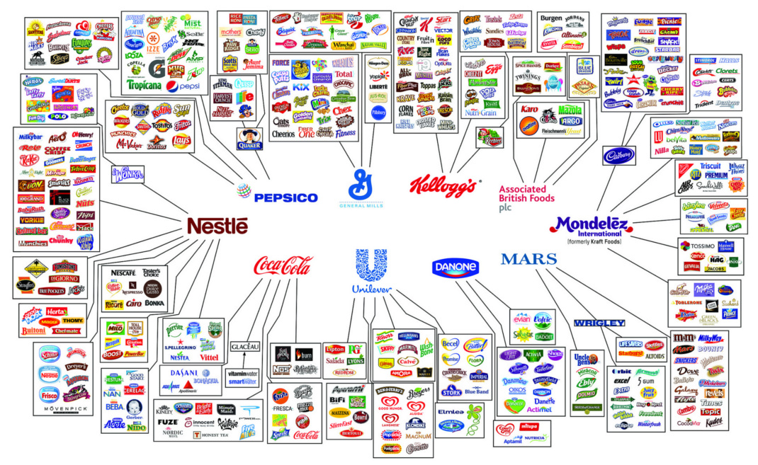
Notes:
Illusion of choice

Slide 56

Thank you for your attention

