Slide 1

Trade Organizations
Marketing research in retail

Slide 2
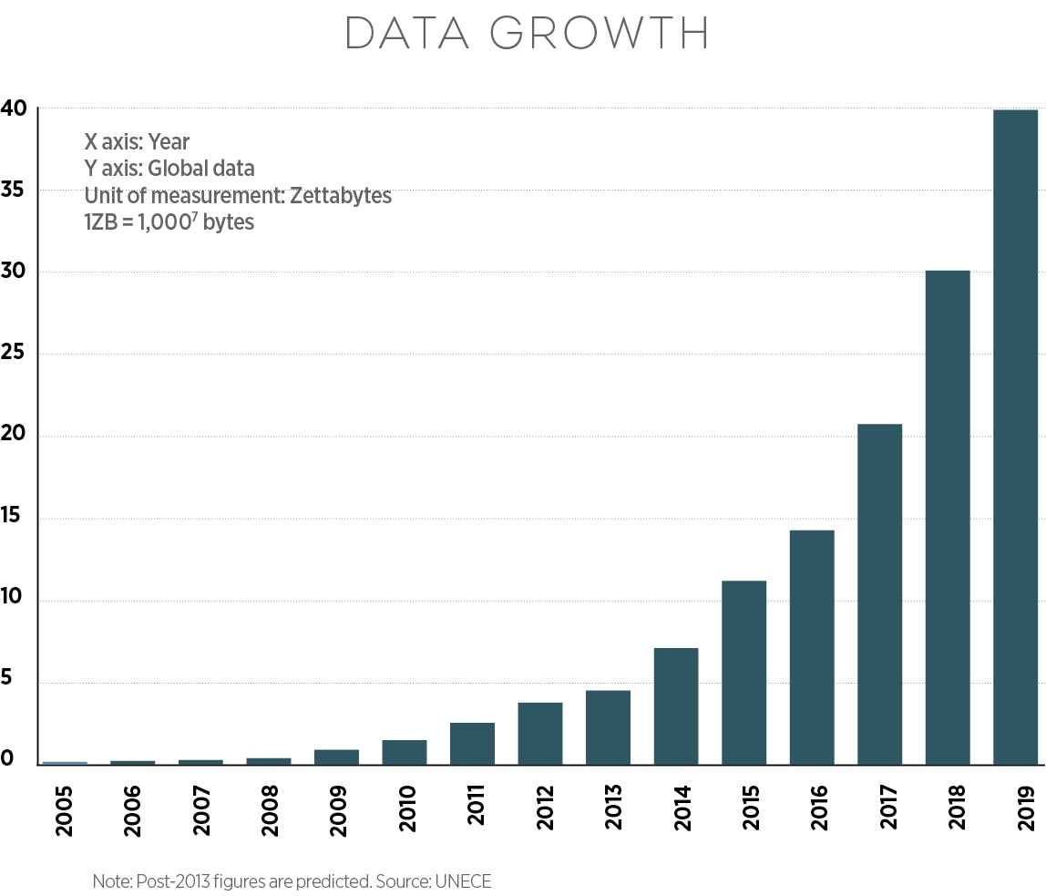
Data, information, knowledge

Slide 3
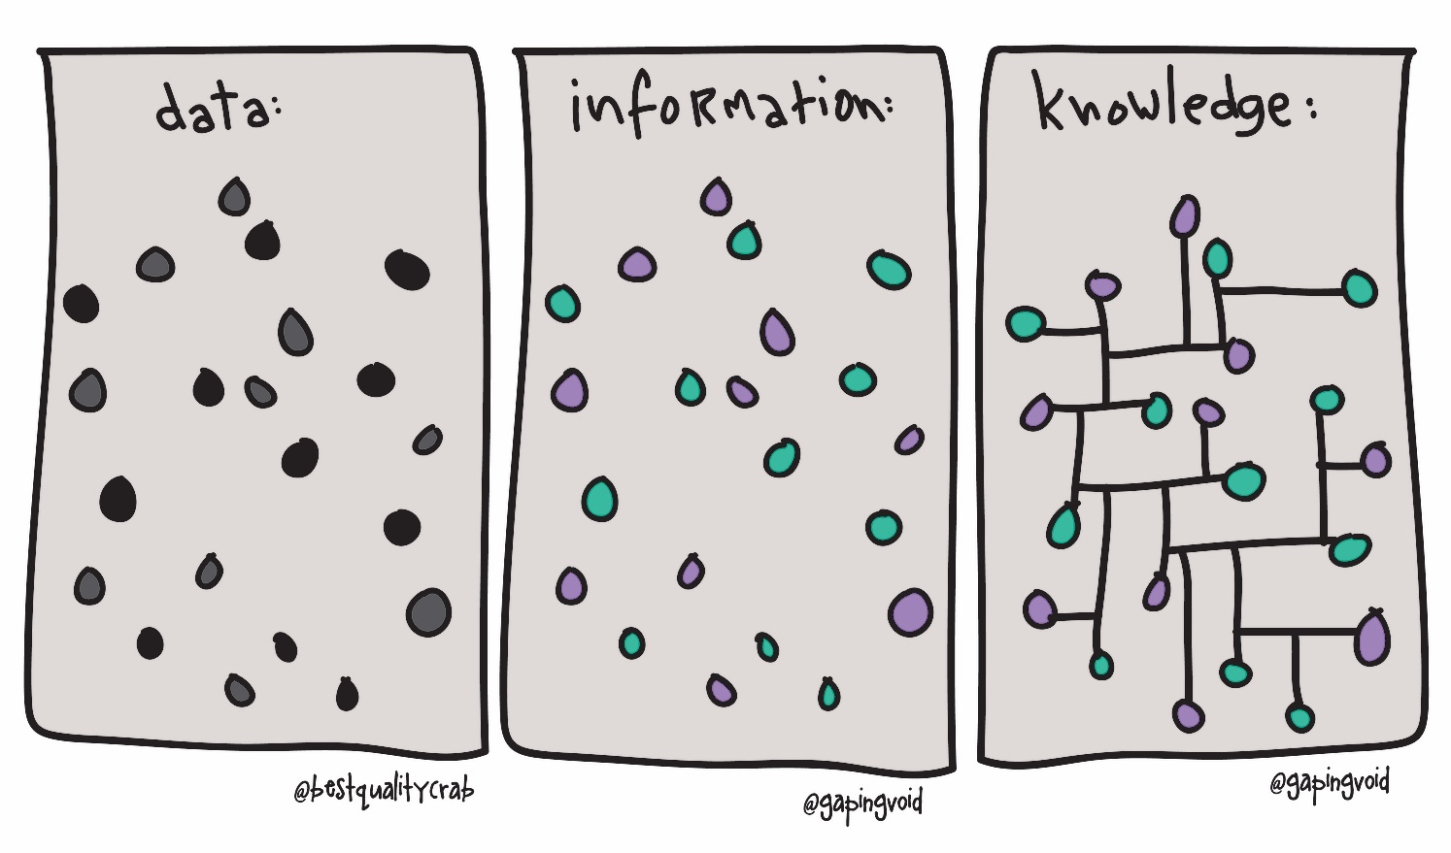

Slide 4
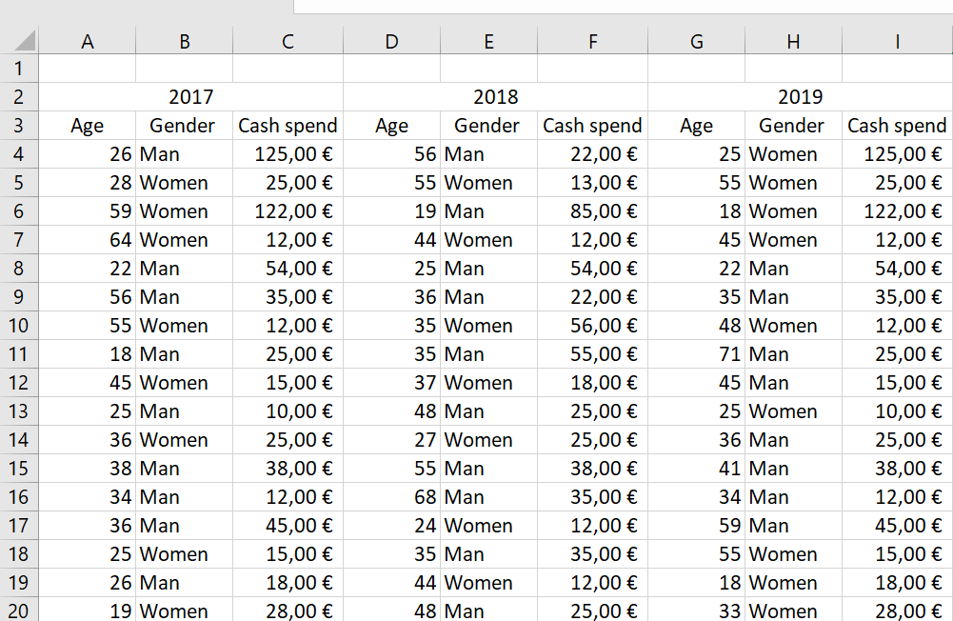
Can we make decision based on these customer data?

Slide 5
Age | 2017 | 2018 | 2019
18-29 | 15% | 10% | 6%
30-39 | 18% | 13% | 13%
40-49 | 26% | 22% | 15%
50-59 | 18% | 24% | 21%
60-69 | 15% | 18% | 25%
70+ | 8% | 13% | 20%

Slide 7
Notes:
Propojením informací vznikají znalosti.
Informace je základní stavební kámen komunikace

Slide 8
Data and information differences
Data is the most basic form of knowledge, e.g. the brand of butter sold to a particular customer in a certain town. This statistic is of little worth in itself but may become meaningful when combined with other data.
Information is a combination of data that provide decision-relevant knowledge, e.g. the brand preferences of customers in a certain age category in a particular geographic region.

Slide 9
Goals of marketing research
Understand the market
  Present
  Future
Identify threats and opportunities
Formulate marketing actions and assess its effectiveness

Slide 10
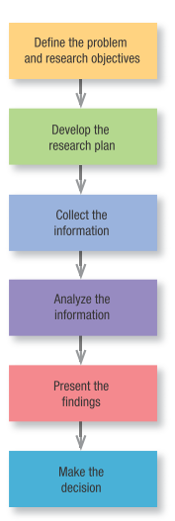
Marketing research process
PREPARATION PHASE
  Problem definition
  Situation analysis
  Research project planing
  Pre-research
REALISATION PHASE
  Data collection
  Data processing
  Analysis and interpretation
  Visualisation and presentation

Slide 11
Problem definition
Most important part of the research project
Well defined problem is half-solved
There are no bad answers in marketing research, only bad questions

Slide 12
Case study 1: Retailer introducing new store brand
Retailer asked marketing research company to do taste research on their new product.
There were three new flavours of their soft drink: mango, banana and pineapple.
Research company offered sample of all three flavours to 350 people and 43% chose banana flavour.
Company introduced new flavour and failed miserably.
What are the possible causes of this unsuccessful product launch?

Slide 13






Marketing research:
In-house or agency?

Slide 14


Slide 15


BRIEF
Business problem
Know-how
RESEARCH PLAN
ORDER
RESEARCH REPORT
Knowledge
$$$ $$$ $$$

Slide 16

What is brief?
Well defined assignment for agency is fundamental!
Good breif consist of:
  Well defined request for the agency.
  Clearly stated goals
  Reasoning why do we need to carry research project
  Defined context of a problem
  Defined target group and methodology requirements
  Clearly defined outcome with acceptation criteria
  Timeframe, budget and team allocation

Slide 17
Research question
Research question is a clear statement of the problem formulated in sentence ending with question mark.
Clear expression of what will be studied (Kolb, 2008)
It influence whole research process:
  What literature we have to study in advance?
  How we design research scope?
  What access to the date do we need to negotiate?
  What type of research design will be chosen?
  What data will be needed?
  Sample selection process.
  Nature of a final report.

Slide 18
Research question examples
What?
  What make our clients leave for our competition?
When?
  When do our clients visit our store for the first rebuy?
Where?
  Where exactly Instagram influencers buy fashion products?

Slide 19
Research question examples
Who?
  Who spreads negative brand sentiment online?
How?
  How product rebranding influenced attitudes of general public?
Why?
  Why do companies outsource marketing research?

Slide 20
Research types
Quantitative
  Based on numbers
  Measurement and counting
  Large sample size
Qualitative
  Based on text, sound, video and pictures
  Interpretation
  Small sample sizes

Slide 21
Exploratory
Explanatory
Descriptive

Slide 22
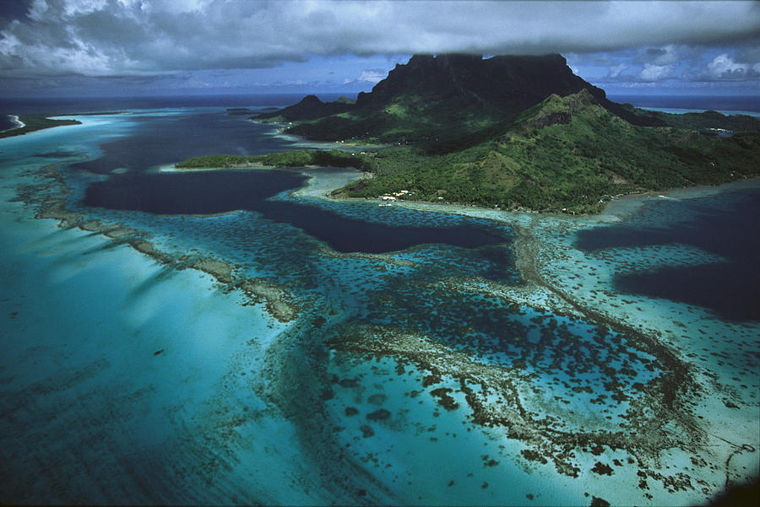

Slide 23
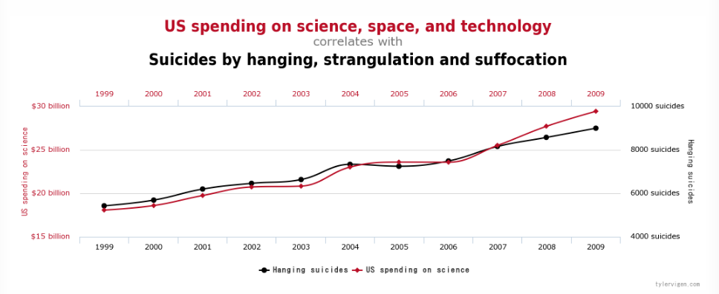

Slide 24
Problems with causality
For example, a correlation has been found between having breast implants and suicide (Koot, Peeters, Granath, Grobbee, & Nyren, 2003).
However, it is unlikely that having breast implants causes you to commit suicide – presumably, there is an external factor (or factors) that causes both; for example, low self-esteem might lead you to have breast implants and also attempt suicide.

Slide 25
Research types
Primary data
  Do not exist at the beginning of the research project
  Data collected throughout the project
Secondary data
  Data already existing
  Reports, statistical data, business data, reused data, analytical data.

Slide 26
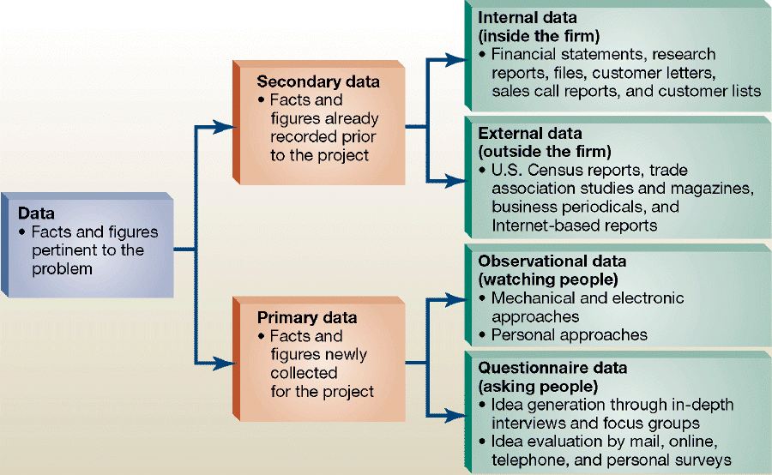

Slide 27
Sample and sample size
Sample is a part of population which, when collected properly, can produce results which are generalizable.
Greater the sample size more reliable the results are.
Reality = Parametr + Error
Population
People
Data
Statistics
Parametr
Sample

Slide 28
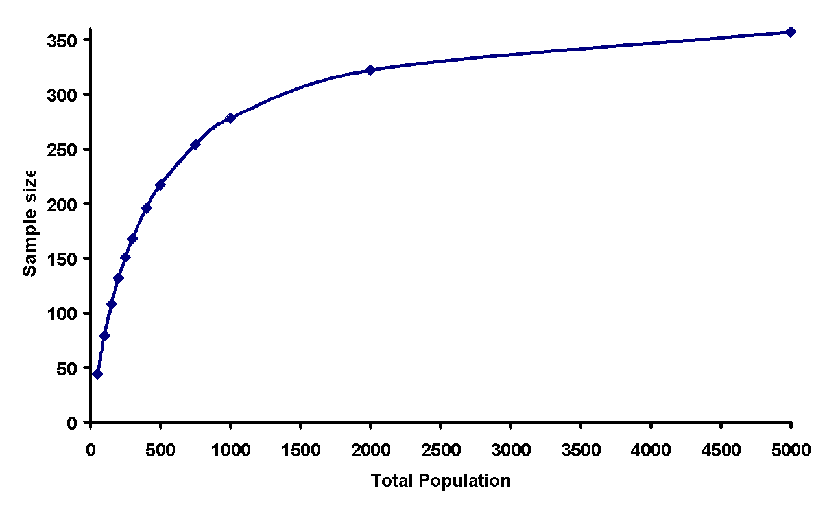
Ideal sample size

Slide 29
Favourite colour example
In a class, teacher ask students what is their favourite colour.
The realtime results goes like this:
Respondent | Answer | Results PINK in % | Results GREEN in % | Change
1 | Pink | 100 | 0 | No data
2 | Green | 50 | 50 | 50%
3 | Green | 33,5 | 66,5 | 16,5%
4 | Pink | 50 | 50 | 16,5%
5 | Green | 40 | 60 | 10%
6 | Green | 33,5 | 66,5 | 6,5%
7 | Green | 28 | 72 | 5,5%
8 | Pink | 37 | 63 | 9%
9 | Pink | 44 | 56 | 7%
10 | Pink | 50 | 50 | 6%

Slide 30
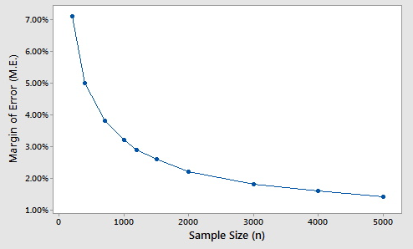
Margin of error
It is statistic expressing the amount of random sampling error in a survey's results.
The larger the margin of error, the less confidence one should have that the reported research results are close to the "true" figures; that is, the figures for the whole population.

Slide 31
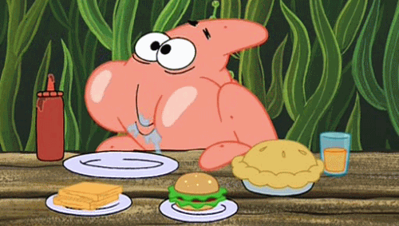
Sample size in qualitative studies
The data collection takes place as long as there is no condition in which further examination of the selected sample does not bring new substantial information.
Theoretical saturation
The goal of qualitative research is not generalization, so it is not the aim of the results to relate to the whole population but to reveal the connections and causes of a certain behavior of customers.

Slide 32
Primary data collection methods
Survey
  Interview
  Questionnaire
Observation
Experiment

Slide 33

Survey vs. Observation
Coop Jednota
Distant learners in UK

Slide 34
Data collection techniques - qualitative
Deep interviews
Focus group discussions
Expert consultations
Observation

Slide 35
Data collection techniques - quantitative
Face to face interviews
Telephone interviews
Postal survey
Electronic survey
Observation
Experiment

Slide 36

Data collection techniques - specifics for retail

Slide 37
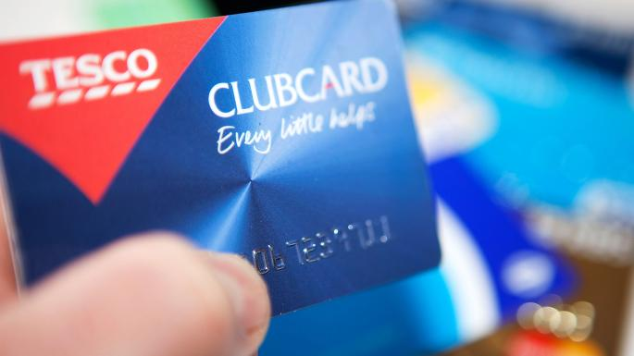
Data collection techniques - specifics for retail

Slide 38
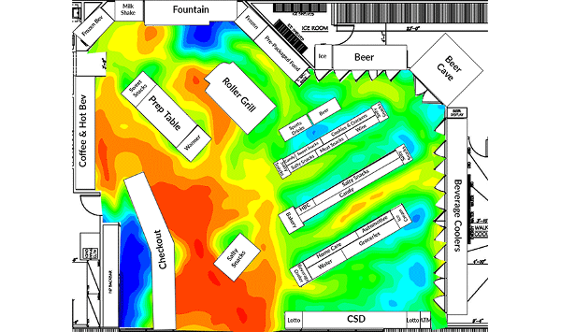
Data collection techniques - specifics for retail

Slide 39
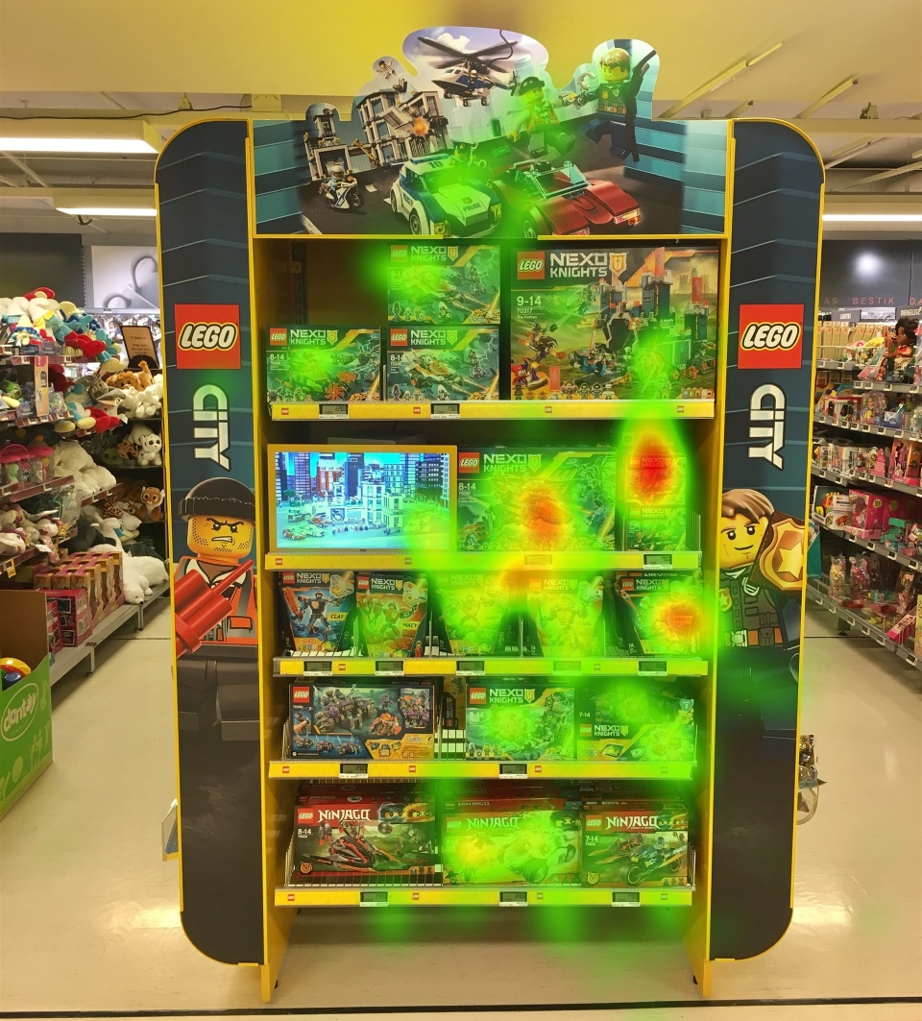
Data collection techniques - specifics for retail

Slide 40
Case study 2: Pepsi challenge
Famous Pepsi challenge research showed some disturbing results. Despite the leading position of Coca cola, during the blind taste tests people prefered Pepsi.
Based on few sips of Coke and Pepsi, consumers immediately chose Pepsi for its sweater taste. Coca cola reacted quickly with brand new product: New Coke.
However, market shares dropped down immediately and the new taste was not accepted by the customers as managers predicted.
What are the possible causes of this unsuccessful product launch?

Slide 41
Validity
Valid questions are those that give us answers exactly what we ask - what is the main goal of research.

Slide 42
Reliability
It expresses the degree of sustainability of research tools.
To what extent the question remains reliable and still valid in further iterations - for example, in other time, social and cultural conditions.

Slide 43
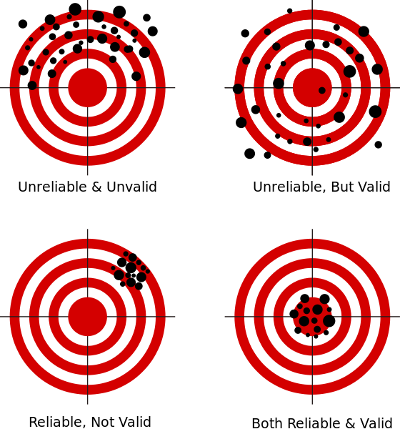

Slide 44
Experiential excercise assignment
The students in each class will be organized into teams. Each team of students will visit a chosen retail shop in Karviná (Tesco, Lidl, Kaufland, Hruška, Billa) and observe the retail mix adopted by the store (i.e. merchandise, location, customer service, store design, pricing and promotion). The team should further examine the competitive advantages compared to other stores that sell similar merchandise. You may purchase some products by yourself and analyze the purchase experiences to assist your evaluation of the retail mix.
Each team will present the findings in the class (about 20 minutes for each team) and make recommendations on how the chosen retailer might improve the retail mix in order to achieve growth in sales or profit.

Slide 45
Experiential excercise assignment
Merchandise – width and depth of the product portfolio in categories: shampoo, milk, toothbrush.
Location – strengths and weaknesses
Customer service level
Store design type
Sales promotion – what products, where and how.
Competitive advantages compared to other stores that sell similar merchandise.

Slide 46
Thank you

