Slide 1
Trade Organizations Retail types

Slide 2
Typology of retail stores
There are 7 main types of retailers which can be defined by the size of their business and the way they in which they sell their products:
Department Store
Supermarkets / Hypermarkets
Warehouse retailers
Speciality retailers
Speciality warehouse
Convenienec store
Discount retailer
E-tail

Slide 3
1. Department store
This type of retailer is often the most complex offering a wide range of products and can appear as a collection of smaller retail stores managed by one company.
The department store retailers offer products at various pricing levels.
This type of retailer adds high levels of customer service by adding convenience enabling a large variety of products to be purchased from one retailer.

Slide 4
1. Department store
Range of products: wide, deep including food, restaurant (refreshment), "comprehensive shopping under one roof„
Prices: medium and higher at medium and higher quality goods
Localization: city centers, regional shopping malls
Trends: stagnation due to the market saturation

Slide 5
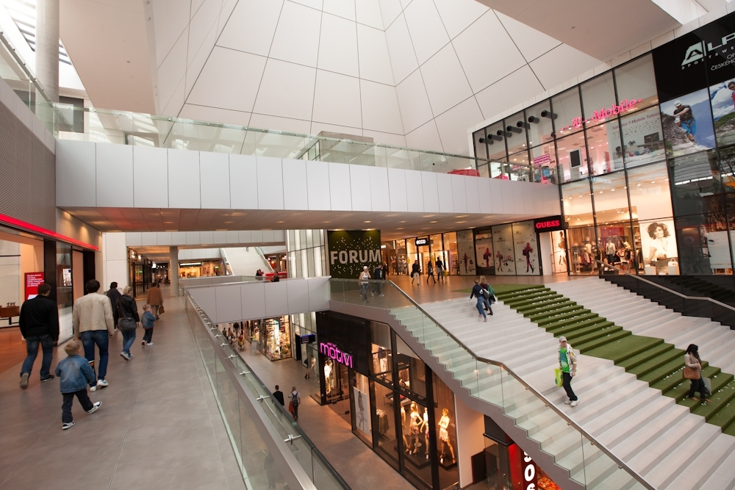

Slide 6
2. Supermarket/Hypermarket
Generally this type of retailer concentrates in supplying a range of food and beverage products.
However many have now diversified and supply products from the home, fashion and electrical products markets too.
Supermarkets and hypermarkets have significant buying power and therefore often retail goods with reasonable margin.
Supermarkets: 400 - 2 500 m²
Hypermarkets: from 2 500 m²

Slide 7
2. Supermarket/Hypermarket
Range of products: comprehensive range of food and basic non-food goods
Prices: medium at a standsrd quality level of goods
Localization: residential areas with an accessibility range of 400 - 700 m according to the density of the area, city boundaries with access roads and parking
Form of sale: self-service combined with counter sale
Trend: slows down due to saturation of the market, rebuilding and innovations are starting

Slide 8
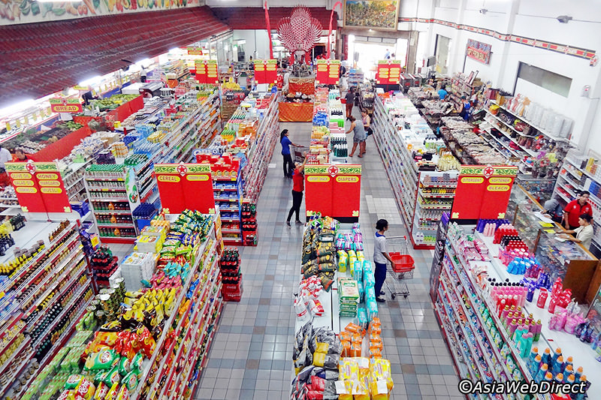

Slide 9
3 Warehouse retailers
This type of retailer is usually situated in retail or Business Park and where premises rents are lower.
This enables this type of retailer to stock, display and retail a large variety of good at very competitive prices.

Slide 10
3 Warehouse retailers
Range of products: comprehensive range of food and basic non-food goods
Prices: lower due lower logistic expenses
Localization: suburbs, city exits with access roads and parking
Form of sale: self-service
Trends: stagnation due to increasing customer convenience requirements

Slide 11
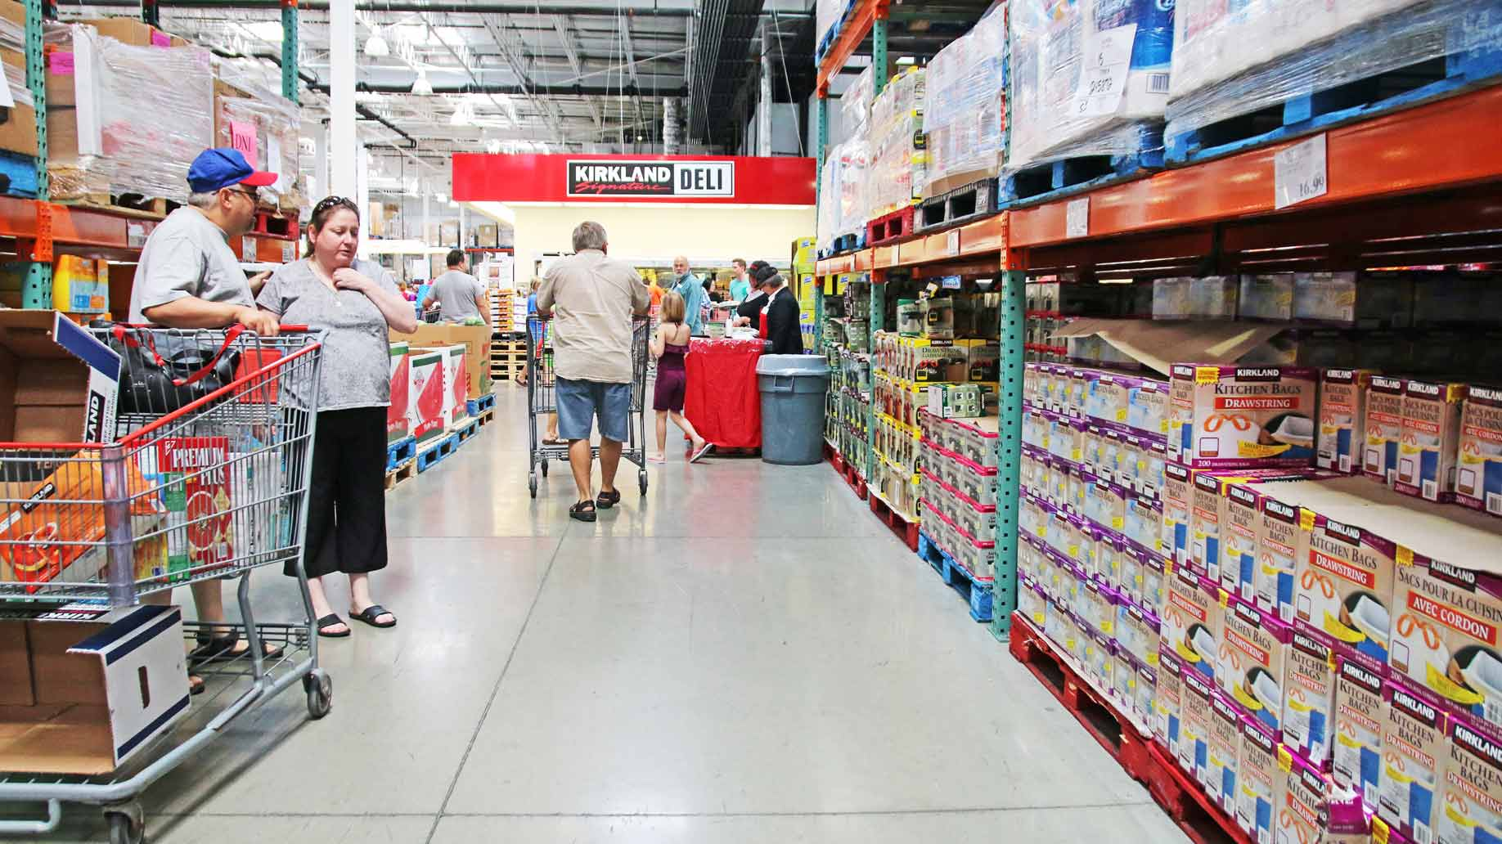

Slide 12
4 Speciality retailers
Specialising in specific industries or products, this type of retailer is able to offer the customer expert knowledge and a high level of service.
They also add value by offering accessories and additional related products at the same outlet.
Examples are cycling, skiing, office supplies, footwear, fashion, computer technology, cosmetics, photo.

Slide 13
4 Speciality retailers
Range of products: very narrow with considerable depth, goods of occasional and long-term consumption prevail
Prices: higher, sales with specialized services (costs of professional staff)
Localization: city centres and shopping malls, deparmtent stores
Trend: growing

Slide 14
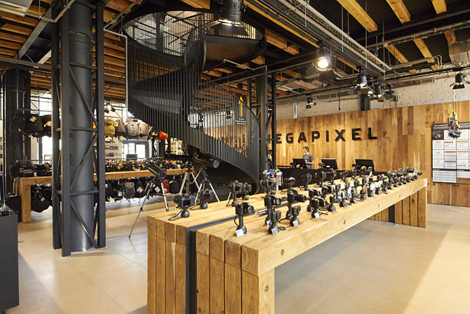

Slide 15
5 Speciality warehouse
Specialising in specific industries or products, this type of retailer is able to offer the customer expert knowledge and a high level of service.
From 800m² and more.
Examples are IKEA, HORNBACH, DECATHLON, OBI, SCONTO.

Slide 16
5 Speciality warehouse
Range of products: very narrow with considerable depth
Prices: low to medium
Localization: suburbs, city exits with access roads and parking
Form of sale: self-service
Trends: fast development at the expense of specialized stores

Slide 17
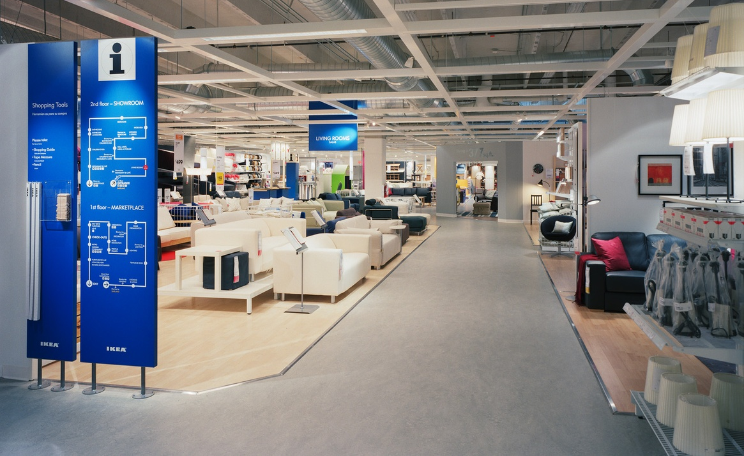

Slide 18
6. Convenience retailer
Usually located in residential areas this type of retailer offers a limited range of products at premium prices due to the added value of convenience.
Some of them has long open hours and provide customers with products of daily consumption.

Slide 19
6. Convenience retailer
Range of products: medium wide with a small depth, focusing on daily necessities with a significant dominance of food
Prices: higher
Localization: countryside and less dense urban areas
Form of sale: self-service combined with counter sale
Trends: decrease due to the concentration of supermarkets and shopping centers

Slide 20
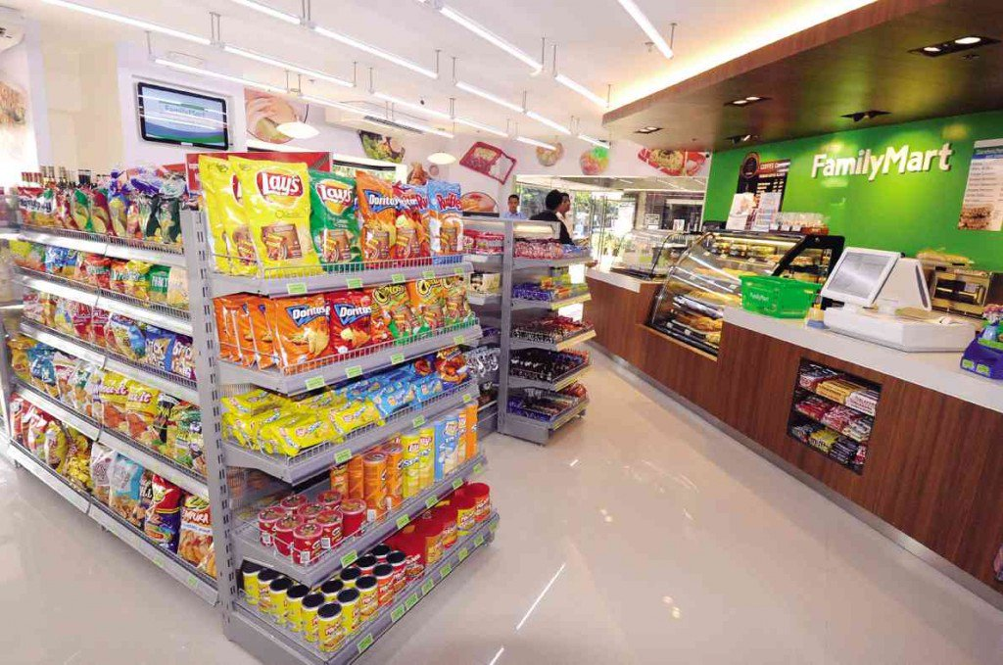

Slide 21
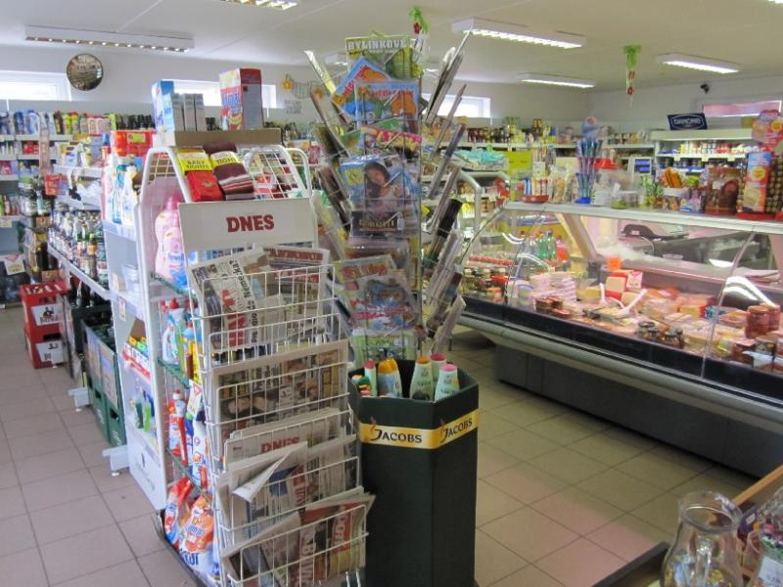

Slide 22
7. Discount retailer
This type of retailer offers a variety of discounted products.
They offer low prices on less fashionable branded products from a range of suppliers by reselling end of line and returned goods at discounted prices.

Slide 23
7. Discount retailer
Range of products: up to 800 items, narrow with a small depth
Prices: lower
Localization: residential areas with an accessibility range of 400 - 700 m according to the density of the area, city boundaries with access roads and parking
Form of sale: self-service
Trends: stagnation

Slide 24
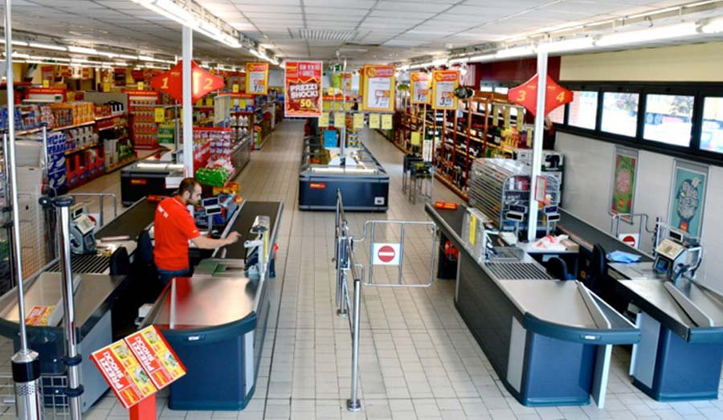

Slide 25
8. E-tailer
This type of retailer enables customers to shop on-line via the internet and buy products which are then delivered.
This type of retailer is highly convenient and is able to supply a wider geographic customer base.
E-tailers often have lower rent and overheads so offer very competitive pricing.

Slide 26
8. E-tailer
E-tail is emerging and complementing (not replacing) brick and mortar.
Drugs, fresh fruits and vegetables are convenient to buy offline.
Electronics, hobby and books are good examples of e-tail use.

Slide 27
Excercise
Work in pairs or single
You will see several product categories
Match those with most convenient retail types
Prepare short talk with arguments why

Slide 28
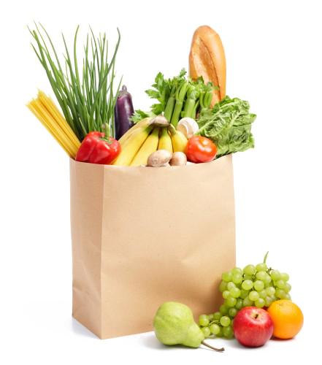
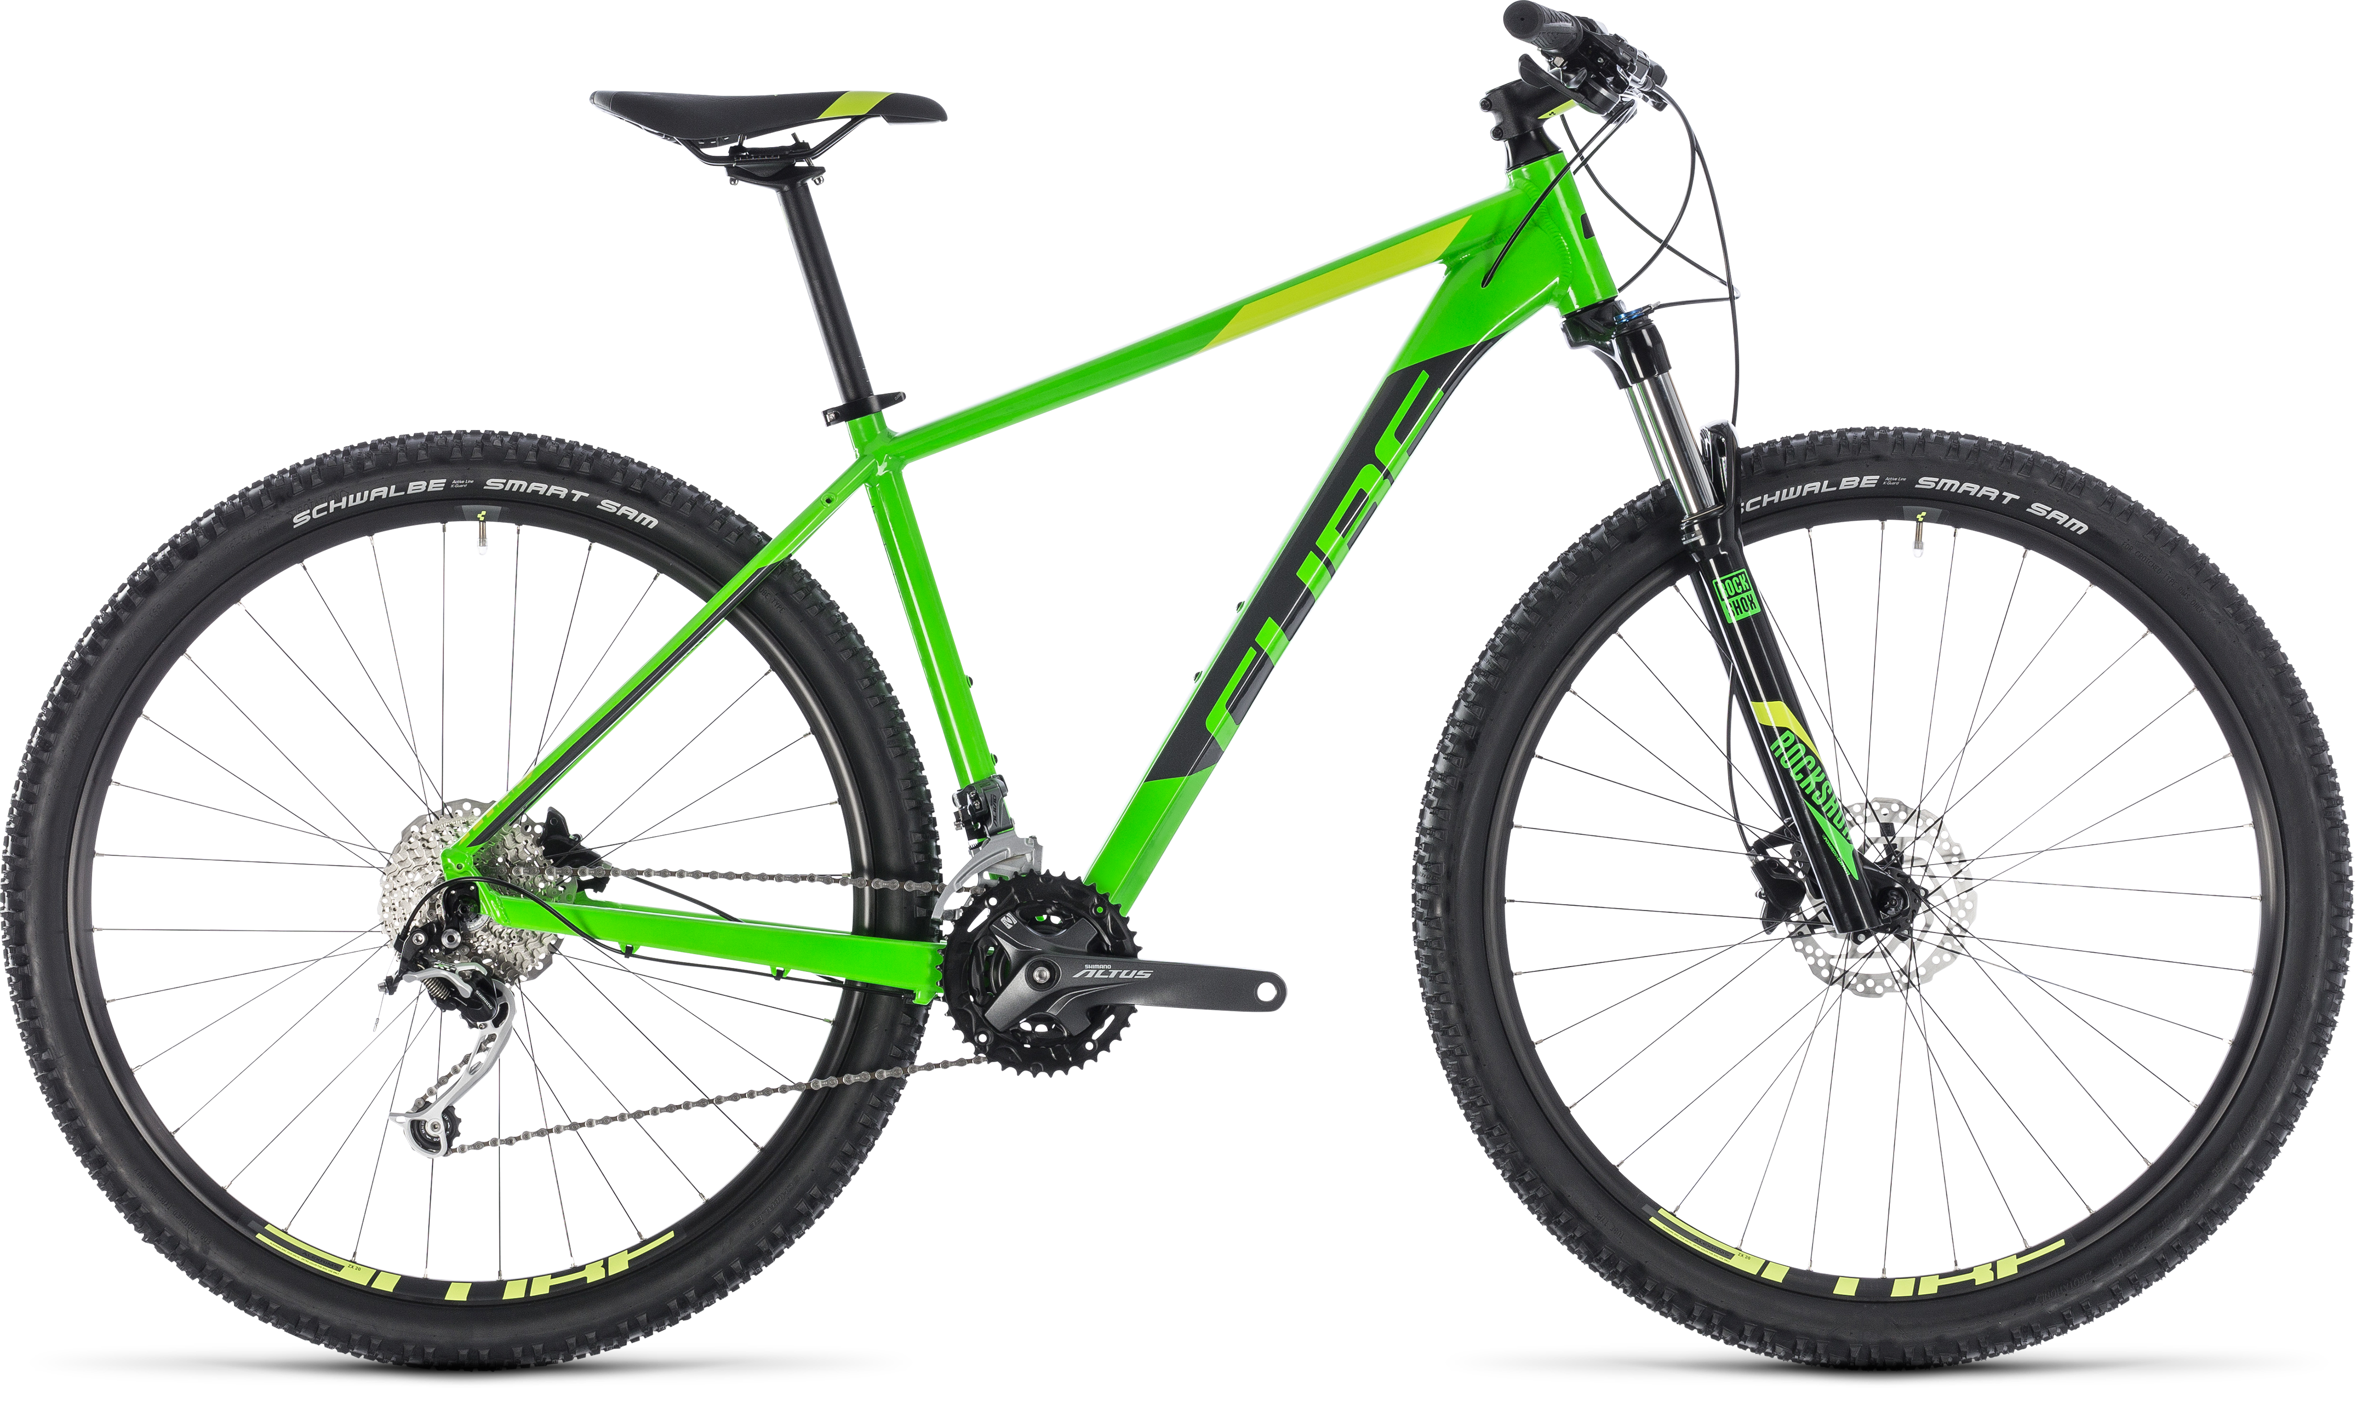
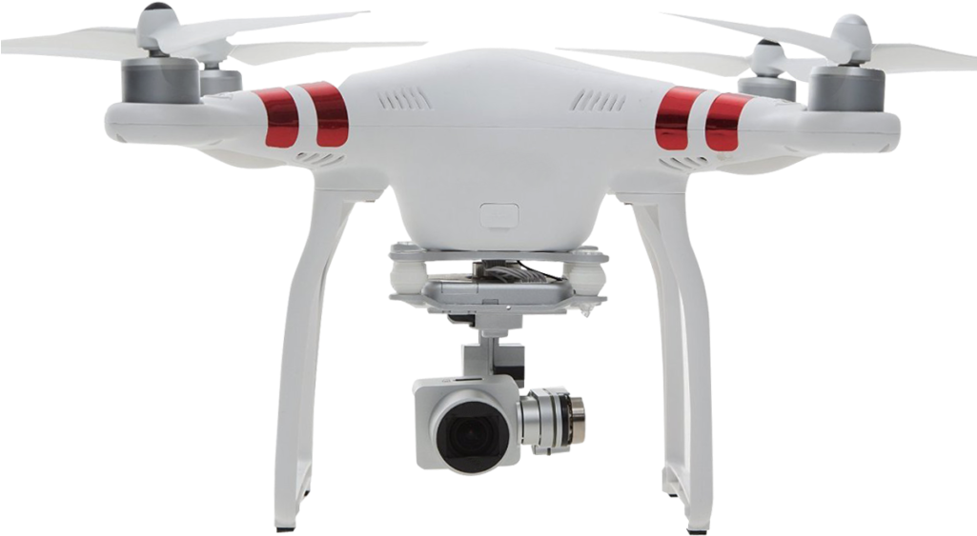
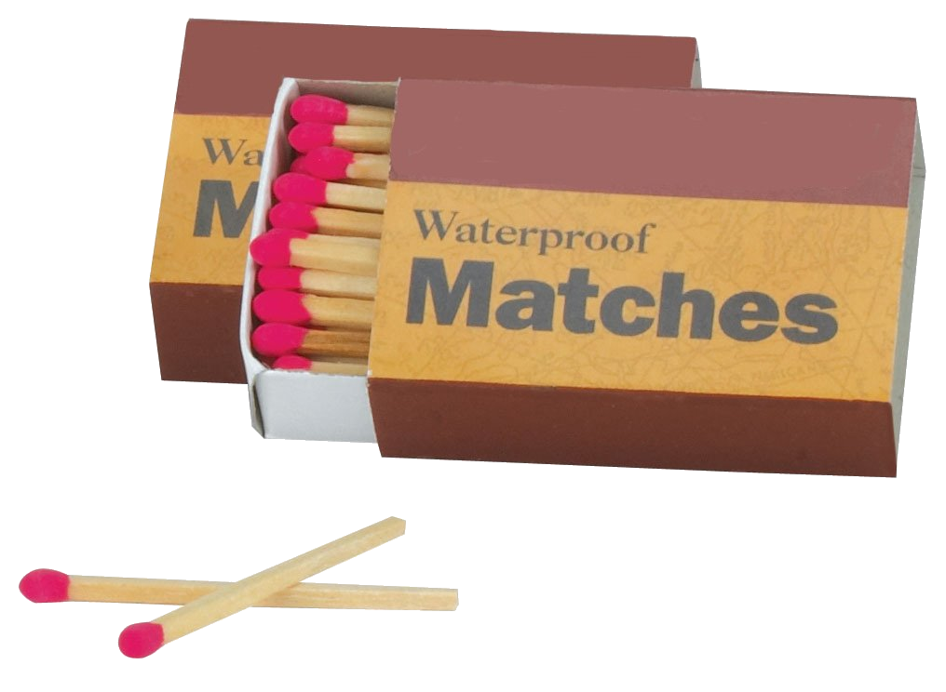
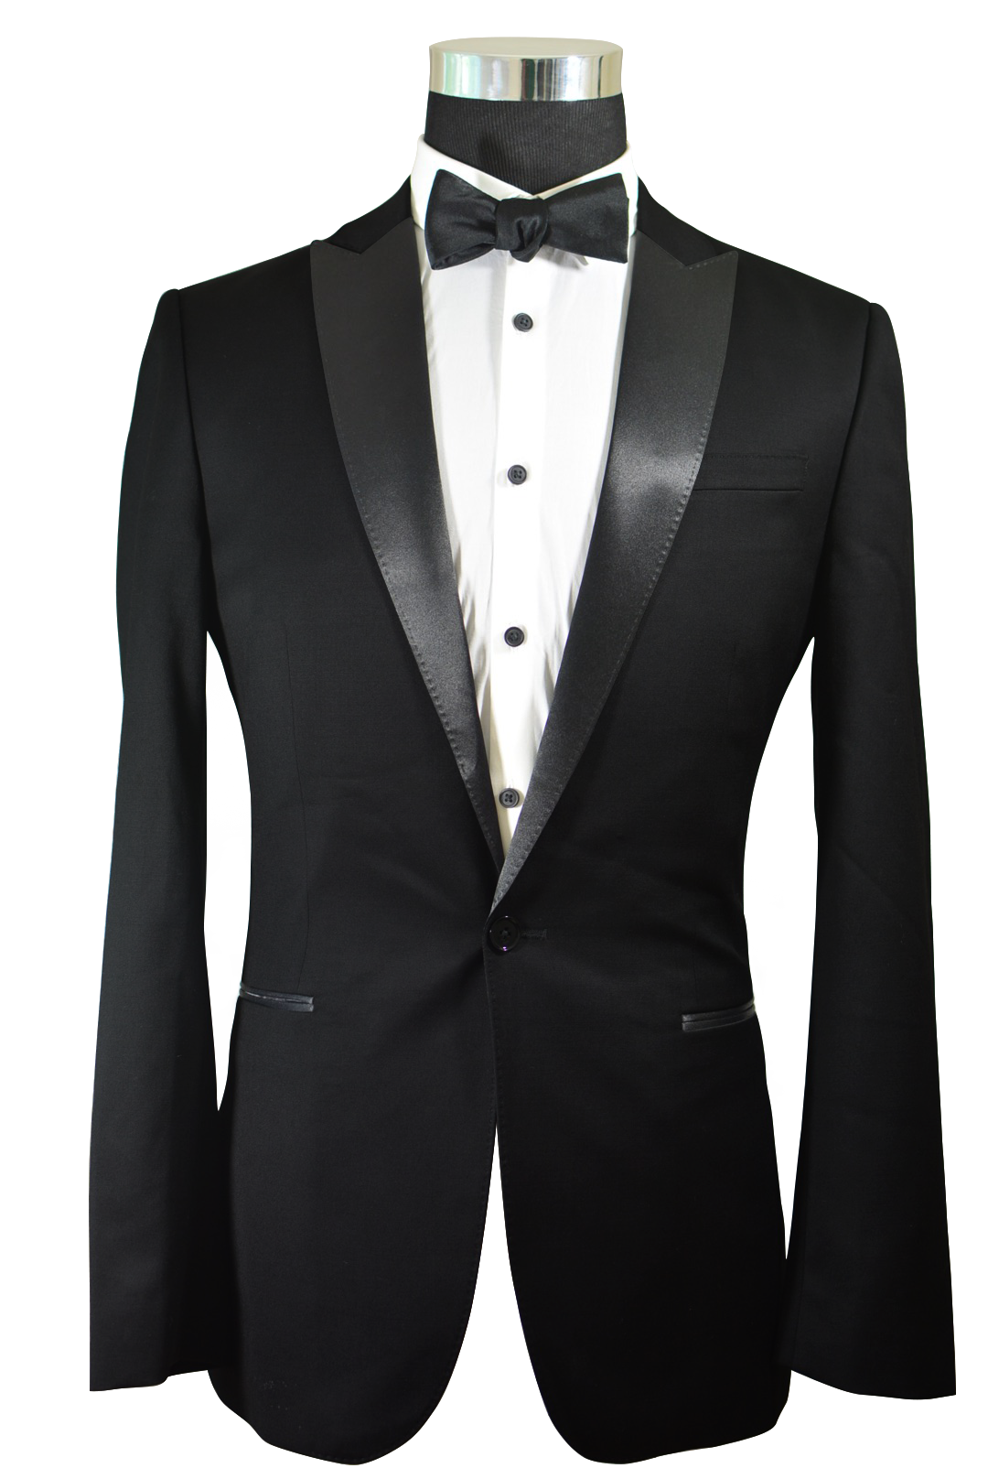
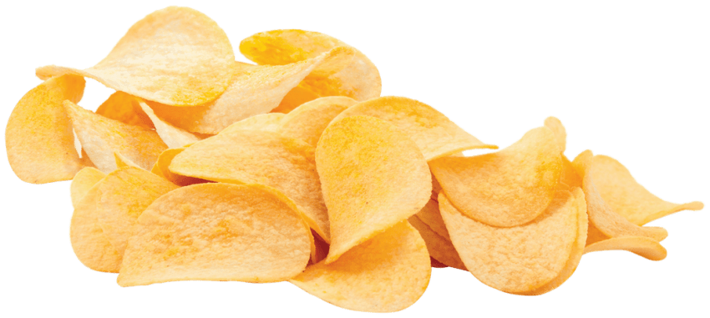
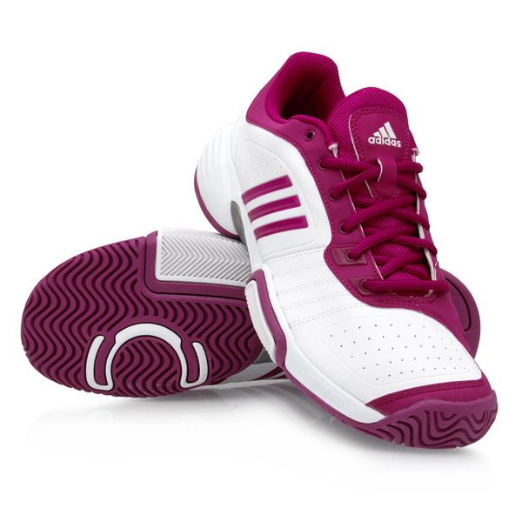
Products
Groceries
Mountain bikes
Drones
Water
Matches
Tuxedo
Chips
Running shoes

Slide 29
Thank you for your attention

