Slide 1

Trade Organizations
Store layout and retail laws.

Slide 2
Store layout
Factors influencing store layout design
Typology of stores
Examples and exercises

Slide 3
Factors influencing layout
External factors
  Competition in location
  Potential number of customers a day
  Type of product and its characteristics
  Entrance for deliveries - supply

Slide 4
Factors influencing layout
Internal factors
  Speed of movement of goods – replacement and delivery costs
  Number of employees
  Form of selling
  Expected structure of turnover

Slide 5
Basic rules
Good store layout design:
  Respects flow of customers
  Respects flow of employees
  Respects flow of goods

Slide 6
Types of layout
  Racetrack design
  Grid design
  Open design
  Counter store design
  Sector design

Slide 7
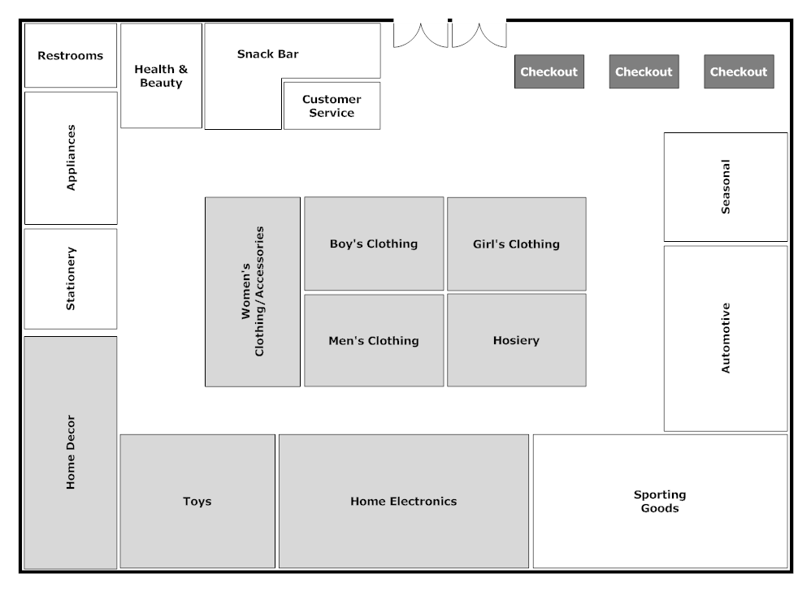
  Racetrack/loop design
Notes:
People are weird and irrational, and there’s much we don’t understand. Like why do shoppers moving in a counterclockwise direction spend on average $2.00 more at the supermarket?
https://conversionxl.com/blog/pricing-experiments-you-might-not-know-but-can-learn-from/

Slide 8
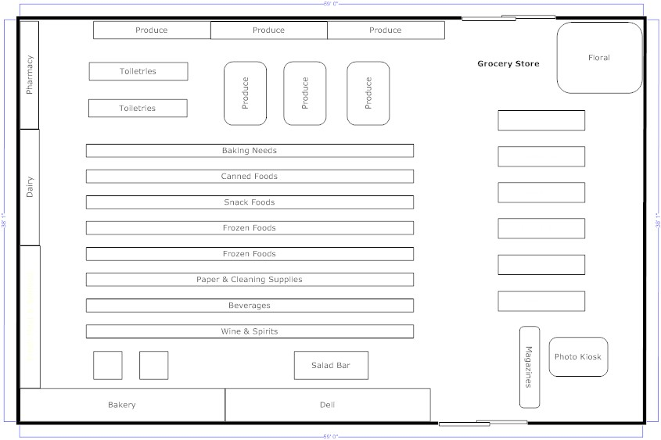
  Grid design

Slide 9
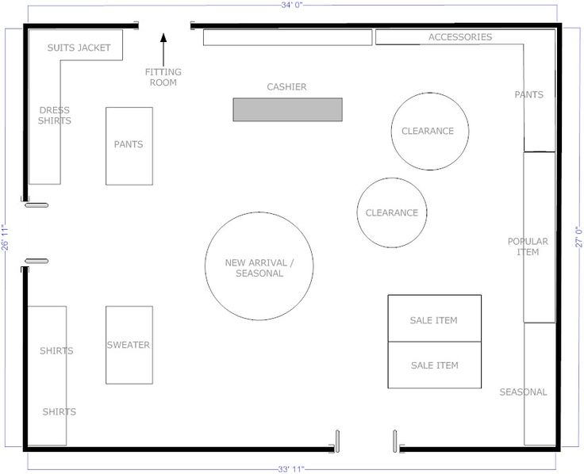
  Open design

Slide 10
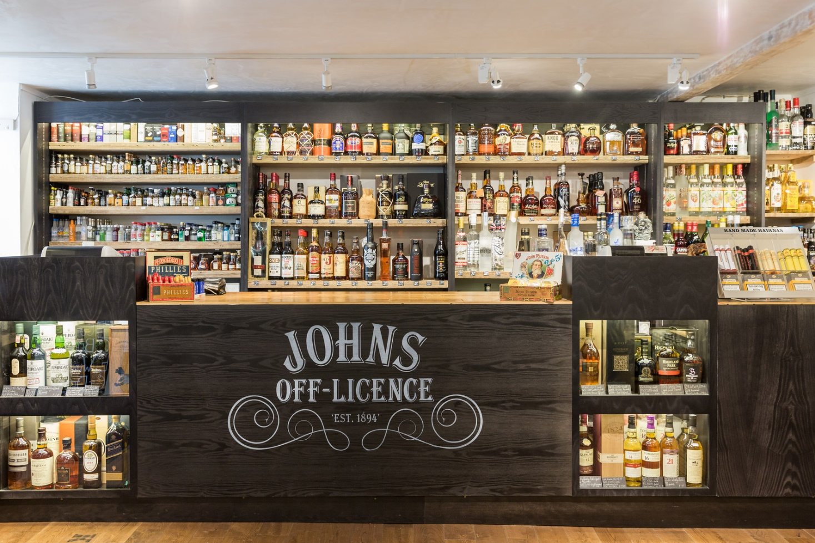
  Counter store design

Slide 11
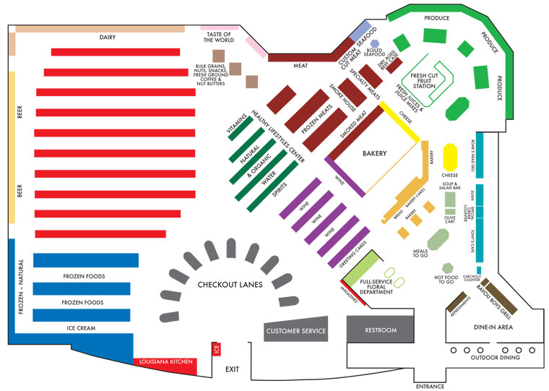
  Sector store design

Slide 12
FIND exapmles
  Racetrack design
  Grid design
  Open design
  Counter store design
  Sector design

Slide 13
Environment Influencers
  Shelf positions
  Music
  Smell
  Light
  POS/POP materials

Slide 14
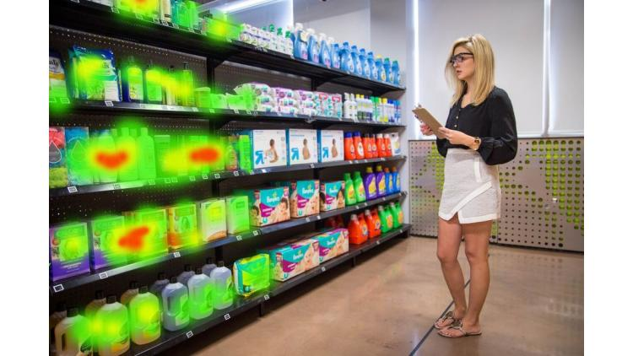
Environment Influencers
  Shelf positions

Slide 15
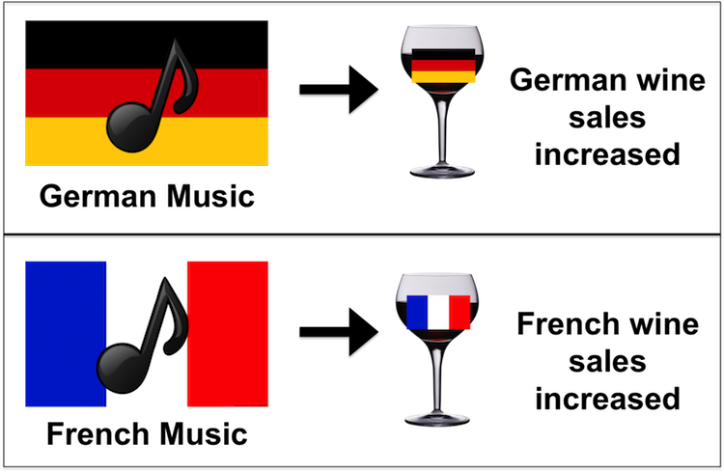
Environment Influencers
  Music
North, A. C., Hargreaves, D. J., & McKendrick, J. (1999). The influence of in-store music on wine selections. Journal of Applied Psychology, 84(2), 271-276.

Slide 16
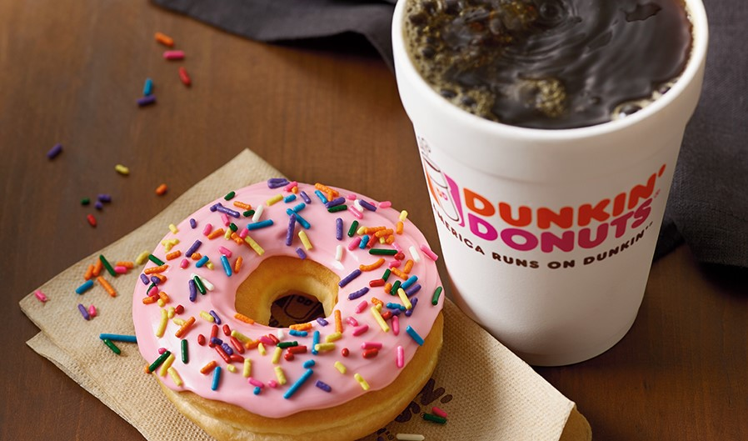
Environment Influencers
  Smell
Dunkin 'Donuts has announced that total traffic in South Korea has increased by 16% and sales by even 29%!
Notes:
https://www.youtube.com/watch?v=kmrc8ZJld8A
LIDL v CZ vůně kávy.

Slide 17
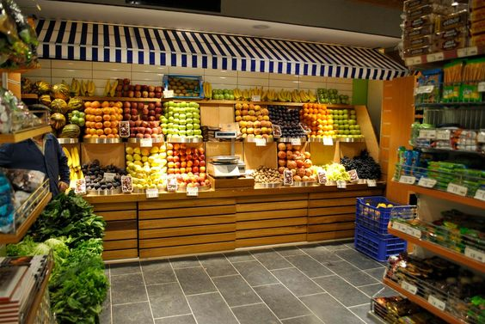
Environment Influencers
  Light

Slide 18
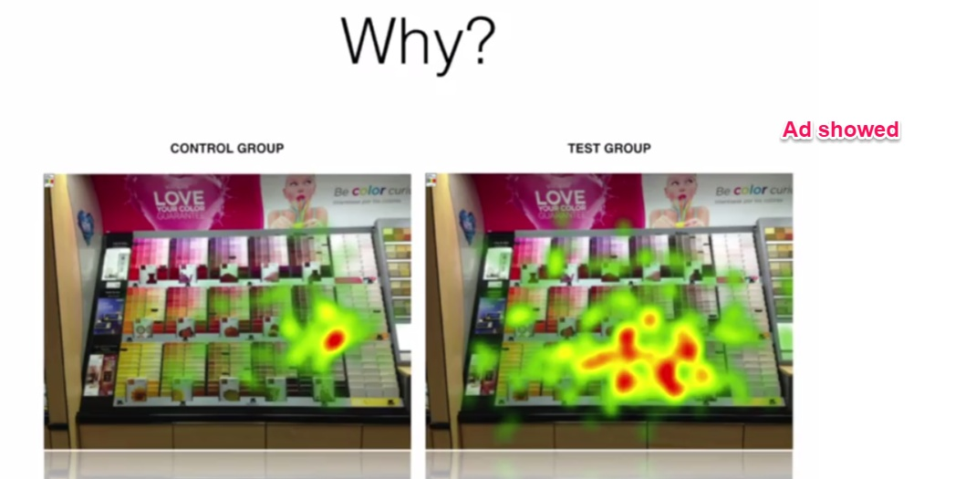
Environment Influencers
  Point of sale materials

Slide 19
Empirical retail laws

Slide 20
How to compete in retail?
Retail market is saturated in most developed countries
Competition is continuously trying to out-do each other with: better locations, new stores, improved layouts, technology, etc.
Larger market share store chains have larger customer bases (penetration) and slightly higher loyalty (both average purchase frequency and average share of department store shopping trips)

Slide 21
Background of the laws
Repeat-purchasing patterns that occur in brand buying also occur in store choice.
Studies shows this repetitive choices in many areas: Supermarket chains, Department stores, Petrol stations, Fast-food chains and Women's fashion boutiques.
It underlines the logic of habitual buying in category of FMCG

Slide 22
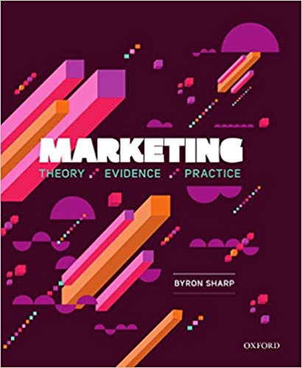
9 empirical laws of shopping in retail
Purchase goals
Mental and physical availability
Limited time
Many short trips
Selective purchasing
Top-selling items
Colors and symbols
Specials
Set paths

Slide 23
1. Purchase goals
Shoppers go to stores because the stores have something they want to buy.
Almost everyone enters a store with a purchase goal in mind (very often specific brand).
This mental list does not preclude them from buying other things.
Retailer advertising almost always shows product.
Primary source of shopper dissatisfaction is not being able to find the product they wanted to buy.

Slide 24
2. Mental and physical availability
Mental and physical availability largely determine store choice.
Customers need to know about you, and you must be at hand.
They miss your competitor on their way to your store only if it is not in their mental availability (store exist, store sells what they want).
Stores need to advertise to build memory structures.

Slide 25
3. Limited time
Shoppers only spend a certain amount of time in store.
If the entire purchase process takes time, customers buy less.
When they find what they need quickly, they tend to look after other goods.
At a time when most of the bite shopping time search products, customers spend much less money.

Slide 26
4. Many short trips
People make many short shopping trips and fewer longer shopping trips
15% shopping trips are to buy single item, even in supermarkets.
50% of them are for 5 or less items.
Frequently purchased items should not move – it extends search time.
Visible category and clearly labeled diagram of selling space.

Slide 27
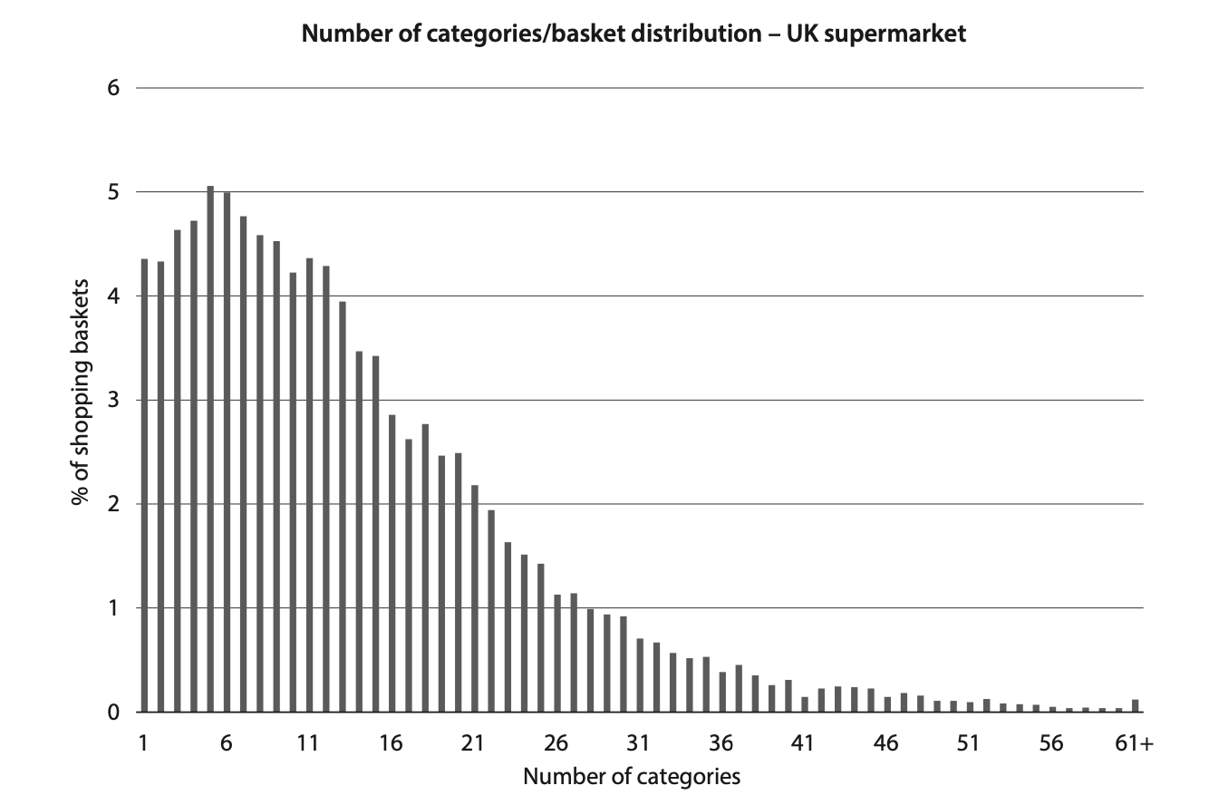
4. Many short trips

Slide 28
5. Selective purchasing
A typical household buys only 300 to 400 stock-keeping units from supermarket in an entire year.
Shoppers are very loyal to their set of favorite products.
Supermarkets offers up to 60 thousands of those items.
The amount the customer chooses the strategy of repeat purchases in places where he knows where to find products.
Again, be careful with moving products.

Slide 29
6. Top-selling items
While typical supermarket sells 30.000 to 50.000 items, the top-selling 1000 items will make up about half of the supermarket‘s sales
Best selling products should be accessible, not hidden in the most remote corner, as some traders do.

Slide 30
7. Colors and symbols
Shoppers read very little in store – instead they react to colors and symbols.
Eye-tracking studies show that customers read very little, and i so, they carefully choose what to read – to save their shopping time.
Colors and symbols are ways to streamline shopping with minimal time loss for the customer.

Slide 31
8. Specials
Shoppers have been trained to buy specials
Highlighting discounts, special offers, news, best selling goods, etc. can help in this effort.
Brand sold in special offer must be known - research shows that people who do not have a brand in mind rarely respond to these offers.

Slide 32
9. Set paths
Shoppers follow pathways of open space, and the checkout is a magnet.
Shoppers speed up towards checkouts.
Monitoring customer pathways is an important part of the design shopping area.
In heat maps we can see most frequently visited space for important products.

Slide 33

Thank you for your attention

