Slide 1
Internal Micro Analysis
Ing. Michal Stoklasa, Ph.D.
Strategic Marketing/subject code

Slide 2
Internal Micro Analysis
Outline of the lecture
Internal Micro Analyses.
SWOT analysis.
Strategic Business Units and their Portfolio Analyses.

Slide 3
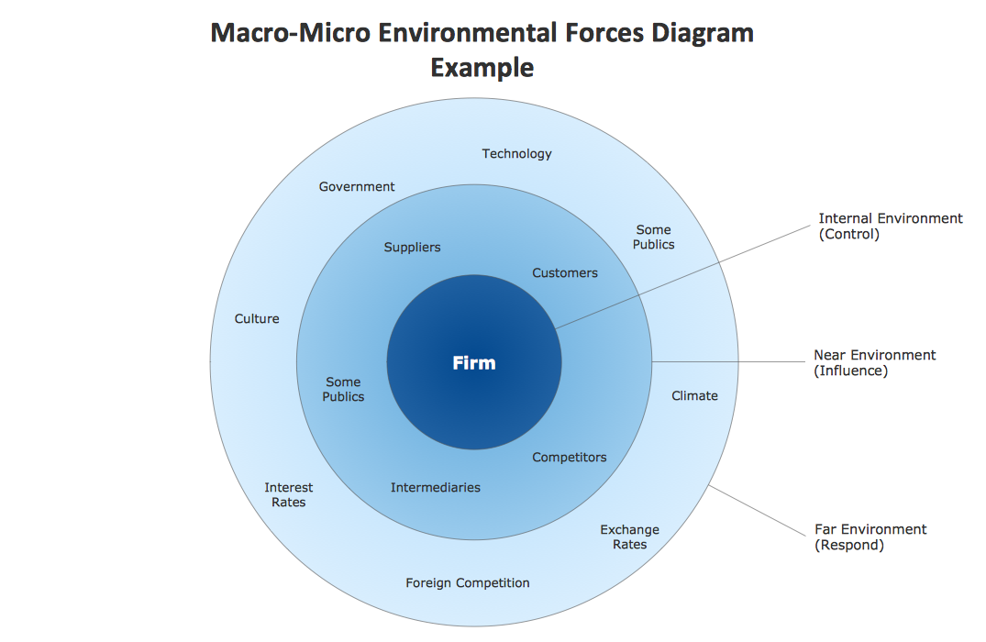
Internal Micro Analysis
MARKETING ENVIRONMENT

Slide 4
Internal Micro Analysis
1. INTERNAL MICRO ANALYSES
Analysis of business potential - resources management, financial resources, human capacity, innovation, information.
Majority of these analyses are part of Management courses, so we will go through only the basics!
Marketing mix - 4P vs. 7P vs. 4C.
SWOT analysis - one of the simplest analysis, able to provide the basics for decision making.
Strategic Business Units (SBU) and their Portfolio Analyses – BCG Matrix, GE Matrix.

Slide 5
Internal Micro Analysis
2. SWOT ANALYSIS
SWOT analysis summarizes main internal strengths and weaknesses, and main threats and opportunities coming from marketing environment of company.
SWOT analysis is a part of a situational analysis, usually its the summarization of all the previous analyses we have conducted.
S = STRENGTHS
W = WEAKNESSES
O = OPPORTUNITIES
T = THREATS

Slide 6
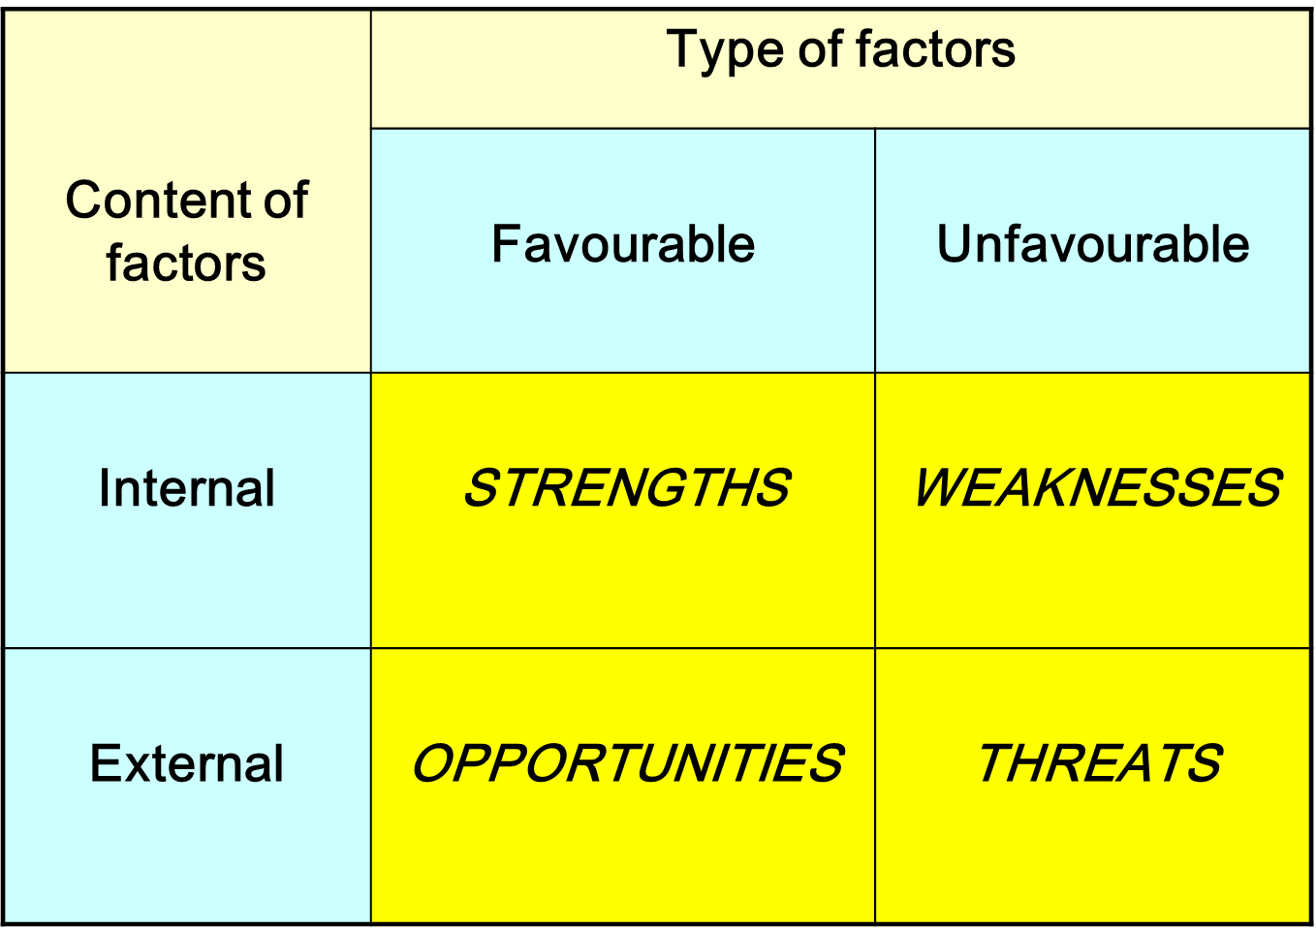
Internal Micro Analysis
SWOT ANALYSIS

Slide 7
Internal Micro Analysis
SWOT ANALYSIS IN PRACTICE
Strengths - High-quality products, Low costs, Tradition, Good financial situation, Well-qualified workforce, Qualified management, High-level of marketing activities, Good services, Own development etc.
Weaknesses - Products of poor quality, Limited capacity of production, High debt, Missing marketing importance, Missing innovation changes, Low-level of information system, Bad reputation, Bad product differentation etc.
Threats - High-powered competition, Barriers to entry to the markets, Substitutes on the market, Unfriendly legislation, Low Customers´ buying power etc.
Opportunities - Missing local and foreign competition, Easy entrance to the new markets, Friendly legislation etc.

Slide 8
Internal Micro Analysis
SWOT ANALYSIS IN PRACTICE
It must be carried out continuously!
It is necessary to assign importance (weights).
Who assesses the factors (subjective view, insufficient experience)?
Strategies should be built on the strengths and respond to opportunities. But must take into account the weaknesses and threats!
In practice it is used for each category of classification according to the criteria (e.g. marketing, manufacturing, finance).
Increasingly, it is being replaced by a methodological variant, quantitative analysis of O-T, i.e. the analysis of strategic scenarios.

Slide 9
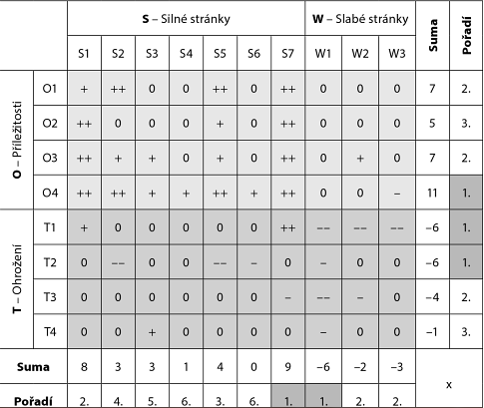
Internal Micro Analysis
SWOT PLUS MINUS MATRIX
Uses interdependencies among the different elements:
Strong mutually positive bond ++
Strong double-sided negative relationship --
Weaker positive bond +
Weaker negative relationship -
No correlation 0
Sums of rows and columns of a matrix gives us the order of the key factors, which should rely upon the proposed strategy.
Problems:
subjective evaluation,
experience.
Notes:
Source: Čichovský, 2013, s. 15-17

Slide 10
Internal Micro Analysis
FORMULATION OF SPECIFIC STRENGTHS OF THE COMPANY
Internal analysis - the aim is to identify strengths and weaknesses. Internal analysis is different from the SWOT analysis by being simpler (faster, cheaper, more missleading).
Internal analysis focuses more on the specific strengths or weaknesses, which set the company apart from the competition (comparative character).
A specific advantage in terms of economics can be described as a factor which allows the company to achieve economic profit.
An example of a specific advantage may be brand, specific technology (e.g. computer software, operating system etc.).

Slide 11
Internal Micro Analysis
3. STRATEGIC BUSINESS UNITS (SBU)
Most companies operate several business ventures (meaning they have several different activities).
The business portfolio is a set of business activities and products that will enhance the company's position in the market.
For quality development we have to analyze existing portfolio. The result is a decision what activities we should continue to support and which to cancel.
Usually included is also the development a new growth strategy.
SBU = is a decentralized part within the enterprise, based on profit, with independent planning in the strategic sense, and managed in a manner that corresponds to a separate unit.
SBU may be a business, product line, or even a single product
An important issue for every business: how to divide into smaller functional units (SBUs)? (By customer – STP, technology? Traffic? Distribution? Region?)

Slide 12
Internal Micro Analysis
SBU CHARACTERISTICS
One company or set of companies that require developing their own unique strategies.
They have their own set of competitors.
Their leadership is responsible for strategic planning, profitability and business performance.
They manage their own resources.
They have their own strategies.
They have their own mission.

Slide 13
Internal Micro Analysis
SBU IN PRACTICE
Breakdown of Nestle company at the SBU level:
Confectionery.
Baby food.
Culinary products and dishes.
Clinical Nutrition.
Feed.
General Electric has established 49 strategic business units.
Question: What are the advantages and disadvantages of a broad portfolio of business units?

Slide 14
Internal Micro Analysis
BRAND PORTFOLIO RATIONALIZATION
Process:
An audit of the brand portfolio.
Determining the optimal portfolio of brands.
Choosing the right strategy for decommissioning brands.
Preparation of the growth strategy for surviving brands.
Methods of disposal: milk out, terminate, merge, sell.
Portfolio Audit = identification of the main business activities that form the basis of a company's development-these are called strategic business units.
Estimate the attractiveness of individual units (brands) and decide about what support they deserve.
Among the most famous portfolio analysis are:
BCG matrix,
GE matrix.

Slide 15
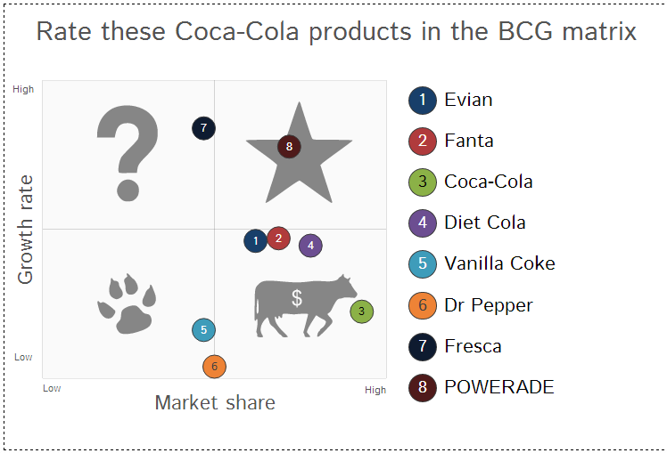
Internal Micro Analysis
BCG MATRIX
The most known method of portfolio analysis by Boston Consulting Group.
Principle: the profitability of individual business units is associated with a share of the company on the market and with a growth rate of this market.
The result is a model of BCG,
which classifies strategic
business units according to
market share and growth
rate of this market.

Slide 16
Internal Micro Analysis
PARTS OF BCG MATRIX
Stars
High growth rate in the market.
It is necessary to invest a lot into them, because their growth is very dynamic.
Cash cows
Slow market growth and high market share.
They are already established and functioning, and thus do not require large investments.
They bring valuable cash for other units.
Question marks
Low market share in the fast growing market.
Need a lot of funds to maintain their position.
Management must decide which are transformed into stars and which will be terminated.
Dogs
Low growth rate and a small market share.
They can produce enough revenue to sustain themselves.
Management usually decides the withdrawal from the market.

Slide 17
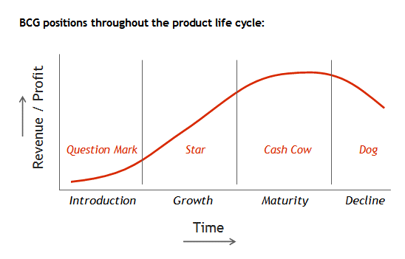
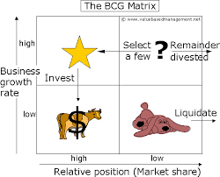
Internal Micro Analysis
BCG MATRING AND PRODUCT LIFE-CYCLE

Slide 18
Internal Micro Analysis
THE ADVANTAGES OF BCG
A simple, widely used analytical tool.
Its trying to explain the interrelationship between relative market share, market growth, and cash.
Estimate the position of each of the surveyed business units due to their relative market share and market growth of the whole sector.
The ability to predict which business unit will produce cash funds at a future time period.

Slide 19
Internal Micro Analysis
THE DISADVANTAGES OF BCG
Impact on financial flows is expressed by only two global factors and is reaction of competitors to strategic decision-making is not captured, although it plays one of the dominant roles.
Matrix does not provide information on the costs and profits of the SBU.
The model is not dynamic (dynamic is introduced by substituting the predicted information: assumed growth rate of the market, some market share and certain sales volumes etc.).
Acquiring ACCURATE information necessary for the design of the matrix is difficult.

Slide 20
Internal Micro Analysis
GE PORTFOLIO MATRIX BY MCKINSEY
GE portfolio matrix (General Electric Business Screen) monitors factors that are identified as a „industry attractiveness“ factor and the „competitive position“ factor.
Unlike the BCG portfolio, these basic factors which determine the strategic success of the company, are not captured in only two basic quantities, but are expressed in complex of sub-acting factors (groups of factors).
It explains the SBU situation more comprehensively than BCG matrix.

Slide 21
Internal Micro Analysis
INDUSTRY ATTRACTIVENESS
Market growth and market size.
The quality of the market.
The profitability of the industry.
The stability of sales.
Price stability.
Complexity and availability of inputs (raw materials, energy).
The situation in the company environment (macro-environment – PEST, micro-environment).

Slide 22
Internal Micro Analysis
COMPETITIVE POSITION
Relative market position (relative market share).
The relative productive potential (capacity).
Relative research and development potential.
Position in distribution, marketing communication effectiveness.
SBU position in quality, brand, technology, marketing and business.
Profitability and its comparison with the average achieved in the field.
The relative ability of management (qualifications, experience, creative level).

Slide 23
Internal Micro Analysis
GE MATRIX UTILIZATION
Number of assessed factors may be extended or narrowed. Factors should be selected with regard to the specific situation.
For both factors, depending on the situation of the company, three zones are established. On this basis, we are creating a total of nine combinatorial arrays.
1, 2, 4 represent an advantageous position of the SBU, the SBU are located in the so-called green zone (dark grey on the next image) for investment (the firm invests in the strategic plan to maintain and improve the position of the SBU).
3, 5, 7 are located in the so-called orange zone (light grey on the next image), where the company must weigh the potential risks associated with investing, performs selective choice and tends to prefer short-term investments.
6, 8, 9 are known as red zone, where the company usually ceises to invest, prepares attenuation or cessation of business or liquidation.

Slide 24
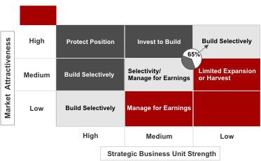
Internal Micro Analysis
GE MATRIX

Slide 25
Internal Micro Analysis
EVALUATION OF THE GE MATRIX
Advantage of the GE portfolio matrix compared with BCG matrix is much broader, more realistic view of the SBU issues.
The downside of the GE portfolio matrix is that the selection criteria and determining their weights of assessed factors is very subjective. It requires experienced staff.
Results in the portfolio models are very susceptible to marking and determine the significance of the individual factors. It may happen that analysts adjust the valuation of the factors in such a way that the final position of the SBU corresponds to their idea (it looks good / bad).

Slide 26
Internal Micro Analysis
THE END
Thank you for your attention.
☺

