Slide 1
Production and Technology Choice
LESSON 5
MICROECONOMICS
2023/2024

Slide 2
OUTLINE OF THE LECTURE
AND
STUDY GOALS
Students should be able to:
Understand the terms, production, input, output.
Distinguish between total, average and marginal product.
Analyze production relationship and show how the law of diminishing marginal returns implies a certain pattern of output in the short run.
Understand the difference between production in the short-run and the long-run.
Understand how firm‘s cost optimum is formed
Production, Input and Output
Total, Average and Marginal Product
Production in the Short Run: The Law of Diminishing Marginal Returns
Production in the Long-Run: Isoquant
Analysis of Costs: Isocost
Firm Optimum

Slide 3
Firm
Represents the supply on the market products and services
Causes of the existence of the firm:
  the benefits of teamwork
  reducing the costs associated with entering into contracts
Neoclassical theory of the firm - analysis of behavior in the marketplace with an emphasis on deciding the amount and cost of production and of technology choice
Limitations:
  Market - level of demand for farm-produced
  Economic - on the cost side (limitations in terms of competition)
  Techologically - a limited number of technologies and natural conditions
The main objective of the firm is to MAXIMIZE THE PROFIT (first used by Antoine Augustin Cournot)

Slide 4

Production
Process of using the services of labor and equipment together with other inputs to make goods and services available
Inputs: the labor, capital, land, natural resources and entrepreneurship that are combined to produce any output
Production function: the relationship between any combination of inputs and the maximum output obtainable from that combination
An improvement of technology increases the maximum output obtainable from any combination of inputs -> a new production function
Q$=f(A, L, K, t)$

Slide 5
The Period of Production
Short-run (Immediate)
Period of production when some inputs cannot be varied
Fixed inputs
Variable inputs
Long-run (Future, planned)
Period of production which is long enough for managers to vary all inputs
All inputs are variable
Managers have more flexibility
The actual time period (days, months) representing the short and long run varies among industries:
Owner of hot-dog stand might increase (change) all inputs in less than a month.
An oil company might take years to increase capital inputs (refineries).

Slide 6

Production in the Short-Run – relationship between TP, MP, AP
Labor – variable
Capital – fixed
Total product
TP = f(L)
total quantity of output produced with all the given inputs
Average product
AP = TP/L
the product produced by every variable input
Marginal product
MP = TP‘ or MP = $∆TP/∆L$
the net change in total production by using the additional units of input
Capital (machines, factories) | Labor (workers) | Marginal Product | Total Product | Average Product
1 | 0 | 0 | 0 | 0
1 | 1 | 2
1 | 2 | 4
1 | 3 | 5
1 | 4 | 5
1 | 5 | 3
1 | 6 | 1
1 | 7 | 0

Slide 7
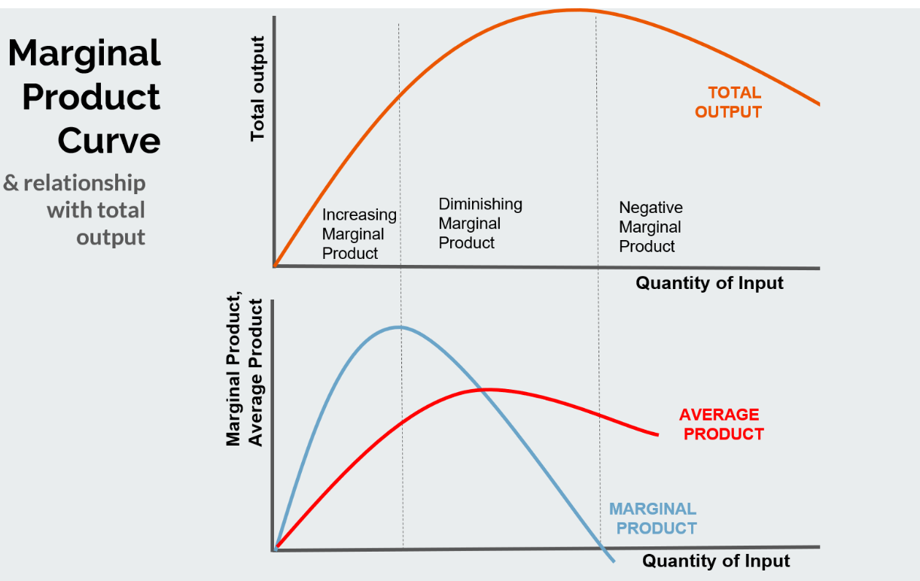
Production in the Short-Run – relationship between TP, MP, AP
The law of diminishing marginal returns:
The additional product obtained by hiring additional unit of labor (MP) will eventually begin to decrease (point A).
At some point (B), total production (TP) will start to decrease by hiring additional units of labor.
Optimum of Firm in the Short Run
- is based on maximalizing the total product:
TP(max) => MP = 0
A B

Slide 8
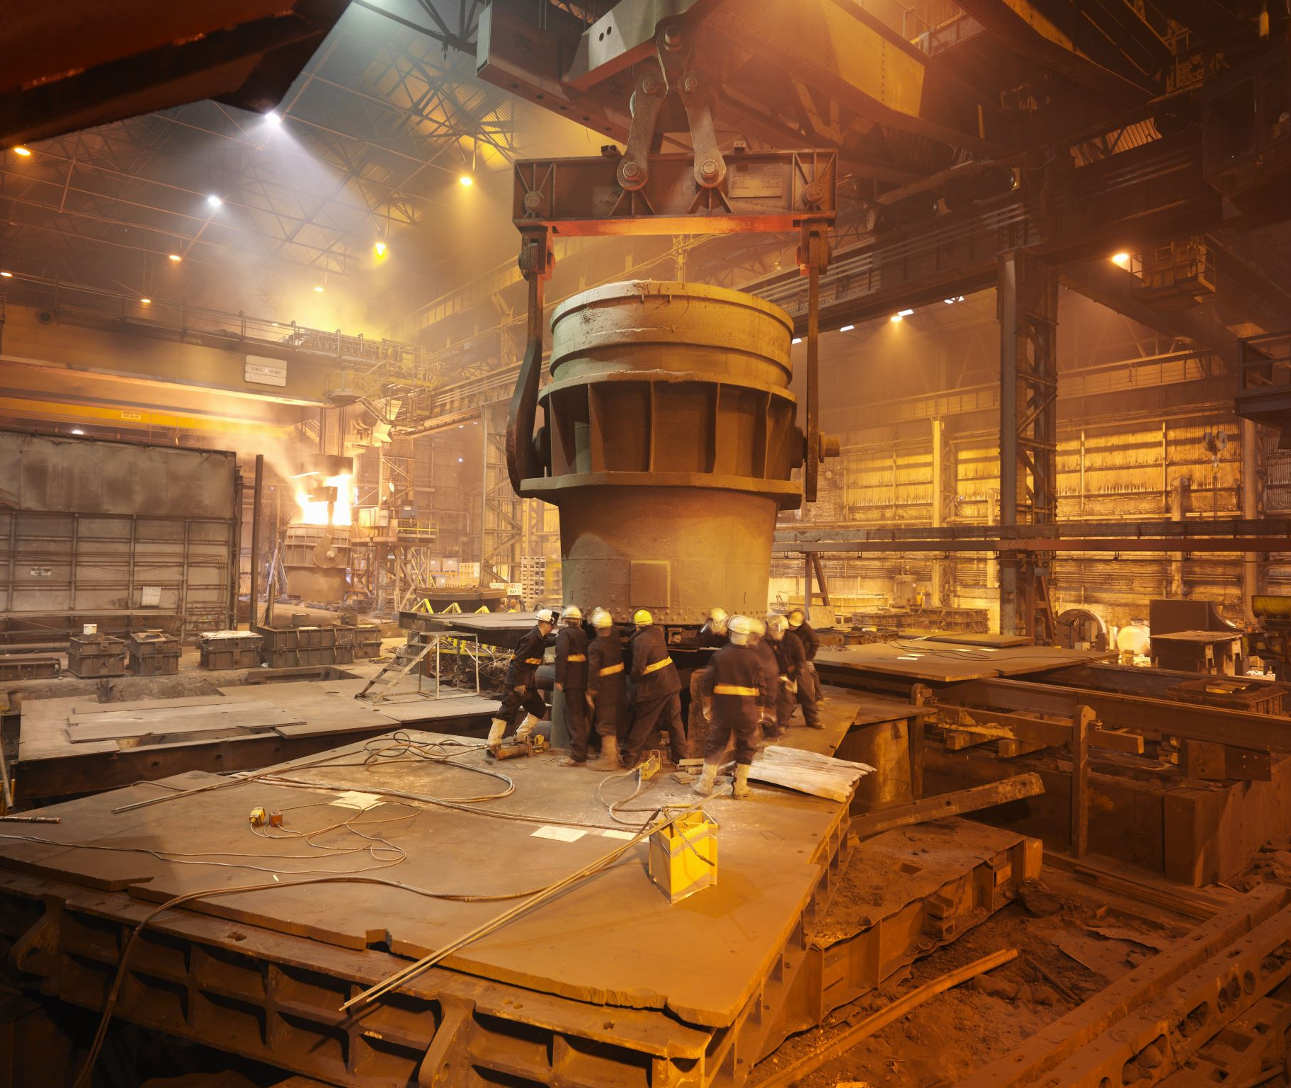
Production in the Long-Run
All production factors are variable
Q = f (K, L)
Production function in the long term measures the maximum volume of production which the firm is able to produce with various combinations of inputs

Slide 9
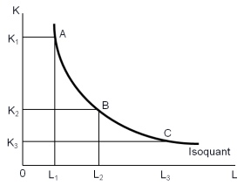
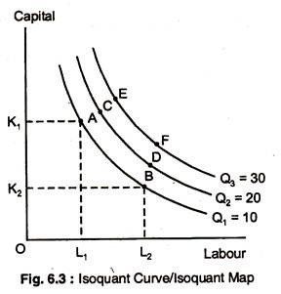
Production in the Long-Run
Graphical representation: ISOQUANT (ISOPRODUCT CURVE = IQ)
IQ represents a certain level of production and shows all possible combinations of two inputs that can be used to achieve a given output
IQ ISOQUANT MAP

Slide 10

Production in the Long-Run
TECHNICAL SUBSTITUTION
The firm produces some production with various techniques - various combinations of labor and capital
If there is one production technology, production factors are COMPLEMENTS (usually in short run)
In the long run we can always find a combination of inputs and they are SUBSTITUTES
The ratio at which one unit is replaced by another input so that production remained unchanged:
MARGINAL RATE OF TECHNICAL SUBSTITUTION
$MRTS= \frac{ΔK}{ΔL}$ = $\frac{MPl}{MPk}$

Slide 11
Finding the Optimum of the Firm
So far we discussed what production can be achieved by different combinations of factors of production. But which of said combinations of labor and capital should be actually used?
The main target of the firm is PROFIT MAXIMIZATION = producing as much as possible with the lowest total costs as possible.
Thus, we need to consider also the costs of labor and capital.

Slide 12
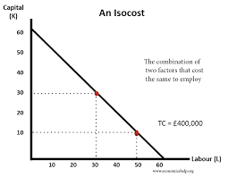
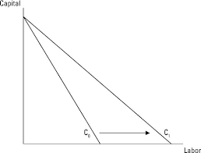

Total Costs
The total costs (TC) of firm are dependent on the volume of input used and on the input prices
Mathematical expression: TC = pL x L + pK x K
Graphical expression: an isocost (equal line costs) CL
For given input prices, isocosts farther from the origin are associated with higher costs
Changes in input prices change the slope of the isocost line
S = - $\frac{ΔK}{ΔL}$ = $\frac{Pl}{Pk}$

Slide 13

Finding the Optimum of Firm
So far, we solved the problem:
HOW THE FIRM DETERMINES THE MOST EFFICIENT PRODUCTION (PRODUCTION FUNCTION – SHORT-TERM, LONG-TERM)
HOW THE FIRM STATES THAT THE PRODUCTION IS AVAILABLE BY THAT AMOUNT OF COSTS (ISOCOST)
It remains to be solved: how much production will be least expensive?

Slide 14
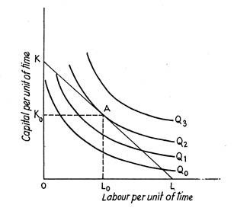
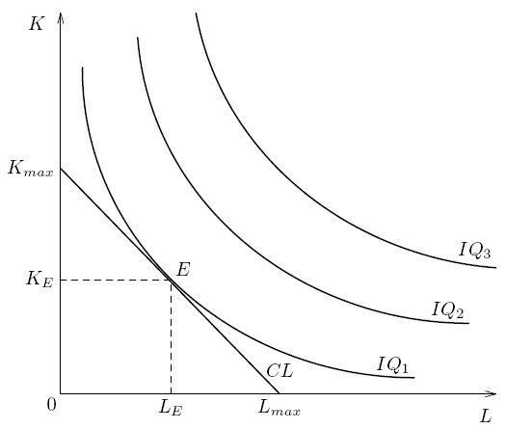

FIRM COST OPTIMUM:
The last monetary unit spent on hire of individual inputs brings the same growth of production.
The last monetary unit spent on capital brings the same growth of production as the last monetary unit spent on labor.
$MRTS= \frac{pL}{pK} \frac{MPl}{MPk}$ = $\frac{pL}{pK} \frac{MPl}{pK}$ = $\frac{MPk}{pK}$
MINIMIZING OF COSTS MAXIMIZING OF PRODUCTION

Slide 15
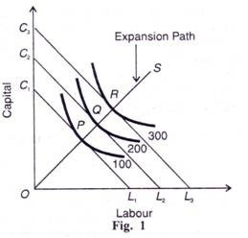
LONG EXPANSION PATH OF FIRM
Connecting all the firm optimum points
The efficient input combinations for every level of output:
the path of increasing the output levels while minimalizing the costs

Slide 16



LONG EXPANSION PATH OF FIRM
LEP shows how the volume output changes when the firm changes the quantities of inputs.
Returns to scale: the proportionality of changes in output after the quantity of all inputs have been changed
the volume of output grows faster than the amount of inputs
the growth rate of output (1%) exceeds the growth rate of total costs (less than 1%)
Increasing returns to scale
output volume grows at the same rate as the number of inputs
the growth rate of production (1%) corresponds to the growth rate of costs (1%)
Constant returns to scale
the volume of output grows more slowly than the number of input
the growth rate of production (1%) is lower than the growth of costs (more than 1%)
Decreasing returns to scale

Slide 17
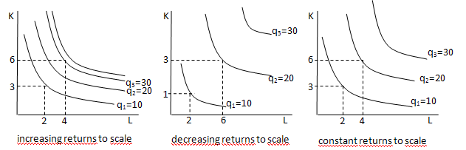
LONG EXPANSION PATH:
DIFFERENT SHAPES OF ISOQUANT MAPS
Labor and Capital: increase by 100%
Output: increase by 200%
increase by 200%
increase by 100%
increase by 100%
increase by 100%

