Slide 1

GENERAL EQUILIBRIUM
LESSON VI
Dr. Ingrid Majerova
Advanced Microeconomics/EVS/NAAMI

Slide 2
GENERAL EQUILIBRIUM
Outline of the lecture
Model of Partial Equilibrium
Efficiency
Edgeworth Box Diagram
Possibility Production Frontier
General Equilibrium

Slide 3

GENERAL EQUILIBRIUM
MODEL OF PARTIAL AND GENERAL EQULIBRIUM
In previous lectures - analysis of partial equilibrium - equilibrium on separate markets
(methodological approach - Alfred Marshall)
Now - general equilibrium (author of the theory M. E. L. Walras) - analysis of the behavior and interaction of all markets
Model of simple economics
MODEL 2x2x2x2

Slide 4
GENERAL EQUILIBRIUM
ASSUMPTIONS OF GENERAL EQULIBRIUM MODEL
The aim of consumers is to maximize the UTILITY, aim of producers is to maximize PROFIT
All markets are perfectly competitive
The economy is barter-economy where goods are easily exchanged for another.
It is a closed economy (without foreign trade).

Slide 5
GENERAL EQUILIBRIUM
ASSUMPTIONS OF GENERAL EQULIBRIUM MODEL
There are only two firms that produce consumer goods (call them A and P)
There are only two kinds of consumer goods - X and Y consumers for them spend their whole income.
There are only two factors of production - L and K (labor and capital). Consumers own these factors and by their sales gain income.
There are only two people forming a society - A & B (eg. Adam and Barbra).

Slide 6
GENERAL EQUILIBRIUM
EFFICIENCY
The situation of general equilibrium assumes equilibrium of the whole economic system that must be therefore achieved:
  equilibrium in consumption, respectively. exchange
  equilibrium in production
  and consistency between what is produced and consumption requirements simultaneously.
Economic theory in connection with that formulates requirement of achieving overall efficiency through
PARETO EFFECTIVE ALLOCATION
the goods/factors of production can not be reallocate without without increasing the usefulness/production result into a reduction of the usefulness or production of a second consumer/firm

Slide 7
GENERAL EQUILIBRIUM
EFFICIENCY
efficiency in the exchange - it must be impossible to redistribute the supply of produced goods so that one consumers can benefit from it and the second consumer is damaged in the same time
efficiency in production - all the factors of production in an effective combination must be used in the economy
producer-consumer efficiency (efficiency of the production mix) - it must be impossible to change produced combination of products and services so that one consumer would benefit from it without simultaneously damaging anyone else

Slide 8
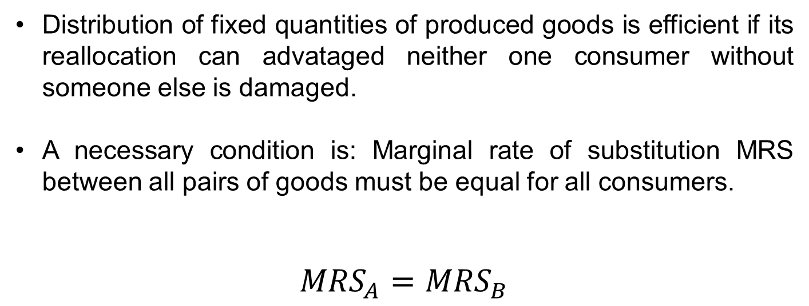
GENERAL EQUILIBRIUM
EFFICIENCY OF EXCHANGE
Distribution of fixed quantities of produced goods is efficient if its reallocation can advataged neither one consumer without someone else is damaged.
A necessary condition is: Marginal rate of substitution MRS between all pairs of goods must be equal for all consumers.
$${MRS}_{A}={MRS}_{B}$$

Slide 9
GENERAL EQUILIBRIUM
EFFICIENCY OF EXCHANGE – INDIFFERENCE MAP
To derive efficiencies in the exchange we have to take into account consumer preferences.
We express them using indifference maps of two consumers (A, E) for the two commodities (X, Y).

Slide 10
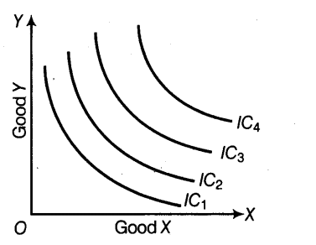
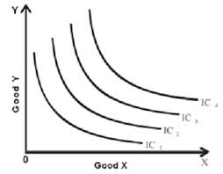
GENERAL EQUILIBRIUM
EFFICIENCY OF EXCHANGE – INDIFFERENCE MAP
CONSUMER A
CONSUMER B

Slide 11
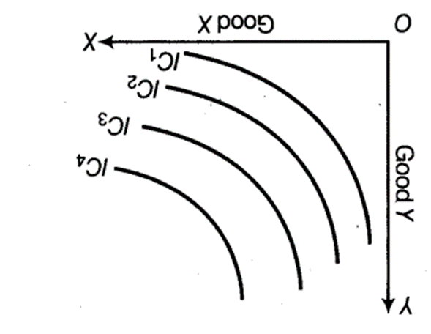
GENERAL EQUILIBRIUM
EDGEWORTH BOX DIAGRAM OF EXCHANGE
On the previous figure we can see that both consumer preferences are not equal - the indifference maps have different shapes.
Now we turn a figure showing indifference map of consumer B a180 degrees

Slide 12
GENERAL EQUILIBRIUM
EDGEWORTH BOX DIAGRAM OF EXCHANGE
By joining the indifference maps of consumers A with turned map of consumer B arises box scheme of exchange – EEDGEWORTH BOX DIAGRAM of exchange.
It shows all possible means of distributing the specified amounts of two produced goods between two consumers.

Slide 13
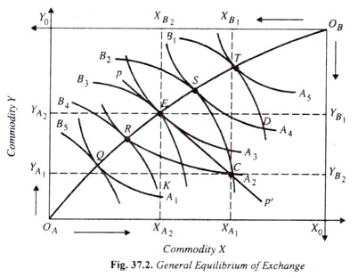
GENERAL EQUILIBRIUM
EDGEWORTH BOX DIAGRAM OF EXCHANGE

Slide 14
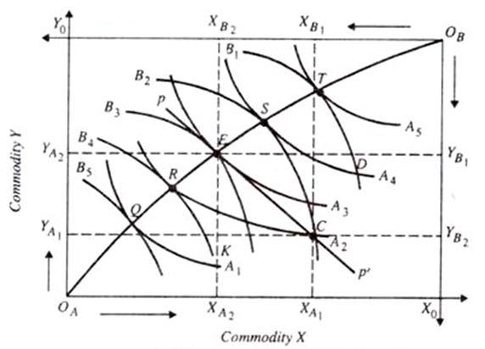

GENERAL EQUILIBRIUM
EDGEWORTH BOX DIAGRAM OF EXCHANGE
Each point in schemere presents the distribution of the total supply of both goods between both consumers and the level of utility, which provides adequate combination of both goods to both consumers (expressed by indifference curves)
Contract Curve CC - Consumer contract curve is the set of points (Pareto set of consumers), which represent efficient allocation of two goods between two consumers

Slide 15
GENERAL EQUILIBRIUM
EDGEWORTH BOX DIAGRAM OF EXCHANGE
If point E on the contract curve is the position of exchange equilibrium actually reached, then individual A has exchanged the amount of commodity X equal to commodity Y
Since point E lies on the CC, which is the locus of the tangency points of indifference curves of the two individuals, marginal rate of substitution between the two goods (MRSXY) of individual A equals marginal rate of substitution between the two com­modities (MRSXY) of individual B.

Slide 16
GENERAL EQUILIBRIUM
EFFICIENCY IN PRODUCTION
A fixed amount of resources will be efficiently distributed in the economy if is not possible produce more of one good without being necessary to reduce the production of another good.
Production is situated on production possibility frontier PPF, if resources are located so that it is not possible with their redistribution to produce more good X without limiting the production of good Y.

Slide 17
GENERAL EQUILIBRIUM
PRODUCTION POSSIBILITY FRONTIER
PPF is determined by various combinations of output that can be produced at a given number of inputs and production technology.
The curve of production possibility frontier shows alternative combinations of two products that can be efficiently produced with a certain fixed range of sources.

Slide 18
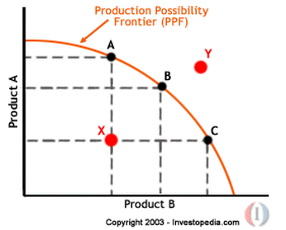
GENERAL EQUILIBRIUM
PRODUCTION POSSIBILITY FRONTIER
Points A, B, C are efficient combination of production
Point X is uneffiecient and attainable
Point Y is unattainable

Slide 19
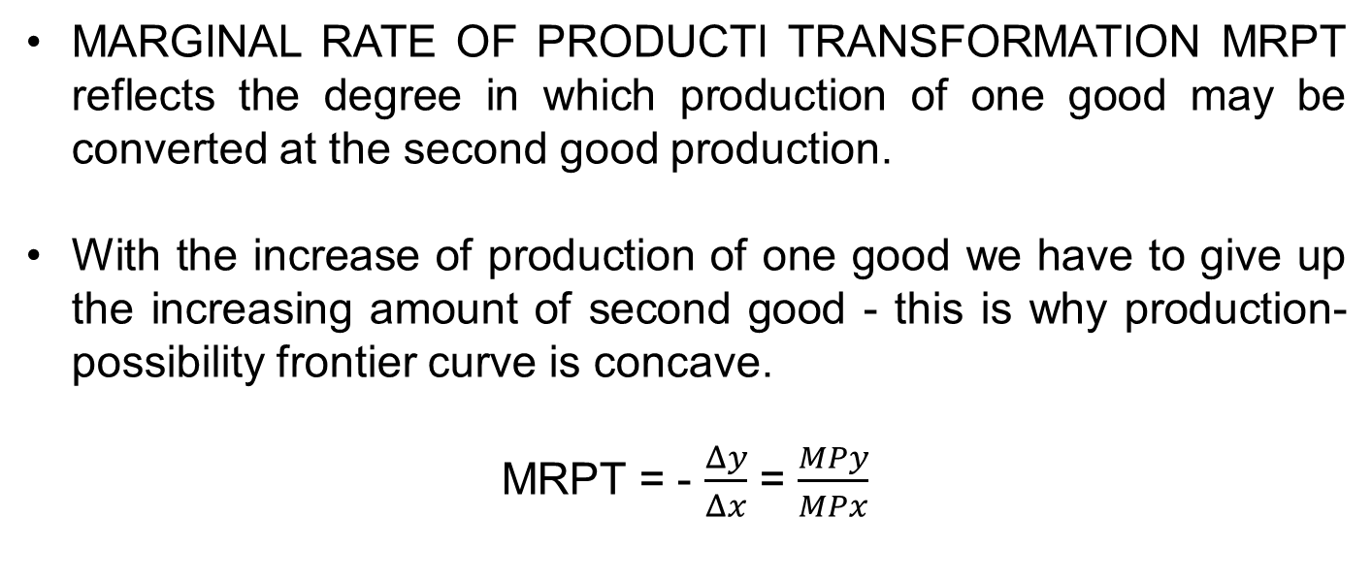
GENERAL EQUILIBRIUM
MARGINAL RATE OF PRODUCT TRANSFORMATION
MARGINAL RATE OF PRODUCTI TRANSFORMATION MRPT reflects the degree in which production of one good may be converted at the second good production.
With the increase of production of one good we have to give up the increasing amount of second good - this is why production-possibility frontier curve is concave.
MRPT = - $\frac{Δy}{Δx}$ = $\frac{MPy}{MPx}$

Slide 20
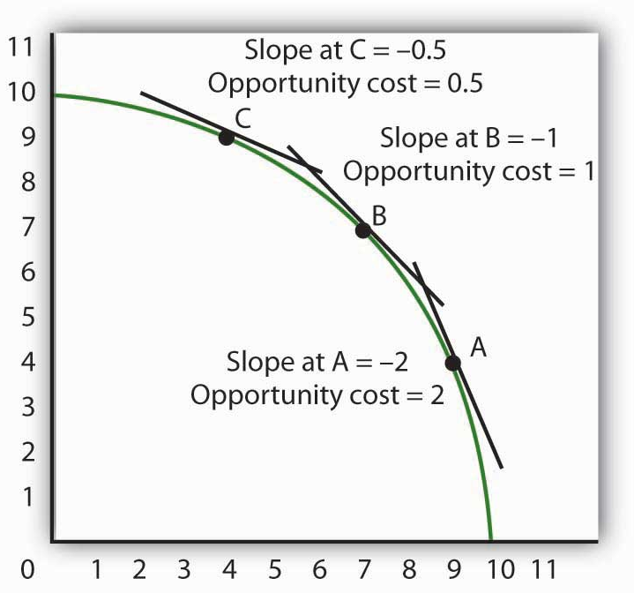
GENERAL EQUILIBRIUM
SLOPE OF PRODUCTION POSSIBILITY FRONTIER
At point A - any reduction in the production of X with one unit causes increase of Y production by more than 1 unit.
At point C - opposite.
concave shape of the PPF curve is a graphical representation of rising opportunity costs.
In case of constant cost alternative would be a straight line..

Slide 21
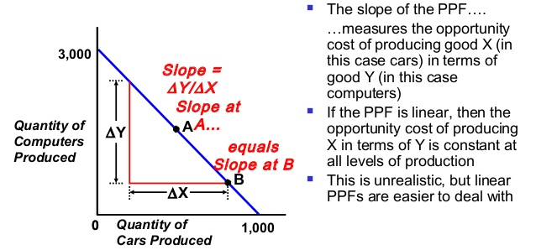
GENERAL EQUILIBRIUM
SLOPE OF PRODUCTION POSSIBILITY FRONTIER

Slide 22
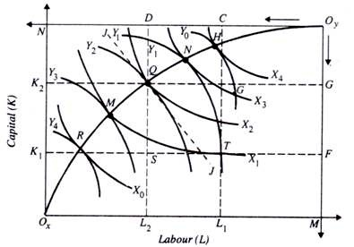
GENERAL EQUILIBRIUM
EDGEWORTH BOX DIAGRAM OF PRODUCTION

Slide 23
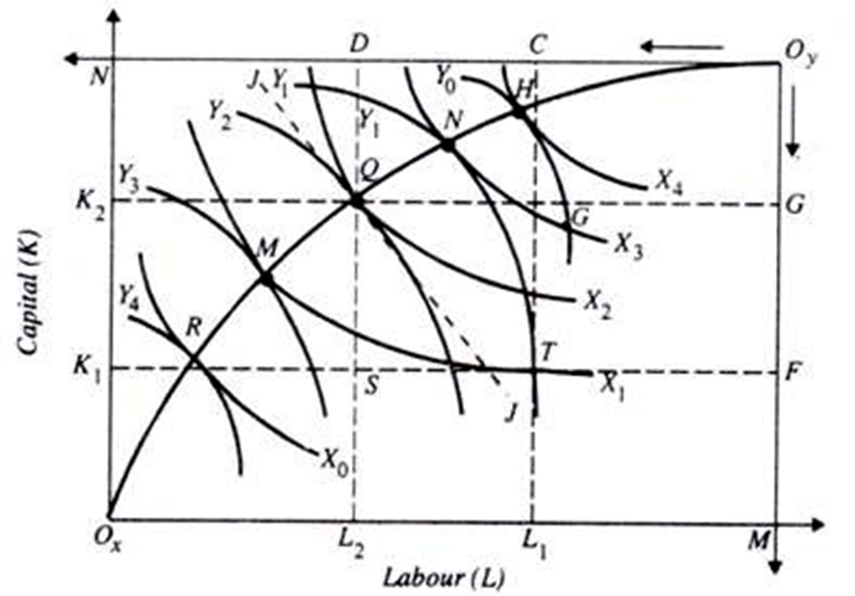
GENERAL EQUILIBRIUM
EDGEWORTH BOX DIAGRAM OF PRODUCTION
Each point of scheme represents the distribution the total supply of both production factors between the two firms and production levels, which gives an appropriate combination of these two factors for both firms (expressed by isoquant).
CC curve (Contract Curve) - Contract curve of producers is a set of points (Pareto set of producers), which represents efficient allocation of two production factors between the two firms.

Slide 24
GENERAL EQUILIBRIUM
PRODUCER-CONSUMER EFFICIENCY
The aim of an economic system is to meet human needs - efficiency in production may not be desirable if it is made a bad combination of products regarding to consumer requirements.
To achieve overall efficiency must be simultaneously fulfilled the conditions for achieving efficiency in production and efficiency in the exchange.
Both conditions are fulfilled it is still not sufficient condition for overall effectiveness - it is necessary to harmonize consumer preferences with production possibilities.
The condition of producing the right combination of goods is
MRS = MRPT

Slide 25

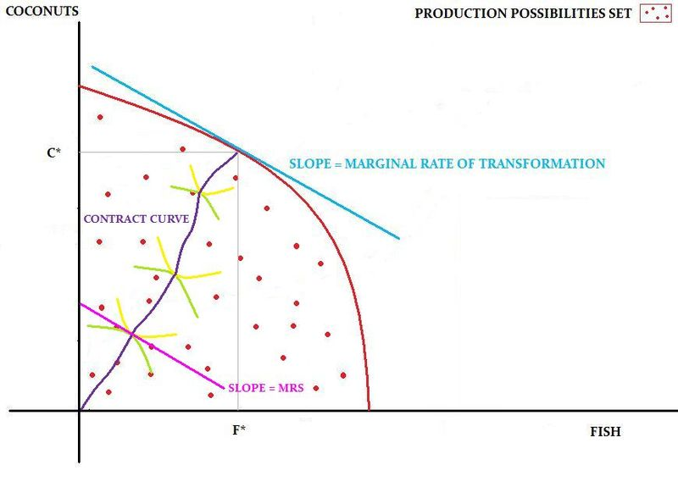
GENERAL EQUILIBRIUM
PRODUCTION MIX EFFICIENCY
Point - there will be produced x units of X, and y units of Y in the economy, it is currently the total amount of X and Y, which will be divided among both consumers
tangents are parallel - IC slope = PPF slope
Marginal rate of transformation = marginal rate of substitution

Slide 26
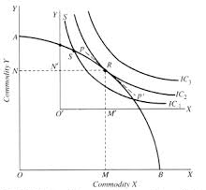
GENERAL EQUILIBRIUM
GENERAL EQUILIBRIUM
Curve IC3 is unattainable.
Conversely, any combination of the output in the part of IC1 between points S and T is available, the resources of economy, however, allow greater consumer utility.
The highest indifference curve, the consumer can achieve is IC2, when the economy produces and consumes in a range represented by the point R. At this point, the curve IC2 touches the curve PPF.

Slide 27
GENERAL EQUILIBRIUM
THANK YOU FOR YOUR ATTENTION…

