Slide 1
Informatics
Spreadsheet calculator - II
Petr Suchánek
Informatics

Slide 2
Outline of the lecture
Filters
autofilter
advanced filter
Groups
Subtotals
Pivot table
Sensitivity analysis

Slide 3
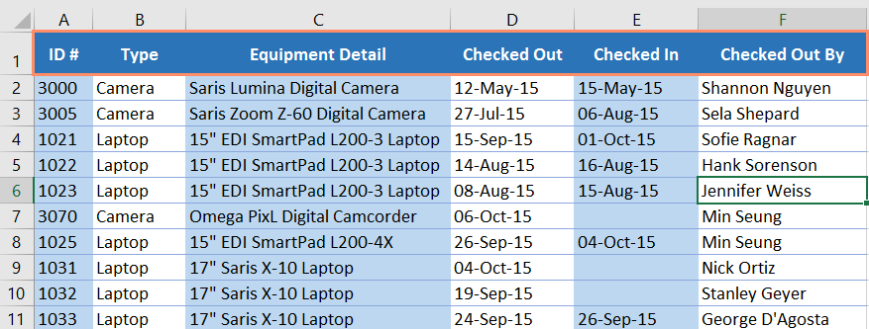
Filtering data
If your worksheet contains a lot of content, it can be difficult to find information quickly.*
Filters can be used to narrow down the data in your worksheet, allowing you to view only the information you need.*
In order for filtering to work correctly, your worksheet should include a header row, which is used to identify the name of each column.*
*https://edu.gcfglobal.org/en/excel2016/filtering-data/1/

Slide 4
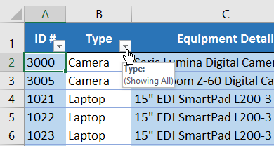
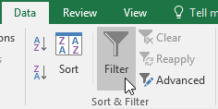
Filtering data
Select the Data tab, then click the Filter command.*
A drop-down arrow will appear in the header cell for each column.*
Click the drop-down arrow for the column you want to filter. In our example, we will filter column B to view only certain types of equipment.*
*https://edu.gcfglobal.org/en/excel2016/filtering-data/1/

Slide 5
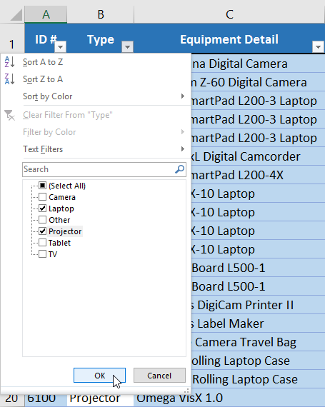
Filtering data
Uncheck the box next to Select All to quickly deselect all data.*
Check the boxes next to the data you want to filter, then click OK.*
In this example, we will check Laptop and Projector to view only these types of equipment.*
*https://edu.gcfglobal.org/en/excel2016/filtering-data/1/

Slide 6
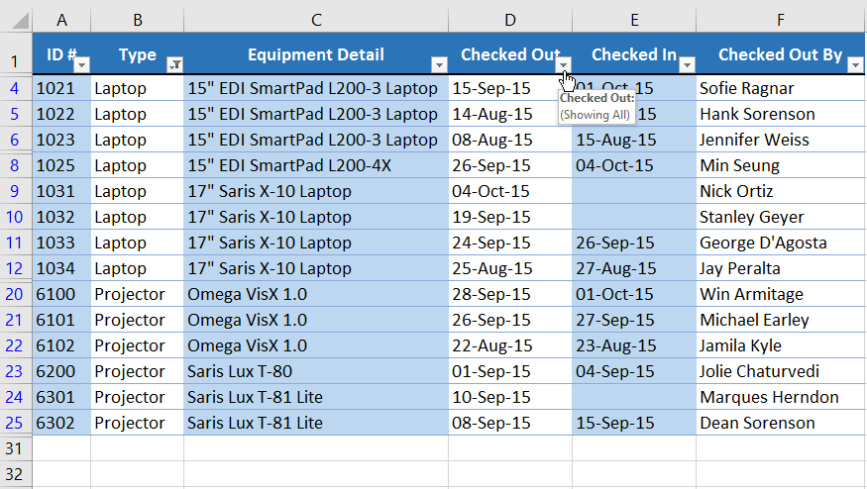
Filtering data
Filters are cumulative, which means you can apply multiple filters to help narrow down your results.*
*https://edu.gcfglobal.org/en/excel2016/filtering-data/1/

Slide 7
Filtering data – advanced filter
Compared to the basic AutoFilter tool, Advanced Filter works differently in a couple of important ways.*
Excel AutoFilter is a built-in capability that is applied in a single button click. Just hit the Filter button on the ribbon, and your Excel filter is ready to go.*
Advanced Filter cannot be applied automatically since it has no pre-defined setup, it requires configuring the list range and criteria range manually.*
*https://www.ablebits.com/office-addins-blog/2016/09/07/excel-advanced-filter/

Slide 8
Filtering data – advanced filter
AutoFilter allows filtering data with a maximum of 2 criteria, and those conditions are specified directly in the Custom AutoFilter dialog box.*
Using Advanced Filter, you can find rows that meet multiple criteria in multiple columns, and the advanced criteria need to be entered in a separate range on your worksheet.*
Below you will find the detailed guidance on how to use Advanced Filter in Excel as well as some useful examples of advanced filters for text and numeric values.*
*https://www.ablebits.com/office-addins-blog/2016/09/07/excel-advanced-filter/

Slide 9
Filtering data – advanced filter
In addition to manual data filtering Excel enables fully automated filtering based on data from the specified range of cells. Before you can use the advanced filtering feature, you must set up a criteria range. A criteria range is a designated range on a worksheet that conforms to certain requirements.*
The criteria range holds the information that Excel uses to filter the list. It must conform to the following specifications:*
It consists of at least two rows, and the first row must contain some or all field names from the list. An exception to this is when you use computed criteria. Computed criteria can use an empty header row.*
The other rows consist of your filtering criteria.*
*https://www.officetooltips.com/excel_2016/tips/using_advanced_filtering.html

Slide 10
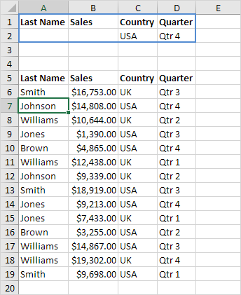
Filtering data – advanced filter
Create a Criteria range (blue border below for illustration only) above your data set. Use the same column headers. Be sure there's at least one blank row between your Criteria range and data set.*
To display the sales in the USA and in Qtr 4, execute the following steps.*
1. Enter the criteria shown below on the worksheet.*
*https://www.excel-easy.com/examples/advanced-filter.html

Slide 11
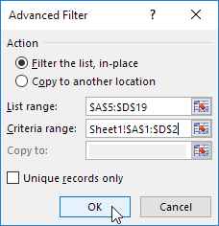
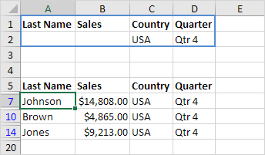
Filtering data – advanced filter
2. Click any single cell inside the data set.*
3. On the Data tab, in the Sort & Filter group, click Advanced.*
4. Click in the Criteria range box and select the range A1:D2 (blue).*
5. Click OK.*
*https://www.excel-easy.com/examples/advanced-filter.html

Slide 12
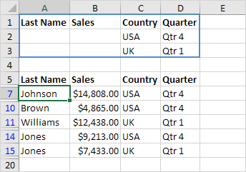
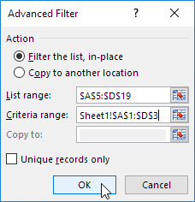
Filtering data – advanced filter
To display the sales in the USA in Qtr 4 or in the UK in Qtr 1.*
*https://www.excel-easy.com/examples/advanced-filter.html

Slide 13
Filtering data
https://edu.gcfglobal.org/en/excel2016/filtering-data/1/
https://www.ablebits.com/office-addins-blog/2016/09/07/excel-advanced-filter/
https://www.excel-easy.com/data-analysis/filter.html
https://spreadsheeto.com/filters/
https://www.youtube.com/watch?v=dD0QQsdgSr4
https://www.officetooltips.com/excel_2016/tips/using_advanced_filtering.html

Slide 14
Filtering data – groups
Worksheets with a lot of content can sometimes feel overwhelming and even become difficult to read.*
Fortunately, Excel can organize data into groups, allowing you to easily show and hide different sections of your worksheet.*
You can also summarize different groups using the Subtotal command and create an outline for your worksheet.*
*https://edu.gcfglobal.org/en/excel2016/groups-and-subtotals/1/

Slide 15
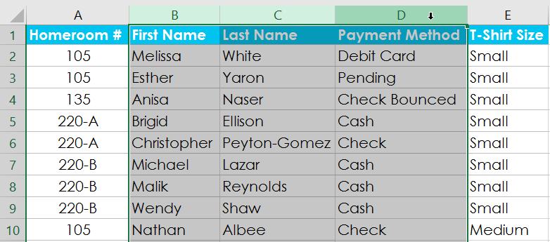
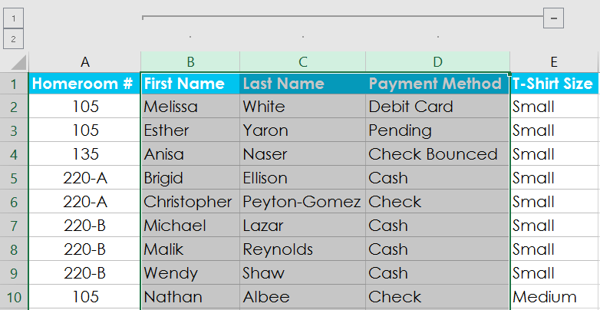
Filtering data – groups
Select the rows or columns you want to group. In this example, we'll select columns B, C, and D.*
Select the Data tab on the Ribbon, then click the Group command.*
The selected rows or columns will be grouped. In our example, columns B, C, and D are grouped.*
*https://edu.gcfglobal.org/en/excel2016/groups-and-subtotals/1/

Slide 16
Filtering data – subtotals
The Subtotal command allows you to automatically create groups and use common functions like SUM, COUNT, and AVERAGE to help summarize your data.*
For example, the Subtotal command could help to calculate the cost of office supplies by type from a large inventory order.*
It will create a hierarchy of groups, known as an outline, to help organize your worksheet.*
In our example, we'll use the Subtotal command with a T-shirt order form to determine how many T-shirts were ordered in each size (Small, Medium, Large, and X-Large). This will create an outline for our worksheet with a group for each T-shirt size and then count the total number of shirts in each group.*
*https://edu.gcfglobal.org/en/excel2016/groups-and-subtotals/1/

Slide 17
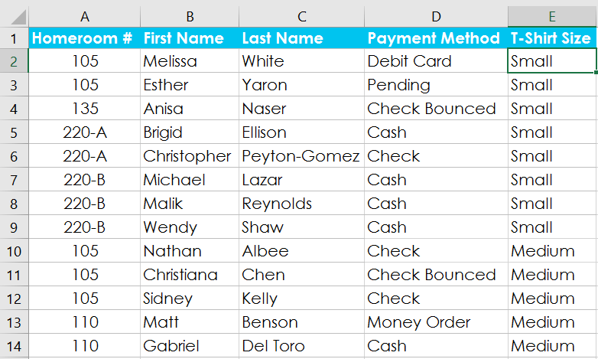
Filtering data – subtotals
First, sort your worksheet by the data you want to subtotal. In this example, we'll create a subtotal for each T-shirt size, so our worksheet has been sorted by T-shirt size from smallest to largest.*
Select the Data tab, then click the Subtotal command.*
*https://edu.gcfglobal.org/en/excel2016/groups-and-subtotals/1/

Slide 18
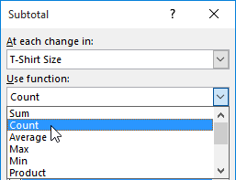
Filtering data – subtotals
The Subtotal dialog box will appear. Click the drop-down arrow for the At each change in: field to select the column you want to subtotal. In our example, we'll select T-Shirt Size.*
Click the drop-down arrow for the Use function: field to select the function you want to use. In our example, we'll select COUNT to count the number of shirts ordered in each size.*
*https://edu.gcfglobal.org/en/excel2016/groups-and-subtotals/1/

Slide 19
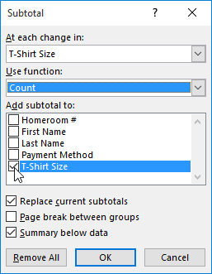
Filtering data – subtotals
In the Add subtotal to: field, select the column where you want the calculated subtotal to appear.*
In our example, we'll select T-Shirt Size. When you're satisfied with your selections, click OK.*
*https://edu.gcfglobal.org/en/excel2016/groups-and-subtotals/1/

Slide 20
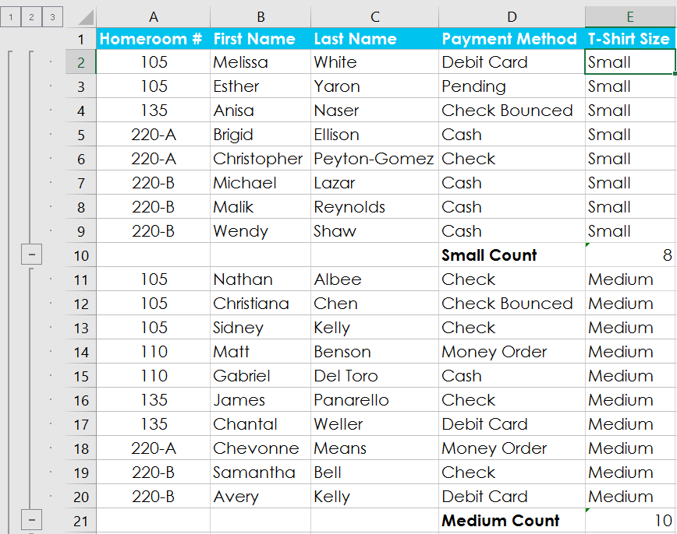
Filtering data – subtotals
The worksheet will be outlined into groups, and the subtotal will be listed below each group.*
In our example, the data is now grouped by T-shirt size, and the number of shirts ordered in that size appears below each group.*
*https://edu.gcfglobal.org/en/excel2016/groups-and-subtotals/1/

Slide 21
Filtering data – subtotals
When you create subtotals, your worksheet it is divided into different levels.*
You can switch between these levels to quickly control how much information is displayed in the worksheet by clicking the Level buttons to the left of the worksheet. In our example, we'll switch between all three levels in our outline.*
While this example contains only three levels, Excel can accommodate up to eight.*
*https://edu.gcfglobal.org/en/excel2016/groups-and-subtotals/1/

Slide 22
Filtering data – subtotals
Click the lowest level to display the least detail. In our example, we'll select level 1, which contains only the grand count, or total number of T-shirts ordered.*
Click the next level to expand the detail. In our example, we'll select level 2, which contains each subtotal row but hides all other data from the worksheet.*
*https://edu.gcfglobal.org/en/excel2016/groups-and-subtotals/1/

Slide 23
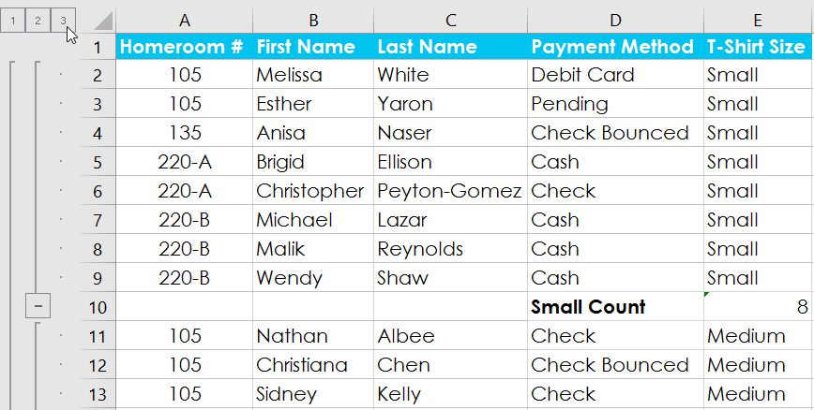
Filtering data – subtotals
*https://edu.gcfglobal.org/en/excel2016/groups-and-subtotals/1/

Slide 24
Filtering data – groups and subtotals
https://edu.gcfglobal.org/en/excel2016/groups-and-subtotals/1/
https://www.officetooltips.com/excel_2016/tips/creating_subtotals.html
https://support.office.com/en-us/article/why-can-t-i-add-subtotals-in-an-excel-table-excel-for-mac-1df3b78d-8508-486b-95d8-d970dff1bb05
https://support.office.com/en-us/article/insert-subtotals-in-a-list-of-data-in-a-worksheet-7881d256-b4fa-4f81-b71e-b0a3d4a52b3a
https://www.ablebits.com/office-addins-log/2011/11/17/multiple-excel-subtotals/

Slide 25
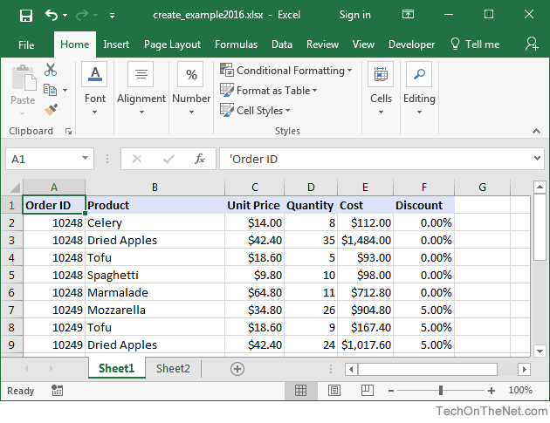
Filtering data – pivot table
Before we get started, we first want to show you the data for the pivot table. In this example, the data is found on Sheet1.*
*https://www.techonthenet.com/excel/pivottbls/create2016.php

Slide 26
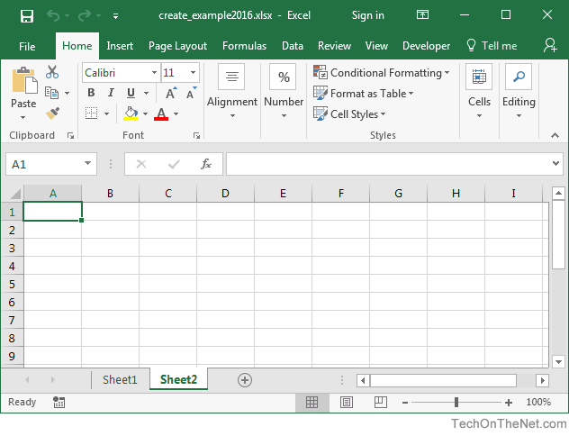
Filtering data – pivot table
Highlight the cell where you'd like to create the pivot table. In this example, we've selected cell A1 on Sheet2.*
*https://www.techonthenet.com/excel/pivottbls/create2016.php

Slide 27
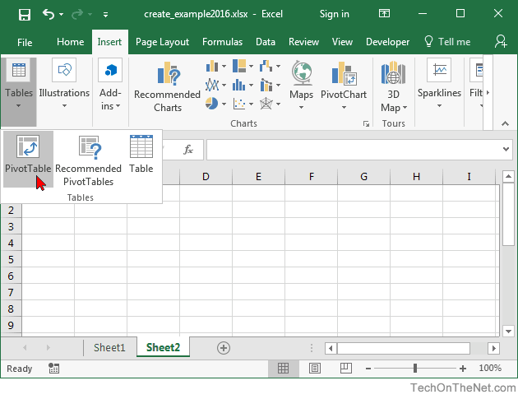
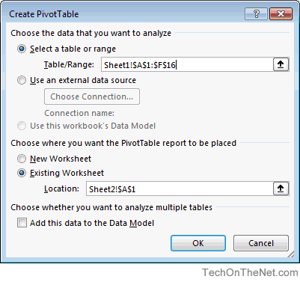
Filtering data – pivot table
Next, select the Insert tab from the toolbar at the top of the screen. In the Tables group, click on the Tables button and select PivotTable from the popup menu.*
A Create PivotTable window should appear. Select the range of data for the pivot table and click on the OK button. In this example, we've chosen cells A1 to F16 in Sheet1 as indicated by Sheet1!$A$1:$F$16.*
*https://www.techonthenet.com/excel/pivottbls/create2016.php

Slide 28
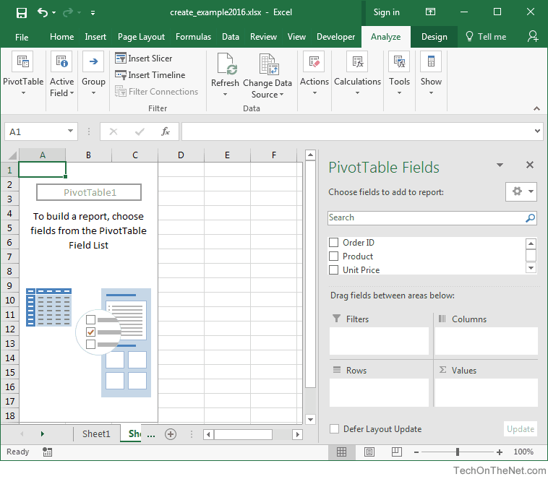
Filtering data – pivot table
*https://www.techonthenet.com/excel/pivottbls/create2016.php

Slide 29
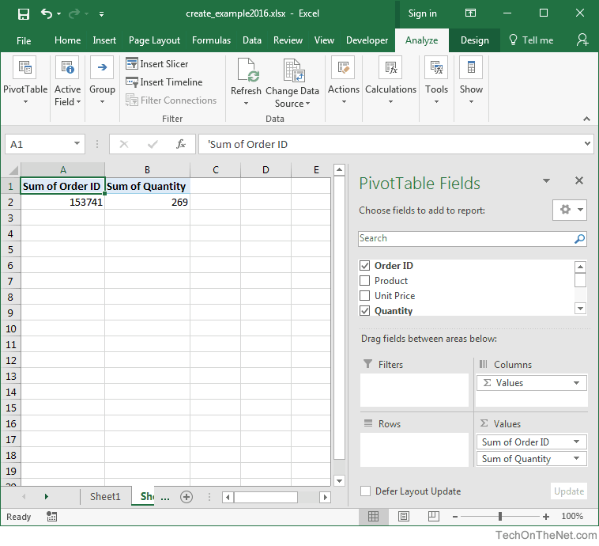
Filtering data – pivot table
Next, choose the fields to add to the report. In this example, we've selected the checkboxes next to the Order ID and Quantity fields.*
*https://www.techonthenet.com/excel/pivottbls/create2016.php

Slide 30
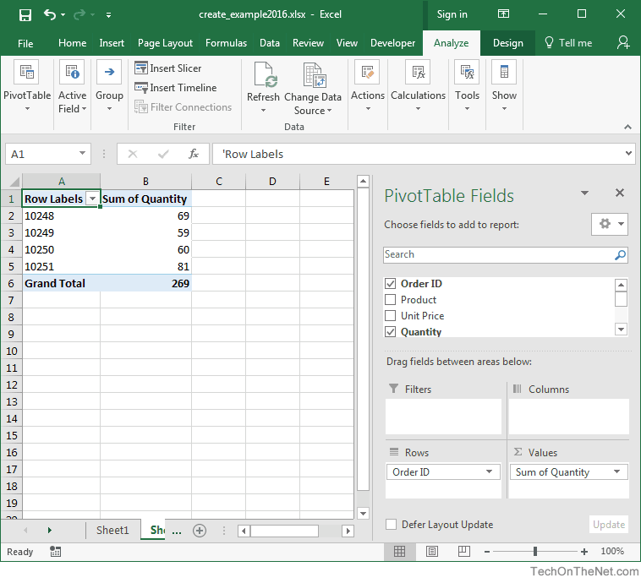
Filtering data – pivot table
Next in the Values section, click on the "Sum of Order ID" and drag it to the Rows section.*
*https://www.techonthenet.com/excel/pivottbls/create2016.php

Slide 31
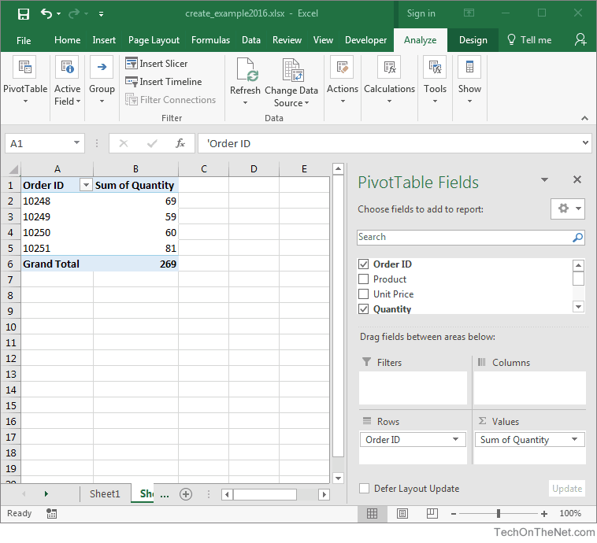
Filtering data – pivot table
Finally, we want the title in cell A1 to show as "Order ID" instead of "Row Labels". To do this, select cell A1 and type Order ID.*
Your pivot table should now display the total quantity for each Order ID as follows:*
*https://www.techonthenet.com/excel/pivottbls/create2016.php

Slide 32
Filtering data – pivot table
https://www.techonthenet.com/excel/pivottbls/create2016.php
https://support.office.com/en-us/article/create-a-pivottable-to-analyze-worksheet-data-a9a84538-bfe9-40a9-a8e9-f99134456576
https://edu.gcfglobal.org/en/excel2016/intro-to-pivottables/1/
https://www.groovypost.com/howto/create-pivot-tables-microsoft-excel-2016/
https://www.excel-easy.com/data-analysis/pivot-tables.html

Slide 33
Filtering data – sensitivity analysis
Sensitivity analysis in excel helps us study the uncertainty in the output of the model with the changes in the input variables.*
It primarily does stress testing of our modeled assumptions and leads to value-added insights.*
In the context of DCF valuation, Sensitivity Analysis in excel is especially useful in finance for modeling share price or valuation sensitivity to assumptions like growth rates or cost of capital.*
*https://www.wallstreetmojo.com/sensitivity-analysis-in-excel/

Slide 34
Filtering data – sensitivity analysis
https://www.youtube.com/watch?v=N924D6tGOG8
https://www.dummies.com/software/microsoft-office/excel/how-to-create-a-two-variable-data-table-in-excel-2016/
https://www.wallstreetprep.com/knowledge/financial-modeling-techniques-sensitivity-what-if-analysis-2/
https://www.wallstreetmojo.com/sensitivity-analysis-in-excel/

Slide 35
The end
Thank you for your attention!
Any questions?

