Slide 1

Informatics
Database management system - I
Petr Suchánek
Informatics

Slide 2

Outline of the lecture
Database
Database types
Relational database
Relationship
Microsoft Access 2016
Tables
Table Wizard
Table – Design View

Slide 3
Database
A database is a collection of data that is organized so that it can be easily accessed, managed and updated.*
Computer databases typically contain aggregations of data records or files, containing information about sales transactions or interactions with specific customers.*
Most databases contain multiple tables, which may each include several different fields.**
For example, a company database may include tables for products, employees, and financial records.**
Each of these tables would have different fields that are relevant to the information stored in the table.**
*https://searchsqlserver.techtarget.com/definition/database
**https://techterms.com/definition/database

Slide 4
Relational database
A relational database, invented by E.F. Codd at IBM in 1970, is a tabular database in which data is defined so that it can be reorganized and accessed in a number of different ways.*
Relational databases are made up of a set of tables with data that fits into a predefined category.*
Each table has at least one data category in a column, and each row has a certain data instance for the categories which are defined in the columns.*
When creating a relational database, you can define the domain of possible values in a data column and further constraints that may apply to that data value.**
*https://searchsqlserver.techtarget.com/definition/database
**https://searchdatamanagement.techtarget.com/definition/relational-database

Slide 5
Relational database
For example, a domain of possible customers could allow up to 10 possible customer names but be constrained in one table to allowing only three of these customer names to be specifiable. Two constraints relate to data integrity and the primary and foreign keys:*
  Entity integrity ensures that the primary key in a table is unique and that the value is not set to null.
  Referential integrity requires that every value in a foreign key column will be found in the primary key of the table from which it originated.
*https://searchdatamanagement.techtarget.com/definition/relational-database

Slide 6
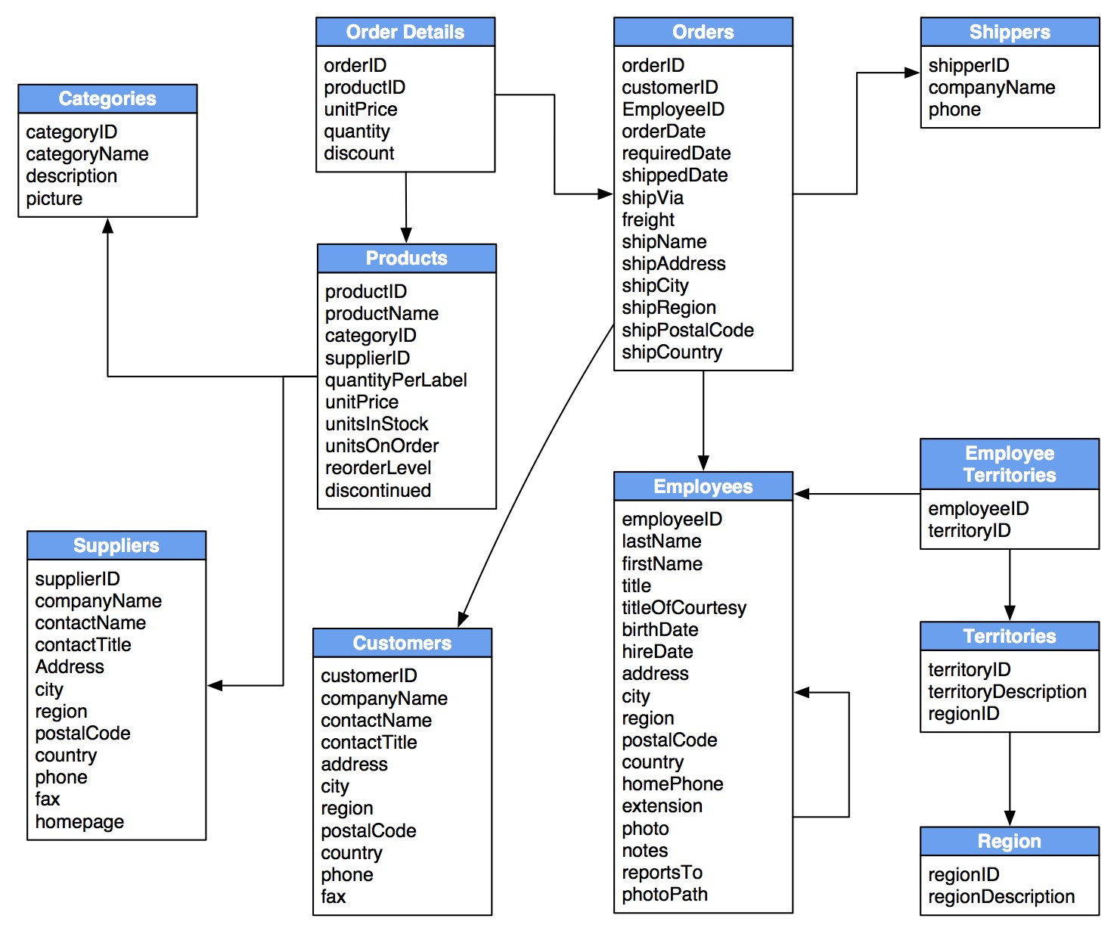
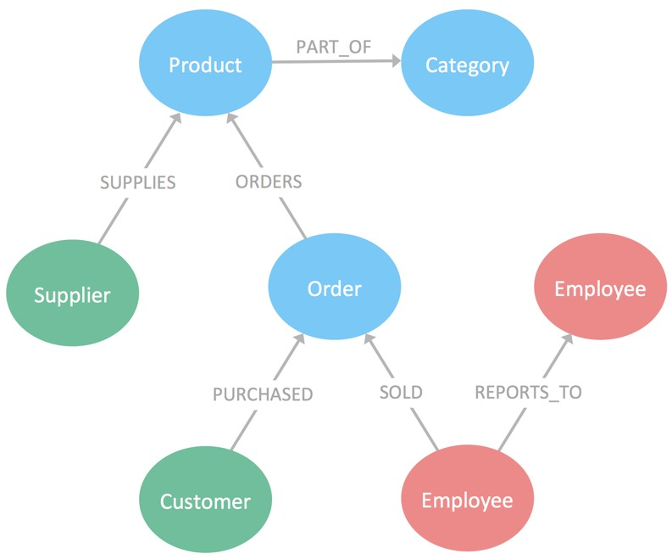
Relational database*
*https://neo4j.com/business-edge/relational-to-relationships/

Slide 7
Relational database - advantages
The main advantage of relational databases is that they enable users to easily categorize and store data that can later be queried and filtered to extract specific information for reports.*
Relational databases are also easy to extend and aren't reliant on physical organization.*
After the original database creation, a new data category can be added without all existing applications being modified.*
*https://searchdatamanagement.techtarget.com/definition/relational-database

Slide 8
Relational database - advantages
Other relational database advantages include:*
Accuracy: Data is stored just once, eliminating data deduplication.
Flexibility: Complex queries are easy for users to carry out.
Collaboration: Multiple users can access the same database.
Trust: Relational database models are mature and well-understood.
Security: Data in tables within a RDBMS can be limited to allow access by only particular users.
*https://searchdatamanagement.techtarget.com/definition/relational-database

Slide 9
Database & Relational database
The majority of software products in today's market incorporate both relational database and regular database compliances.*
Therefore, they can manage databases in the relational tabular form as well as in file form, or both.*
Essentially, in today's market, a relational database is a database and vice versa; however, there are still major differences in data storage between the two systems.*
The most important difference is that a relational database stores data in a tabular form - or arranged in a table with rows and columns - while a database stores data as files.*
*https://searchdatamanagement.techtarget.com/definition/relational-database

Slide 10
Database & Relational database
Database normalization is present in a relational database while it is not present in a database.*
A relational database supports a distributed database while a database does not support a distributed database.*
In a relational database, the data values are stored in the form of tables and each table possesses a primary key. In a database, data is normally stored in hierarchical or navigational form.*
Since data is stored in the form of tables in a relational database, then the relationship between these data values is stored as well. Since a database stores data as files, then there is not relationship between the values or tables.*
*https://searchdatamanagement.techtarget.com/definition/relational-database

Slide 11
Database & Relational database
In a relational database, the integrity constraints are defined for the purpose of an ACID On the other hand, a database does not utilize any security to protect against data manipulation.*
While a relational database is designed to support large amounts of data and multiple users, a database is designed to deal with small amounts of data and one single user.*
One final, major distinction is that the data storage in a relational database is accessible, meaning the value can be updated by the system.*
Furthermore, the data within an RDBMS is physically and logically independent.*
*https://searchdatamanagement.techtarget.com/definition/relational-database

Slide 12
Database & Relational database
https://searchdatamanagement.techtarget.com/definition/relational-database
https://en.wikipedia.org/wiki/Relational_database
https://dev.to/lmolivera/everything-you-need-to-know-about-relational-databases-3ejl
https://www.codecademy.com/articles/what-is-rdbms-sql

Slide 13
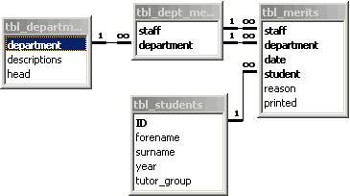
Database - relationship
A relationship, in the context of databases, is a situation that exists between two relational database tables when one table has a foreign key that references the primary key of the other table.*
Relationships allow relational databases to split and store data in different tables, while linking disparate data items.*
*https://www.techopedia.com/definition/24438/relationship-databases

Slide 14
Database – Relationship – one-to-one
A row in table A can have only one matching row in table B, and vice versa.*
This is not a common relationship type, as the data stored in table B could just have easily been stored in table A.*
However, there are some valid reasons for using this relationship type.*
A one-to-one relationship can be used for security purposes, to divide a large table, and various other specific purposes.*
*https://database.guide/the-3-types-of-relationships-in-database-design/

Slide 15
Database – Relationship – one-to-many
This is the most common relationship type.*
In this type of relationship, a row in table A can have many matching rows in table B, but a row in table B can have only one matching row in table A.*
In the above example, the Customer table is the “many” and the City table is the “one”.*
Each customer can only be assigned one city. One city can be assigned to many customers.*
*https://database.guide/the-3-types-of-relationships-in-database-design/

Slide 16
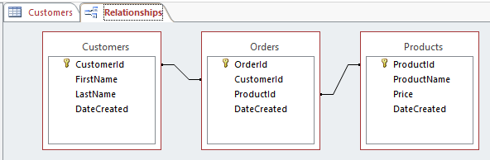
Database – Relationship – many-to-many
In a many-to-many relationship, a row in table A can have many matching rows in table B, and vice versa.*
A many-to-many relationship could be thought of as two one-to-many relationships, linked by an intermediary table.*
So in order to create a many-to-many relationship between the Customers table and the Products table, we created a new table called Orders.*
*https://database.guide/the-3-types-of-relationships-in-database-design/

Slide 17
Database – Relationship
https://database.guide/the-3-types-of-relationships-in-database-design/
https://www.techrepublic.com/article/relational-databases-defining-relationships-between-database-tables/
https://www.lifewire.com/database-relationships-p2-1019758
https://www.techopedia.com/definition/24438/relationship-databases

Slide 18
MS Office Access
Microsoft Access is a database management system (DBMS) from Microsoft that combines the relational Microsoft Jet Database Engine with a graphical user interface and software-development tools.*
It is a member of the Microsoft Office suite of applications, included in the Professional and higher editions or sold separately.*
In Access, most tasks can be performed via the graphical user interface (GUI), but more advanced users can also develop applications using Visual Basic for Applications (VBA) code.*
Advanced users can also use SQL code to write or modify queries.*
*https://database.guide/what-is-microsoft-access/

Slide 19
MS Office Access – main tasks
Some of the main tasks performed in Access include:*
  Create and maintain databases and their tables.
  Set up rules and restrictions over the type of data that can be entered into the database.
  Create and run queries.
  Create forms to allow non-technical users to enter data, search the database, and perform other tasks.
  Create reports so that the data can be presented in a more readable format, or emailed, printed out, etc.
  Create macros so that multi-step tasks can be performed with the click of a button (or even upon opening the database).
  Import and export data from external sources (such as Excel spreadsheets, .csv files, etc).
*https://database.guide/what-is-microsoft-access/

Slide 20
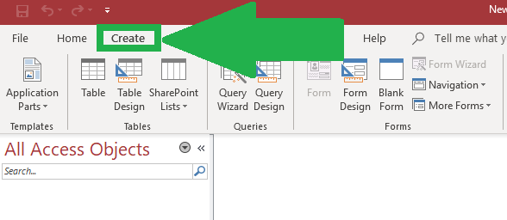
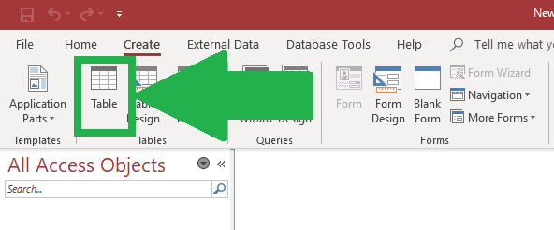
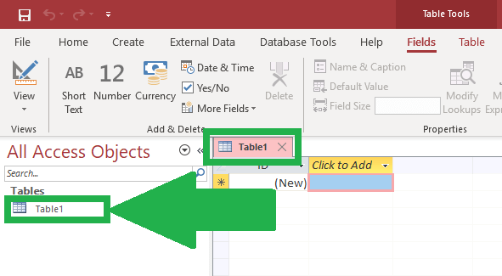
MS Office Access – tables
To start, go to the Create tab.*
Then, click on the Table icon.*
A new table would be created with a default name of ‘Table1:’.*
*https://datatofish.com/create-table-access/

Slide 21
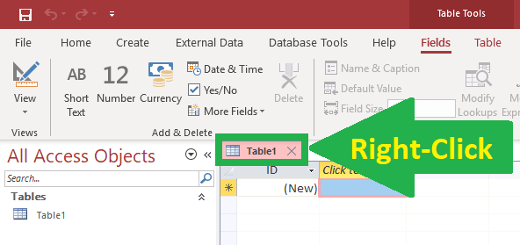
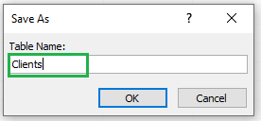
MS Office Access – tables
To save your table with a different name, right-click on the tab that displays the default name of ‘Table1.’*
Then, from the drop-down menu, choose Save.*
Now, type a new table name within the ‘Save As’ input box.*
*https://datatofish.com/create-table-access/

Slide 22
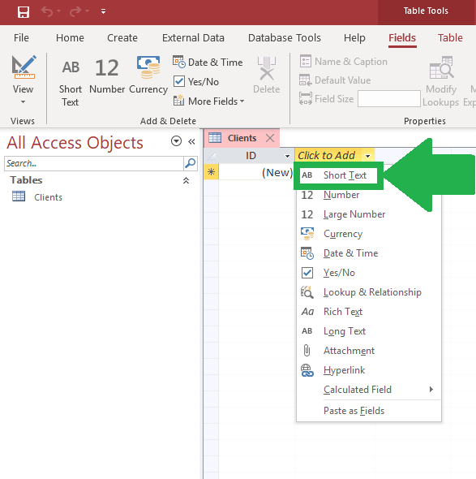
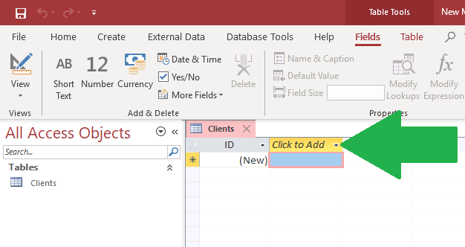
MS Office Access – tables
Steps to Add Columns to the Table Created*
*https://datatofish.com/create-table-access/

Slide 23
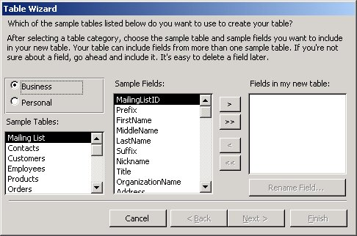
MS Office Access – table wizard
Open Database window.*
Click Tables / New Table in objects bar.*
Double click Create table by using wizard. The Table Wizard will start.*
Select fields in your new table.*
*https://www.desktopclass.com/computer-it/procedure-creating-table-using-table-wizard.html

Slide 24
MS Office Access – table – design view
Datasheet View displays the table as a grid. The fields are displayed as columns, and the records are displayed as rows. The field names are listed as the column headers.*
Datasheet View displays the data. If this table had data, it would be displayed in the cells.*
Each row represents a record. If the table had say, five records, there would be five rows of data.*
In Datasheet View, if you want to find out a field's data type, you need to select that field, then select the Fields tab on the Ribbon. The field's data type and other properties will be listed on the right side of the Ribbon.*
*https://www.quackit.com/microsoft_access/microsoft_access_2016/tutorial/create_a_table_in_design_view_in_microsoft_access.cfm

Slide 25
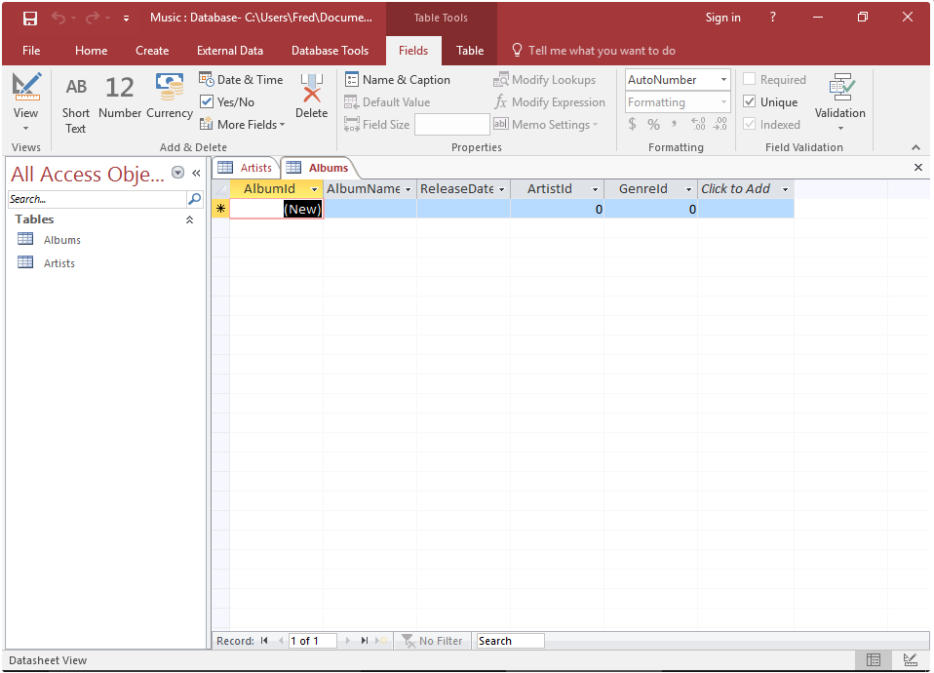
MS Office Access – table – design view
*https://www.quackit.com/microsoft_access/microsoft_access_2016/tutorial/create_a_table_in_design_view_in_microsoft_access.cfm

Slide 26
MS Office Access – table – design view
Design View doesn't display any data. Therefore, there's more space available to display other settings.*
In Design View, the fields are listed vertically. They are listed above and below each other as opposed to side-by-side.*
In Design View, you can see the data type listed next to each field.*
The way Design View works is, when you click on a field (in the top frame), the bottom frame displays the properties for that field. You can then change these properties as required.*
*https://www.quackit.com/microsoft_access/microsoft_access_2016/tutorial/create_a_table_in_design_view_in_microsoft_access.cfm

Slide 27
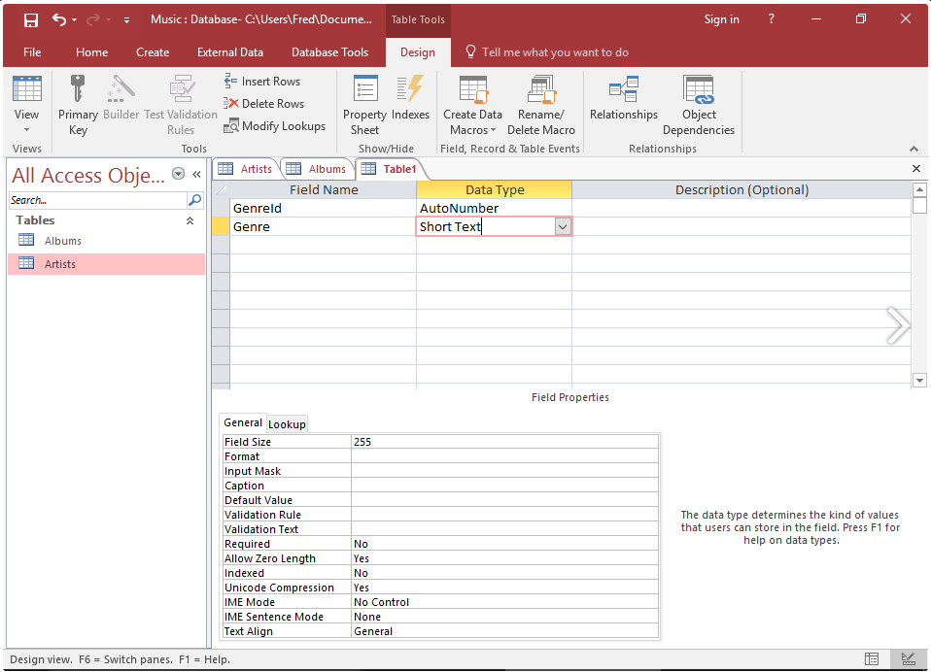
MS Office Access – table – design view
Now we will enter each field and select their data type.*
In the first cell under Field Name add a field called GenreId. Select Autonumber as its data type.*
Under that field, create a new one called Genre and select Short Text for its data type.*
*https://www.quackit.com/microsoft_access/microsoft_access_2016/tutorial/create_a_table_in_design_view_in_microsoft_access.cfm

Slide 28
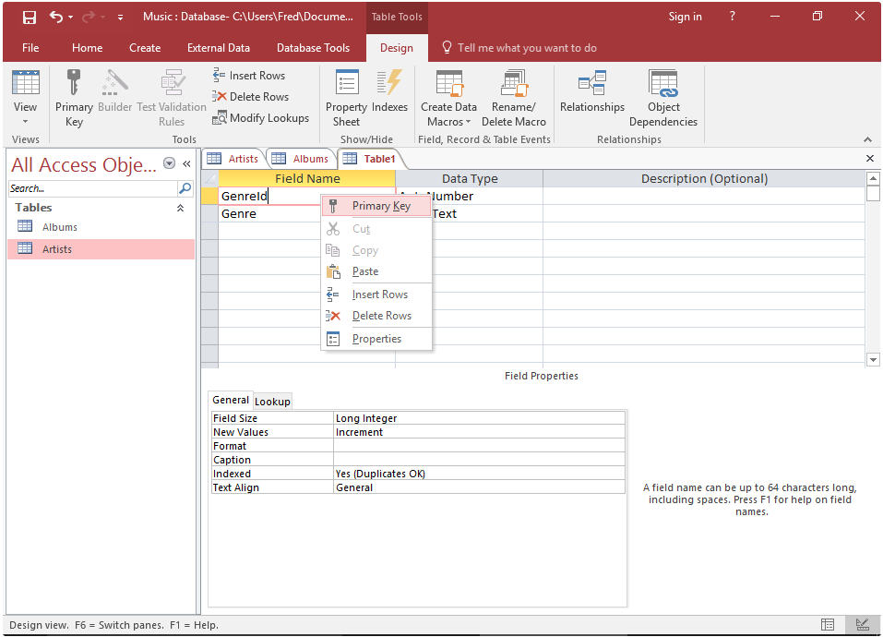
MS Office Access – table – design view
Right-click on the GenreId field and select Primary Key from the drop down list.*
This makes the field a primary key field. Once you've done this, you'll see a little key icon to the left of GenreId.*
*https://www.quackit.com/microsoft_access/microsoft_access_2016/tutorial/create_a_table_in_design_view_in_microsoft_access.cfm

Slide 29
The end
Thank you for your attention!
Any questions?

