Slide 1

Master thesis seminar (1)
Final thesis (FT) roadmap, Seminar agenda, Topics, Documents and forms
Assoc. Prof. Dr. Roman Šperka, PhD
Head of Economics and management study program

Slide 2
Seminar agenda
2nd Seminar – What is FT?
3rd Seminar – Description of FT
Schedule
4th Seminar – FT template, presentation
Word template of FT
Communication with supervisor
Purpose of FT
1st Seminar – FT roadmap
Roadmap for February examination
Roadmap for June examination
Seminar agenda
Proofreading
Sample FT, FT topics
Revisions
Documents and forms on webpage
Presentation template for FT defence
Goals, methodology, methods, outputs
Plagiarism, citations
Library and e-resources
Content
IS SU explanation
Insertion into IS
Assoc. Prof. Šperka
October 3, 2023
Dr. Stoklasa
October 10, 2023
Assoc. Prof. Palečková
October 17, 2023
Dr. Stoklasa
November 7, 2023

Slide 3
Seminar agenda
6th Seminar – Research methods II
Analysing qualitative data
5th Seminar – Research methods I
Critically reviewing the literature
Statistical analysis of quantitative data
Writing convincing conclusions
Collecting primary data
Using secondary data
Presentation skills
Sample selection and sample size
Assoc. Prof. Klepek
November 14, 2023
Assoc. Prof. Klepek
November 21, 2023

Slide 4

Sample FT and topics
The impact of digital marketing on consumer behavior in the modern world (dr. Klepek)
Impact of green marketing on consumer behaviour(dr. Stoklasa)
Evaluation of economic situation of selected company (dr. Šeligová)
Sales promotion and satisfaction of dealers: A case of Havells India Ltd. (dr. Majerová)
VAT schemes for small business (dr. Sobotovičová)
The recommendation of marketing activities for Czech university to attract foreign students (Assoc. Prof. Šperka)
Evaluation of the company´s competitiveness (dr. Adámek)
Strategy for small and medium-sized enterprise (dr. Zapletalová)
Management of foreign exchange exposure of the selected company (dr. Šimáková)
Packing problem (Assoc. Prof. Bartl)
Marketing Strategy for Large Enterprise in International Markets(dr. Zapletalová)
The effect of exchange rate development on foreign direct investments in selected economy (dr. Šimáková)
Trade of small and medium enterprises and its support in the Czech Republic and India (dr. Majerová)
Social media and brand communication (dr. Klepek)
Integrated marketing communication (dr. Matušínská)
A project of a crowdfunding campaign (Assoc. Prof. Šebestová)

Slide 5
Final theses roadmap - examinations in June
by March 31
Consult the topic of FT with teachers
Supervisor inserts topic into Tematikon
by May 31
Select the topic in Tematikon
Supervisor assigns the topic to the student
by December 10
by October 31
Consultation of description of FT
Matching of description with student
Student inserts description into IS
Description approval in IS SU by an authorized person
by February 18
Student receives credits in IS SU for the Master Thesis Seminar course
by May 6
Student uploads digital FT into IS SU
June 10-14
State final examination
Defence of FT
Find supervisor
Further discussion might be required
  1st year
  2nd year
  Recommended activity

Slide 6
Final theses roadmap - examinations in February
by October 31
Consult the topic of FT with teachers
Supervisor inserts topic into Tematikon
by December 31
Select the topic in Tematikon
Supervisor assigns the topic to the student
by April 30
by March 31
Consultation of description of FT
Matching of description with student
Student inserts description into IS
Description approval in IS SU by an authorized person
by June 30
Student receives credits in IS SU for the Master Thesis Seminar course
by December 17
Student uploads digital FT into IS SU
February 12-16
State final examination
Defence of FT
Find supervisor
Further discussion might be required
  1st year
  2nd year
  Recommended activity

Slide 7
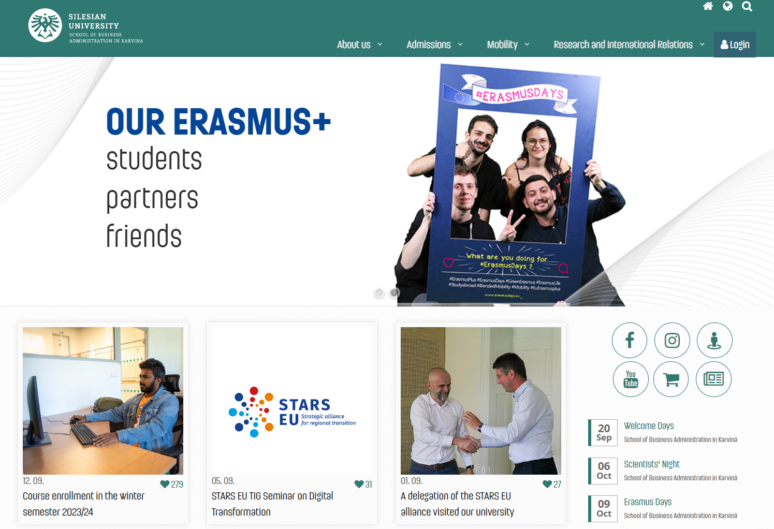
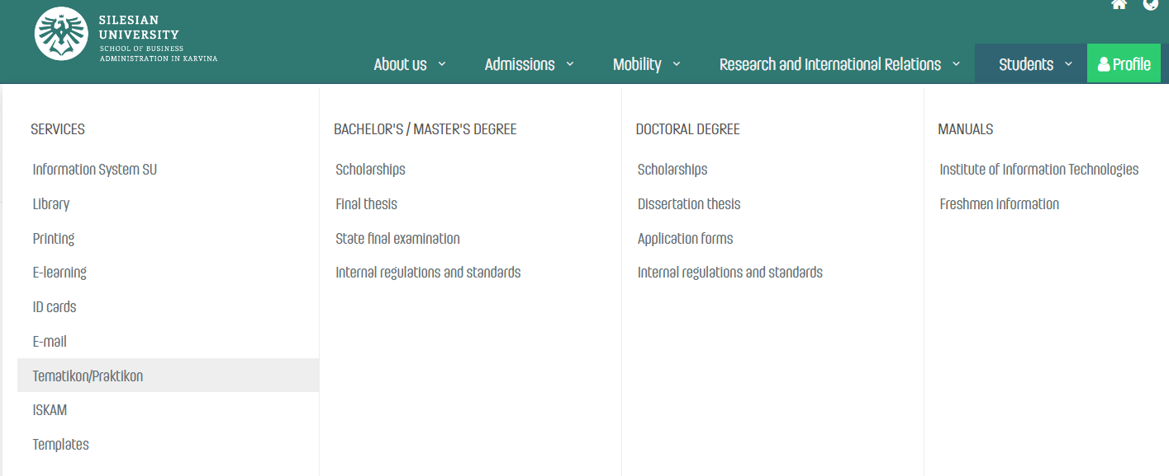
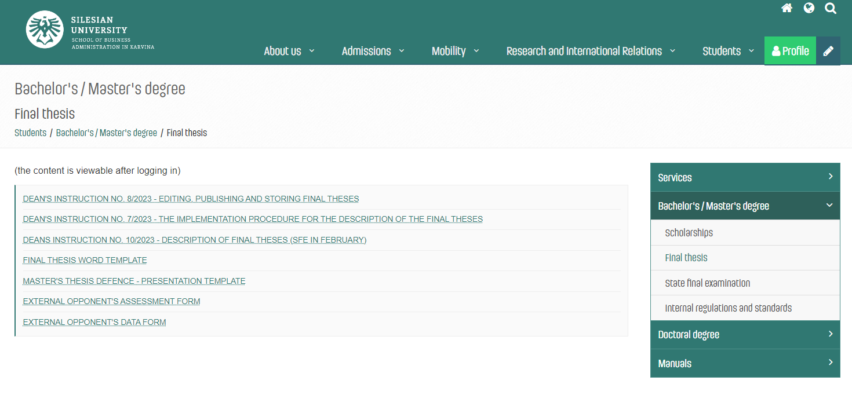
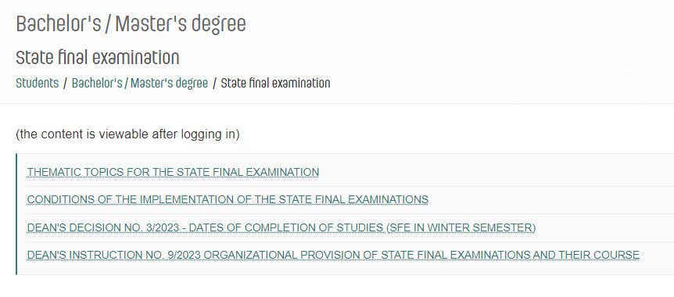
Documents, forms, templates, Tematikon

